Slide 1

College of Engineering
Department of Civil Engineering Spring 2021 – Learning Outcome Assessment III CE
(Final Presentation)
Abqaiq – Half-moon Highway Design with Reinforced Concrete Bridge Design Section
Presented by: (Group 1)
Abdullah S. Alshammari 201801677
Abdulmohsen B. Alkhalifa 201601825
Hassan A. Alhajji 201602934
Turki A.Albasha 201601658
Advisor: Dr. Mohammed Ali Khasawneh, Ph.D.
Coordinator: Dr. Andi Asiz, Ph.D.

Slide 2

Outlines
Main Project: Transportation Highway.
Introduction.
Project Description.
Traffic analysis.
Horizontal Alignment.
Vertical Alignment.
Soil Investigation.
Pavement Design.
Derange system.
Intersections Design.
Sub – Project: Precast section Bridge.
Cost estimation.
Summary & Conclusions.
References.

Slide 3
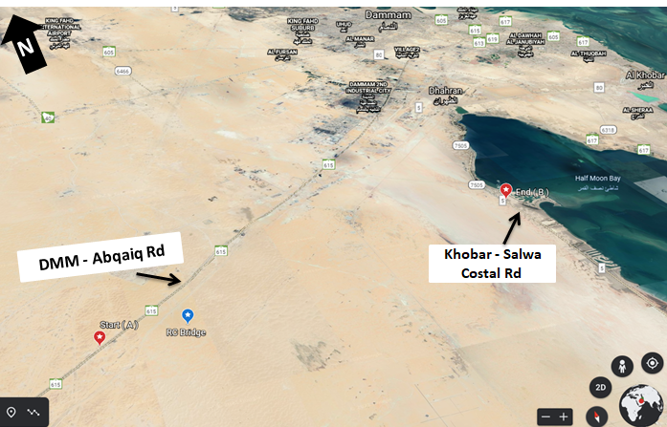
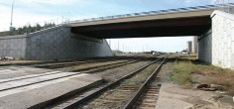
Introduction
Project Background.
Project Area.
Objectives:
Geometrical design of the highway.
Structural design of the pavement (including drainage).
Structural and geotechnical design of a single span RC bridge.
Cost estimation.
Project constraints.
Figure 1 - Project Location (Google Earth Pro)

Slide 4
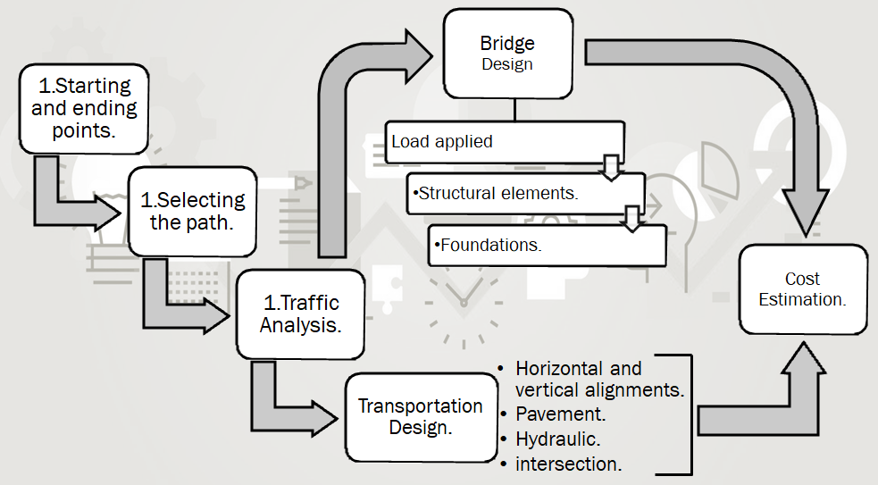
Introduction
Methodology
Figure 2 – Methodology Procedure

Slide 5

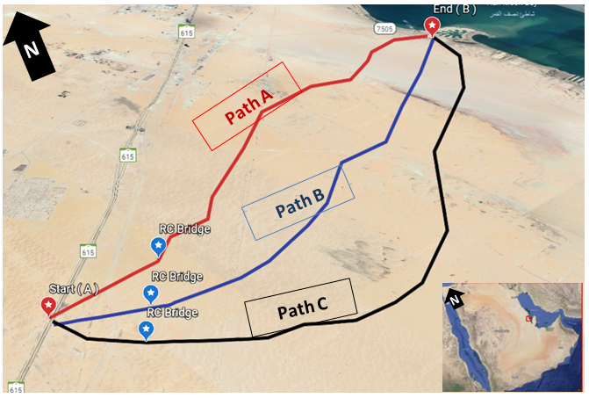
Project Description
How to Select the best Alternative Path? Why?
Table 1 - Alternative selection information
Alternatives | Road length (km) | No. of Horizontal Curves | No. of Vertical Curves | Cut / Fill Net Quantity (𝐦^{𝟑})
Path A | 24.9 | 10 | 7 | 203934 (Fill)
Path B | 25.5 | 6 | 4 | 1559308 (Fill)
Path C | 26.2 | 5 | 6 | 279841 (Fill)
Figure 3 - Alternative paths (Google Earth Pro)

Slide 6
Traffic Analysis
Traffic Analysis Data
Speed Design
Number of Lanes

Slide 7
Traffic Analysis
Table 2 – Traffic analysis calculation
Month | No. of Weekdays In Month (days) | Total Days in Month (days) | Total Monthly Volume (vehs) | Total Weekday Volume (vehs) | Average Weekday Traffic (veh/day) | Average Daily Traffic (veh/day)
Jan | 22 | 31 | 980,483 | 552,346 | 25,107 | 31,628
Feb | 20 | 28 | 1,110,231 | 648,736 | 32,437 | 39,651
Mar | 22 | 31 | 1,109,486 | 596,254 | 27,102 | 35,790
Apr | 22 | 30 | 1,352,329 | 748,392 | 34,018 | 45,078
May | 21 | 31 | 1,458,900 | 699,837 | 33,326 | 47,061
Jun | 22 | 30 | 1,744,297 | 800,481 | 36,386 | 58,143
Jul | 23 | 31 | 1,267,345 | 822,830 | 35,775 | 40,882
Aug | 21 | 31 | 1,56,7320 | 910,271 | 43,346 | 50,559
Sep | 22 | 30 | 1,606,438 | 700,392 | 31,836 | 53,548
Oct | 22 | 31 | 999,825 | 444,372 | 20,199 | 32,252
Nov | 21 | 30 | 1,000,239 | 633,283 | 30,156 | 33,341
Dec | 22 | 31 | 932,357 | 492,774 | 22,399 | 30,076
Total | 260 | 365 | 15,129,250 | 8,049,968 | ___ | ___
Analysis of Traffic Data
and Calculations.

Slide 8




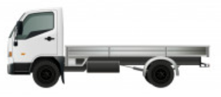




Traffic Analysis
Traffic consists of different types of vehicles.
1.Passenger cars (PC)
2.JEEP MODEL
3.TRUCKS 2/6
4.PICK UP
5.LIGHT TRUCK
6.TRUCKS 4/14
7.BIG BUS
8.SMALL BUS
9.TRUCKS 5/18
Chart 1 - Percentage of Vehicle Type Annual
Figure 4- different types of vehicles
Note: All vehicles type pictures above are from (Freepik)

Slide 9

Traffic Analysis
Design of Speed.
Table 3 - Speed limit according to (AASHTO 2001)
Upper speed (km/h) | Lower speed (km/hr) | Road degree
50 | 30 | Local
60 | 50 | Collector
100 | 80 | Arterial Highway
90 | 70 | Less disorder
60 | 50 | High disturbance
120 | 90 | Freeway
Table 4- Speed with respect to the area according to (AASHTO 2001)
Accordingly, it is classified as a (Freeway) and (Urban) road. So, the designed speed = 120 km/h.
Speed (km/h) |  |  | Nature of the region
Rural road | Secondary road | Urban road
80 | 100 | 120 | Plain area
60 | 80 | 100 | Rolling area

Slide 10
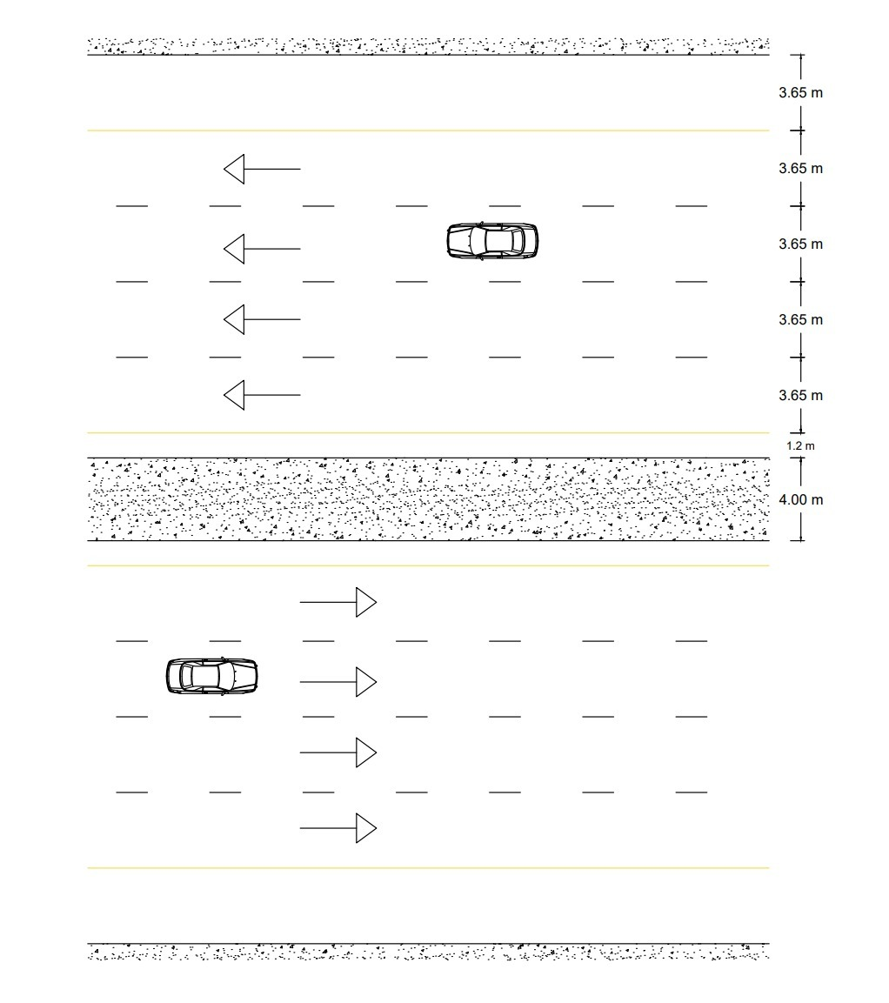
Traffic Analysis
Number of Lanes.
Final Shape.
Number of lane = 4
Table 5- standers dimensional according to (ASSHTO 2001)
Functional classification | Width (m)
Lane | 3.65
Right shoulder | 3.65
Left shoulder | 1.2
Medians | 4
Figure 5 - Illustrating the highway diminutions (Final Shape)

Slide 11
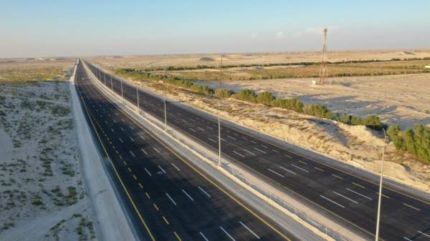
Horizontal Alignment
What is Horizontal Alignment?
Figure 6 - Horizontal curves road (al-madina)

Slide 12
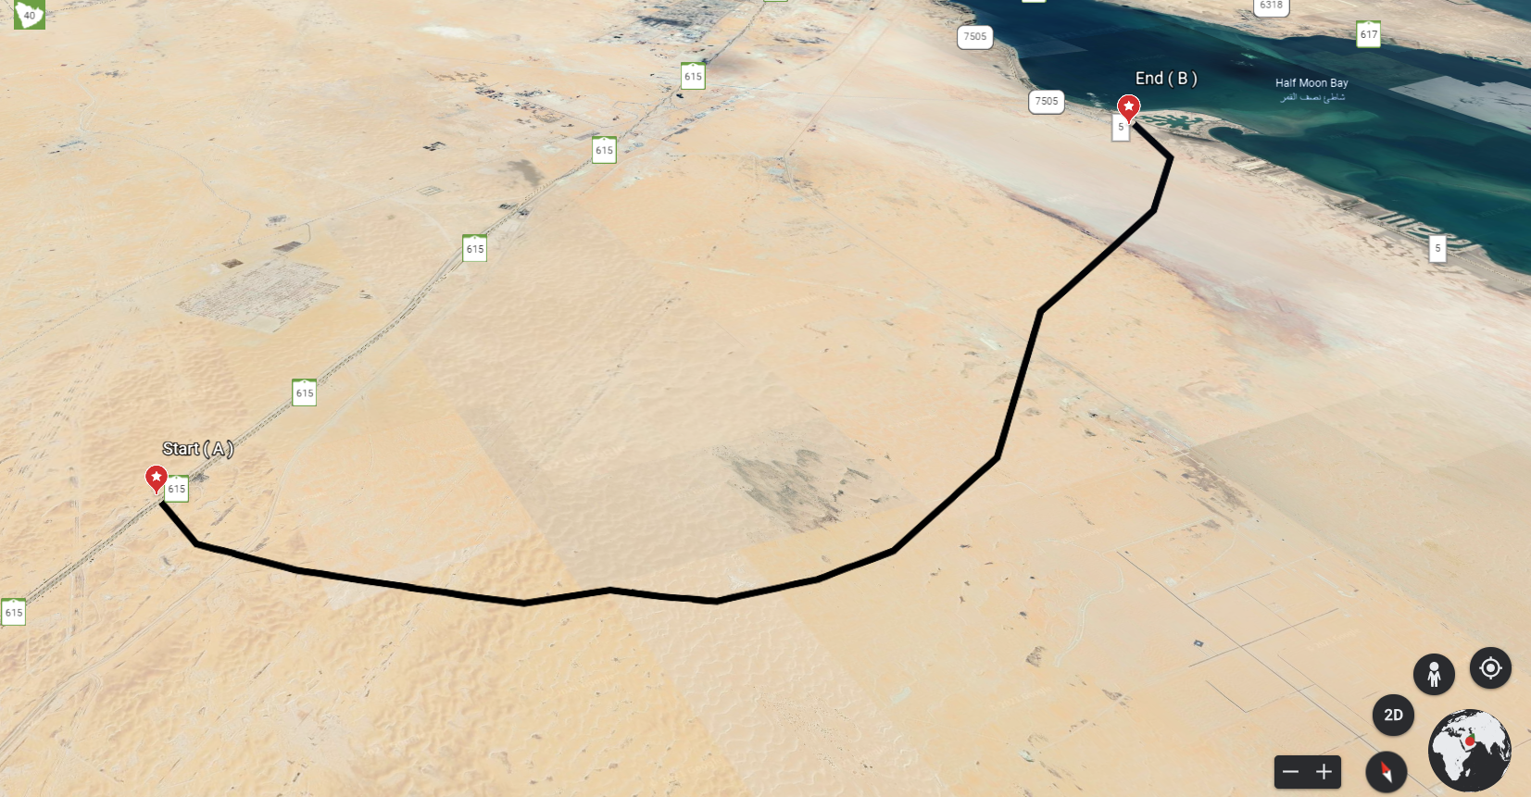
Horizontal Alignment
Example of horizontal curve no. 3 (12+534.75)
12 + 534.75
Figure 7 - Horizontal curves Location (Google Earth pro)

Slide 13
Horizontal Alignment
Example of horizontal curve no. 3 (12+534.75)
1-Mid ordinate:
$$M=9.75$$
2-Central Angle:
$$∆=18.78 °$$
3-Degree of Curvature:
$$D=2.15°$$
8-Points of curve:
Table 6 - Points of Horizontal Curve no. 3
Station | Degree (Ɵ) | X (m) | Y (m) | L (m)
12+534.75 | 0 | 0 | 0 | 0
12+584.75 | 1.075 | 15.01 | 0.141 | 50
12+634.75 | 2.15 | 30.01 | 0.563 | 100
12+684.75 | 3.225 | 45.01 | 1.267 | 150
12+734.75 | 4.3 | 59.98 | 2.252 | 200
12+796.83 | 5.63 | 78.48 | 3.859 | 262.08
4-Length of Curvature:
$$L=262.08 m$$
5-Chord length:
$$C=261.05 m$$
6-External distance:
E = 15.07 m
7-Tangent length:
$$T=132.3m$$
Required stopping sight distance
${SSD}_{re}$ < ${SSD}_{design}=250 m$

Slide 14
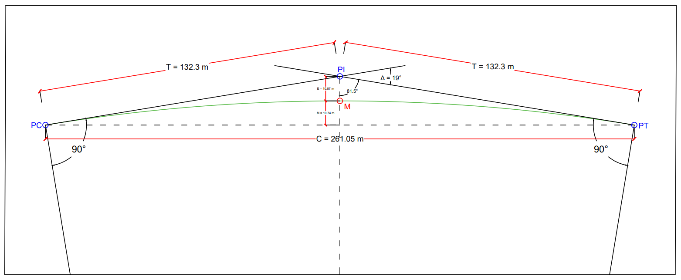
Horizontal Alignment
Example of horizontal curve no. 3 (12+534.75)
Figure 8 - Details of horizontal curve no.3

Slide 15
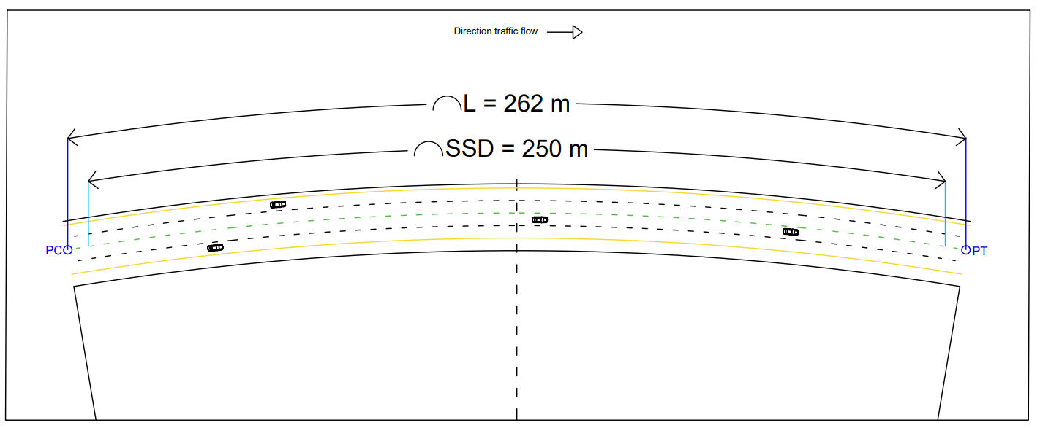
Horizontal Alignment
Example of horizontal curve no. 3 (12+534.75)
Figure 9 - Realistic simulation of horizontal curve no.3

Slide 16
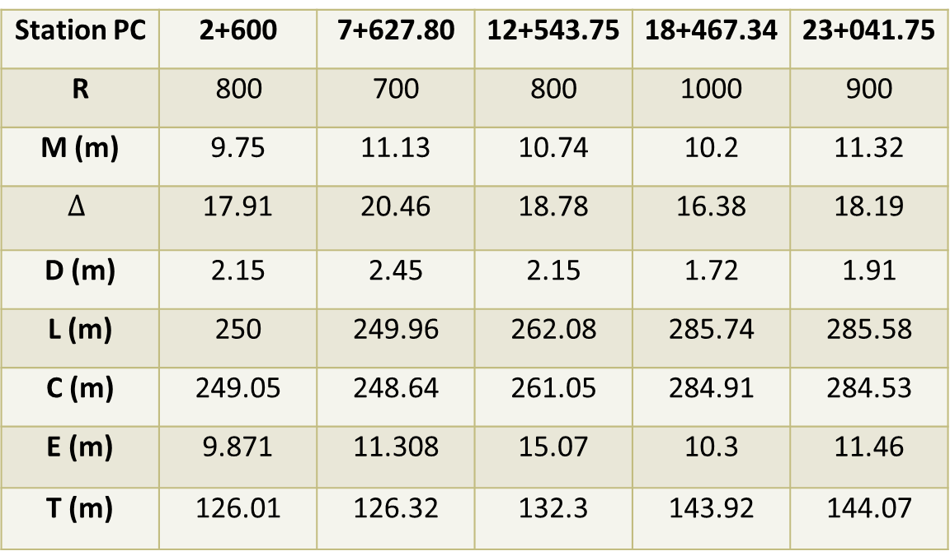
Results
Horizontal Alignment
Table 7 - Summary of the horizontal curves.
Station PC | 2+600 | 7+627.80 | 12+543.75 | 18+467.34 | 23+041.75
R | 800 | 700 | 800 | 1000 | 900
M (m) | 9.75 | 11.13 | 10.74 | 10.2 | 11.32
$$∆$$ | 17.91 | 20.46 | 18.78 | 16.38 | 18.19
D (m) | 2.15 | 2.45 | 2.15 | 1.72 | 1.91
L (m) | 250 | 249.96 | 262.08 | 285.74 | 285.58
C (m) | 249.05 | 248.64 | 261.05 | 284.91 | 284.53
E (m) | 9.871 | 11.308 | 15.07 | 10.3 | 11.46
T (m) | 126.01 | 126.32 | 132.3 | 143.92 | 144.07
There are five horizontal curves the following table shows summary of the horizontal curves' calculation.

Slide 17
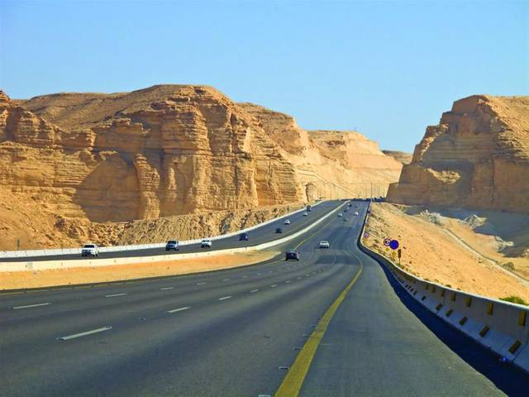
Vertical Alignment
What is Vertical Alignment ?
Figure 10 - Vertical curves road (Freelik).

Slide 18
Vertical Alignment
Example of vertical curve no.1 (1+830.48)
1 + 830.48
Figure 11 - Vertical curves Location (Google Earth pro)

Slide 19
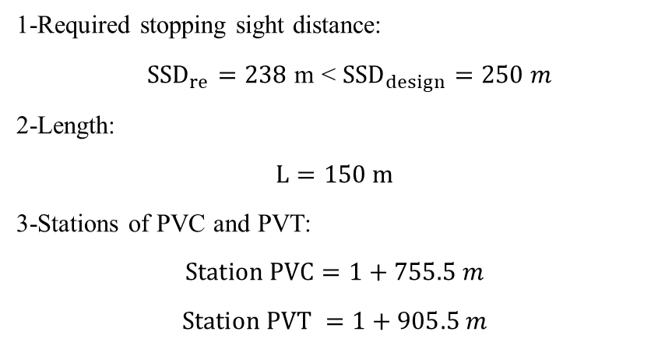
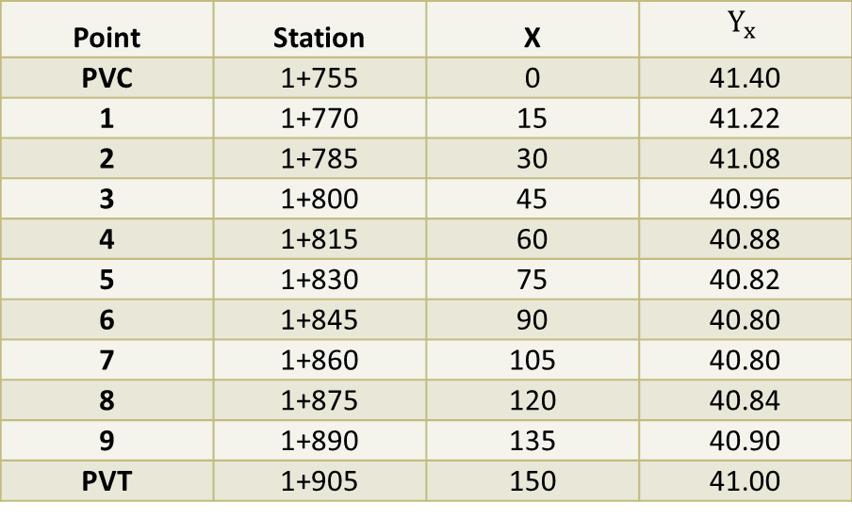
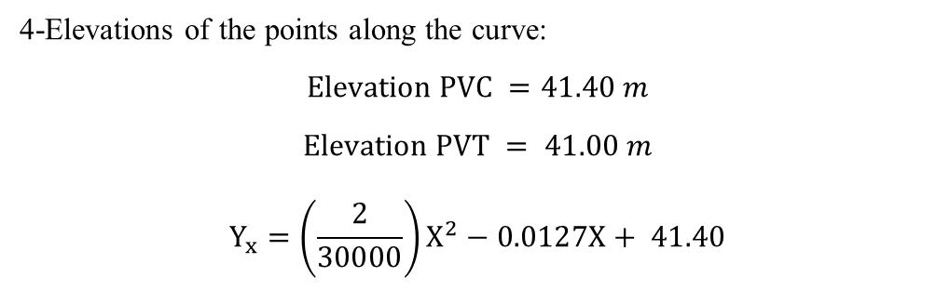
Vertical Alignment
Example of vertical curve no.1 (1+830.48)
1-Required stopping sight distance:
${SSD}_{re}=238$ m < ${SSD}_{design}=250 m$
2-Length:
$$L=150 m$$
3-Stations of PVC and PVT:
$$Station PVC=1+755.5 m$$
$$Station PVT =1+905.5 m$$
Table 8 - Elevations of the points along the vertical curve no. 1
Point | Station | X | $$Y_{x}$$
PVC | 1+755 | 0 | 41.40
1 | 1+770 | 15 | 41.22
2 | 1+785 | 30 | 41.08
3 | 1+800 | 45 | 40.96
4 | 1+815 | 60 | 40.88
5 | 1+830 | 75 | 40.82
6 | 1+845 | 90 | 40.80
7 | 1+860 | 105 | 40.80
8 | 1+875 | 120 | 40.84
9 | 1+890 | 135 | 40.90
PVT | 1+905 | 150 | 41.00
4-Elevations of the points along the curve:
$$Elevation PVC =41.40 m$$
$$Elevation PVT = 41.00 m$$
$$Y_{x}=\left(\frac{2}{30000}\right)X^{2}−0.0127X+ 41.40$$

Slide 20
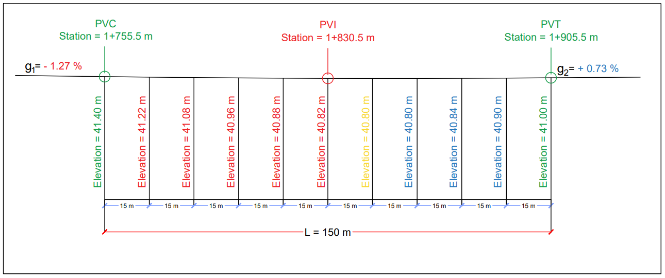
Vertical Alignment
Example of vertical curve no.1 (1+830.48)
Figure 12- Details of Vertical curve no.1

Slide 21
Results
Vertical Alignment
Table 9 - Vertical curves summary
Curve No. |  | 1 | 2 | 3 | 4 | 5 | 6
Classification |  | Sag (Type III) | Crest (Type I) | Sag (Type III) | Crest (Type II) | Crest (Type II) | Sag (Type III)
Length (m) |  | 150 | 150 | 70 | 100 | 100 | 100
Station (m) | PVC | 1+755.5 | 2+820 | 6+585 | 10+270 | 14+505 | 21+725
 | PVI | 1+830.5 | 2+895 | 6+620 | 10+320 | 14+555 | 21+775
 | PVT | 1+905.5 | 2+970 | 6+655 | 10+370 | 14+605 | 21+825
Elevation (m) | PVC | 41.40 | 47.71 | 20.80 | 24.59 | 23.45 | 2.35
 | PVI | 40.44 | 48.27 | 20.54 | 24.64 | 23.53 | 2.20
 | PVT | 41.00 | 47.72 | 20.58 | 24.63 | 23.38 | 2.31
There are six vertical curves the following table shows summary of the vertical curves' calculation.

Slide 22
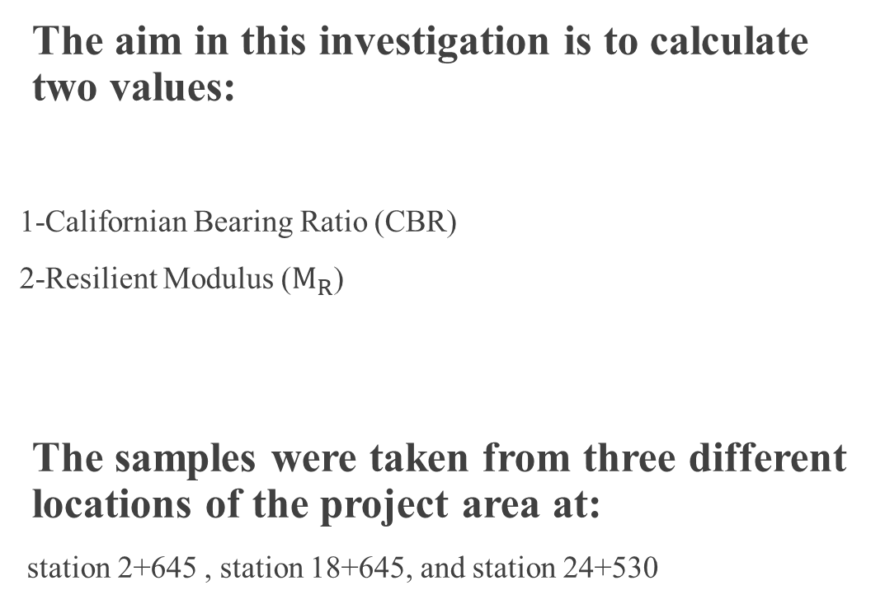
Soil Investigation
The aim in this investigation is to calculate two values:
1-Californian Bearing Ratio (CBR)
2-Resilient Modulus ($M_{R}$)
The samples were taken from three different locations of the project area at:
station 2+645 , station 18+645, and station 24+530

Slide 23
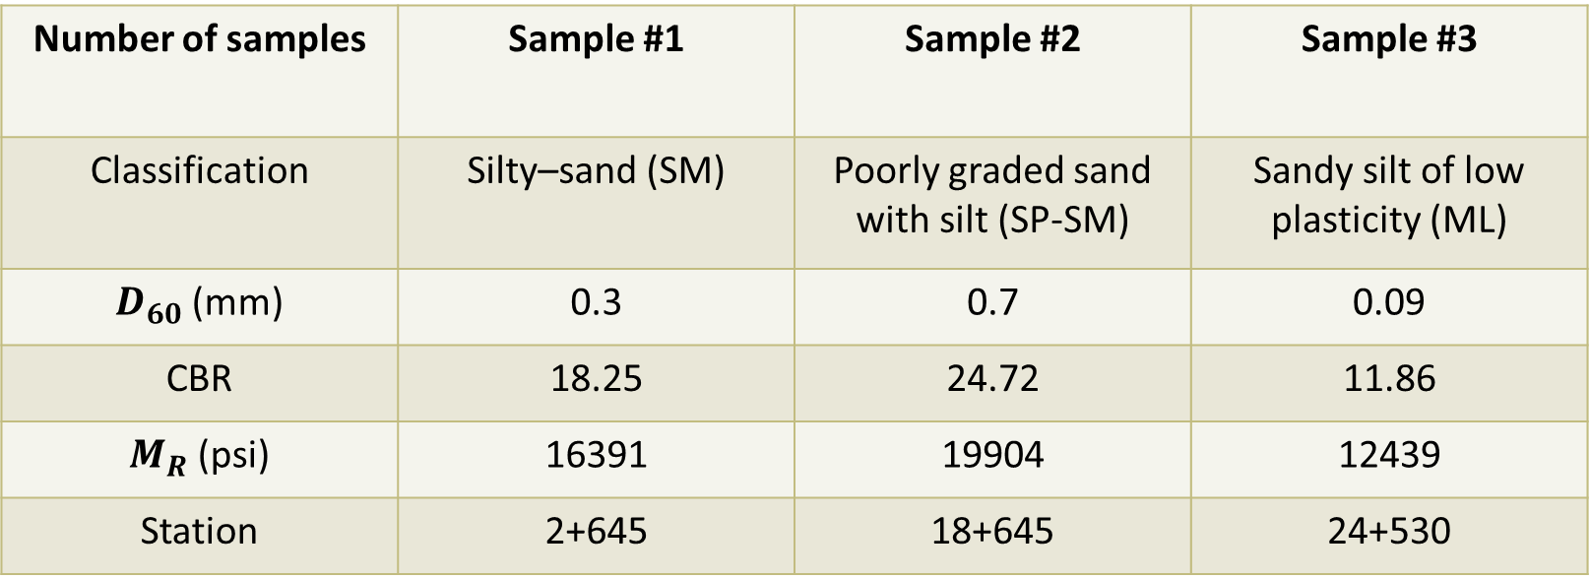
Soil Investigation
Table 10 – Soil investigation summary
Number of samples | Sample #1 | Sample #2 | Sample #3
Classification | Silty–sand (SM) | Poorly graded sand with silt (SP-SM) | Sandy silt of low plasticity (ML)
$D_{60}$ (mm) | 0.3 | 0.7 | 0.09
CBR | 18.25 | 24.72 | 11.86
$M_{R}$ (psi) | 16391 | 19904 | 12439
Station | 2+645 | 18+645 | 24+530
Notes:
Where $D_{60}:$Diameter at 60% passing from the Grain Size Distribution – mm

Slide 24
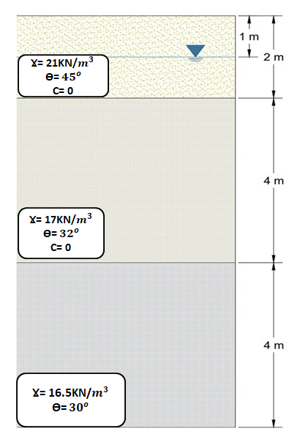
Soil Profile
Layers specifications for
intersection of the road with the railway located
at station 1+270
Figure 13 - Soil Profile at Project site

Slide 25
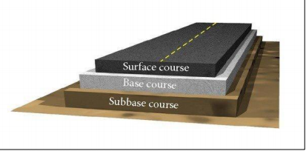
Pavement Design
Surface Course.
Base Course.
Subbase Course.
Figure 14 – Pavement layers
Source: Transportation Engineering Slides, Dr. M. Khasawneh, Ph.D

Slide 26
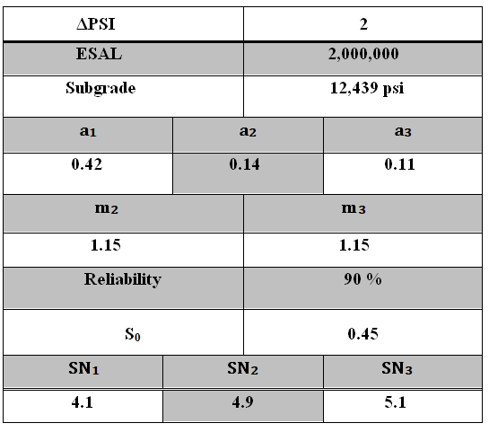
Summary Table
Pavement Design
Table 11 – Summary values of pavement design

Slide 27
Pavement Design
Design 1st
Asphalt Course:
D1 = 10 in
Base Course:
D2 = 15 in
Sub – Base :
D3 = 12 in

Slide 28
Pavement Design
Design 2nd
Asphalt Course:
D1 = 6 in
Base Course:
D2 = 7 in
Sub – Base :
D3 = 9 in

Slide 29
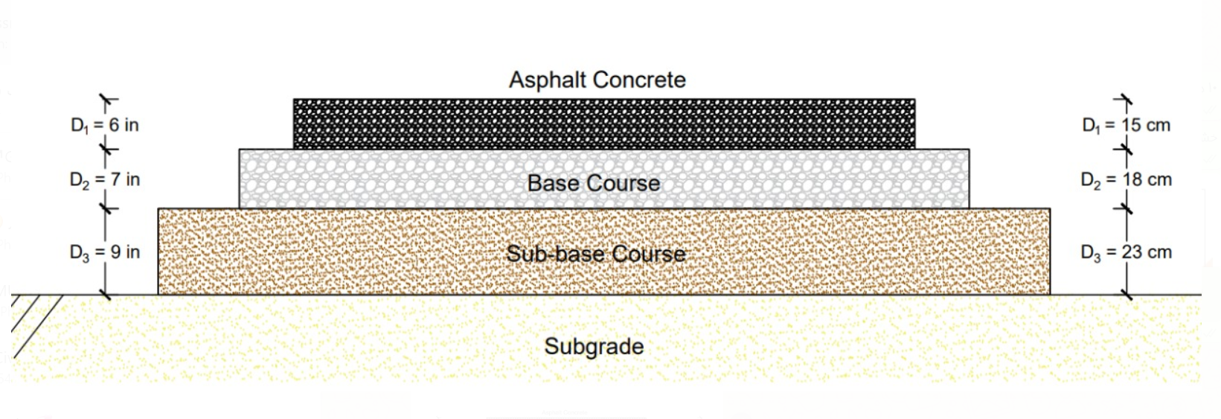
Pavement Design
Design 2
Figure 15 - Final pavement design

Slide 30
Drainage system
Characteristics of natural basins
Mean intensity
Hydraulic Design

Slide 31
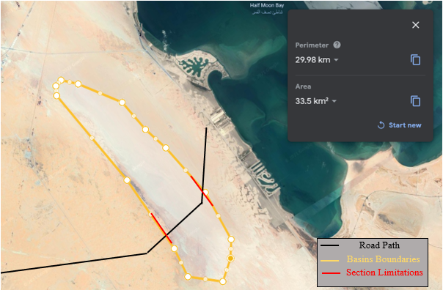
Drainage System
Characteristics of natural basins
Table 12 - Basins Characteristics
Section | Area (km²) | Highest Elevation (m) | Lowest Elevation (m) | Slop (%)
17+200 – 19+890 | 33.5 | 7 | 1 | 0.3
The design period (50) years.
Figure 16 - Natural basins location (Google Erath Pro)

Slide 32
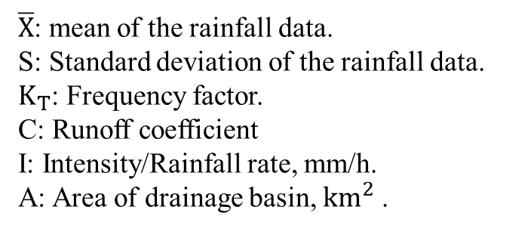
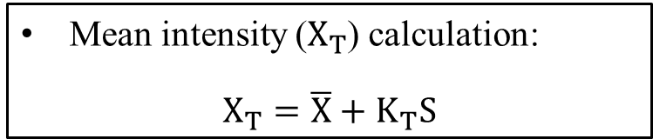
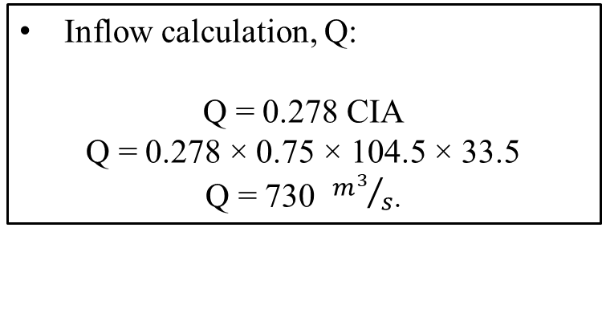
Drainage System
Mean intensity ($X_{T}$) calculation:
$$X_{T}=\overline{X}+K_{T}S$$
Inflow calculation, Q:
Q = 0.278 CIA
Q = 0.278 × 0.75 × 104.5 × 33.5
Q = 730 ${m^{3}}/s$.
Table 13 - Mean intensity
Duration (hours) | Return period T (Years)
 | 2 | 5 | 10 | 50 | 100
 | Mean intensity (mm/h)
1 | 45.16 | 64.2 | 76.8 | 104.5 | 116.2
2 | 60.9 | 89.2 | 107.8 | 148.8 | 166.2
6 | 77.34 | 128.1 | 161.8 | 235.8 | 267.2
12 | 85.32 | 143.9 | 182.8 | 268.2 | 304.3
24 | 93.9 | 154.5 | 194.7 | 283 | 320.3
$\overline{X}$: mean of the rainfall data.
S: Standard deviation of the rainfall data.
$K_{T}$: Frequency factor.
C: Runoff coefficient
I: Intensity/Rainfall rate, mm/h.
A: Area of drainage basin, ${km}^{2}$ .

Slide 33
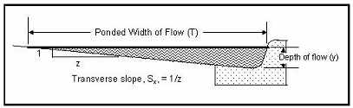
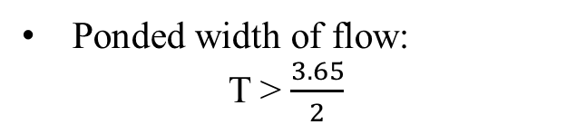

Drainage System
Hydraulic Design
Transvers slope is 2%
Curb depth:
W = (20 - 4)= 16 m
d = 16 × 0.02 = 0.32 m = 32 cm
Calculation the slope of maximum
gutter flow Q by:
Figure 17 - Gutter flow cross section definition of terms (HDM)
$$Q=K\left(\frac{z}{n}\right)s^{1/2}y^{3/8}$$
K: constant = 0.38 ${m^{3}}/s$.
z: reciprocal of the cross-transverse slop of the gutter. n: roughness coefficient of surface = 0.016.
s: slop of the gutter.
$S_{x}:$ Transvers slope.
y: water depth in the gutter at the curb.
s = 0.89 % → let s = 1%
Ponded width of flow:
T > $\frac{3.65}{2}$

Slide 34

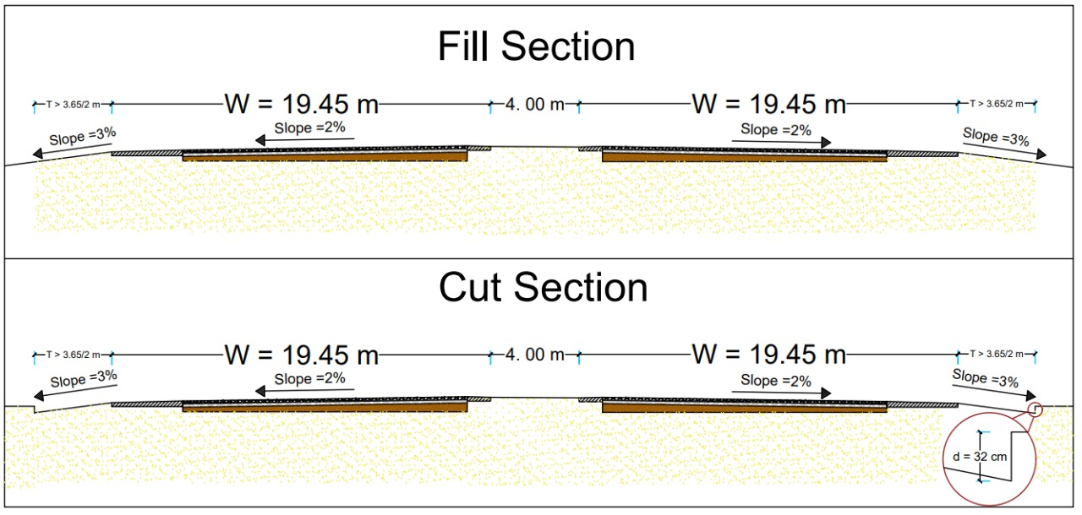
Drainage System
Figure 18 - Cross-section of road in cut/fill

Slide 35
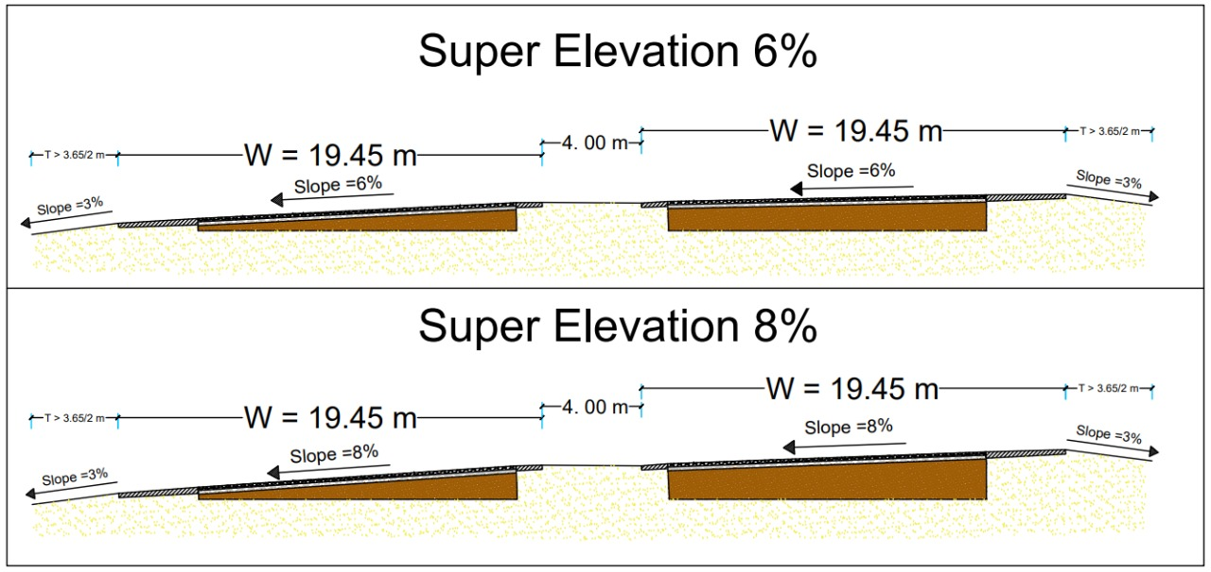
Drainage System
Figure 19 - Cross-section of super elevation

Slide 36
Intersection Design
Selected Interchange
Interchange's locations
Ramps Design
Summary

Slide 37
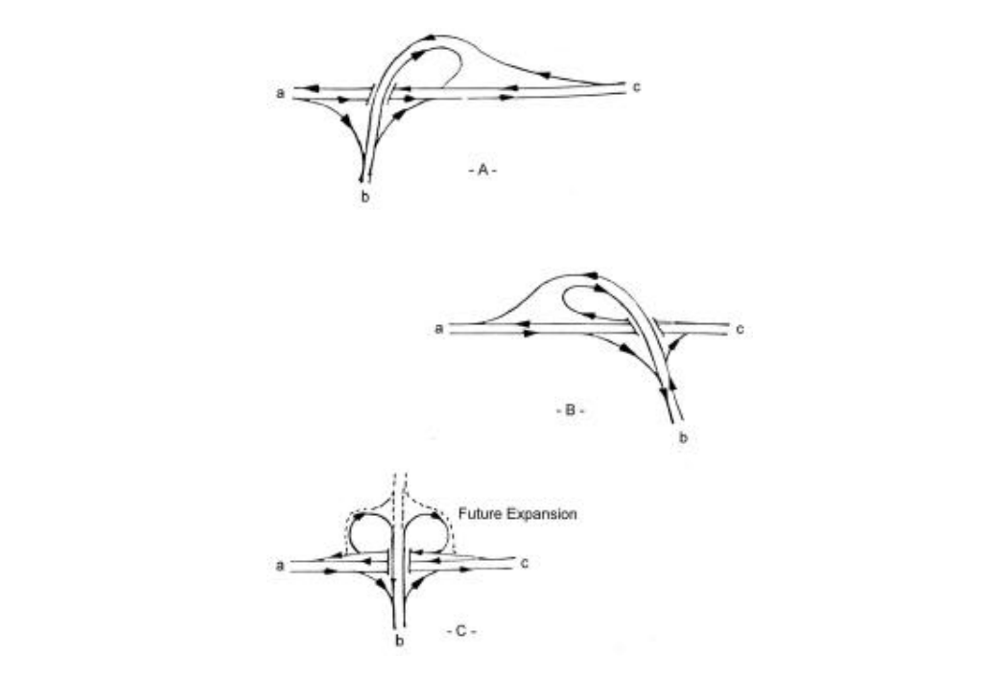
Intersection Design
Selected Interchange
Freeway-freeway intersection:
Interchange.
Locations of interchanges at start and end points:
Three legs: (Trumpet-B)
Semidirect directions:
Designed Road Heading Abqaiq City.
Designed Road Heading Half-moon.
Figure 20 - Three legs interchanges types (AASHTO 2001)

Slide 38

Intersection Design
Interchange's locations
Table 14 - The required interchanges
Intersection Station | Interchange Location | Interchange classification | Type
0+000 | Al Dharan – Abqaiq Rd. | Three legs | Trumpet - B
26+275 | Al Khobar – Salwa Rd. | Three legs | Trumpet - B
26 + 275
0 + 000
Figure 21 - Interchanges Locations (Google Earth Pro)

Slide 39
Intersection Design
Summary
Table 15 - Summary of the interchange design
Ramp Type | Lanes No. | Speed Design (km/h) | Radius (m) | La, Exist (m) | La, Enter (m)
Loop | 2 | 70 | 175 | 230 | ----
Outer Connection #1 | 2 | 90 | 275 | 210 | 245
Outer Connection #2 | 2 | 90 | 275 | 210 | 245
Semidirect | 2 | 90 | 275 | ----- | 245

Slide 40

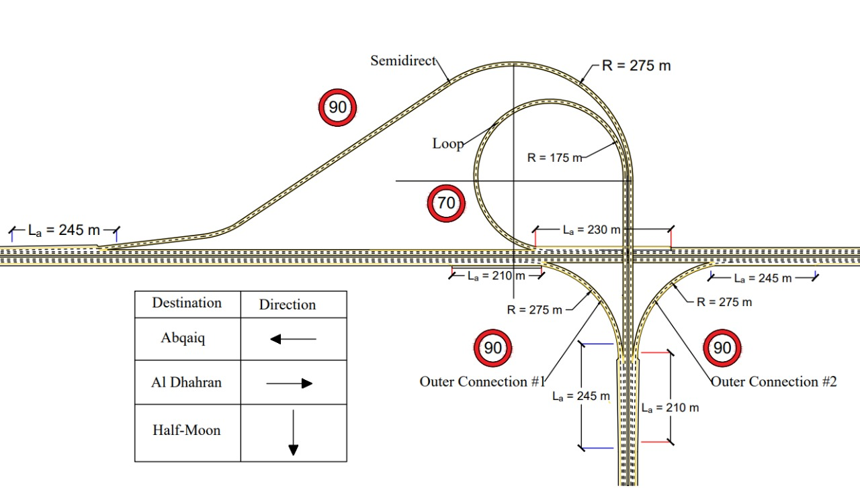
Intersection Design
Summary
Figure 22 - Realistic simulation of final interchange

Slide 41
Bridge Design
Sub – Project
Layout
Girders
Pier Cap
Pier
Foundation
Loads

Slide 42
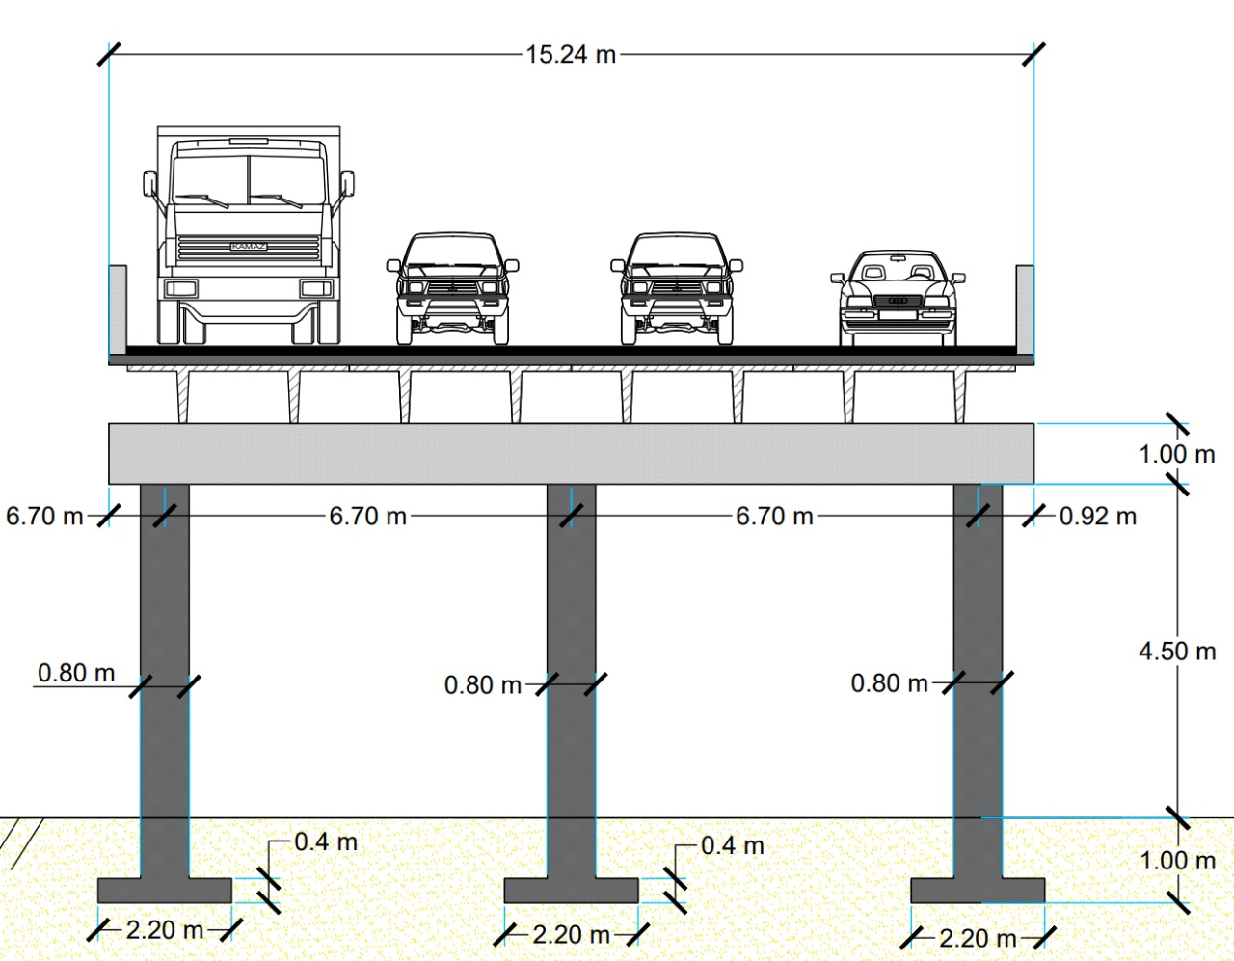
Bridge Design
Girders
Layout
Geometric description:
Supporting conditions: Simply Supported Span
Span length:$80’$ ~ 24.4 m
Lane width: $12’$ ~ 3.35 m
Cross section width, including
shoulders: $50′$ ~ 15.2 m
Pier Cap
Pier
Foundation
Figure 23 - Realistic simulation of the bridge

Slide 43
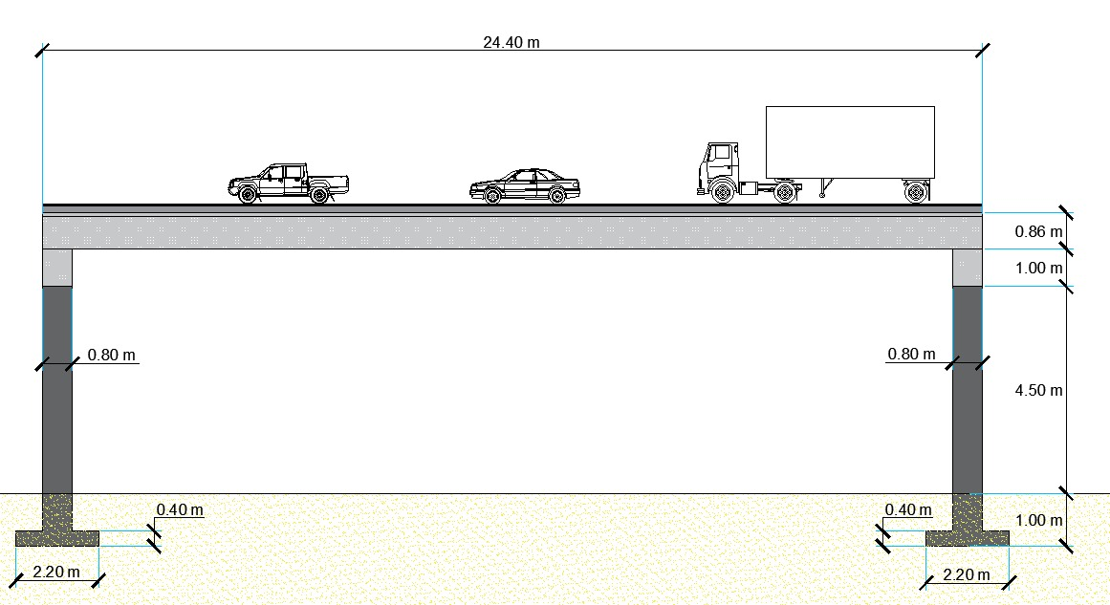
Bridge Design
Layout
Figure 24 - sideview of the bridge

Slide 44
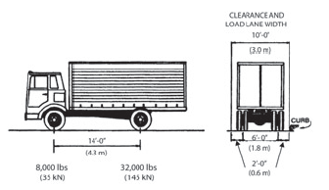
Bridge Design
Loads
Load calculations: Dead load
Asphalt load $=35.2 psf$
Slab (light weight) = $69 psf$
Total superimposed dead load = $104 psf$
Load calculations: Live load
Number of trucks = $4$
Load per truck $=40000 lb$
Total truck load $=160000 lb$
Equivalent distributed truck load = $\frac{Truck load}{Span length ×Width}$
Total superimposed live load = $40 psf$
Figure 25 - Superimposed live load (AASHTO 2001)

Slide 45
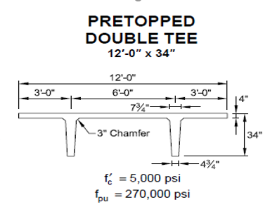
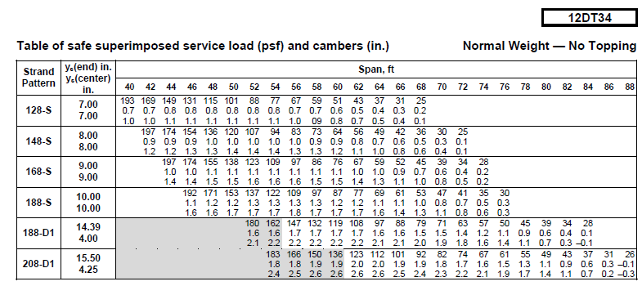
Bridge Design
Girders
Section: 12DT34
Figure 26 - PCI section selection (PCI)

Slide 46
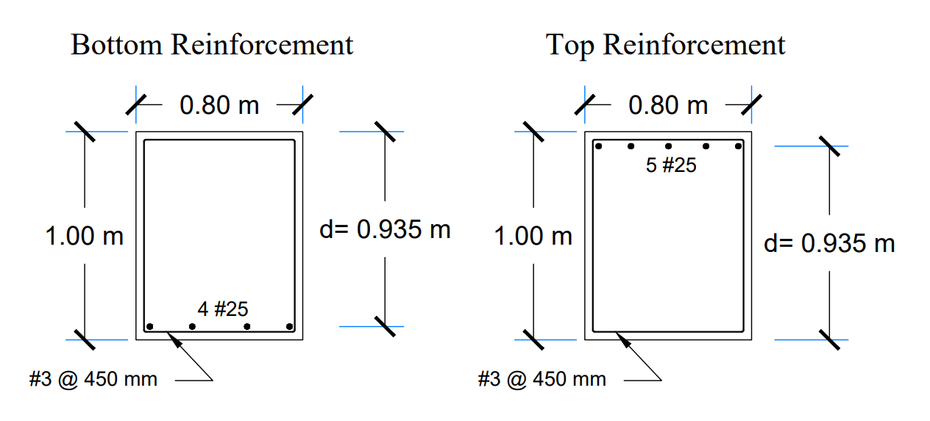
Bridge Design
Pier Cap
Max M+ = 611 KN.m
Max M- = 825 KN.m
Max V = 550 KN
R = 1100 KN
Figure 27 - Cross section of the pier cap

Slide 47
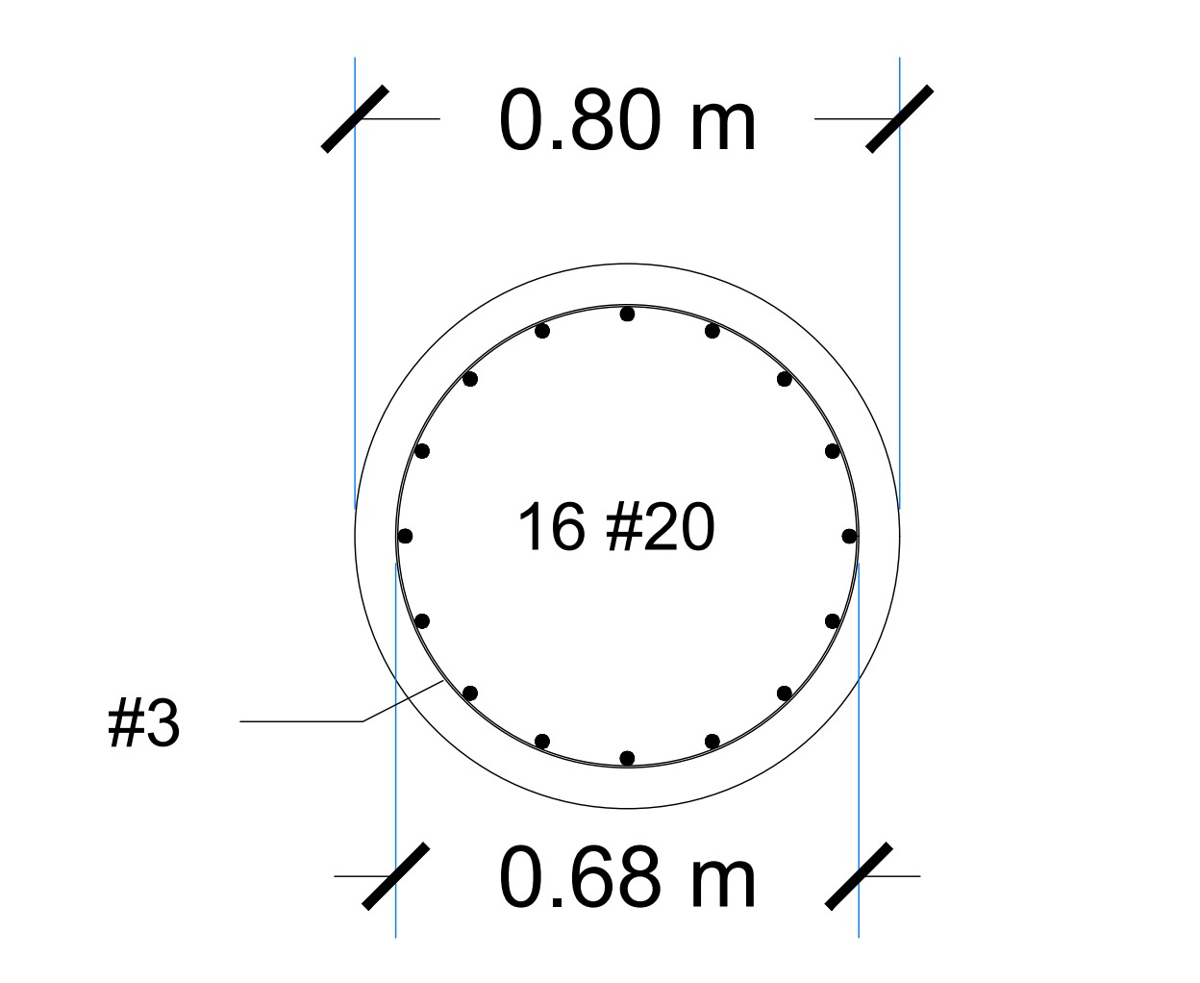

Bridge Design
Pier design
Max M = 266 KN.m
Max axial force = 460 KN.m
The reinforcement percentage , ρ = 0.01
Gross area , $A_{g}$ $=0.5 m^{2}$
Area of steel , $A_{s}$ = 5000 ${mm}^{2 }$
Figure 28 - Cross section of the pier

Slide 48
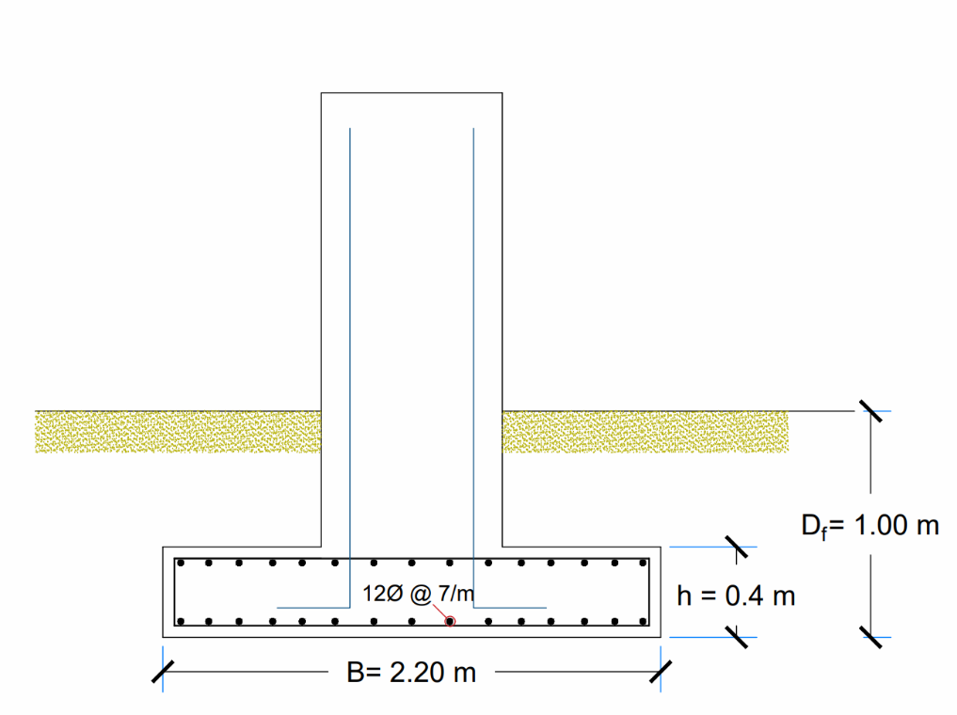

Bridge Design
Foundation
Depth , $D_{f}$= 1.00 m
Width , B = 2.20 m
Thickness , h = 0.4 m
Ultimate moment , $M_{u}$ = 55.6 KN.m
Area of steel , $A_{s}$ = 720 ${mm}^{2}$/$m$
Figure 29 - Reinforcement detailing of the foundation

Slide 49
Cost Estimation.
Cost Estimation Criteria
Cost Estimation Agenda

Slide 50

Cost Estimation.
Cost Estimation Criteria
1.Cut and fill quantities.
2. Leveling of ground.
3. Material price.
4. Equipment work time.
5. Labor's price.
6. Management cost.
7. External expenses.

Slide 51
Cost Estimation.
Cost Estimation Agenda
Highway
Total cost of the Highway = 81,951,552 SAR
Bridge
Total cost of the Bridge = 561,040 SAR
Operation
Cost of the Operation = 8,251,259 SAR

Slide 52


Table 16 – Construction
Ministry of Transportation General Administration of Roads and Transportation in the Eastern Region
Project Title: Abqaiq – Half-moon Highway Design with Reinforced Concrete Bridge Design Section.
Contractor & Consulting: Group one: Alhajji, Albasha, Alshammari, Alkhalifah. Co
Date of signing the contract 2020/12/27 | The date the contractor was notified of the contract 2020/10/08
Project end date (initial) 2022/05/10 | The date of the start of the project implementation 2021/01/01
Advisor : Dr. Mohammed Ali Coordinator: Dr. Andi Asiz | Duration of contract extension After the expiry date of the contract
Total cost : 90,763,852 SAR

Slide 53
Summary & Conclusions.
Complexity
Final Modeling of the project.

Slide 54






References

Slide 55
Thank you for listening
ASSE 4311
Learning Outcome Assessment III CE
Final Presentation
Group 1
(We are happy to answer your recommendations and questions)

