Slide 1


Learning Outcome Assessment III
Final
Design of 30-Storey Tower Using RC & CLT in Dammam
  Student Names & ID’s:
1- Abdel Aziz Albobali, 201400523
2- Ammar Alshaki, 201102686
3- Yasser Bekheit, 201502739
4- Naif Bin Mahfouz, 201401393
Advisors:
Engr. Danish Ahmed
Dr. Tahar Ayadat
Coordinator:
Dr. Andi Asiz
1

Slide 2
Outline
Project Objectives
Project Scope
Project Description
Codes and Design Specifications
Project Constraints
Structural Design of the Building
ETABS Modelling
Geotechnical and Foundation System Design
Cost Estimation
Summary
2

Slide 3
Project Objectives
Design and analysis of 30-Storey building (+ 5 Basements ), including:
Selection of codes and design specifications
Performing the analysis between two different floor systems.
Project constraints
Structural design of the building, and checking the design using ETABS
Geotechnical design of the foundation system
Comparing the two structure system
Assure sufficient parking lot for building purposes
3

Slide 4
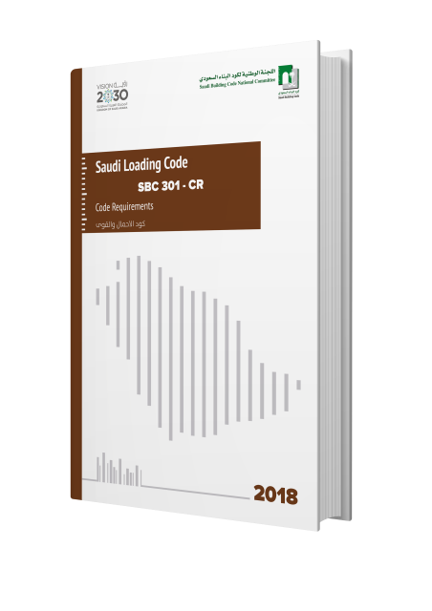
Codes and Design Specifications
Saudi Building Code structural requirements (SBC):
Loading and Forces (SBC 301),
Concrete Structures (SBC 304),
Soil and Foundations (SBC 303),
Steel Structures (SBC 306).
4

Slide 5
4
Project Scope
Chapter | Description
Project Description | Description of the of the original and modified layout
Project Constraints and Structural Design | Required codes and the detailed design of the structure
Preliminary Design | The design of the ( slab , beam, and column ) sections
Steel Reinforcement | Choose suitable size steel bars for reinforcement
Used Software | Using ETABS and AutoCAD modeling
Geotechnical Design and Foundation System | Design applicable foundation system according to the geotechnical properties
Comparing the two Systems | Comparison between CLT and RC system
Cost Estimation | Provide the cost estimation of each material we used

Slide 6
Project Constraints
5
Constraints |  | Solutions
Geotechnical | High level of water table (0.45 m - 1.3 m) | Consider temporary dewatering and permanent drainage system
 | Sabkha Soil (Difficult Soil) | Removal of the contaminated Sabkha soil
 | Foundation Design | Using the mat with pile due to the huge settlement
Material | High Sulfate content in soil | Using type V cement
 | High Chloride content in soil | Application on structural members epoxy or bitumen coating
Environmental | Contaminated “Sabkha” soil | Disposal of excavated contaminated soil and water
Structural | Deflection limits and stability | Consider all possible load combination cases
 | Load combination cases
Cost | All previous constrains | Applying standards and codes to minimize the overall cost

Slide 7

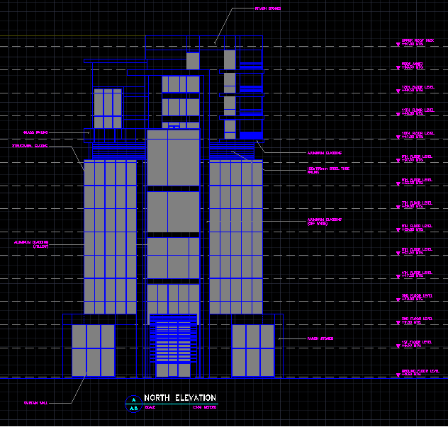
Project Description (Original/Actual)
Designed by (AFM) consultants
15 floors
80 m in length
42 m in width
57.3 m in height
Elevation per floor 4 m
SIDE ELEVATION
6

Slide 8
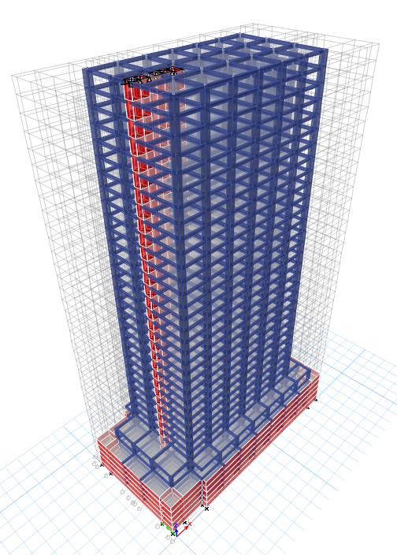
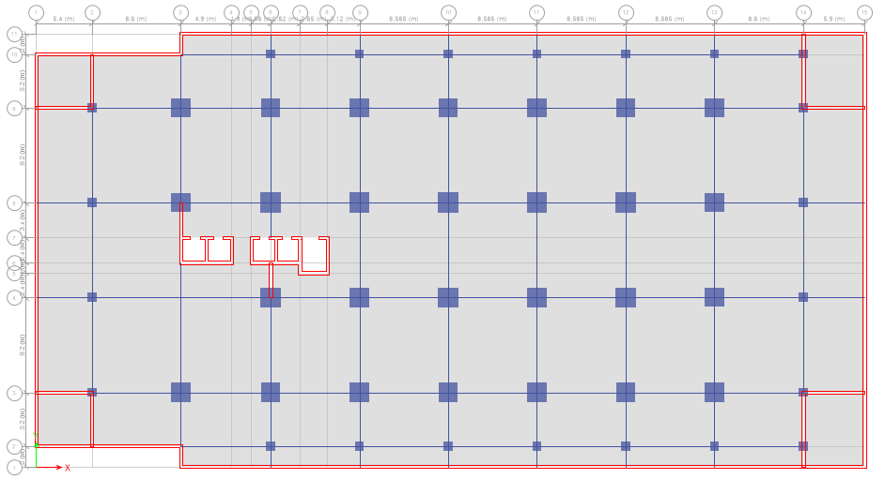
Project Description (Edited/Modified)
30 floors (+5 Basements)
80 m in length
42 m in width
136 m in height
Elevation:
Basement: 3 m, Ground floor: 5 m, All other floors: 4 m
3D
GRIDLINE
7

Slide 9
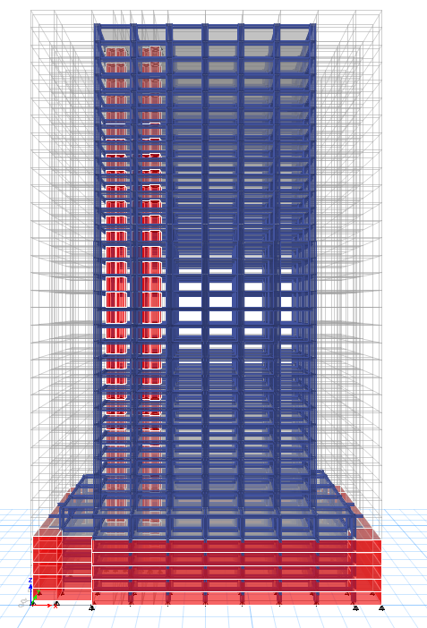

Project Description
RESIDENTIAL
Floor 18 to 30 (13 floors)
RECREATIONAL
Floor 15 to 17 (3 floors)
COMMERCIAL
Floor 1 to 14 (14 floors)
PARKING
Basement 5 + Ground floor (6 floors)
8

Slide 10
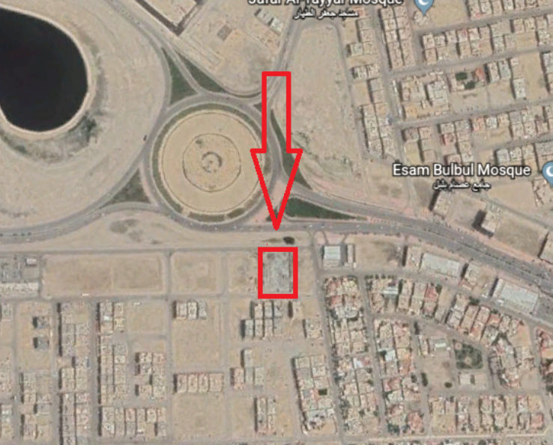
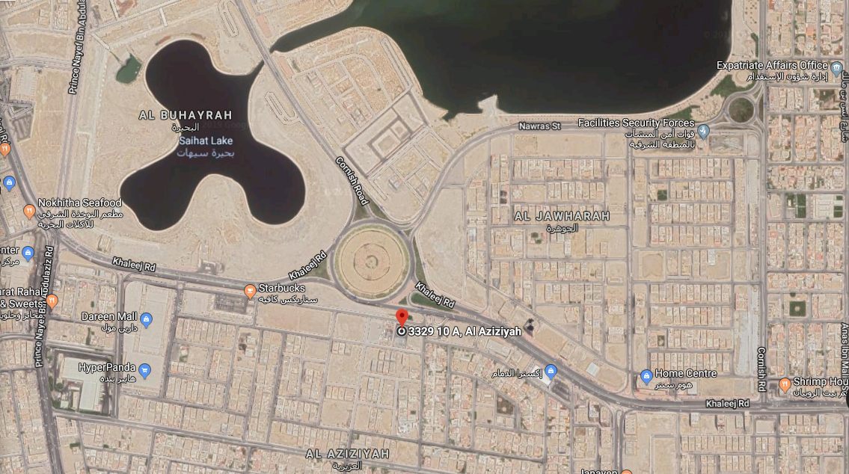
Project Description (Location)
Sihat
Round-about
Sihat
Round-about
9

Slide 11
Structural Design of the building
Preliminary:
Load combinations formulae used:
ETABS Modeling
    Slab
    Beams
Columns
    Shear Walls
12

Slide 12
Structural Design
$$P_{u}=1.2 \left( L_{D} \right)+1.6 \left( L_{L} \right)= {kN}/{m^{2}}$$
15

Slide 13
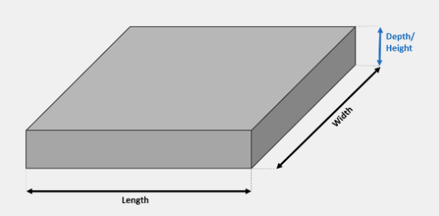
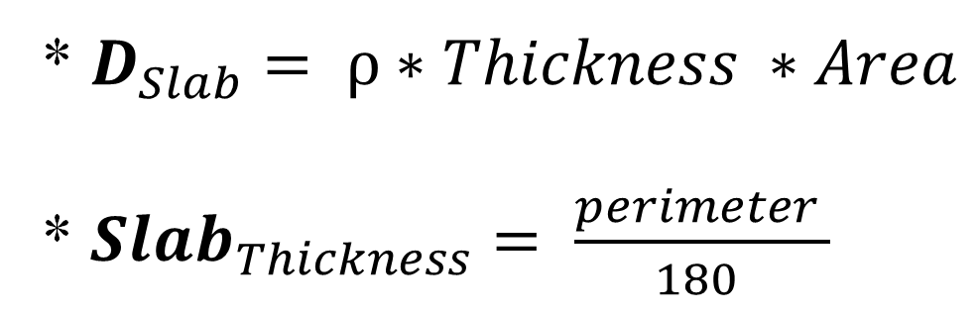
Structural Design
Slab
$$P_{u}=1.2 \left( L_{D} \right)+1.6 \left( L_{L} \right)= {kN}/{m^{2}}$$
* $D_{Slab}= ρ∗Thickness ∗Area$
* ${Slab}_{Thickness}= \frac{perimeter }{180 }$
13

Slide 15
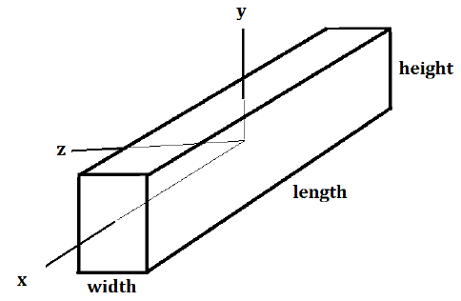

Structural Design
Beams
$$P_{u}=1.2 \left( L_{D} \right)+1.6 \left( L_{L} \right)= {kN}/{m^{2}}$$
*$D_{Beam=ρ∑ [\left(b∗h∗l\right)]}$
* Cross section of beam:
14

Slide 17
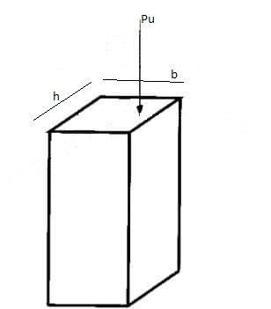
Structural Design
Gross area for columns and shear wall
$$\left.∅P_{u}= ∅ r [ 0.85 {f^{′}}_{c} \left(A_{g}− A_{st}\right)+ f_{y} A_{st}\right]$$
* Cross section of columns:
16

Slide 20
Structural Design
  ETABS © Modeling and Analysis
Extended Three Dimensional Analysis
of Building Systems;
Gridlines
3D view of the structure
Members Analysis
Wind – Seismic loads
Deflection Mapping
17

Slide 21
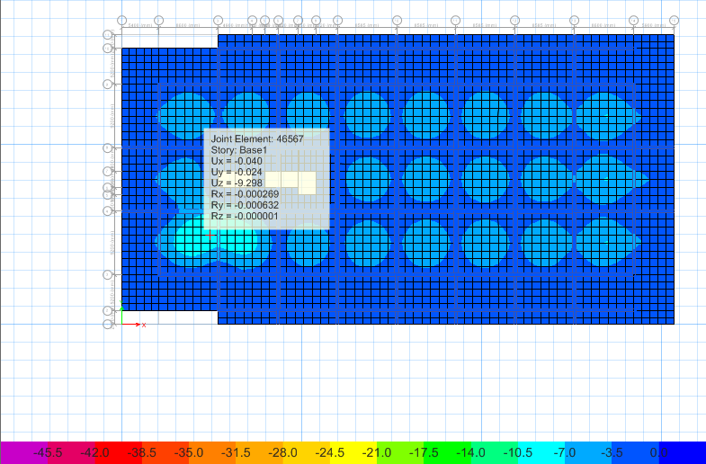
Structural Design
  ETABS © Modelling and Analysis
18

Slide 22
Structural Design
  ETABS © Modelling and Analysis
19

Slide 23
Geotechnical Design of Foundation System
  Soil Profile
  Chemical Analysis
20

Slide 24
Soil Profile
Boreholes | Soil Description | Range of SPT “N” values
BH-1 to BH-5 | Layer: 1 ( 0.0m - 2.50m ) brownish to dark gray, very loose to loose,silty sand | 4 – 10 ( loose )
 | Layer: 2 (2.50m – 9.00m) dark gray, yellowish to grayish ,very soft , sandy lean clay ( sabkha) | 1 – 13 ( loose)
 | Layer:3 ( 9.00m – 12.00m) grayish to brownish , medium dense, poorly graded | 14 – 23 ( medium )
 | Layer: 4 (12.00m -15.00m) gray to brownish, hard, sandy lean clay medium dense to dense | 17 – 47 (medium to dense )
 | Layer: 5 (15.00m - 25.00m) gray to brownish , hard , sandy lean clay | 21 - > 50 (medium dense – dense very dense )
 | Layer: 6 (25.00m - 30.50m) gray to brownish , hard , sandy lean clay | 47 - > 100 ( very dense )
10

Slide 25
Soil Profile
10

Slide 26
Chemical Analysis
Chemical analysis (Sulfate & Chloride)
Type of materials | Type of test | Chemical con.
 |  | Sulfate(%) | Chloride(%)
Soil | Acid Soluble | 0.195-0.424 | 1.277-2.528
11

Slide 27
Obtained Soil Profile and Chemical Analysis
High level of water table ​ (0.45 m - 1.3 m)​ | Consider temporary dewatering and permanent drainage system​
Sabkha Soil (Difficult Soil)​ | Removal of the contaminated Sabkha soil​
Foundation Design ​ | Using the mat with pile due to the huge settlement ​
20

Slide 28
Geotechnical Design of Foundation System
  Piled Raft Foundation
20

Slide 29
Geotechnical Design of Foundation System
  Piled Raft Foundation
20

Slide 30
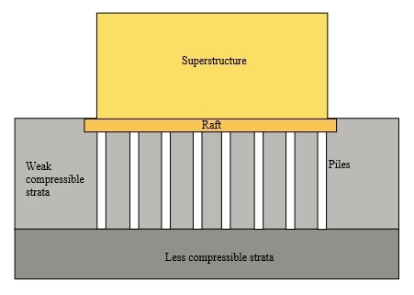
Required Foundation System
(System #3: Piled Mat Foundation )
http://www.abuildersengineer.com/2012/12/piled-foundations-typical-examples.html
21

Slide 31
Cost Estimation
Floor | Area m² | Unit price SAR/m² | Cost
Basement | 3314.8 × 5 | TBD | TBD
Ground | 2198.54 × 1 | TBD | TBD
Floors | 1424.44 × 29 | TBD | TBD
Total | 60081.3 | TBD | TBD
22

Slide 32





References
Saudi Building Code (SBC)
American Concrete Institute. ACI. (2014). Building code requirements for structural concrete (ACI 318-14).
Soil Profile and Chemical Analysis
CSI© ETABS© 2016 Ultimate; version 16.2.0
Autodesk© AutoCAD© 2019: Educational Version.
Lecture notes Geotechnical , foundation , concrete ,structural and environmental
25

Slide 33
Thank You
Any Questions ?
26

