Slide 1
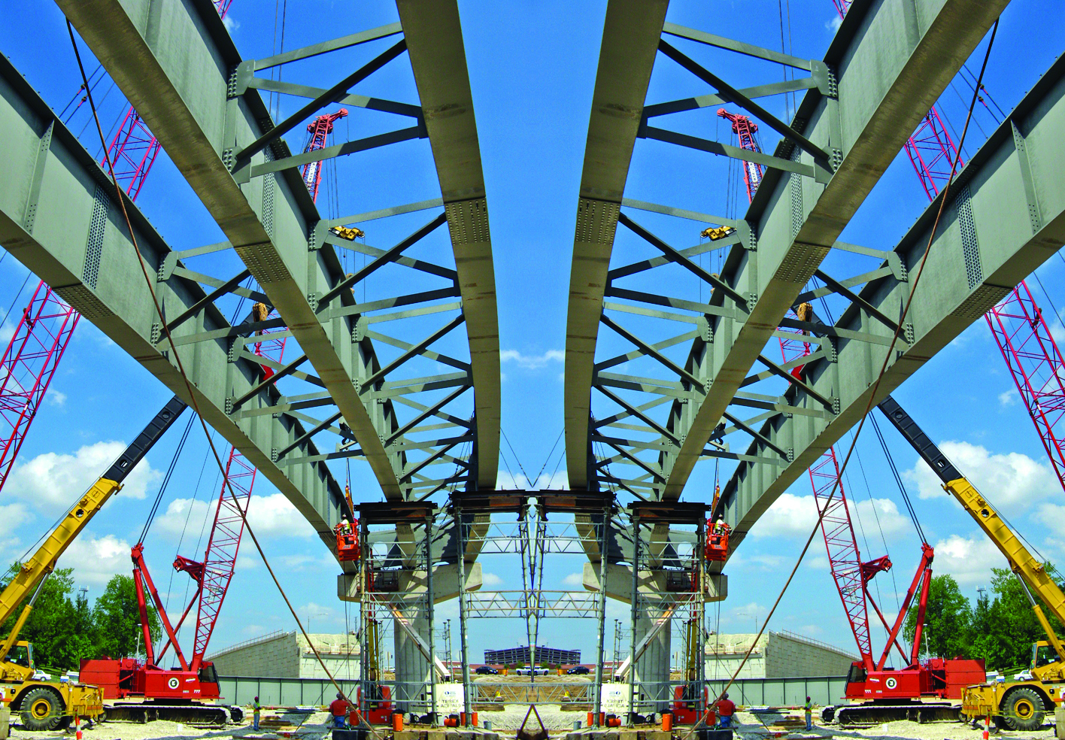



ASSE 4311: Learning Outcome Assessment III/Civil Engineering
Fall 2019 - Final Presentation
ASSE 4311 Learning Outcome Assessment III (Senior Design Project)
Design of Double-Span Bridge
ASSE 4311: Learning Outcome Assessment III/Civil Engineering
Slide (1)

Slide 2
ASSE 4311: Learning Outcome Assessment III/Civil Engineering
Presented by
Muayyad Almalazi 201403400
Yousef Alkhamees 201402171
Walid Karkour 201201424
Kusai Knakri 201401640
Supervised by
Dr. Mohammad Khasawneh
Eng. Mohd. Nayeemuddin
ASSE 4311: Learning Outcome Assessment III/Civil Engineering
Slide (2)

Slide 3




Our Team
Walid
Karkour
Muayyad
Al Malazi
Yousef
Al Khamees
Kusai
Knakri
201403400
201402171
201201424
201401640
Slide (3)

Slide 4
Outline
Design of
Column & Base plate
Design of Retaining Wall
Project
Constraints
1
3
5
Review
Conclusion
2
4
Geotechnical &
Structural Design of Foundation
Cost Estimation
Slide (4)

Slide 5
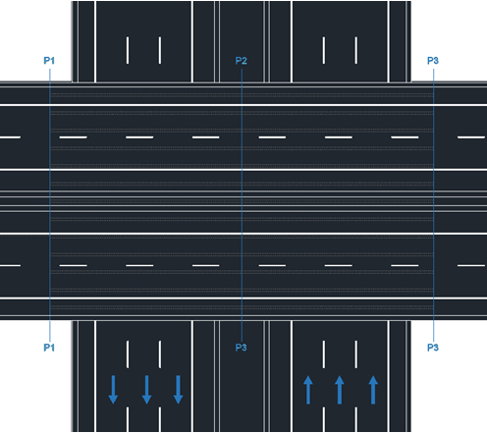
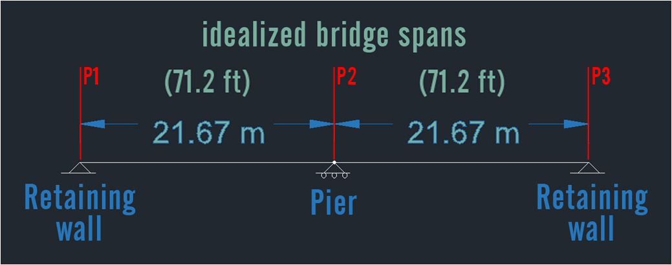
Project Review
Slide (5)

Slide 6
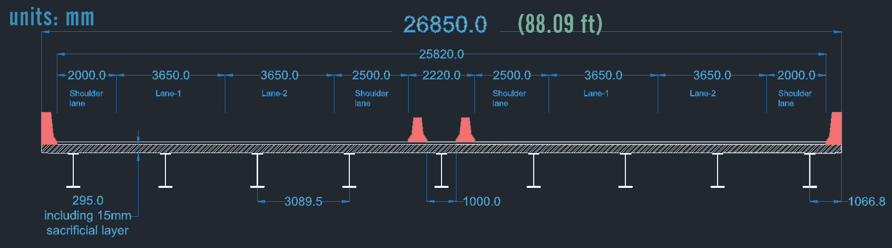
Project Review
Bridge cross section
fhfdh
Slide (6)

Slide 7
Project Review
Slide (7)

Slide 8
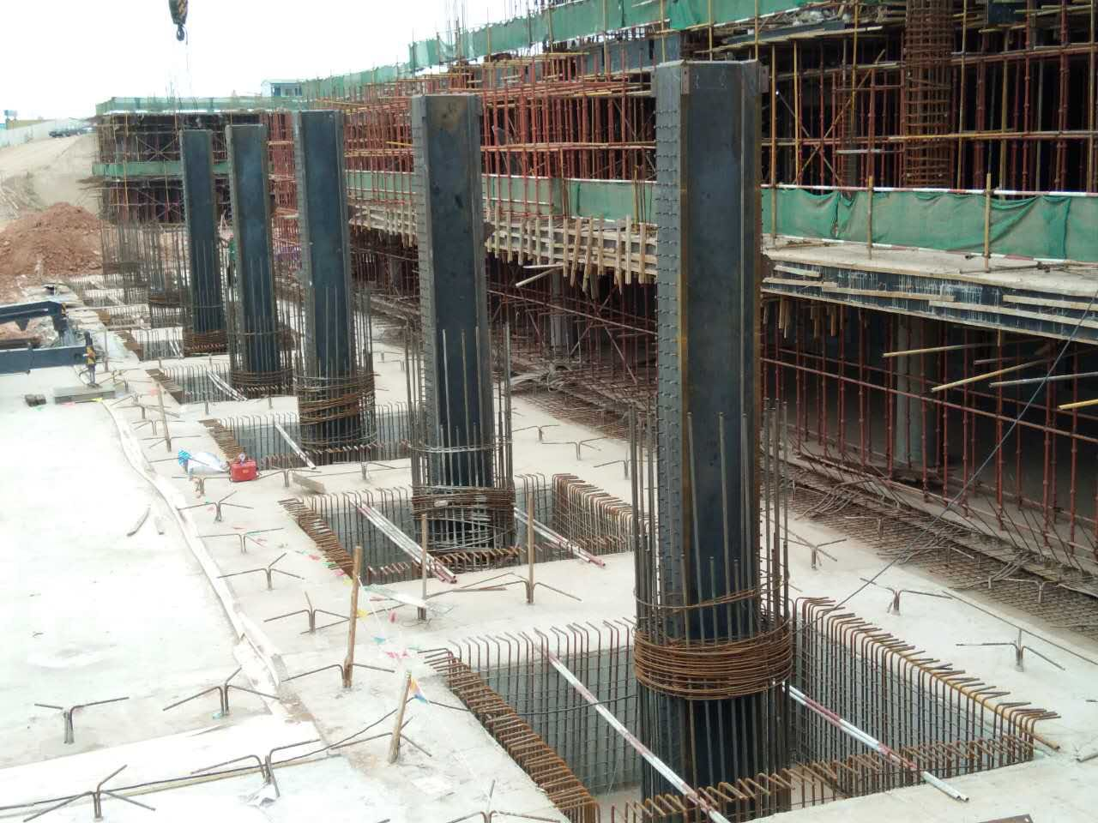
Figure[46]
Design of Columns & Base Plates
Slide (8)

Slide 9
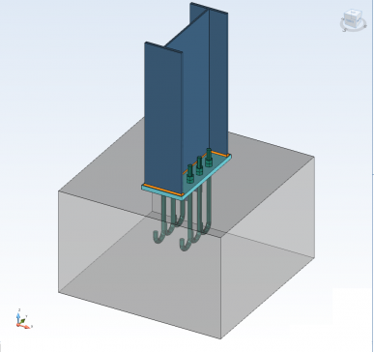

Design Procedure
Column
Design
Base plate
Design
Design is done according to BS 5950
Slide (9)

Slide 10
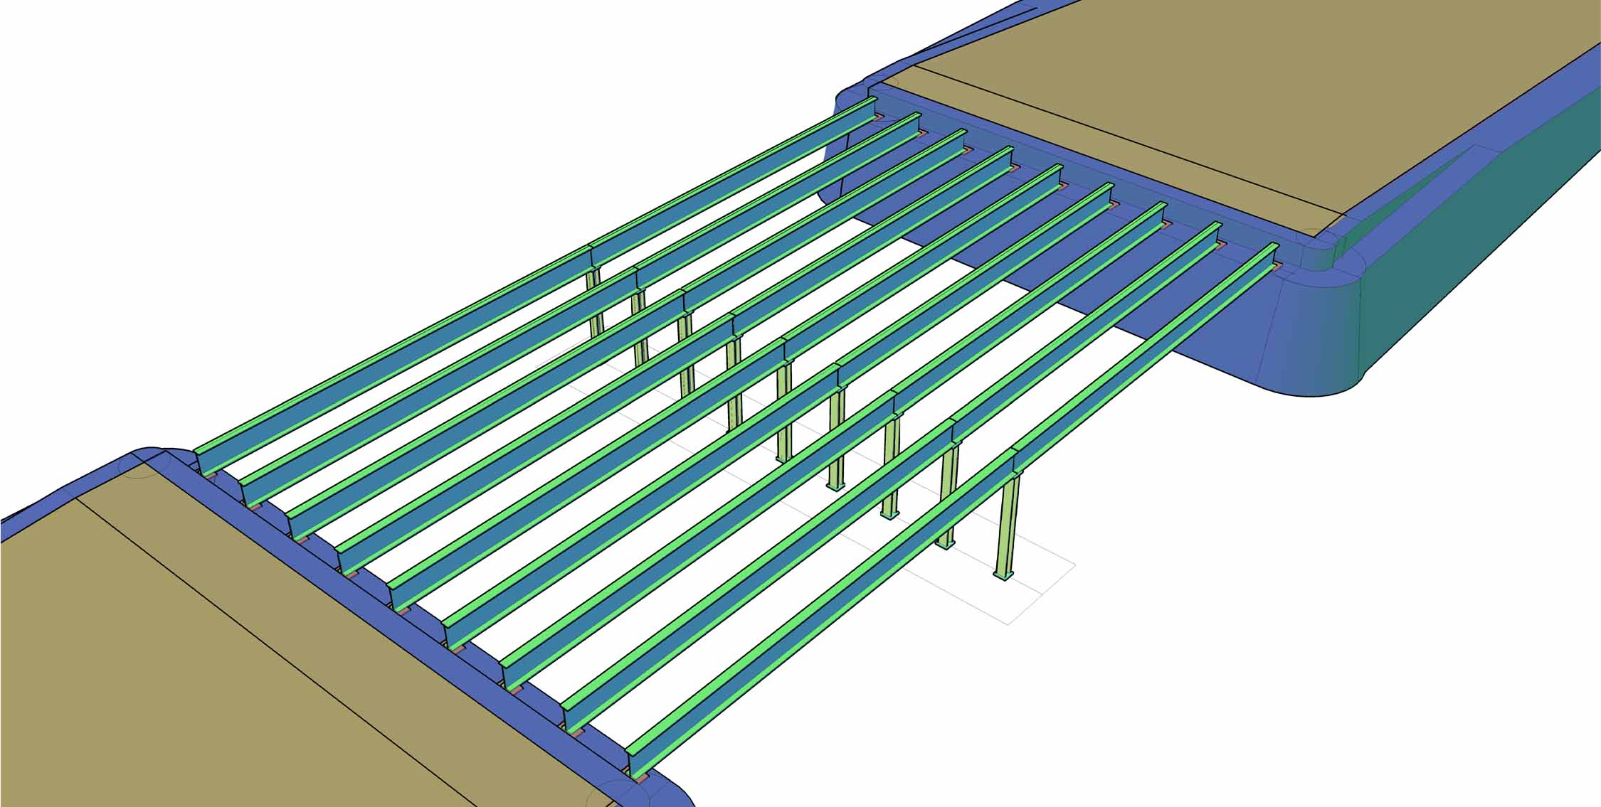
Loads
Each column is supporting 2 beams.
Total load on each column = 4448 kN (444.8 Tons)
Slide (10)

Slide 11
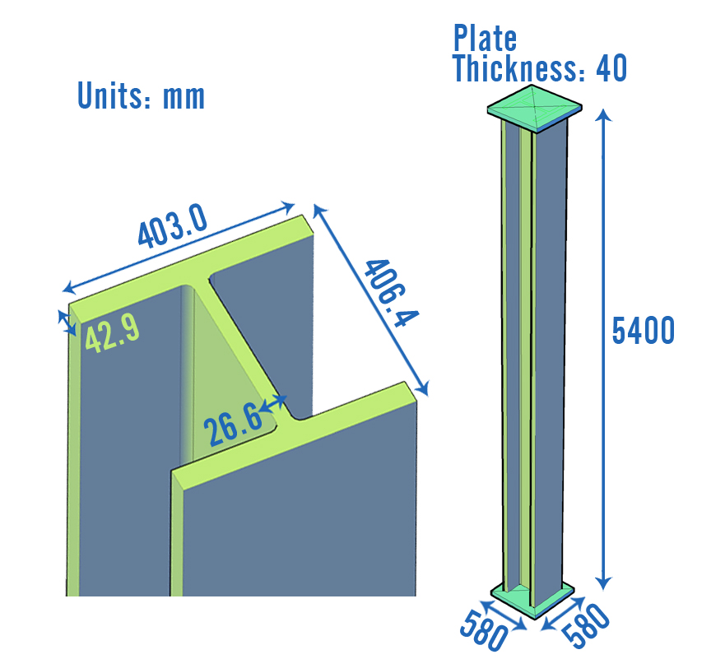
Design Section
Section UC 356 x 406 x 340 is used.
Column height: 5400 mm
Weight of column: 18.35 kN
Total compression capacity
Pc=9093 kN.
FS= Total load/Pc = 2.03 ✓
Slide (11)

Slide 12
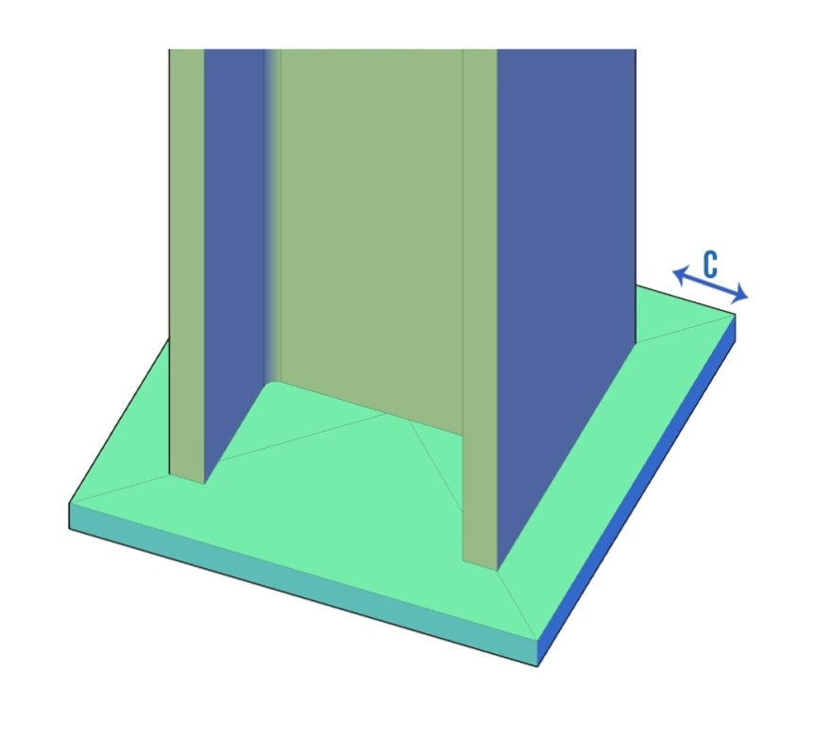

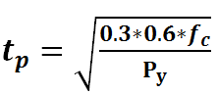
Base Plate
Steel columns cannot be connected directly to concrete foundation. Must provide Base plate
Solve for ( C )
tp
Slide (12)

Slide 13
Column Summary
Slide (13)

Slide 14
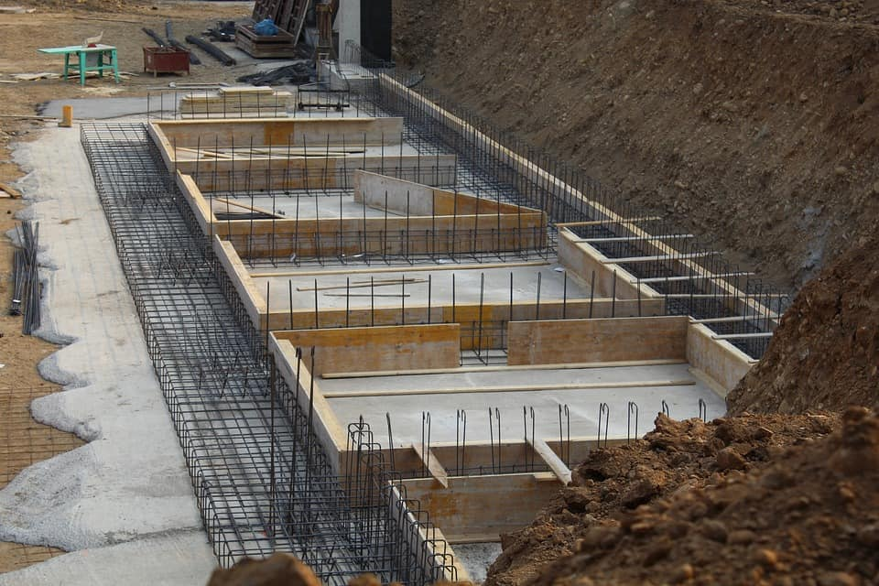
Figure[46]
Geotechnical & Structural Design of Foundation
Slide (14)

Slide 15
Design Procedure
Geo-technical
Design
Structural
Design
Sizing of foundation
Soil bearing capacity
Soil settlement
Moments
Sizing & spacing of rebar
Slide (15)
Notes:
Gravity retaining walls rely fully on their weight to resist the forces acting against them

Slide 16
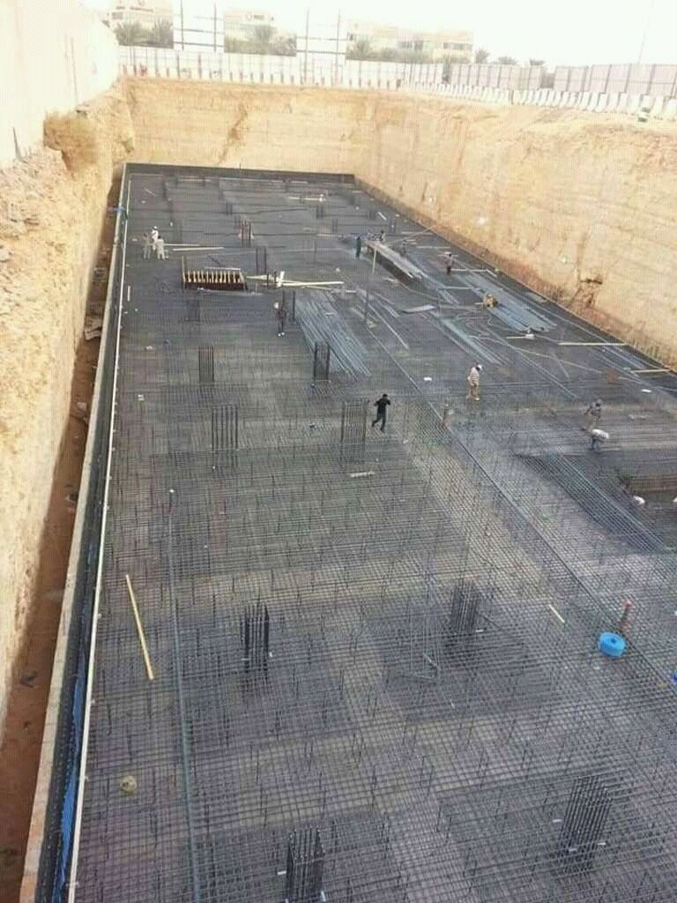
Design Choice
Mat (Raft) Foundation
Continuous reinforced concrete slab that rests on the soil.
Extends over the entire area of the structure that it supports
Used for weak soils
Slide (16)
Notes:
Gravity retaining walls rely fully on their weight to resist the forces acting against them

Slide 17
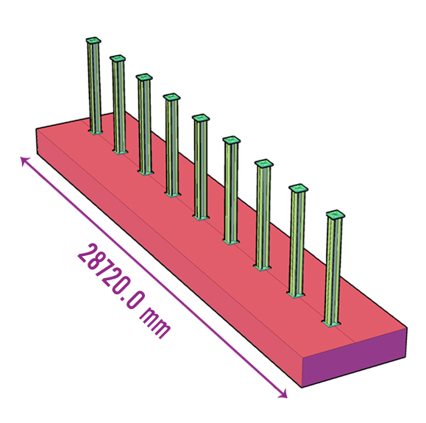
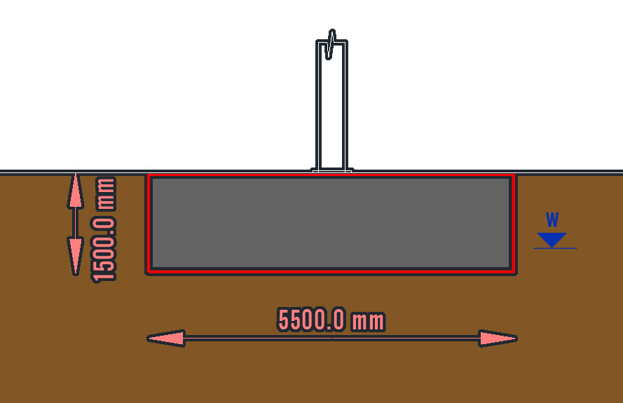
Design Parameters
Initial design assumptions
B=5500 mm
L=28720 mm
H=1500 mm
Slide (17)

Slide 18
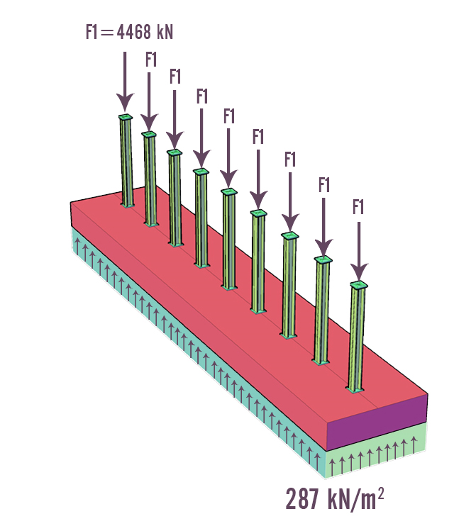
Soil Stresses
Loads on columns are obtained from factored shear envelope
Self weight is calculated.
Qnet =(F/ Area) represents the foundation reaction on the soil. Qnet =(287 kN/m²)
Must check bearing capacity of the soil
Qnet=
Slide (18)

Slide 19
Soil Bearing Capacity
Bearing Capacity (Qu) is found using Terzagi’s Eq.
Qu= 588.8 kN/m² FS= 2
Qallowable=294.4 kN/m²
Qnet > Qallowable <Ok>
Slide (19)

Slide 20
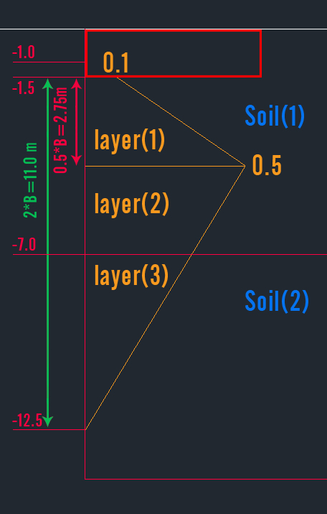

Settlement
Using Schmertsmann’s method
C2 requires inputting time in years.
50 years will be used
Slide (20)
Notes:
Gravity retaining walls rely fully on their weight to resist the forces acting against them

Slide 21
Settlement
Settlement = 71.6 mm
Maximum allowable settlement for mat foundations is
50 mm or 50-100 mm
Settlement after removing 7m of soil
Settlement = 13.3 mm
Excavating and backfilling 1000m³ of soil
Slide (21)
Notes:
Gravity retaining walls rely fully on their weight to resist the forces acting against them

Slide 22
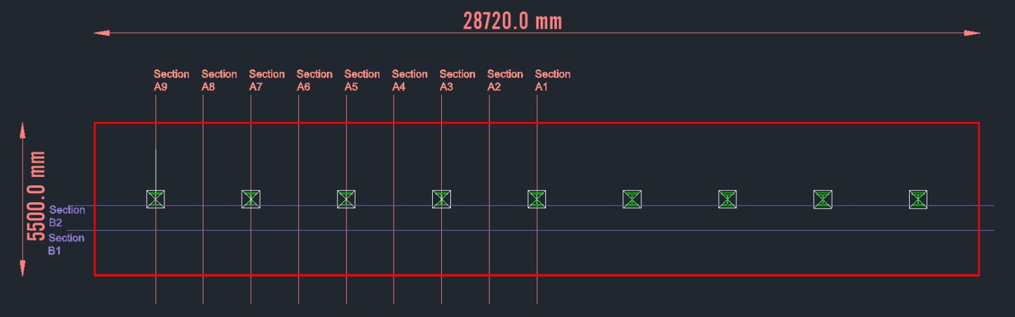
Structural Design
Goal: Sizing of reinforcement rebar
Slide (22)
Notes:
Gravity retaining walls rely fully on their weight to resist the forces acting against them

Slide 23
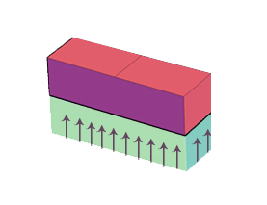
Structural Design
Section-A9
Slide (23)
Notes:
Gravity retaining walls rely fully on their weight to resist the forces acting against them

Slide 24
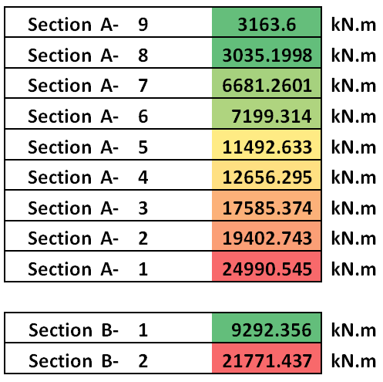
Structural Design
Long bars: sections-A
Short bars: sections-B
Slide (24)
Notes:
Gravity retaining walls rely fully on their weight to resist the forces acting against them

Slide 25
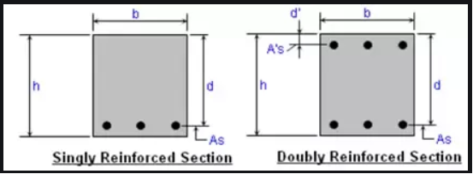
Structural Design
Design procedure is very similar to design of concrete beams:
Using (h), (b) & (d)
(K)= (M/f’c*b*d² ) if < 0.167 (Singly reinforced)
(Z) then (As):Required area of steel
Slide (25)
Notes:
Gravity retaining walls rely fully on their weight to resist the forces acting against them

Slide 26
Design Issue
For long bars, if we use Ø25, we need 86 bars.
Spacing= 38 mm ✖ bars don’t fit
Solution: Use smaller bars and place them in 2 layers. Ø22, total of 114 bars in 2 layers (57 each).
Spacing is 74 mm
Slide (26)
Notes:
Gravity retaining walls rely fully on their weight to resist the forces acting against them

Slide 27
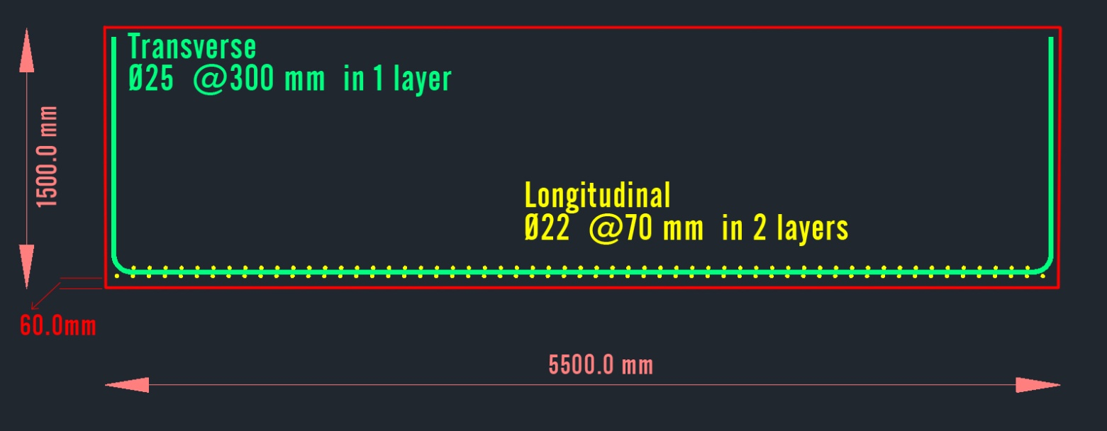
Rebar Summary
Long reinforcement: Ø22 @70 mm in 2 layers
Transverse reinforcement: Ø25 @300 mm in 1 layer
Slide (27)
Notes:
Gravity retaining walls rely fully on their weight to resist the forces acting against them

Slide 28
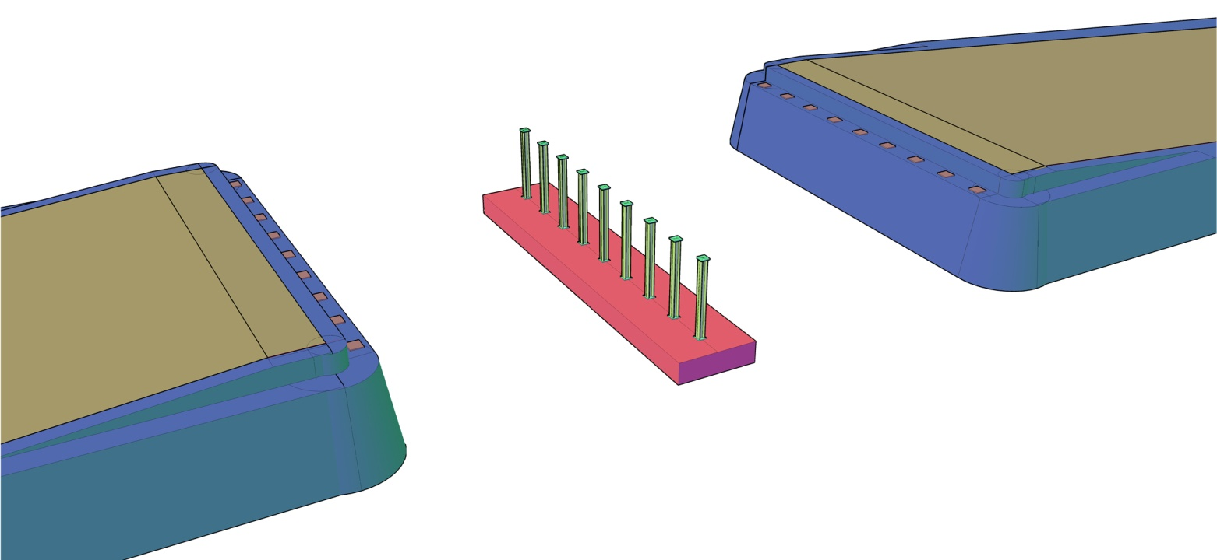
3D Model
Slide (28)
Notes:
Gravity retaining walls rely fully on their weight to resist the forces acting against them

Slide 29
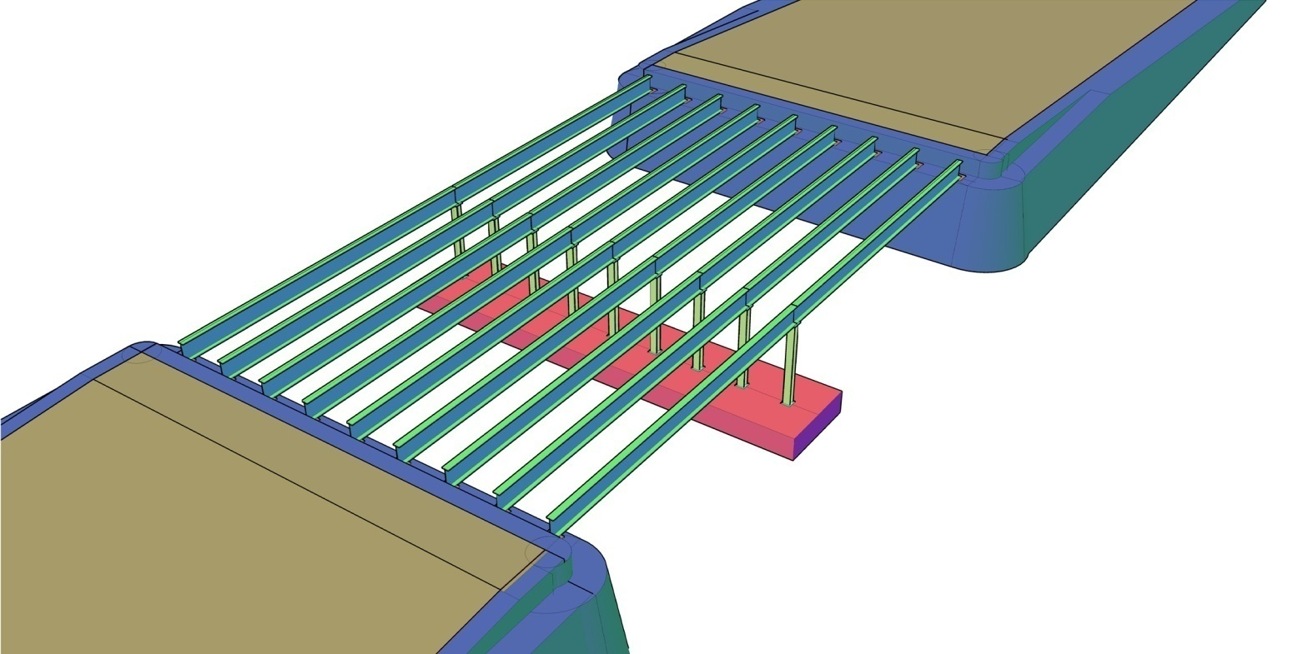
3D Model
Slide (29)
Notes:
Gravity retaining walls rely fully on their weight to resist the forces acting against them

Slide 30
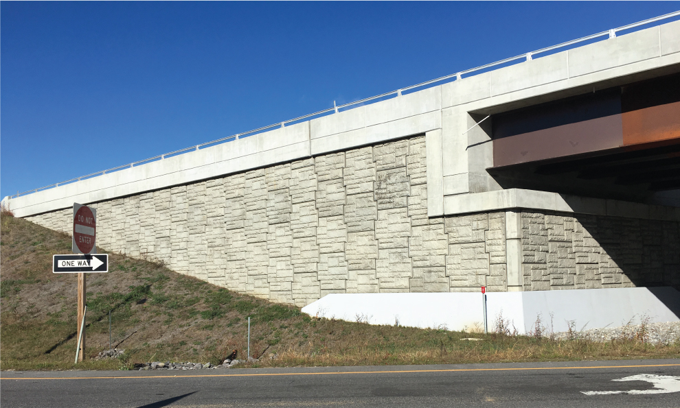
Retaining Wall Structure
Slide (30)

Slide 31
Retaining Wall Structure
Idealized Bridge Spans
Slide (31)

Slide 32
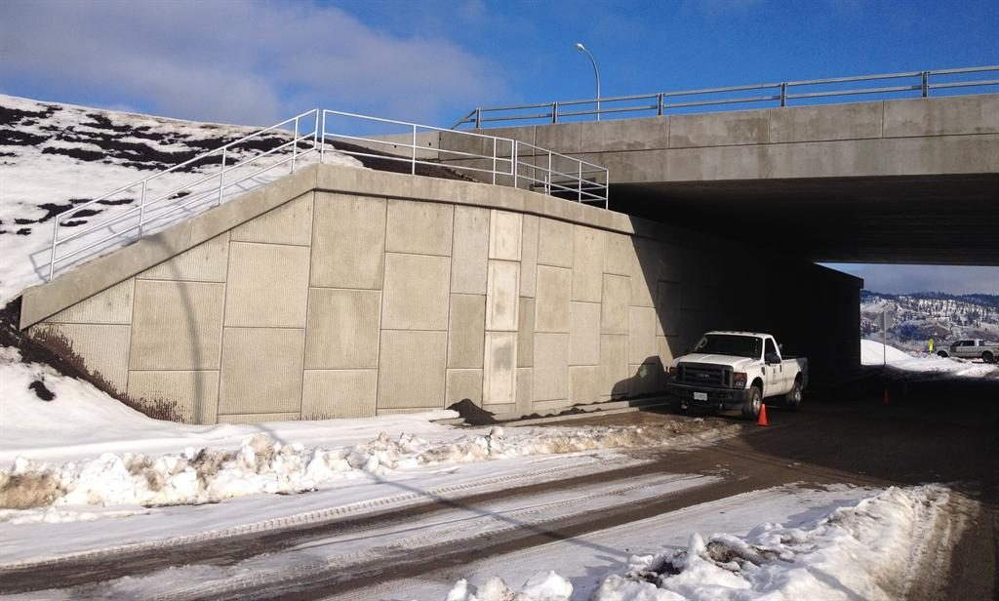
Objectives
Protect bridge underpass from retained soil
Slide (32)

Slide 33
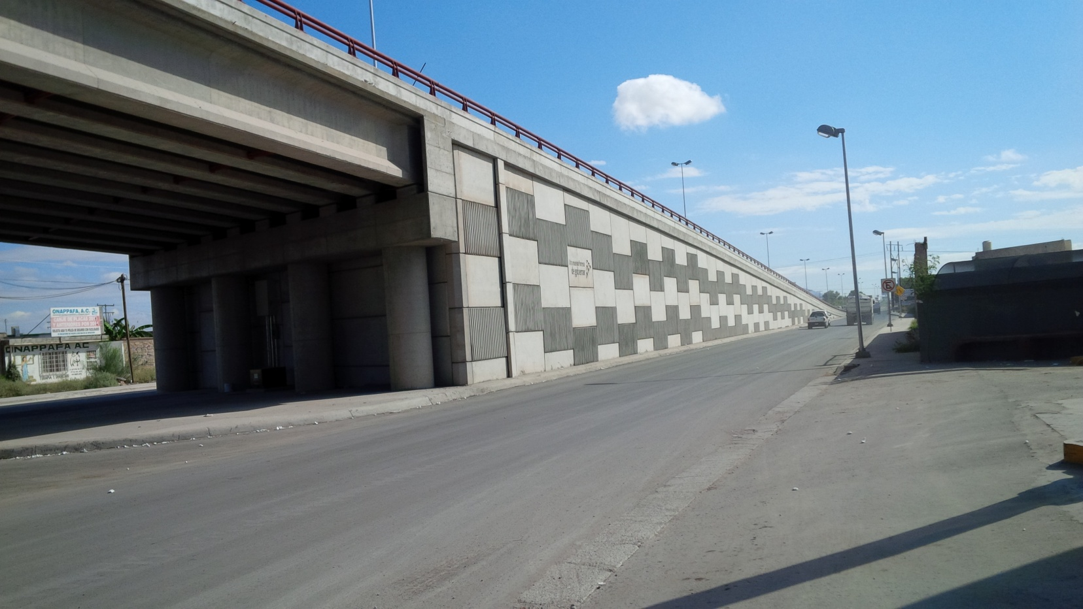
Objectives
Provide sufficient inclined distance for vehicles to rise
Slide (33)

Slide 34
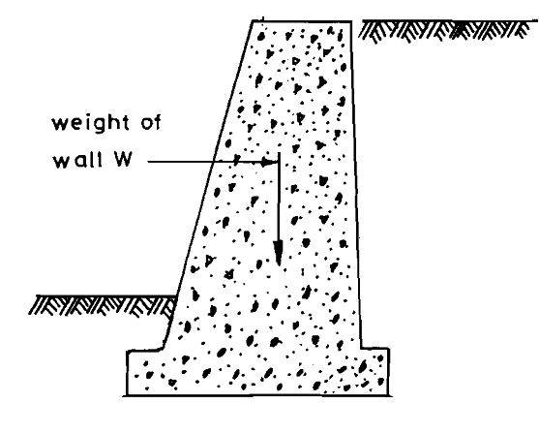
Type of Retaining Wall
Gravity retaining wall
Slide (34)
Notes:
Gravity retaining walls rely fully on their weight to resist the forces acting against them

Slide 35
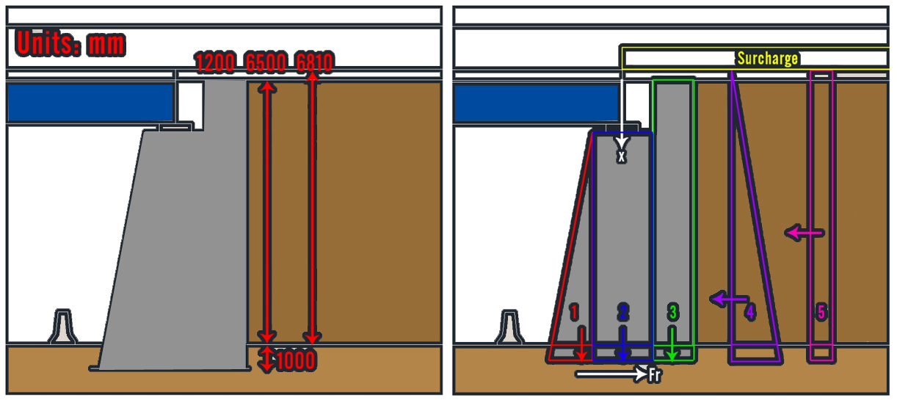
Design Geometry
Slide (35)

Slide 36
Loads Acting On The Wall
Slide (36)

Slide 37
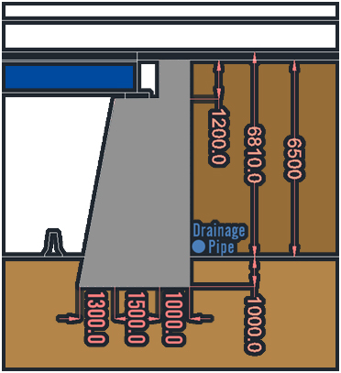
Checks & Factors of Safety
Sliding Check: 2.65 > 1.5 <OK>
Overturning Check: 2.71 > 2 <OK>
Eccentricity (e) = < B/6 <OK>
Minimum stress: 40.24 kN/m² <OK>
Maximum stress(Qmax): 595 kN/m²
Must check bearing capacity of soil
Slide (37)

Slide 38
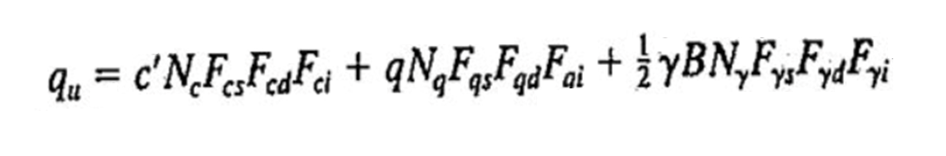
Soil Bearing Capacity
Bearing Capacity (Qu) is found using Meyerhofs’Eq.
Qu= 1325 kN/m²
FS= Qu/Qmax= 2.226> 2 OK
Slide (38)

Slide 39
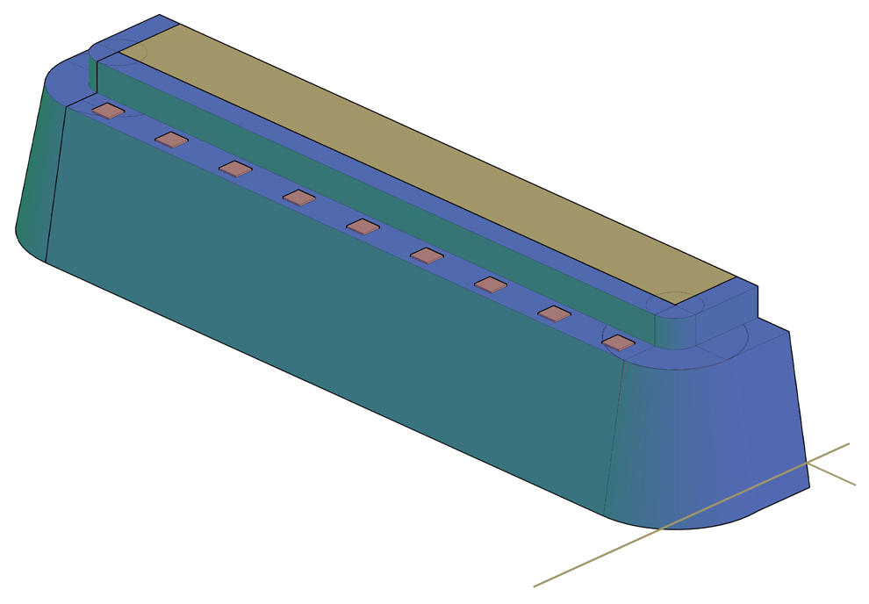
Full Retaining Wall Structure
Slide (39)

Slide 40
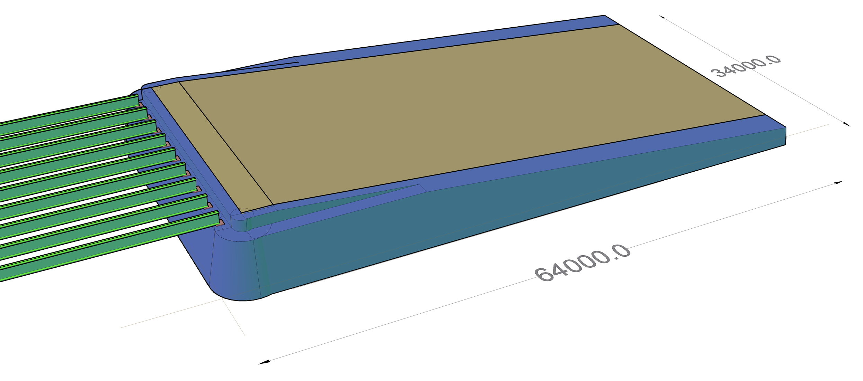
Full Retaining Wall Structure
Slide (40)

Slide 41

Figure[46]
Cost Estimation
Slide (41)

Slide 42
Cost Breakdown
Material
Equipment (Owned / Rented)
Labor & Personnel ( Daily / Fixed salary )
Engineering services
Overhead (Rents/ vehicles...)
Other (Legal / Insurance...)
Slide (42)

Slide 43
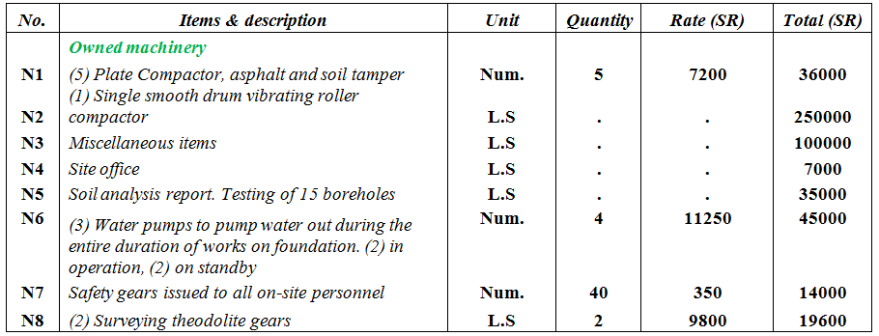
Bill of Quantity
Slide (43)

Slide 44
Bill of Quantity
Mat foundation include:
Excavation
Back filling & compacting
Supply of steel + Laying
Supply of concrete
Water proofing paint
Sheet piling around foundation + 24/7 Water pumps
Slide (44)

Slide 45
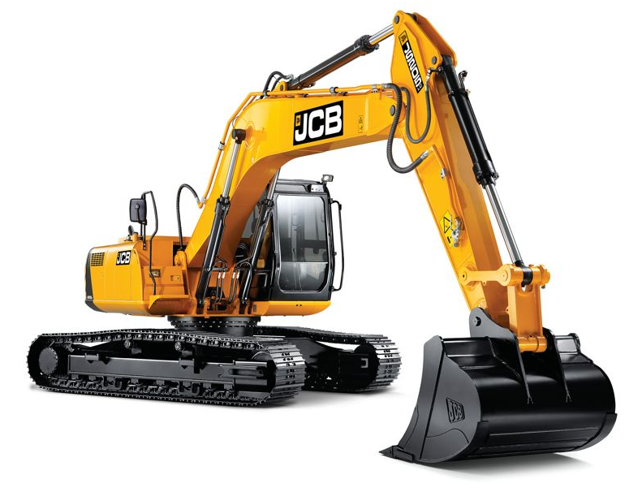
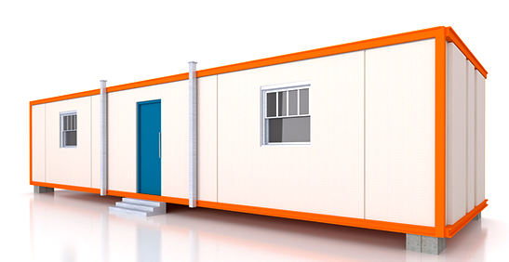
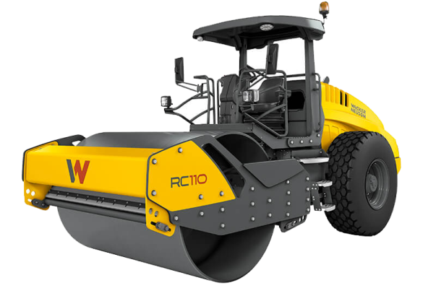
Performance Rates
JCB excavator → 70 m³/shift → 800SR/ day
Laying of rebar → 18 hr/ton
Laborers → 140 SR/day.
Site office
Compactors
Surveying gear
Slide (45)

Slide 46
Final Costs
Project duration: 18 months
Project cost: 10,950,000 SR
Profit margin + error : 55%
Bidding price : 17,000,000 SR
Slide (46)

Slide 47

Project Constraints
Slide (47)

Slide 48
Constraints
Knowledge: This project meant researching a new topic and setting foot in a completely new territory.
Legal Constraints: The legal requirements and regulations that are set by the government. Tendering procedure is legally binding. Rules set by the Saudi Ministry of Labor & Social Development applies .
Social Constraints: Takes into account the impact that this project will have on the community and the general public. What would come of businesses and shops on this street? How would people access this area during the construction?
Economical Constraints Budgeting & allocation of resources. This item goes hand in hand with (Time) and (Quality).
Slide (48)

Slide 49
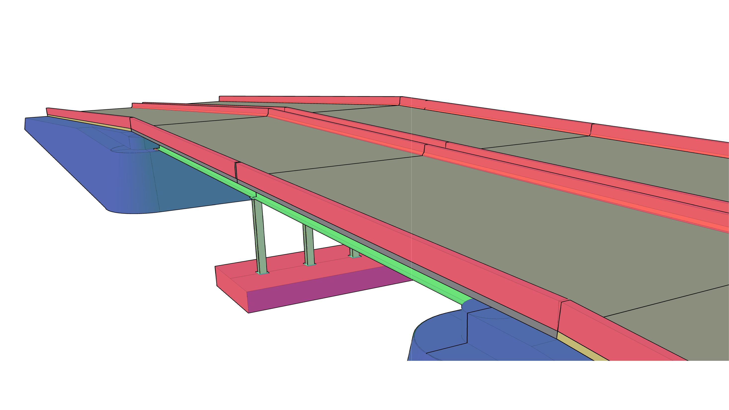
Conclusion
Slide (49)

Slide 50
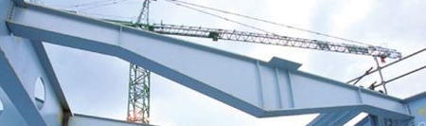
Conclusion
Successfully designed a 2-Span steel girder bridge according to AASHTO specifications.
Steel girders performance rate 76%
Recommendations for future bridge designs can include more research in girder sizing to achieve higher performance rate (More economical)
Further research and calculations can lead to the use of tapered beams
Slide (50)

Slide 51
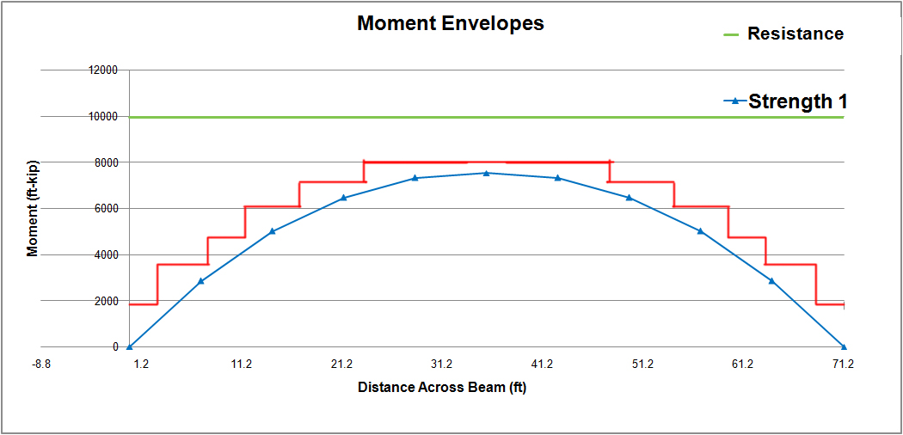
Conclusion
Tapered beams are tailor fit to the bridge needs
Slide (51)

Slide 52
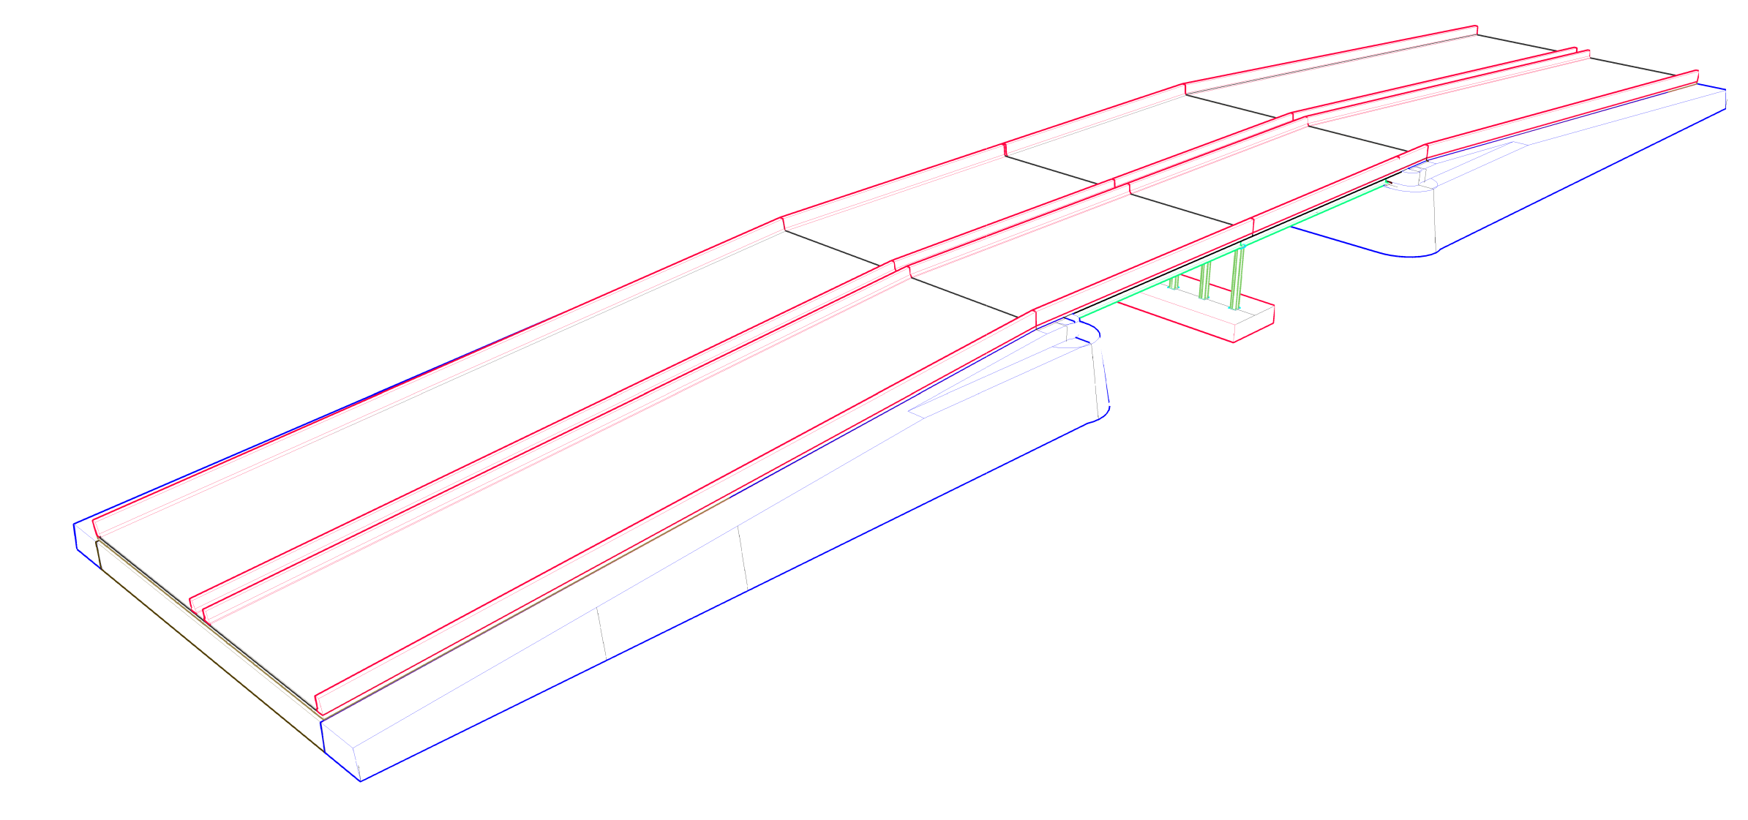
Conclusion
Slide (52)

Slide 53

Conclusion
Slide (53)

Slide 54





References
[1] AASHTO LRFD 2012 Bridge Design Specifications.
[2] Ministry of Municipal and Rural Affairs (MOMRA) in Saudi Arabia - Bridge Design Manual (AR)
[3] Steel Bridge Design Handbook - Design Example 2A - U.S. Department of Transportation , Federal Highway Administration
[4] Steel Construction, AISC Manual. 14th Edition
[5] Geotechnical Investigation – Gulf consultant
Slide (54)

Slide 55
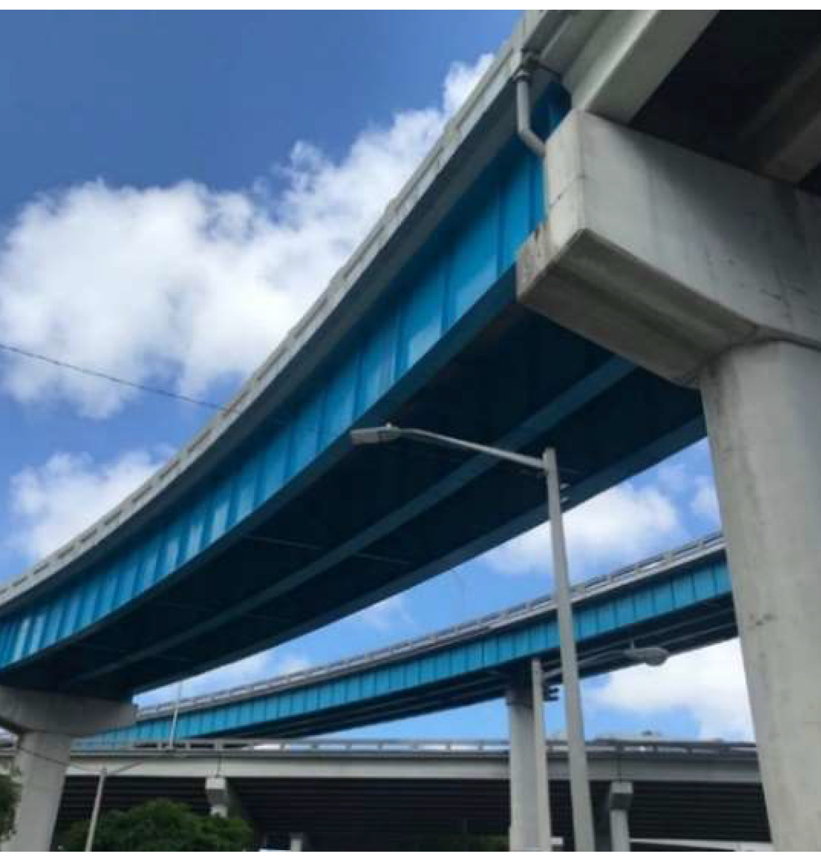
Thank You For Listening
Feel free to ask us anything!
Slide (55)

