Slide 1
Design of Drinking Water Treatment Plant at New JUC Campus
Advisor:
Dr. SAIDUR CHOWDHURY
Coordinator:
Dr. Andi Asiz
Students Name & ID:
1-ABDULMOHSEN ALMOMEN
2-MOHAMMAD GHADER
3-HUSSAIN BUSALED
201400875
201503131
201502450

Slide 2
01.
Introduction
04.
Environmental Design
02.
Objective
05.
Structural Design
03.
Methodology
06.
References

Slide 3
INTRODUCTION
What is water treatment?
Water treatment is any process that improves the quality of water to make it more acceptable for a specific end-use.
Treated Water follows the Drinking Water KSA Standard

Slide 4
Water is a transparent liquid that is colorless, tasteless, and odorless
Water is vital to humans and other living organisms
Also, water is used for various purposes such as, agricultural. It is estimated that 70% of worldwide water is used for irrigation, with 15-35 % of irrigation withdrawals being unsustainable. It takes around 2,000 - 3,000 liters of water to produce enough food to satisfy one person's daily dietary need
Water treatment is done in a series of stages. The conventional sequence goes from Filtration to Water Disinfection
Background

Slide 5
Problem Statement
Water treatment plant is important as any other necessary facility to build in a population or a city. Every human being needs clean water in order to function normally.
A large area in the Jubail Industrial City at Al Firdous District is allocated to develop a new JUC campus. The new campus includes academic buildings (class rooms, laboratories, library and etc.) and residential area. The design population of the JUC new campus is 18,000.
A large number of dwellers living in this area require huge quantity of water for drinking as well as for other uses.

Slide 6
Objectives
To select a suitable location for the proposed water treatment plant near the new JUC campus.
To decide about the source of water based on laboratory tests and literature review.
To determine the volume of underground water around the new JUC campus.
To estimate the amount of water during the design period of 20 to 25 years.
To design the water treatment units (-Coagulation-Flocculation-Sedimentation-Filtration and Disinfection) for the estimated water.

Slide 7
METHODOLOGY
Schematic Design Phase :
Pre – Design Phase:
1-Population prediction
2-Decide the location of treatment plant.
3-The quality and availability of groundwater.
4-Decide about degree of Treatment.
1-Hydraulic Design
2-Environmental Treatment Process Design
3-Basic Structural Design.

Slide 8
Typical characteristics for groundwater
Parameters | Groundwater characteristics | Treated water [10-11]
pH | 6.9 – 7.1 | 6.5-8.5
EC( da/m) | 0.92 – 0.98 | 0.15
TDS (mg/l) | 610 – 670 | 200
Total solids (mg/l) | 970 – 990 | 500
Ca (mg/l) | 15.4 – 18.7 | 10-12
Mg (mg/l) | 28.2 – 28.9 | 12-15
Na (mg/l) | 25.52 – 25.88 | 3-5
Cl (mg/l) | 48.71 – 49.2 | 43
K (mg/l) | 4.94 – 4.98 | 0.2-0.5
PO4 (mg/l) | 0.36 – 0.38 | 0.35-0.4
BOD (mg/l) | 2.0 - 2.2 | 0
COD (mg/l) | 2.8 - 3.0 | 0
Color (pt-co-units) | ND | 15
D.O (mg/l) | 5.9 - 6.1 | -
Coliform (MPN) | 5.8 – 12.5 | 3

Slide 9
Water use for various purposes
WATER USE | VOLUME OF WATER
Avg. Water use in USA Bathing One shower Toilet Washing machines Kitchen sink Bathroom sink | 100 Gallon per day 30 – 40 Gallon 20 – 40 Gallon 5 Gallon per flush Avg. 25 Gallon per load 20 Gallon per day 15 Gallon per day

Slide 10
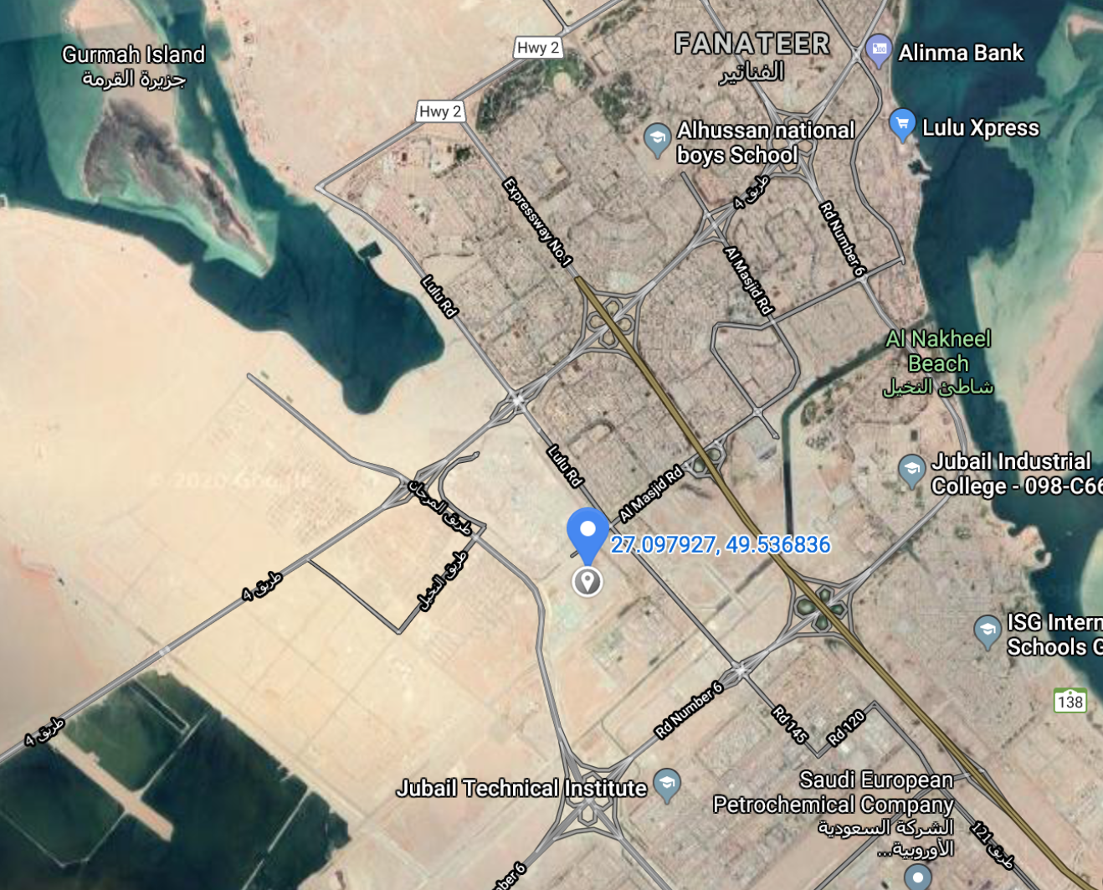
Location
N
Al-Firdous District, Al Jubail

Slide 11
Design Constraints and Operational Code
For any water treatment plant, major operational standards should be taken into account:
Performance Standards
Purpose and Scope
Water Source

Slide 12

Environmental Design

Slide 13
DESIGN METHODOLOGY
Expected population growth
Useful life based on wear and tear.
Feasibility for expansion.
Financial constraints and interest rate.

Slide 14
Steps
Groundwater
Coagulation
Flocculation
Sedimentation
Filtration
Disinfection
Tank

Slide 15
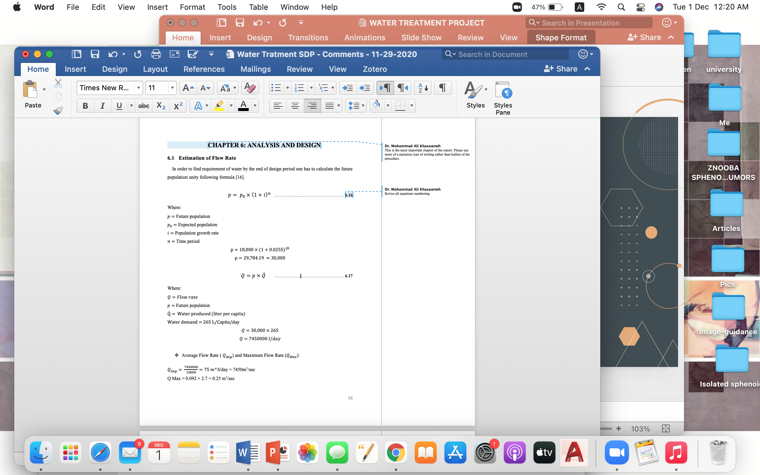
Estimation of Flow Rate

Slide 16
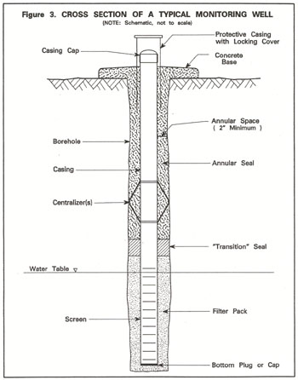
Groundwater
Wells | Depth | Screen depth | Ground water level
1 | 75 ft | 15 ft | gravel
2 | 65 ft | 10 ft | sand
3 | 70 ft | 10 ft | clay
4 | 50 ft | 15ft | Silty clay
75 ft
10-15 ft

Slide 17
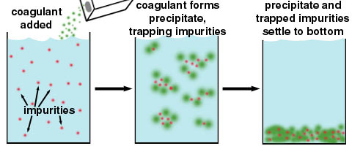
Coagulation Tank

Slide 18
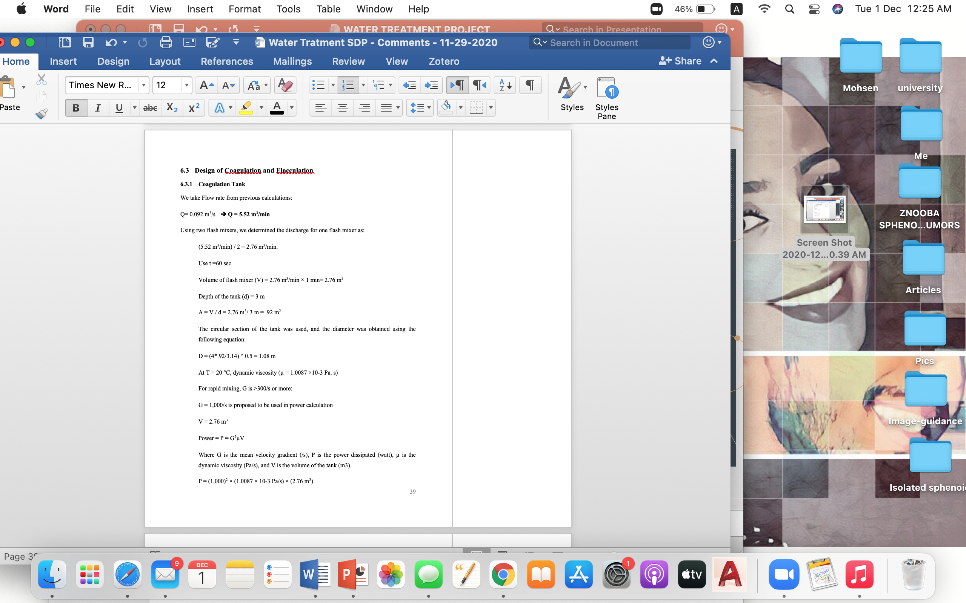
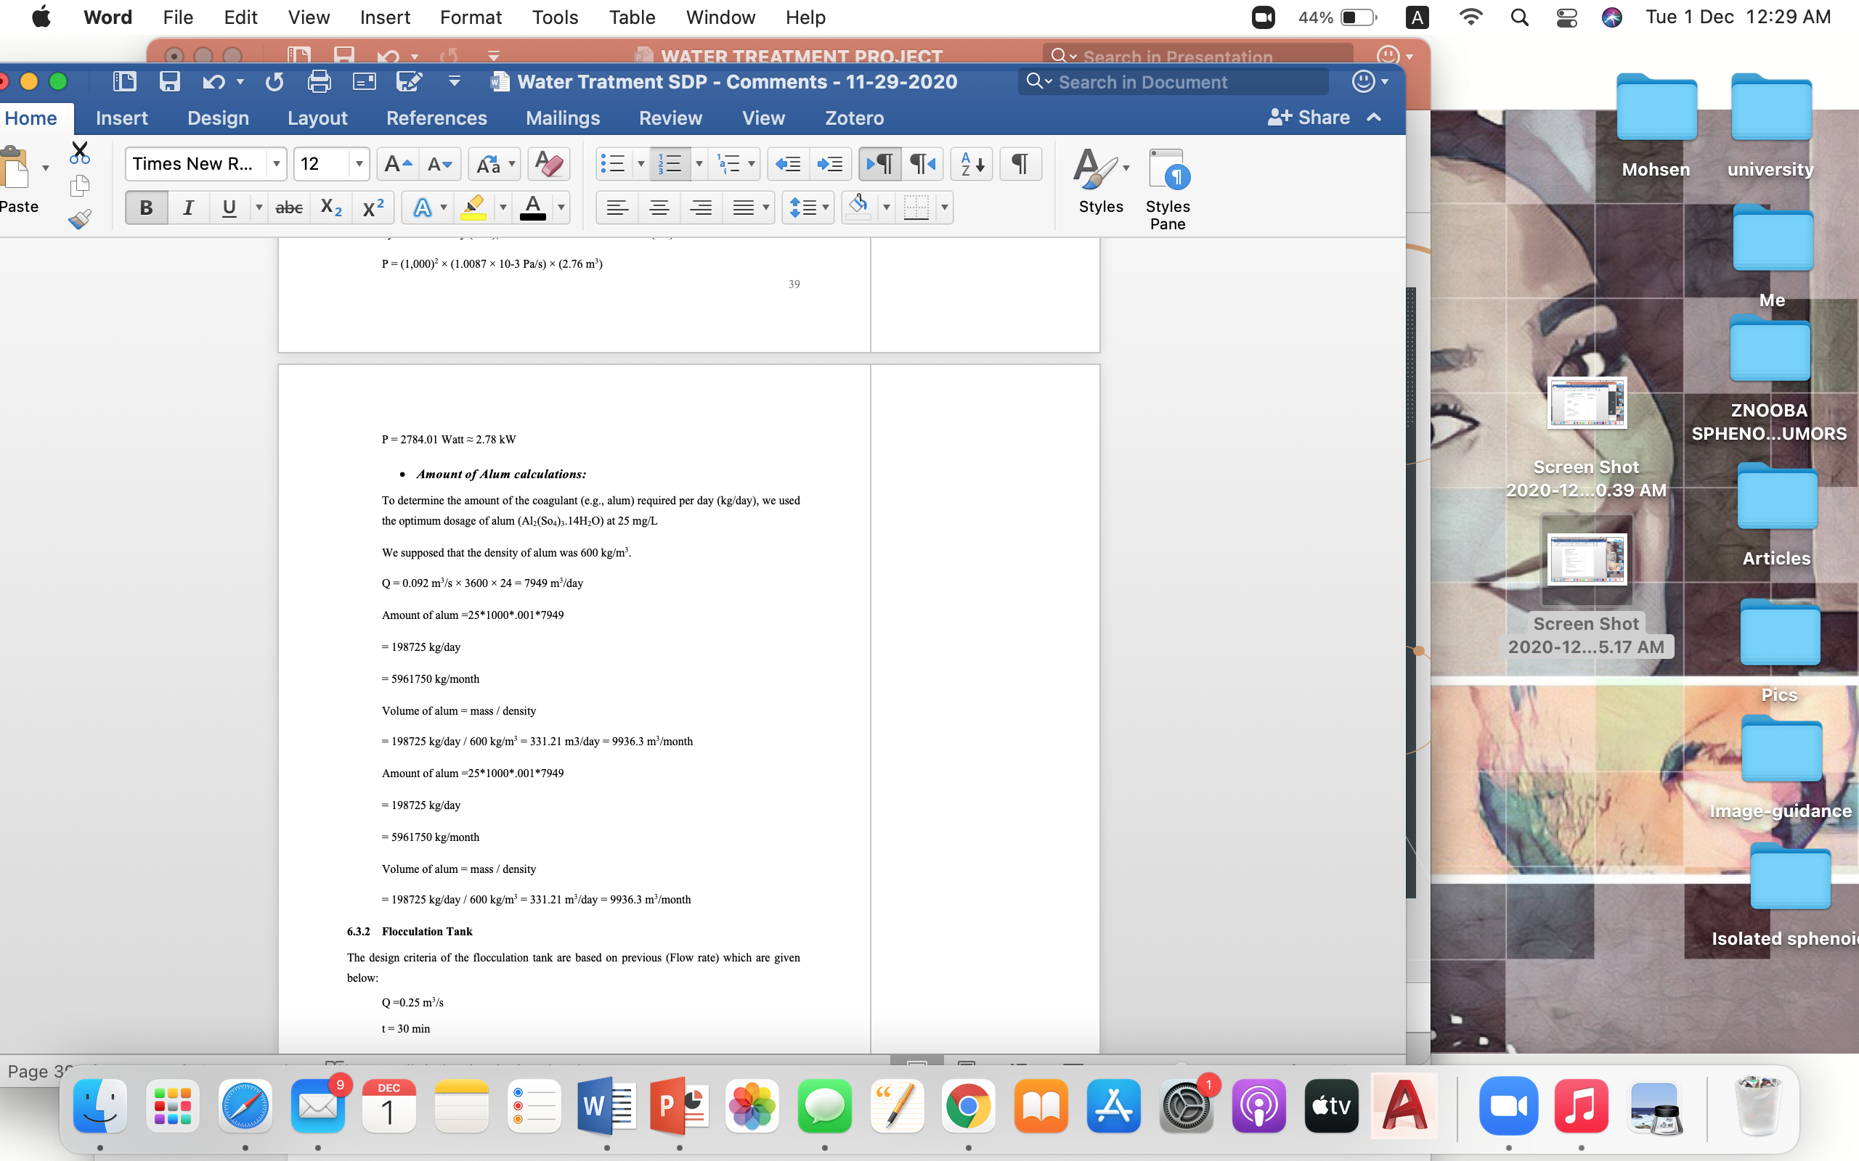
Coagulation Tank

Slide 19
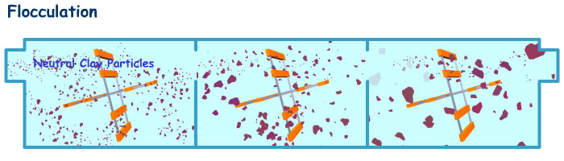
Flocculation

Slide 20
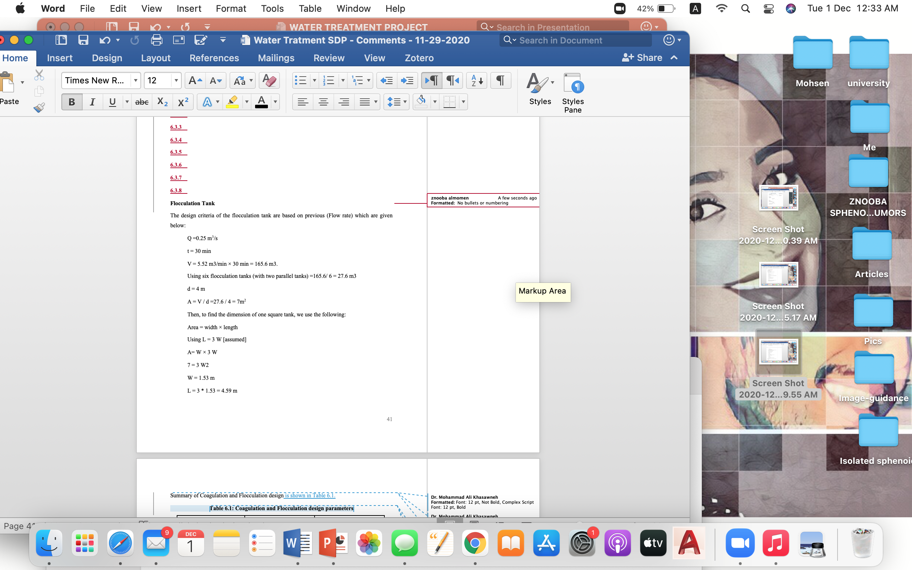
Flocculation Tank

Slide 21
Coagulation and Flocculation
Table 1: Coagulation and Flocculation design parameters
Parameters | Coagulation Tank | Flocculation Tank
Length | - | 4.6 m
Width/Diameter | 1.0 m | 1.53 m
Depth | 3 m | 4 m
Amount of Alum | 198725 kg/day | -
No. of Tanks | 2 | 6 tanks
Type | Circular | Square
Detention Time | 60 sec | 30 min
Flow | 0.25 m³/s | 0.25 m³/s

Slide 22
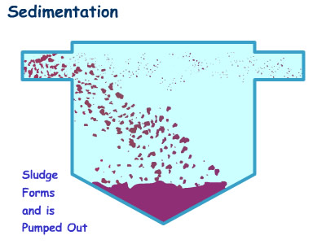
Sedimentation

Slide 23
Design of Sedimentation Tank
Sedimentation, also known as settling or clarification is the process of removing solid particles by gravity. To design a clarification tank, we use the following:
Q = 0.25 m³/s
Using four sedimentation tanks.
Sedimentation design parameters
Q per tank | Time | Volume | Depth | Area | Diameter | Settling velocity | Sourcing velocity
0.023m³/s | 2h | 165.6m³ | 4m | 41.4m² | 7.26m | 3.59*10⁴m/s | 64.7mm/s

Slide 24
Sedimentation
Table 2: Sedimentation tank design parameters
Parameters | Value
Diameter | 7.26 m
Depth | 4 m
Volume | 165.6 m³ each tank
Types | Circular
Number of tanks | 4
Slope of sludge zone | 1 : 6
Inlet zone | -
Outlet zone | 11

Slide 25
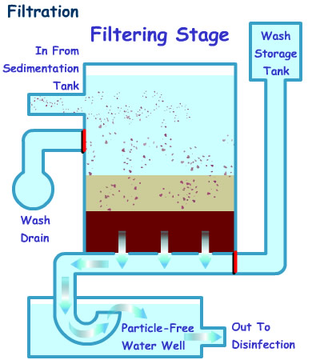
Filtration

Slide 26
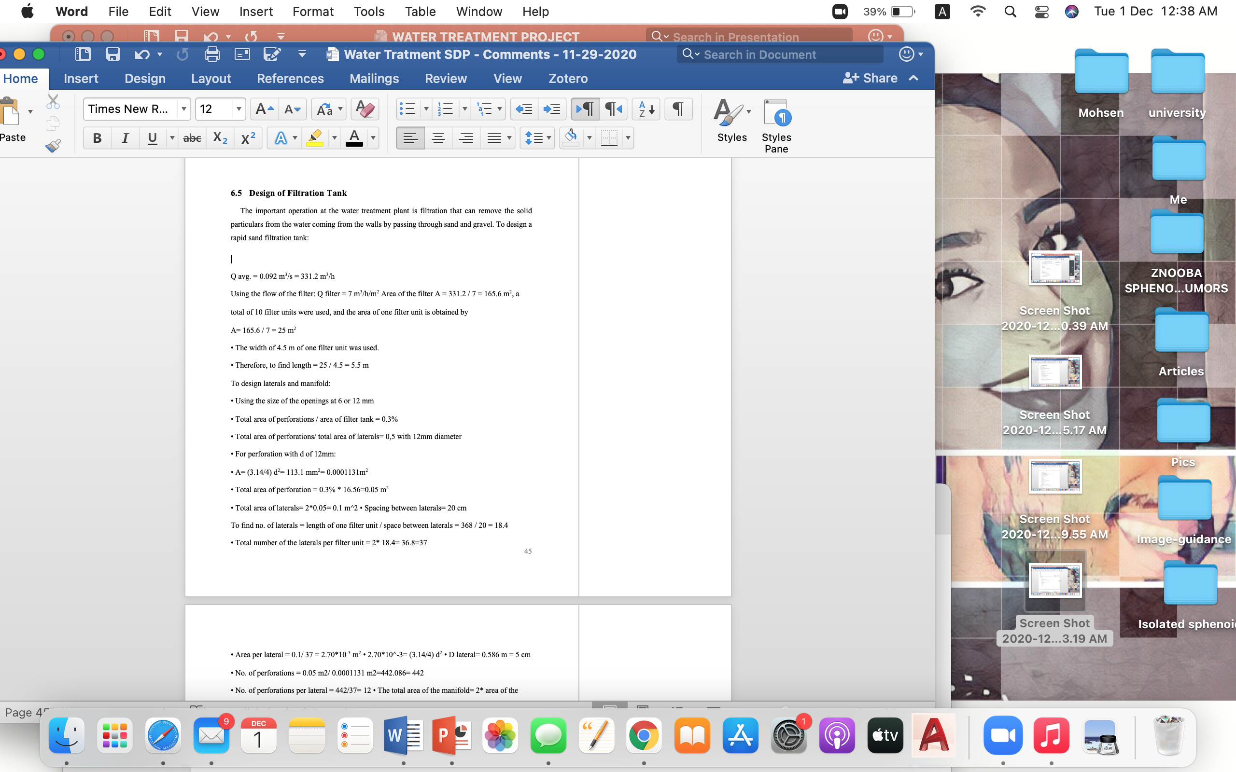
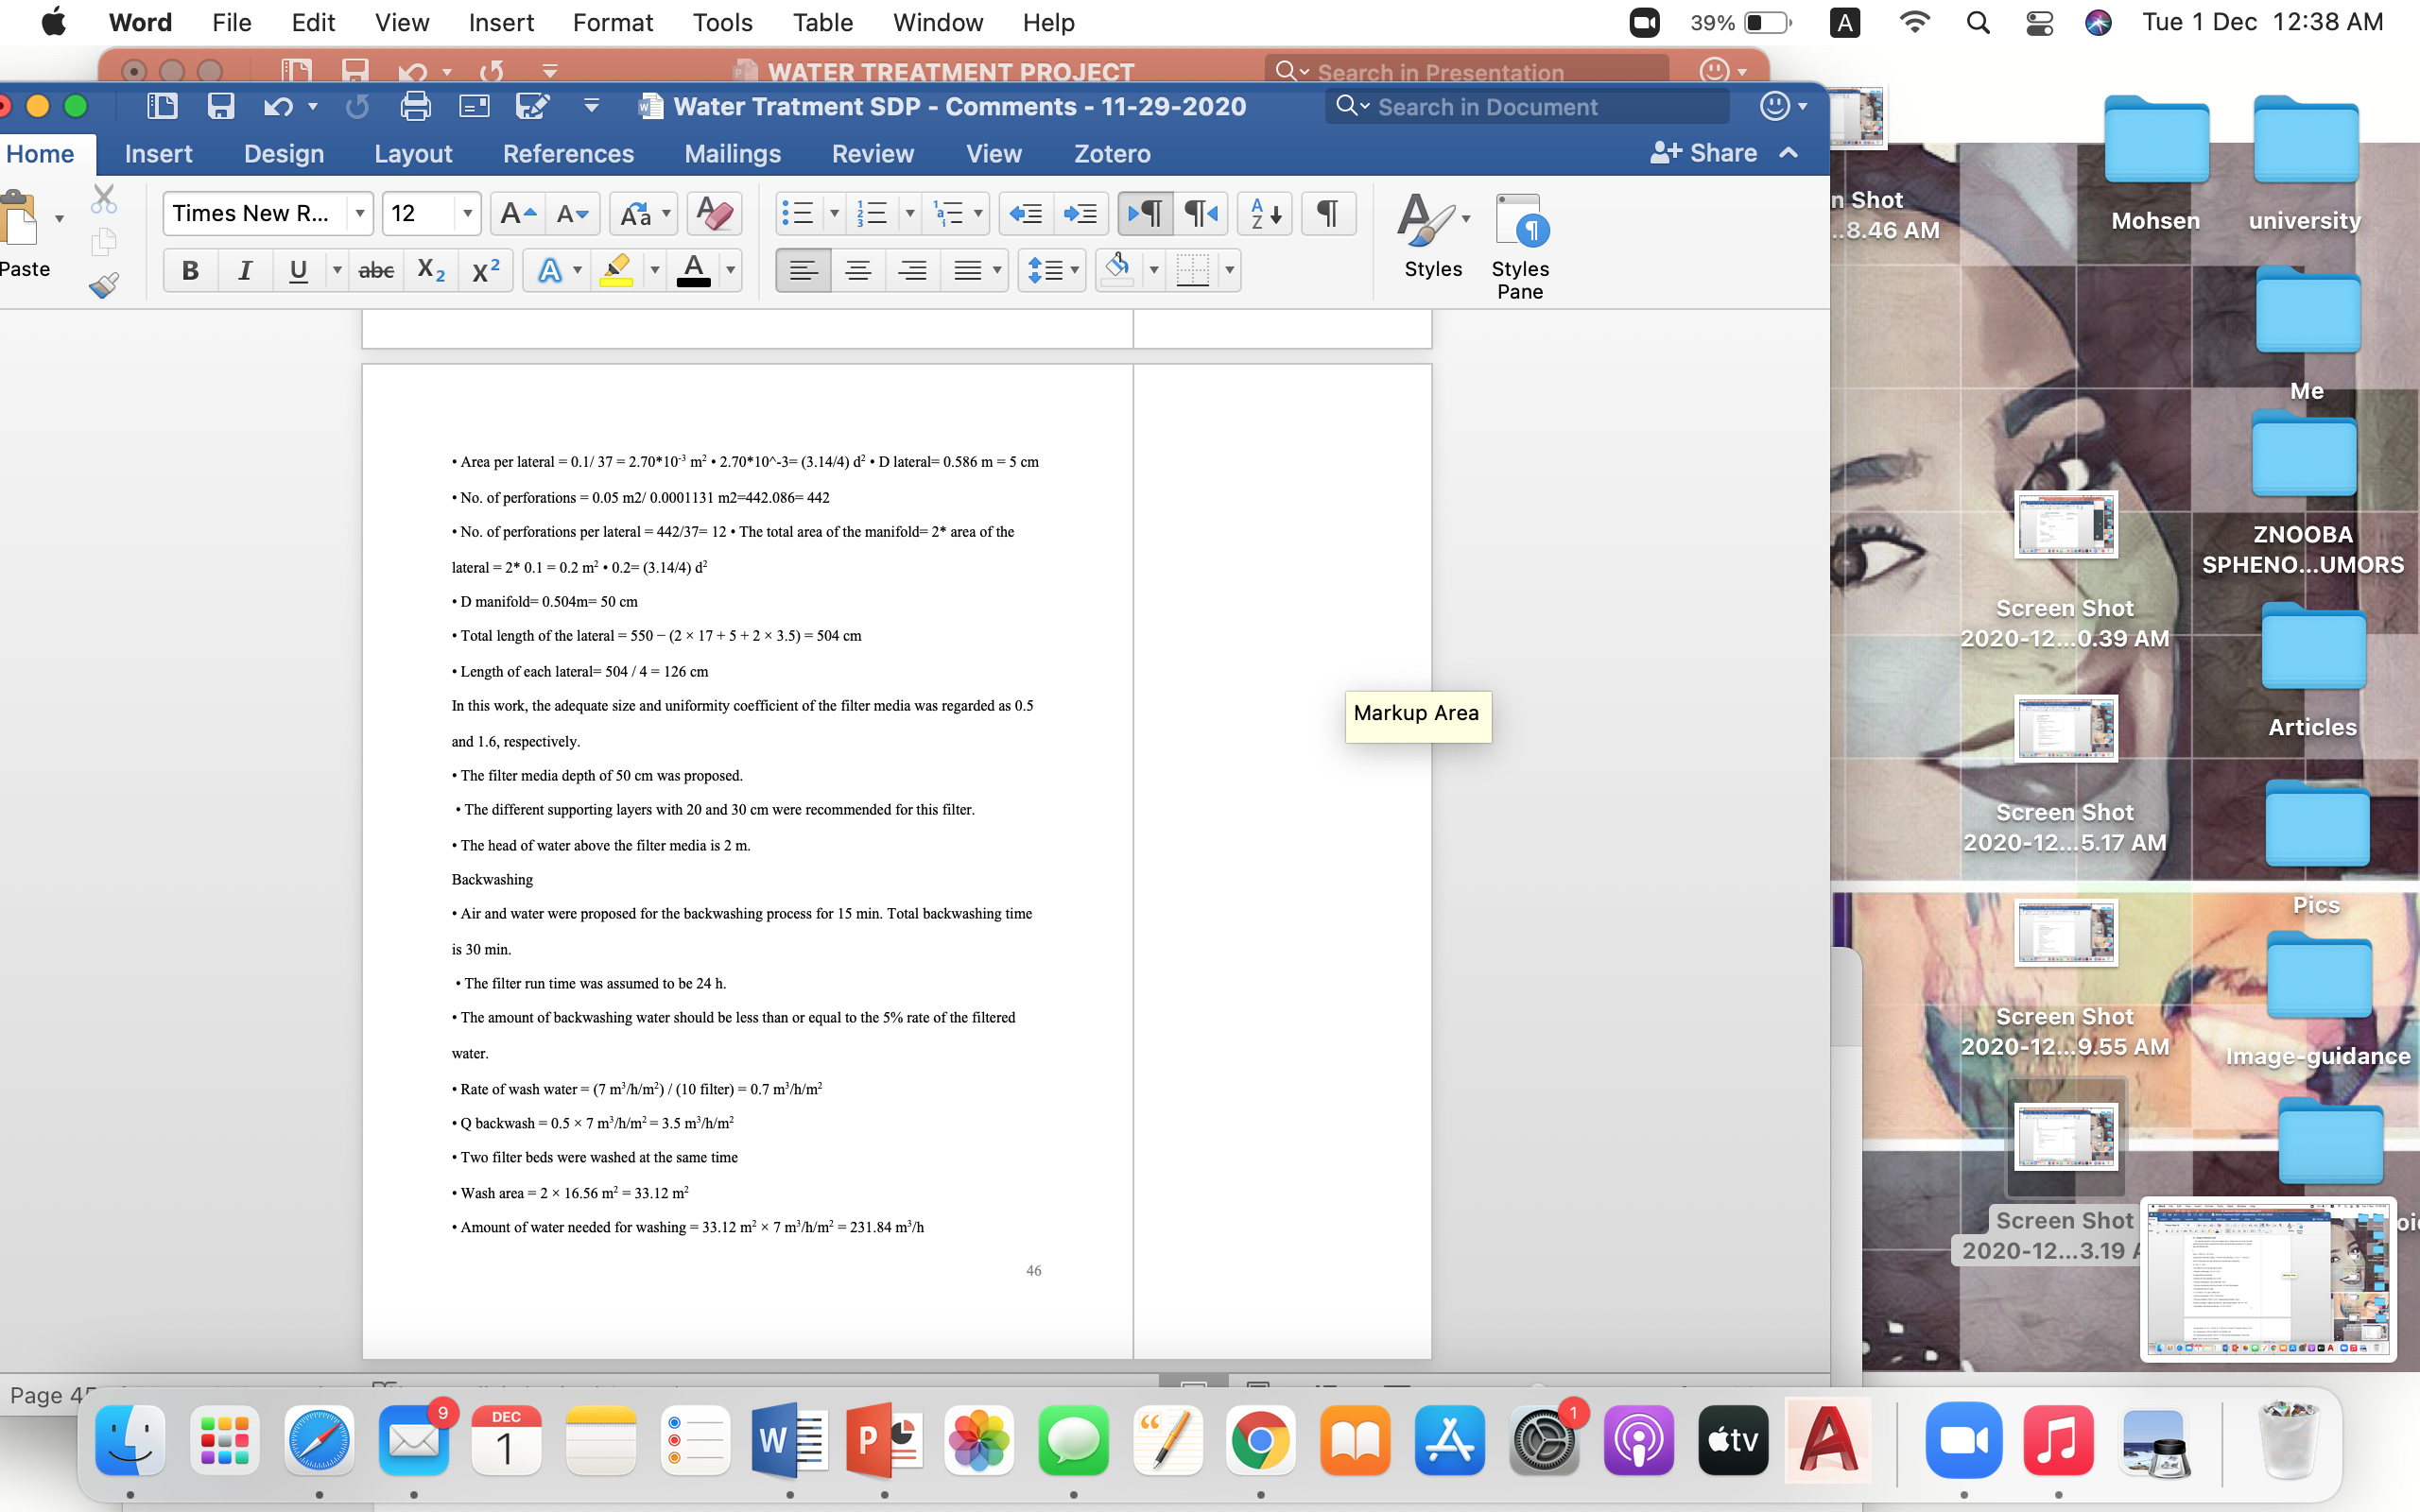
Design of Filtration Tank

Slide 27
Filtration
Table 3: filtration tank design parameters
Parameters | Value | Standard Ranges
length | 5.5 m | 4-8 m
Depth | 6 m
Width | 4.5 m
Type | rectangular | Rapid sand gravity filter
Number of tanks | 7 | -
Flow rate | 7 m/h | 7 – 20 m/h
No. of laterals | 37 per filter unit | -
Area of each filter | 25 m² | 25 – 100 m²
Filter media | Sand and gravel | Sand and gravel
Effective size | 0.5 mm | 0.9 – 1.4 mm
Uniformly coefficient | 1.6 | 1.3 – 1.8
Filter media depth | 0.5 m | 0.3 – 0.75 m
Filter run time | 24 hours | -

Slide 28
Disinfection
Volume = Q × time
Volume = 21600 m³/day × (1/24) × 0.5 h = 450 m³
Using effective depth of 4 m and length (L) = 2× width (W)
A = 450 m³/ 4 m = 112.5 m²
L × W = 112.5 m²
2 W × W = 112.5 m²
W^2 = 56.25 m²
W = 7.5 m and L = 2 × 7.5 = 15 m

Slide 29
Disinfection
Table 4: disinfection tank design parameters
Parameters | Value
Width | 7.5m
Length | 15m
Depth | 4 m
Volume | 450 m³

Slide 30
Hydraulic Design

Slide 31
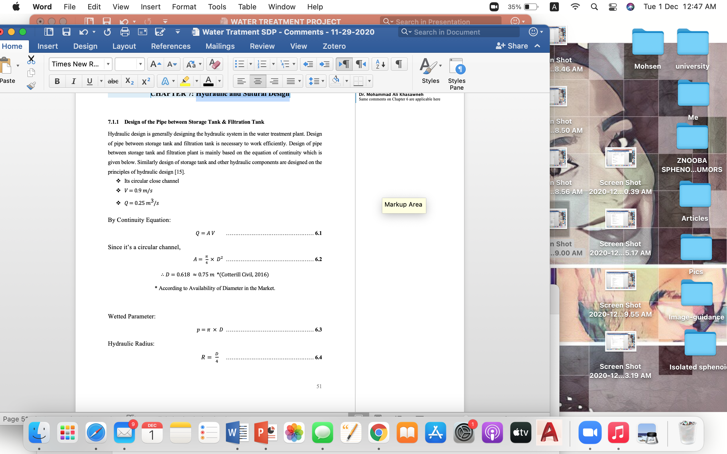
Hydraulic Design

Slide 32
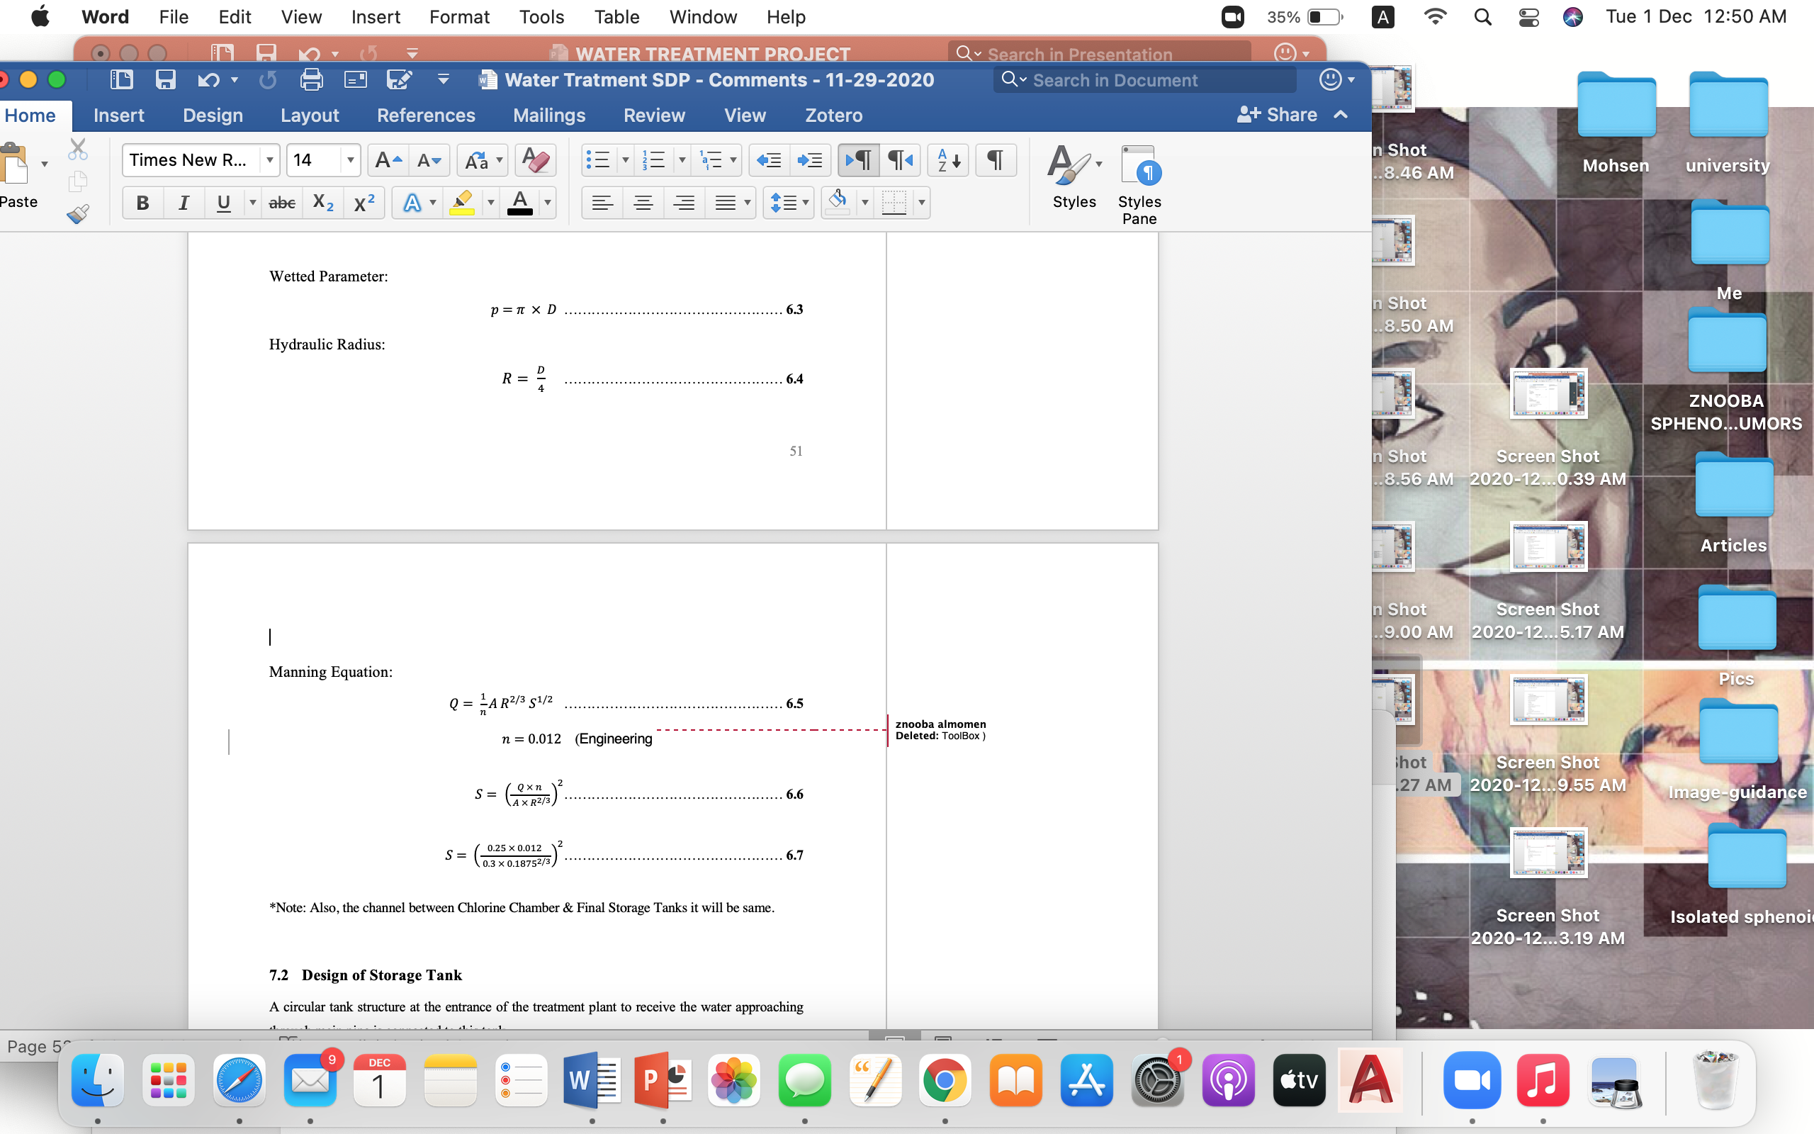
Hydraulic Design

Slide 33
Structural Design

Slide 34
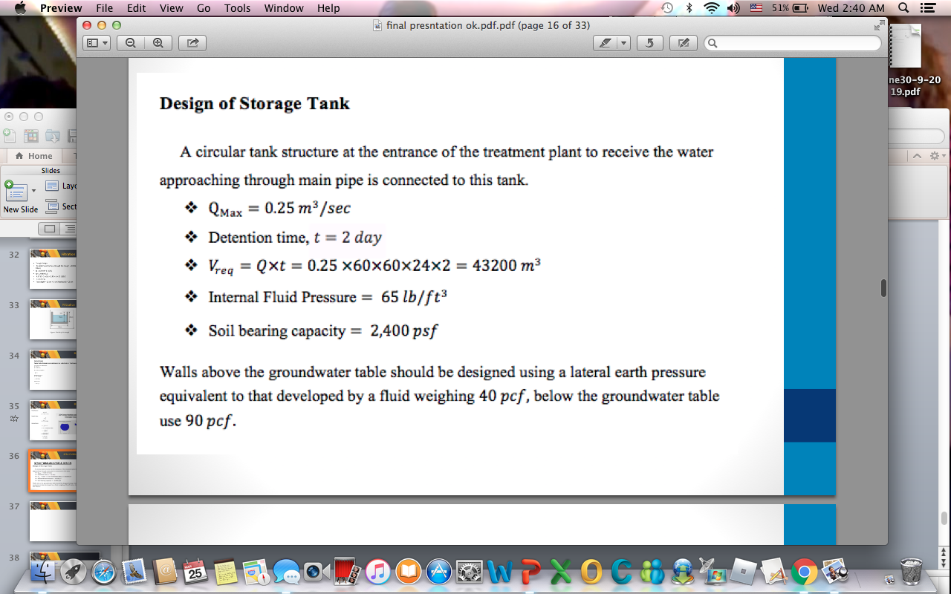
STRUCTURAL ANALYSIS & DESIGN

Slide 35
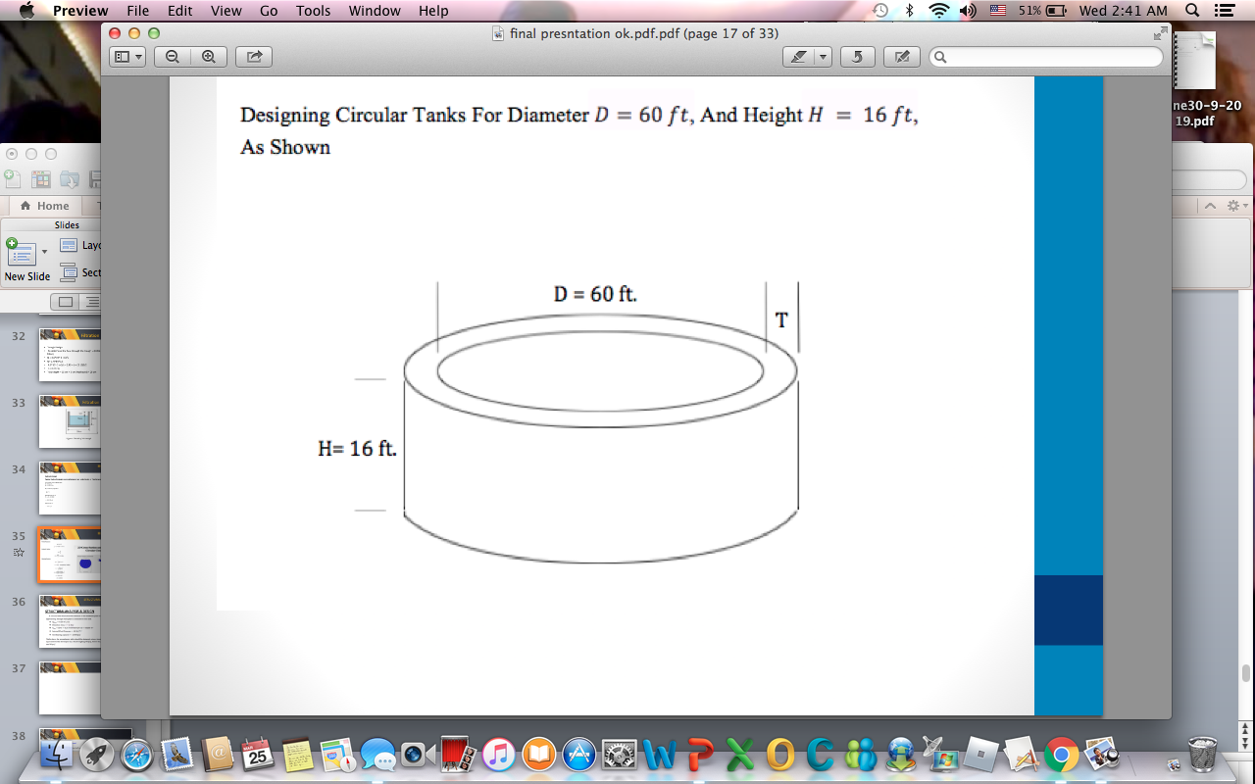
Storage Tank
Table 5: Size of storage tank
Tank dimensions | Value in meter
Length | 60 ft = 18 m
Diameter | 60 ft = 18 m
Depths | 16 ft = 5 m

Slide 36
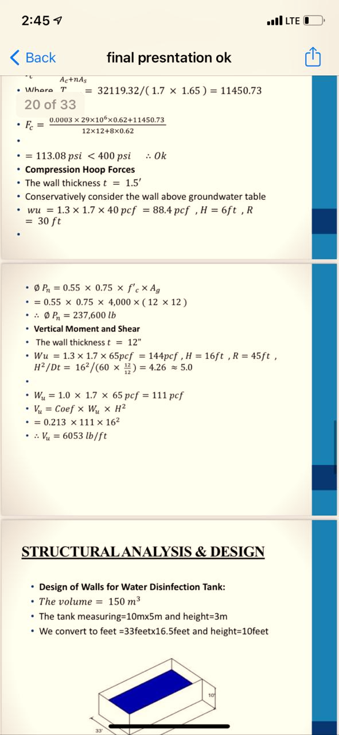
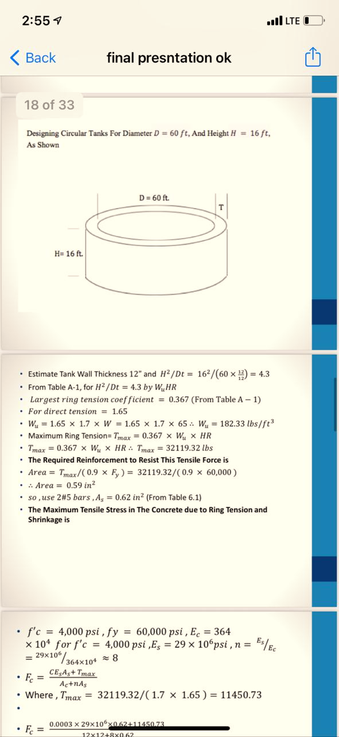
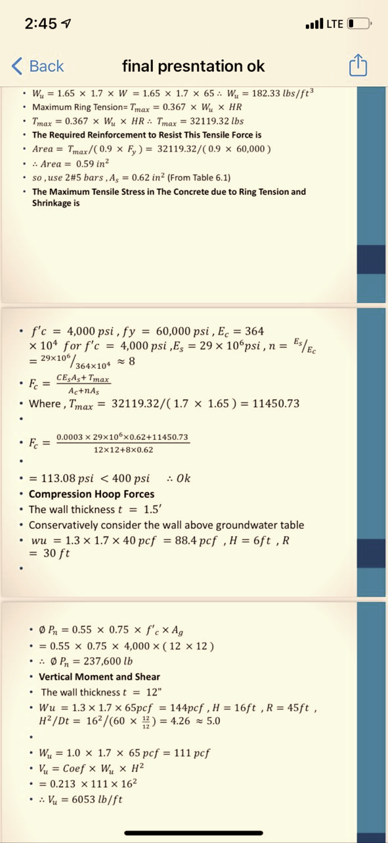
Storage Tank Stages

Slide 37
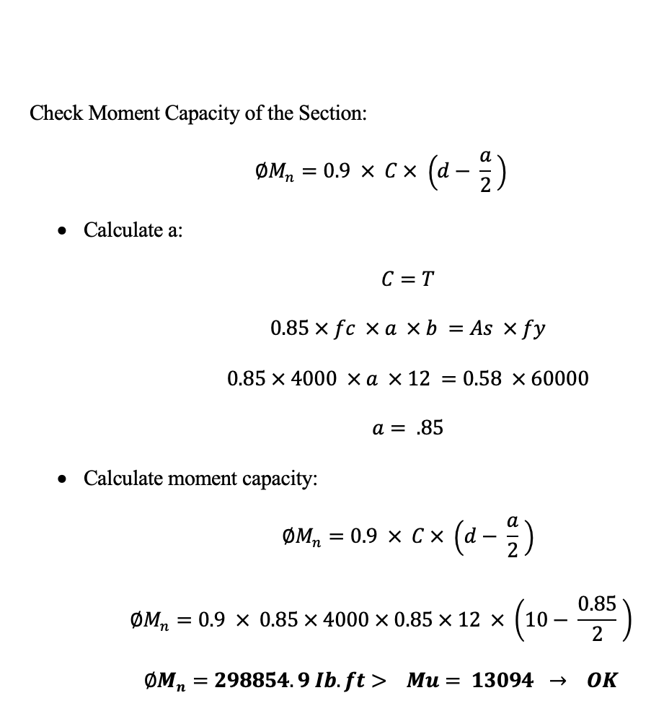
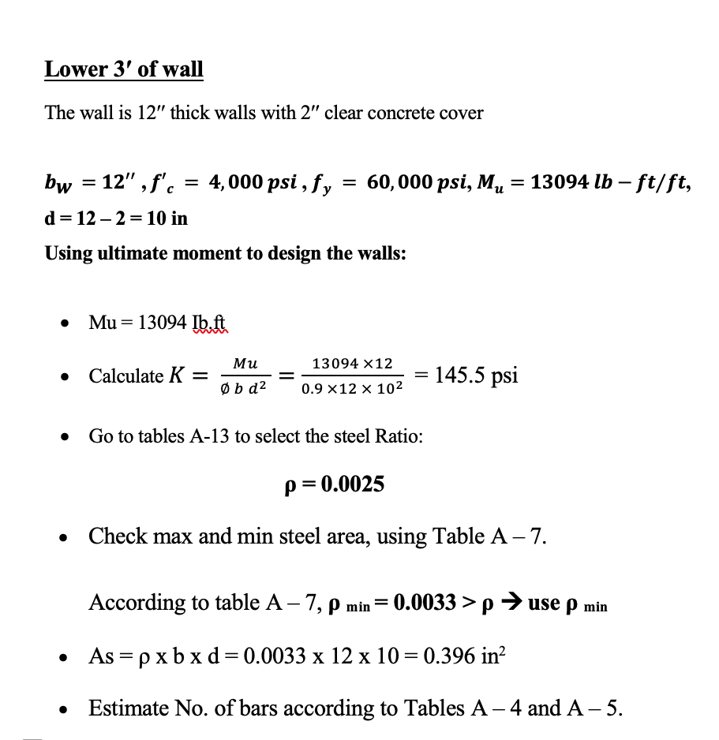
Lower Well

Slide 38
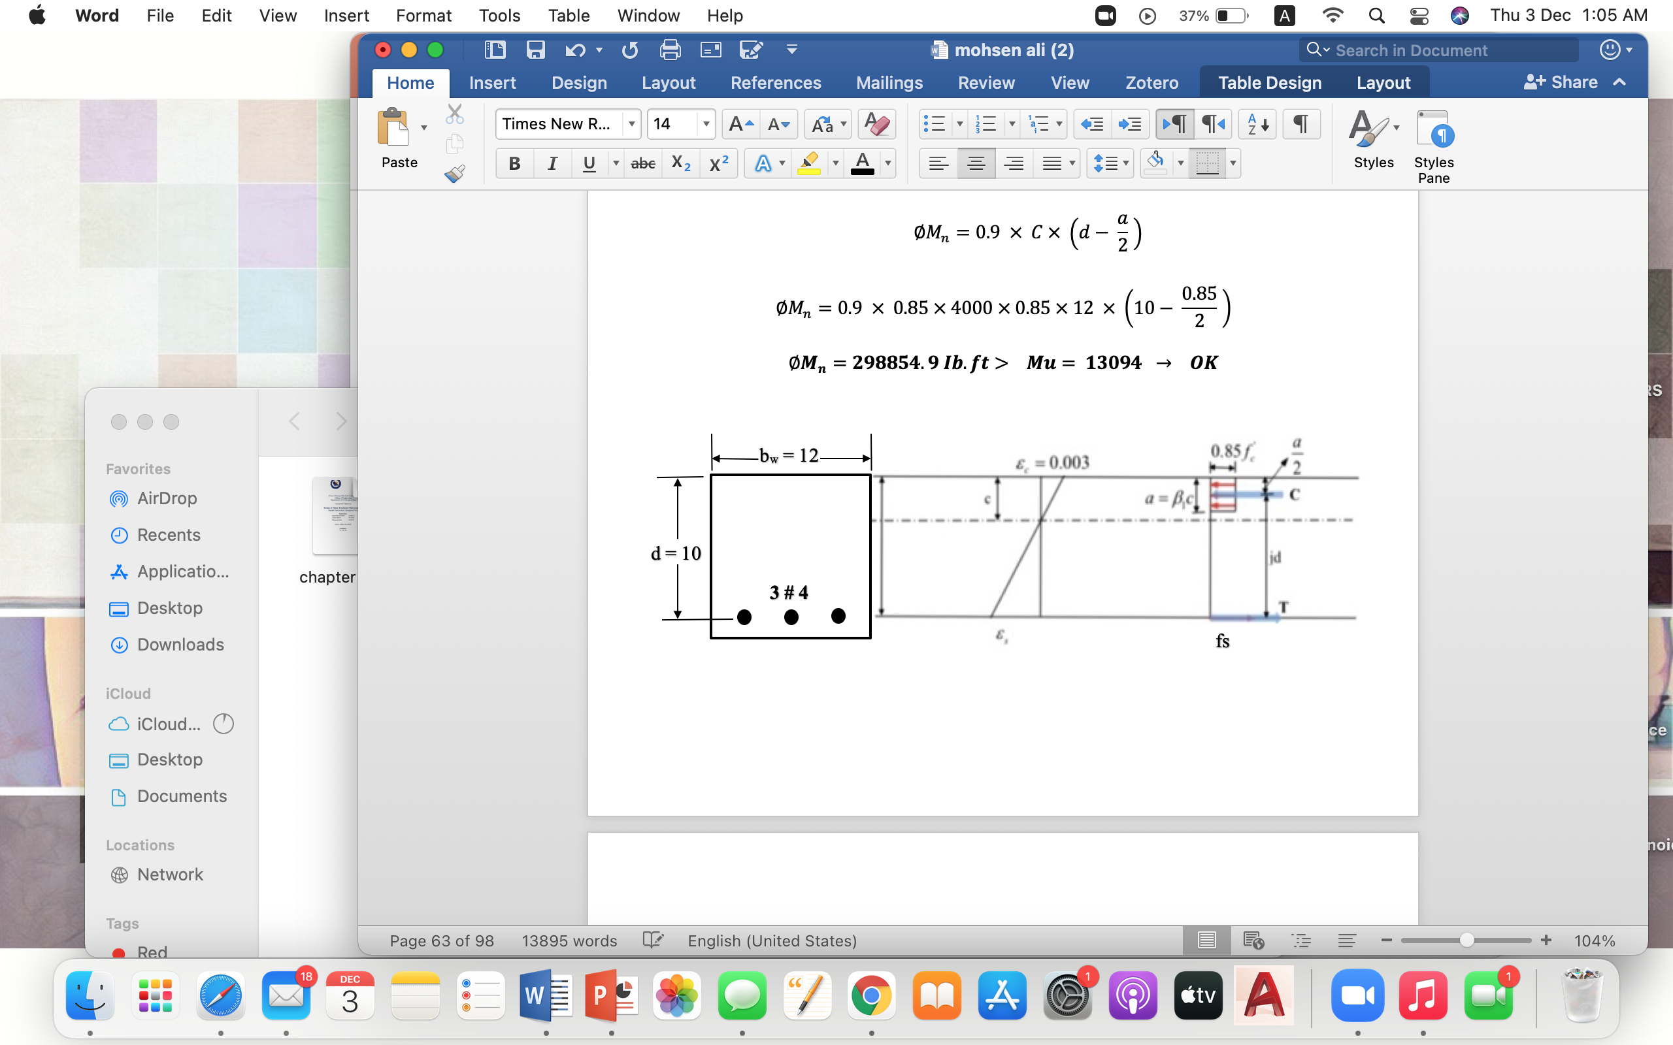
Lower Well

Slide 39
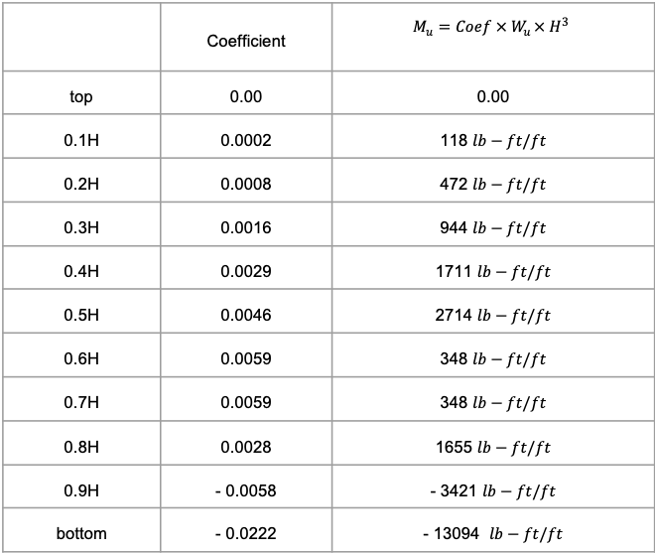
Lower Well
 | Coefficient | $$M_{u}=Coef × W_{u }× H^{3}$$
top | 0.00 | 0.00
0.1H | 0.0002 | 118 $lb−ft/ft$
0.2H | 0.0008 | 472 $lb−ft/ft$
0.3H | 0.0016 | 944 $lb−ft/ft$
0.4H | 0.0029 | 1711 $lb−ft/ft$
0.5H | 0.0046 | 2714 $lb−ft/ft$
0.6H | 0.0059 | 348 $lb−ft/ft$
0.7H | 0.0059 | 348 $lb−ft/ft$
0.8H | 0.0028 | 1655 $lb−ft/ft$
0.9H | - 0.0058 | - 3421 $lb−ft/ft$
bottom | - 0.0222 | - 13094 $lb−ft/ft$

Slide 40
Lower Well
Bars (Table A – 4) | As (in²) | Min width used (Table A – 5) | Check | Selected As
3 # 4 | 0.58 | 8.3 | OK | Selected
2 # 5 | 0.61 | 6.9 | OK
2 # 6 | 0.88 | 7 | OK

Slide 41
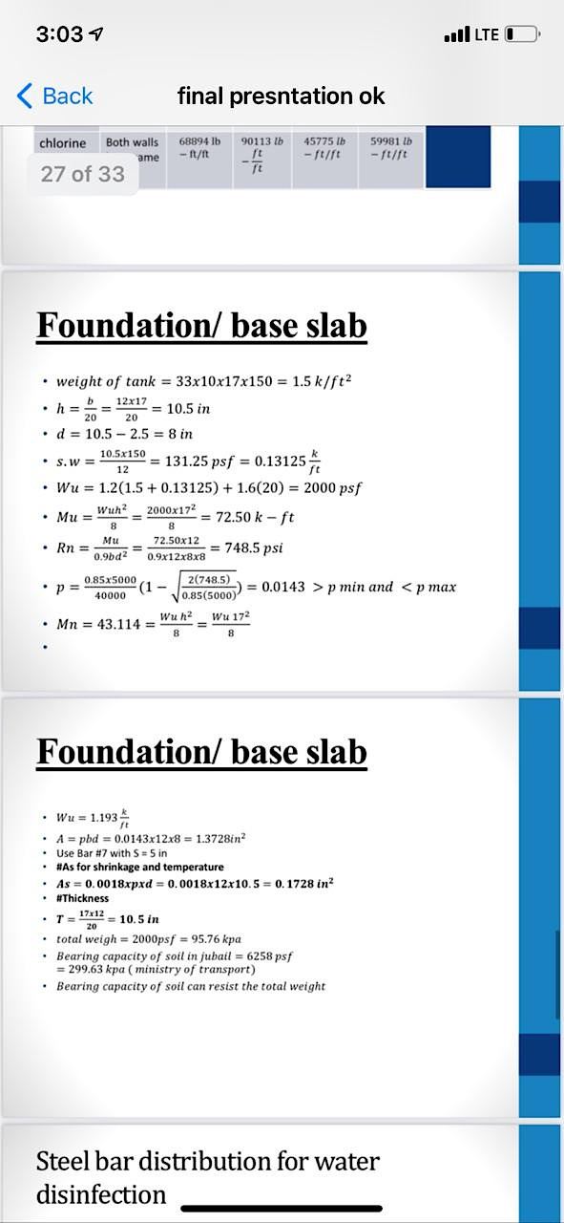
Foundation/base slab

Slide 42
Conclusion
The proposed water treatment plant will be helpful for actual design in future.
Quality of source water is suitable for use after treatment.
Filtration and disinfection with chlorine will provide required quality of water.
Hydraulic and structural design of water treatment plant was done.

Slide 43
References
J. Fabregas, “Journal Pre-proof,” 2020.
J. Yang, S. Wang, Y. Li, Y. Zhang, and D. Xu, “Novel design concept for a commercial-scale plant for supercritical water oxidation of industrial and sewage sludge,” Journal of Environmental Management, vol. 233, no. October 2018, pp
https://www.livescience.com/47612-civil-engineering.html
https://www.emerald.com/insight/content/doi/10.1108/eb0489/full/html
S. Asian, “Design and Construction of Water-Treatment Plants on Novel Technology,” 2017.

Slide 44
References
W. Is and T. Book, “Introduction: the nature of water and effluent treatment plant design,” pp. 1–12, 2018.
J. C. Lozier and J. W. Chapman, “Selection , design , and procurement of a demineralization system for a surface water treatment plant,” vol. 88, pp. 3–31, 1992.
Davis ML. Water and wastewater Engineering: Design principles and practice. 2011: McGraw-Hill Education, 2 Penn Plaza, New York, USA. ISBN 978-007-128924-5.

Slide 45
THANK YOU

