Slide 1

Design of Municipal Wastewater Treatment Plant in Aljubail
Department of Civil Engineering
Design Project
Students Team
Feras Alhelal 201602736
Mohammad Alahmadi 201400725
Naif Alqahtani 201500817
Abdullah Alkhaldi 201000954
Supervisor Name
Dr. Saidur chowdhury

Slide 2
Table of Contents
Introduction
Aim and Objective
Scope and Limitations
Design constrains
Estimation of Flow Rate
Design of Dimensions
Environmental impact assessment
Cost estimation
References

Slide 3
Introduction
A design project is prepared for the treatment of wastewater generated in the new district in Jubail area.
The objective was to reduce the pressure on the existing WWTP of Jubail Industrial city.
Various components of primary WWTP designed by considering the various standards and permissible limits.
The design period of the plant is 25years to serve the population of 82030 dwellers who will generate about 16,406 m³/day of wastewater.
In order to protect the environment, small scale Environmental Impact Assessment (EIA) was carried out.

Slide 4
Aim and Objective
To select a suitable location for the proposed wastewater treatment plant near new Al-jubail district – Alfurdous .
To decide about a typical wastewater characteristics based on literature review.
To estimate the volume of wastewater generated from the new jubail district
To estimate the volume of wastewater to be generated during the design period of 25 years.
To design the primary wastewater treatment units for the estimated wastewater.

Slide 5
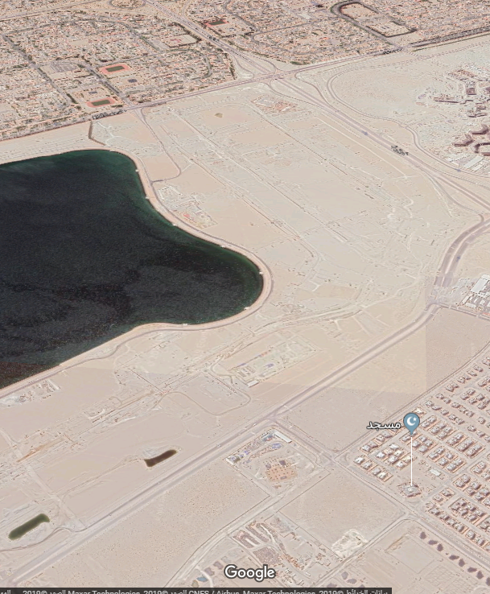
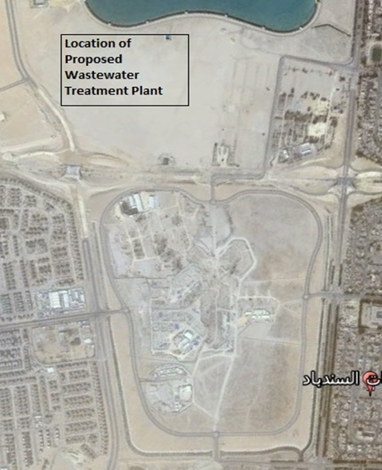
Proposed location
N
N
Proposed plant Location
Figure: Proposed location in Aljubail industrial city \ Al-Firdous District

Slide 6
Scope and Limitations
Basic design of receiving chamber, bar screen, grit chamber, sedimentation, Aeration, sludge process and secondary sedimentation tank
Basic hydraulic design within the treatment plant.
Considering most of the pipelines and controllers are open channel in which the flow moves due to gravity.
Project doesn’t include any structural, foundation , and mechanical design

Slide 7
Scope and Limitations
Design of pumping station is not in the scope.
Design of other parts such as control room, visitors' room and parking also not included.
Any electrical and plumbing system is not included.
It's assumed that the effluent will be discharged from the wastewater treatment plant and maybe supplied to the sea or agriculture use or to the existing tertiary WWTP for the treatment.

Slide 8
Design constraints
Economical constraints:
Capital Cost
Operational Cost
Maintenance Cost
Land constraints:
Enough space for future expansion and sludge disposal/utilization
Adequacy of isolation from residential areas
Location of drinking water sources
Close to dumping location
Plant size extension in the near future
Accessibility into the site

Slide 9

Assimilation capacity of receiving water body
ability of a body of water to cleanse itself
Different amount of water receiving is major constraint because during rush days
Prevailing wind direction
Houses and district need to be prevented from wind that coming from Wastewater plant
Design capacity
The design capacity should be such that the treated effluent would continuously meet established quality criteria

Slide 10
Design Constraints
Unavoidable conditions
There were no unavoidable conditions present at the site selected for the plant construction.
Chemical requirements:
Readily available chemicals have been considered during the plants construction and operation.
Environmental impact:
Temperature, rain, humidity as well as climate also affect different treatment unit performance.
Operating and Maintenance requirements:
This is one of the important constraints for plant operation after the construction.

Slide 11
Estimation of Flow Rate
p= p0×(1+i)^n
(I value is adopted from the population estimates by province and administration area 2015 – 2017, Central Department of Statistics and Information, www.cdsi.gov.sa)
Where:
p= Future population
p0= Expected population
i= Population growth rate
n= Time period
p=50,000×(1+0.020)^25
p=82030

Slide 12
Estimation of Flow Rate
Q=p×Q
(Q value is adopted from Mirza Barjees Baig, King Saud University, Riyadh, 2014)
Q=Flow rate
p= Future population
Q= Wastewater produced liter per day
Q=82030×200
Q=16,406,000 l/day
Maximum Flow Rate (QMax):
Qmax=
Qmax =16,406 m3/day≈ 0.57m3/sec
QMax=0.57m3/sec

Slide 13
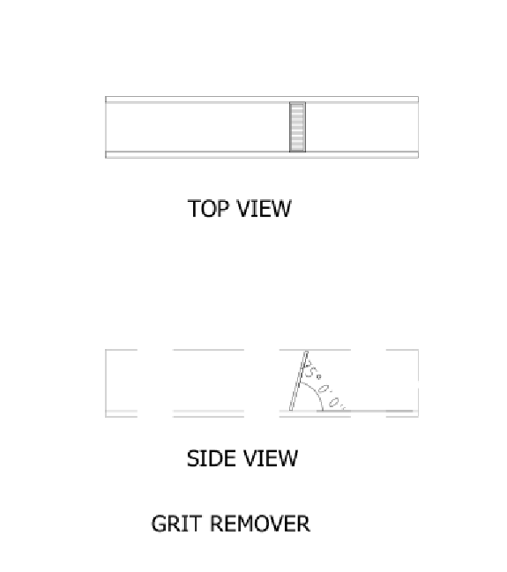
Design of Receiving Chamber
A rectangular tank structure at the entrance of the treatment plant to receive the wastewater approaching through a wastewater system and main pipe is connected to this tank.
$Q_{Max}=0.57 m^{3}/sec$
Detention time, $t=60 sec$
Assume depth , $d=2 m$ (based on the hydraulic consideration)
Required Volume of Receiving Chamber
$V_{req}=Q×t=0.57 ×60=34.2 m^{3}$

Slide 14
Design of Dimensions
Receiving Chamber:
No. | Design Parameter | Value
1 | Maximum flow in receiving chamber | 0.6 m³/sec
2 | Detention time | 60 sec
3 | Volume of receiving chamber | 36 m³
4 | Area of the receiving chamber | 18 m²
5 | Depth of receiving chamber | 2 m
6 | Length of receiving chamber | 6 m
7 | Width of receiving chamber | 3 m

Slide 15
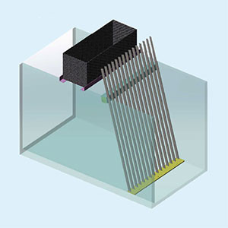
Design of Dimensions
Bar Screen (two Mechanical Screening):The first operation at the wastewater treatment plant is bar screen which the wastewater passes through this screen to protect the pipes and other equipment's and to trap and remove the floating materials such as cans, papers, tree leaves and timber pieces etc.
(Site.iugaza.edu.ps, 2019)
No. | Design Parameter | Value
1 | Maximum flow through bar screen | 0.6m³/ sec
2 | Velocity through bar screen | 0.6 m/ sec
3 | Numbers of clear opening in bar screen | 29
4 | Number of spacing | 28
5 | Width of the bar screen | 1 m
6 | Depth of channel for bar screen | 1 m
7 | Clear spacing | 0.025 m
8 | Width of the bar | 0.01 m
9 | Angle of Bar screen | 90∅

Slide 16
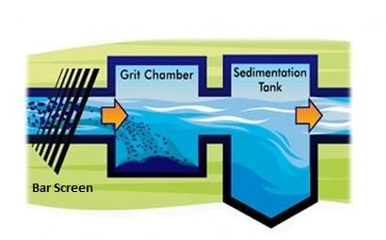
Design of Dimensions
Bar Screen (Manual Screening): (Site.iugaza.edu.ps, 2019)
No. | Design Parameter | Value
1 | Maximum flow through bar screen | 0.6m³/ sec
2 | Velocity through bar screen | 0.6 m/ sec
3 | Numbers of clear opening in bar screen | 29
4 | Number of spacing | 28
5 | Width of the bar screen | 1 m
6 | Depth of channel for bar screen | 1 m
7 | Clear spacing | 0.025 m
8 | Width of the bar | 0.01m
9 | Angle of Bar screen | 45∅

Slide 17
Standard Used for Bar Screen
Based on (Site.iugaza.edu.ps, 2019)
Characteristics of mechanical bar screen
Bar spacing range | 1.5 to 4 cm
The screen angle | 70 to 90 degrees from horizontal
Bars size | 1 cm thick, 2.5 wide
Minimum approach velocity in the bar screen | 0.45 m/s
Maximum velocity between the bars | 0.9m/s
Characteristics of manual bar screen
Bar spacing range | 2 to 5 cm
The screen angle | 45 to 75 degrees from horizontal
Bars size | 1 cm thick , 2.5 wide
Minimum approach velocity in the bar screen | 0.45 m/s
Maximum velocity between the bars | 0.9m/s

Slide 18
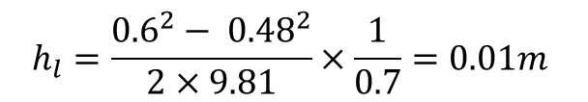
Head Loss
Head losses due to installation of screens must be controlled so that back water will not cause the entrant wastewater to operate under pressure. Head loss through a bar rack can be calculated by using Bernoulli equation:
Where,
h = head loss through the bar screen
Vb = Velocity through the openings
Va = approach Velocity
g = Gravity = 9.81
Ke = 1.43 coefficient of head loss
Head loss through the screen (when the screen is clean):
$$h =\frac{Va^{2}−Vb^{2}}{2g}∗\frac{1}{0.7}$$
$$h_{l}=\frac{{0.6}^{2}− {0.48}^{2}}{2×9.81}×\frac{1}{0.7}=0.01m$$

Slide 19
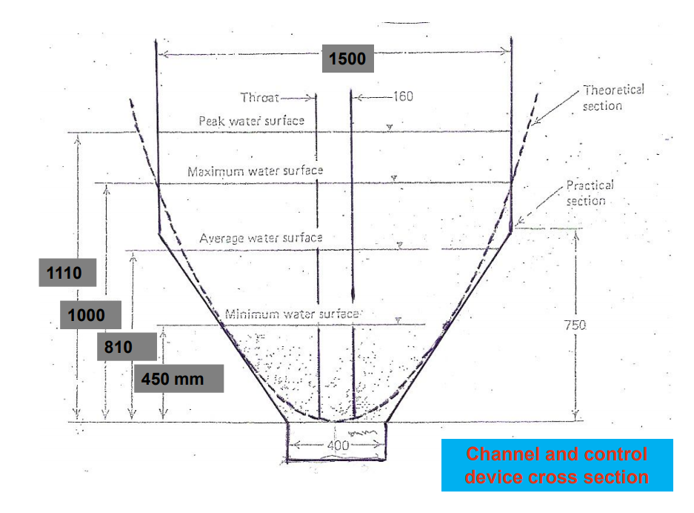
The controller
  Now we will use the controller for the flow rate. The controller job is to make the water flow rate constant.
A = 2/3wd
Q = Av → Va
Q = 2/3wd Va
Qpeak→Qmax→Qavg→Qmin
Qpeak→0.57 m/s
Qavg→0.24 m/s
Qmax→2/3Qpeak→0.38 m/s
Qmin→0.1m/s
We assumed W= 1.5 m
Q=AV
Qpeak=2/3*1.5*d*0.59
d = 1 m

Slide 20
The controller
Q m/s | Width m | Depth m | Width m | Depth M
Peak = 0.6 | 1.5 | 1 | 0.40 | 0.65
Max = 0.38 | 1 | 0.66 | 0.40 | 0.65
Avg =024 | 0.63 | 0.42 | 0.40 | 0.65
Min=0.1 | 0.26 | 0.175 | 0.40 | 0.65

Slide 21
Design of Dimensions
Grit Chamber: placed after the screening to remove the inorganic particles which have a specific gravity of 2.65 such as gravel and sand also it can removes the materials that may clog the channels and damage the pipes because of the abrasion and to prevent their accumulation. Grit chamber is designed to let the heavy grit particles settle down
No. | Design Parameter | Value | Solver
1 | Maximum flow of grit chamber | 0.465 m³/sec | 0.465 m³/sec | 0.465 m³/sec
2 | Velocity of the settling of particles (Vs) | 16.01 cm/s | 14.53 cm/s | 4.56 cm/s
3 | Velocity of the scour (Vh) | 1.46 cm/s | 0.93 cm/s | 1.52 cm/s
4 | Volume of grit chamber | 24.96 m³ | 27.84 m³ | 60 m³
5 | Depth of grit chamber | 0.78m | 0.87m | 2m
6 | Width of grit chamber | 4m | 4m | 5m
7 | Length of grit chamber | 8m | 8m | 6m

Slide 22
Standard Used for Grit Chamber
Based on ACI code of the Environmental Construction.
Table - Typical Design Information for Aerated Grit Chambers
Design criteria of Grit chamber
Detention time (min) | 2-5
Length (m) | 7.5-20
Width (m) | 2.5-7
Depth (m) | 2-5

Slide 23
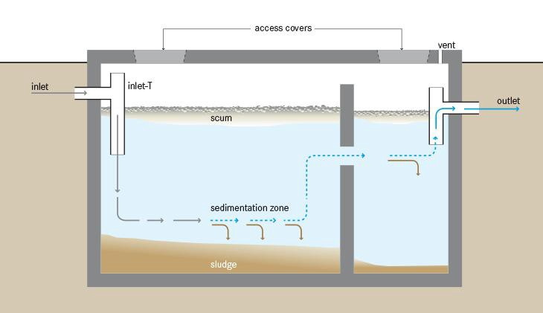
primary sedimentation
A settling tank is to remove the organic solids which are less than 0.2 mm and having a specific gravity of 2.65
Sedimentation Tank (Clarifier):

Slide 24
Design of Dimensions
Sedimentation Tank (Clarifier):
No. | Design Parameter | Value | Solver
1 | Quantity of wastewater | 39,399 m³/day | 39,399 m³/day
2 | Volume of wastewater(each tank) | 1690m³ | 1622.4m³
3 | Detention period (time) | 2 hours | 2 hours
4 | Velocity of the flow | 1.64 m/s | 0.4 m/s
5 | Area of primary sedimentation tank(each tank) | 338m² | 338m²
6 | Depth of primary sedimentation tank | 5 m | 4.8 m
7 | Width of primary sedimentation tank | 13 m | 13 m
8 | Length primary sedimentation tank | 26 m | 26 m

Slide 25
Standard Used for Sedimentation Tank
Based on ACI code of the Environmental Construction.
Table – Range and typical values of Sedimentation Tank
Design criteria of primary sedimentation tank
Detention time (h) | 1.5-2.5
Overflow rate m³/m². d at average flow | 32-50
Length (m) | 15-90
Width (m) | 3-24
Depth (m) | 3-5

Slide 26
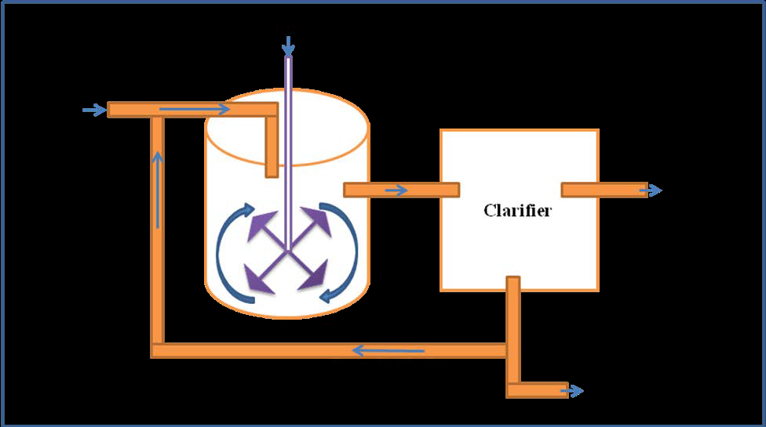
Design of Dimensions (secondary treatment)
Aeration tank:
No. | Design Parameter | Value
1 | BOD =( biological oxygen demand )
2 | TSS =(Total suspended solids )
3 | Kd =( decay rate of bacteria ) | Kd
4 | Y = Growth rate of bacteria | Y= 0.5
5 | S =Required cleaning 70% of TSS | S= 0.3x50=15
 | Volume of the tank | 8000
6 | 2 curricular tanks | 42 m Diameter
7 | depth of the tanks | 6 m
8 | Mechanical Air mixers will be proposed based on oxygen demand

Slide 27
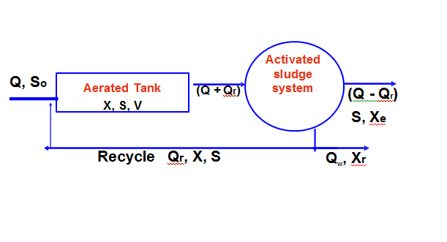
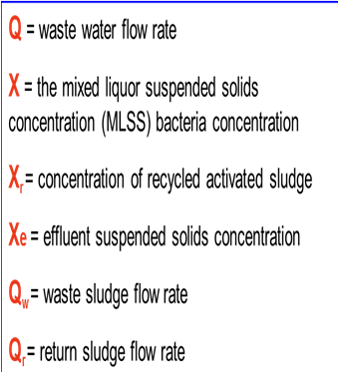
Design of Dimensions (secondary treatment)
Secondary Sedimentation tank
Activated sludge design :
No. | Design Parameter | Value
1 | Sludge volume
2 | Sludge area
3 | Sludge depth | 5m
4
5
6 | = time to flow to settle in sludge | 2.4 hour
7 |  | 70%
8
9 | Food To microorganism ratio

Slide 28
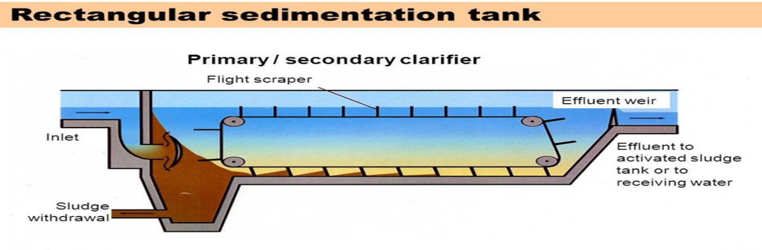
Design of Secondary Sedimentation Tanks
The secondary sedimentation tanks allows the mechanism to settle down. This sludge is pumped back into the inlet end of the primary sedimentation tanks. The BOD may be reduced to 75 – 80%.
Sedimentation Tank (Clarifier):

Slide 29
Design of Secondary Sedimentation Tanks
Sedimentation Tank (Clarifier):
No. | Design Parameter | Value
1 | Quantity of wastewater | 40,000 m³/day
2 | Volume of wastewater(two tanks) | 526m³
3 | Detention period (time) | 2 hours
4 | Area of primary sedimentation tank(each tank) | 526m²
5 | Depth of primary sedimentation tank | 4 m
6 | Width of primary sedimentation tank | 17 m
7 | Length primary sedimentation tank | 31 m

Slide 30
Environment Impact Assessment (EIA)
Environmental Impact Assessment (EIA) can identify the short term or long-term effects
wastewater treatment plant baseline study was carried out for project location, climate, effluent discharge, and ecology. Identification of possible environmental impacts of the project done
The main objective of EIA for this project is to protect individuals, society and the environment from harm by establishing proper design and maintaining proper operation
Different parameters was checked and found to be within KSA regulation
such as :Discharged Point , Performance Standards for Discharge and Hydro-geologic Condition

Slide 31
Cost Estimation
Purchases:
  5 liters of chlorine gallons
  19 tons of water
  11 tons of water trucks
WWTP construction
Administration coasts
  Licenses costs
  Chamber of commerce membership fee
  Purchasing
  Office papers and preparing
  Phones and internet
Energy cost
Maintenance cost
Installation cost
  Researches
  Employment
  Other operational costs
Construction cost
Machines:
  Treatment plant
  6 Fiber glass tanks
  10 Chlorine test machine
  6 Tanks
  Air conditioner
Man power (salaries):
  Project CEO
  Executive director
  Sales manager
  2 Chemical engineering
  2 Hydraulic engineering
  1 Civil engineering
  1 Sewage treatment engineering
  16 plant technicians
  150 workers

Slide 32
Costs :
Operational cost: | In Saudi riyals
Purchasing and row material cost | 5014420.8
Salaries | 6018000
Rentals | 650000
Energy costs | 144000
Maintenance and spare parts | 65000
Administration cost | 57400
Total | 11948820.6
Total + 5% from Total (spare money) | 12546261.7
Fixed Assets:
Buildings | 1260000
Machines | 8133200
Furnishers | 13600
Installation cost | 54200
Assets %5 of total operational costs | 627313
Total | 10088313

Slide 33
Revenue :
Items | Amount | Unit price | Cost (yearly) SR
Filling Water trucks | 2181.8 tons | 30 | 785454.5
Water for agriculture | 24000 m3/day | 1.5 | 432000
Water for disposal in the see | 870000 m3/day | 0.2 | 2088000
Total revenue | 3305454.5 Saudi Riyals
Total cost
Operational cost | 12546261.7
Fixed Assets: | 10088313
Total | 22634574.7 Saudi Riyals
Total Revenue
Revenue | 3305454.5 Saudi Riyals

Slide 34
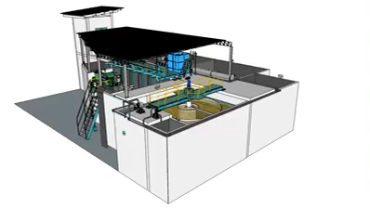
3D-max design of the purposed WWTP

Slide 35
References
Water and Wastewater Technology (7th Edition), Prentice Hall, 2011
Omar Malik, 2014. Case Study. Primary vs. Secondary: Types of Wastewater Treatment. Environmental Performance Index, Yale University 2015
Holden, J. (2013). Water resources: an integrated approach. Routledge.
Wastewater Engineering: Treatment and Resource Recovery (7th Edition),H. David stensel , 2013
Site.iugaza.edu.ps. (2019). [online] Available at: http://site.iugaza.edu.ps/frabah/files/2011/09/2.-Preliminiary-treatment-.pdf
Syed R.Qasim. "Wastewater Treatment Plants: Planning, Design, and Operation". 1998.
Concrete.org. (2019). 350.4R-04: Design Considerations for Environmental Engineering Concrete Structures. [online] Available at: https://www.concrete.org/store/productdetail.aspx?ItemID=350404&Format=DOWNLOAD&Language=English&Units=US_AND_METRIC

Slide 36
We appreciate your listening
and thank you for the attention.

