Slide 1



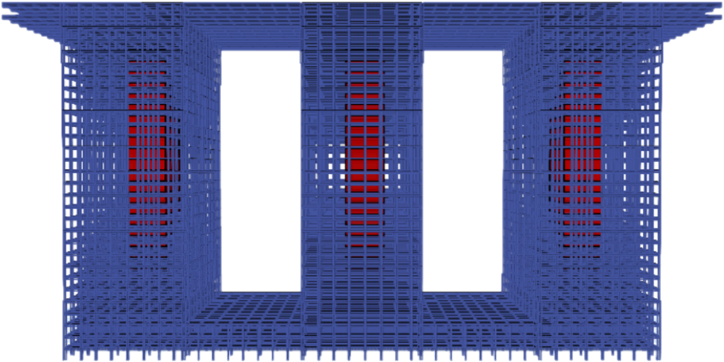


Structural & Geotechnical Design of RCC
Commercial and Residential Triple Towers
Advisors:
Students Names & ID’s:
Engr. Danish Ahmed
Dr. Tahar Ayadat
Tarek Chami, 201503124
Habib Aldokmak, 201503106
Rami Choker, 201503128
Youssef Moussa, 201600217
Coordinator:
Learning outcome assessment III
Dr. Andi Asiz

Slide 2



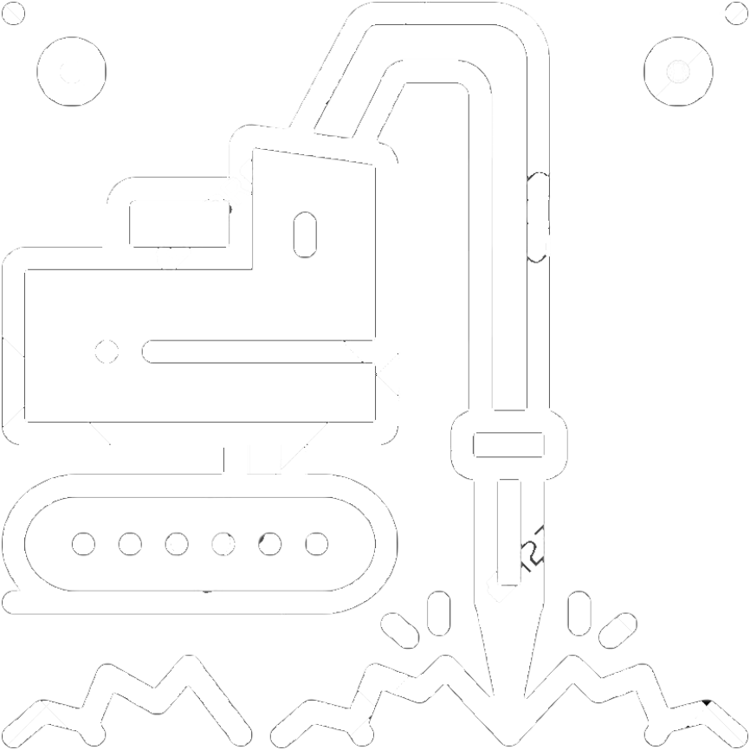




2
Learning Outcome Assessment 3
Final
Outline
Geotechnical and Foundation System Design
Project Objectives
Project Description
Project Constraints
Structural Design
Work Distribution

Slide 3
3
Learning Outcome Assessment 3
Final
Objectives
1
Modeling of the structures
2
Structural Design
3
4
Cost Estimation
Geotechnical Design of the Substructure

Slide 4
4
Learning Outcome Assessment 3
Final
Project Description
1
Location of the project
2
General description
3
Project Layout

Slide 5
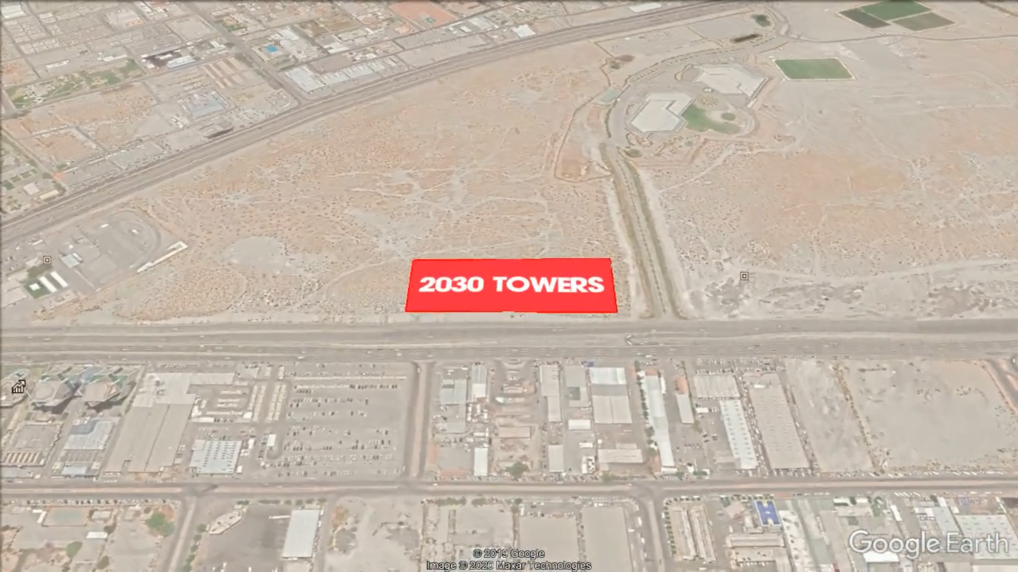
5
Learning Outcome Assessment 3
Final
Location
King Saud Road
King Fahd Road
Saudi Arabia, Eastern Province
Al-Khobar, between King Fahd and King Saud roads

Slide 6
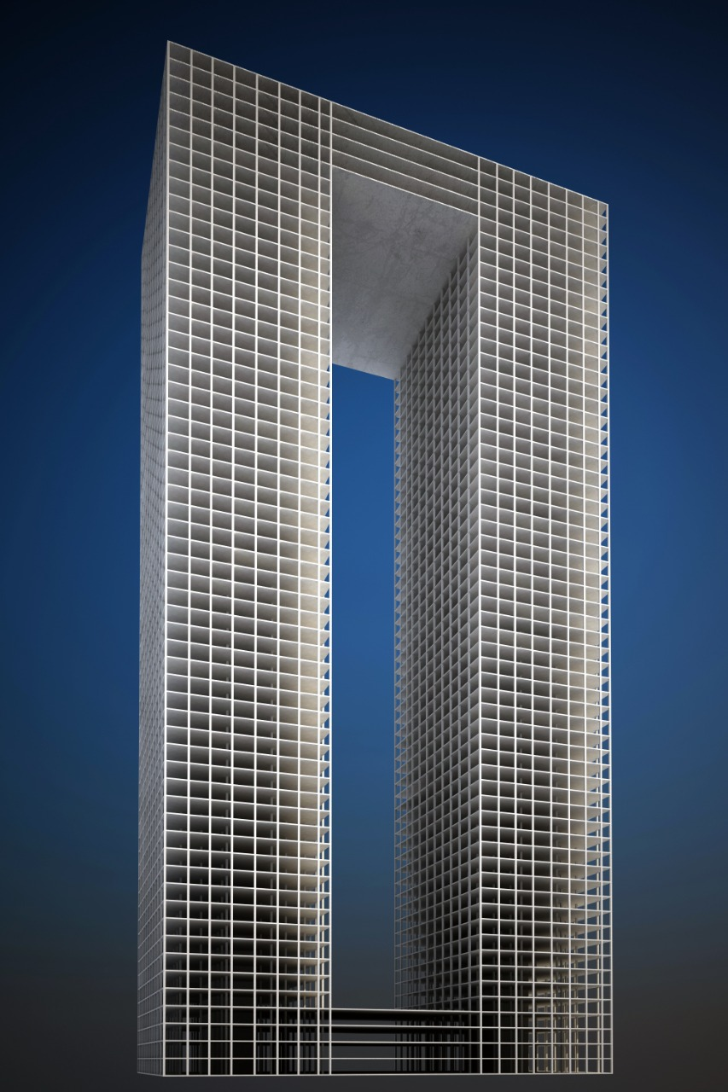
6
Learning Outcome Assessment 3
Final
Project Reference
Original Project
1
Twin Tower (60-storey)
2
Between Dammam & Al-Khobar
3
Commercial and Residential
Abdulaziz Group project

Slide 7
7
Learning Outcome Assessment 3
Final
General Description
Number of towers: 3
Number of stories in each tower: 30
Typical Floor area: 2400m²
Top floor area:14400m²
Cumulative area: 229600m²
Cantilever area: 1200m²
Connection area: 2400m²

Slide 8
8
Learning Outcome Assessment 3
Final
Stories Cluster
Cluster 1
Hotel and decks (patio on roof)
Residential
Cluster 2
Cluster 3
Residential
Cluster 4
Mechanical Floor
Commercial
Cluster 5
Mall and Brands
Cluster 6
Parking

Slide 9
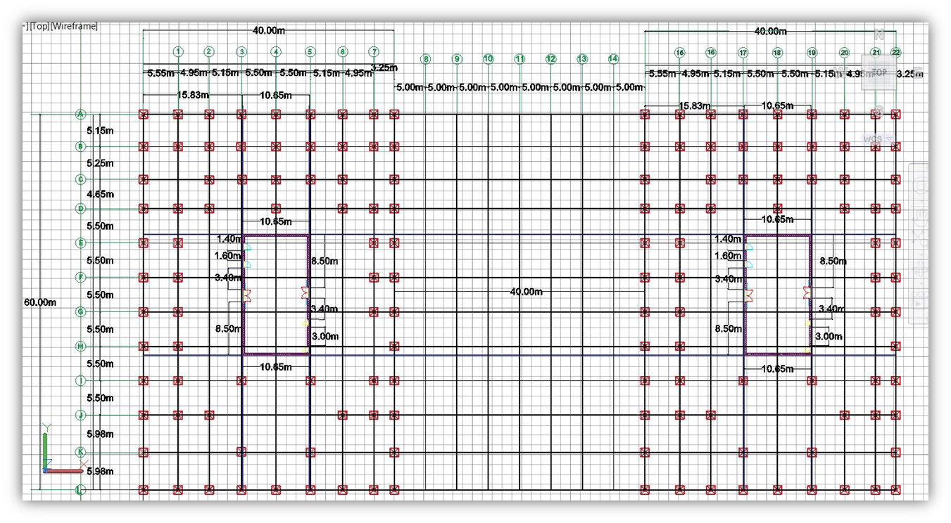
9
Learning Outcome Assessment 3
Final
Original Layout 1
Abdulaziz group project Layout 1

Slide 10
10
Learning Outcome Assessment 3
Final
Basement Layout
B1_B3
Basement

Slide 11
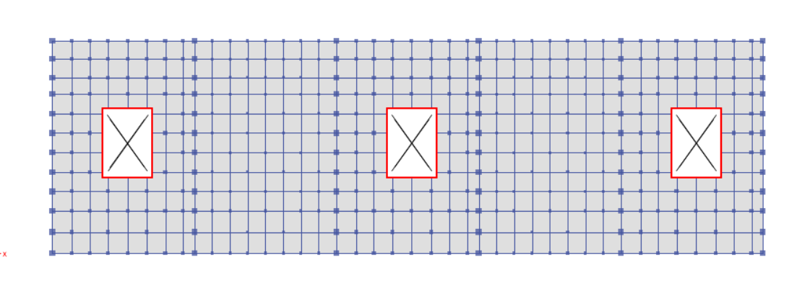
11
Learning Outcome Assessment 3
Final
Basement Layout
60 m
200 m
Floor: B1_B3
Area = 12,000 m²

Slide 12
12
Learning Outcome Assessment 3
Final
Storey Layout
Storey
F1_F25

Slide 13
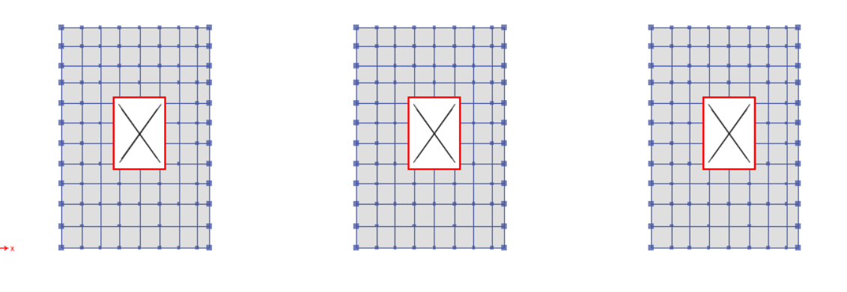
13
Learning Outcome Assessment 3
Final
Storey Layout
60 m
40 m
40 m
40 m
Floor: 1_25
Area = 2,400 m²
Area = 3 X 2,400 m² = 7,200 m²

Slide 14
Learning Outcome Assessment 3
Final
14
Top Storey Layout
F26_27
Top Storey

Slide 15
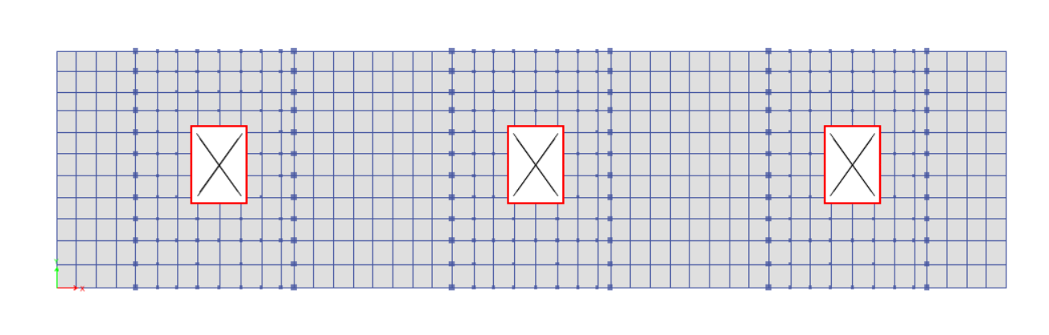
15
Learning Outcome Assessment 3
Final
Top Storey Layout
20 m
40 m
40 m
40 m
40 m
40 m
20 m
60 m
240 m
Floor: 26_27
Area = 14,400 m²
2 X 14,400 = 2800 m²

Slide 16


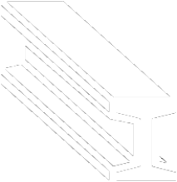


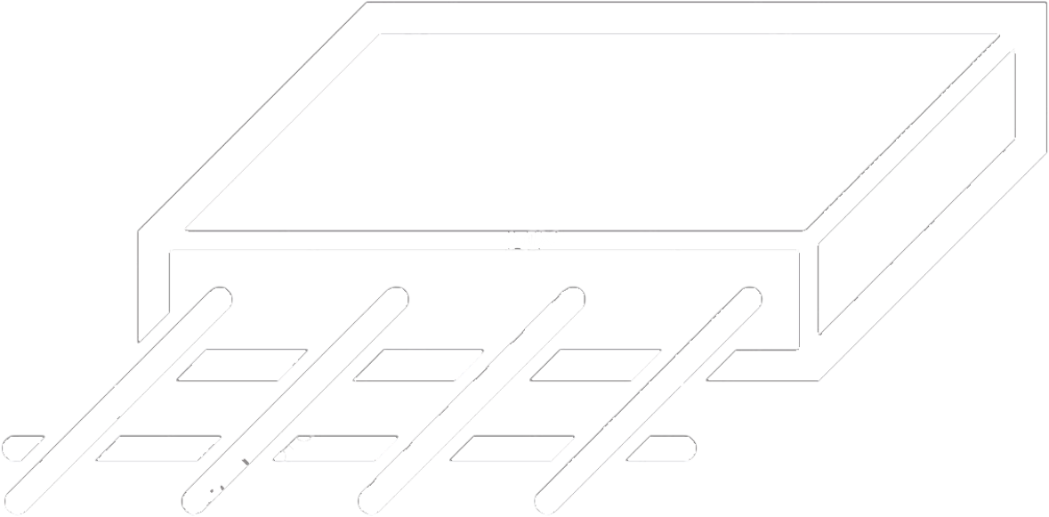

16
Learning Outcome Assessment 3
Final
Structural Design
Methodology
Steel structure elements design
Structure loads
Etabs Modeling
Concrete structure elements design
Structure breakdown

Slide 17








17
Learning Outcome Assessment 3
Final
Floors’ Clusters
Saudi Building Code
Methodology
Preliminary Design
Final Design
ETABS Modeling
Notes:
Referring to our story division, pick up the codes from SBC
Preliminary design for the structural members
Modeling and analyzing using ETABS

Slide 18
18
Learning Outcome Assessment 3
Final
Design loads
Wind Load
Structural Loads
Seismic load
Combination load

Slide 19
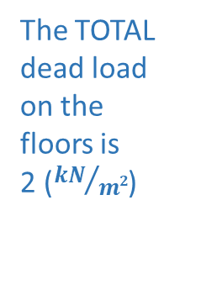
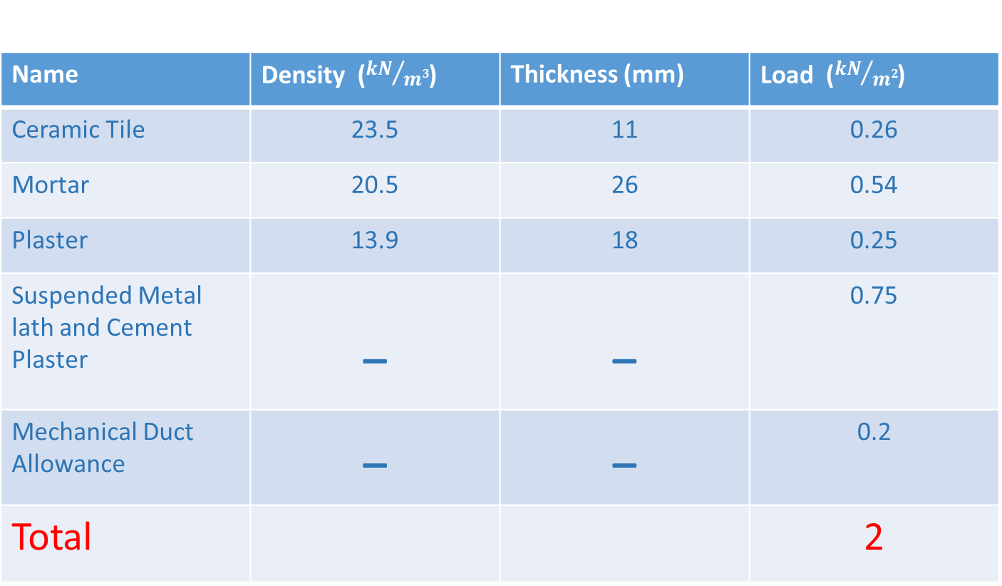
19
Learning Outcome Assessment 3
Final
Finishing’s Dead Load
Name | Density (${kN}/{m3}$) | Thickness (mm) | Load (${kN}/{m2}$)
Ceramic Tile | 23.5 | 11 | 0.26
Mortar | 20.5 | 26 | 0.54
Plaster | 13.9 | 18 | 0.25
Suspended Metal lath and Cement Plaster | _ | _ | 0.75
Mechanical Duct Allowance | _ | _ | 0.2
Total |  |  | 2
According to ACI, SBC and Rak for tiles the book Ceramics 2020
The TOTAL dead load on the floors is
2 (${kN}/{m2}$)

Slide 20
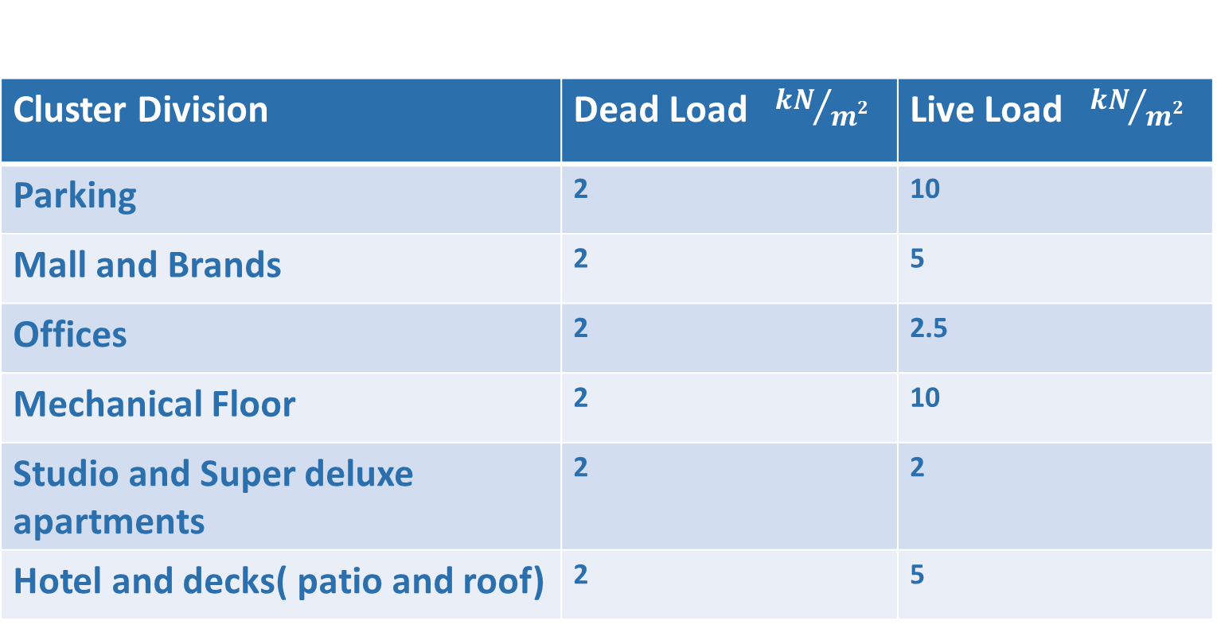
20
Learning Outcome Assessment 3
Final
Structural Loads
Cluster Division | Dead Load ${kN}/{m2}$ | Live Load ${kN}/{m2}$
Parking | 2 | 10
Mall and Brands | 2 | 5
Offices | 2 | 2.5
Mechanical Floor | 2 | 10
Studio and Super deluxe apartments | 2 | 2
Hotel and decks( patio and roof) | 2 | 5
Saudi Building Code

Slide 21
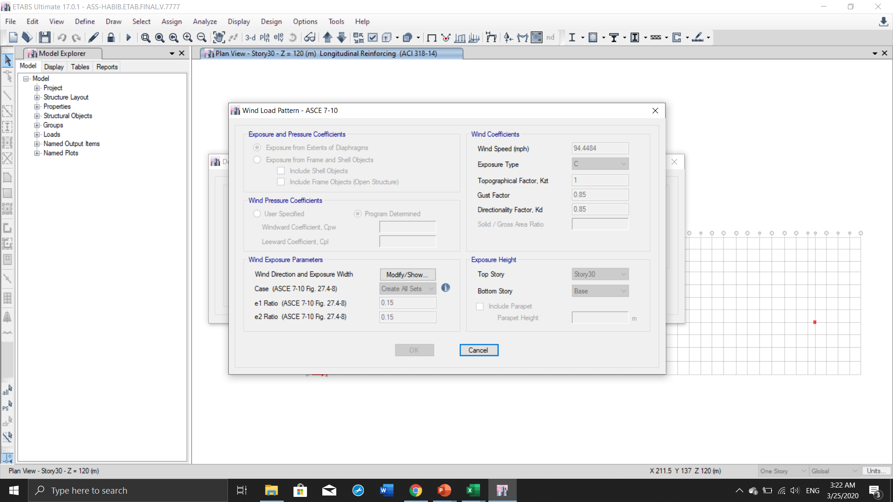






21
Learning Outcome Assessment 3
Final
ASCE,
Saudi Building Code
$$Wind Speed=152\frac{km}{h}$$
$$=94.4484 mph$$
$$Exposure Type:C$$
$$K_{zt}=1$$
$$Gust Factor=0.85$$
$$K_{d}=0.85$$

Slide 22
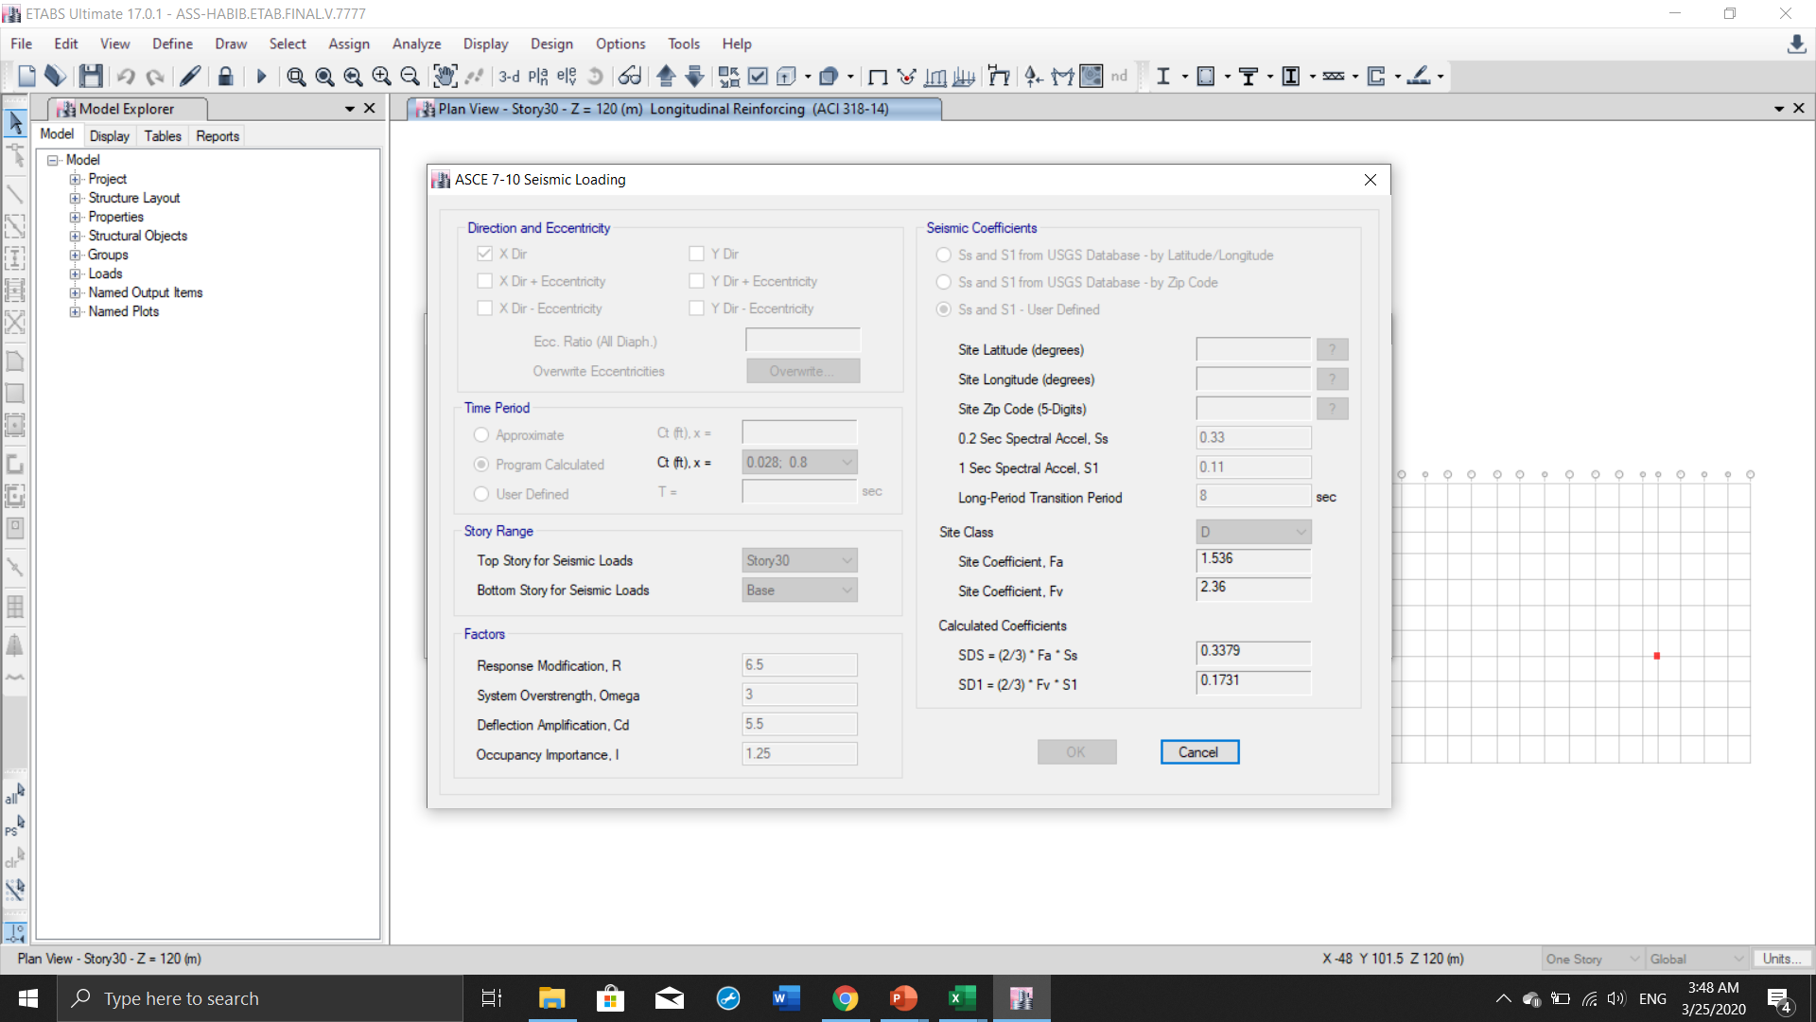









22
Learning Outcome Assessment 3
Final
ASCE,
Saudi Building Code
$$R=6.5$$
$$Omega=3$$
$$Exposure Type:C$$
$$C_{d}=5.5$$
$$I=1.25$$
$$S_{a}=0.33$$
$$S1=0.11$$
$$S1=8$$
$$Site Class:D$$

Slide 23
23
Learning Outcome Assessment 3
Final
Combination Loads
Type | Combination | Reference
Dead and Live Load | 1.2(DL) + 1.6(LL) | ASCE & Saudi Building Code
Dead and Wind Load | 0.9(DL) + 1(WL)
Dead and Seismic Load | 1(DL) + 1(EL)

Slide 24
24
Learning Outcome Assessment 3
Final
Concrete Structure Elements Design
Slab Design
Beam Design
Columns Design

Slide 25
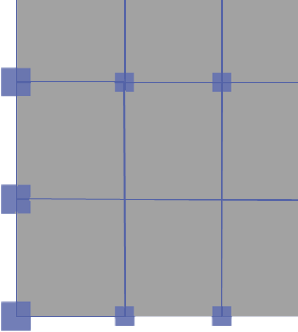
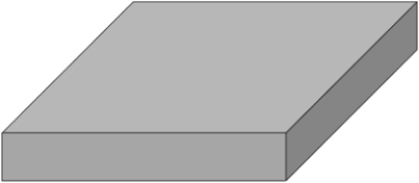


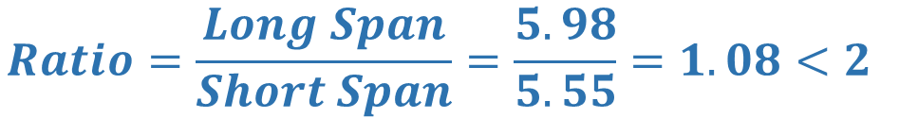

25
Learning Outcome Assessment 3
Final
RCC Slab Design
$$Ratio=\frac{Long Span}{Short Span}=\frac{5.98}{5.55}=1.08<2$$
$$Two Way$$
$$Slab$$
$$Slab Thikness=\frac{Perimeter}{180}+Cover≈20 cm$$
5.98 m
𝒇′𝒄 =10 ksi
𝒇𝒚 =60 ksi
20 cm
5.55 m

Slide 26



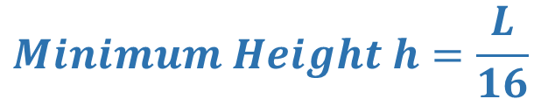
26
Learning Outcome Assessment 3
Final
RCC Beam Design
$$Minimum Height h=\frac{L}{16}$$
5.98 m
$$\frac{d}{b}=1.5 to 2.2$$
$$A_{st}^{′}$$
600 mm
530 mm
$$A_{st}$$
Height h = 600 mm
Depth d = 530 mm
Width b = 400 mm
𝒇′𝒄 =10 ksi
𝒇𝒚 =60 ksi
400 mm

Slide 27
27
Learning Outcome Assessment 3
Final
RCC Beam Design
$$Minimum Height h=\frac{L}{16}$$
11.96 m
$$\frac{d}{b}=1.5 to 2.2$$
$$A_{st}^{′}$$
950 mm
880 mm
$$A_{st}$$
Height h = 950 mm
Depth d = 880 mm
Width b = 550 mm
𝒇′𝒄 =10 ksi
𝒇𝒚 =60 ksi
550 mm

Slide 28
28
Learning Outcome Assessment 3
Final
RCC Beam Design
$$Minimum Height h=\frac{L}{16}$$
15.65 m
$$\frac{d}{b}=1.5 to 2.2$$
$$A_{st}^{′}$$
1150 mm
1080 mm
$$A_{st}$$
Height h = 1150 mm
Depth d = 1080 mm
Width b = 800 mm
𝒇′𝒄 =10 ksi
𝒇𝒚 =60 ksi
800 mm

Slide 29
29
Learning Outcome Assessment 3
Final
Column Design
Dead Load:
  Slab
  Beam
  Finishing
Live Load
Slab
Beam
Column

Slide 30
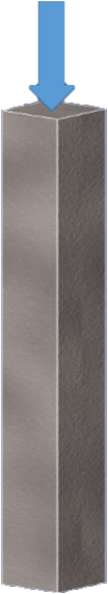

30
Learning Outcome Assessment 3
Final
Column Design
$$∅P_{n}=∅ r [0.85f_{c}^{′}\left(A_{g}−A_{st}\right)+f_{y}A_{St}]$$
$$A_{g}=a∗a$$
∅𝑷𝒏=Axial load acting on the element (in kN or kips).
∅ = Safety factor for a rectangular element ≈ 0.65 (unitless)
𝒓 = Safety factor for a rectangular column ≈ 0.80 (unitless)
𝒇′𝒄 =Compressive strength of the concrete (using 68 MPa)
𝒇𝒚 =yield strength of the steel (using 240 MPa)
𝑨𝒈 =Gross area of the concrete element.
𝑨𝒔𝒕 =Area of steel required
a

Slide 31
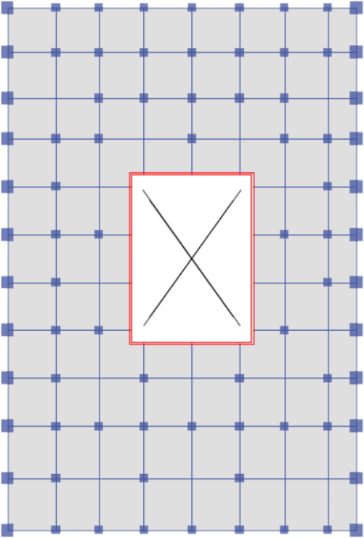
31
Learning Outcome Assessment 3
Final
Column Design
Column | Cross section size (cm X cm)
Group 1 | 46X46
Group 2 | 59X59
Group 3 | 70X70
Group 4 | 81X81
Group 5 | 92X92
Group 6 | 101X101

Slide 32
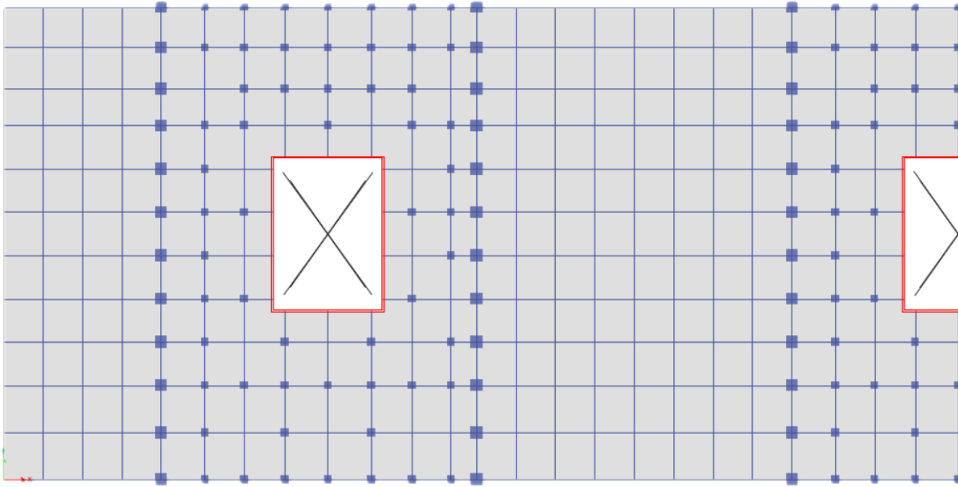
32
Learning Outcome Assessment 3
Final
Column Design
Column | Cross section size (cm X cm)
Group 1 | 65X65
Group 2 | 75X75
Group 3 | 85X85
Group 4 | 94X94
Group 5 | 103X103
Group 6 | 112X112

Slide 33
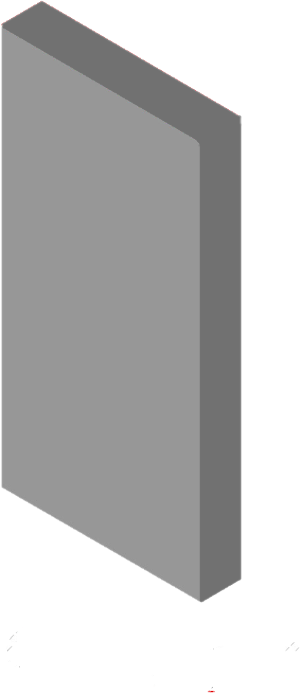
33
Learning Outcome Assessment 3
Final
Shear Wall Design
$$∅P_{n}=∅ r [0.85f_{c}^{′}\left(A_{g}−A_{st}\right)+f_{y}A_{St}]$$
∅𝑷𝒏=Axial load acting on the element (in kN or kips).
∅ = Safety factor for a rectangular element ≈ 0.65 (unitless)
𝒓 = Safety factor for a rectangular column ≈ 0.80 (unitless)
𝒇′𝒄 =Compressive strength of the concrete (using 68 MPa)
𝒇𝒚 =yield strength of the steel (using 240 MPa)
𝑨𝒈 =Gross area of the concrete element.
𝑨𝒔𝒕 =Area of steel required

Slide 34

34
Learning Outcome Assessment 3
Final
Shear Wall Design
$$A_{g}=19.3 ∗x$$
$$x=20cm$$
4 m
19.3 m
x ??

Slide 35
35
Learning Outcome Assessment 3
Final
Steel Structure Elements Design
Connection Girder
Column Design
Cantilever Girder
Sub-Beam
Girder Design

Slide 36
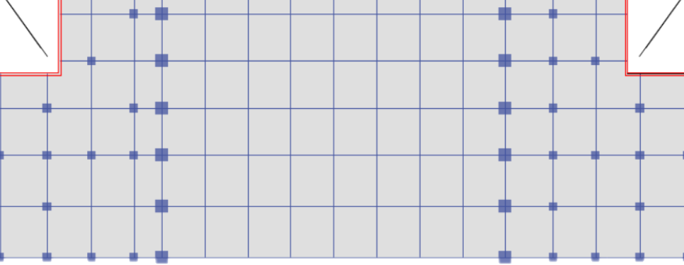
36
Learning Outcome Assessment 3
Final
Connection Beam Design

Slide 37



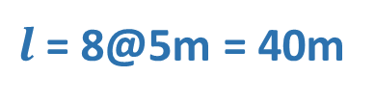

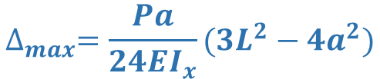


37
Learning Outcome Assessment 3
Final
Connection Beam Design
$$P=2R_{u}$$
Rectangular HSS
20 cm
$$∆_{all}$$
$l$= 8@5m = 40m
$$L10X10X13/8$$
120 cm
$$∆_{all}=\frac{l}{240}=6.56in=166mm$$
$$∆_{max}=\frac{Pl^{2}}{48EI_{x}}$$
$$∆_{weight}=\frac{M_{1}l^{2}}{C_{1}I_{x}}$$
𝒇𝒚 =60 ksi
20 cm
$$∆_{max}=\frac{Pa}{24EI_{x}}(3L^{2}−4a^{2})$$
15 cm
15 cm
AISC
90 cm

Slide 38
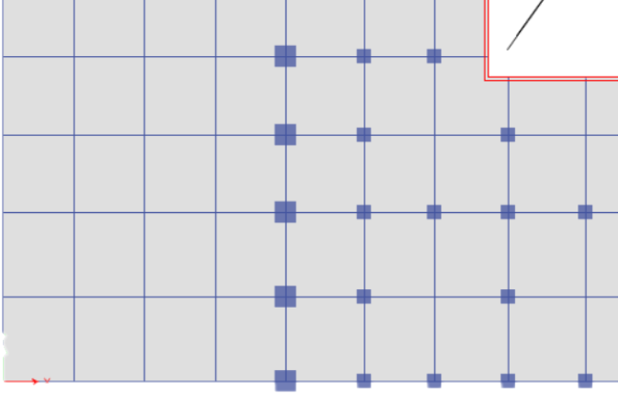
38
Learning Outcome Assessment 3
Final
Cantilever Beam Design

Slide 39





39
Learning Outcome Assessment 3
Final
Cantilever Beam Design
$$P=2R_{u}$$
Rectangular HSS
DL & LL
20 cm
$$∆_{all}$$
$$L10X10X13/8$$
140 cm
20m
5.55m
10.1m
$$∆_{all}=\frac{l}{150}=5.25 in=133mm$$
𝒇𝒚 =60 ksi
20 cm
M$acaulay Eq: −EI_{x}\frac{d^{2}w}{dx^{2}}=M$
20 cm
20 cm
100 cm
Structural analysis

Slide 40
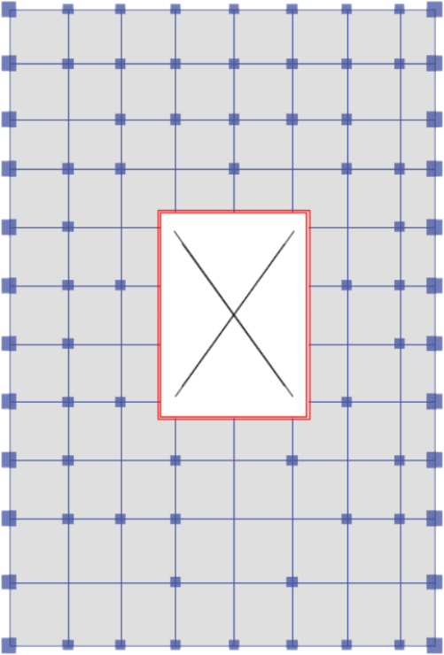
40
Learning Outcome Assessment 3
Final
Steel Beam Design
Sub Beam
Girder

Slide 41







41
Learning Outcome Assessment 3
Final
Steel Sub Beam Design
$$DL\&LL=6.1{Kip}/{ft}$$
$$W27X84$$
0.64 in
$$∆_{all}$$
$$5.98m$$
0.46 in
26.7 in
$$∆_{all}=\frac{l}{240}$$
$$M=\frac{w{(l)}^{2}}{8}$$
𝒇𝒚 =60 ksi
$$V=\frac{WL}{2}$$
$$∆ =\frac{M({l)}^{2}}{C_{1}I_{x}}$$
10 in

Slide 42

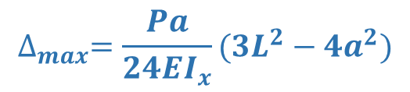




42
Learning Outcome Assessment 3
Final
Steel Girder Design
$$2R$$
$$2R$$
$$W44X290$$
1.58 in
$$∆_{all}$$
$$15.86m$$
0.865 in
43.6 in
$$∆_{all}=\frac{l}{240}$$
AISC
$$M=\frac{w{(l)}^{2}}{8}$$
$$∆_{max}=\frac{Pa}{24EI_{x}}(3L^{2}−4a^{2})$$
$$V=\frac{wL}{2}$$
$$∆ =\frac{M({l)}^{2}}{C_{1}I_{x}}$$
𝒇𝒚 =60 ksi
15.8 in

Slide 43
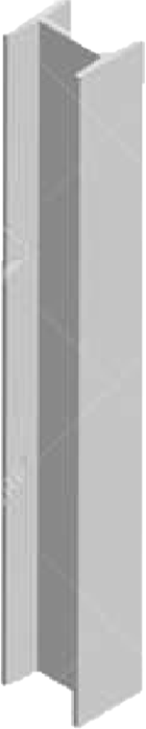





43
Learning Outcome Assessment 3
Final
Steel Column Design Example
$$W14X550$$
3.83 in
$$∅Pn=Ag∅Fcr$$
$$λ=\frac{Kl}{r}$$
AISC
13.1 ft.
2.38 in
20.2 in
$$R=\frac{WL}{2}$$
$$∆ =\frac{M({l)}^{2}}{C_{1}I_{x}}$$
𝒇𝒚 =60 ksi
17.3 in

Slide 44
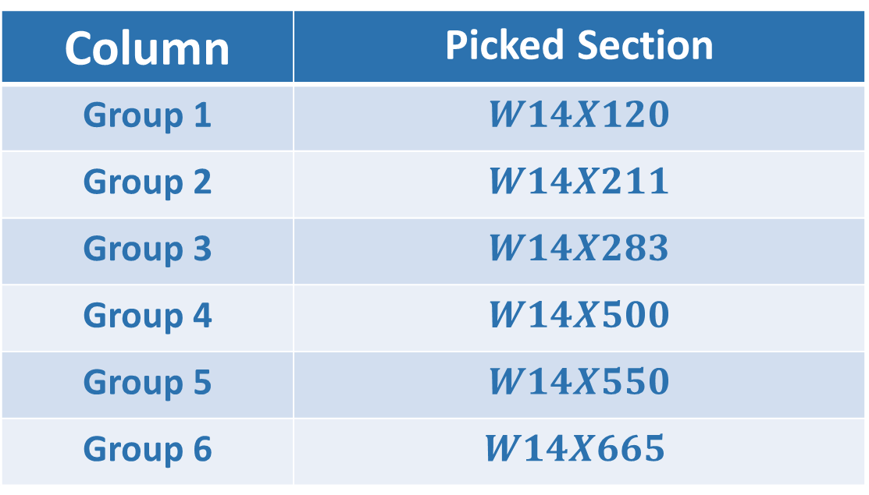
44
Learning Outcome Assessment 3
Final
Column Design
Column | Picked Section
Group 1 | $$W14X120$$
Group 2 | $$W14X211$$
Group 3 | $$W14X283$$
Group 4 | $$W14X500$$
Group 5 | $$W14X550$$
Group 6 | $$W14X665$$

Slide 45
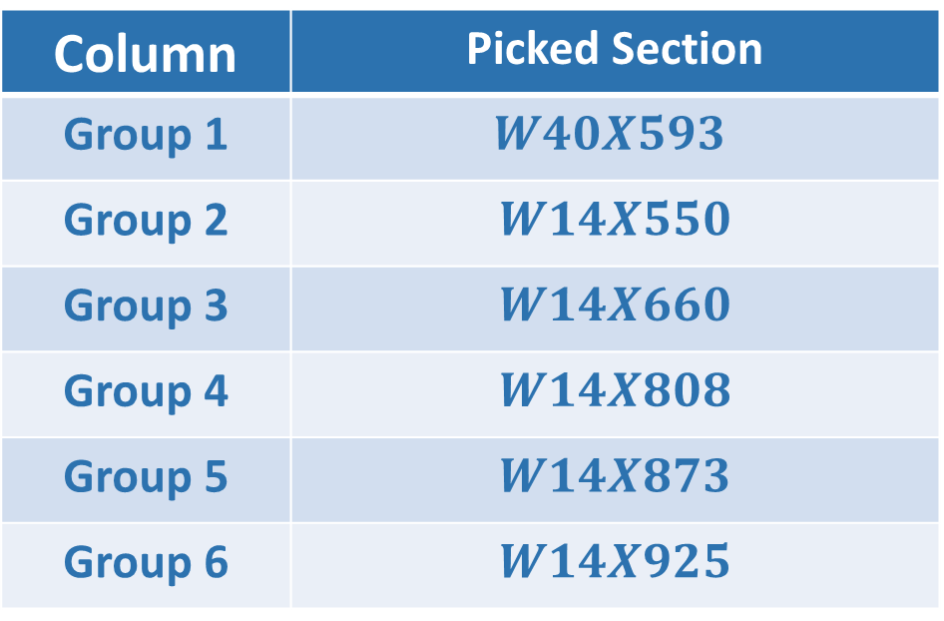
45
Learning Outcome Assessment 3
Final
Column Design
Column | Picked Section
Group 1 | $$W40X593$$
Group 2 | $$W14X550$$
Group 3 | $$W14X660$$
Group 4 | $$W14X808$$
Group 5 | $$W14X873$$
Group 6 | $$W14X925$$

Slide 46
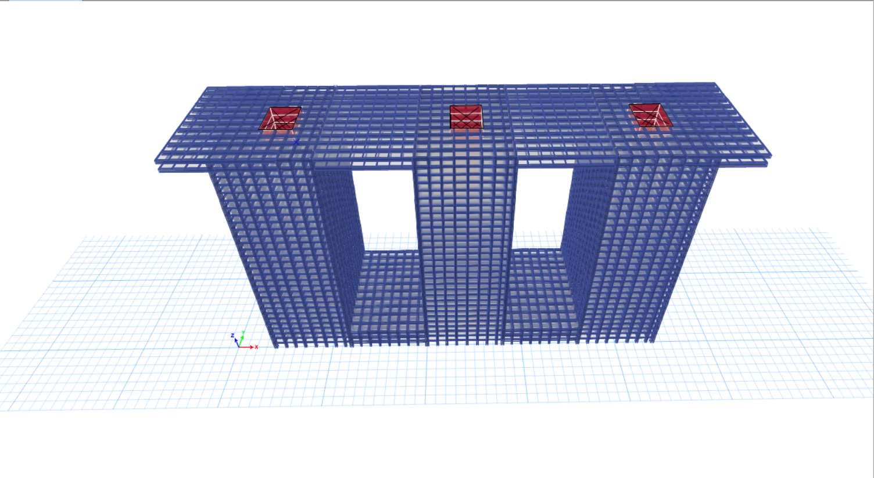
46
Learning Outcome Assessment 3
Final
Etabs modeling

Slide 47
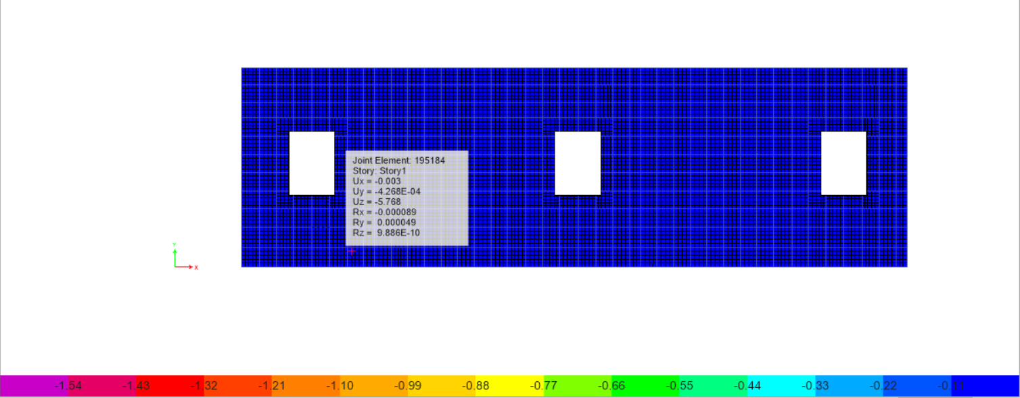
47
Learning Outcome Assessment 3
Final
Etabs modeling
Slab Deflection after applying the highest load
5.768mm<25mm
ACI
Passed

Slide 48
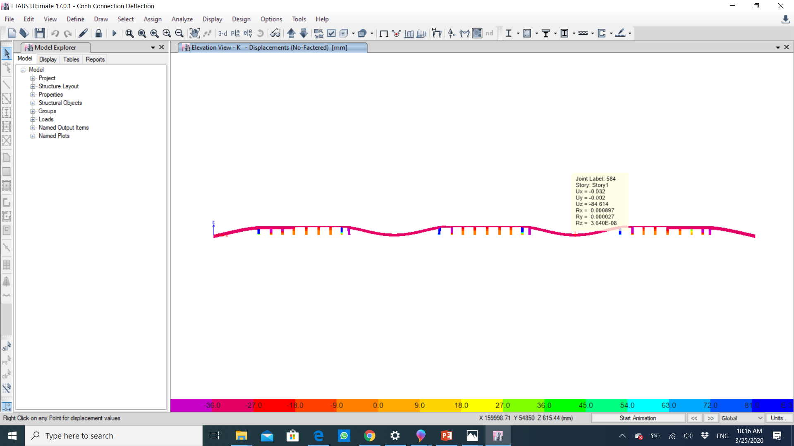
48
Learning Outcome Assessment 3
Final
Etabs modeling
Connection beam deflection
84.614<166mm
Passed

Slide 49
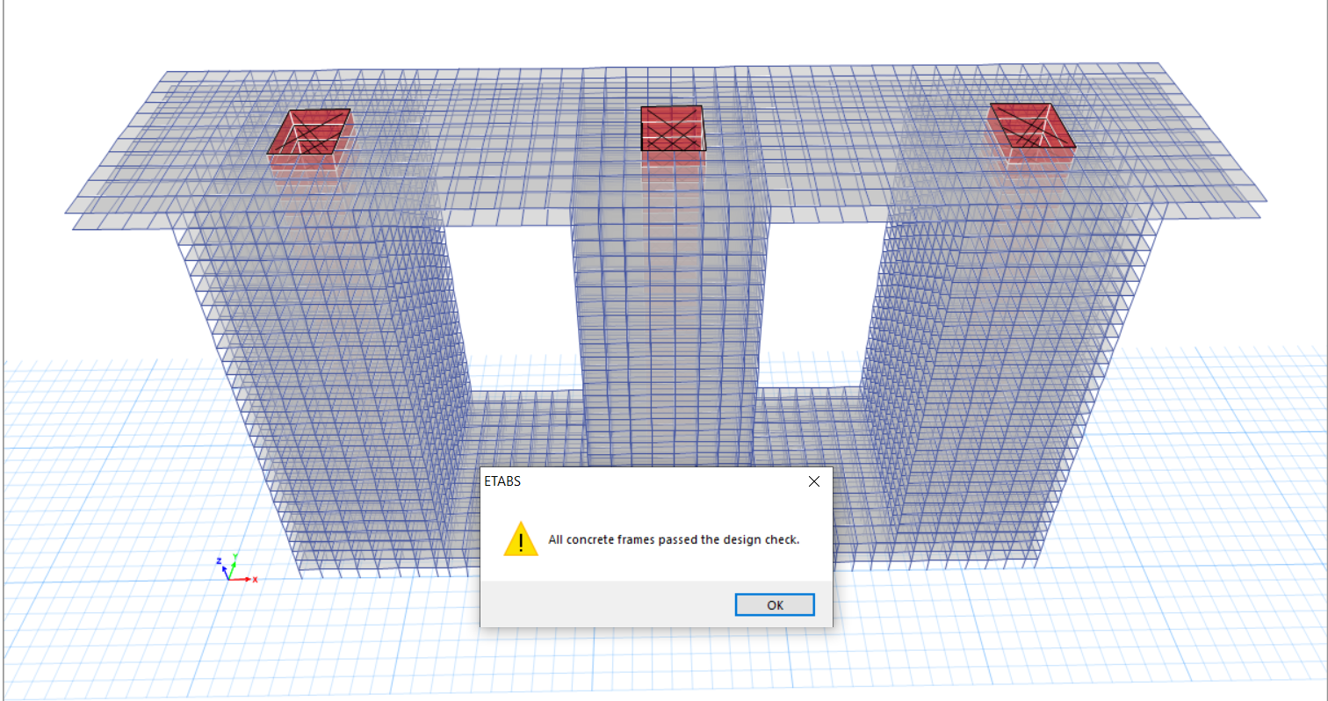
49
Learning Outcome Assessment 3
Final
Etabs modeling

Slide 50
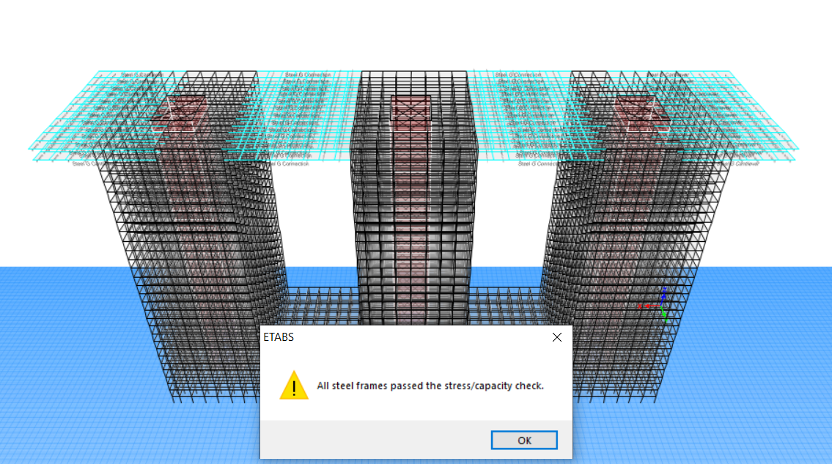
50
Learning Outcome Assessment 3
Final
Etabs modeling

Slide 51
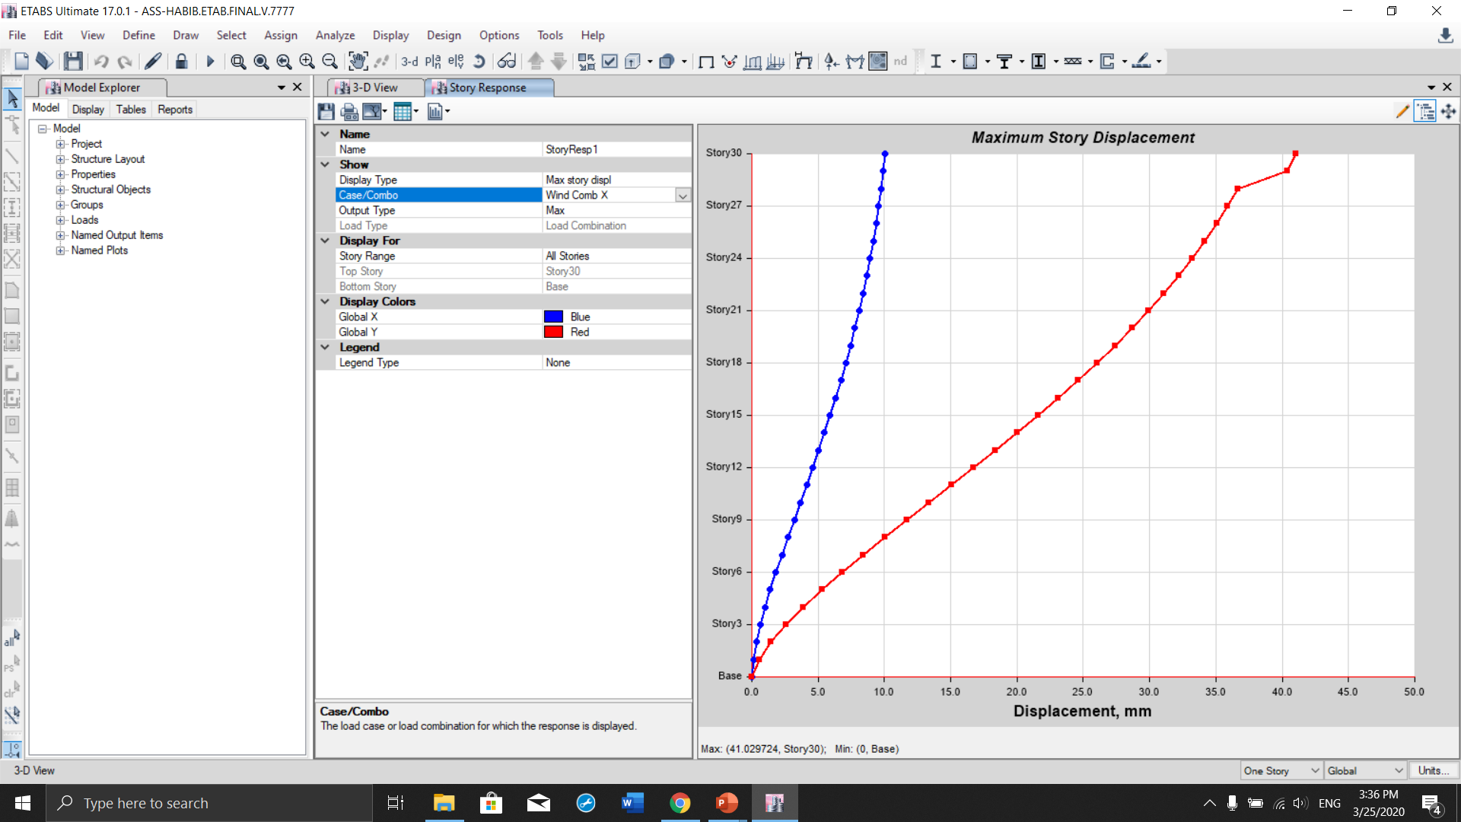

51
Learning Outcome Assessment 3
Final
Wind Load Deflection
ASCE,
Saudi Building Code
$$∆_{all}=\frac{l}{500} =\frac{120}{500}=240mm$$
41<240
Passed

Slide 52
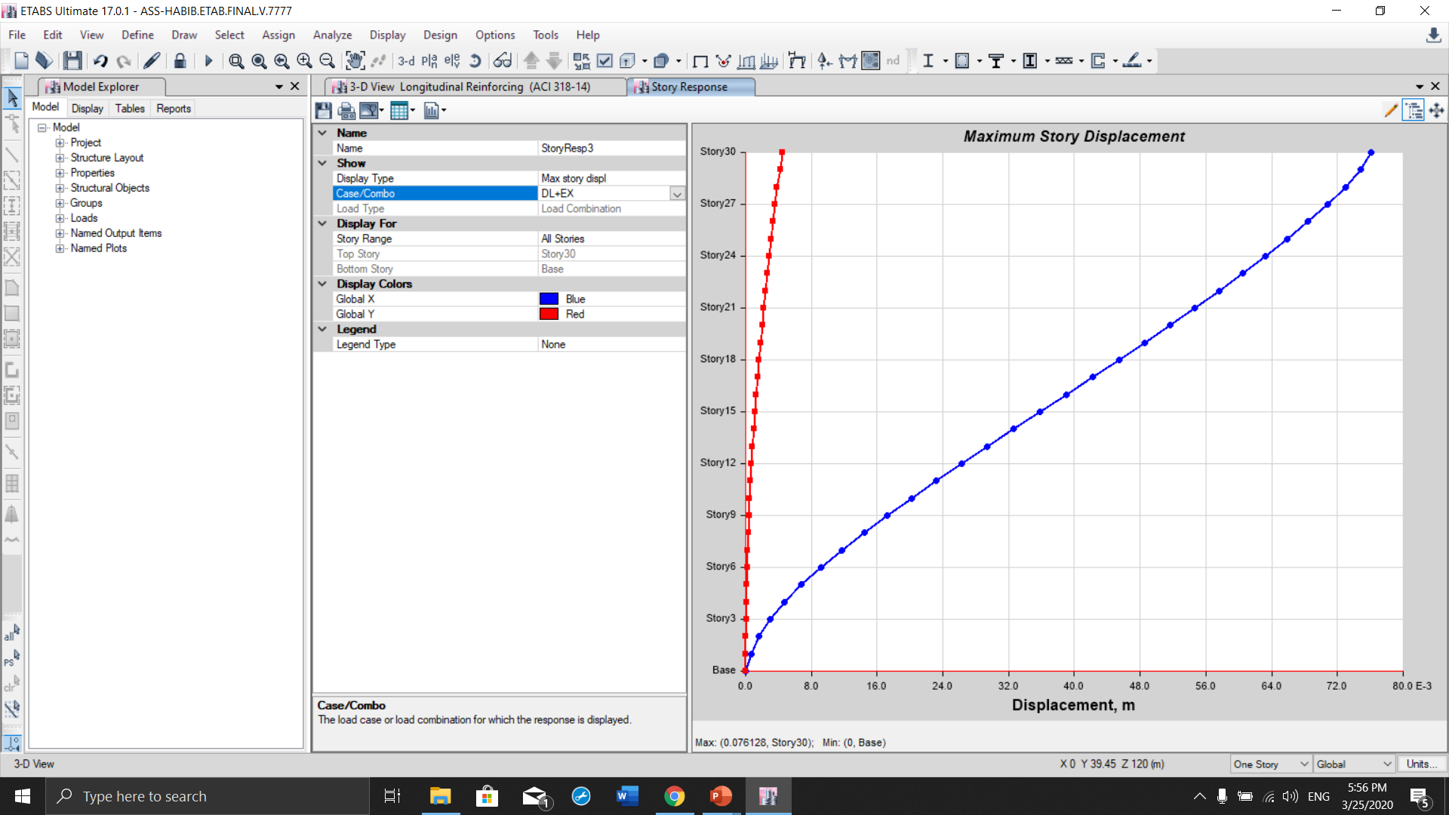
52
Learning Outcome Assessment 3
Final
Seismic Load Deflection
ASCE,
Saudi Building Code
$$∆_{all}=\frac{l}{500} =\frac{120}{500}=240mm$$
75<240
Passed

Slide 53
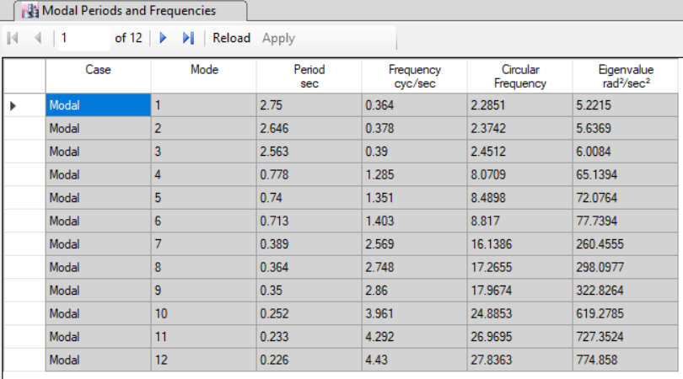


53
Learning Outcome Assessment 3
Final
Etabs modeling
ASCE,
Saudi Building Code
Period
T$=0.1 X number of storey$
T$allowable=0.1 X 30=3sec$
T < T_{allowable}

Slide 54
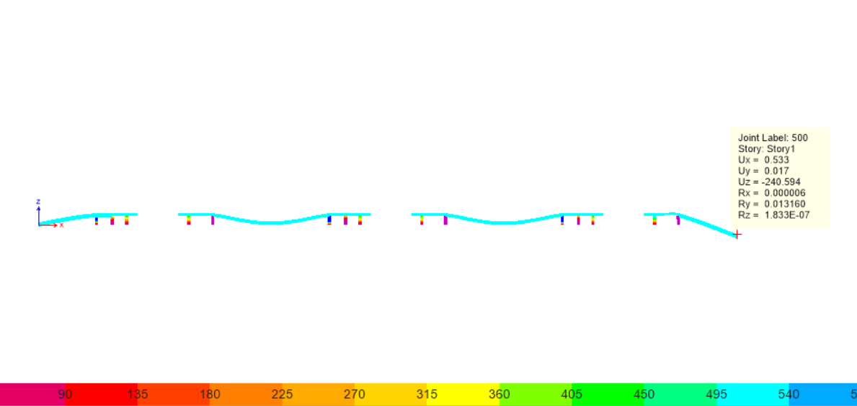

54
Learning Outcome Assessment 3
Final
Beam Deflection
$$∆_{all}=\frac{l}{150} =\frac{20}{150}=133mm$$
Cantilever Beam deflection
240>133mm
Failed

Slide 55
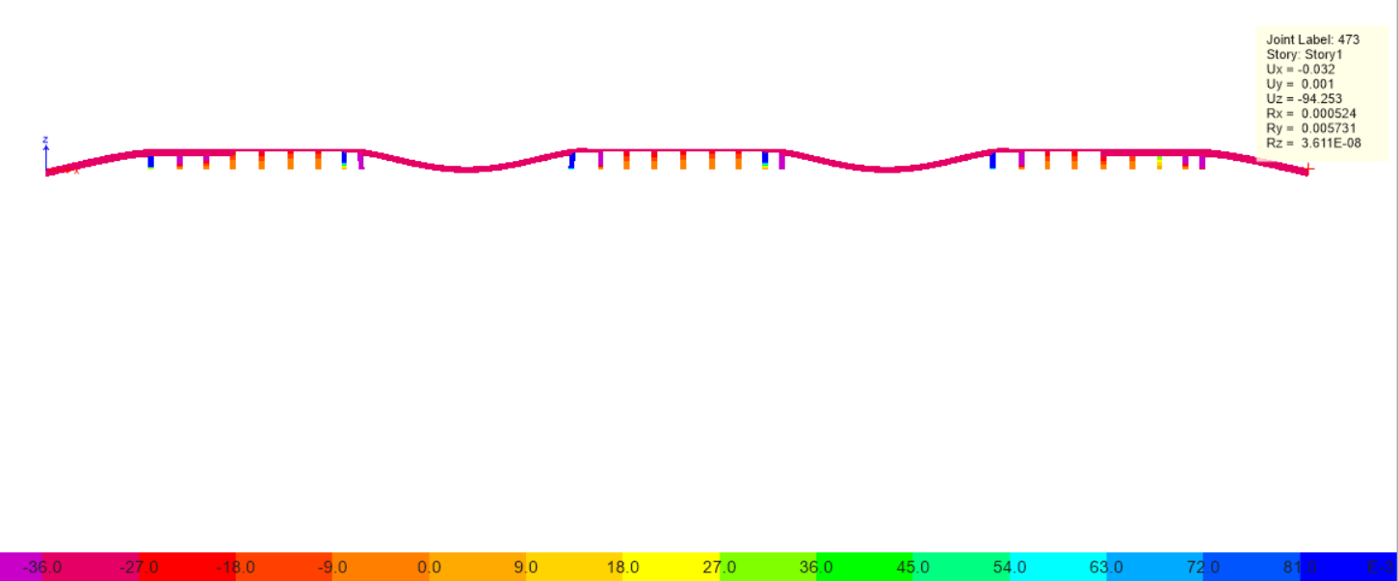
55
Learning Outcome Assessment 3
Final
Beam Deflection
$$∆_{all}=\frac{l}{150} =\frac{20}{150}=133mm$$
Cantilever Beam deflection
94<133mm
Passed

Slide 56


56
Learning Outcome Assessment 3
Final
Slab Reinforcement
M max = 452543.4 N. mm
B=5980mm
d = 180mm
k = $\frac{M}{0.9×B×{(d)}^{2}}$
k =$2.595 \frac{MN}{m^{2}}$
𝛒 = 0.0068
As= 𝛒bd = $7319.5 {mm}^{2}$
➔ So, 9#32 bars will be enough to reinforce the main structure’s slab.
S max$=657 mm$
S min= 25 mm minimum spacing from SBC
So, 9#32 @ 300 mm $c/c$

Slide 57



57
Learning Outcome Assessment 3
Final
Slab Reinforcement
5.98 m
20 cm
9#32 @ 300 mm 𝑐⁄𝑐
5.55 m
20 cm
5.98 m
18 cm
9#32 @ 300 mm 𝑐⁄𝑐
2 cm
9#32 @ 300 mm 𝑐⁄𝑐

Slide 58
58
Learning Outcome Assessment 3
Final
Beam Reinforcement
15.65m Beam:
M = 1470564998 N-mm
b = 650 mm
h= 1150mm
d= 1150 – 70 = 1080 mm 𝑑/𝑏=1.6 1.5 < 1.6 < 2.2 check ok!
k = 1470564994/(0.9×650×1080^2 ) =2.155 ⇒𝛒 = 0.0054
As = 𝛒bd = 3790.8 〖𝑚𝑚〗^2
Pick 6#29 ⇒ As = 3870mm2 3870>3790.8 ok!
d actual= h – (cover + dst + 𝑑𝑠/2 )
= 1150 – (30 + 10 + 29/2 )
= 1095 > 1080 ok!
Provide #10 @ 150mm stirrups c/c

Slide 59



59
Learning Outcome Assessment 3
Final
Beam Reinforcement
650 mm
3#29
1150 mm
3#29
#10 @ 150mm stirrups c/c

Slide 60
60
Learning Outcome Assessment 3
Final
Column with Cross Section 0.8m X 0.8m
Ag= 800mm X 800mm = 640000mm2
As = (0.01 to 0.08)Ag
As = 0.01 Ag
=6400mm2
# of Bars = (𝐴_𝑠 (𝑟𝑒𝑞))/(𝐴_𝑠 (𝑜𝑛𝑒 𝑏𝑎𝑟))
Choose #29 for one bar
𝜋/4 29^2=661 〖𝑚𝑚〗^2
# of Bars = 6400/661=9.68 𝑏𝑎𝑟𝑠 ≈10 𝑏𝑎𝑟𝑠
So, pick 10#29 ⇒ As = 6450 mm2
⇒6450>6400 checking ok!
Lateral ties reinforcement:
Provide #10 mm ties @ 240 mm c/c

Slide 61


61
Learning Outcome Assessment 3
Final
Column with Cross Section 0.8m X 0.8m
800 mm
#10 mm ties @ 240 mm c/c
800 mm
30 mm
10#29 mm bars

Slide 62
62
Learning Outcome Assessment 3
Final
Shear Wall Reinforcement
Ag= 19300mm X 200mm = 3860000mm2
As = (0.01 to 0.08) Ag
As = 0.01 Ag
=38600mm2
# of Bars = (𝐴_𝑠 (𝑟𝑒𝑞))/(𝐴_𝑠 (𝑜𝑛𝑒 𝑏𝑎𝑟))
Choose #32 for one bar
𝜋/4 32^2=804 〖𝑚𝑚〗^2
# of Bars = 38600/804=48.6 𝑏𝑎𝑟𝑠 ≈49 𝑏𝑎𝑟𝑠
So, pick 49#32 ⇒ As = 39396 mm2
⇒39396>38600 checking ok!
Lateral ties reinforcement:
Provide #10 mm ties @ 240 mm c/c

Slide 63

63
Learning Outcome Assessment 3
Final
Shear Wall Reinforcement
19.3 m
2 m
#10 mm ties @ 240 mm c/c
49#32 mm bars

Slide 64
64
Learning Outcome Assessment 3
Final
Final Design
Final Design of Concrete Columns
Internal Columns
Columns No | Size (mm) | Longitudinal Reinforcement | Lateral Ties
1 | 800 X 800 | 10 # 29 | #10 mm @250mm c/c
2 | 820 X 820 | 12 # 29 | #10 mm @250mm c/c
3 | 850 X 850 | 12 # 29 | #10 mm @250mm c/c
4 | 900 X 900 | 14 # 29 | #10 mm @250mm c/c
5 | 970 X 970 | 16 # 29 | #10 mm @250mm c/c
6 | 1050 X 1050 | 18 # 29 | #10 mm @250mm c/c
Parking | 800 X 800 | 10 # 29 | #10 mm @250mm c/c
Final Design of Concrete Columns
External Columns
Columns No | Size (mm) | Longitudinal Reinforcement | Lateral Ties
1 | 1600 X 1600 | 18 # 43 | #10 mm @250mm c/c
2 | 1650 X 1650 | 20 # 43 | #10 mm @250mm c/c
3 | 1700 X 1700 | 20 # 43 | #10 mm @250mm c/c
4 | 1720 X 1720 | 22 # 43 | #10 mm @250mm c/c
5 | 1750 X 1750 | 22 # 43 | #10 mm @250mm c/c
6 | 1800 X 1800 | 24 # 43 | #10 mm @250mm c/c

Slide 65
65
Learning Outcome Assessment 3
Final
Geotechnical and foundation system design
Soil profile
  Soil profile
  Backfilled soil profile
Recommendations of the foundation design
  Raft (Matt) foundation with drainage system
  Raft foundation with piles

Slide 66










66
Learning Outcome Assessment 3
Final
0.9m
Water Table
Very loose to medium sand
$$γ=15\frac{kN}{m3} ∅=24°$$
6m
1.5m
Lean Clay
$$γ=19\frac{kN}{m3} C=250Kpa$$
Calcareous sand
$$γ=18\frac{kN}{m3} ∅=30°$$
5m
Soil Profile
Medium to very dense sand
$$γ=18.5\frac{kN}{m3} ∅=32°$$
15m
Hard Clay
$$γ=21.5\frac{kN}{m3} C=350Kpa$$

Slide 67





67
Learning Outcome Assessment 3
Final
Backfill Soil Granular
$$γ=21\frac{kN}{m3} ∅=40°$$
6m
Backfilled soil profile
0.61m
Water Table
Completely changing of the top layer (loose sand) with a new material (denser granular soil)
5m
Calcareous sand
$$γ=18\frac{kN}{m3} ∅=30°$$
Medium to very dense sand
$$γ=18.5\frac{kN}{m3} ∅=32°$$
15m
Hard Clay
$$γ=21.5\frac{kN}{m3} C=350Kpa$$

Slide 68


68
Learning Outcome Assessment 3
Final
Dewatering System
Temporary Dewatering
Permanent Dewatering

Slide 69
69
Learning Outcome Assessment 3
Final
Foundation Design
(concrete part)
2m
Matt (Raft) Foundation
6m
0.6m
Water Table
5m
𝑼= 𝒃𝒐𝒅 [ 𝝓 (𝟎.𝟑𝟒)√𝒇′𝒄 ]
The thickness of the Mat foundation:
d = 1.87 m ≈ 2 m
15m

Slide 70

70
Learning Outcome Assessment 3
Final
Point Soil Pressure Under Each Column
Soil pressure under each column
$q \left(x , y \right)= \frac{Qtotal}{A} ± \frac{My . X}{Iy} ± \frac{Mx . Y}{Ix}$
Allowable soil pressure
𝒒𝒖=𝒄 𝑵𝒄𝑭𝒄𝒔𝑭𝒄𝒅𝑭𝒄𝒊+𝒒 𝑵𝒒𝑭𝒒𝒔𝑭𝒒𝒅𝑭𝒒𝒊 + 𝟏𝟐 𝑩𝜸𝑵𝜸𝑭𝜸𝒔𝑭𝜸𝒅𝑭𝜸𝒊
Critical Point Pressure (kN/m2) |  | Bearing Capacity of the Soil (kN/m2)
874.456 | < | 6666.43

Slide 71

71
Learning Outcome Assessment 3
Final
Foundation Design
Calculated settlement (mm) |  | Allowable settlement (mm)
883 | > | 40-65

Slide 72

72
Learning Outcome Assessment 3
Final
Design of the piles
2m
Matt (Raft) Foundation
6m
0.6m
Water Table
5m
where
For sand
15m
For clay
Q_{allowable} (pile) = 4,028 kN

Slide 73

73
Learning Outcome Assessment 3
Final
Design of the piles
2m
Matt (Raft) Foundation
6m
0.6m
Water Table
5m
number of piles = $\frac{total loads (applied)}{Qallowable (pile)}$ = 484 piles
total number of piles = 484 x 3 = 1452 piles
15m
Checking:
(Qallowable (pile)) x (number of piles)
= 1,949,552 kN > applied load on foundation.

Slide 74

74
Learning Outcome Assessment 3
Final
Raft foundation Reinforcement
Spacing | Diameter (mm) | Spacing (mm) c/c | As provided (mm^2/m)
Top | 57 | 80 | 30,930
Bottom | 57 | 80 | 30,930
12#57 @80 mm C/C
2 m
12#57 @80 mm C/C
12#57 @80 mm C/C
12#57 @80 mm C/C
Notes:
Picture needed to be changed

Slide 75
75
Learning Outcome Assessment 3
Final
Foundation Design
(steel part)
1.5m
Matt (Raft) Foundation
6m
0.6m
Water Table
5m
𝑼= 𝒃𝒐𝒅 [ 𝝓 (𝟎.𝟑𝟒)√𝒇′𝒄 ]
The thickness of the Mat foundation:
d = 1.22 m ≈ 1.5 m
15m

Slide 76
76
Learning Outcome Assessment 3
Final
Point Soil Pressure Under Each Column
Soil pressure under each column
$q \left(x , y \right)= \frac{Qtotal}{A} ± \frac{My . X}{Iy} ± \frac{Mx . Y}{Ix}$
Allowable soil pressure
𝒒𝒖=𝒄 𝑵𝒄𝑭𝒄𝒔𝑭𝒄𝒅𝑭𝒄𝒊+𝒒 𝑵𝒒𝑭𝒒𝒔𝑭𝒒𝒅𝑭𝒒𝒊 + 𝟏𝟐 𝑩𝜸𝑵𝜸𝑭𝜸𝒔𝑭𝜸𝒅𝑭𝜸𝒊
Critical Point Pressure (kN/m2) |  | Bearing Capacity of the Soil (kN/m2)
607.30 | < | 6666.43

Slide 77

77
Learning Outcome Assessment 3
Final
Foundation Design
Calculated settlement (mm) |  | Allowable settlement (mm)
621 | > | 40-65

Slide 78
78
Learning Outcome Assessment 3
Final
Design of the piles
1.5m
Matt (Raft) Foundation
6m
0.6m
Water Table
5m
where
For sand
15m
For clay
Q_{allowable} (pile) = 4,028 kN

Slide 79

79
Learning Outcome Assessment 3
Final
Design of the piles
1.5m
Matt (Raft) Foundation
6m
0.6m
Water Table
5m
number of piles = $\frac{total loads (applied)}{Qallowable (pile)}$ = 334 piles
total number of piles = 334 x 3 = 1002 piles
15m
Checking:
(Qallowable (pile)) x (number of piles)
= 1,345,352 kN > applied load on foundation.

Slide 80
80
Learning Outcome Assessment 3
Final
Raft foundation Reinforcement
Spacing | Diameter (mm) | Spacing (mm) c/c | As provided (mm^2/m)
Top | 57 | 80 | 40,740
Bottom | 57 | 80 | 40,740
16#57 @80 mm C/C
1.5 m
16#57 @80 mm C/C
16#57 @80 mm C/C
16#57 @80 mm C/C
Notes:
Picture needed to be changed

Slide 81
81
Learning Outcome Assessment 3
Final
Cost of Concrete Structure
The following steps are followed to calculate the total cost of the concrete structure:
Volume of RC Columns
Volume of RC beams
Volume Slabs
Volume of Foundation
cost of piles
Weight of Steel reinforcement
Total volume cost per cubic meter
Total steel weight cost per unit ton
Cost of finishing
Final Estimation

Slide 82
Prices provided by Saeed Ali Al-Qahtani Sons Readymix Concrete Factory LTD 20
82
Learning Outcome Assessment 3
Final
Cost of Concrete Structure
𝑪𝒐𝒔𝒕 𝑬𝒔𝒕𝒊𝒎𝒂𝒕𝒊𝒐𝒏 𝒐𝒇 𝑪𝒐𝒏𝒄𝒓𝒆𝒕𝒆
No | 𝑬𝒍𝒆𝒎𝒆𝒏𝒕 | Volume (m3) | Unit Price (SAR/m3) | 𝑪𝒐𝒔𝒕 (𝑺𝑨𝑹)
1 | Slabs | 48,960 | 180 | 8,812,980
2 | Beams | 30,317 | 180 | 5,457,060
3 | Columns | 10,311 | 180 | 1,855,980
4 | Shear Wall | 4,708 | 180 | 847,440
5 | Raft Foundation | 2,400 | 180 | 432,000
6 | Piles | 20,516 | 180 | 3,693,016.8
7 | Total Cost |  |  | 21,098,477

Slide 83
83
Learning Outcome Assessment 3
Final
Cost of Reinforcement
Using ratio of 140 kg/m3 to determine weight of reinforcement
Reinforcement weight = Total volume of concrete * Ratio
Cost Estimation of Reinforcements
No | 𝑬𝒍𝒆𝒎𝒆𝒏𝒕 | Volume (m3) | Estimation Ratio (Kg/m3) | Tonnage (MT) | Unit Price (SAR/MT Ton) | 𝑪𝒐𝒔𝒕 (𝑺𝑨𝑹)
1 | Total | 96,696 | 140 | 13,537 | 2,200 | 29,781,400
Total Cost |  |  |  |  |  | 29,781,400
Quotation provided by Bawan Metal industries Co.

Slide 84
Quotation provided by Zamil Structural Steel Fabrication and Manufacturing 23
84
Learning Outcome Assessment 3
Final
Cost estimation of cantilever beam and connection beam
Steel Cantilever and Connection Beams
Elements | Weight of one member (kg) | Total weight (kg) | Total weight (MT) | Unit Price (SAR/MT) | Cost (SAR
HSS Cantilever | 2,390.01 | 114,720.48 | 114.72 | 9000 | 1,032,480
HSS Connection | 3,836.04 | 184,129.92 | 184.13 | 9000 | 1,657,170
Total Cost (SAR) |  |  |  |  | 2,689,650

Slide 85
85
Learning Outcome Assessment 3
Final
Total Project Cost
Total Cost = Cost Estimation of Concrete + Cost Estimation of Reinforcements + Steel cantilever and connection beams
Total Cost = 21,098,477 + 29,781,400 + 2,689,650 = 53,569,527 SAR + finishing
Where finishing is 30% of the total project ( Referring to Mohamad Chehadi Project)
Total cost = 53,569,527 + 16,070,858 = 69,640,385 SAR

Slide 86
86
Learning Outcome Assessment 3
Final
Cost of Steel Structure
The following steps are followed to calculate the total cost of the steel structure:
Weight of Steel beam sections
Weight of Steel Columns sections
Weight of steel connection and cantilever beams
Volume of RC slabs
Volume of Foundation
Cost of piles
Total steel weight cost per unit ton
Total volume cost per cubic meter
Final Estimation

Slide 87
87
Learning Outcome Assessment 3
Final
Cost of Concrete in steel structure
𝑪𝒐𝒔𝒕 𝑬𝒔𝒕𝒊𝒎𝒂𝒕𝒊𝒐𝒏 𝒐𝒇 𝑪𝒐𝒏𝒄𝒓𝒆𝒕𝒆
No | 𝑬𝒍𝒆𝒎𝒆𝒏𝒕 | Volume (m3) | Unit Price (SAR/m3) | 𝑪𝒐𝒔𝒕 (𝑺𝑨𝑹)
1 | Slabs | 48,960 | 180 | 8,812,980
2 | Shear Wall | 4,708 | 180 | 847,440
3 | Raft Foundation | 2,400 | 180 | 432,000
4 | Piles | 20,516.76 | 180 | 3,693,016.8
5 | Total Cost |  |  | 13,785,436.8
Prices provided by Saeed Ali Al-Qahtani Sons Readymix Concrete Factory LTD

Slide 88
88
Learning Outcome Assessment 3
Final
Cost of Reinforcement
Cost Estimation of Reinforcements
No | 𝑬𝒍𝒆𝒎𝒆𝒏𝒕 | Volume (m3) | Estimation Ratio (Kg/m3) | Tonnage (MT) | Unit Price (SAR/MT Ton) | 𝑪𝒐𝒔𝒕 (𝑺𝑨𝑹)
1 | Total | 56,068 | 140 | 7,850 | 2,200 | 17,270,000
Total Cost |  |  |  |  |  | 17,270,000
Estimation of reinforcement in steel structure
Quotation provided by Bawan Metal industries Co.

Slide 89
89
Learning Outcome Assessment 3
Final
Total Project Cost
The estimated total cost of the Reinforced Concrete structure, with only the aforementioned criteria is:
Total Cost = Structural Steel Section + Steel Cantilever and Connection Beams + Cost Estimation of Concrete + Cost Estimation of Reinforcements + finishing
Total Cost = 280,086,660 + 1,840,500 + 13,785,436.8 + 17,270,000 + 16,070,858 = 329,053,455 SAR

Slide 90
90
Learning Outcome Assessment 3
Final
Project Constraint
Constraint | Solution
Cantilever deflection | Using Continuous beam
Cantilever beam torsion failure | Replacing W-section steel beam by rectangular HSS-section
Connection between steel beam and concrete column | fixing steel rod in the concrete with bolts on the top
Connection between steel beam and concrete beam | Changing the concrete beam by steel beams on the top storey
Lateral forces | Increase the stiffness of the structure by selecting the adequate dimensions of structural members
High water table | Backfilling or dewatering to decrease the ground water table

Slide 91
91
Learning Outcome Assessment 3
Final
Work Distribution
Topics number | Topics | Names
1 | Preliminary Design | HABIB RAMI TAREK YOUSUF
2 | Modeling | HABIB TAREK
3 | Final Design & Reinforcement Details | HABIB
4 | Geotechnical Analysis and Foundation Design | HABIB RAMI
5 | Cost Estimation | HABIB RAMI
6 | Final Report | HABIB RAMI YOUSUF

Slide 92
92
Learning Outcome Assessment 3
Final
100 %
100 %
100 %
100 %
100 %
100 %
Geotechnical Analysis and Foundation Design
Final Design & Reinforcement Details
Modeling
Cost Estimation
Final Report
Preliminary Design

Slide 93







91
Learning Outcome Assessment 3
Final
References

Slide 94
94
Learning Outcome Assessment 3
Final
hank you
كرا

Slide 95


