Slide 1


ASSE 4311: Learning Outcome Assessment III
Structural & Geotechnical Design of Alkhawther SEC Substation (13.8) kV
Group #4 Final Presentation
Group members:
Sultan Binkulaib
Hassan Alzahrani
Faisal Alqahtani
Zaid Alotaibi
ID #s
201702220
201302382
201600795
201403543
Advisor:
Engr. Mohd Nayeemuddin
Course Coordinator:
Dr. Andi Asiz
Examiners committee:
Engr. Danish Ahmed
Dr. Saidur Chowdhury
1

Slide 2

Today’s Agenda:
01
Section 1:
Project introduction which will cover background and objective.
06
02
Section 2:
Section 6:
RCC Design and Calculations
Geotechnical design
03
Section 3:
07
Section 7:
Precast concrete design
04
Cost Estimation
Section 4:
08
Section 8:
Floor layout, 3D model, and ETABS
Constraints & complexity
05
Section 5:
Soil profile and chemical analysis
2

Slide 3
Section
Break 1
Background and objective
3

Slide 4
Background
Project name:
Alkhawther SEC Substation (13.8) kV
Project location:
  AlKhawther, AlKhobar, Kingdom of Saudi Arabia
Two floor main building
Heavy equipment foundation
Precast elements
4

Slide 5
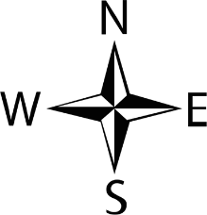
Fig. (1.1): Project location with the district [1]
5

Slide 6


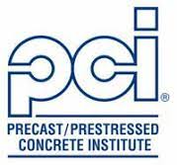
Project Objective
The geotechnical and structural design for a SEC substation.
Supplying Alkhawther district with the needed electricity.
Using reinforced concrete for the building elements.
Using precast concrete for some elements for comparative purposes.
6

Slide 7
Project Scope of Work
Main Building
M
Designing the main building in RCC which includes slabs, beams, columns, and footings. Then will compare the RCC design with a comparative design which precast slabs and columns
Foundation Selected in the Description Below
Designing foundation for the main building which will transfer the loads from the columns to the ground. Also, design foundation for the transformer machines which wights +100 tons/ transformer. Moreover, designing footing for AUX transformers and capacitors.
S
F
Precast Boundary Wall
Designing the reinforcement for the precast boundary wall.
P
Software Analysis
Using the advantage of the software availability which analyzing, modeling, and drawing. Ex. ETABS, Excel, AutoCAD, and etc.
Cost Estimation
Estimating the cost of this project which a hand calculation and compare it with a quotation from a specialized company.
C
7

Slide 8
Section
Break 2
RCC Design & Calculations
8

Slide 9
Minimum Slab Thickness:
Table 2.1: Summary of Minimum Slab Thickness of one-way slab
(table 9.5a and c in ACI -318-11)
We found the longest beam lengths for both end continues, one end continues, and cantilever. These lengths are; 4.96 m, 5.46 m, and 1.5 m, respectively.
Members | Simply supported | One end continuous | Both end continuous | Cantilever
Span length from AutoCAD (m) | - | 5.46 | 4.96 | 1.5
Solid one-way slab minimum values | L/20 | L/24 | L/28 | L/10
Minimum thickness of one-way slab (m) | - | 0.2275 | 0.177 | 0.15
Summary of Minimum Slab Thickness of two-way slab (table 9.5c in ACI-317-11)
From table 9.5c in ACI code book, we found minimum two-way slab thickness value for our situation is L/33. which it gives us 5.45/33= 0.165 m
9

Slide 10
Minimum Slab Thickness (Summary):
Table 2.2: Summary of Minimum Slab Thickness (table 9.5a and c in ACI -318-11)
Members | Minimum thickness required (mm) | Selected Thickness for each type (mm) | Selected Slab thickness for the whole slab (mm)
Solid one-way slab minimum thickness | 228 | 240 | 240
Solid two-way slab minimum thickness | 165 | 180
10

Slide 11
Dead loads per unit area:
Table 2.3: Dead Loads Per Unit Area
No. | Items | Density of load (kN/m³) |  | Thickness (mm) | Load per unit area (kN/m²) | Reference
1 | Slab | 23.5 |  | 240 | 5.64 | SEC specifications
2 | Sand | 0.015 per mm |  | 100 | 1.5 | SBC Table3.1
3 | Tile with mortar | - |  | 20+25 | 1.10 | SBC Table3.1
4 | Plaster | 20 |  | 12.5 | 0.25 | SBC Table3.1
Total DL |  |  |  |  | 8.5
Total thickness with finishes |  |  | 397.5
11

Slide 12
The minimum distributed Live Loads:
Table 2.4: Minimum Distributed Live Leads
No. | Floor | Floor Usage | Live Load (KN/m²)
1 | Ground Floor | Light Manufacturing Area (T4.1) | 5
2 | First Floor | Offices, machine equipment (T4.2) | 5
3 | Roof | Section (4.9 SBC) | 1
 | Total LL |  | 11
12

Slide 13
Floor Ultimate Loads:
Table 2.5: Floor Ultimate Loads
Floor | Dead Load (KN/m²) | Live Load (KN/m²) | Wu = 1.2DL+1.6LL (KN/m²)
Ground Floor | 8.5 | 5 | 18.2
First Floor | 8.5 | 5 | 18.2
Roof | 8.5 | 1 | 11.8
13

Slide 14

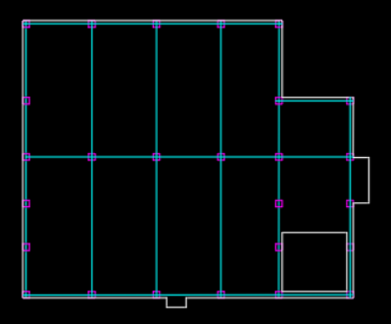
Beam Layout:
B2
B1
B1
B1
2.5 m
5 m
Fig (2.1) : Selected beams (Beam 1 and 2)
14

Slide 15
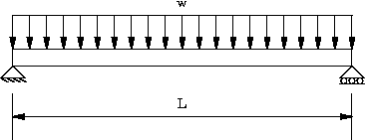
Beam 1 Design:
W = Wu * width = 18.2 x 5 = 91 KN/m
W = 91 KN/m
= 10.48 m
15

Slide 16
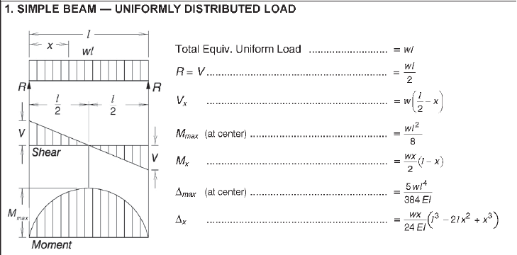
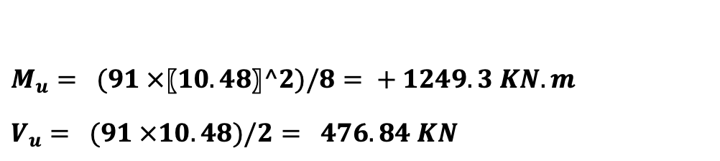
Beam 1 Design:
$M_{u}= (91 ×〖10.48〗^2)/8= + 1249.3 KN.m$
$V_{u}= (91 ×10.48)/2= 476.84 KN$
16

Slide 17
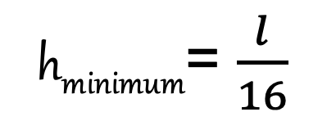
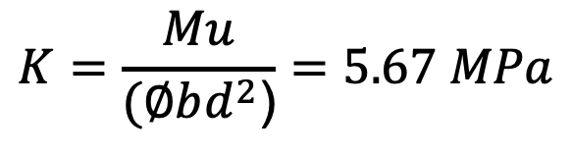
Beam 1 Design:
W = 91 KN/m
= 10.48 m
h_{minimum}= $\frac{l}{16}$
h = 750 mm
d = h – cover
d = 700 mm
$$K=\frac{Mu}{(∅bd^{2}\text{)}}=5.67 MPa$$
b = 500 mm
A_{st}
17

Slide 18
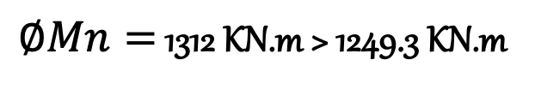
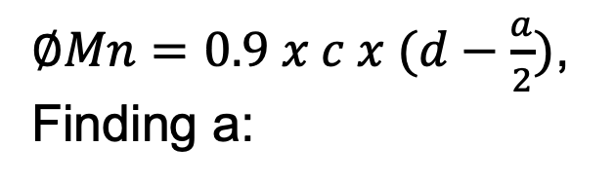



Beam 1 Design:
ρ_{max >} ρ = 0.0157> ρ_{min}
As = ρ x b x d = 5495 mm²
h = 750 mm
Use 4 # 43 bars
d = 700 mm
$∅Mn=0.9 x c x (d−\frac{a}{2})$,
Finding a:
b = 500 mm
4 # 43
$$c=t$$
$$0.85xfc x a x b=As x fy$$
$$a=205 mm$$
$∅Mn=$ 1312 KN.m > 1249.3 KN.m
Cover+Stirrup+dbar/2
25+10+43/2
=56.5mm
18

Slide 19
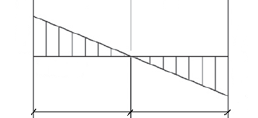
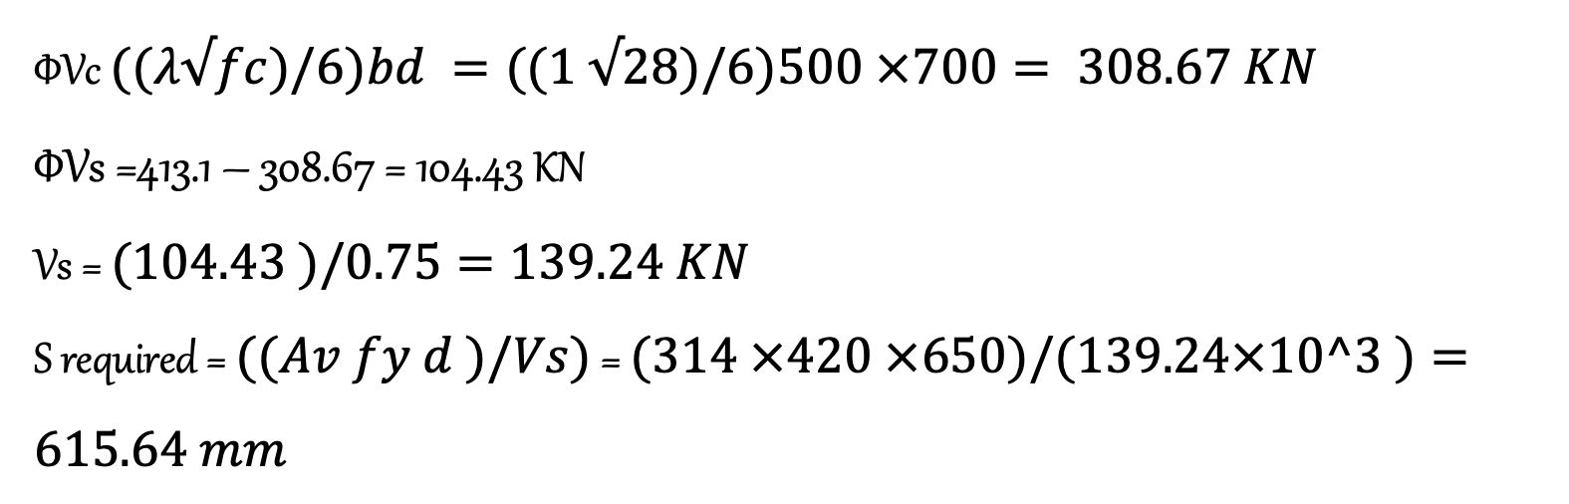
Beam 1 Design:
For Shear Design:
476.8 KN
Vu max
Vu = 476.8 KN , d = 700 mm
Vu max = 413.1 KN at distance d from the face of the support
Assuming double stirrup of ø 10 mm (4 legs) => Av = 314 mm²
d = 0.7 m
4.54 m
5.24 m
5.24 m
ΦVc $((λ√fc)/6)bd =((1 √28)/6)500 ×700= 308.67 KN$
ΦVs =413.1 – 308.67 = 104.43 KN
Vs = $(104.43 )/0.75=139.24 KN$
S required = $((Av fy d )/Vs)$ = $(314 ×420 ×650)/(139.24×10^3 )=615.64 mm$
19

Slide 20
Beam 1 Design:
h = 750 mm
For Stirrup Spacing:
b = 500 mm
4 # 43
d = 700 mm
1] S required = 615 mm
2] d/2 = 700/2 = 350 mm
Use stirrups spacing of @ 350 mm
# 10 @ 350 mm
Cover+Stirrup+dbar/2
25+10+43/2
=56.5mm
20

Slide 21
Beam Design Summary :
Table 2.6: RCC Beam Groups Table
SR No. | Type | b (m) | h (m) | Length (m) | Design moment Top (+) | Design moment Bottom (-) | Shear force
1 | Group 1 | 0.25 | 0.45 | 5.46001 | -1.8638 | 0.9319 | 6.0076
2 | Group 2 | 0.25 | 0.45 | 10.56016 | -0.7329 | 0.3664 | 6.0076
3 | Group 3 | 0.25 | 0.45 | 14.86016 | -2.0341 | 1.0171 | 6.0076
4 | Group 4 | 0.25 | 0.45 | 24.90001 | -0.66 | 0.6048 | 6.0076
5 | Group 5 | 0.5 | 0.75 | 20.76056 | -96.5851 | 5.7555 | 21.2576
6 | Group 6 | 0.5 | 0.75 | 10.56016 | -8.1032 | 44.294 | 21.2576
21

Slide 22
Column Layout:
C 2
5.1 m
5 m
C 1
10.35 m
5 m
2.5 m
5 m
Fig (2.2) : Selected Columns (Column 1 and 2)
22

Slide 23
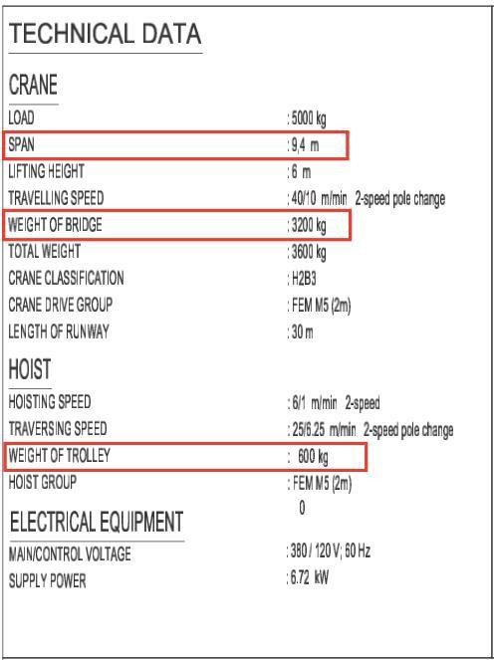
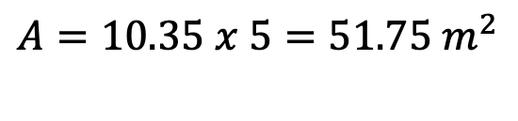

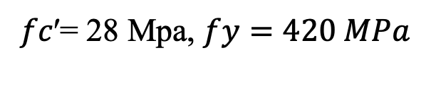



Column 1 Design:
Data Collected:
𝑓𝑐′= 28 Mpa, $fy=420 MPa$
$$A=10.35 x 5=51.75 m^{2}$$
$$Length=4.5 m$$
$$∅=0.65, r=0.8$$
$$Located in the groud floor of the building$$
$$A_{st}=0.02 A_{g}$$
$$Crane Weight=\left(3200+600\right) Kg=3.8 Ton=38 KN$$
$$Crane load=5 Ton=50KN$$
Fig (2.3) : Crane loads and details [2]
23

Slide 24
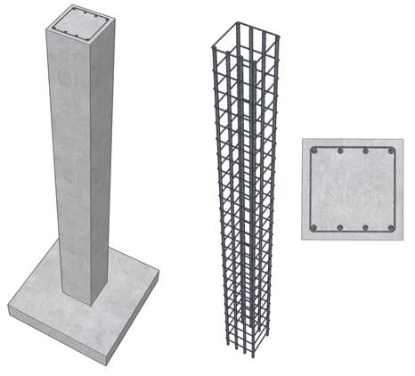




P_{u}
Column 1 Design:
Design Process:
$$P_{u}=∅ x r[0.85 fc^{′}\left(A_{g}−A_{st}\right)+fy A_{st}]$$
$$P_{u}=Wu x Area+Crane load=1662.5 KN$$
$$1662.5x{10}^{3}=0.65 x 0.8[0.85 x 28\left(A_{g}−0.02A_{g}\right)+420 x 0.02 A_{g}]$$
Solving for A_{g}:
$$A_{g}=100779 {mm}^{2}$$
Fig (2.4): Pu Acting on a Column [11]
$$a^{2}=100779⇒a=\sqrt{100779}=317.45 mm$$
$$Dimention Selected=350 x 350 mm$$
$$A_{g \left(new\right)}=122500 {mm}^{2}$$
24

Slide 25






Column 1 Design:
Design Process:
$$Use spacing ties @ 250mm$$
Solving for A_{st}:
$$1662.5x{10}^{3}=0.65 x 0.8[0.85 x 28\left(122500−A_{st}\right)+420 x A_{st}]$$
a = 350 mm
8 # 16
b = 350 mm
$$A_{st}=711 {mm}^{2}$$
$$For ties use \#10 mm$$
Spacing for ties:
# 10 @ 250 mm
$S≤16 d_{bar}=16 x 16=256 mm$
2. $S≤48 d_{tie}=48 x 10=480 mm$
$$3. Least dimention=350 mm$$
25

Slide 26
Column Design Summary:
Table 2.7: RCC Square Column Groups Table:
SR. No. | Type | a (m) | a (m)
1 | Group 1 | 0.25 | 0.25
2 | Group 2 | 0.35 | 0.35
3 | Group 3 | 0.5 | 0.5
26

Slide 27
Section Break 3
Precast Concrete Design
27

Slide 28
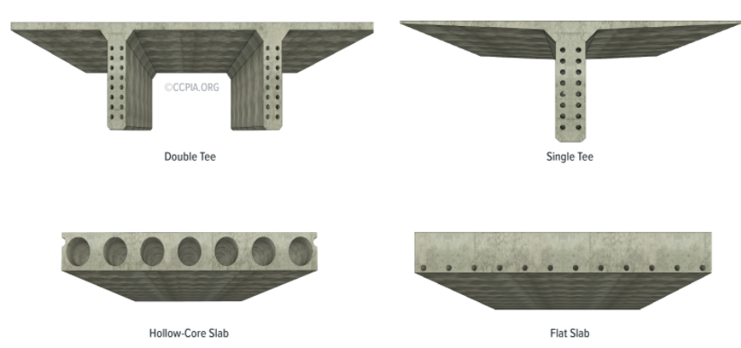
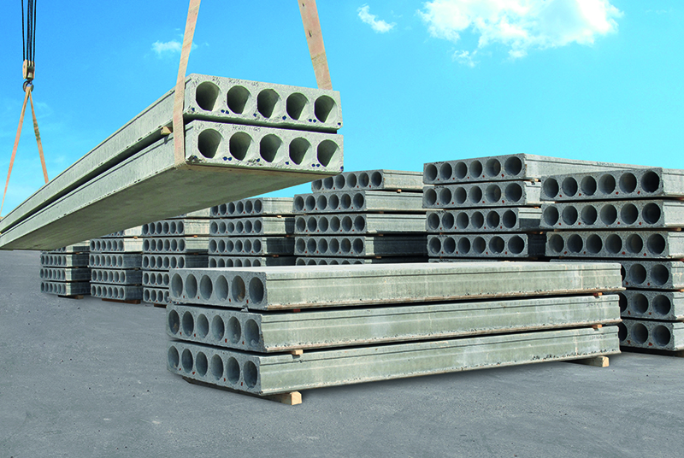
Precast Concrete Design:
According to PCI code (section 2.2.2), typical span-to-depth ratios of flexural precast, prestressed concrete members are:
Type | Ratio | Result
Hollow-core floor slabs | 30 to 40 | Depth = 5.46/30 = 18.2 cm → use 20 cm
Hollow-core roof slabs | 40 to 50 | Depth = 5.46/40 = 13.65 cm → use 15 cm
Converted live load table to psf and ft.
Floor | Live Load (KN/m²) | Live Loads (psf) | Span length (m) | Span length (ft)
Ground Floor | 5 | 104.4 | 5.46 | 18
First Floor | 5 | 104.4 | 5.46 | 18
Roof | 1 | 20.88 | 5.46 | 18
Fig (3.1) : Hollow-core slabs example [13]
28

Slide 29
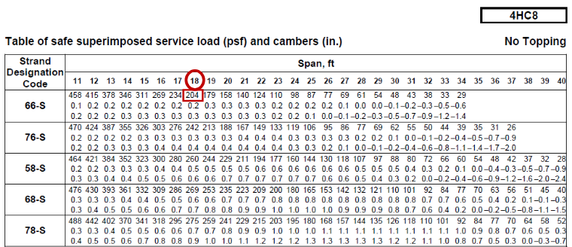
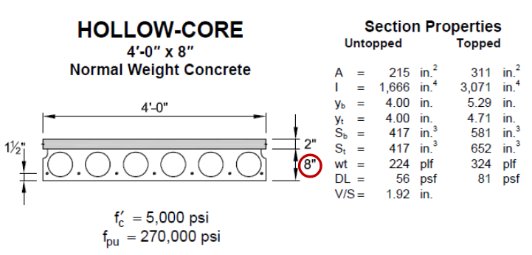
Precast Concrete Design:
Slab for first and second floor
Use 4’ x 8” Hollow Core 66-S
Table (3.1) : Table of safe superimposed service load and cambers [14]
(Section capacity 204 psf > 104.4 psf → OK)
29

Slide 30
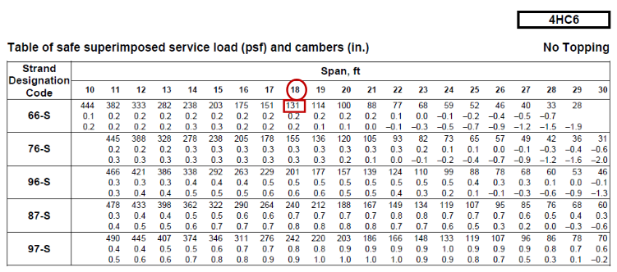
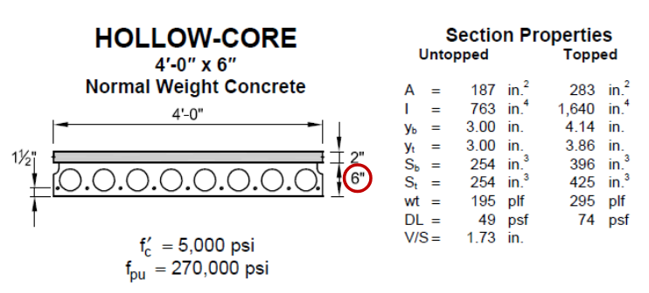
Precast Concrete Design:
Slab for roof floor
Table (3.2) : Table of safe superimposed service load and cambers [14]
Use 4’ x 6” Hollow Core 66-S
(Section capacity 131 psf > 20.88 psf → OK)
30

Slide 31
Precast Concrete Design:
5.3 m
B2
Beam Designs:
B1
10.48 m
Fig (3.2) : Selected beams grapgh
Beam No. | Ratio | Result | Selected section from PCI | Beam reinforcement from total service load
B1 | 10-20 | 40 in | 16x40 in | =796 p/ft gives 12RB16 88-S
B2 | 10-20 | 24 in | 16x24 in | =485 p/ft gives 12RB16 58-S
31

Slide 32
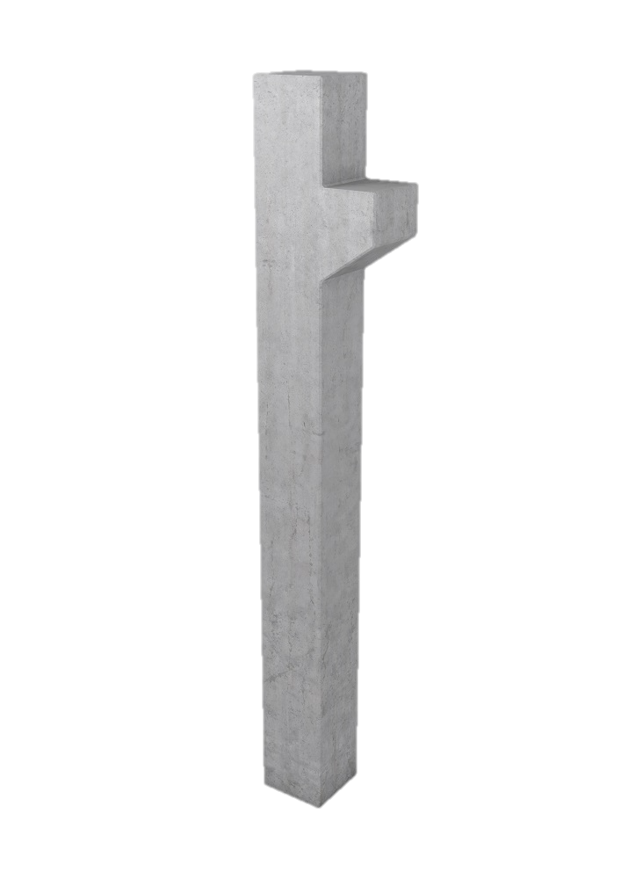
Precast Concrete Design:
Column Designs:
Column No. | Area (m²) | Pu (kips) | Mmax Kip.ft | From curve grapg in PCI
C1 | 51.75 | 373.73 | 810.7 | 24x24 in with steel 12#11
C2 | 25.5 | 94 | 810.7 | 24x24 in with steel 12#11
C3 | 51.75 | 349 | - | 16x16 in with steel 4#8
Column Group | Column width (in) | Column Length (in) | Steel Reinforcement
Group 1 | 24 | 24 | 12 # 11
Group 2 | 16 | 16 | 4 # 8
Fig (3.3) : Precast column example [13]
32

Slide 33
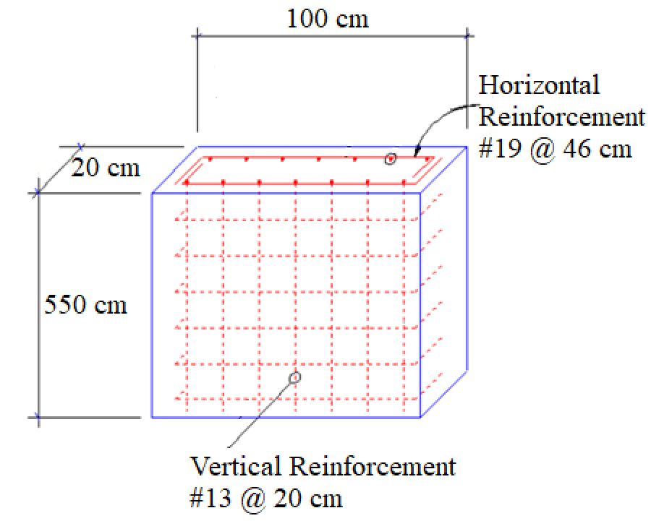
Precast Concrete Design:
Boundary wall Design:
Minimum vertical steel ratio as per ACI Code 11.9.9.4:
ρ_{l} (min) = 0.0025
Horizontal reinforcement:
As (min) = ρ_{l} x h_{w} x h = 0.0025∗5500∗200 = 2750 mm²
Select 10 # 19 with a spacing of S = 5500 / 10 = 550 mm = 55 cm
Check ACI limits of Spacing is the lowest of :
≤ h_{w}/5 = 550/5 = 55 cm
≤ 3h = 3 (20) = 60 cm
≤ 46 cm
Use #19 @ 46 cm
Boundary wall design of 1 meter width
33

Slide 34
Precast Concrete Design:
Boundary wall Design:
Minimum vertical steel ratio as per ACI Code 11.9.9.4:
ρ_{l} (min) = 0.0025
Vertical reinforcement:
As (min) = 0.0025∗1000∗200 = 500 mm².
Select 5 # 13 with a spacing of S = 1000 / 5 = 200 mm = 20 cm
Check ACI limits of Spacing is the lowest of :
≤ h_{w}/5 = 100/5 = 20 cm
≤ 3h = 3 (20) = 60 cm
≤ 46 cm
Use #13 @ 20 cm
Boundary wall design of 1 meter width
34

Slide 35
RCC vs. Precast
Parameter | RCC | Precast
Casting | In situ during construction process | Casted earlier and ready to be used directly.
Time of construction | Slower as we need to wait till the concrete hardened | Faster as the elements are ready to install
Transportation | No need as they casted in the site | Need to be transported from the casted place to the site
Section dimensions | Thicker and heavier | Thinner and lighter
Self-weight | More self-weight due to thick sections | Less self-weight of the structure
Cost of material used | Lower cost | Higher cost, (high tensile steel is about three times costlier than mild steel).
Special Equipment | Doesn’t required special equipment | requires specialized tensioning equipment and devices which are very costly
Behavior of failure | More ductile | More brittle because of use of high-tension steel.
Environment effects | Depending on weather conditions , such as, raining, or hot weather conditions. | Dose not depend on weather conditions , such as, raining, or hot weather conditions.
Overall price | Cheaper | Costlier
35

Slide 36
Section Break 4
Floor layout, 3D model, and ETABS
36

Slide 37
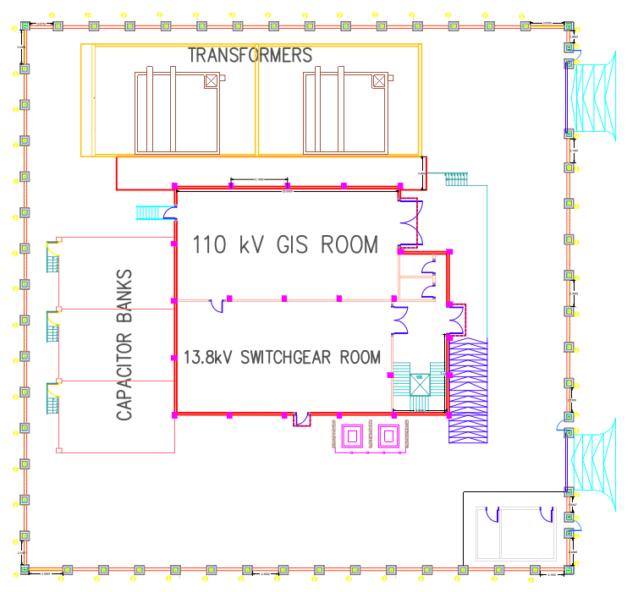
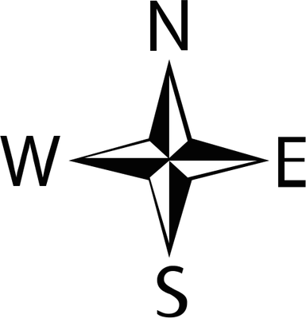
Floor layout:
Total area = 2500 m²
Main building area = 485 m²
Figure (4.1) AutoCAD Model
37

Slide 38
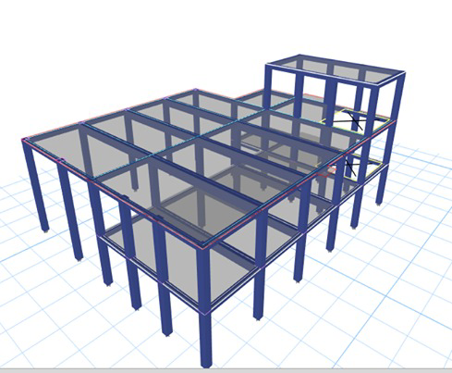
3D layout:
Figure (4.2) ETABS 3D Model
38

Slide 39
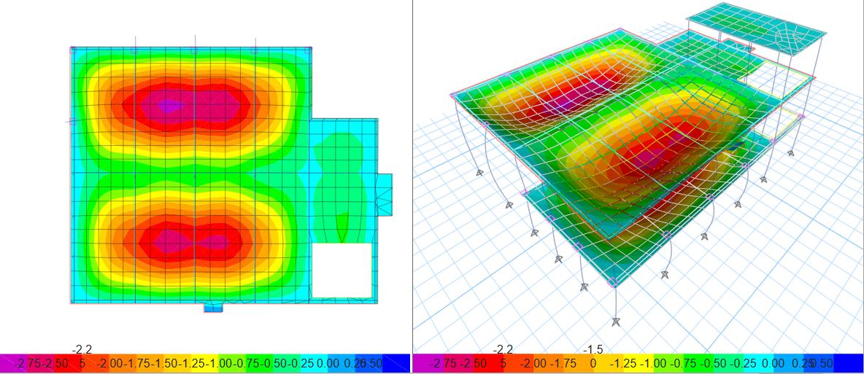
ETABS Deflection:
Allowable = 25 mm
Max deflection
= 2.75 mm
Figure (4.3) ETABS Deflection Model
39

Slide 40
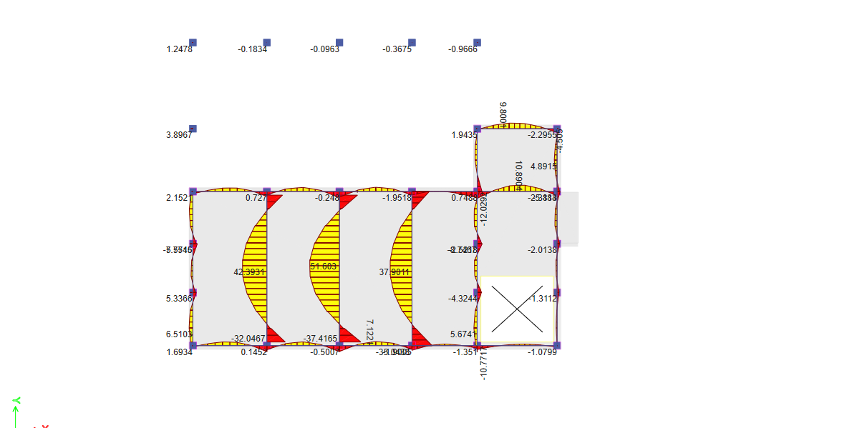
ETABS Bending Moments:
Figure (4.4) First Floor Bending Moment Diagram
40

Slide 41
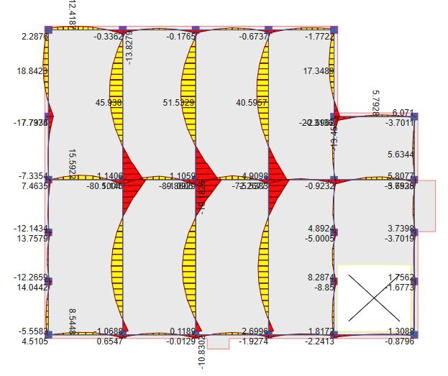
ETABS Bending Moments:
Figure (4.5) Second Floor Bending Moment Diagram
41

Slide 42
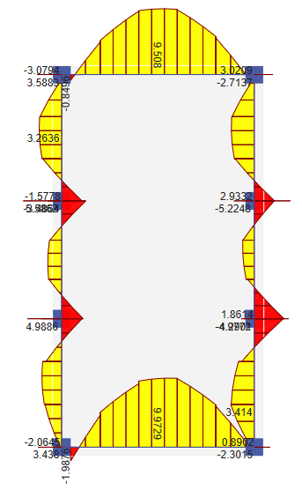
ETABS Bending Moments:
Figure (4.6) Third Floor Bending Moment Diagram
42

Slide 43
Section
Break 5
Soil Profile & Chemical Analysis
43

Slide 44
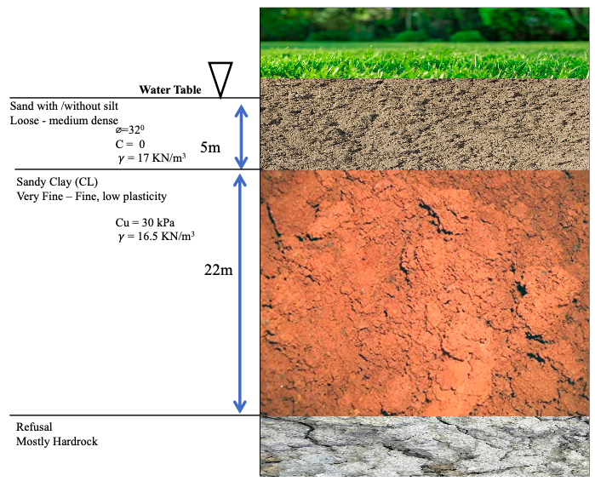
Soil Profile:
The water table (ground water) is found at the average depth of 1m below existing ground surface.
The top layer is Sand with traces of Silt of, loose to medium in density having a thickness of 5m.
22 m of low plasticity, Very Fine to Fine Sandy clay.
A bottom layer which refused penetration, assumed to be of hard bedrock in composition.
44
Fig (5.1): Soil Profile of the project site

Slide 45

Chemical Analysis of soil composition:
Sample No. | Depth (m) | Chlorides % | Sulphate %
1 | 1 | 0.318 | 0.391
2 | 1 | 0.321 | 0.400
3 | 3 | 0.088 | 0.375
0.2
0.3
Average
Max permissible value > value> 0.05 %
Max permissible 0.3 %
45

Slide 46
Section
Break 6
Geotechnical Design
46

Slide 47

Soil Analysis:
As the soil profile was provided in the project report on chapter two section three, we can consider the depth of foundation is 3 meters below the surface, which gives soil bearing capacity that taken from the soil report is equals to 200 kN/m² (20 ton/m²).
Figure (6.1) Soil Profile
47

Slide 48
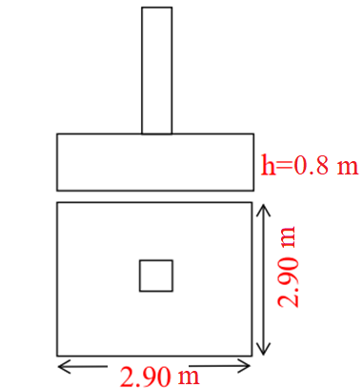
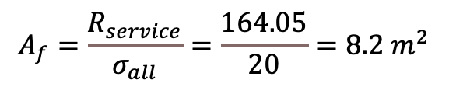

Footing Design Manual Calculation :
For our manual calculation we take the critical one which is C14:
$$A_{f}=\frac{R_{service}}{σ_{all}}=\frac{164.05}{20}=8.2 m^{2}$$
$⇒B=\sqrt{8.2}=2.9$ m
So, use 2.9x2.9 m
Assume h= 0.8 m
As a result, the dimensions will be as in figure 4.2.
Figure (6.2) Footing Dimensions
48

Slide 49
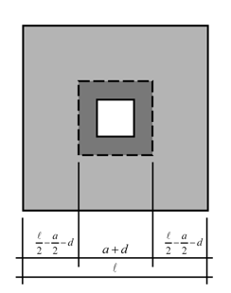


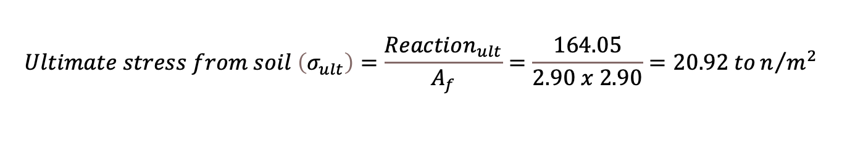

Footing Design Manual Calculation :
Checking footing thickness based on two-way shear:
$$Vu_{punching}=Reaction−\left(Punched area under column× ultimate stress from soil\right)$$
$$Reaction=164.05$$
$$Ultimate stress from soil \left(σ_{ult}\right)=\frac{Reaction_{ult}}{A_{f}}=\frac{164.05}{2.90 x 2.90}=20.92 ton/{m^{2}}$$
$$∅{V_{c}}_{punching}=Vu_{punching}$$
$$0.75\left(\frac{1}{3}\right)\sqrt{28} \left(0.8 π d\right)\left(1000\right)=164.05−\left(\frac{π}{4}{\left(0.50+\frac{d}{2}\right)}^{2}× 20.92 \right)$$
$$d=0.68 m$$
Figure (6.3) Two-way shear on footings (15)
$$h=d+cover=0.68+0.06=0.74 m≈0.8 m$$
49

Slide 50
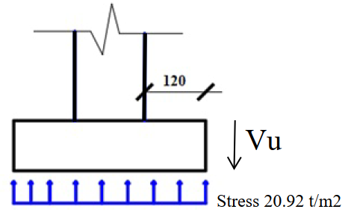
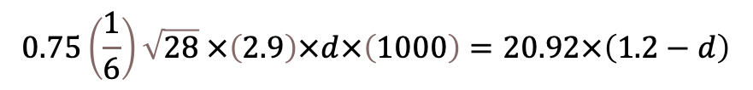


Footing Design Manual Calculation :
Checking footing thickness based on one-way shear:
$$The footing can view as a cantilever of length= \frac{2.9−0.5}{2}=1.2 m$$
This cantilever is subjected to ultimate soil stress under the footing ($σ_{ult}=20.92 ton/m^{2}$).
$$∅V_{c}={V_{u}}_{wide−beam shear}$$
$$0.75\left(\frac{1}{6}\right)\sqrt{28} ×\left(2.9\right)×d×\left(1000\right)=20.92×\left(1.2−d\right)$$
$$d=0.67 m$$
$$h=d+cover=0.67+0.06=0.73 m<0.80 m →OK$$
Figure (6.4) Foundation Dimension Details
50

Slide 51
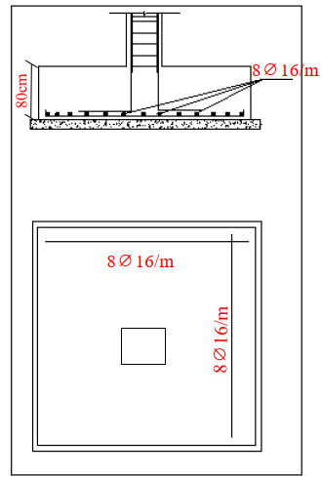

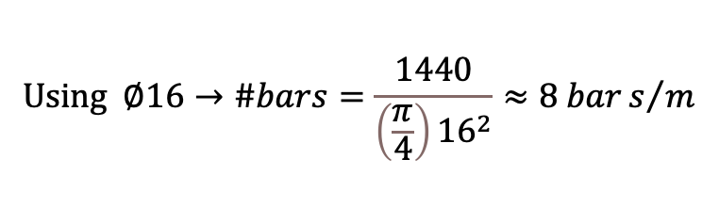

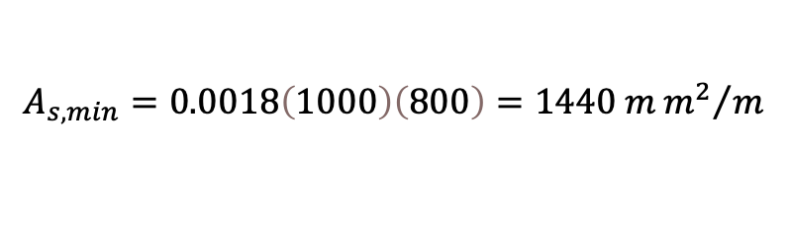
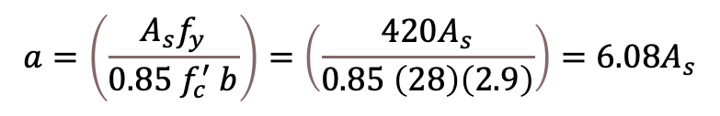

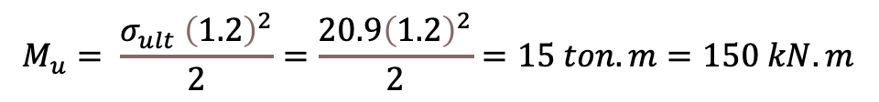
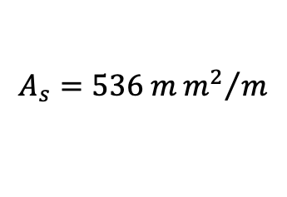


Footing Design Manual Calculation :
Calculating Area of Reinforcement:
$$M_{u}= \frac{σ_{ult} {\left(1.2\right)}^{2}}{2}=\frac{20.9{\left(1.2\right)}^{2}}{2}=15 ton.m=150 kN.m$$
$$a=\left(\frac{A_{s}f_{y}}{0.85 f_{c}^{′} b}\right)=\left(\frac{420A_{s}}{0.85 \left(28\right)\left(2.9\right)}\right)=6.08A_{s}$$
To find $A_{S}$:
$∅ M_{n}=M_{u}$ $→$
$0.9\left(420\right)\left(A_{s}\right)\left(0.74−\frac{6.08 A_{s}}{2}\right)\left(1000\right)=150$ $→$
$$A_{s}=536 m{m^{2}}/m$$
Checking for $A_{s \text{minimum}}=A_{s}(shrinkage)$:
$$A_{s, min}=0.0018\left(1000\right)\left(800\right)=1440 m{m^{2}}/m$$
$$Using ∅16→\#bars=\frac{1440}{\left(\frac{π}{4}\right){16}^{2}}≈8 bars/m$$
Figure (6.5) Footing reinforcement Details
Use $8∅16/m$ in two directions.
51

Slide 52
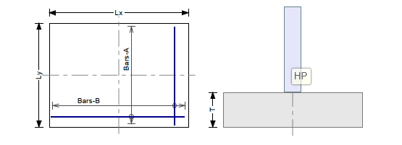
Footing Design Summary:
(Main Building)
Figure (6.6) Foundation Reinforcement Details
SR. No. | Type | Lx (m) | Ly (m) | T (cm) | Rebars A | Rebars B
1 | F 1 | 1.2 | 1.2 | 50 | 10⦰12mm | 10⦰12mm
2 | F 2 | 1.6 | 1.6 | 50 | 14⦰12mm | 14⦰12mm
3 | F 3 | 2.0 | 2.0 | 50 | 18⦰12mm | 18⦰12mm
4 | F 4 | 2.3 | 2.3 | 80 | 18⦰16mm | 18⦰16mm
5 | F 5 | 2.9 | 2.9 | 80 | 22⦰16mm | 22⦰16mm
Table (4.1) Footing table
52

Slide 53
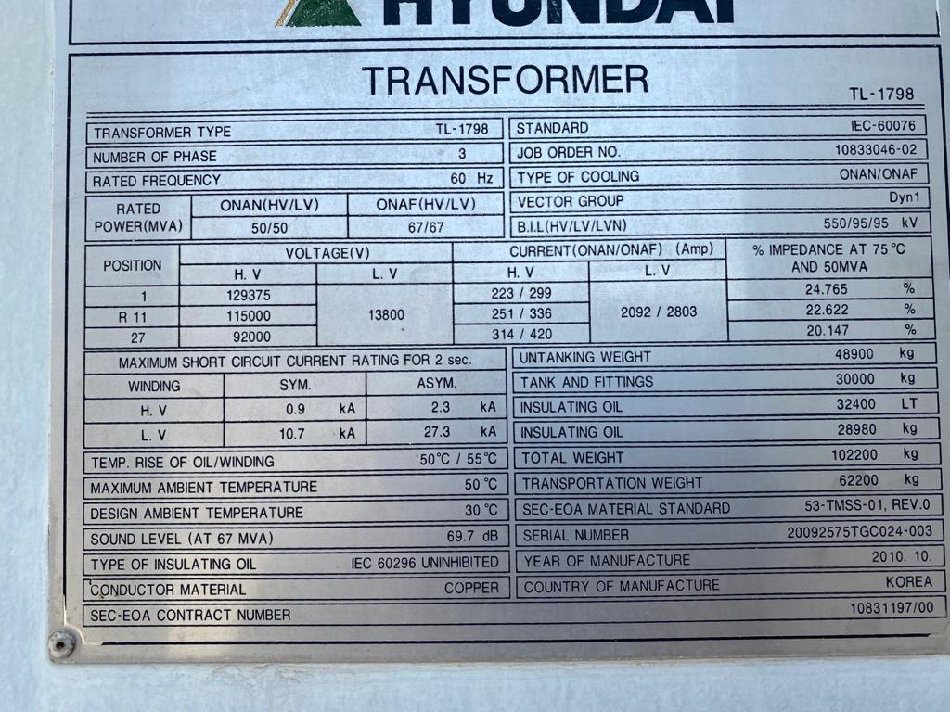
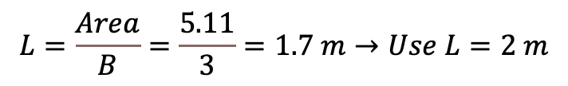

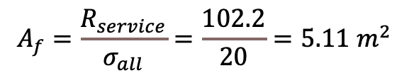
Machine Footing Designs:
Transformer footing hand calculations:
$$A_{f}=\frac{R_{service}}{σ_{all}}=\frac{102.2}{20}=5.11 m^{2}$$
$$⇒B=\sqrt{5.11}=2.26 m$$
Use the footing width of 3 meters (B = 3)
$$L=\frac{Area}{B}=\frac{5.11}{3}=1.7 m→Use L=2 m$$
The Footing dimensions are 3 x 2 meters.
Assume h = 50 cm
Figure (6.7) Transformer Information[from our SEC visit]
53

Slide 54



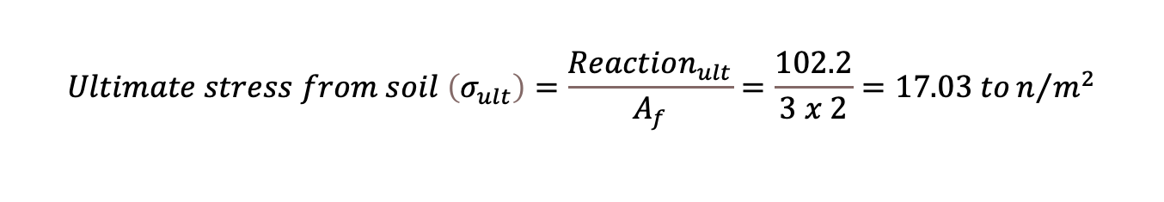
Machine Footing Designs:
Checking footing thickness based in punching shear
$$Vu_{punching}=Reaction−\left(Punched area under transformer× ultimate stress from soil\right)$$
$$Reaction=102.2 ton$$
$$Ultimate stress from soil \left(σ_{ult}\right)=\frac{Reaction_{ult}}{A_{f}}=\frac{102.2}{3 x 2}=17.03 ton/{m^{2}}$$
$$∅{V_{c}}_{punching}=Vu_{punching}$$
$$0.75\left(\frac{1}{3}\right)\sqrt{28} \left(0.8 π d\right)\left(1000\right)=102.2−\left(\frac{π}{4}{\left(1+\frac{d}{2}\right)}^{2}× 17.03\right)$$
$$Find d=0.267 m$$
$$h=0.267+cover=0.267+0.06=0.327m<0.5 m→OK$$
54

Slide 55
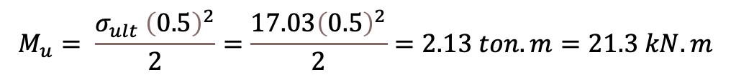












Machine Footing Designs:
3 m
Transformer
1.5 m
2 m
Electrical trench
2 m
1 m
Checking footing thickness based in wide-beam shear
Transformer
0.5 m
Footing
0.5 m
$$∅V_{c}={V_{u}}_{wide−beam shear}$$
Concrete protection layer
0.1 m
$$0.75\left(\frac{1}{6}\right)\sqrt{28} \left(2\right)d\left(10\right)=17.03\left(0.5−d\right)$$
Cross section
Plan
Figure (6.8) Transformer footing details
$$d=0.28 m$$
$$∅ M_{n}=M_{u}$$
To find $A_{S}$:
$$h=0.28+cover=0.28+0.06=0.34 m <0.5 m→OK$$
$$0.9\left(420\right)\left(A_{s}\right)\left(0.44−\frac{8.82 A_{s}}{2}\right)\left(1000\right)=21.3$$
Area of reinforcement calculation:
$$M_{u}= \frac{σ_{ult} {\left(0.5\right)}^{2}}{2}=\frac{17.03{\left(0.5\right)}^{2}}{2}=2.13 ton.m=21.3 kN.m$$
$$A_{s}=128.23 m{m^{2}}/m$$
Checking for $A_{s \text{minimum}}=A_{s}(shrinkage)$:
$$a=\left(\frac{A_{s}f_{y}}{0.85 f_{c}^{′} b}\right)=\left(\frac{420A_{s}}{0.85 \left(28\right)\left(2\right)}\right)=8.82A_{s}$$
$$A_{s, min}=0.0018\left(1000\right)\left(500\right)=900 m{m^{2}}/m$$
$$d=500−cover=500−60=440 mm=0.44 m$$
$$Using ∅12→\#bars=\frac{900}{\left(\frac{π}{4}\right){12}^{2}}=7.96≈ 8 bars/m$$
$$∅ M_{n}=∅ ×N_{T}×d=∅ ×{A_{s }×f}_{y}×\left(d−\frac{a}{2}\right)=0.9×\left(420\right)\left(A_{s}\right)\left(0.44−\frac{8.82 A_{s}}{2}\right)$$
55

Slide 56



Machine Footing Design (Summary):
Machine Footing Types
SR. No. | Type | Lx (m) | Ly (m) | T (cm) | Rebars A | Rebars B
1 | F 1 | 2.0 | 3.0 | 50 | 8⦰16mm | 8⦰16mm
2 | F 2 | 1.0 | 1.0 | 50 | 8⦰12mm | 8⦰12mm
3 | F 3 | 0.5 | 0.5 | 30 | 3⦰12mm | 3⦰12mm
Figure (6.8) Equipment [from our SEC visit]
56

Slide 57







Bearing Capacity Check:
C = 0 kPa
$γ=$ 17 kN/$m^{2}$
$q=$ $γ xD_{f}$ =
17 x 3= 51 kN/ $m^{2}$
B = 2.9 m
$$qu=1.3CN_{C}+qN_{q}+0.4 Bγ{ N}_{γ}$$
$$q_{u}=1984.4 kN/{m^{2}}$$
$$Allowable bearing capacity = q_{all}= \frac{q_{u}}{FS}= \frac{1984.4}{3}=661.47 kN/{m^{2}}$$
Critical column service load = 1640.5 kN
$N_{C}$ $=$ 44.04
$$N_{q}=28.52$$
$N_{γ}$ $=$ 26.87
$$q_{u}=\frac{Q_{u}}{Area}=195 kN/{m^{2}} < 661.47 kN/{m^{2}} → OK$$
57

Slide 58
Section
Break 7
Cost Estimation
58

Slide 59
Estimated RCC Cost:
Total hand calculations for RCC
No. | Material | Volume | Unit Price | Cost (SAR)
1 | Concrete works | 743.041(m3) | 190 SAR/m3 | 141170
2 | Steel works | 115029.99(kg) | 3000 (SAR/ton) | 345089.97
3 | Manpower | 743.041(m3) | 85 SAR | 63158.485
Total structural cost |  |  |  | 652105.453
59

Slide 60
Estimated Precast Cost:
Total hand calculations for Precast
Element | Volume | Unit price | Total Price
Slabs | 600 m² | 800 | 480000
Columns | 241.515 m³ | 400 | 96606
Footings | 77.576 m³ | 400 | 31030.4
Boundary wall | 242 m² | 400 | 96800
Total price for precast works SAR | 704436.4
60

Slide 61
RCC cost vs. Precast cost:
Cost Comparison Between Manual Calculations and ALMARSHAD Co.
Comparison | Manual calculations price SAR | ALMARSHAD Co. price SAR
Cast in situ | 652105.453 | 476700
Precast | 704436.4 | 684650
61

Slide 62
Section Break 8
Constraints and Project Complexity
62

Slide 63
Design Safety:
Saudi Building Code (SBC)
American Concrete Institute (ACI-318)
Structural Design:
Precast Design
Heavy Loads Equipment
Geotechnical:
Soil Type: clay with low plasticity ( problematic soil)
Water Table (High)
Material :
High sulphate
High Chloride
Constraints
Deter pollution of land
Water waste
contaminated soil
Environmental:
Being on the assigned budget
Being economical
Cost:
63

Slide 64
Project Complexity:
The project is a comprehensive analysis and design of several parts including “Main building, Machine footing, Boundary wall”, not only one structure system.
The Main building has a moving crane carried by half of the area in the ground floor columns, which is a new idea of load distribution and analysis in the building.
The project consists of RCC design and Precast design, and the study of PCI code and the way of manual design of precast element itself is a challenge for us.
Software analysis using different programs including ETABS for structural elements, Excel for quantity and cost estimation.
For cost estimation, we went to several companies to get a real and professional cost estimation. so, we got verified quotations for both cost estimations for RCC and PCI constructions.
64

Slide 65

https://youtu.be/OB8nTrkMPlw
Presentation Video
65

Slide 66


66

Slide 67
References:
[1] Google earth website. (2021). Project location with the district.
[2] National Grid Saudi Arabia. (2013). Al-Hawaiyah 110/13.8 kV Substation.
[3] Zdenek P. Bažant, Qiang Yu, Walter Gerstle, James Hanson, and J. Woody Ju (2007). Justification of ACI 446 Proposal for Updating ACI Code Provisions for Shear Design of Reinforced Concrete Beams. ACI Structural Journal, 104.
[4] Bhatt, P., Choo, B. and MacGinley, T. (2014). Reinforced concrete design to Eurocodes.
[5] Committee ACI (2019). 318-19 Building Code Requirements for Structural Concrete and Commentary. 318-19 Build Code Requir Struct Comment. https://doi.org/10.14359/51716937.
[6] Darwin, D., Dolan, C. and Nilson, A. (2016). Design of concrete structures.
[7] National Committee. (2017). Saudi Building Code, Loads and Forces Requirements – 301.
67

Slide 68
References:
[8] Robert O. Disque. (2017).Steel construction manual fourteenth edition American institute of steel construction.
[9] Housing and Building Research Institute (Dhaka, Bangladesh); Bangladesh Standards and Testing Institution. (2011). Bangladesh National Building Code. Detailing of Reinforcment in Concrete Structures, Part 6: Structural Design, Chapter 8.
[10] Ahmed, D. (2020). Reinforced Concrete Design. Course material and lecture notes, Prince Mohammad bin Fahd University.
[11] https://structurepoint.org/pdfs/Interaction-Diagram-Tied-Reinforced-Concrete-Column-Symmetrical-CSA-23.3-94.htm
[12] https://youtu.be/OB8nTrkMPlw
[13] Google images (2021)
[14] Wilden, Helmuth. PCI Design Handbook: Precast and Prestressed Concrete. Chicago: Precast/Prestressed Concrete Institute, 2010.
[15] Jack McCormac and Russell Brown, “Design of Reinforced Concrete, 10th Edition”. Applying ACI Code Specificati
[16] https://nitterhouseconcrete.com/precast-concrete-vs-site-cast-concrete/
68

