Slide 1




ASSE 4311: Learning Outcome Assessment III Final Presentation
Structural & Geotechnical Design of a Multistory Building using RCC & CLT
Submitted By Group 5
Mohammed Abdi 201503119
Ali Al Khatim 201200808
Nasser Banihameem 201201710
Ahmed El- Ghoneimy 201601198
Coordinator’s name
Examiner's name
Dr. Andi Asiz
Dr. Mohammad Khasawneh
Supervisor’s name
Examiner's name
Engr. Danish Ahmed
Dr. Tahar Ayadat

Slide 2

OUTLINES
GEOTECHNICAL DESIGN
OBJECTIVES
PROJECT CONSTRAINTS
PROJECT DESCRIPTION
STRUCTRAL DESIGN
COMPARISON BETWEEN RCC &CLT
METHODOLOGY
PROJECT SUMMARY

Slide 3
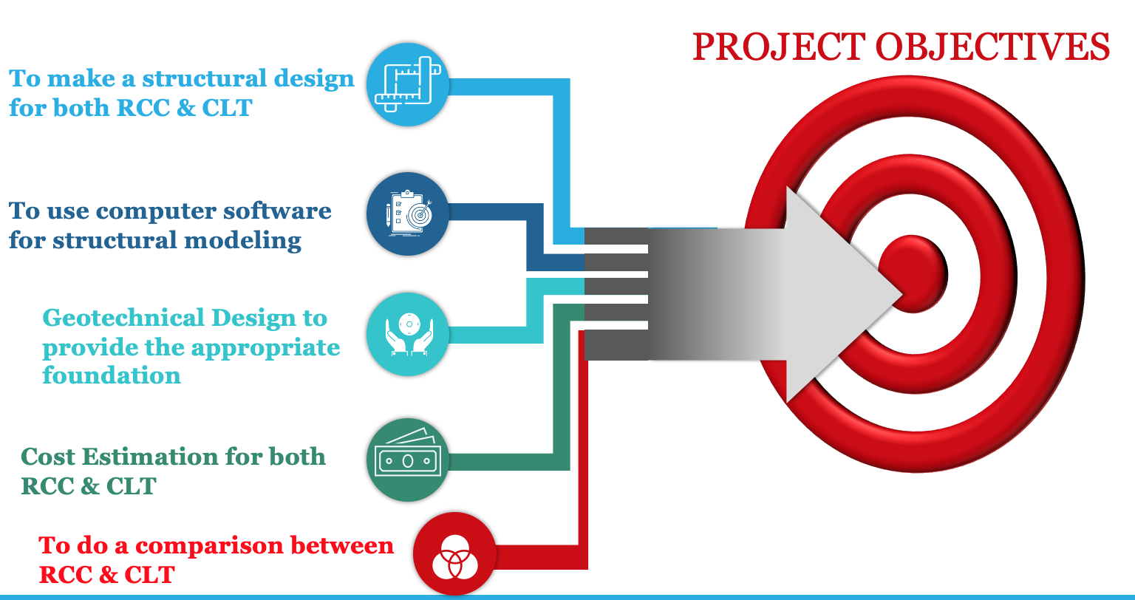
3

Slide 4

Project Location
The location of the building is on Al Aziziyah, Khobar, Saudi Arabia
(Google Map 2021) [1]

Slide 5
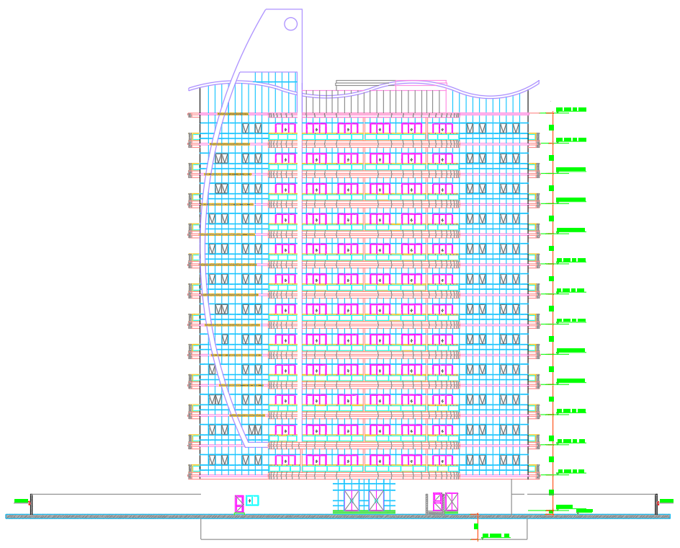
Project Description
Purpose:
Residential & Commercial building
Number of Storeys:
13 Floor
Area of the Building:
1330 m²
Height of Building:
48 m
Height of floor:
Parking 3.5 m
Ground floor 4.25 m
Each floor 3.60 m
Elevation View of the project [4]

Slide 6
Floor Planning & Utilization
Table (1):Floor Plan
Structure | Function
Two Basement Floor | Parking
Ground Floor | Health Club
First Floor | Commercial
Second Story to the Roof | Residential

Slide 7
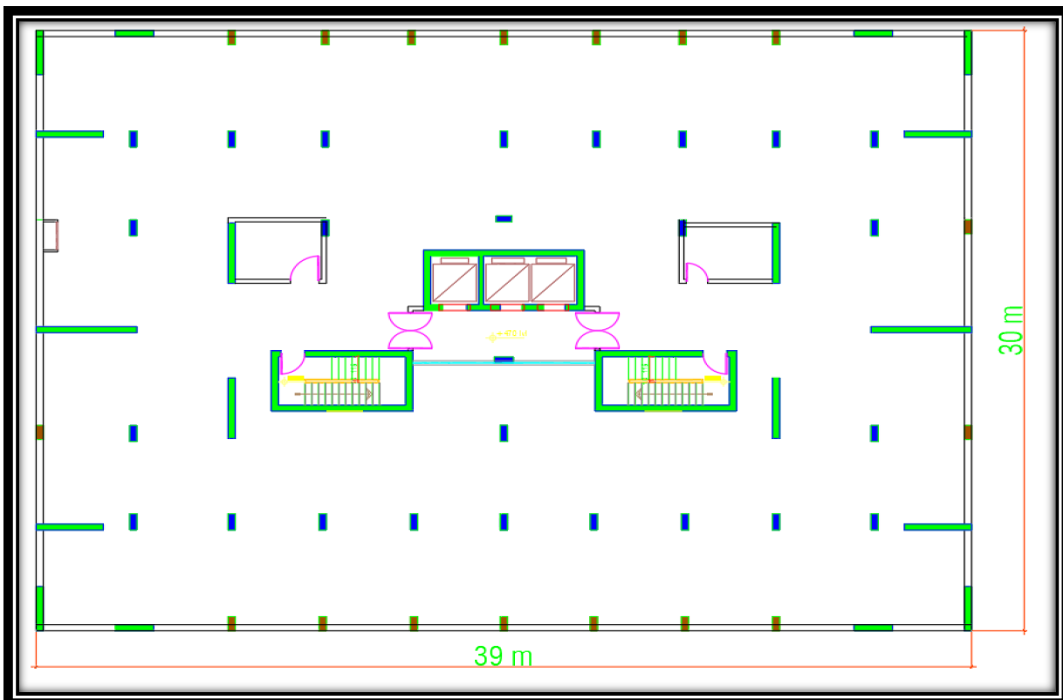
Original Layout
Original layout (MDCEO, 2021) [4]

Slide 8
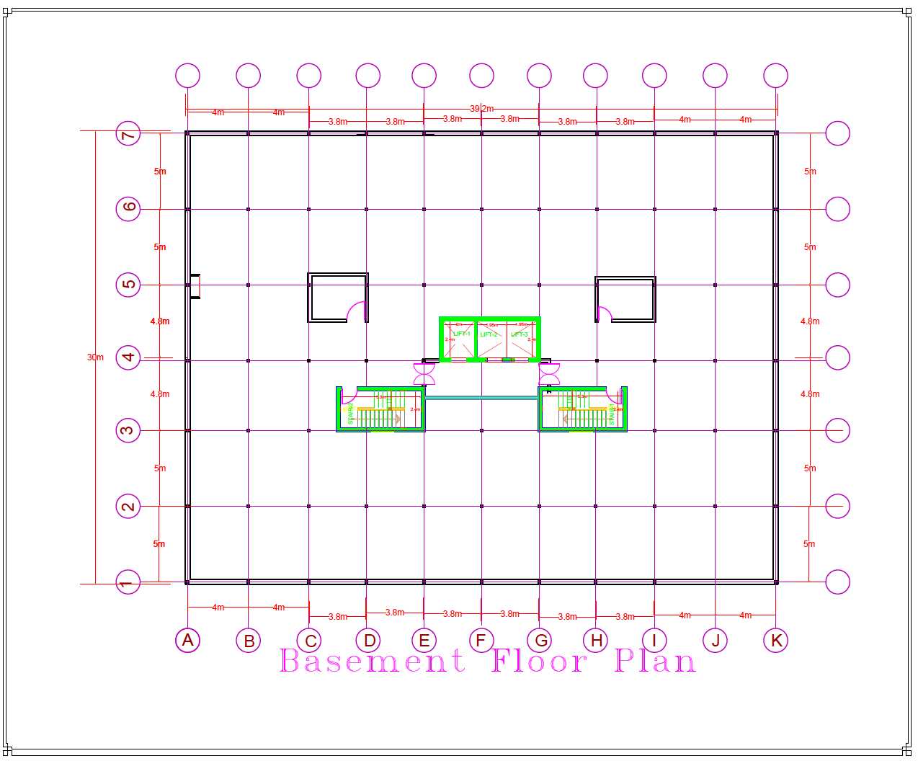
Modified Layout
Basement layout of the project [4]

Slide 9
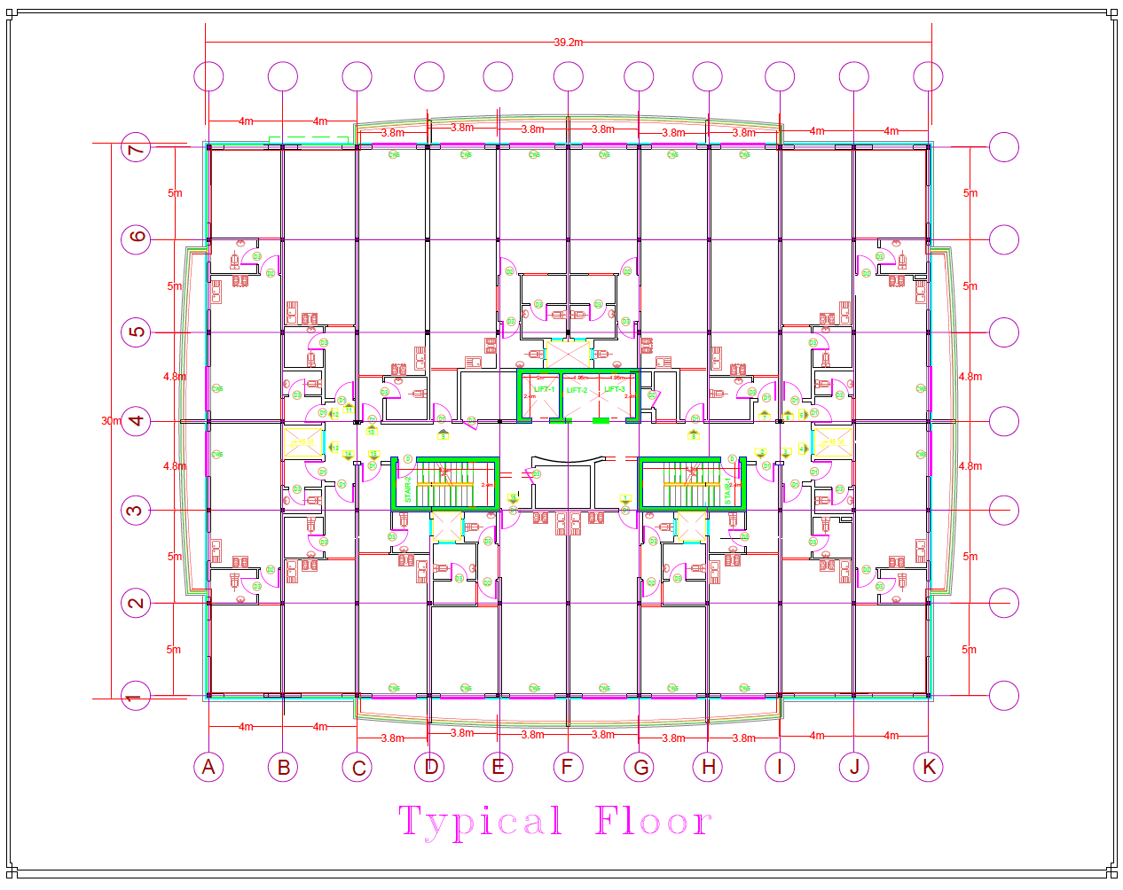
Replicated Floor Layout
Layout of the replicated floors of the project [4]

Slide 10
Structural Design
Structural Loads
1
Methodology
2
3
Concrete Structural
Element Design
4
CLT Structural
Element Design
5
ETABS Modeling

Slide 11




Methodology
Constraints
Layout Drawing
ETABS
Methodology
Saudi Building Code
Structural Elements
Loads &load combinations
11

Slide 12
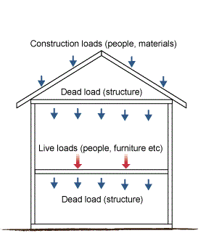
Loads acting on the Structure
Types of Loads acting on the Structure:
1- Dead loads
2- Live loads
3-Wind loads (x,y)
4- Earthquake (x,y)
5-Load combinations
Load Directions [8]

Slide 13
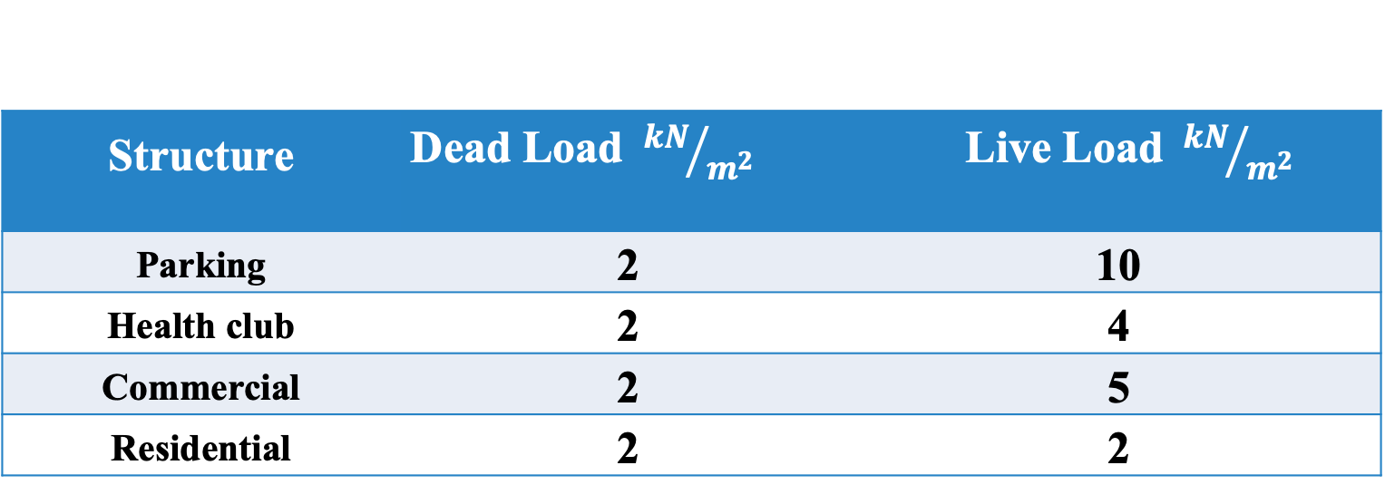
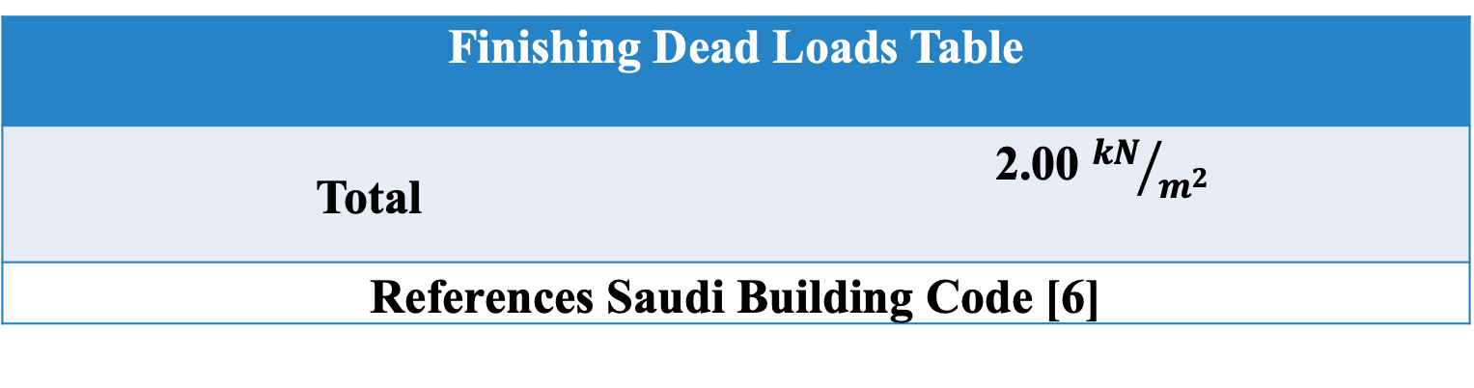
Live Loads & Dead Loads acting on the structure
Table (2): Dead Loads & Live Loads
Structure | Dead Load${kN}/{m^{2}}$ | Live Load${kN}/{m^{2}}$
Parking | 2 | 10
Health club | 2 | 4
Commercial | 2 | 5
Residential | 2 | 2
Finishing Dead Loads Table | Load${kN}/{m^{2}}$
Total | 2.00 ${kN}/{m^{2}}$
References Saudi Building Code [6]

Slide 14
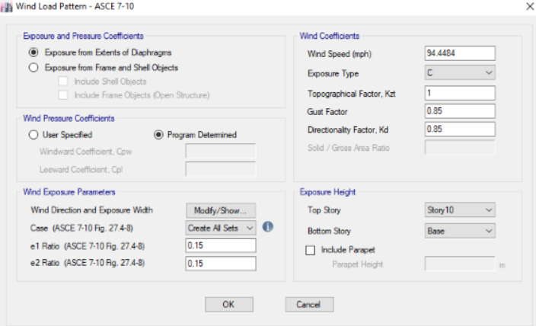
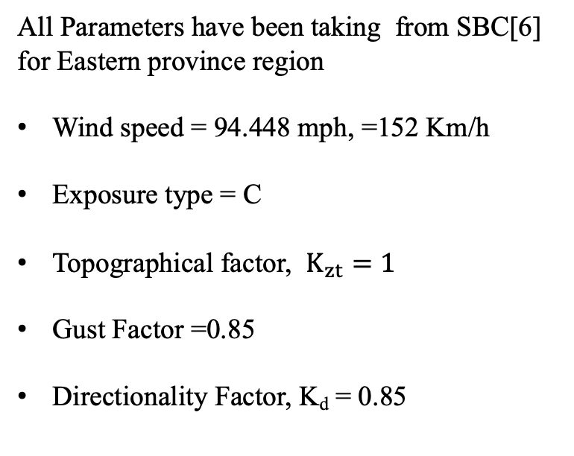
Wind Loads
Wind Loads acting on the structure:
All Parameters have been taking from SBC[6] for Eastern province region
Wind speed = 94.448 mph, =152 Km/h
Exposure type = C
${\text{Topographical} \text{factor}\text{, }K}_{zt}=1$
Gust Factor =0.85
Directionality Factor, K_{d} = 0.85
Retrieved from ETABS

Slide 15
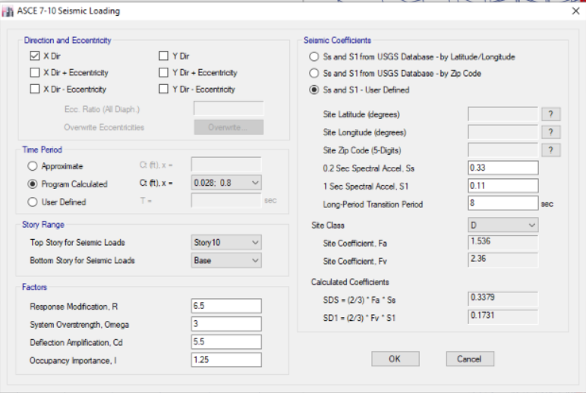
Seismic Loads
Seismic Loads EQ (X,Y) :
All Parameters been taking from SBC [6]
for Eastern province region
Ss=0.33
S1=0.11
Transition Period=8 sec
site type = D
R=6.5
Omega=3
Cd=5.5
I=1.25
Retrieved from ETABS

Slide 16
Loads Combinations
Table (3):Load Combinations
Type | Combination
Dead Load and Live Load | 1.2(DL) + 1.6(LL) (Design and calculation use)
DL and Wx | 0.9(DL) + 1.6 (WLX)
DL and Wy | 0.9(DL) + 1.6(WLy)
DL and Eqx | 1(DL) + 1(Eqx)
DL and Eqy | 1(DL) + 1(Eqy)
References ASCE Code [3]

Slide 17
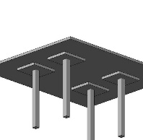
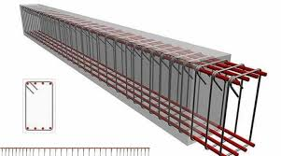
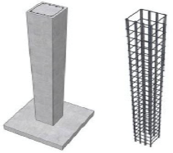
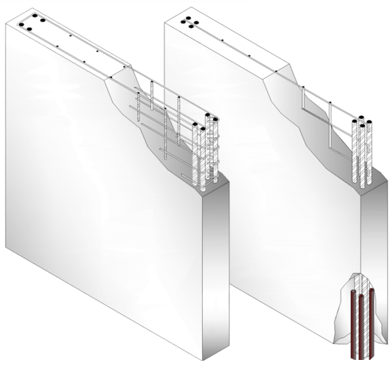
Slab Design and Reinforcement
Beams Design and Reinforcement
Column Design and Reinforcement
Shear Walls Design and Reinforcement
RCC Structural Elements

Slide 18
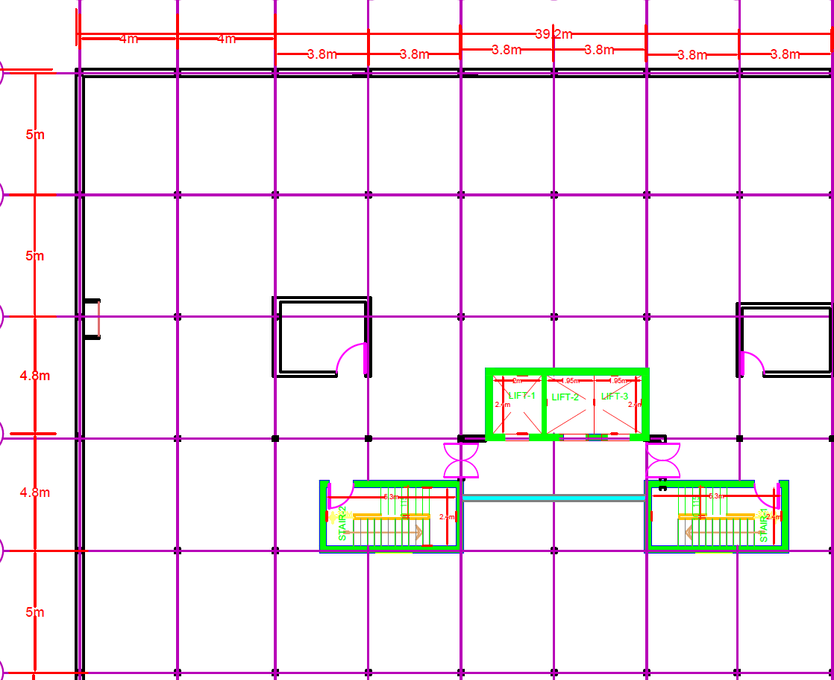
RCC Slab Design
RCC Slab Design location :
Critical Slab
Slab 3
Slab 1
Slab 2

Slide 19

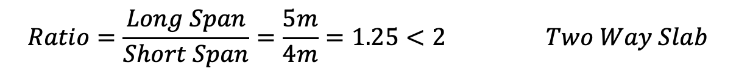

RCC Slab Calculation
3.8 m
$$Ratio=\frac{Long Span}{Short Span}=\frac{4.8m}{3.8m}=1.26<2 Two Way Slab$$
Slab 1
4.8 m
3.8 m
$$Ratio=\frac{Long Span}{Short Span}=\frac{5m}{3.8m}=1.31<2 Two Way Slab$$
Slab 2
5 m
4 m
$$Ratio=\frac{Long Span}{Short Span}=\frac{5m}{4m}=1.25<2 Two Way Slab$$
Slab 3
5 m

Slide 20
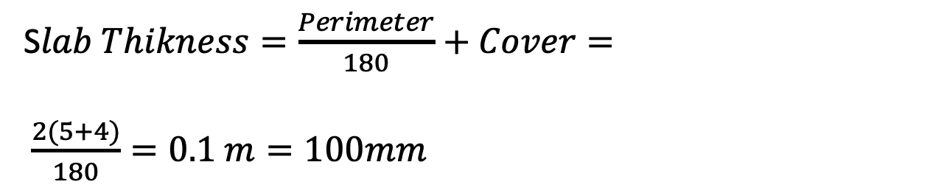


RCC Critical Slab
4 m
S$lab Thikness=\frac{Perimeter}{180}+Cover=$
$\frac{2(5+4)}{180}=0.1 m=100mm$
Critical Slab 3
$$Cover=2in=50mm$$
5 m
s$lab Thikness=100+50=150mm$
Critical Slab

Slide 21
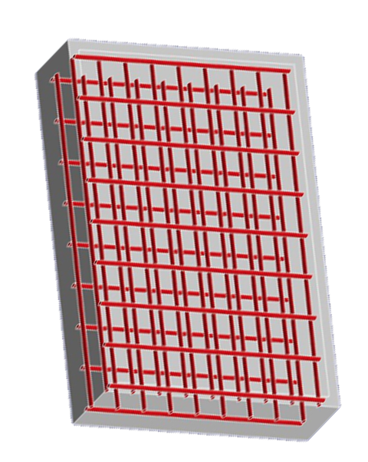
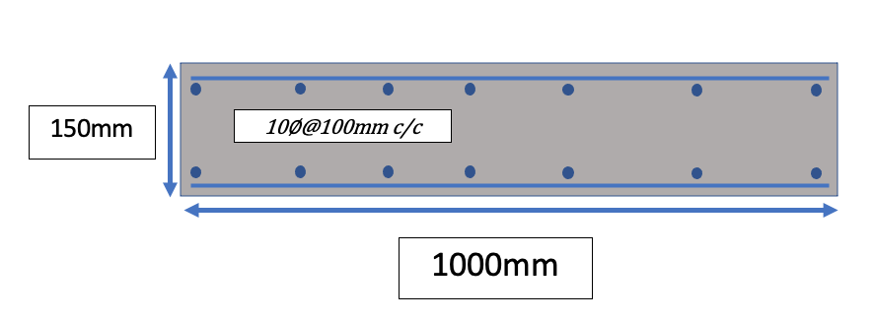

RCC Critical Slab Reinforcement
$$Area of steel provided=3600 {mm}^{2}$$
Cut Cross-section of the Slab Reinforcement
Two Way Slab Reinforcement [3]

Slide 22
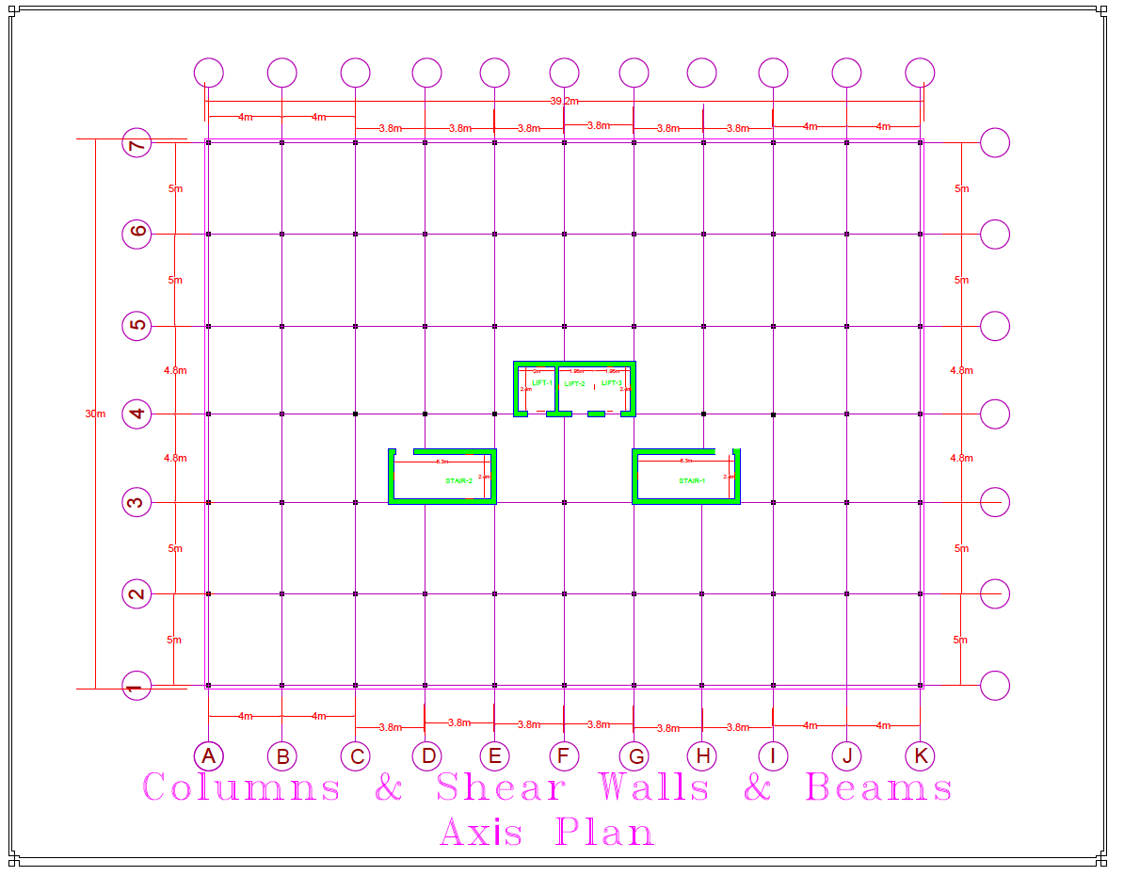
RCC Beam Design
RCC Beam Design location:
Location [1] : 5m
Location [2] : 4m
Location [3] : 2.4m
4m
2.4 m
5m
Beams Locations

Slide 23
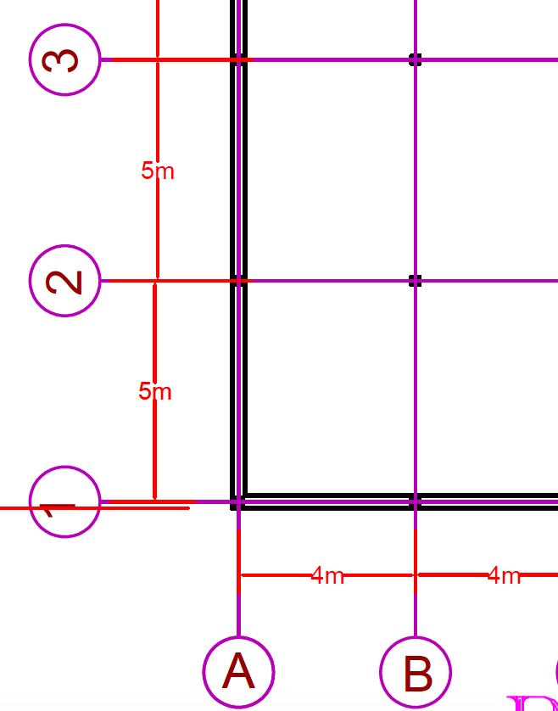
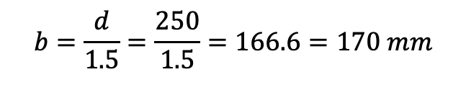



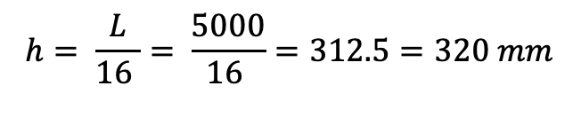

RCC Critical Beam Calculation
RCC Beam Design (Critical Beam 5m)
$$h= \frac{L}{16 }= \frac{5000}{16 }=312.5=320 mm$$
Location [1] : 5m
$$d=h−3 convert 3 in to mm=76.2$$
$$d=320−76.2−243.8=250 mm$$
Ratio$=1.5 to 2$
$$b=\frac{d}{1.5}=\frac{250}{1.5}=166.6=170 mm$$
5m
h=320mm
d=250mm
Cross section beam $=320 ×170 mm$
A_{st}
Retrieved from ACI [2]
b=170 mm
23

Slide 24
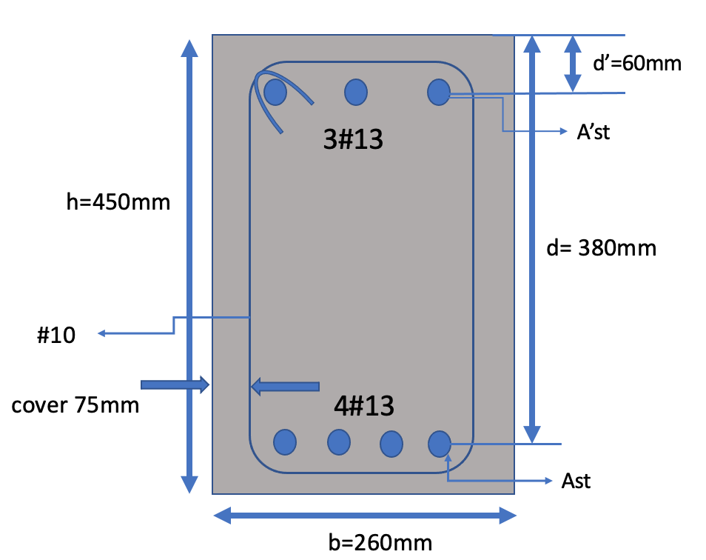
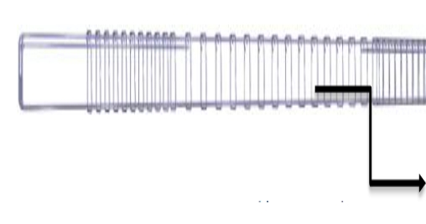
RCC Critical Beam Reinforcement
Beam Dimensions (5m) cross-section(450mm x 260mm)
All data has been taking from ETABS
Area of steel top= 338 mm²
Area of steel bottom= 430 mm²
Provide 10@ 100mm stirrups c/c
Beam Stirrup (retrieved from ETABS)[3]
Beam Reinforcement Detail (retrieved from ETABS)

Slide 25
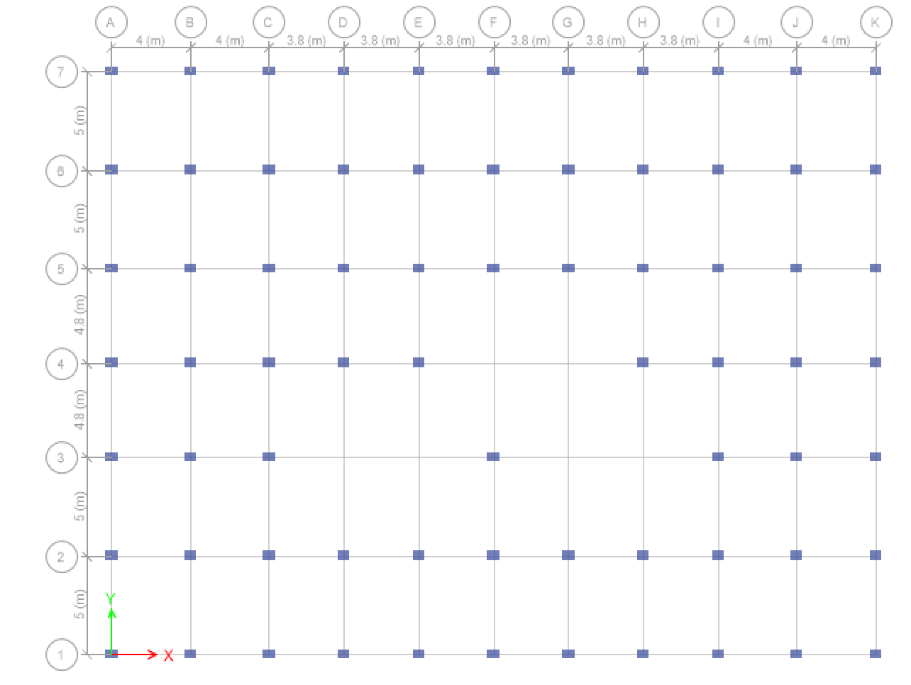
RCC Column Design
A7
B7
C7
D7
E7
F7
G7
H7
I7
J7
K7
A6
B6
C6
D6
E6
F6
G6
H6
I6
J6
K6
A5
B5
C5
D5
E5
F5
G5
H5
I5
J5
K5
A4
B4
C4
D4
E4
H4
I4
J4
K4
A3
B3
C3
F3
I3
J3
K3
A2
B2
C2
D2
E2
F2
G2
H2
I2
J2
K2
F1
J1
K1
A1
B1
C1
D1
E1
G1
H1
I1
RCC Columns Location

Slide 26
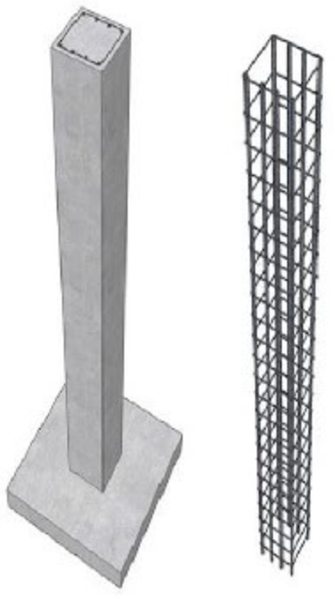
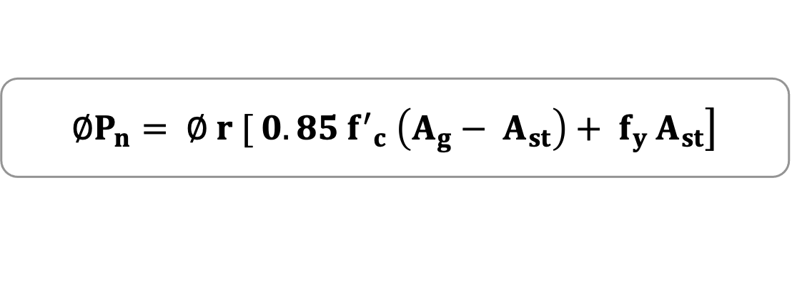
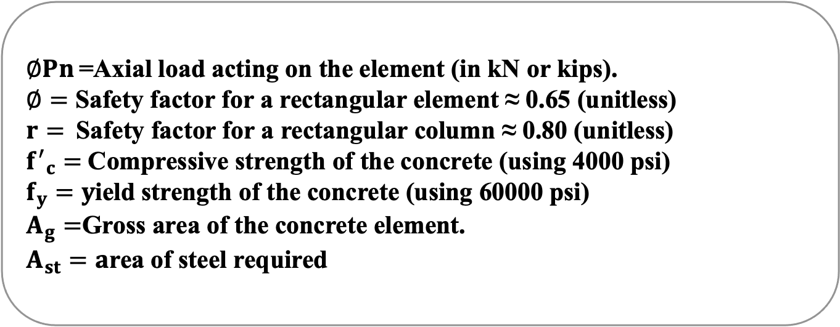
RCC Column Design Calculation
$$\left.∅P_{n}= ∅ r [ 0.85 {f^{′}}_{c} \left(A_{g}− A_{st}\right)+ f_{y} A_{st}\right]$$
$∅Pn$ =Axial load acting on the element (in kN or kips).
$∅=$ Safety factor for a rectangular element ≈ 0.65 (unitless)
$r=$Safety factor for a rectangular column ≈ 0.80 (unitless)
${f^{′}}_{c}=$Compressive strength of the concrete (using 4000 psi)
$f_{y}=y$ield strength of the concrete (using 60000 psi)
$A_{g}=$Gross area of the concrete element.
$A_{st}=a$rea of steel required
Retrieved from ACI [2]
Column [8]

Slide 27
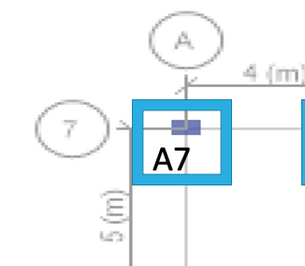
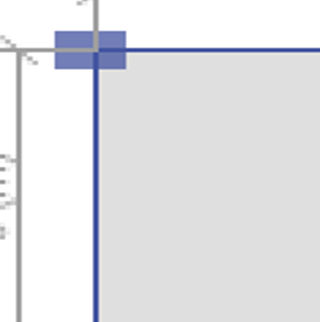
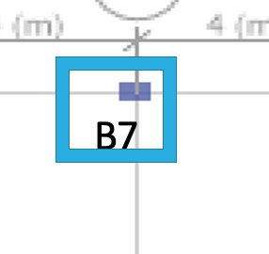

RCC Types of Column
Exterior
Corner
Table (4):Cross Sections
Table (5):Cross Sections
Column | Cross section (mm)
8th Story | 200x200 mm
5th Story | 220x220 mm
2nd Story | 250x250 mm
G Story | 280x280 mm
B1 Story | 300x300 mm
Column | Cross section (mm)
8th Story | 220x220 mm
5th Story | 230x230 mm
2nd Story | 300x300 mm
G Story | 320x320 mm
B1 Story | 380x380 mm
27

Slide 28


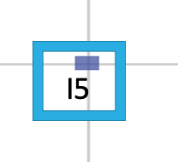
RCC Types of Column
Interior
Center
Table (6):Cross Sections
Table (7):Cross Sections
Column | Cross section (mm)
8th Story | 250x250 mm
5th Story | 300x300 mm
2nd Story | 380x380 mm
G Story | 420x420 mm
B1 Story | 480x480 mm
Column | Cross section (mm)
8th Story | 300x300 mm
5th Story | 350x350 mm
2nd Story | 400x400 mm
G Story | 430x430 mm
B1 Story | 500x500 mm
28

Slide 29
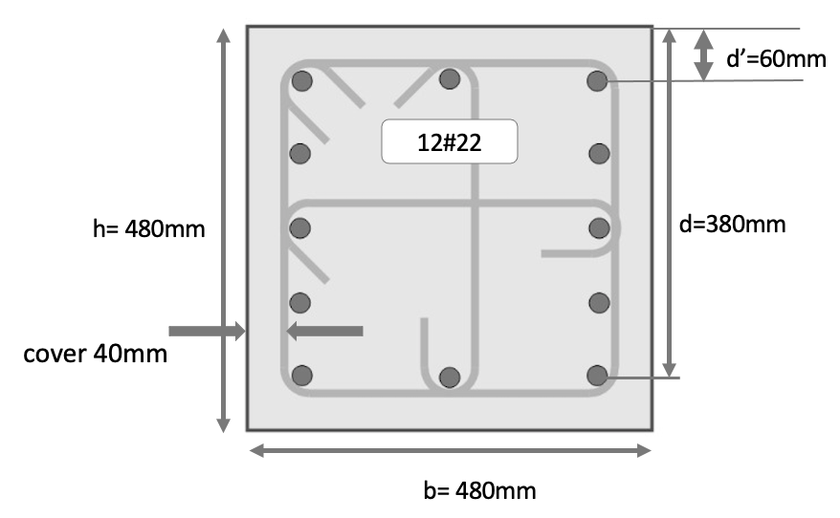
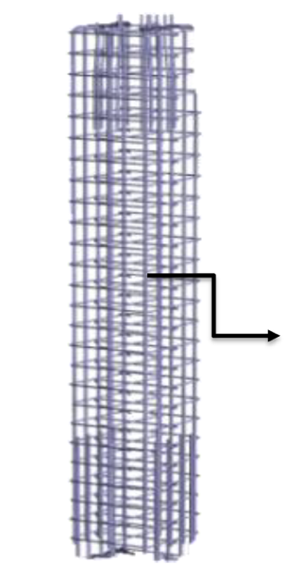
RCC Critical Column Reinforcement
Column 480mm x 480mm
(All data has been taking from ETABS) ,( Area of steel 4236 mm² ),( Using #22 dimeter), (Provide 12#22 )
12 ties @ 300 mm c/c
Column Stirrup (retrieved from ETABS)[3]
Column Reinforcement Detail (retrieved from ETABS)

Slide 30
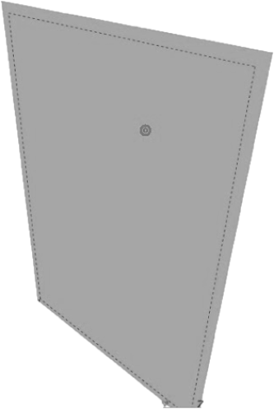


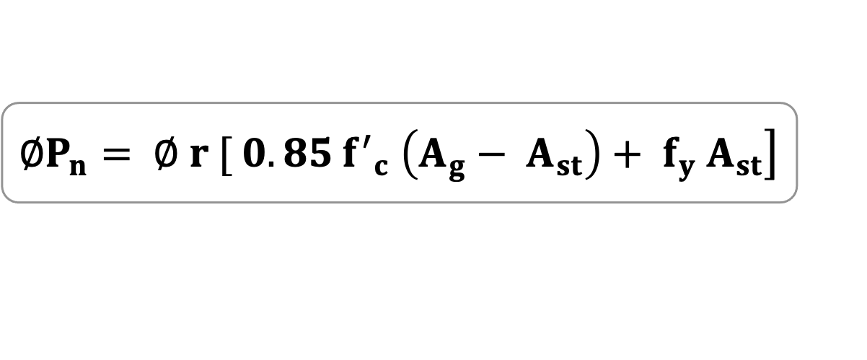
RCC Shear wall Design
Shear Wall Design
$$\left.∅P_{n}= ∅ r [ 0.85 {f^{′}}_{c} \left(A_{g}− A_{st}\right)+ f_{y} A_{st}\right]$$
Shear wall
$$A_{g}=6.3 x$$
2.4 m
$$x=6 in ≈150 mm$$
6.3 m
Retrieved from ACI [2]
6 in

Slide 31
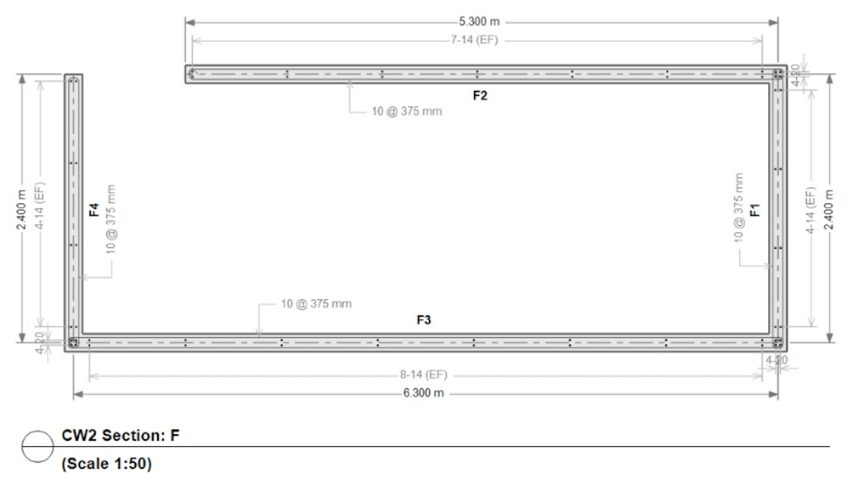
RCC Critical Shear wall Reinforcement
Length 6300 mm Thickness 160mm
All data has been taking from ETABS
Area of steel 7346 mm²
Using #29 dimeter:
Provide 12#29
Critical Shear wall
Shear wall Reinforcement Detail (retrieved from ETABS)

Slide 32
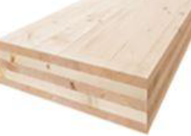
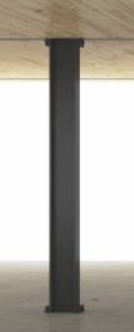
CLT
Slab Design
Column Design
CLT Structural Elements

Slide 33
Mechanical properties of CLT slab
Table (8):Mechanical properties [9]
Mechanical properties of CLT slab | Orthotropic
Directional Property | Orthotropic
Density(kg/m³) | 400
Elastic Modulus (GPa) | E1=9,E2=4.5,G12=0.5
Poisson’s Ratio | V1=0.3
Strength (MPa) | F_{t-1}=20,f_{t-2}=15,f_{c-1}=30,f_{c-2}=25,f_{shear}=5
Notation: E = modulus of elasticity; G = modulus of rigidity; 1 = CLT major direction; 2 = CLT minor direction; t = tension; c = compression

Slide 34
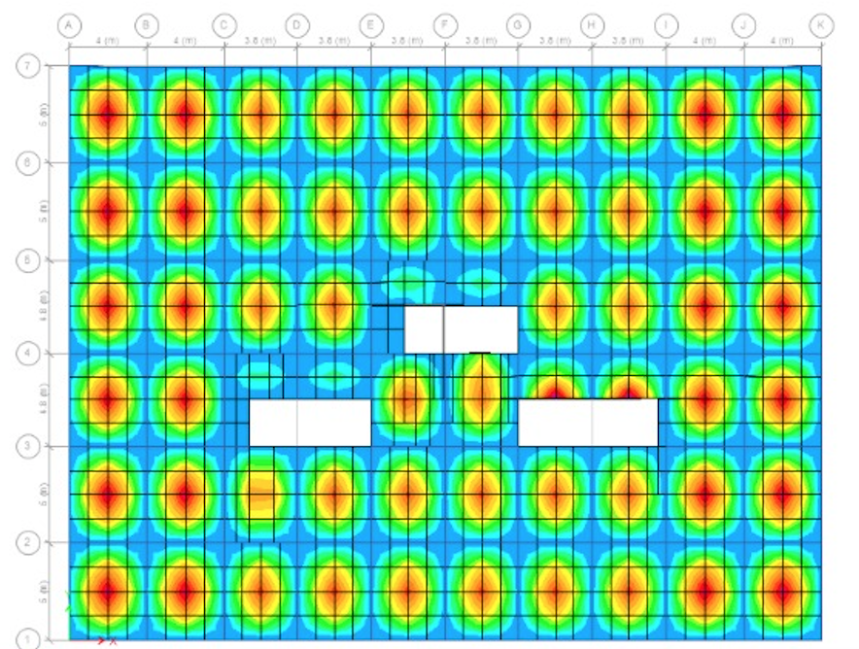
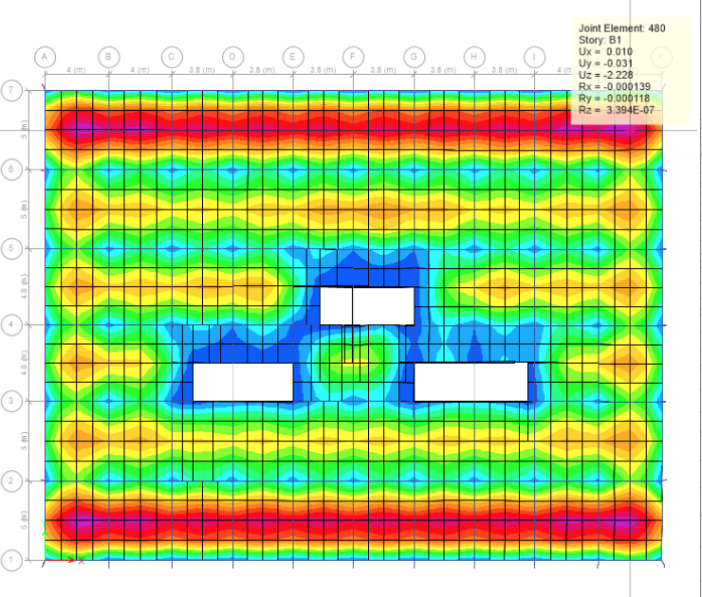
CLT Slab Design
150 mm
300 mm
CLT Slab Deflection with 150 mm
CLT Slab Deflection with 300 mm

Slide 35
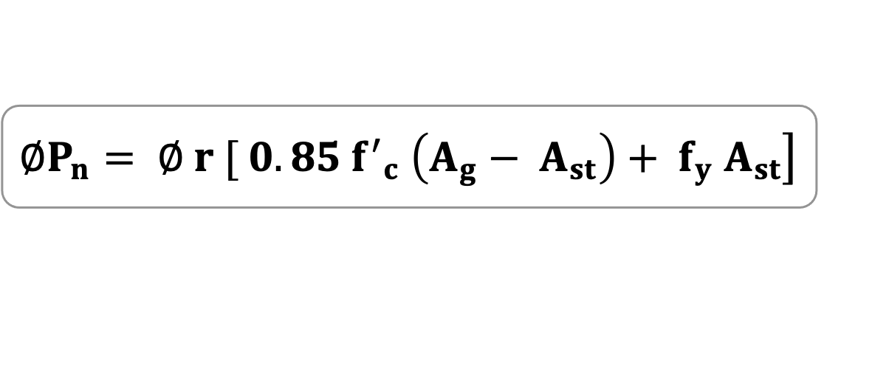
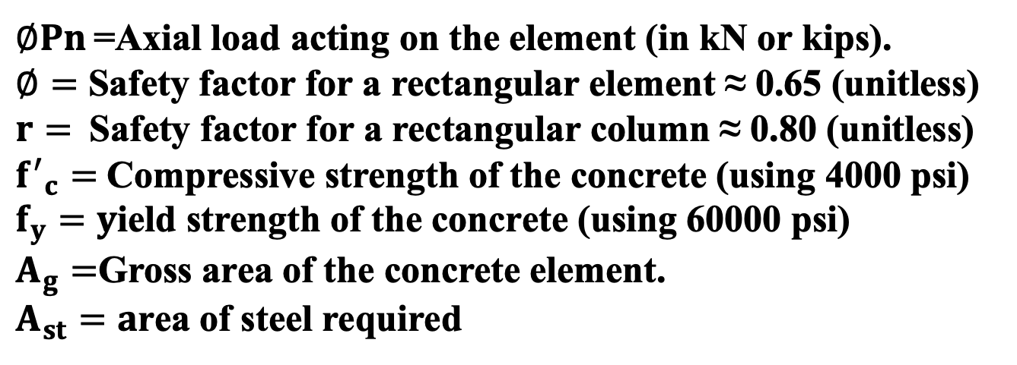
CLT Columns Design Calculation
$$\left.∅P_{n}= ∅ r [ 0.85 {f^{′}}_{c} \left(A_{g}− A_{st}\right)+ f_{y} A_{st}\right]$$
$∅Pn$ =Axial load acting on the element (in kN or kips).
$∅=$ Safety factor for a rectangular element ≈ 0.65 (unitless)
$r=$Safety factor for a rectangular column ≈ 0.80 (unitless)
${f^{′}}_{c}=$Compressive strength of the concrete (using 4000 psi)
$f_{y}=y$ield strength of the concrete (using 60000 psi)
$A_{g}=$Gross area of the concrete element.
$A_{st}=a$rea of steel required
Retrieved from ACI [2]
RCC column with CLT Slab

Slide 36
CLT Types of Column
Exterior
Corner
Table (9):Cross Sections
Table (10):Cross Sections
Column | Cross section (mm)
8th Story | 200x200 mm
5th Story | 210x210 mm
2nd Story | 220x220 mm
G Story | 230x230 mm
B1 Story | 250x250 mm
Column | Cross section (mm)
8th Story | 200x200 mm
5th Story | 220x220 mm
2nd Story | 250x250 mm
G Story | 260x260 mm
B1 Story | 300x300 mm
36

Slide 37
CLT Types of Column
Interior
Center
Table (11):Cross Sections
Table (12):Cross Sections
Column | Cross section (mm)
8th Story | 200x200 mm
5th Story | 250x250 mm
2nd Story | 300x300 mm
G Story | 350x350 mm
B1 Story | 400x400 mm
Column | Cross section (mm)
8th Story | 200x200 mm
5th Story | 250x250 mm
2nd Story | 300x300 mm
G Story | 350x350 mm
B1 Story | 400x400 mm
37

Slide 38
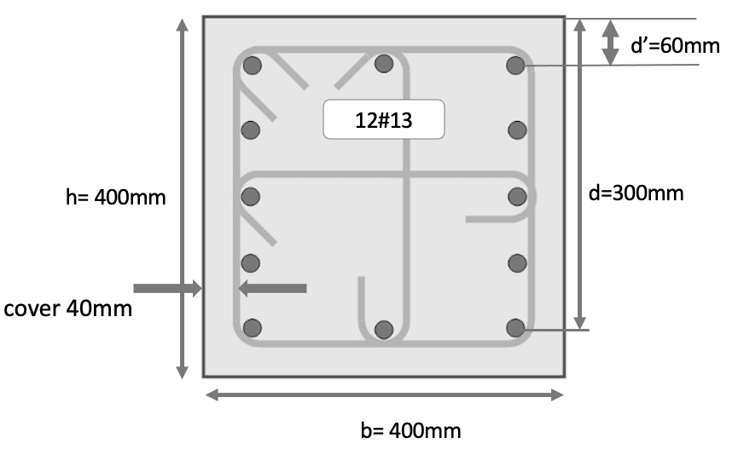
CLT Critical Column Reinforcement
Column 400mm x 400mm
(All data has been taking from ETABS) ,( Area of steel 1600 mm² ),( Using #13 dimeter), (Provide 12#13 )
12 ties @ 200 mm c/c
Column Reinforcement Detail (retrieved from ETABS)
Column Stirrup (retrieved from ETABS) [3]

Slide 39
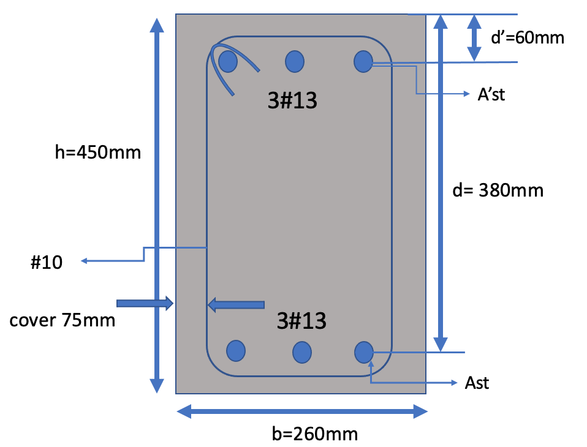
CLT Critical Beam Reinforcement
Beam Dimensions (5m) cross-section(450mm x 260mm)
All data has been taking from ETABS
Area of steel top= 338 mm²
Area of steel bottom= 338 mm²
Provide 10@ 100mm stirrups c/c
Beam Stirrup (retrieved from ETABS)[3]
Beam Reinforcement Detail (retrieved from ETABS)

Slide 40
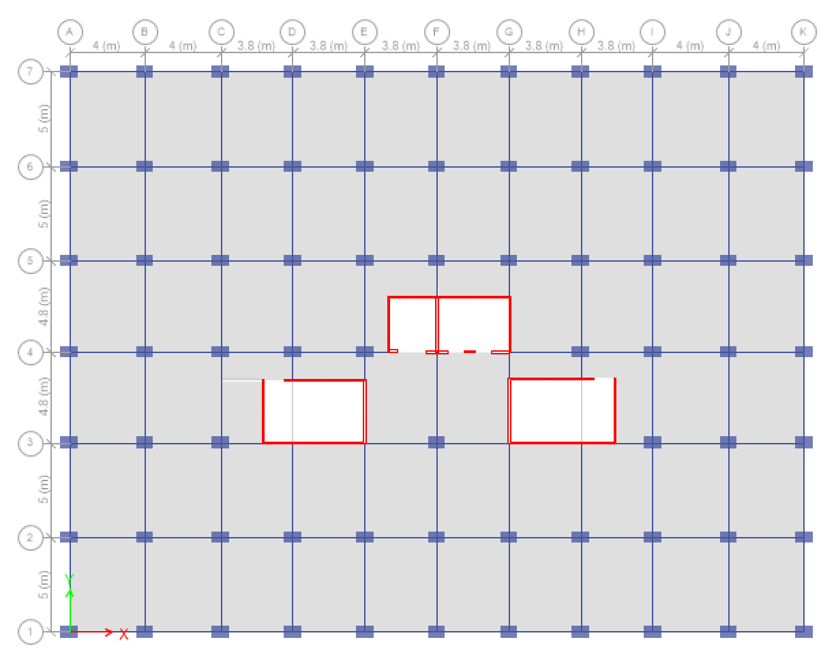
ETABS Modeling
ETABS Modeling

Slide 41
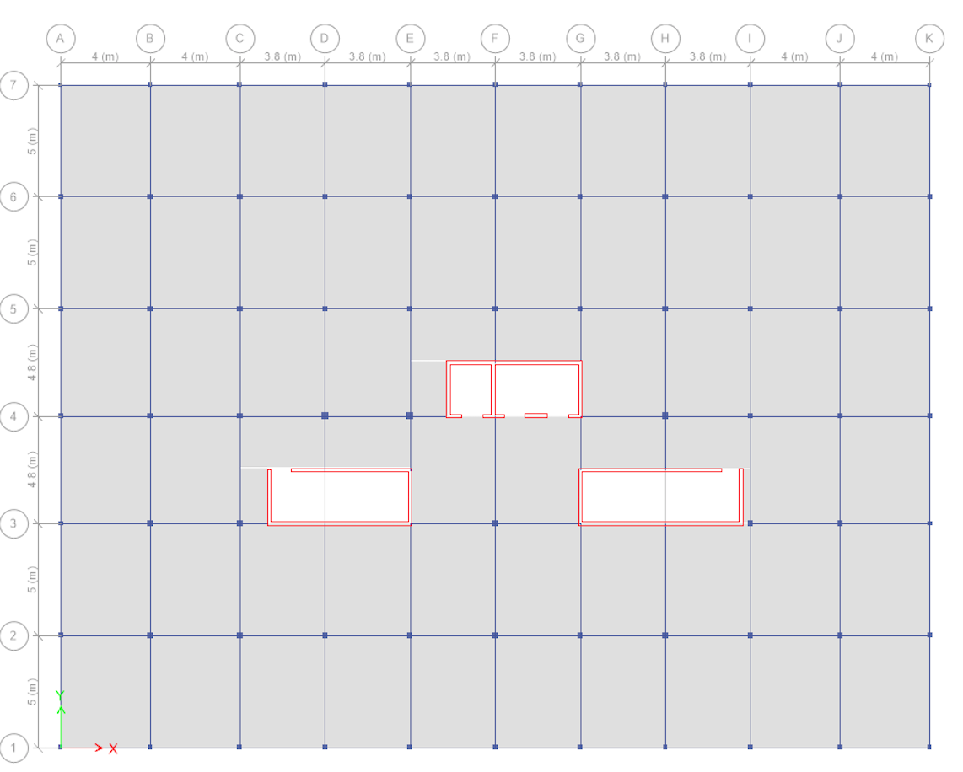
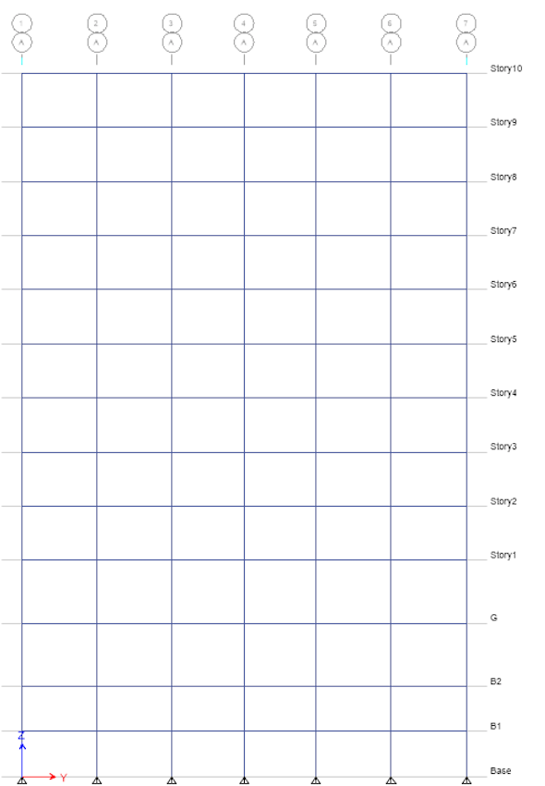

ETABS Modeling
Plane Floor View
Elevation View
3D View

Slide 42


RCC Slabs Deflection
Slab Deflection after applying the highest load
3.6mm < 25mm
ACI (Passed)
RCC Slab Deflection (Dead Load + Live Load)

Slide 43


CLT Structure Modeling
Slab Deflection after applying the highest load
2.28mm < 25mm
ACI (Passed)
CLT Slab Deflection (Dead Load + Live Load)

Slide 44


Elements Frame Check
RCC All Frames Passed
CLT All Frames Passed

Slide 45


Displacement for RCC
Maximum story displacement for (Seismic load)
Maximum story displacement for (Wind load)

Slide 46


Displacement for CLT
Maximum story displacement for (Seismic load)
Maximum story displacement for (Wind load)

Slide 47

Geotechnical Design
Geotechnical design:
Soil Profile
Soil Analysis
Analysis of Different Foundation Design:
Isolated Foundation
Raft (Mat Foundation)
Pile Foundation
Raft with Pile
Soil Layers (MDCEO, 2021) [4]

Slide 48



Soil Profile & Analysis
Temporary Dewatering
Well Point System
Permanent Dewatering
French Drainage System
Modified Soil Layers After excavating (MDCEO, 2021) [4]

Slide 49



Alternative Foundation Design
Isolated Foundation:
Q$u$= $5049.12$
$$Qall=\frac{qu}{qs}=\frac{5049.12}{3}=1683{kn}/{m^{2}}$$
$Qmax=\frac{5952.2814}{2(2)}+\frac{6(270.556)}{2^{2}(2)}=1690.98{Kn}/{m^{2}}$
$$Qmin=\frac{5952.2814}{2(2)}−\frac{6\left(270.556\right)}{2^{2}\left(2\right)}=12851.15{Kn}/{m^{2}}$$
2m
7m
16m
Table (13):Bearing Capacity
The net allowable soil bearing capacity (kN/m²) |  | Bearing Capacity of the Soil (kN/m²)
$$1683$$ | < | $$1690.98$$ (Not ok)
Isolated foundation Design [4]

Slide 50






Alternative Foundation Design
RCC Raft Foundation:
$$U= bod [ φ (0.34)√f′c ]$$
$$critical column cross section \left(0.5m×0.5m\right)$$
$$bo=2\left(0.5+0.5\right)=2m$$
$$d=\frac{U}{bo\left[∅\left(0.34\right)\sqrt{fc}\right]}=\frac{4.459}{2\left[0.85\left(0.34\right)\sqrt{28}\right]}=1.458M$$
$$thickness of the Raft is d≈1.5M$$
The soil pressure under each column:
Raft foundation Design [4]
$$q\left(x,y\right)=\frac{Q_{t}}{A}± \frac{M_{y}x}{I_{y}}± \frac{M_{x}y}{I_{x}}$$
Table (14):Reinforcement Detail Selection
Critical Soil Point Pressure (kPa) |  | The bearing capacity of the soil(kPa)
$$223.36 {kN/m}^{2}$$ | < | $$4550.2 kN/m^{2}$$
The bearing capacity of the soil:
$q_{u}=c N_{C}f_{cs}f_{cd} f_{ci }+qN_{q}F_{qs }f_{qd} f_{qi}+\frac{1}{2} γ B lN_{y} f_{γs} f_{γd} f_{γi}$

Slide 51

Alternative Foundation Design
Pile with Raft Foundation:
D= 30 cm
L= 23m
No. of Piles=77
Pile foundation with raft Design [4]

Slide 52






RCC Raft Foundation Reinforcement
$q_{v}= \frac{q_{first}+ q_{last}}{2}$
Soil Reaction = $q_{av}LB$
$${Load}_{av}= \frac{Soil reaction+\sum{Q}}{2}$$
$${ q}_{av(modi)}=q_{av}× \frac{{Load}_{av}}{Soil reaction}$$
$$F= \frac{{Load}_{av}}{\sum{Q}}$$
$${ q}^{′}= q_{av\left(modi\right)} ×B_{1}$$
Critical Strips (retrieved from ETABS)

Slide 53





Raft RCC Foundation Reinforcement
${ M}^{′}= \frac{{Moment}_{max}}{B_{1}}$
${ M_{u}= M}^{′}(F)$
$$M_{u}= øA_{s}f_{y}(d−\frac{a}{2} )$$
$a= \frac{A_{s}f_{y}}{0.85{f^{′}}_{c}b}$
Critical Strip 39 m

Slide 54


Raft RCC Foundation Reinforcement
Table (15):Reinforcement Detail Selection
Spacing | Diameter(mm) | Spacing (mm) c/c | As provided (mm²)
Top | 29 | 80 | $12350$ mm²
Bottom | 29 | 80 | $12350$ mm²
20#29@80mm c/c
20#29@80mm c/c
20#29@80mm c/c
20#29@80mm c/c
Foundation Reinforcements

Slide 55




Alternative Foundation Design
CLT Raft Foundation:
$$U= bod [ φ (0.34)√f′c ]$$
$$critical column cross section \left(0.5m×0.5m\right)$$
$$bo=2\left(0.4+0.4\right)=1.6 m$$
$$d=\frac{U}{bo\left[∅\left(0.34\right)\sqrt{fc}\right]}=\frac{1.0835}{2\left[0.85\left(0.34\right)\sqrt{28}\right]}=0.5 m$$
$$thickness of the Raft is d=0.5 m$$
The soil pressure under each column:
$$q\left(x,y\right)=\frac{Q_{t}}{A}± \frac{M_{y}x}{I_{y}}± \frac{M_{x}y}{I_{x}}$$
Raft foundation Design [4]
Table (16):Reinforcement Detail Selection
Critical Soil Point Pressure (kPa) |  | The bearing capacity of the soil(kPa)
$$49.69 {kN/m}^{2}$$ | < | $$4550.2 kN/m^{2}$$
The bearing capacity of the soil:
$q_{u}=c N_{C}f_{cs}f_{cd} f_{ci }+qN_{q}F_{qs }f_{qd} f_{qi}+\frac{1}{2} γ B lN_{y} f_{γs} f_{γd} f_{γi}$

Slide 56
CLT Raft Foundation Reinforcement
$q_{v}= \frac{q_{first}+ q_{last}}{2}$
Soil Reaction = $q_{av}LB$
$${Load}_{av}= \frac{Soil reaction+\sum{Q}}{2}$$
$${ q}_{av(modi)}=q_{av}× \frac{{Load}_{av}}{Soil reaction}$$
$$F= \frac{{Load}_{av}}{\sum{Q}}$$
$${ q}^{′}= q_{av\left(modi\right)} ×B_{1}$$
Critical Strips (retrieved from ETABS)

Slide 57

Raft CLT Foundation Reinforcement
${ M}^{′}= \frac{{Moment}_{max}}{B_{1}}$
${ M_{u}= M}^{′}(F)$
$$M_{u}= øA_{s}f_{y}(d−\frac{a}{2} )$$
$a= \frac{A_{s}f_{y}}{0.85{f^{′}}_{c}b}$
Critical Strip 39 m

Slide 58

Raft CLT Foundation Reinforcement
Table (17):Reinforcement Detail Selection
Spacing | Diameter(mm) | Spacing (mm) c/c | As provided (mm²)
Top | 25 | 90 | $7574$ mm²
Bottom | 25 | 90 | $7574$ mm²
15#25@90mm c/c
15#25@90mm c/c
15#25@90mm c/c
15#25@90mm c/c
Foundation Reinforcements Details

Slide 59
RCC Cost Estimation
Table (18):RCC Cost Estimation
Cost Estimation of RCC Structure
No. | Materials | Volume (m³) | Unit Price (SR/m³) | Unit Price(SR) |  | Cost (SR)
1 | Concrete | 4635.4 | 210 | -------------- |  | 973,434
2 | Reinforcement | (4635.4 * 160)/1000 Kg/m³ | ----------------- | 742 ton* 2600 |  | 1,929,200
3 | Finishing | 60%of the Total cost | -------------- | -------------- |  | 1,741,580
Total Project Cost = SAR4,644,214
Prices of the material was provided by MADCO for contracting company, 2021

Slide 60
CLT Cost Estimation
Table (19):CLT Cost Estimation
Cost Estimation of CLT Structure
No. | Materials | Volume (m³) | Unit Price (SR/m³) | Unit Price(SR) |  | Cost (SR)
1 | CLT Slab | 4352.4 | 1200 | -------------- |  | 5,222,880
2 | Concrete | 1071 | 210 | -------------- |  | 224,910
3 | Reinforcement | (1071 * 160)/1000 Kg/m³ | ----------------- | 171 ton* 2600 |  | 444,600
4 | Finishing | 60% of the Total cost | -------------- | -------------- |  | 3,535,434
Total Project Cost = SAR 9,427,824
Prices were taking from PMU library (senior project, 2018)

Slide 61
Project Constraints
Table (20):Project Constraints
Constraints |  | Solutions
Structural (sizes of the beams & columns) |  | Increasing Cross-Sections of Beam Increasing Cross-Sections of columns
Geotechnical |  | Applying Temporary Dewatering & Permanent Dewatering system
Material (CLT) |  | More research and used computer software such us ETABS
Cost |  | Using PMU Library for previous senior design project for CLT cost
Environmental |  | Follow the PME's environmental plan to protect Saudi's health and natural resources

Slide 62
Project Complexity
Table (21):Project complexity
Complexity | Uniqueness
Soil Treatment | Distinguish location
Location | Spectacular scenery
CLT option | First of its own
Special arrangement | CLT option
-------------------- | PMUs Graduating Students

Slide 63
Comparison Between RCC & CLT
Table (22):Comparison
 | RCC | CLT
Cost | Economically | Costly
Durability | More Durable | less Durable
Construction | Longer Period of time | Shorter Period of time
Environmentally | Environmentally Harmful | Environmentally Friendly
Strengths | Strong | Strong
Safety | Fulfilled all Safety Requirements | Fulfilled all Safety Requirements

Slide 64






Project Summary & Conclusion
Design of a Multistory Building
Aim of This Project
Comprehensive Study of The Foundation System
Software Program Analysis
Comprehensive Cost Estimation
Final Thoughts

Slide 65
Structural Design of a Multistory Building using RCC & CLT
REFERENCES
Location Google map, Saudi Arabia,2021.
American Concrete Institute. ACI. (2014). Building code requirements for structural concrete (ACI 318-14). Farmington Hills, Michigan.
3. PMU library senior design project, design of 60 story RCC&CLT connected twin towers in Al-Khobar, 2018
Modern Designing Consulting Engineering Office (MDCEO),Saudi Arabia,2021
Cross-laminated Timber: Design and Performance, Exova BM TRADA, 2017 - Engineered wood construction - 153 pages.
Saudi Building Code National Committee (SBCNC), 2007.
CSI ETABS Program. (n.d.). Retrieved from Computer and Structures. (2016).
Bhatt and MacGinley, T. (n.d.). (2017) Reinforced concrete design to Eurocodes.
Asiz, A., Smith, I. (2009), Demands Placed on Steel Frameworks of Tall Buildings Having Reinforced Concrete or Massive Wood Horizontal Slabs, Structural Engineering International, Vol. 19, No. 4, 395-403 (9).

Slide 66
Thank You

