Slide 1

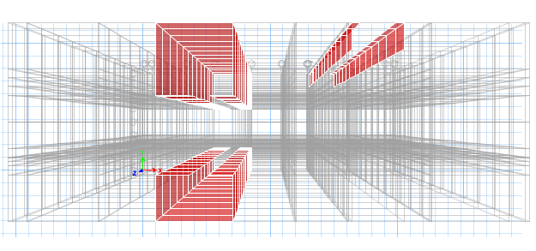
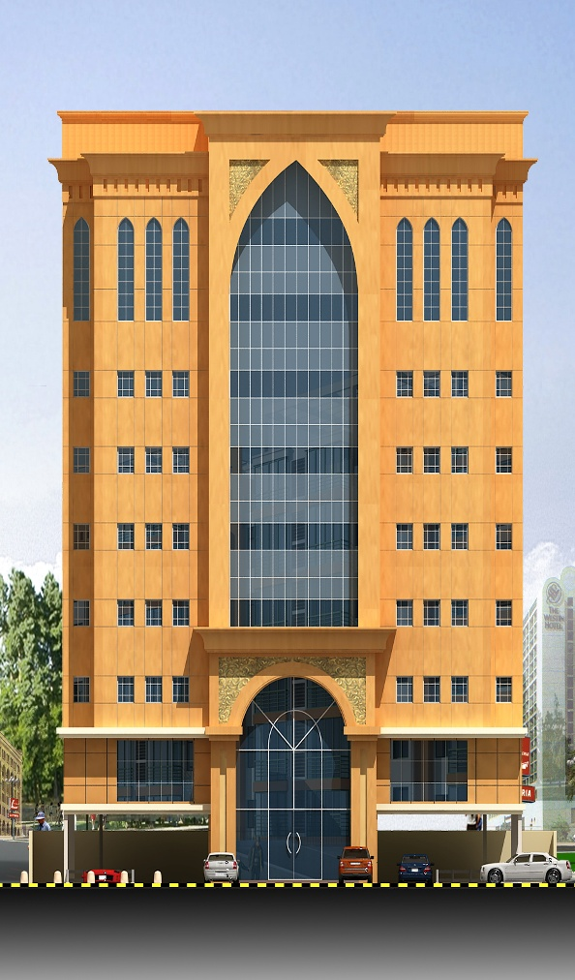
Conclusion
جامعة الأمير محمد بن فهد
PRINCE MOHAMMAD BIN FAHD UINVERSITY
Design a thirteen-story commercial-residential building using two-way solid slab systems.
Develop 3D-model for the whole building using ETABS software.
The design was performed based on ACI and Saudi Building Code.
Geotechnical design for substructure was carried out. Piled-raft foundation system was used because of very weak soil.
Drawings are provided to show the final design for the project.
Design
High-Rise Building On Soft Clayed Soil
Prepared by:
201000432 | Abdulkhalek Alhaj
201001506 | Ziyad Al-Otaibi
201300772 | Nasser Alsabhan
201200684 | Abdullah Alhussaini

Slide 2
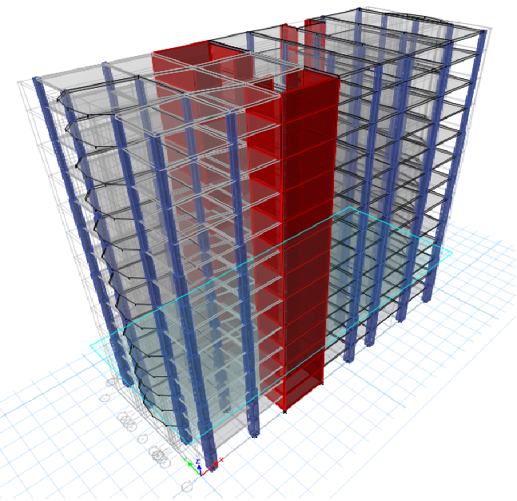
Project Description
Supervised by:
Eng. Danish Ahmed
Dr. Tahar Ayadat
The project has the following main features:
Located in Jizan City – KSA
Residential/Commercial Building
Consists of thirteen (13) floors
Land area is 2024.05 m2
Typical floor footprint area is 857.29 m2
Typical Floor height is 3 m
Abstract
Project objectives
A Thirteen-Story commercial-residential building that is in Jizan City is analyzed and designed using ETABS software. This structural work is integrated with geotechnical. The structure is modeled using 3D solid elements using ETABS software. ETABS software is a powerful software one can use for analyzing and designing any structure. The preliminary design is used to get the initial column and sizing and slabs thicknesses. Two-way flat-plate slab system is used. Saturated clay is available at the construction site leading to select the mat foundation as the best option under the structure loads. Conventional strip method is used to design the mat foundation assuming the foundation is rigid. Lastly, steel rebar is determined for columns, slabs, and mat foundation. Typical structural details of each is provided.
In any structural system, there are many alternatives that can be used; successful engineer is the one who can make the right choice depending on the serviceability, safety and economy. This project is intended to analyze and design a thirteen-story residential and commercial building.
The main objectives of the project are stated as follows:
Preliminary design of the structural members.
Select the most compatible structural systems depending.
Modeling the whole building using ETABS software.
Geotechnical design of the foundation system.

