Slide 1
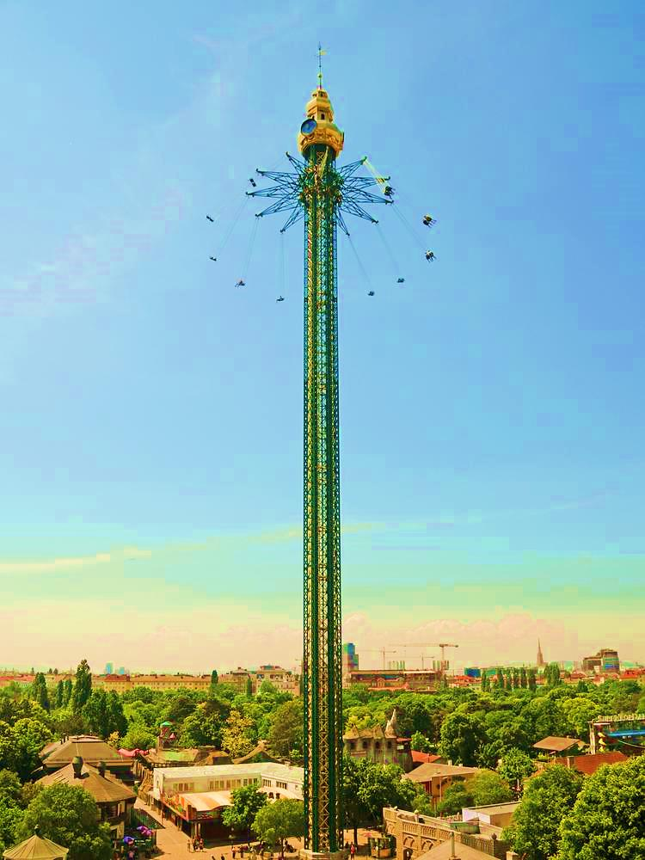
Geotechnical Design of a Star Flyer Tower (Six Flags) Projected Nearby a Slope
Spring 2015/2016
ASSE 4311: Learning Outcome Assessment III/Civil Engineering
Progress Presentation
Mohamed AL-Habib (ID: 200900638)
Omar G. Abdullah (ID: 201200201)
1

Slide 2
Outline
Objectives
Architectural Planes
Geotechnical Design
- Foundation System
- Slope Stability Analysis
- Pavement Design
Prototype
Conclusion

Slide 3
Objectives
The objectives of this project are summarized as follow:
Collecting Data/information about Six Flags and Star Flyers.
Searching/Selecting of the appropriate emplacement of the Star Flyer in Al-Khobar.
Preliminary computation of the different applied forces and moments on the Star Flyer Tower.
Geotechnical design of the appropriate foundation systems for the Star Flyer Tower.
Slope stability analysis by hand calculations.
Pavement design of prototype section of the access road.
Development of a prototype.

Slide 4
Architectural Planes

Slide 5
Architectural Planes

Slide 6
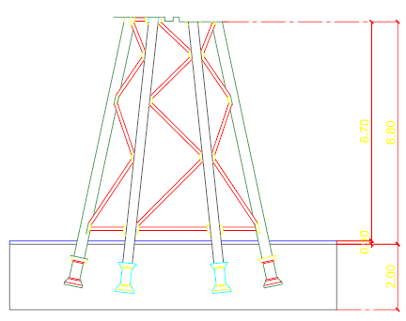
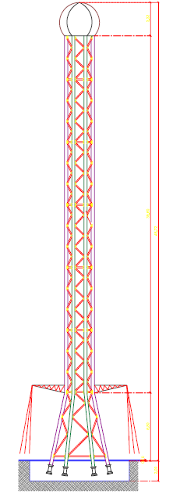
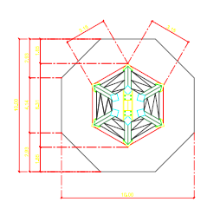
Architectural Planes

Slide 7
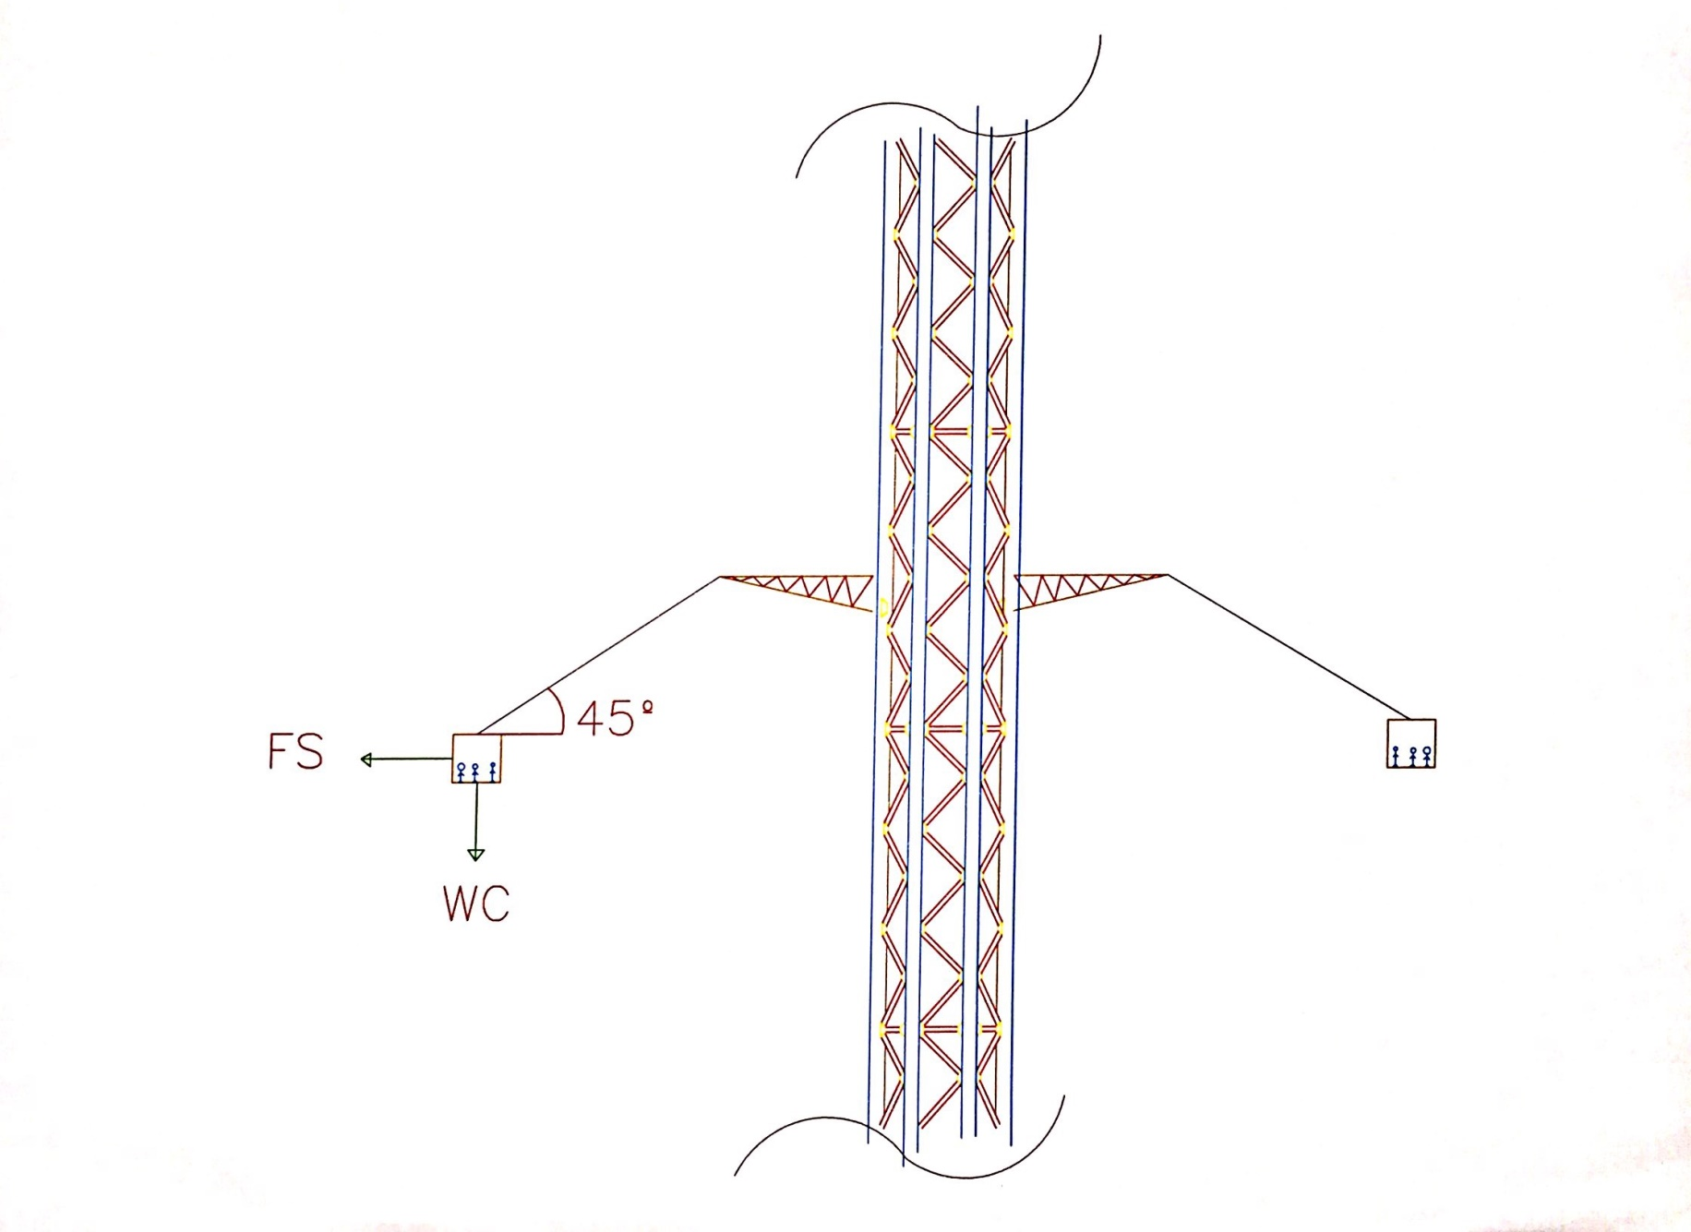

Slide 8
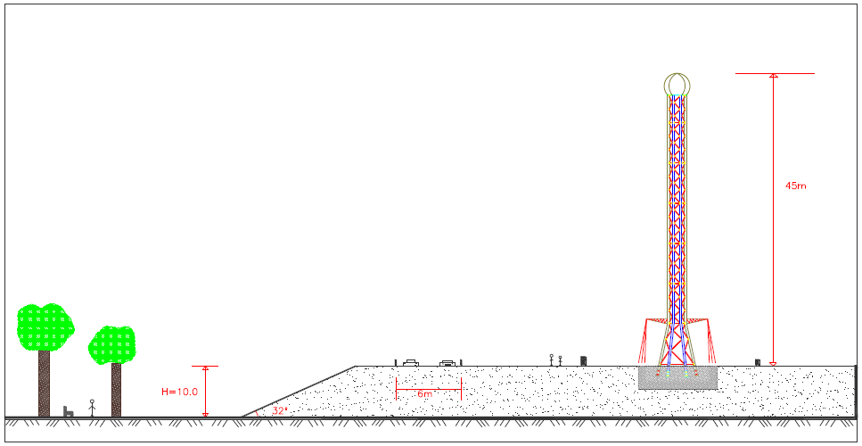
Architectural Planes

Slide 9
Geotechnical Design
Slope Stability Analysis
Pavement design
Foundation system

Slide 10
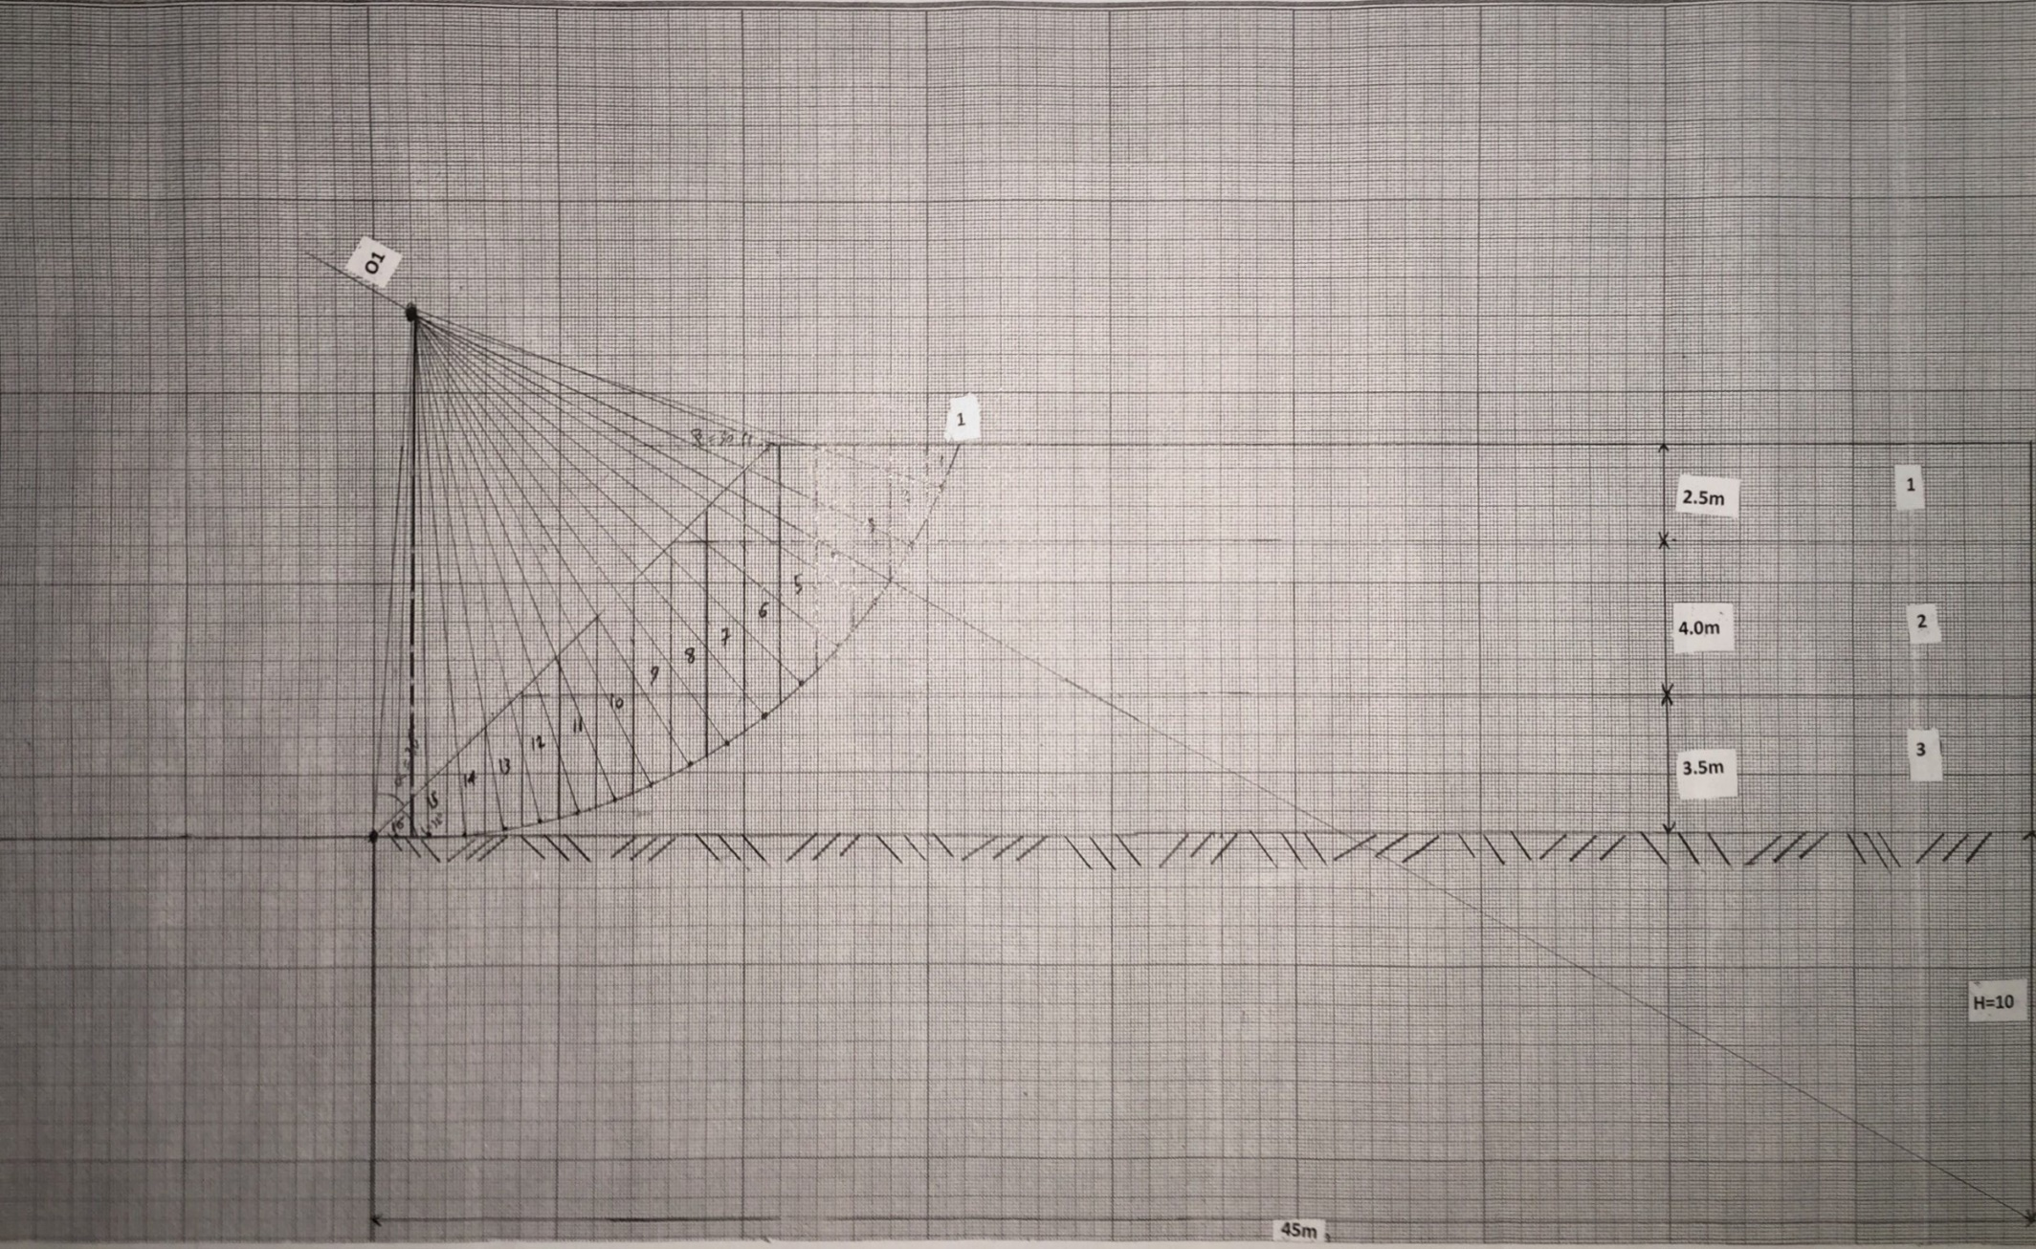
Slope Stability (Case 1)
45 m
45 m
Slope Stability (1)

Slide 11
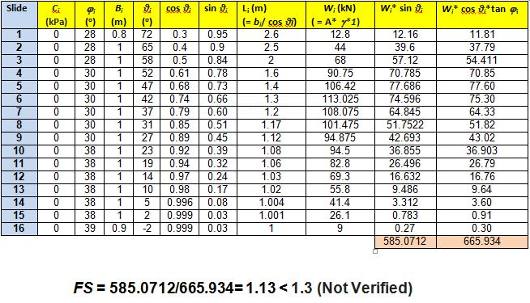
Slope Stability (Case 1)

Slide 12
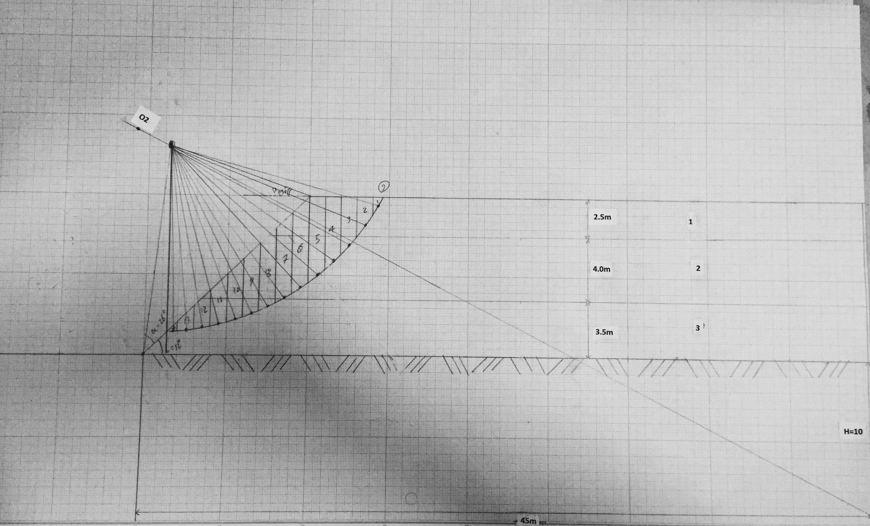
Slope Stability (case 2)
45m
Slope Stability (2)

Slide 13
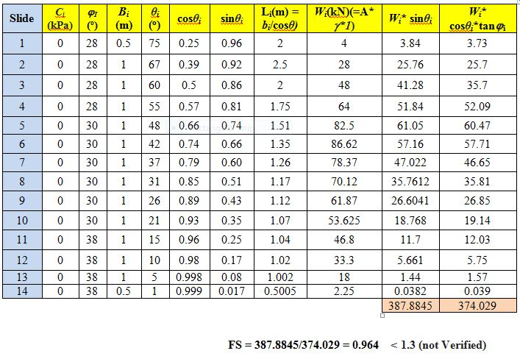
Slope Stability (case 2)
Slope Stability (2)

Slide 14
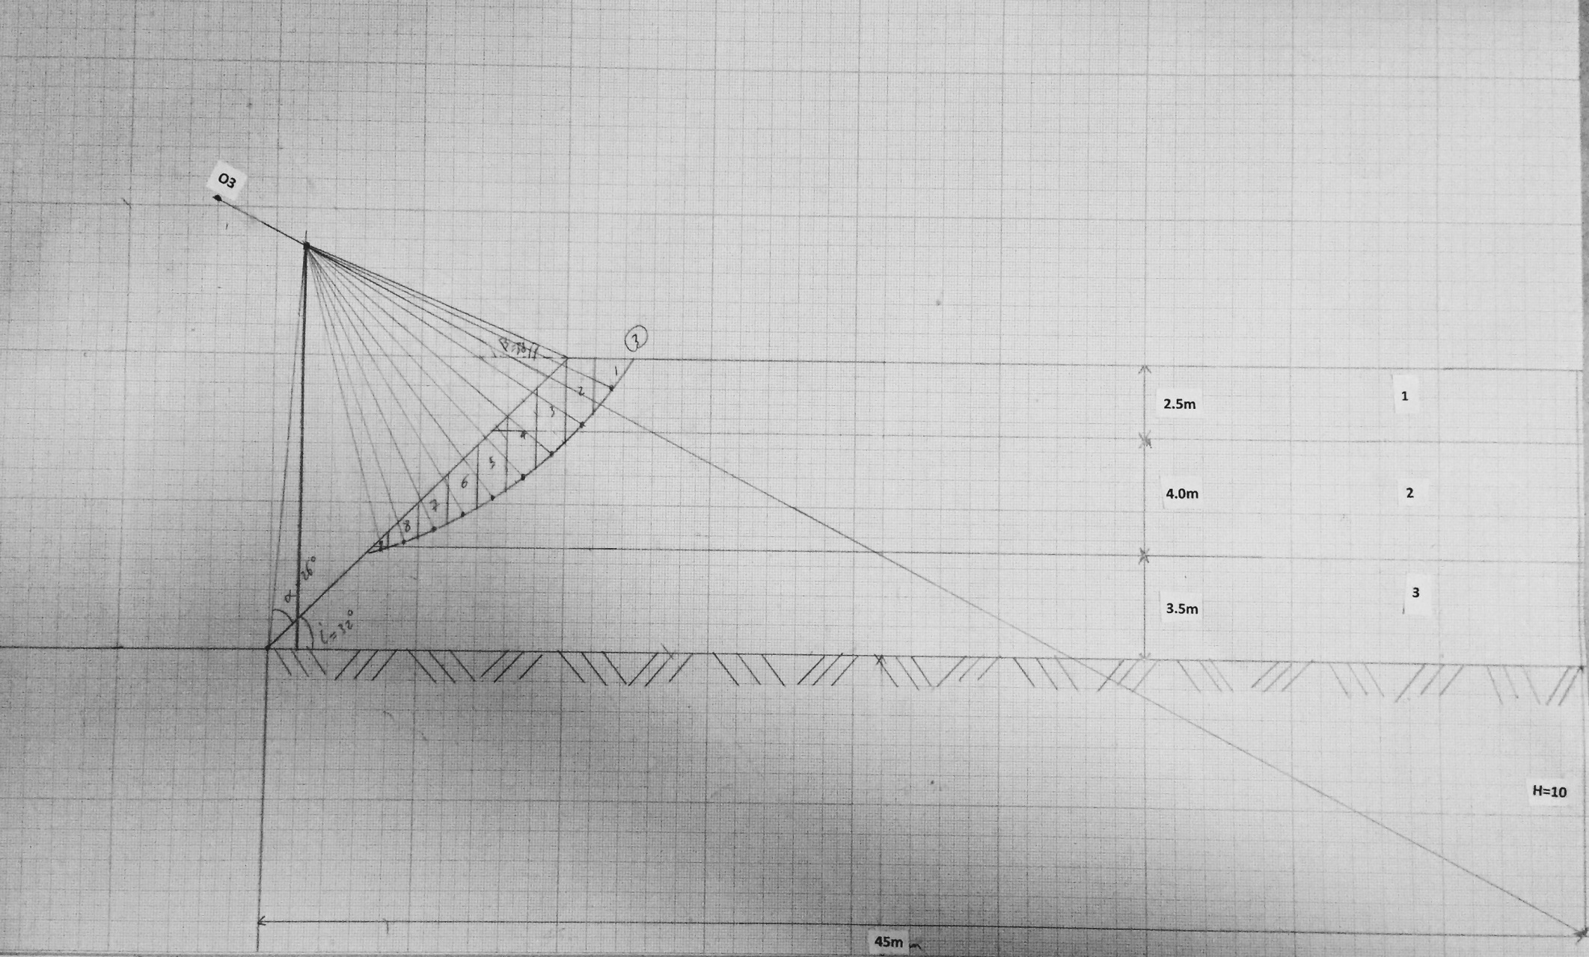
Slope Stability (Case 3)
45m
Slope Stability (3)

Slide 15
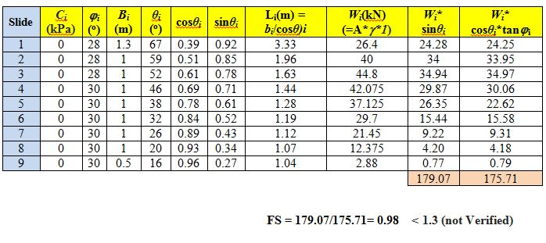
Slope Stability (case 3)
Slope Stability (3)

Slide 16
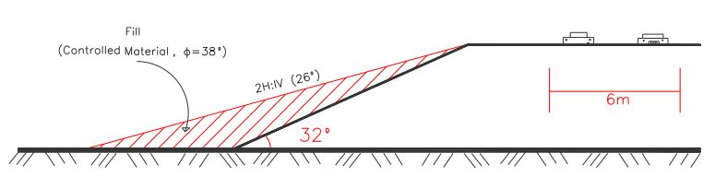
Remedial Measures for Slope

Slide 17
Pavement Design
Asphalt Concrete (AC):
MR= 400,000 psi
Base Material:
MR= 30,000 psi
CBR = 60
Sub-base Material:
MR= 15,000
CBR= 30
Subgrade:
MR= 4000 psi

Slide 18
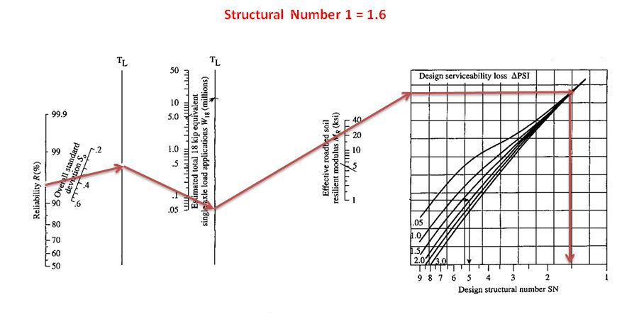
Pavement Design

Slide 19
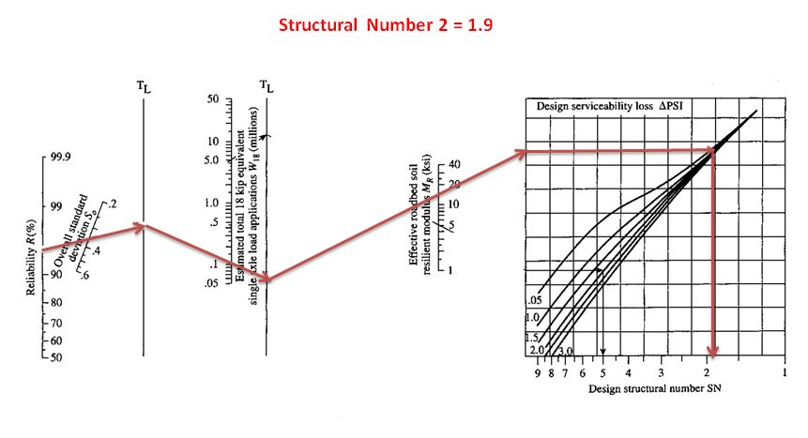
Pavement Design

Slide 20
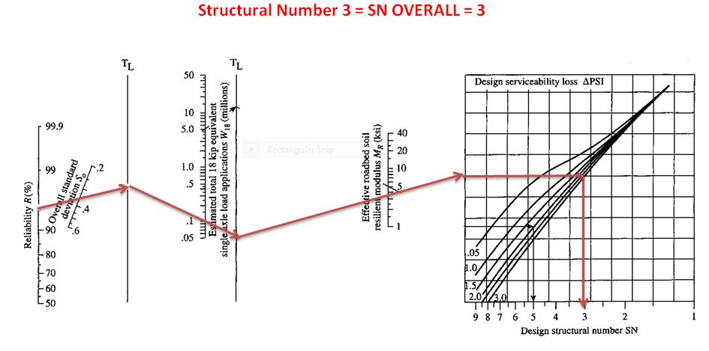
Pavement Design

Slide 21
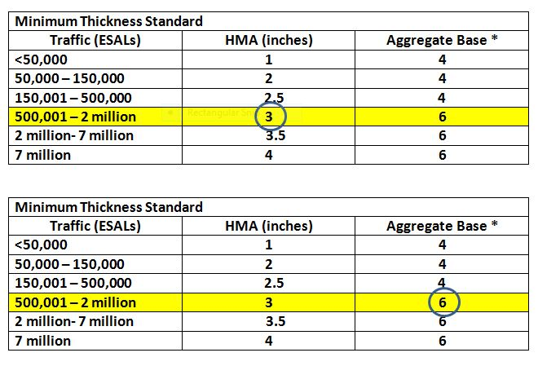
Pavement Design

Slide 22
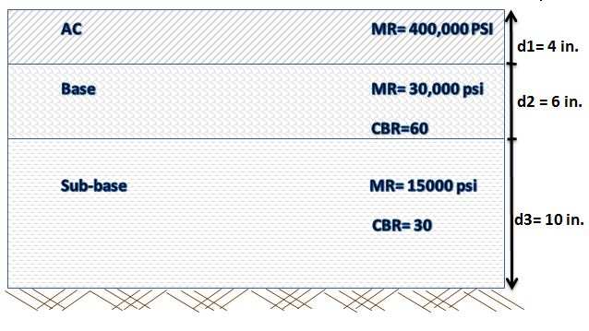
Pavement Design

Slide 23
Raft Foundation
1- Dimensions:
Diameter = 10.0 m
Thickness = 3.0 m
2- Calculation of Loads and Moments:
q | kN or kN.m | Description
FV (down) | 574.8 | Structure Weight
FV (up) | 124.4 | Up-lift force
FH | 865.2 | Wind force
M | 16483 KN.m | Moment due to wind

Slide 24
Raft Foundation
3- Verification of Bearing Capacity (Mayerhoff):
q | kPa | Verification | Condition
qult. | 1431.49
qall | 477.10
qmax | 99.70 | qmax < qall. | Verified
qmin | -98.08 | qmin < 0 | Not verified

Slide 25
Raft Foundation
4- Verification of Settlement (Schmertmann):
δ | mm | Verification | Condition
δmax | 151.8
δall | 40 | δmax > δall. | Not verified

Slide 26
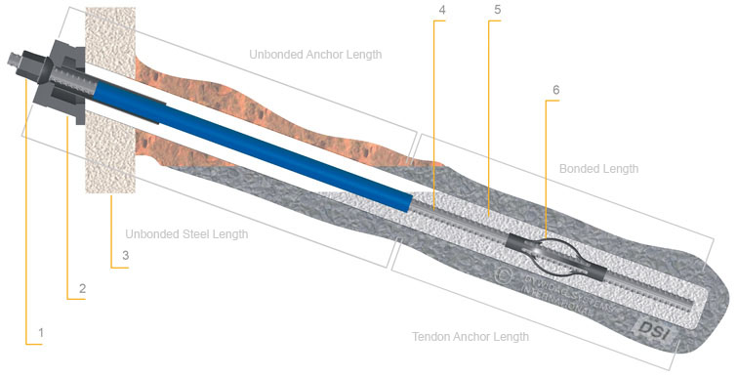
Piled Foundation
Diwidag Pile

Slide 27
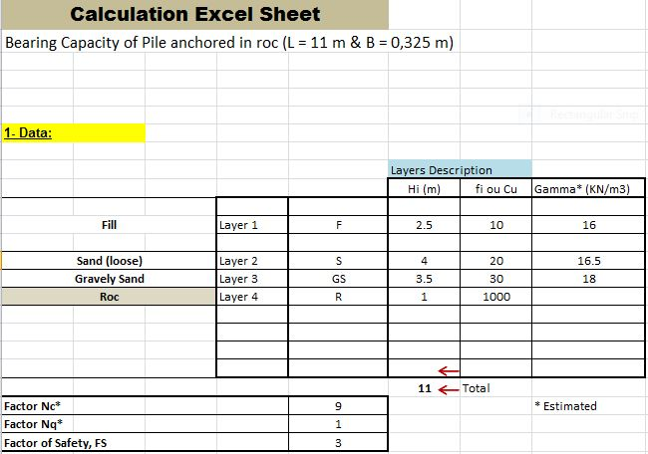
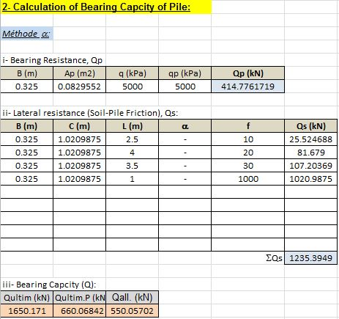
Piled Foundation
1.Bearing Capacity

Slide 28
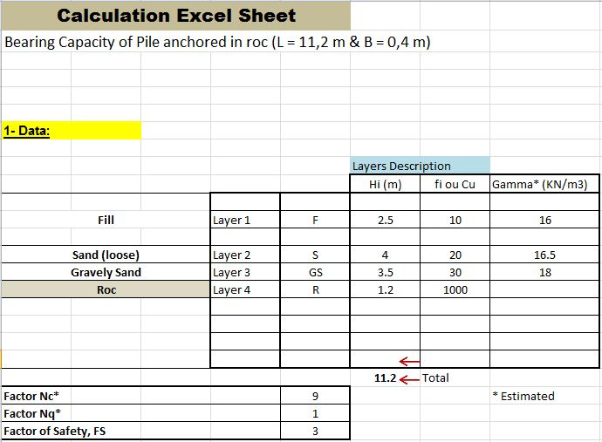
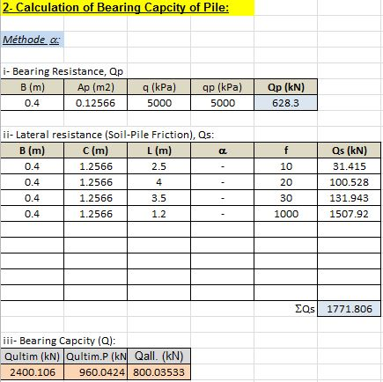

Slide 29
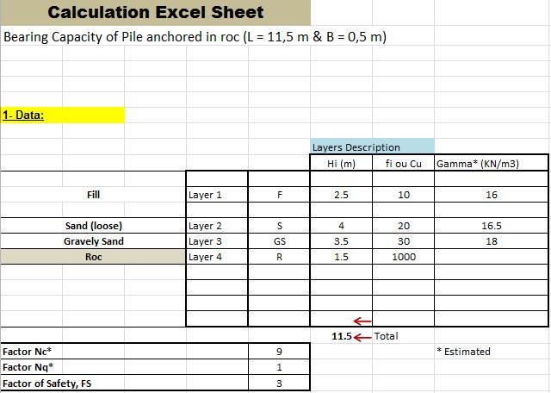
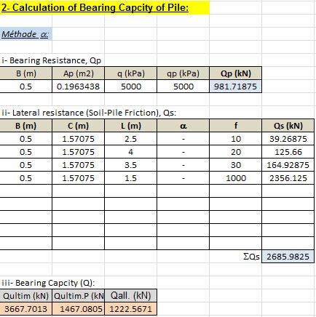

Slide 30
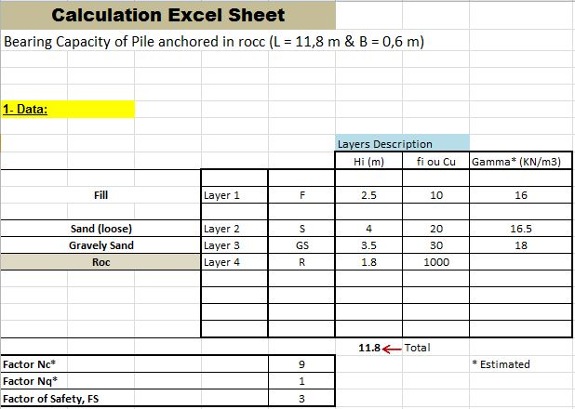
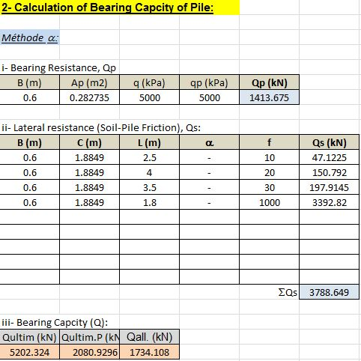

Slide 31
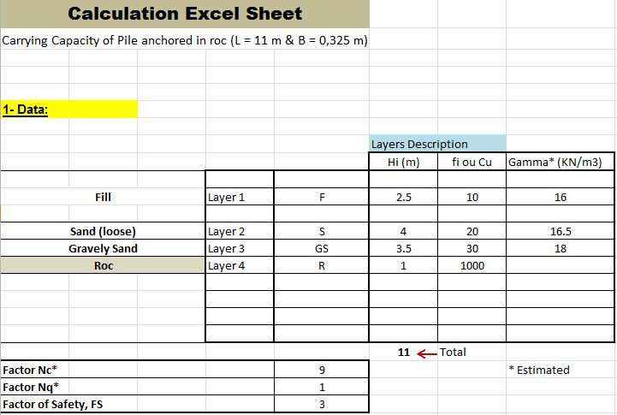
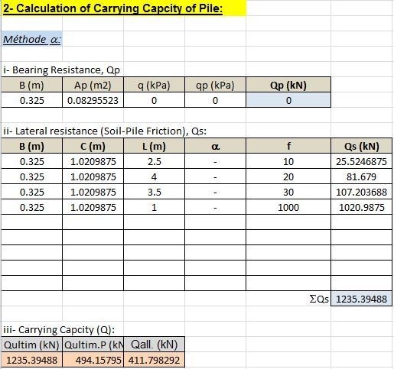
Piled Foundation
2. Carrying Capacity

Slide 32
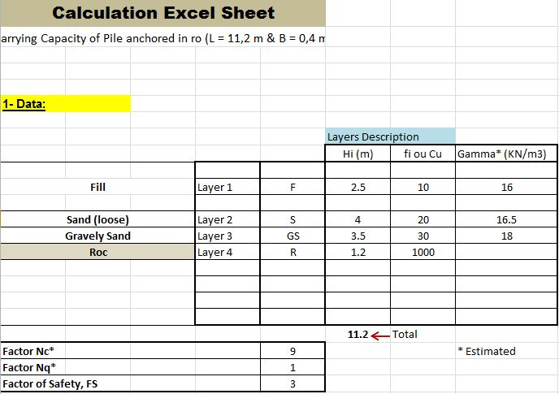


Slide 33
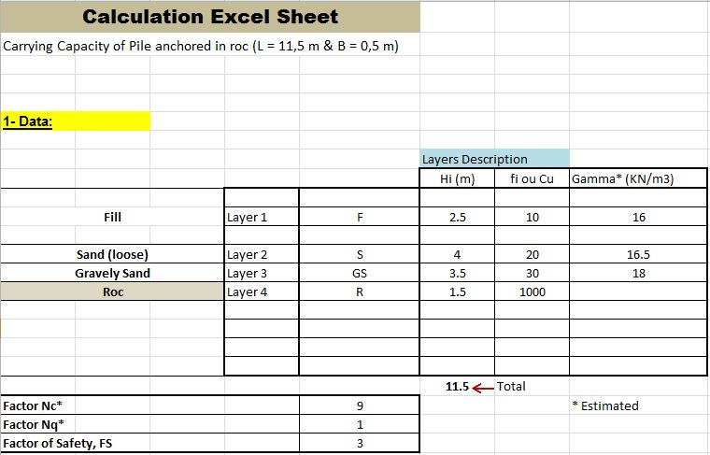
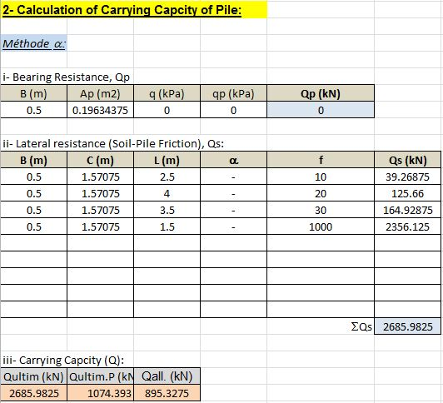

Slide 34
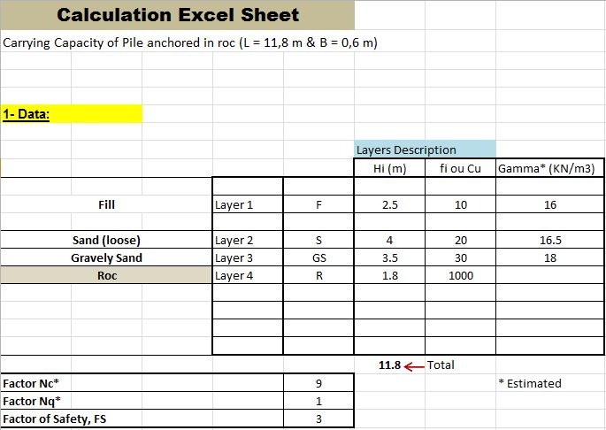


Slide 35
Piled Foundation
Results of The Bearing Capacity of Piles
Diameter (m) | 0.325 | 0.4 | 0.5 | 0.6
Q_{all(b)} (kN) | 550.05702 | 800.03553 | 1222.5671 | 1734.108
Results of The Carrying Capacity of Piles
Diameter (m) | 0.325 | 0.4 | 0.5 | 0.6
Q_{all(c)} (kN) | 411.7982 | 590.602 | 895.3275 | 1262.883
Elastic Settlement In The Soil
Diameter (m) | 0.325 | 0.4 | 0.5 | 0.6
Settlement (m) | 0.032 | 0.021 | 0.013 | 0.009
21 mm < 25 mm Verified

Slide 36
Horizontal Sliding of The Tower
Verification of Ground Passive Pressure:
R₁ : Passive Pressure on the ground of the raft foundation
R₂ : Passive Pressure on the ground of the piles foundations
F_{H} = Wind Force
R₁ = 199.4 kN
R₂ = 1474.41 kN
F_{H} = 862.2 kN
R_{total} = R₁+R₂ = 199.4+1474.41 = 1673.81 kN
Therefore, R_{total} > F_{H} (Verified)

Slide 37
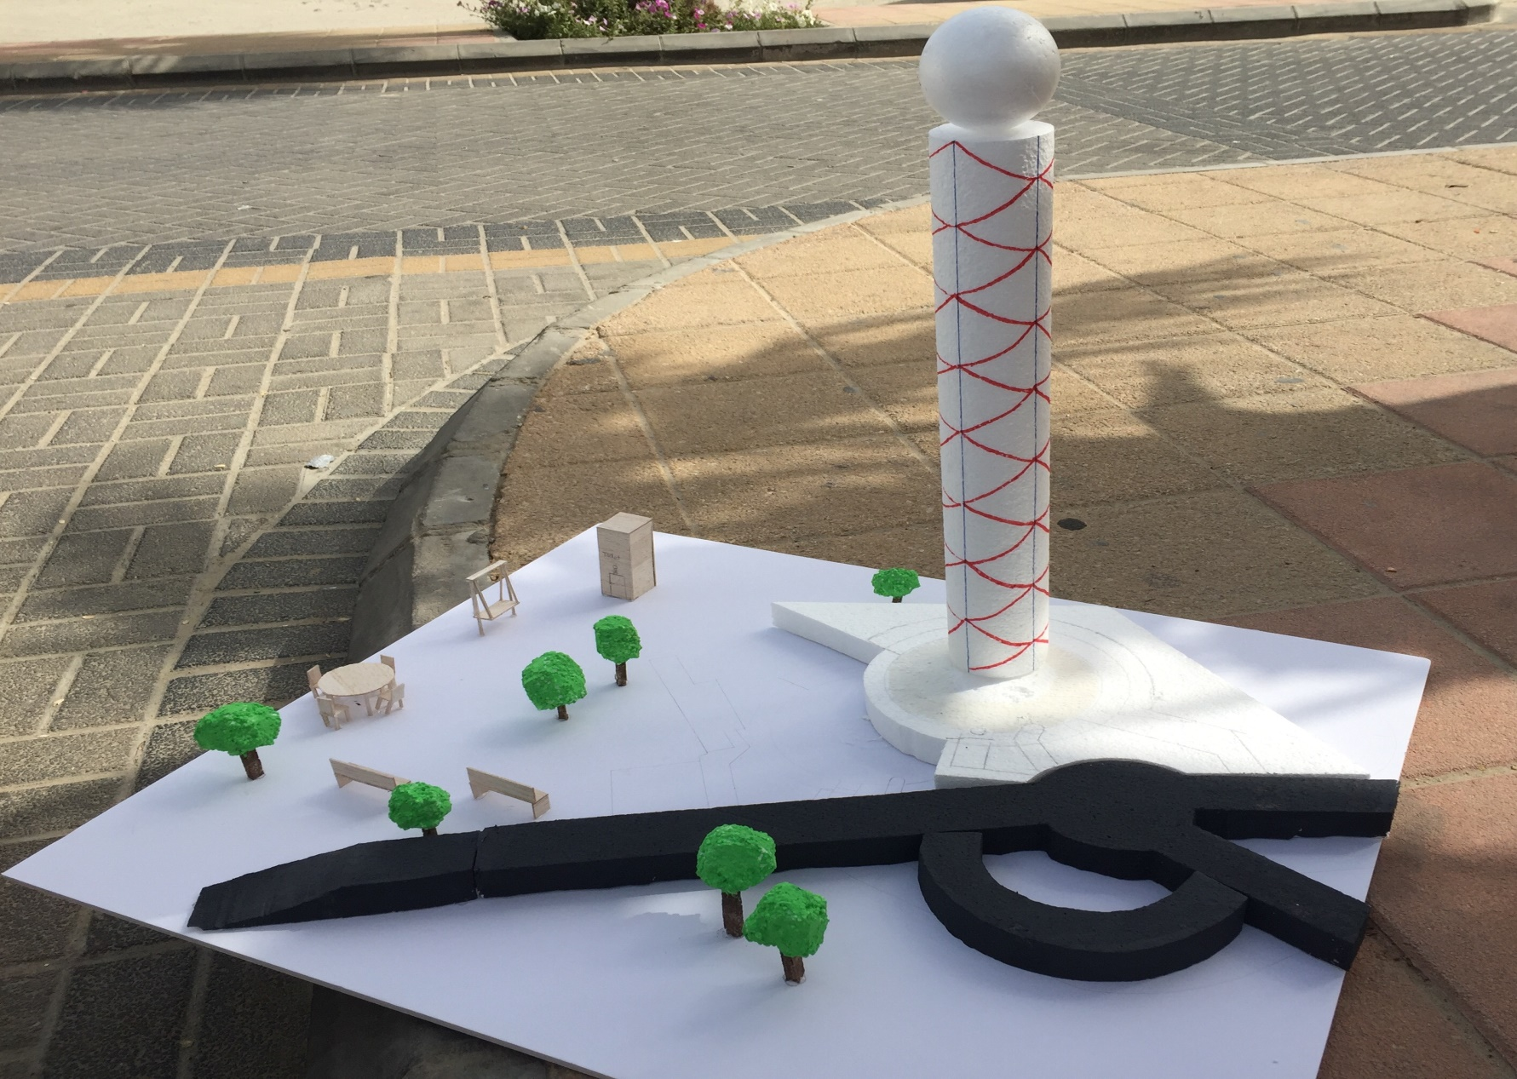
Prototype

Slide 38
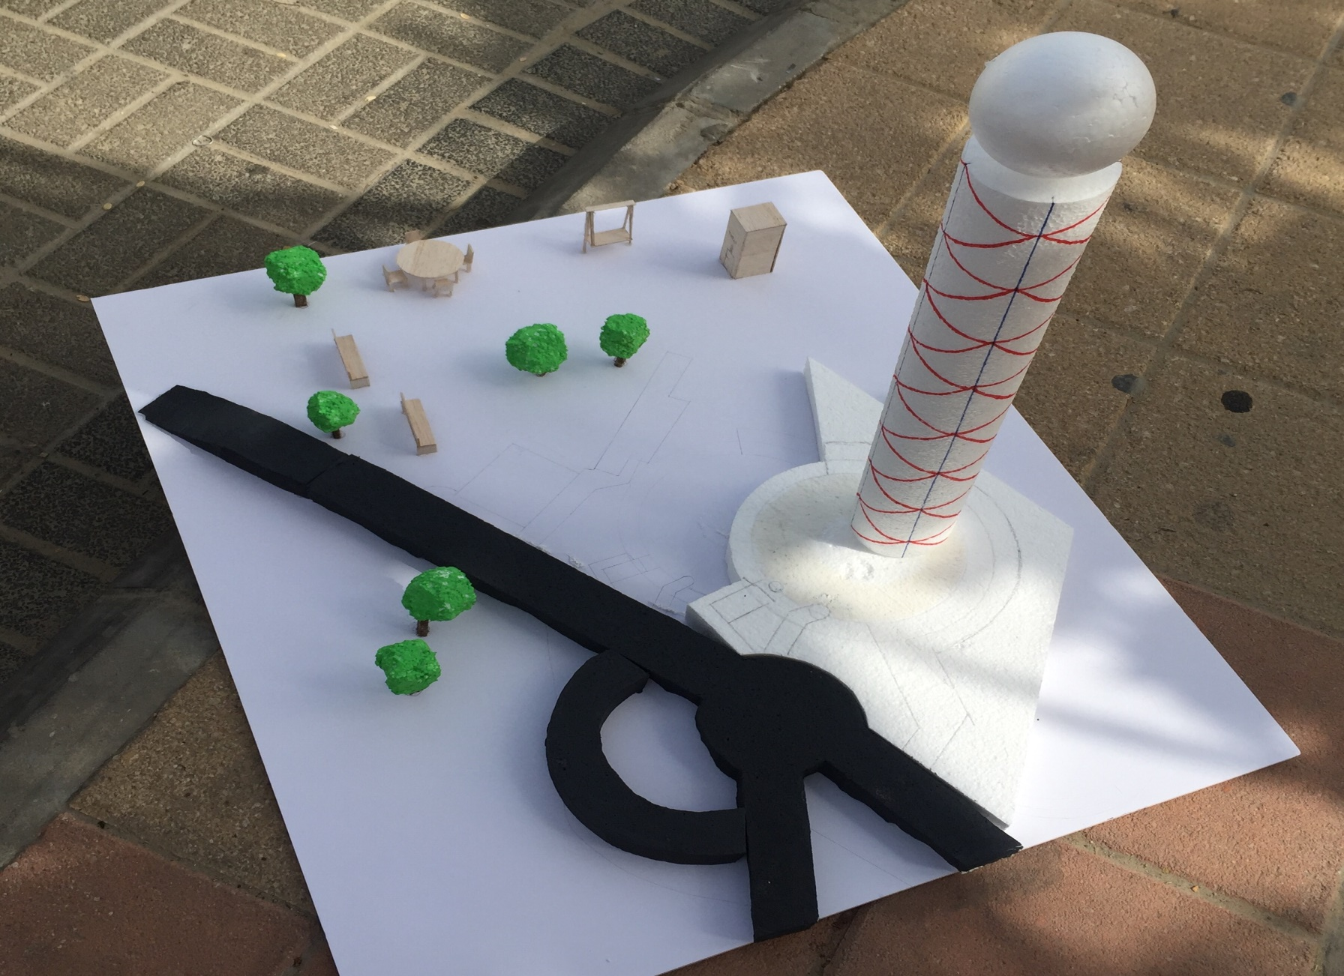

Slide 39
Conclusion
A Star Flyer Tower was developed and designed in a site situated nearby a slope of granular soils. The site of the project extends over an area of about 70000 m² and located near Cornish at Al-Khobar (Saudi Arabia).
A prototype of the Star Flyer Tower was developed. The prototype shows the different components of the Tower, the slope nearby, and the paved road.

Slide 40
Conclusion
A geotechnical design was performed in order to select the appropriate foundation system for the tower.
Two combined types of foundation system were adopted for this project, including raft and piled foundations bored and anchored in the rock.

Slide 41
Conclusion
A hand calculation and analysis was conducted to investigated the stability of the granular slope. Furthermore, a remedial measure was suggested to overcome the problem of the slope instability.
The local paved access road was designed using the AASHTO method.

Slide 42
Thank You…..
Any Questions?

