Slide 1

Prince Mohamed Bin Fahd University
College of Engineering
Department of Civil Engineering
Senior Design Project (ASSE III)
Spring 2014
Management of Al-Khaldiyah Road to optimize Safety and improve sight View
Presented by:
Ameer AL-Sary 200801605
Hassan AL-Halal 200901309
Supervised by:
Dr. Tahar Ayadat
Dr. Andi Asiz

Slide 2
Outline
Introduction
Description of the project
Soil Report
Geometrical Design
Geotechnical Design
Conclusion
Video/Animation

Slide 3
Introduction
Al-Khaldiyah road is an important and a vital road in the Half Moon Bay. It provides direct access to many local beaches and notably to PMU University
Al-Khaldiyah road was constructed almost about 30 years ago and has been expanded in 2005.
It is characterized by four lines (which become six lines in some places) in both directions extending over about 10 km length
It extends between the bridge of the Air force base and Half Moon Bay road
This road is extensively ridden by PMU university staff and students and by workers in nearby projects.

Slide 4
Introduction (Cont.)
Many accidents were observed in this 10 km road, notably in the last two years.
Many injuries and deaths were recorded where some of them are from PMU students.

Slide 5
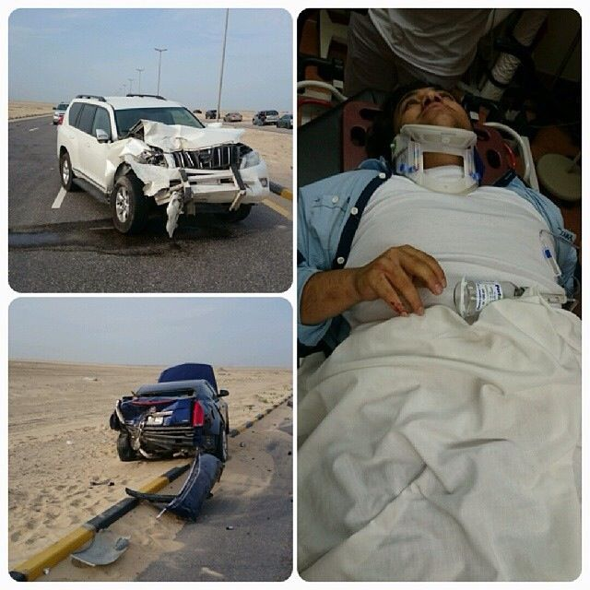
Examples of recent car accidents at the actual Al-Khaldiyah road (1)

Slide 6
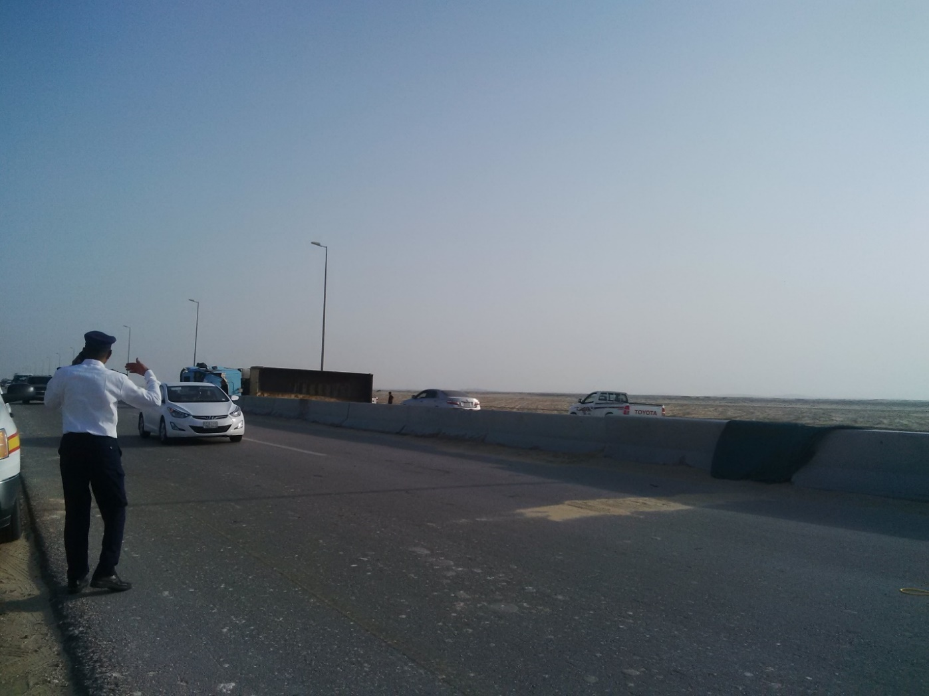
Example of recent car accidents at the actual Al-Khaldiyah road (2)

Slide 7
Outline
Introduction
Description of the project
Soil Report
Geometrical Design
Geotechnical Design
Conclusion
Video/Animation

Slide 8
Description of the project
The road is considered as subdivision road linking the cities of Al-Khobar, Dhahran and Dammam, along a distance or a length of about 9.9 kilometers and an actual width of 19.6
The allowable design width of the road is around 60.0 m.

Slide 9
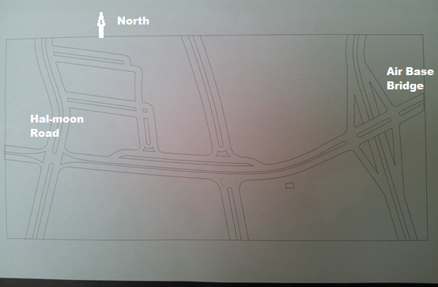
Plane view of the actual Al-Khaldiyah road

Slide 10
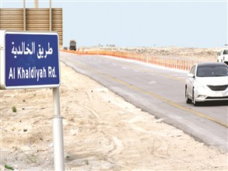
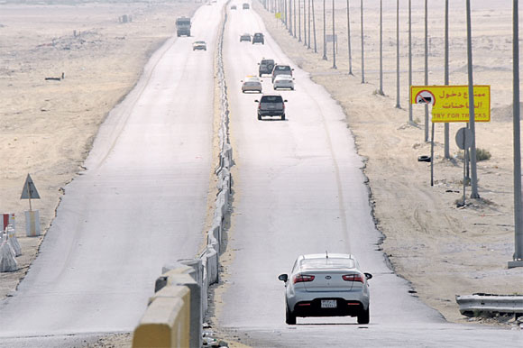
Photos of the actual Al-Khaldiyah road

Slide 11
Outline
Introduction
Description of the project
Soil Report
Geometrical Design
Geotechnical Design
Conclusion
Video/Animation

Slide 12
Soil Report
In general the soil of the site is characteristics by:
→ 7 to 8 m of sand medium to dense,
→ Followed by thick layer of hard clay
→ Water table is located at around 1.0 m

Slide 15
Outline
Introduction
Description of the project
Soil Report
Geometrical Design
Geotechnical Design
Conclusion
Video/Animation

Slide 16
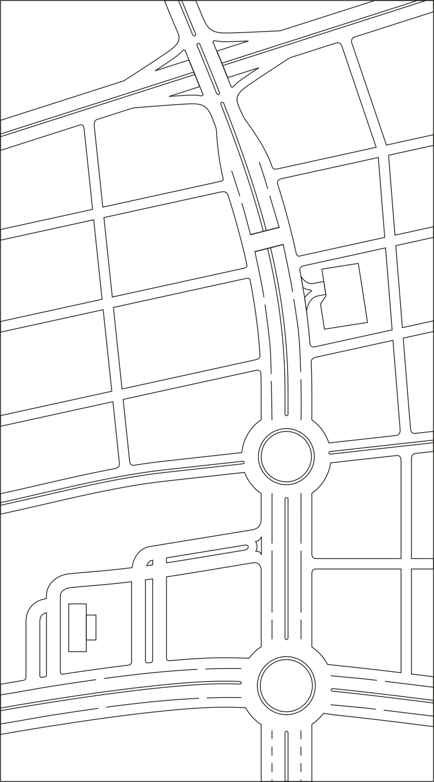
Geometrical Design
Geometrical Design of Proposition #1 (Tunnel and two Roundabout)

Slide 17
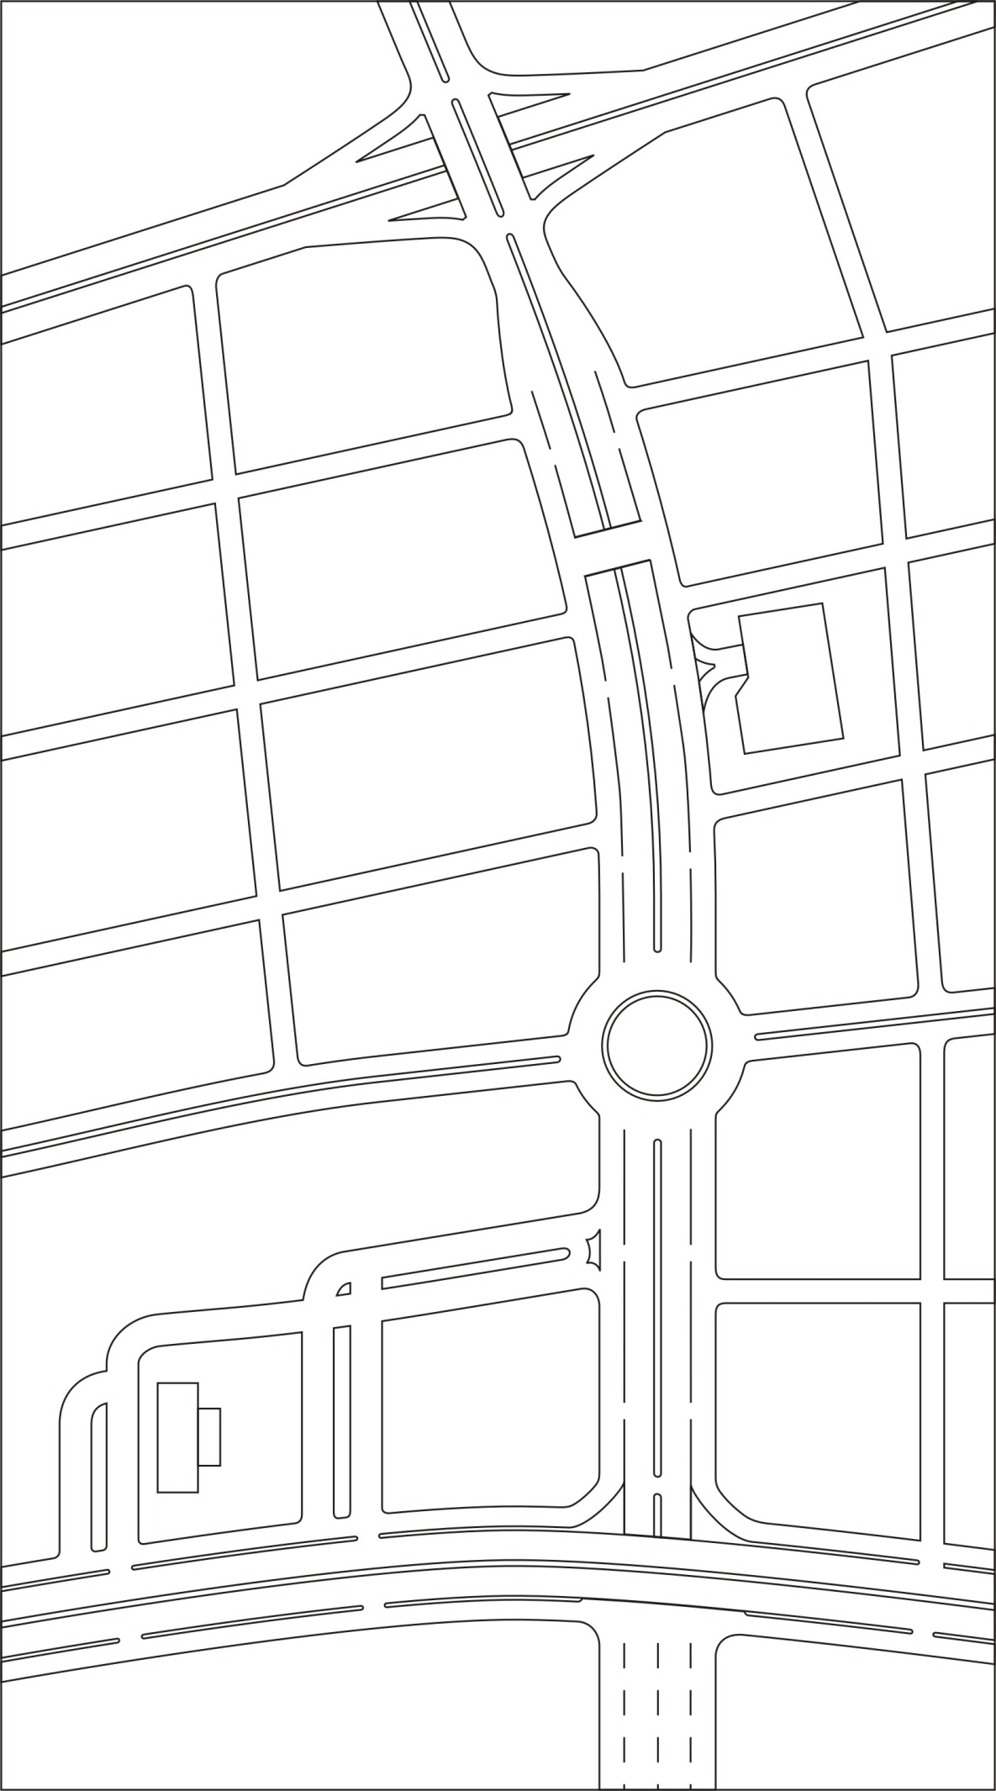
Geometrical Design of Proposition #2 (Tunnel, Roundabout & Bridge)

Slide 18
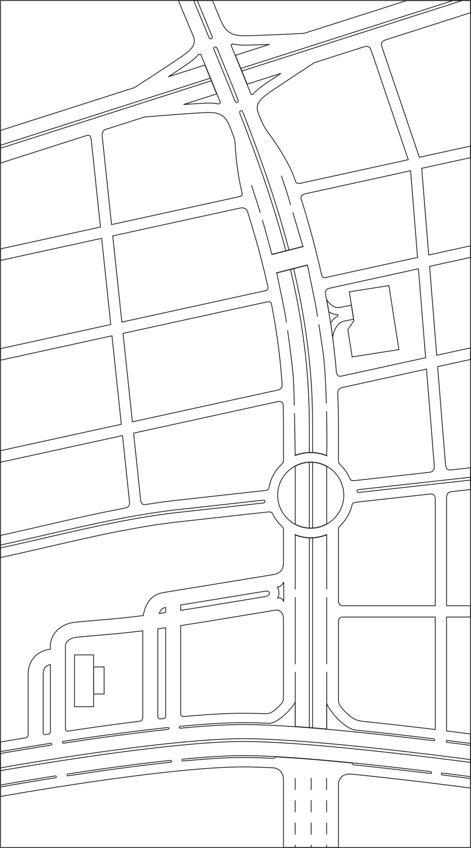
Geometrical Design of Proposition #3 (Tunnel, Tunnel/Roundabout & Bridge)

Slide 19
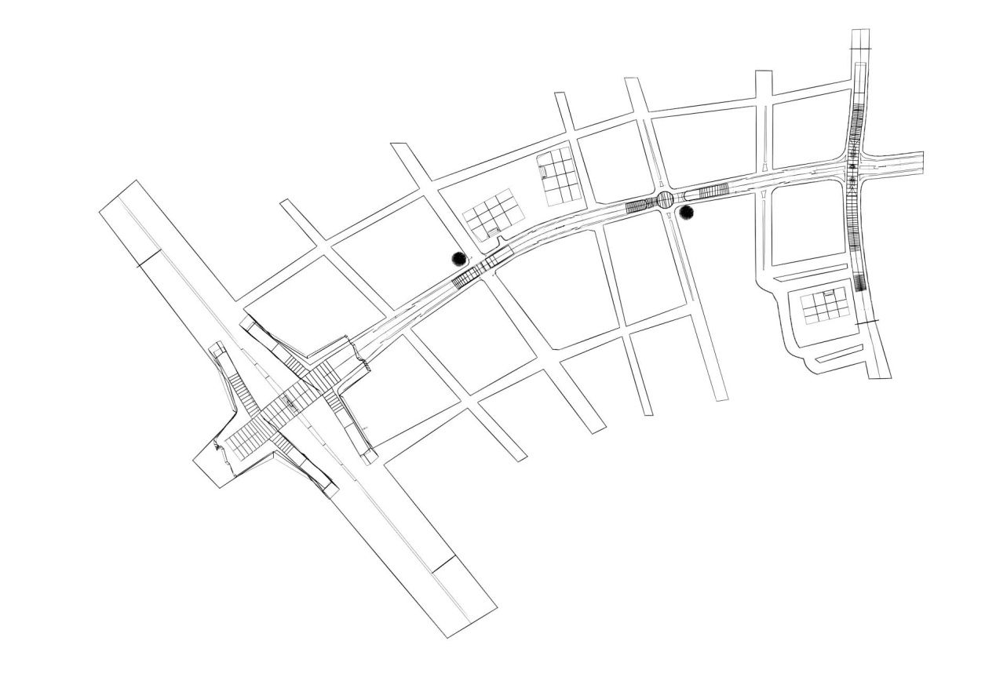
Design Retained
(our final design)
Overall View of the Retained Solution (No 1)

Slide 20
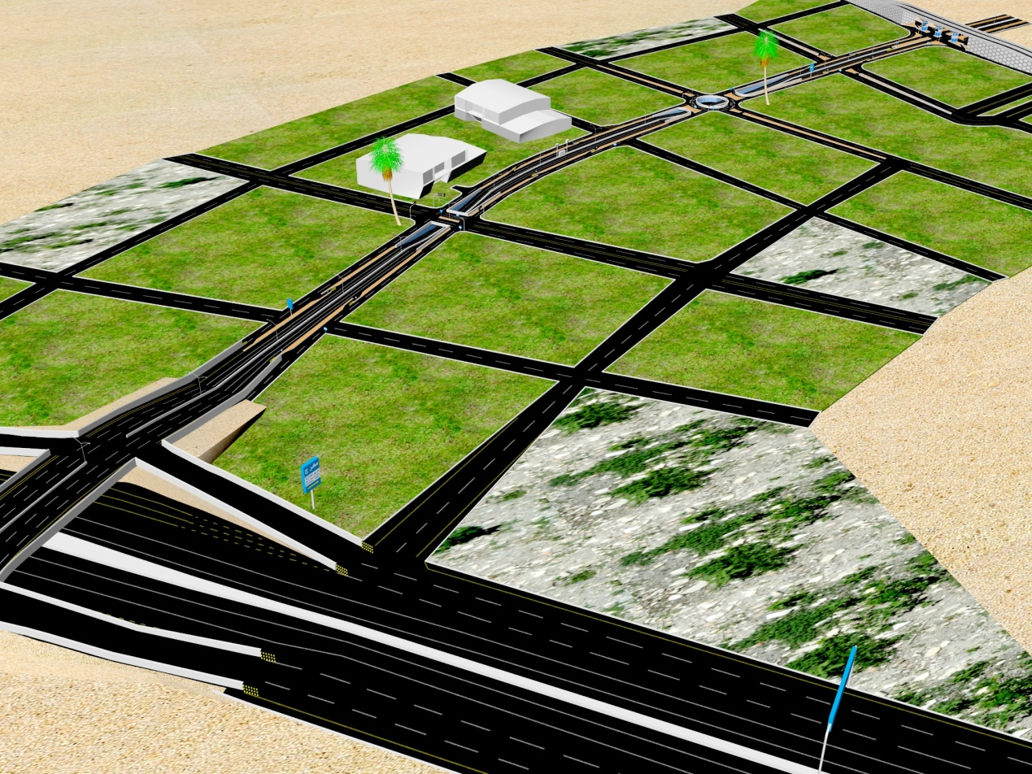
Overall View of the Retained Solution (No 2)

Slide 21
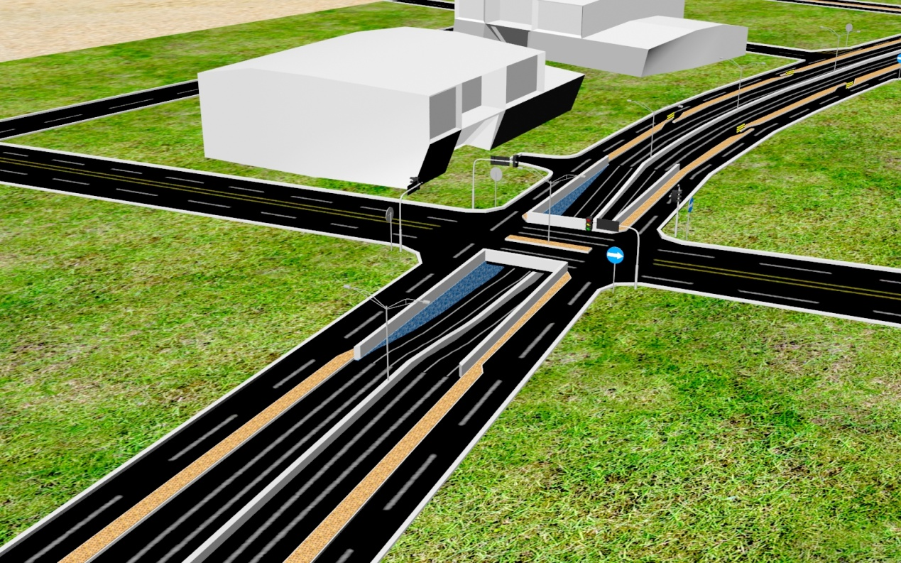
Junction A: The Tunnel
Details:
The tunnel section is 3.3 km away from Air Base Bridge.
→ It has a height of 5.5 m and it is
surrounded by a retaining wall of 6.5 m height.
→ The slope of the road in the tunnel is about is 6%.
View of the Tunnel #1

Slide 22
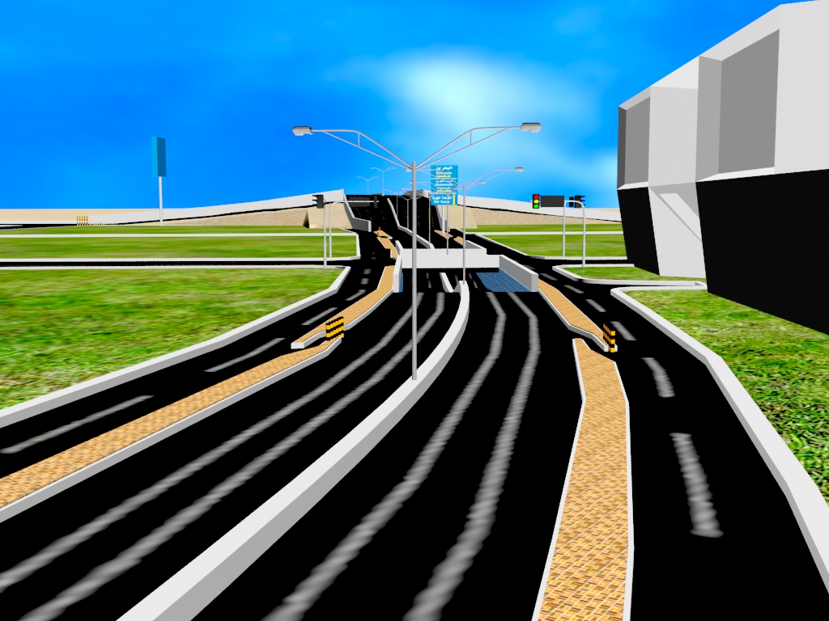
View of the Tunnel #2

Slide 23
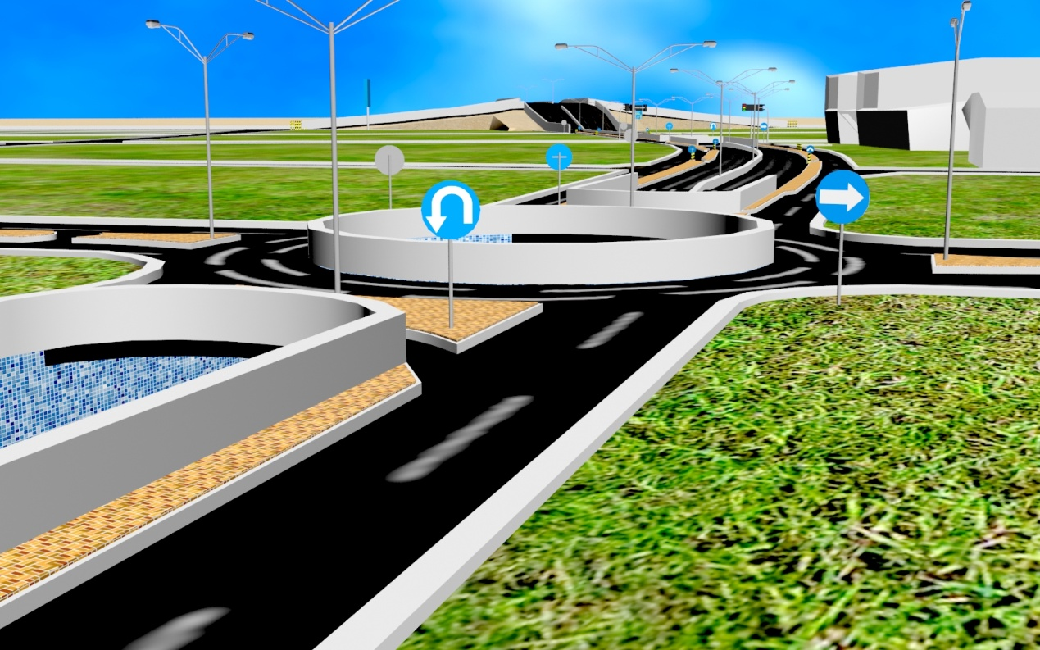
Junction B: The Tunnel/Roundabout
Details:
The tunnel/roundabout junction is about 6.6 km away from Air Base Bridge.
Similarly, it has a height of 5.5 m
and surrounded by a retaining
wall.
The slope of the road in the section
of junction B is about 6% .
View of the Tunnel/Roundabout #1

Slide 24
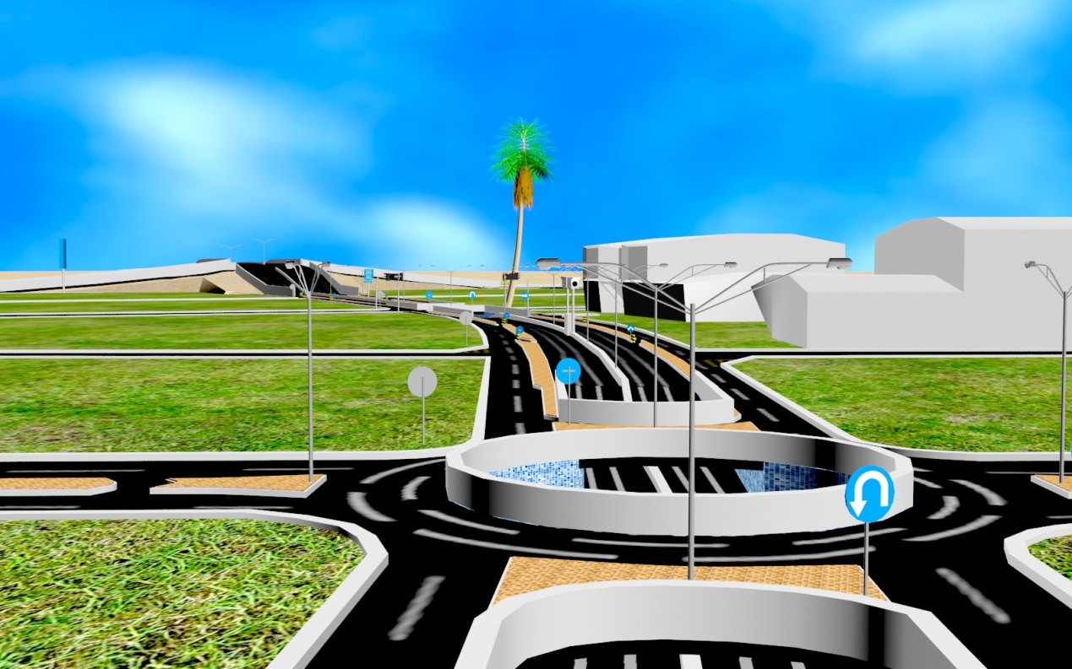
View of the Tunnel/Roundabout #2

Slide 25
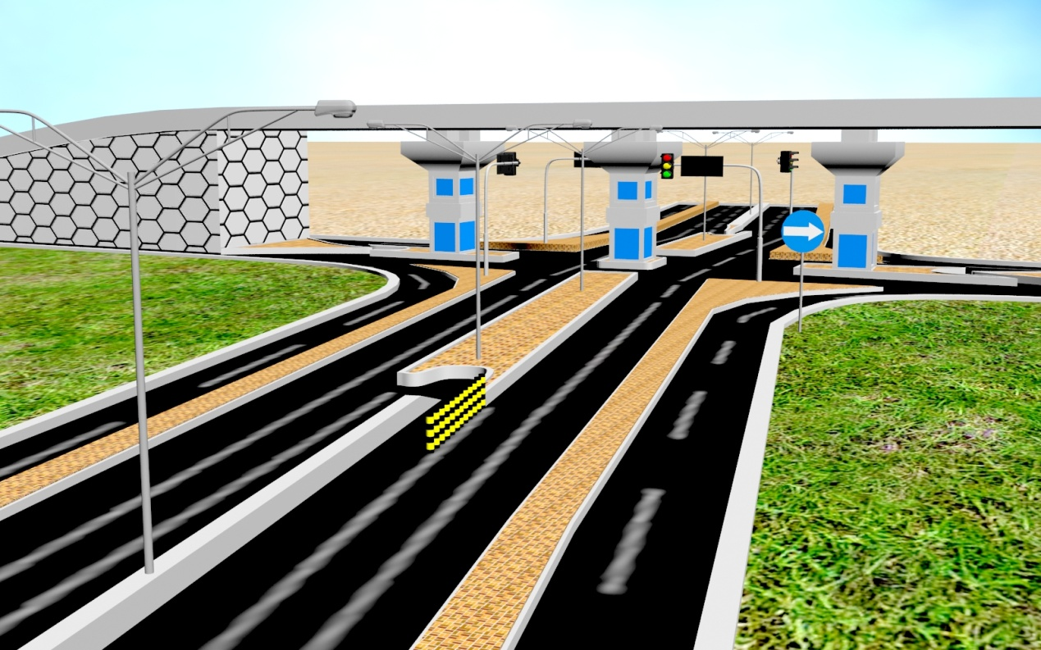
Junction C: The Bridge
Details:
The bridge is located at the intersection of Al-Khaldiyah and Half-moon roads.
It is composed of four freeways, where two freeways are used as U-turn
View of the Bridge #1

Slide 26
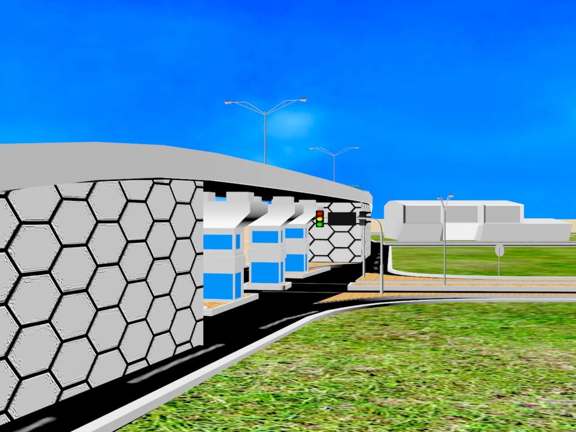
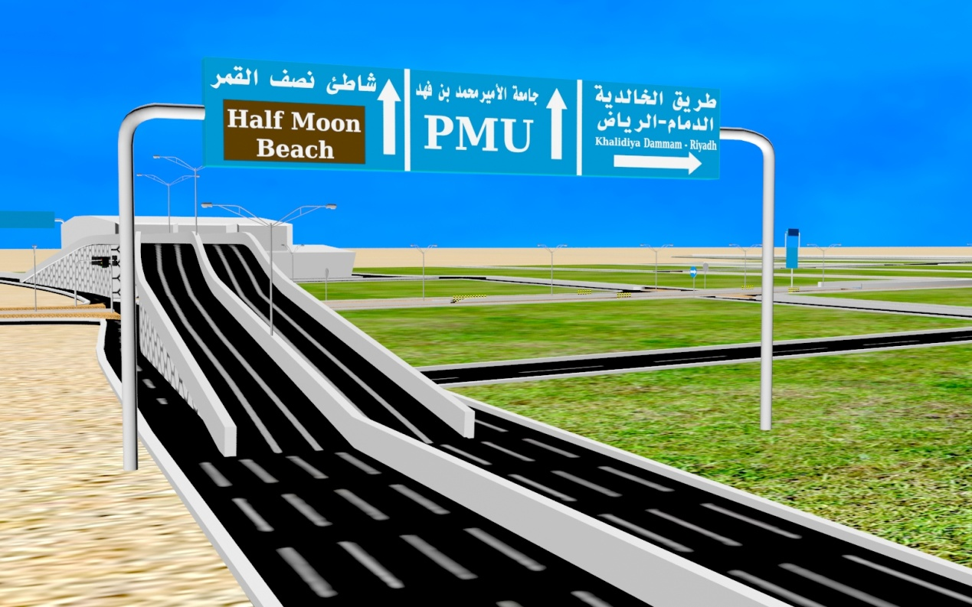
Views of the Bridge #2 & #3

Slide 27
Outline
Introduction
Description of the project
Soil Report
Geometrical Design
Geotechnical Design
Conclusion
Video/Animation

Slide 28
Geotechnical Design
The geotechnical design Included:
→ Retaining Wall (tunnel and tunnel/roundabout)
→ Foundation of the bridge abutment
→ Pavement Design of Managed Road

Slide 29
Part 1: Retaining Wall
(for the tunnel and the tunnel/roundabout)
1- Stability against overturning:
→ FOS = 2.2 (≥ 2, ☺ verified)
2- Stability against base sliding:
→ FOS = 3.9 F (≥ 1.5, ☺ verified)
3- Stability against bearing capacity failure:
→ FOS = 2.62 (≥ 2, ☺ verified)

Slide 30

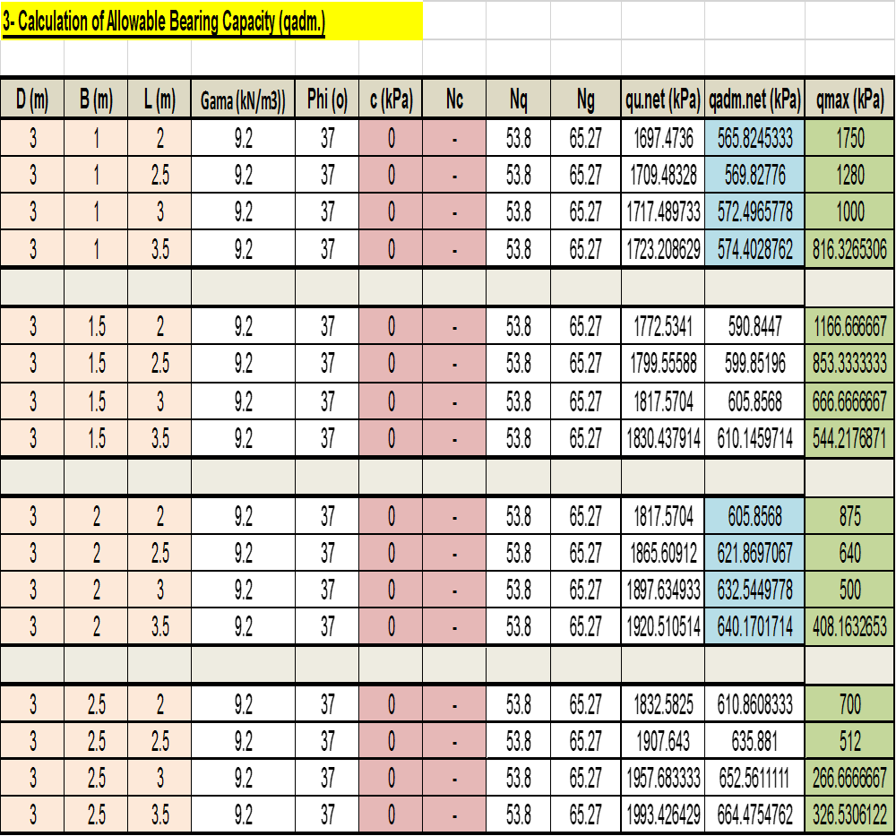
Part 2: Foundation of Bridge
(for bridge abutment)

Slide 31
Part 2: Foundation of Bridge
(for bridge abutment)
The dimensions retained from the analysis are:
          → D = 3 m,
          → B = 2 m, and
          → L = 3.5 m.

Slide 32
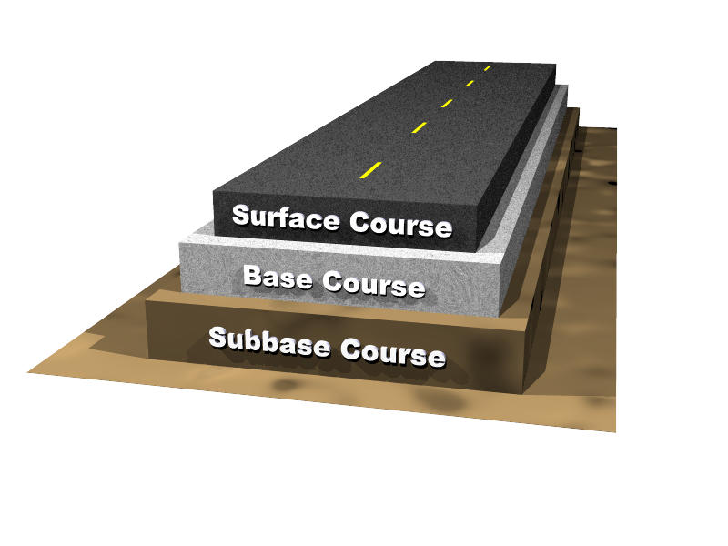
Part 3: Pavement Design
(for main Road)
→ Asphalt Concrete: d₁ = 8 in.
→ Granular Base: d₂ = 6 in.
→ Granular Sub base: d₃ = 18 in.
d (total) = 8 in. + 6 in. + 18 in. = 32 in.

Slide 33
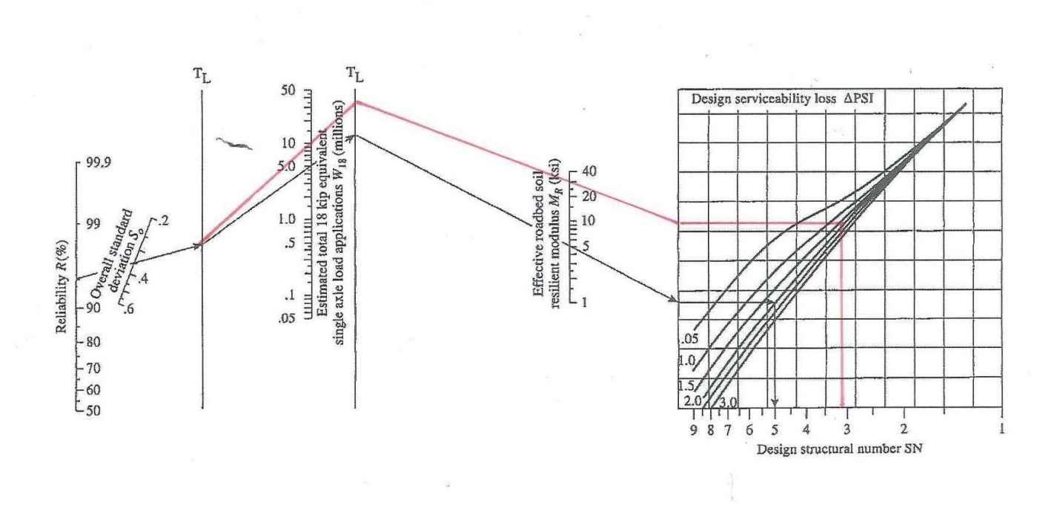
Part 3: Pavement Design
(for main Road)
Determination of SN1

Slide 34
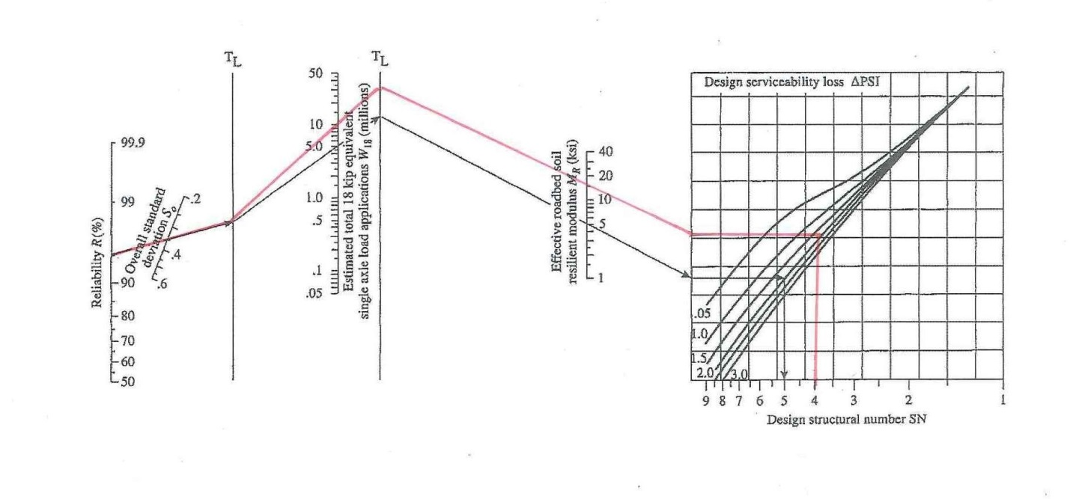
Part 3: Pavement Design
(for main Road)
Determination of SN2

Slide 35
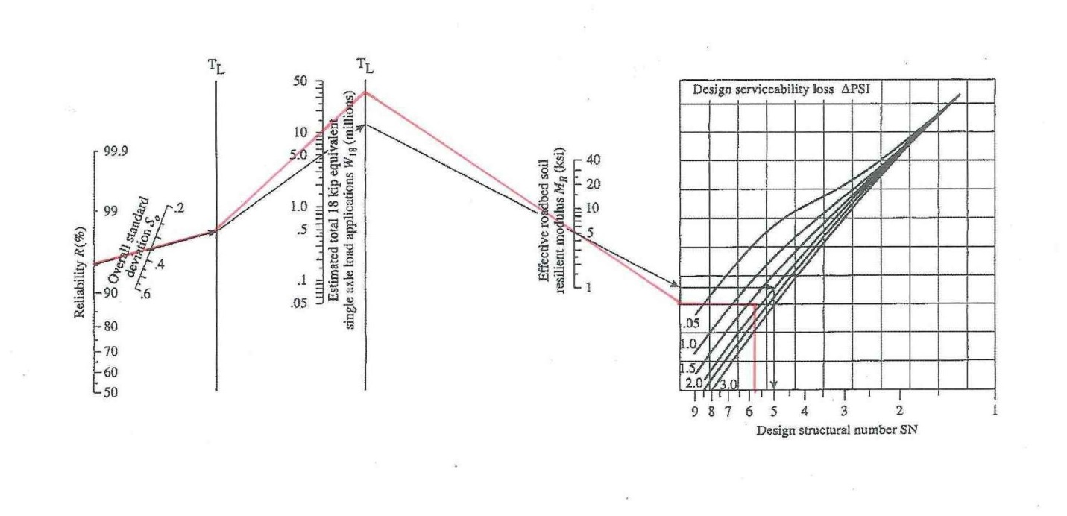
Part 3: Pavement Design
(for main Road)
Determination of SN3

Slide 36
Outline
Introduction
Description of the project
Soil Report
Geometrical Design
Geotechnical Design
Conclusion
Video/Animation

Slide 37
Conclusion
Three different solutions were proposed in order to manage the road of al-Khaldiyah. A comparative study were carried out in order to optimize the management of the road also the improvement of its sight view.
The solution retained for the purpose of this project consisted on the prevision of three different junctions in this case: tunnel, tunnel/roundabout and bridge. The new bridge will connect Al-Khaldiyah and Half-moon roads.
A prototype of the managed road (i.e. the new proposition) was developed. The prototype shows the different components of the roads, as well as, the surrounding facilities.

Slide 38
Conclusion (Cont.)
A geotechnical design was performed (using appropriate Excel Sheet) in order to assess the stability of the tunnel retaining wall and to select the appropriate dimensions of the abutment foundation of the bridge.
A pavement design was carried out using AASHTO method and Saudi code to determine the thicknesses of the different components of a section prototype of the managed road (i.e. Asphalt concrete, granular base and subbase).

Slide 39
Outline
Introduction
Description of the project
Soil Report
Geometrical Design
Geotechnical Design
Conclusion
Video/Animation

