Slide 1
Structural Design & Analysis of 60 story
Building Constructed
Using Ultra-lightweight (ULW) Floor Systems
Students names: Abdulaziz Alhimeidi 201202297
Mohamed Sabbagh 201201997
Rashad Hajjaj 201202604
Abdullah Alattalah 201002345
Advisers: Dr. Andi Asiz & Engr. Danish Ahmed
Department of Civil Engineering
College of Engineering

Slide 2
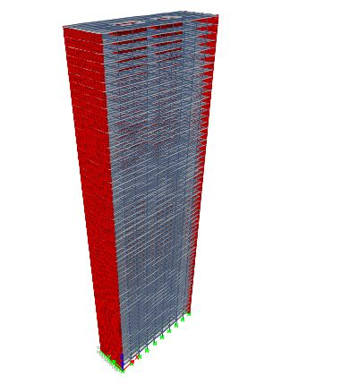
Outline
Objectives
Foundation Design
  Raft Design
  Pile Design
Results
Comparison Summary
Conclusion
1

Slide 3
Objectives
Design 60 story building.
Develop 3D models using ETABS for 60 story buildings.
Compare the CLT floor system with traditional RC floor system.
Check the overall structural performance using ETABS.
Check foundation demand.
2

Slide 4
Foundation Design
Very important element.
Shallow Foundation.
  Raft
  Footing
Deep Foundation.
  Piles
Mixed Foundation.
3

Slide 5
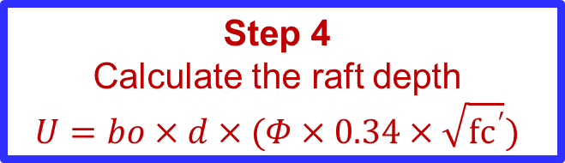
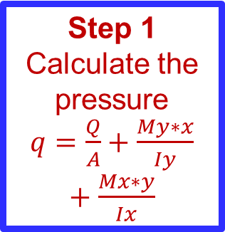
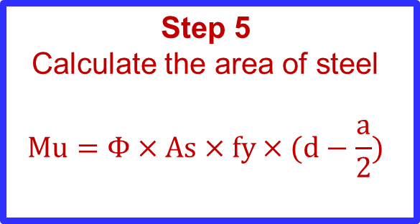
Raft Foundation
Step 1
Calculate the pressure
$q=\frac{Q}{A}+\frac{My∗x}{Iy}+\frac{Mx∗y}{Ix}$
Step 2
Determine the critical strip of joints
Step 3
Obtain shear, moment diagram through SAP2000
Step 5
Calculate the area of steel
$$Mu=Φ×As×fy×(d−\frac{a}{2})$$
Step 4
Calculate the raft depth
$$U=bo×d×(Φ×0.34×\sqrt{{fc}^{′}})$$
4

Slide 6
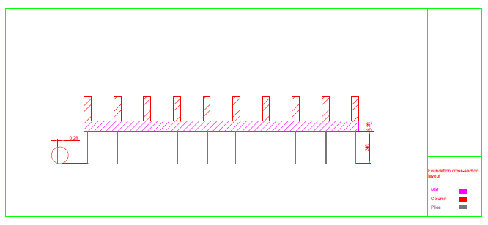
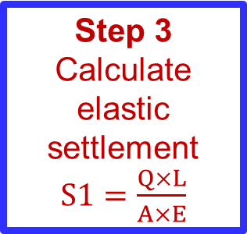
Pile Foundation
Step 1
Calculate the settlement
S=S1+S2+S3
Step 2
Assume several steel pile cross section
Step 3
Calculate elastic settlement
$S1=\frac{Q×L}{A×E}$
5

Slide 8
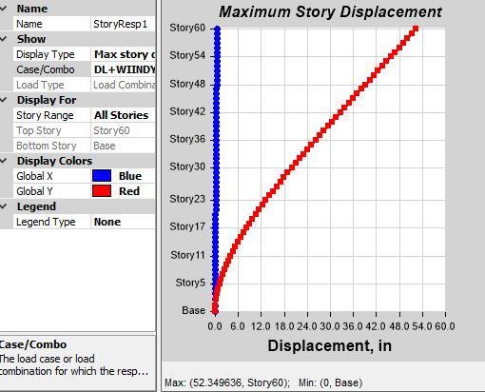
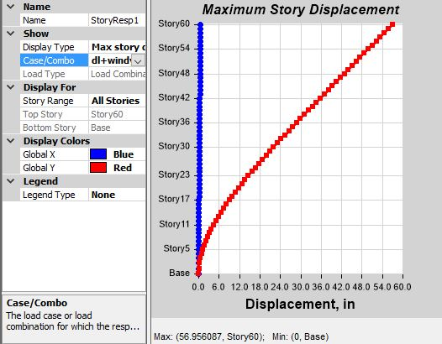
Results
Steel frame drift comparison:
RC
CLT
6

Slide 9
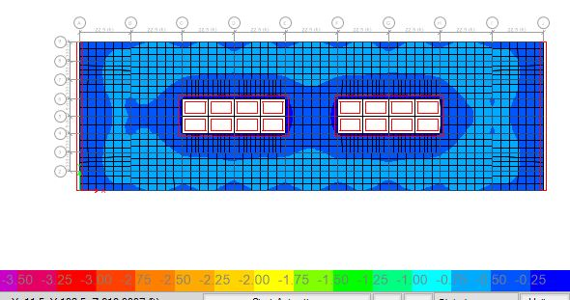
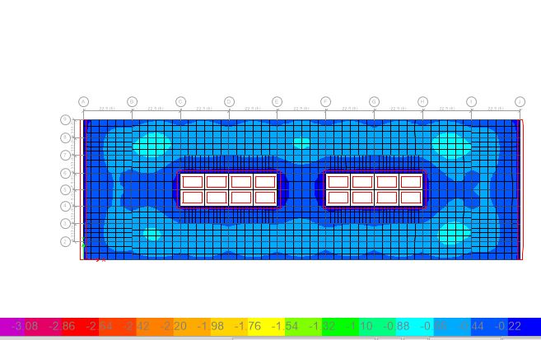
Results
Steel frame slab deflection:
RC
CLT
7

Slide 10
Results
Steel frame foundation demand:
Building type | Steel building with RC slab | Steel building with CLT slab
Raft foundation depth (m) | 2.5 | 2
Raft foundation As (ft²/ft) | 0.12 for negative moment 0.022 for positive moment | 0.1 for negative moment 0.018 for positive moment
Pile foundation settlement (mm) | 0.3 | 0.2
8

Slide 11
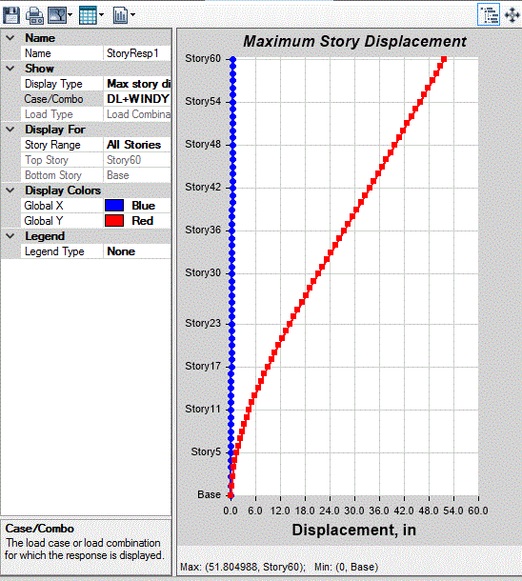
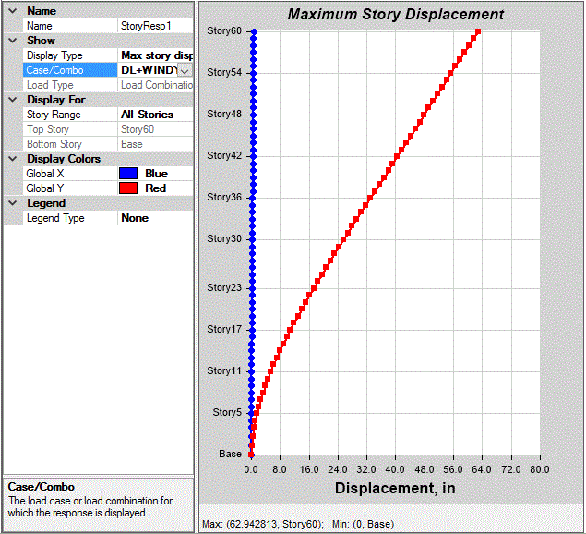
Results
RC frame story drift:
RC
CLT
9

Slide 12
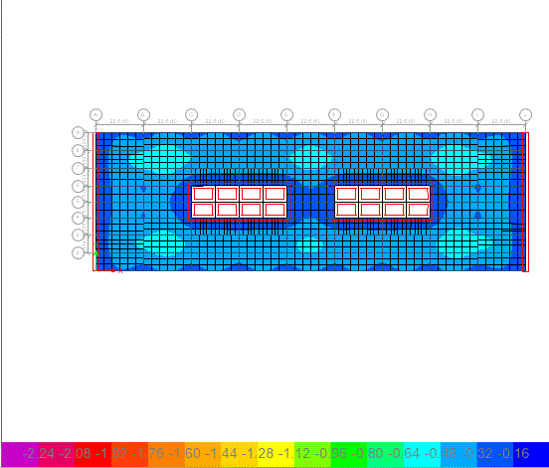
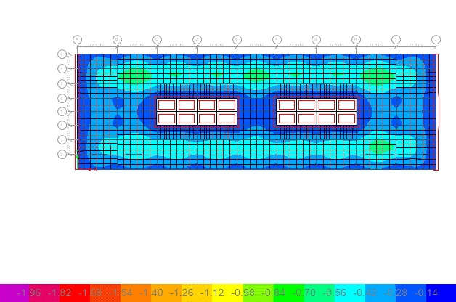
Results
RC frame slab deflection:
RC
CLT
10

Slide 13
Results
RC frame foundation demand:
Building type | RC building with RC slab | RC building with CLT slab
Raft foundation depth (m) | 3 | 2.6
Raft foundation As (ft²/ft) | 0.13 for negative moment 0.027 for positive moment | 0.11 for negative moment 0.018 for positive moment
Pile foundation settlement (mm) | 0.6 | 0.5
11

Slide 14
Comparison Summary
Comparing steel frames with CLT and Concrete slab.
Comparing concrete frames with CLT and Concrete slabs.
Comparing concrete and steel frames.
Foundation Demand.
12

Slide 15
Comparing Steel Frames with CLT and Concrete Slab
The drift in R.C. slab was less by 7.2% .
The steel stress and strain ratio was higher in R.C. slab.
Reaction forces for the CLT slab structure was less by 20%.
Mat foundation demand for CLT slab structure was less by 20%. From 2m - 2.5m.
13

Slide 16
Comparing Concrete Frames with CLT and Concrete Slabs
The drift in concrete frame with reinforced concrete slab was less by 18%.
The CLT slab has 15% more deflection than concrete.
CLT is less 17% in total reaction force acting on column.
Mat Foundation demand for CLT is from 2.6m - 3m.
14

Slide 17
Comparing Concrete and Steel Frames.
Overall structure performance for the steel frame was lighter than the concrete.
The drift for steel frame is very close than the concrete frame for concrete slab.
The matt foundation for steel frame with CLT is 2m while the mat foundation for concrete frame with CLT slab is 2.6m.
15

Slide 18
Foundation Demand
The settlement will differ from the concrete frame with concrete slab from the concrete frame with CLT slab by 17%.
Settlement in steel frame with concrete slab is more than steel frame with CLT slab by 21%.
16

Slide 19
Conclusion
Structural performance perspective.
Save materials.
However it had higher drift.
Obtain better result.
17

