Slide 1

Final Presentation
Structural & Geotechnical Design of a Hotel in the Area of Half Moon Bay
Fall 2016
ASSE 4311: Learning Outcome Assessment III/Civil Engineering
18/1/2017
Abdalla Shalata 201200594
Mohammed Al-Shiha 201400215
Ali Abualhatal 201202539
Advisors: Dr. Tahar Ayadat
Engr. Danish Ahmed

Slide 2
Presentation Outline
1. Introduction
2. Project objectives
3. Project design
2.1 Calculation and analysis
2.2 Structural design
4. Foundation design
3.1 Geotechnical design
3.2 Foundation Systems
3.2.1 Shallow foundations
3.2.2 Deep foundation (Piles)
5. Conclusion

Slide 3
1- Introduction
Half-moon bay is a semi-lunar arch with several attractions: entertainment zones and amusement cities
It is a major recreational area for tourists, who throng the area on the weekends.
Construction of hotels in the area is still not receiving full consideration.

Slide 4
2- Project objectives
The main objectives of the project are to design a multistory hotel of irregular floor layout in the Half-Moon bay, which includes:
Structural design of the superstructure of the multistory hotel.
Geotechnical analysis and design of appropriate foundation systems of the hotel.

Slide 5
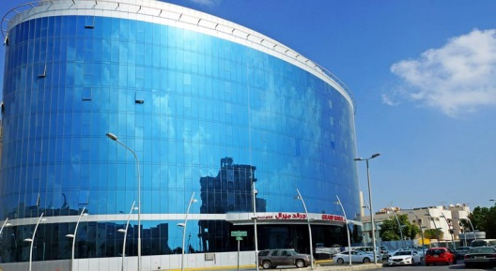

Slide 6
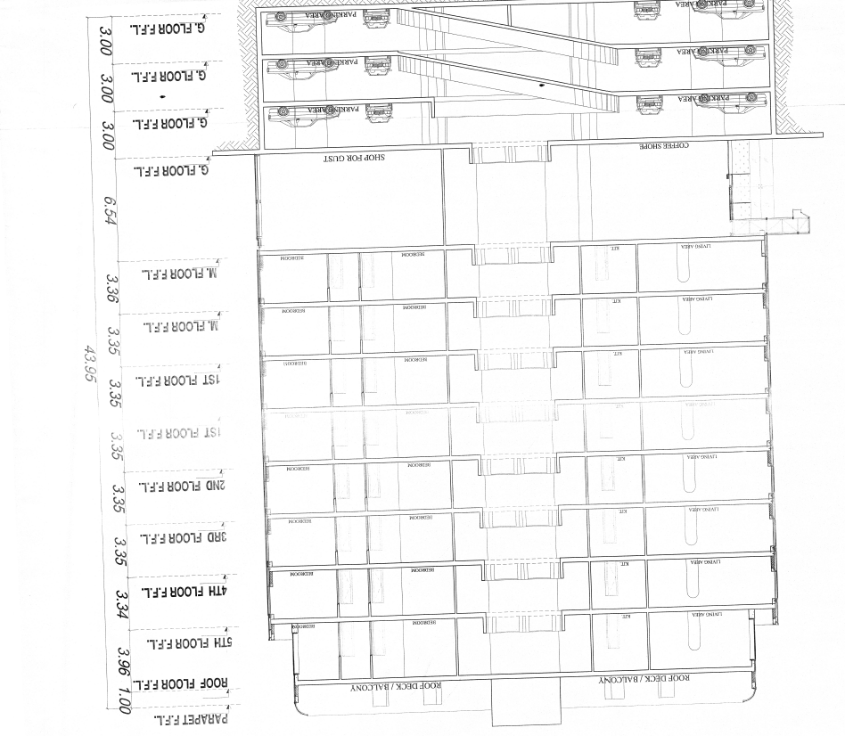

Slide 7
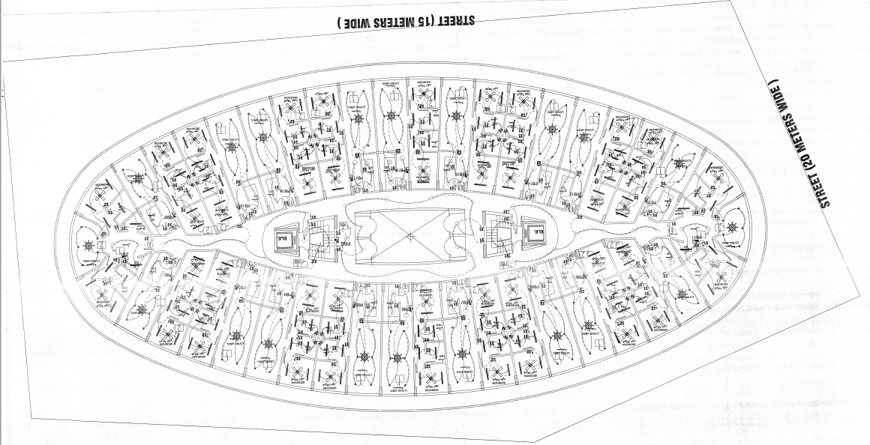
Typical Floor Plan

Slide 8
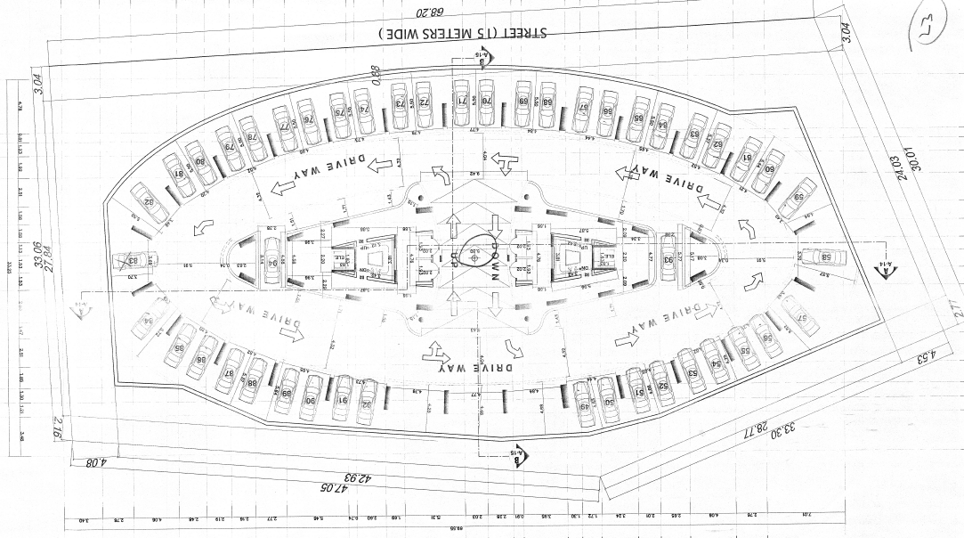
Typical Parking Plan

Slide 9
3- Project design
3.1 Calculation analysis:
3.1.1 Area Calculation
Name | Area in the plan (cm²) | Area in the field (m²)
S1 | 10.58 | 26.22
S2 | 11.67 | 28.29
S3 | 9.03 | 22.38
S4 | 14.4045 | 35.69
S5 | 23.9525 | 59.35
S6 | 10.4575 | 25.91
S7 | 11.12625 | 27.57
S8 | 10.63875 | 26.36

Slide 10
3.1.2 Load Calculation (Saudi Building Code)
floor | pu (kN) | cumulative PU (kN) | Ag cm² | column length cm
Roof | 1505 | 1505 | 1149.73262
7 | 6329 | 7834 | 5984.72116
6 | 708 | 8542 | 6525.59206 | 217.5197352
5 | 708 | 9250 | 7066.46295
4 | 708 | 9958 | 7607.33384
3 | 708 | 10666 | 8148.20474 | 271.6068245
2 | 708 | 11374 | 8689.07563
1 | 708 | 12082 | 9229.94652
G floor | 4203 | 16285 | 12440.7945 | 414.69315
-1 | 540 | 16825 | 12853.3231
-2 | 540 | 17365 | 13265.8518
-3 | 540 | 17905 | 13678.3804 | 455.9460148

Slide 11
3.2 Structural Design
The structural design of the hotel was performed using ETABS.
The hotel is composed of twelve floors or stories.
Each floor will cover an area of about 1870 m2
The maximum live load is taken to be 6.4 KN/m2.

Slide 12
3.2 Structural Design (continued)
Floor # | Calculated Dead load | Calculated Live load
Floor | Dead load (KN/m²) | Life load (KN/m²)
Swimming pool + GYM | 7.1175 | 5
Mechanical room (7) | 7 | 2.68
6 | 7.1175 | 2
5 | 7.1175 | 2
4 | 7.1175 | 2
3 | 7.1175 | 2
2 | 7.1175 | 2
1 | 7.1175 | 2
G | 7.1175 | 6.4
Parking (1) | 7 | 4.9
Parking (2) | 7 | 4.9
Parking (3) | 7 | 4.9

Slide 13
3.2 Structural Design (continued)
Steel bars reinforcement options for positive moment design
Bar # | Number of bars | Total area of bars (in²) | Cross sectional area of one bar (in²) | Bar-to-bar spacing (in)
5 | 6 | 1.86 | 0.31 | To be calculated
6 | 4 | 1.76 | 0.44 | To be calculated

Slide 14
3.2 Structural Design (continued)
Steel bars reinforcement options for negative moment design
Bar# | Number of bars | Total area of bars (in²) | Cross sectional area of one bar (in²) | Bar-to-bar spacing (in)
5 | 6 | 1.86 | 0.31 | 0.8944 (calculated in the positive moment design)
5 | To be calculated | 1.49 | To be calculated | 2.5
6 | 4 | 1.76 | 0.44 | 1.7493 (calculated in the positive moment design)
6 | To be calculated | 1.51 | To be calculated | 3.5

Slide 15
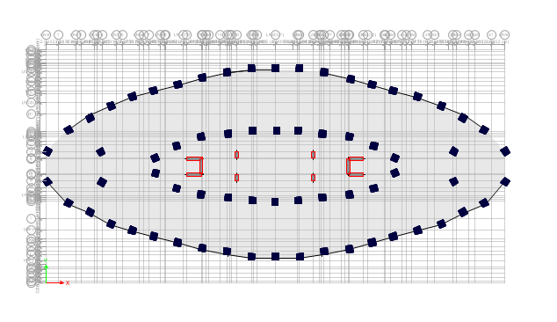
3.2 Structural Design (continued)
Repartition of the columns (2D)

Slide 16
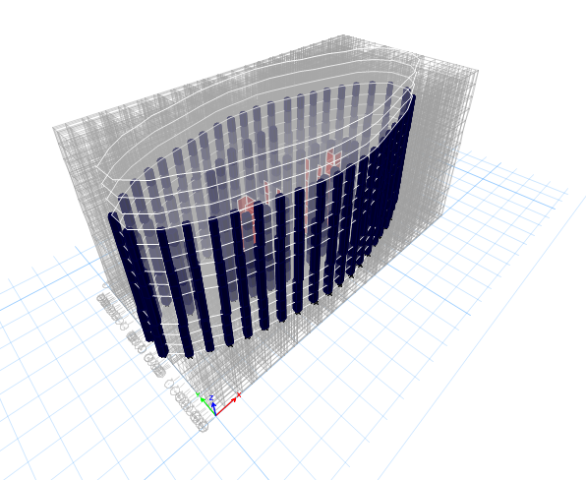
3.2 Structural Design (continued)
Repartition of the columns (3D)

Slide 17
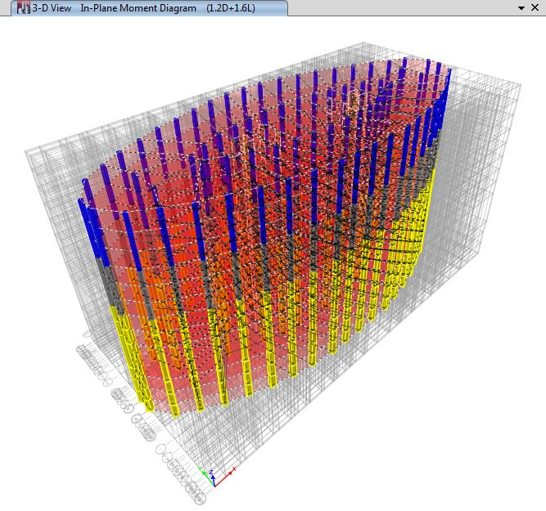
3.2 Structural Design (continued)
Results of Moments Repartitions (3D)

Slide 18
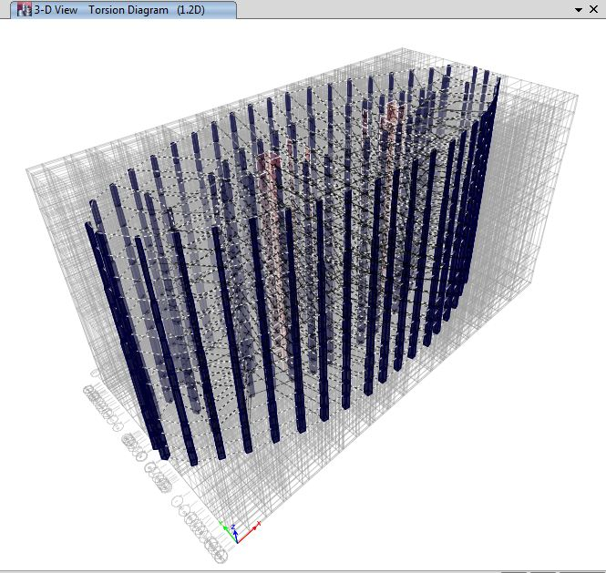
3.2 Structural Design (continued)
Results of Torsion Forces (3D)

Slide 19
3.2 Structural Design (continued)
Results of Shear Forces (2D)

Slide 20
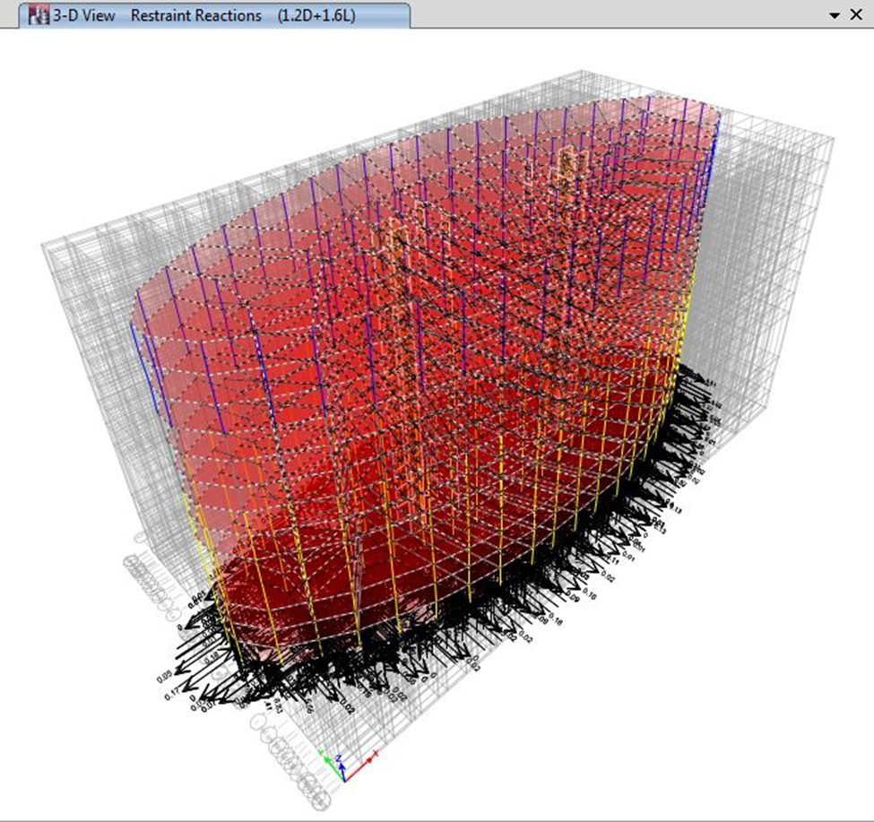
3.2 Structural Design (continued)
Results of Restraint Reactions (3D)

Slide 21
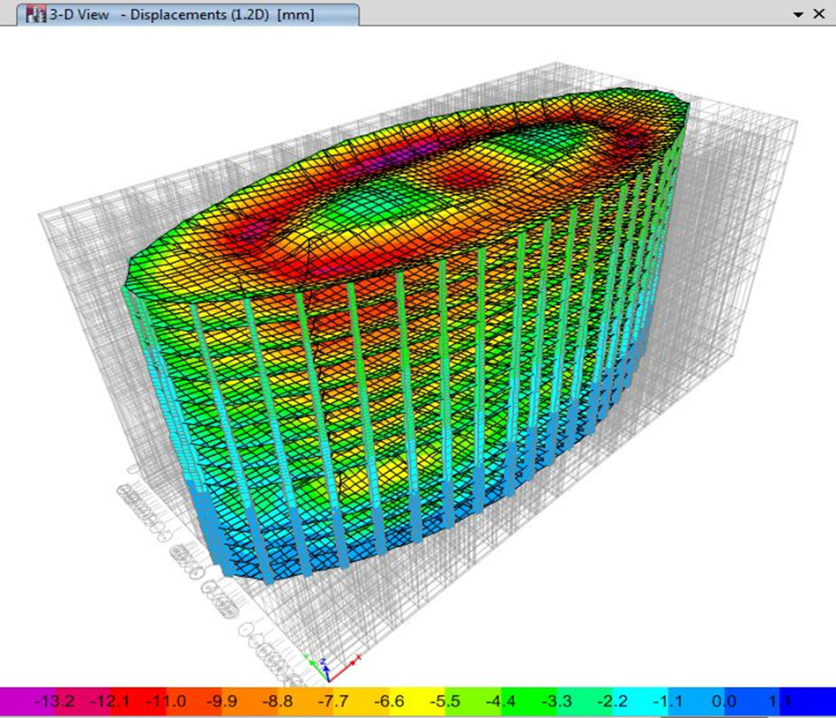
3.2 Structural Design (continued)
Deformed shape of slabs (3D)

Slide 22
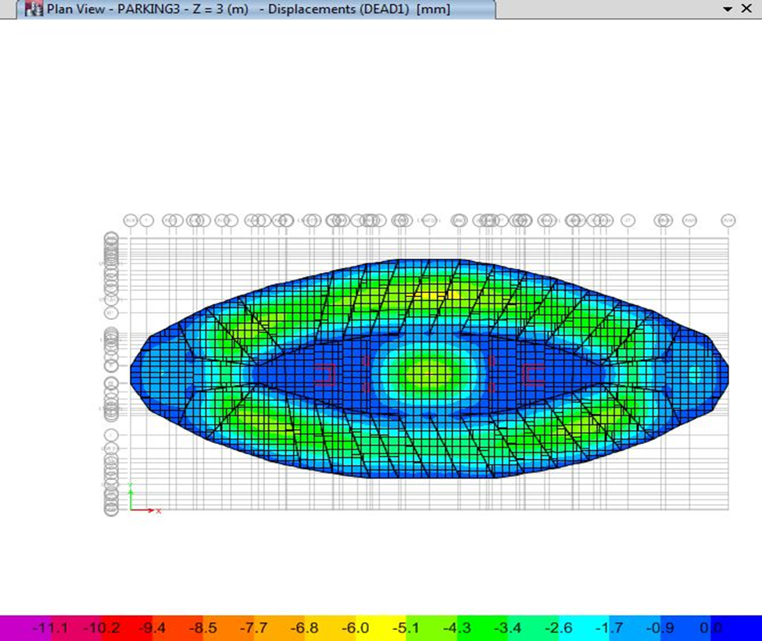
3.2 Structural Design (continued)
Deformed shape of slab of 3

Slide 23
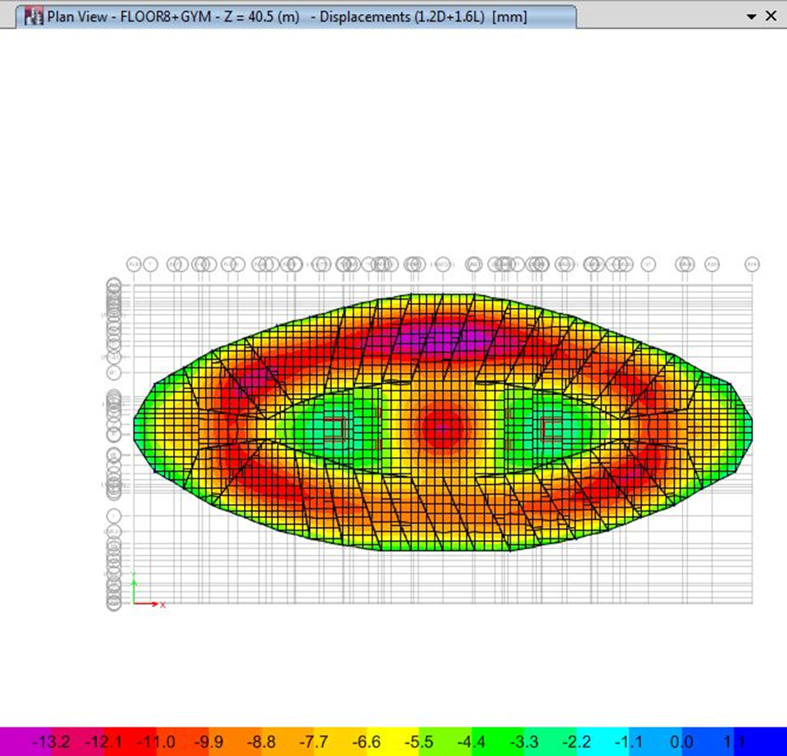

3.2 Structural Design (continued)

Slide 24
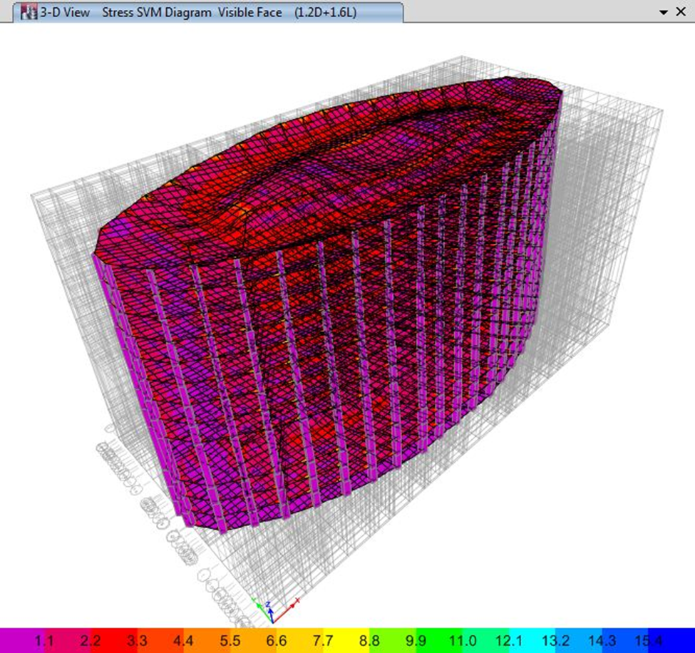
3.2 Structural Design (continued)
Stress in the different slabs (3D)

Slide 25
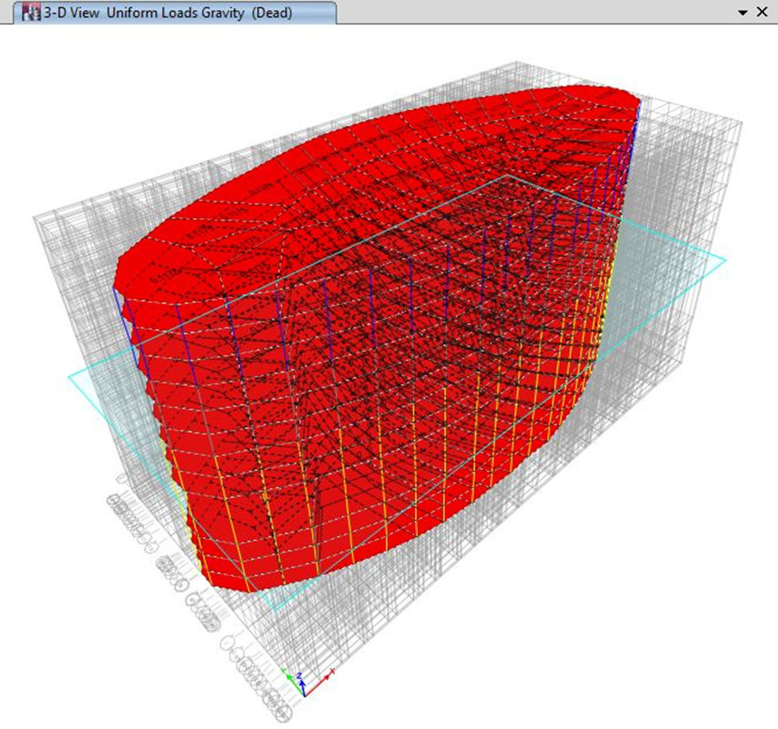
3.2 Structural Design (continued)
Gravity load (3D)

Slide 26
4- Foundation Design
4.1 Soil Profile
Layers | Depth (m) | Description | Number of blows (N) | Soil state | Height of layer (H) | f (unit skin friction)
Layer #1 | 0 – 7.2 | Poorly graded brown sand | 5 to 27 | Loose to medium dense | - | -
Layer #2 | 7.2 – 10.2 | Silty brown sand | 12 to100 | Medium to very dense | - | -
Layer #3 | 10.2 – 13.2 | Sandy silt light brown | 8 to 10 | Medium | 3 | 20
Layer #4 | 13.2 – 24 | Poorly graded sand | 20 to 100 | Medium to very dense | 11 | 30
Layer #5 | 24 – 30 (end of boring) | Sandy lean clay light brown | 100 | Hard | 6 | 50
Deduced from Geotechnical and Environmental Co.Ltd

Slide 27
4.2 Site Conditions
The problems encountered in this project are summarized as follows:
The water table at the half Moon area located in the ground surface.
The ground of the site (sand is loose and saturated state) is susceptible to liquefaction phenomenon.

Slide 28
4.3 Foundation Systems
Shallow foundations ( Dynamic Compaction)
Deep foundations (Piles)

Slide 29
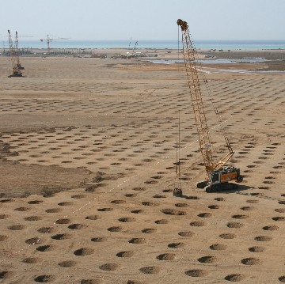
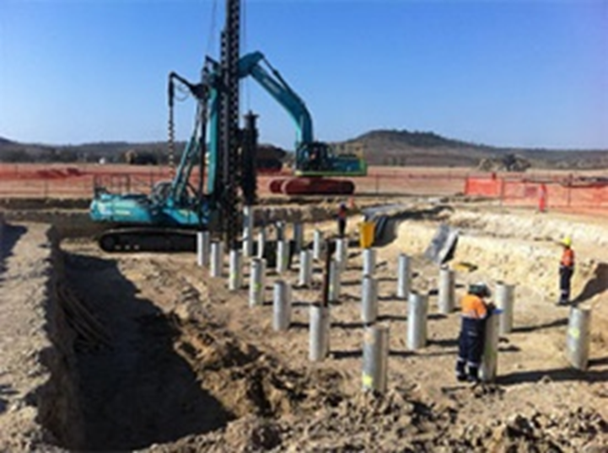
http://www.soffons.org/Soffons/soffons.nsf/Realisations/C5AF1C6F35D64898C125748E00285D18
http://www.keyword-suggestions.com/ZHJpdmVuIHBpbGVz/

Slide 30
4.3.1 Shallow Foundations
D (m) | Z (m) | B (m) | L (m) | γ (Kn/m³⁾ | C (kPa) | Nq | N γ | q_{u} (kPa) | q_{allow} (kPa)
1.5 | 11.5 | 1.5 | 1.5 | 10 | 0 | 134.88 | 271.76 | 16619 | 5539
2 | 12 | 2 | 2 | 10 | 0 | 134.88 | 271.76 | 17026 | 5675
2.5 | 12.5 | 2.5 | 2.5 | 10 | 0 | 134.88 | 271.76 | 17434 | 5811
3 | 13 | 3 | 3 | 10 | 0 | 134.88 | 271.76 | 17842 | 5947
1.5 | 11.5 | 1.5 | 1.5 | 10 | 0 | 134.88 | 271.76 | 17288 | 5762
2 | 12 | 2 | 2 | 10 | 0 | 134.88 | 271.76 | 17696 | 5898
2.5 | 12.5 | 2.5 | 2.5 | 10 | 0 | 134.88 | 271.76 | 18103 | 6034
3 | 13 | 3 | 3 | 10 | 0 | 134.88 | 271.76 | 18511 | 6170
1.5 | 11.5 | 1.5 | 1.5 | 10 | 0 | 134.88 | 271.76 | 17957 | 5985
2 | 12 | 2 | 2 | 10 | 0 | 134.88 | 271.76 | 18365 | 6121
2.5 | 12.5 | 2.5 | 2.5 | 10 | 0 | 134.88 | 271.76 | 18773 | 6257
3 | 13 | 3 | 3 | 10 | 0 | 134.88 | 271.76 | 19180 | 6393
1.5 | 11.5 | 1.5 | 1.5 | 10 | 0 | 134.88 | 271.76 | 18627 | 6209
2 | 12 | 2 | 2 | 10 | 0 | 134.88 | 271.76 | 19034 | 6344
2.5 | 12.5 | 2.5 | 2.5 | 10 | 0 | 134.88 | 271.76 | 19442 | 6480
3 | 13 | 3 | 3 | 10 | 0 | 134.88 | 271.76 | 19850 | 6616

Slide 31
4.3.1 Shallow Foundations (continued)
D (m) | Z (m) | qallow (kPa) | q column (kPa) | B (m)
1.5 | 11.5 | 5947 | 6130 | Not verified (5947<6130)
2 | 12 | 6170 | 6130 | B = 3m
2.5 | 12.5 | 6257 | 6130 | B ≥ 2.5m
3 | 13 | 6209 | 6130 | B ≥ 1.5m

Slide 32
4.3.2 Deep Foundations
 | D=0.325 m |  | D=0.4 m |  | D=0.5m |  | D=0.6m
Soiltype | Qs (KN) | Qp (KN) | Qs (KN) | Qp (KN) | Qs (KN) | Qp (KN) | Qs (KN) | Qp (KN)
Sandy silt | 61.3 | - | 75.4 | - | 94.2 | - | 113.1 | -
Poorly graded sand | 336.9 | - | 414.7 | - | 518.3 | - | 622 | -
Sandy clay | 306.3 | 180.9 | 377 | 274 | 471.2 | 428.1 | 565.5 | 616.5
Sum | 704.6 | 180.9 | 867.1 | 274 | 1083.8 | 428.1 | 1300.6 | 616.5

Slide 33
4.3.2 Deep Foundations (continued)
 | Qu(KN) | Q_{allow} (KN) | Ap(m²) | qu (kPa) | Q_{allow} (kPa)
D=0.325m | 885.4 | 295.1 | 0.083 | 10667.46 | 3555.42
D=0.4m | 1141.1 | 380.3 | 0.1257 | 9077.96 | 3025.45
D=0.5m | 1511.9 | 503.9 | 0.197 | 7674.61 | 2557.86
D=0.6m | 1917.1 | 639 | 0.283 | 6774.20 | 2257.95

Slide 34
5- Conclusion
The general conclusion drawn from this project can be summarized as follows:
A multistory hotel was developed and designed in a the Half-Moon Area. The site of the project extends over an area of about 1870 m². It is composed of twelve floors including three underground car parking.
A structural design using computer software (ETABS) was performed on the hotel superstructure in order to determine the appropriate reinforcements and the different solicitations transmitted to the foundations systems.

Slide 35
5- Conclusion
A geotechnical investigation was carried out in order to select and design the appropriate Foundation System.
Two types of foundation system were adopted for this project, including shallow foundations when the area subjected is subjected to dynamic compaction and deep foundations (i.e. driven piles).

Slide 36


