Slide 1
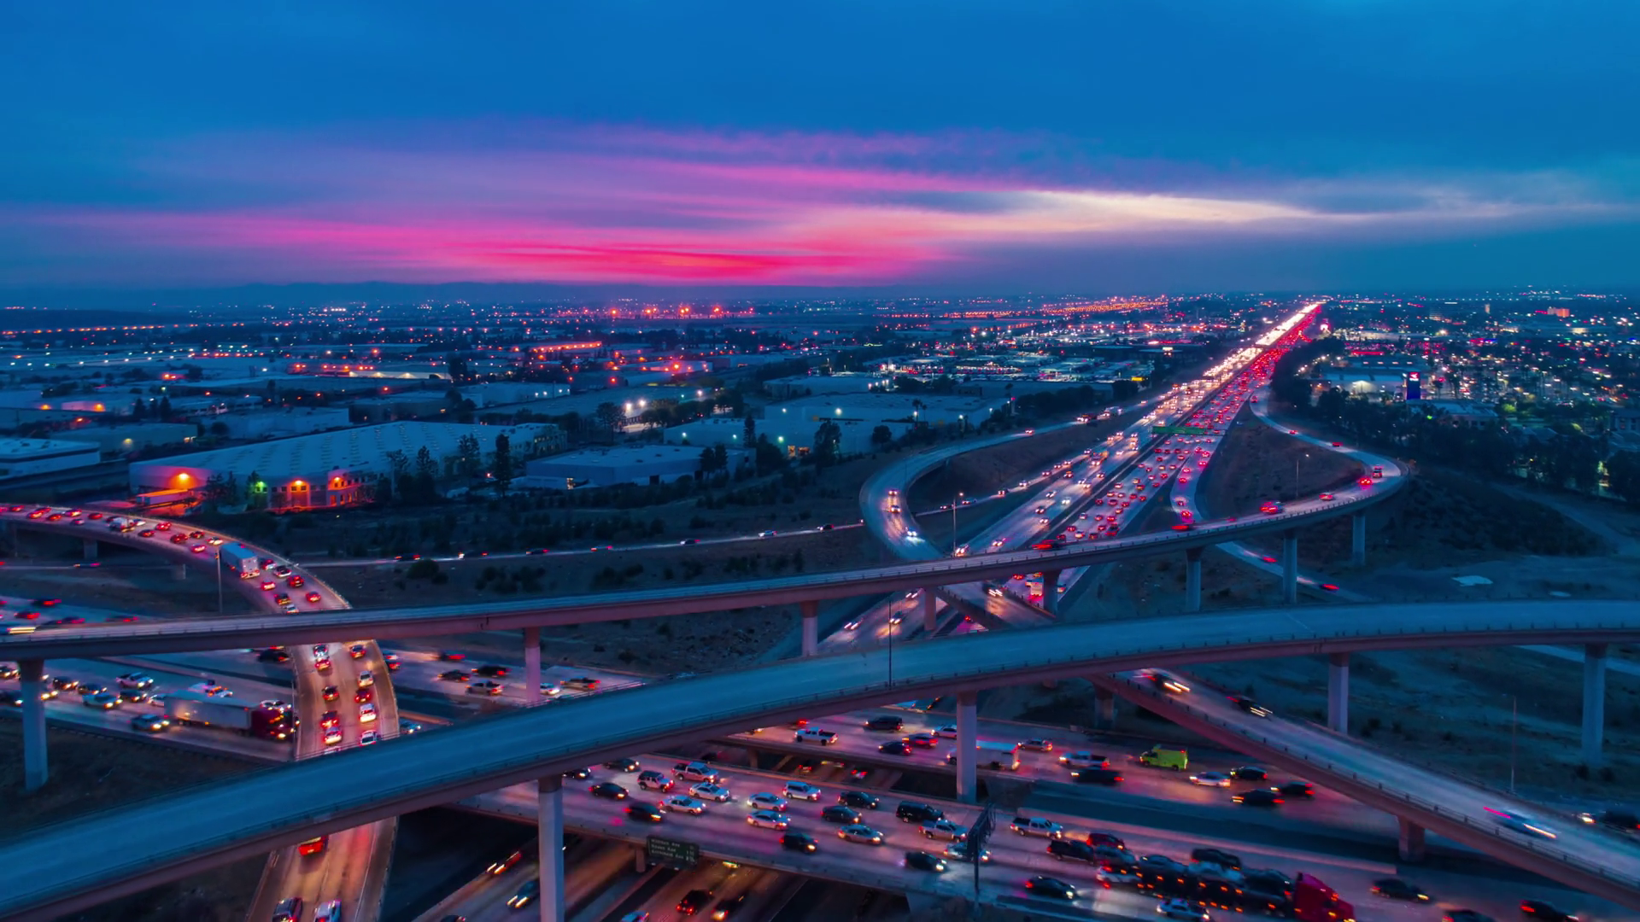
Learning outcome assessment III
Spring 2020
(Final Presentation)
The Design of 10-Lane Highway From Thuwal to Makkah

Slide 2
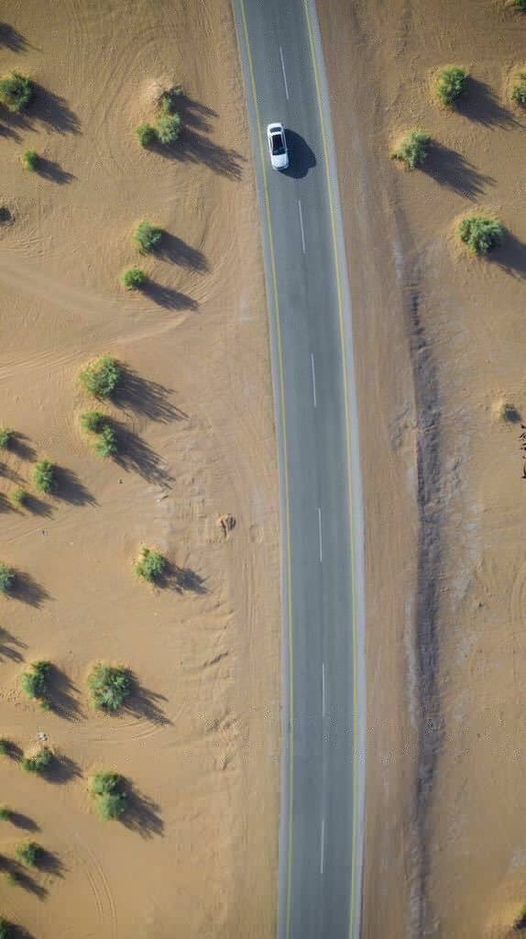
Presented by:
Ahmad Al Rashid - 201100642
Mobarak jawah – 201401980
Ali Altamimi – 201303785
Abdulrahman Alotaibi – 201403009
Supervised by:
Dr. Mohammad Ali Khasawneh
Engr. Mohd Nayeemudin
Coordinator:
Dr.Andi Asiz

Slide 3
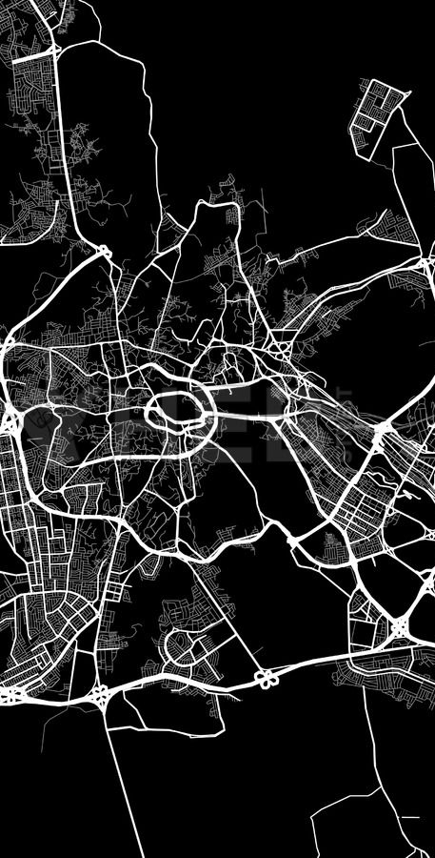
OUTLINE
Introduction
Objectives
Location
Methodology
Constraints
Traffic Analysis
Geometric Design
  Horizontal Curves
  Vertical Curves
Soil Studies
  Soil Classification
  California Bearing Ratio
Structural Design
Drainage System
Interchange and Intersection Design
  AASHTO Standard
  Road Cross-Section
Cost Estimation
Civil 3D Technology (Short Clip)
Conclusion
References

Slide 4

INTRODUCTION
Current roads in Makkah
Preparing for The Future
The Importance of this project
The highway starts from Thuwal, north of Jeddah, passes through the new eastern neighborhoods of Jeddah, and heads to the northern west of Makkah city.

Slide 5
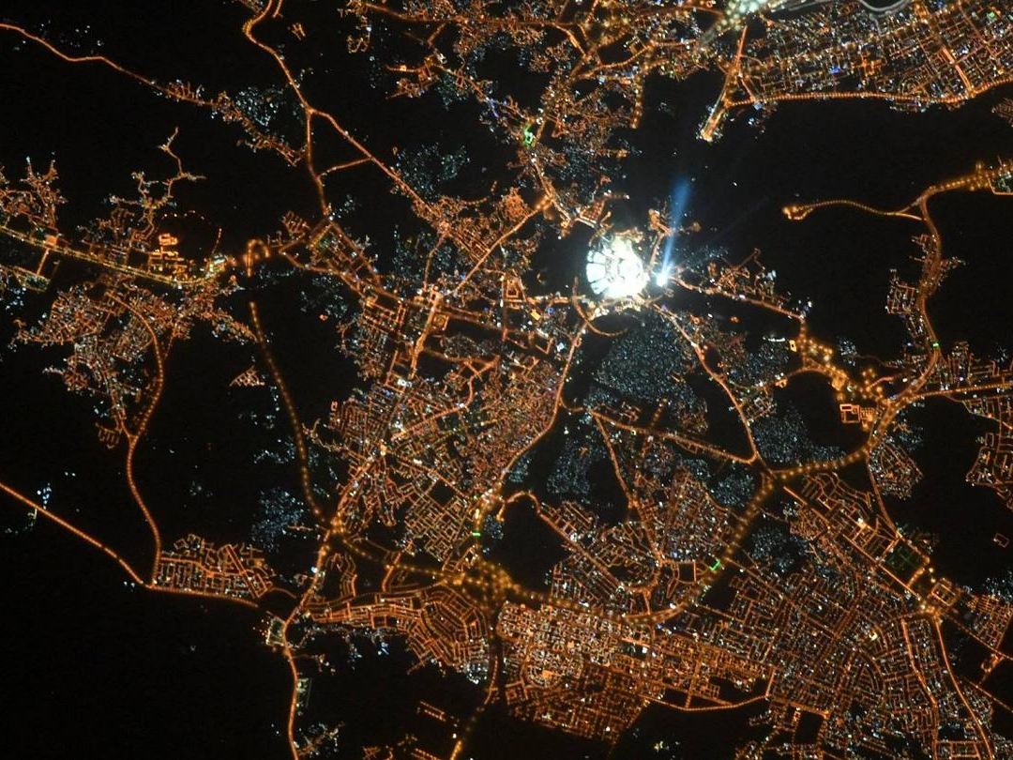

OBJECTIVES
A more organized distribution of permanent traffic volume between Thuwal and Makkah Al-Mukarramah.
Reducing traffic congestion on the Jeddah Makkah Highway
Traffic service towards Jeddah International Airport.
Facilitating commercial movement and movement of goods.
Facilitating industrial movement, and contributing to reducing the time period for the transportation of its products.

Slide 6
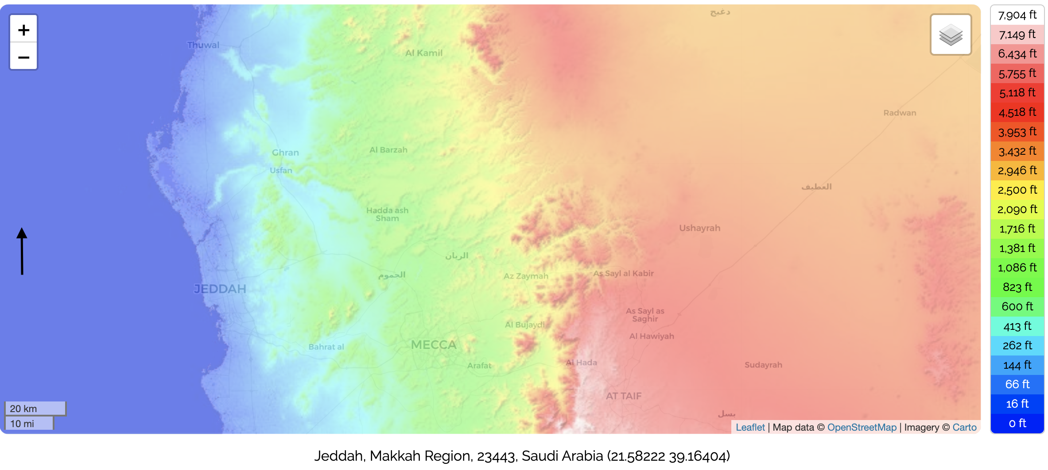
LOCATION
Thuwal
N
Jeddah
Makkah
Figure [1] - Topographic map, © OpenStreetMap contributors.

Slide 7
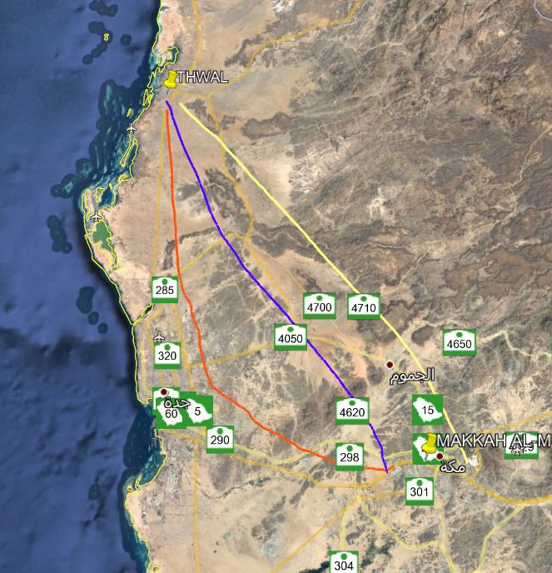
LOCATION
Suggested Options
Figure [2] - Suggested Options

Slide 8

ALTERNATIVES
Three models have been developed and compared to the following figure:
Alternatives | Road Length (Km) | Number of Vertical Curves | Number of Horizontal Curves | Maximum cut height | Maximum fill height
1-Orange | 115.51 | 14 | 12 | 3.6 | 3.4
2-Blue | 97.34 | 24 | 17 | 9.5 | 9.7
3-Yellow | 101.11 | 31 | 62 | 18 | 21.5
Table [1] - Alternatives

Slide 9

Methodology
Data Collection
Highway capacity analysis
Geometric Design
Soil study
Structural Design
Drainage system
Interchage and intersection Design
Cross section
Cost estimation
Completion of the project

Slide 10

CONSTRAINTS
Community and Private Assets
Effects on All Travellers
Geology, Soils, Contaminated Land and Groundwater
Road Drainage and the Water Environment
Ecology and Nature Conservation

Slide 11
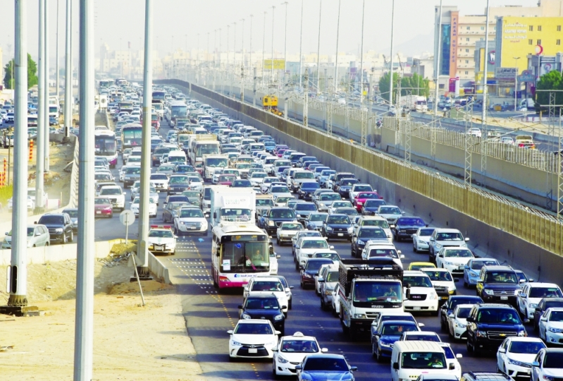
Traffic Analysis
Average Daily Traffic
Future Average Daily Traffic

Slide 12

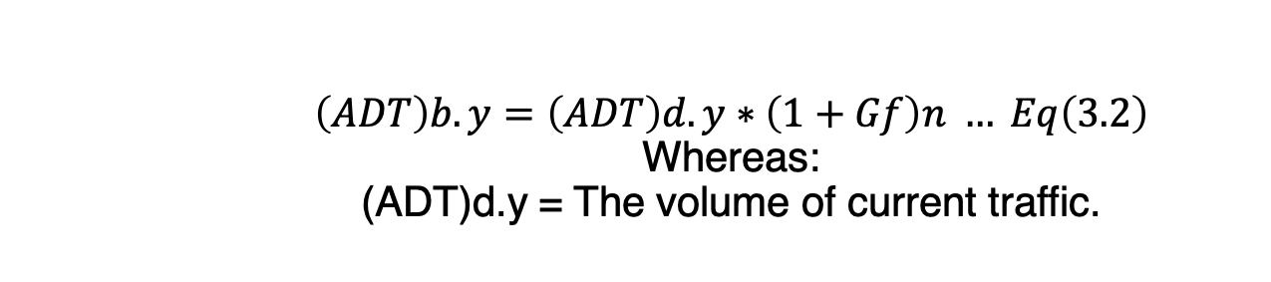
$$\left(ADT\right)b.y=\left(ADT\right)d.y∗\left(1+Gf\right)n … Eq\left(3.2\right)$$
Whereas:
(ADT)d.y = The volume of current traffic.
Traffic Analysis: Average Daily Traffic
Average Traffic for one week
JEDDAH-MAKKAH
Time | PC | PUCK UP | JEEP MODEL | TRUCKS |  |  |  |  | SMALL BUS | BIG BUS | MOTOR CYCLE |  | TOTAL
 |  |  |  | 2 LIGHT | 2 HEAVY | 3 | 4 | 5
Avr. | 14224 | 5137 | 6421 | 356 | 125 | 11 | 21 | 11 | 749 | 500 | 135 |  | 27690
Avarage Traffic for one week
MAKKAH-JEDDAH
Time | PC | PUCK UP | JEEP MODEL | TRUCKS |  |  |  |  | SMALL BUS | BIG BUS | MOTOR CYCLE |  | TOTAL
 |  |  |  | 2 LIGHT | 2 HEAVY | 3 | 4 | 5
Avr. | 13766 | 4917 | 5601 | 363 | 154 | 17 | 34 | 18 | 665 | 367 | 155 |  | 26056
TOTAL
(ADT)d.y | 27990 | 10054 | 12022 | 719 | 279 | 28 | 55 | 29 | 1414 | 867 |  | 290 | 53746
Table [2] – (ADT)d.y

Slide 13

Traffic Analysis: The Volume of Future Traffic (20 Years)
(ADT)F = (ADT)P*(1+GF)^20 *FACTOR (T)
Avarage Traffic for one week
JEDDAH-MAKKAH
Time | PC | PUCK UP | JEEP MODEL | TRUCKS |  |  |  |  | SMALL BUS | BIG BUS | MOTOR CYCLE |  | TOTAL
 |  |  |  | 2 LIGHT | 2 HEAVY | 3 | 4 | 5
Avr. | 14224 | 5137 | 6421 | 356 | 125 | 11 | 21 | 11 | 749 | 500 | 135 |  | 27690
Avarage Traffic for one week
MAKKAH-JEDDAH
Time | PC | PUCK UP | JEEP MODEL | TRUCKS |  |  |  |  | SMALL BUS | BIG BUS | MOTOR CYCLE |  | TOTAL
 |  |  |  | 2 LIGHT | 2 HEAVY | 3 | 4 | 5
Avr. | 13766 | 4917 | 5601 | 363 | 154 | 17 | 34 | 18 | 665 | 367 | 155 |  | 26056
TOTAL
(ADT)d.y | 27990 | 10054 | 12022 | 719 | 279 | 28 | 55 | 29 | 1414 | 867 |  | 290 | 53746
(ADT)b.y | 61330 | 22030 | 26342 | 1575 | 611 | 61 | 121 | 64 | 3098 | 1900 |  | 635 | 117764
FACTOR (T). | 1 | 1.25 | 1.25 | 1.50 | 2.00 | 2.50 | 3.00 | 3.00 | 1.30 | 2.25 |  | 0.50
(ADT)b.y | 61330 | 27537 | 32927 | 2363 | 1223 | 153 | 362 | 191 | 4028 | 4274 |  | 318 | 134705
Table [3] – (ADT)b.y

Slide 14
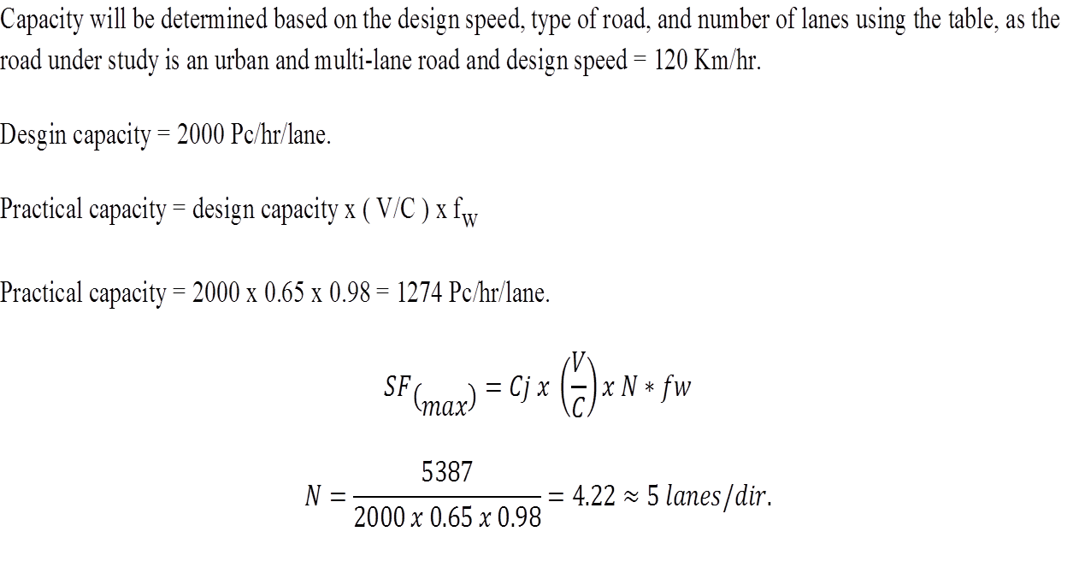
Traffic Analysis: Road Capacity

Slide 15
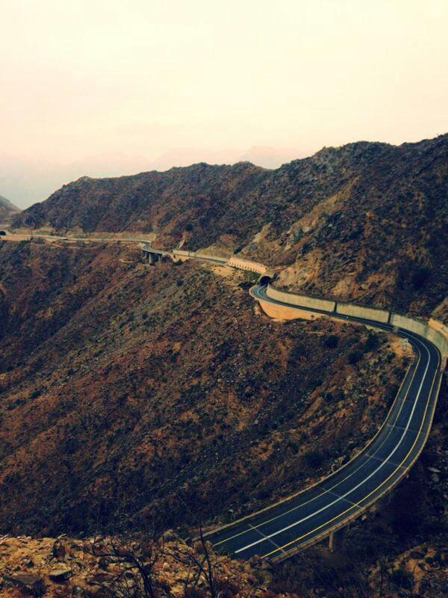
Geometric Design: Horizontal Curves
Purpose:
To provide change in direction to the centre line of a road.
Process:
When a vehicle transverse a horizontal curve, the centrifugal force acts horizontally outwards through the center of gravity of the vehicle.

Slide 16
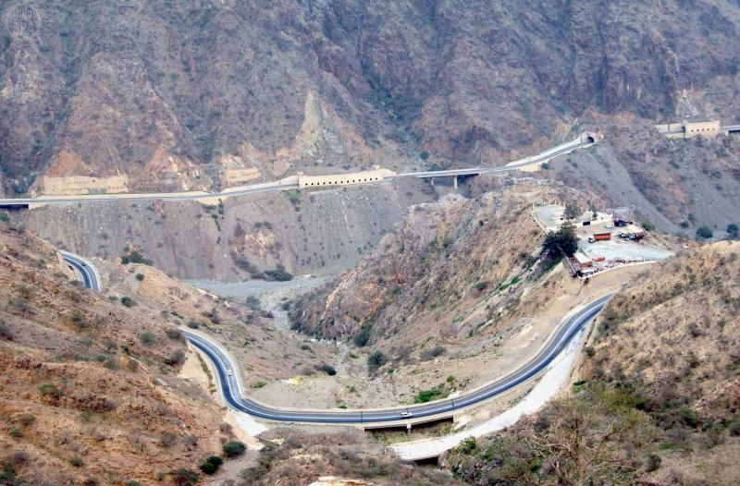
The geometric quality of road when seen from above in “plane” view.
Geometric Design: Horizontal Alignment
Plane View:
Figure [4]: Road in Tabuk, Saudi Press Agency.
Figure [3] Plane View

Slide 17
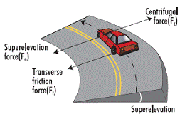
Geometric Design: Superelevation
The centrifugal force acting on a vehicle
passing through a horizontal curve
has two effects:
  Overturning Effect
  Transverse Skidding Effect
P = W V² / g R
Figure [5] Superelevation

Slide 18
Geometric Design: Simple Curve
Circular Curve
Tangent
PC
PT
Point of Curvature
Point of Tangency

Slide 19
Geometric Design: Elements of Horizontal Curves

Slide 20
PI
T
PC
PT
Direction
-PI: Point of Intersection
-PC: Point of Curvature
-PT: Point of Tangency
-T: Tangent Length

Slide 21
L
LC
R
R
  R: Radius of Curve
  LC: Length of Curve
  L: Chord Length

Slide 22
Δ
E
M
^{Δ}/₂
  Δ: Deflection Angle
  E: External ordinate
  M: Middle ordinate
Δ

Slide 23
Geometric Design: Horizontal Curves in The Project
First Curve details
Station (0+00) | Θ (deg) | X (m) | Y (m) | L’ (m)
115+40 | 0° | 0 | 0 | 0
115+60 | 2.076° | 49.99 | 0.9057 | 100
115+80 | 4.152° | 99.9 | 3.6218 | 200
116+00 | 6.227° | 149.622 | 8.142 | 300
116+20 | 8.304° | 199.11 | 14.47 | 400
116+40 | 10.38° | 253.32 | 22.6 | 500
116+80 | 12.46° | 297.74 | 32.5 | 600
117+00 | 14.53° | 346.22 | 44.137 | 700
117+20 | 16.61° | 394.48 | 57.6 | 800
117+24 | 16.87° | 400.47 | 59.387 | 812.31
Table [4]: 1st Curve

Slide 24
Second Curve details
Station (0+00) | Θ (deg) | X (m) | Y (m) | L (m)
167+40 | 0° | 0 | 0 | 0
167+60 | 1.87° | 49.92 | 0.815 | 100
167+80 | 3.74° | 99.8 | 3.26 | 200
168+00 | 5.62° | 149.83 | 7.354 | 300
168+20 | 7.49° | 199.44 | 13.05 | 400
168+40 | 9.36° | 248.83 | 20.37 | 500
168+60 | 11.24° | 298.22 | 29.35 | 600
168+79.85 | 13.10° | 346.77 | 39.82 | 699.285
Table [5]: 2nd Curve

Slide 25
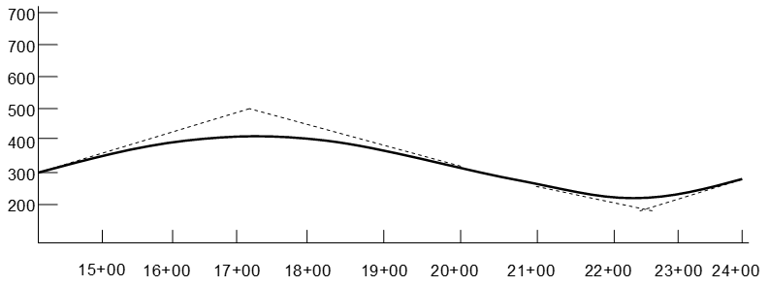
The 1st Procedure in Alignment was Stationing
Geometric Design: Vertical Alignment
Graph [1]: Vertical Alignment
Notes:
Therefore, roads will almost always be a bit longer than their stationing because of the vertical alignment
Draw in stationing on each of these curves and explain it

Slide 26
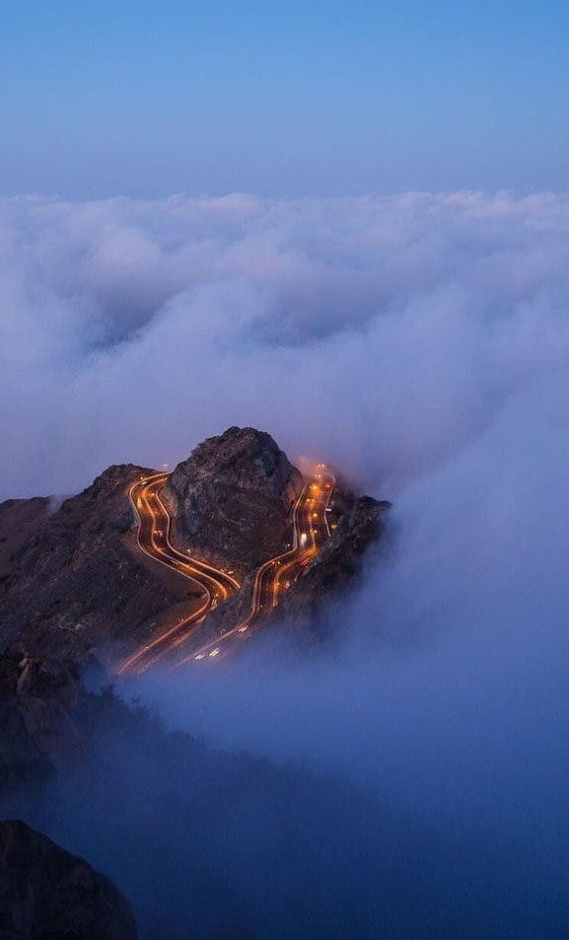
Definition:
  It is the elevation or the profile of the center line of the road
Objective:
-Determine elevation to ensure:
    Proper drainage
    Acceptable level of safety
Primary challenge
  Transition between two grades
  Vertical curves detail
  Quantity of cut and fill
G₁
G₂
Sag Vertical Curve
Crest Vertical Curve
G₁
G₂

Slide 27
Geometric Design: Cut and Fill Quantities
Graph [2] Cut and Fill

Slide 28
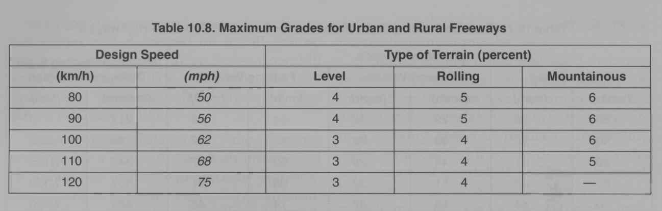
Geometric Design: Maximum Grades for
Urban and Rural Highways
Table : Urban and Rural Freeways

Slide 29
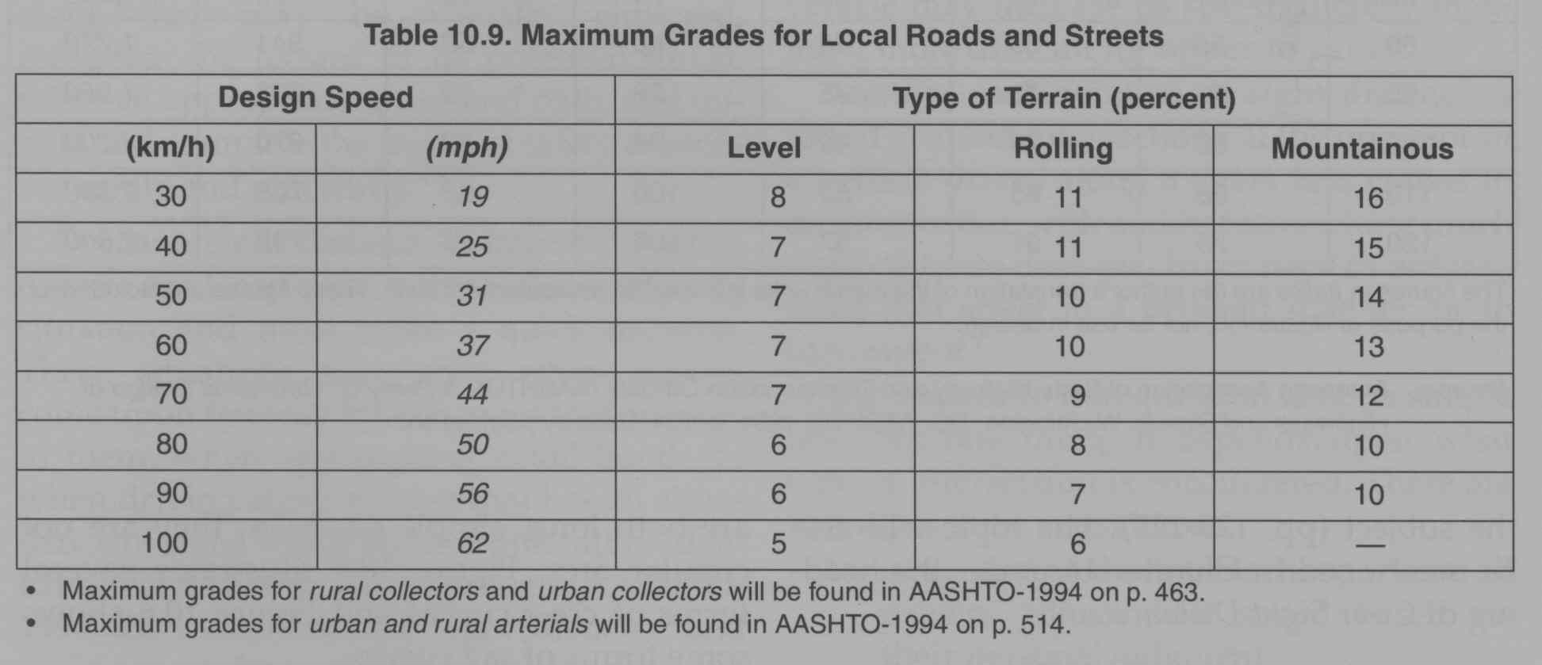
Geometric Design: Maximum Grades for
Local Road and Street
Table Local Roads

Slide 30
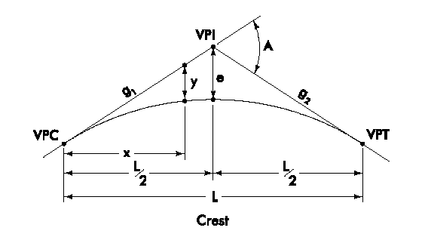
PVI
PVC
PVT
Note: L is measured from here to here
Not here
Source: Iowa DOT Design Manual

Slide 31
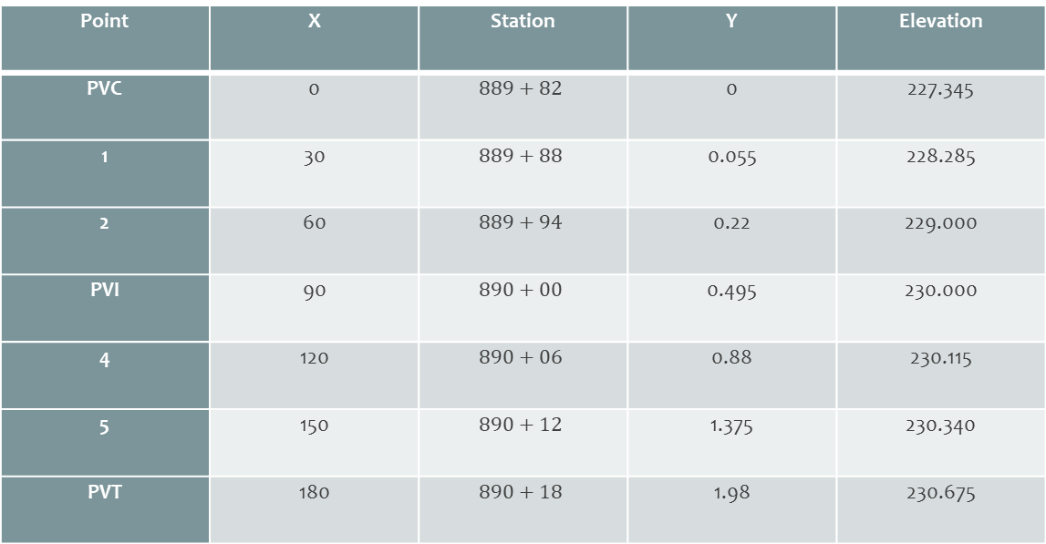
Geometric Design:
Vertical Curves in the project
First Curve details
Point | X | Station | Y | Elevation
PVC | 0 |  | 0 | 227.345
1 | 30 |  | 0.055 | 228.285
2 | 60 |  | 0.22 | 229.000
PVI | 90 |  | 0.495 | 230.000
4 | 120 |  | 0.88 | 230.115
5 | 150 |  | 1.375 | 230.340
PVT | 180 |  | 1.98 | 230.675
Table [6] Curve Details

Slide 32
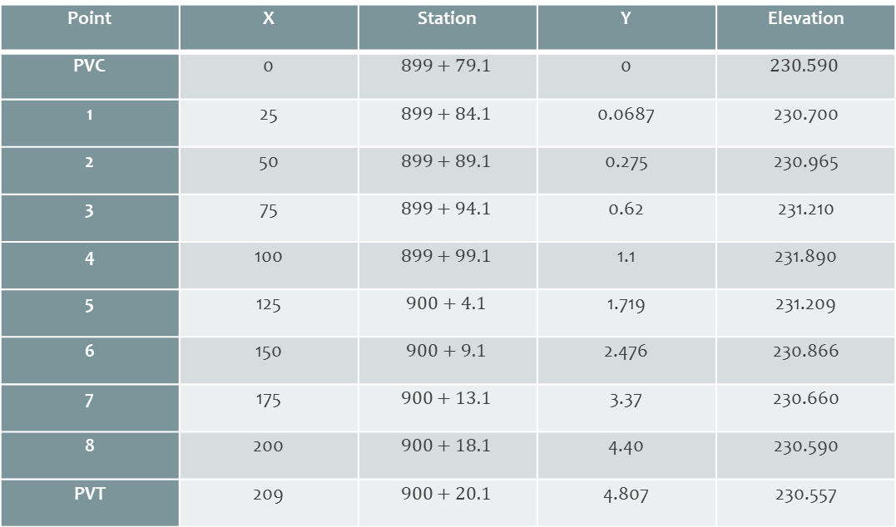
Geometric Design:
\Vertical Curves in the project
Second Curve details
Point | X | Station | Y | Elevation
PVC | 0 |  | 0
1 | 25 |  | 0.0687 | 230.700
2 | 50 |  | 0.275 | 230.965
3 | 75 |  | 0.62 | 231.210
4 | 100 |  | 1.1 | 231.890
5 | 125 |  | 1.719 | 231.209
6 | 150 |  | 2.476 | 230.866
7 | 175 |  | 3.37 | 230.660
8 | 200 |  | 4.40 | 230.590
PVT | 209 |  | 4.807 | 230.557
Table [7] Curve Details

Slide 33
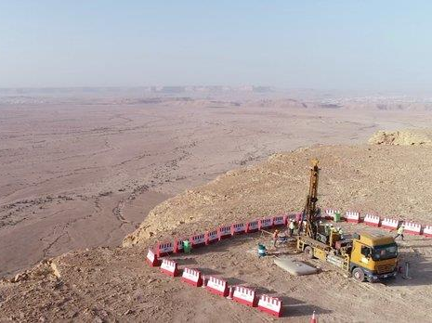
SOIL STUDIES
Soil classification
Engineering classification systems:
  Textural Classification.
  AASHTO.
  Unified Soil Classification.
  The International Soil Classification.
  American Society of Testing Material.

Slide 34
Soil Classification
First sample
Sieve NO. | Sieve open (mm) | Cumulative Reserved (gm.) | Cumulative Reserved (%) | Passing (%)
1.5" | 38.1 | 49.1 | 2.14 | 97.86
1" | 25 | 223.3 | 9.74 | 90.26
0.5" | 12.7 | 526.1 | 22.94 | 77.06
0.31" | 7.9 | 767.7 | 33.48 | 66.52
#4 | 4.75 | 1238.166 | 54 | 46
#10 | 2 | 1504.1 | 65.6 | 34.4
#16 | 1.18 | 1707.2 | 74.46 | 25.54
#18 | 1 | 1747.7 | 76.22 | 23.78
#35 | 0.5 | 1916.6 | 83.59 | 16.41
#40 | 0.425 | 1942.1 | 84.7 | 15.3
#50 | 0.355 | 2011.7 | 87.74 | 12.26
#80 | 0.18 | 2090 | 91.15 | 8.85
#200 | 0.075 | 2206.1 | 96.21 | 3.79
Pan | 0 | 2292.9 | 100 | 0
Graph [3] 1st Sample
A-2-7

Slide 35
Second Sample
Sieve NO. | Sieve open (mm) | Cumulative Reserved (gm.) | Cumulative Reserved (%) | Passing (%)
1.5" | 38.1 | 0 | 0 | 100
1" | 25 | 323.6 | 8.99 | 91.01
0.5" | 12.7 | 817.7 | 22.71 | 77.29
0.31" | 7.9 | 1289.4 | 35.82 | 64.18
#4 | 4.75 | 1727.95 | 48.1 | 51.9
#10 | 2 | 2354.1 | 65.39 | 34.61
#16 | 1.18 | 2550.9 | 70.86 | 29.14
#18 | 1 | 2591.5 | 71.99 | 28.01
#35 | 0.5 | 2805.4 | 77.93 | 22.07
#40 | 0.425 | 2884.7 | 80.13 | 19.87
#50 | 0.355 | 2964.1 | 82.34 | 17.66
#80 | 0.18 | 3118.8 | 86.64 | 13.36
#200 | 0.075 | 3405.3 | 94.59 | 5.41
Pan | 0 | 3599.9 | 100 | 0
Graph [4] 2nd Sample
A-1-b

Slide 36
Third Sample
Sieve NO. | Sieve open (mm) | Cumulative Reserved (gm.) | Cumulative Reserved (%) | Passing (%)
1.5" | 38.1 | 147.5 | 5.04 | 94.96
1" | 25 | 261.1 | 8.92 | 91.08
0.5" | 12.7 | 624.3 | 21.34 | 78.66
0.31" | 7.9 | 803.5 | 27.46 | 72.54
#4 | 4.75 | 1273.8 | 43.54 | 56.46
#10 | 2 | 1514.8 | 51.78 | 48.22
#16 | 1.18 | 1838.6 | 62.84 | 37.16
#18 | 1 | 191.8 | 65.38 | 34.62
#35 | 0.5 | 2249.5 | 76.89 | 23.11
#40 | 0.425 | 2354.7 | 80.48 | 19.52
#50 | 0.355 | 2475 | 84.6 | 15.4
#80 | 0.18 | 2666 | 91.12 | 8.88
#200 | 0.075 | 2892.6 | 98.87 | 1.13
pan | 0 | 2925.7 | 100 | 0
Graph [5] 3rd Sample
A-1-b

Slide 37
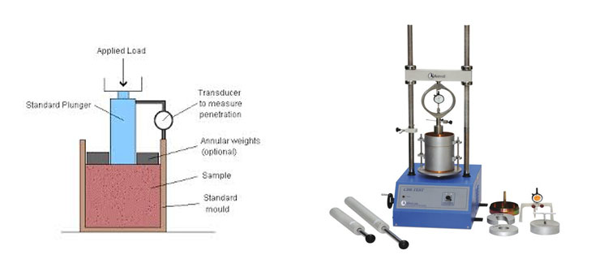
Soil Study: Californian Bearing Ratio (CBR)
Figure [7] CBR Test

Slide 38

CBR Test Results
 | Moisture Content (%) | Compaction (%) | CBR (%)
First Sample | 15.5 | 99.2 | 22.2
Second Sample | 17.4 | 99.5 | 16
Third Sample | 12.96 | 99.6 | 25
Table [7] CBR Test Results

Slide 39
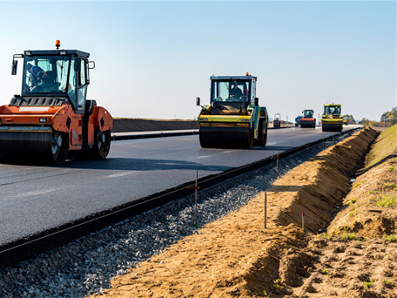
Structural Design:
Layer Thickness of Pavements
Highway Pavements Design Methods
  AASHTO guide method
  The Asphalt Institute )T. A. I. Method(
  Portland Cement Association (PCA)
  N. C. S. A. (National Crushed Stone Association).
  MEPDG (Mechanistic-Empirical Pavement Design)

Slide 40
Structural Design:
AASHTO Design Equation
Structural Number
W₁₈ = design traffic (18-kip ESALs)
Z_{R} = standard normal deviate
S_{o} = combined standard error of traffic and performance prediction
DPSI = difference between initial and terminal serviceability index
M_{R} = resilient modulus (psi)
SN = structural number

Slide 41
Structural Design:
AASHTO Design Equation
Inputs
  Design life (analysis period)
  Traffic (W18)
  Foundation stiffness (MR)
  Performance criterion (ΔPSI)
  Reliability (ZR, So)
Outputs
  Required pavement capacity: Structural Number (SN)

Slide 42
Assuming Structural details:
Structural Design:
AASHTO Design Equation
(AC) | Sub.B (Sand-gravel) | B.C (Crushed Stone) | Layer
Marshall (Stability) (1900 Ib) | 20% | 80% | CBR%
Flexibility ( 40000 psi ) | 16500 | 28500 | Mr(psi)
0.42 | 0.095 | 0.12 | a
Surface a1 = 0.42 (Modulus E = 4.3)
Base a2 = 0.13 (C. B. R. = 80%)
Subbase a3 = 0.095 (C. B. R. = 20%)
Table [8] Pavement Design

Slide 43
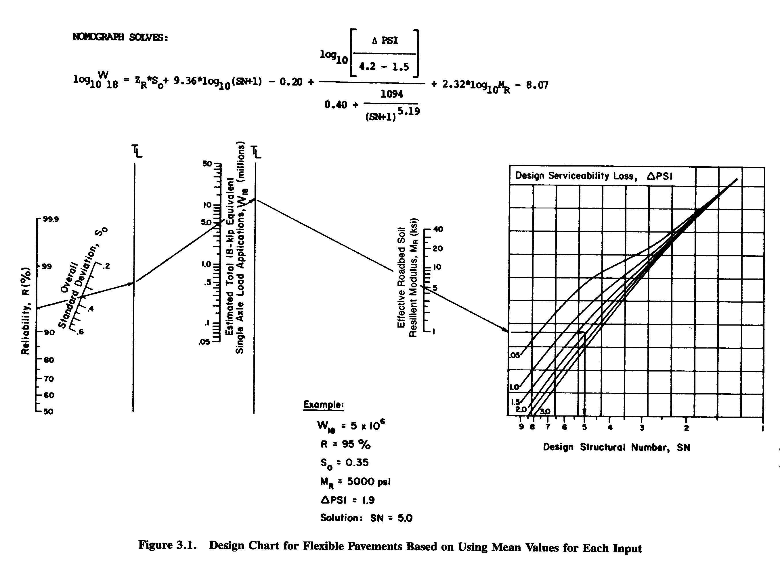
SN:a1d1+ a2d2m2+a3d3m3
Figure [8] Design Chart (AASHTO, 1993)

Slide 44
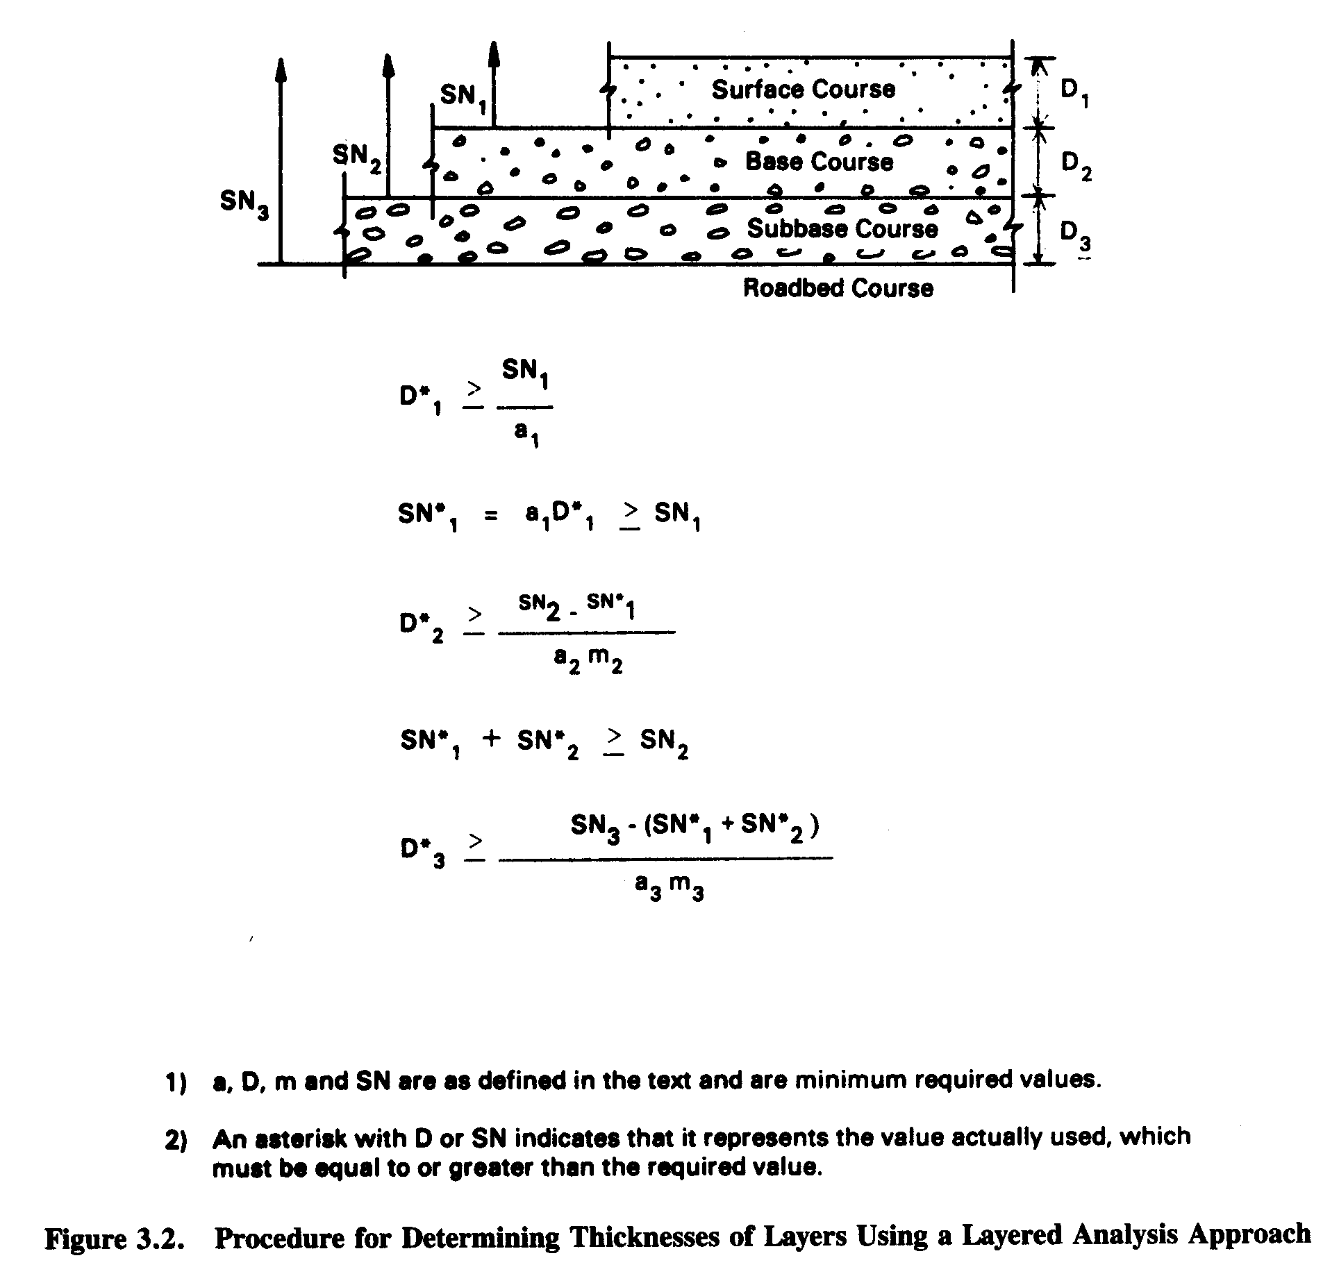
Structural Design:
Thickness of Layers
SN1=1.95
Sn2=2.82
Sn3=3.78
D1= 4.72 in
D2= 7.87 in
D3= 7.87 in
Figure [9] Layers

Slide 45
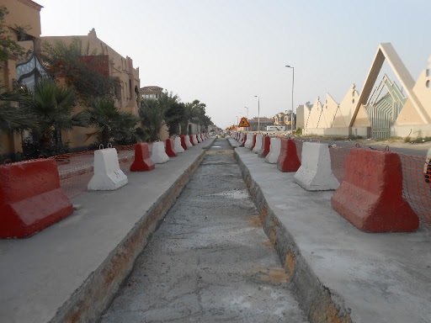
Drainage system
(Design objectives)
Reduce waterlogging.
Control salinity.
Make new land available for agriculture.
Reduces the amount of water stored on or in the soil.
Introduces a flow rate of water through the system.
Disturbance and/or pollution of the environment.
Depletion and/or over-exploitation of the natural resources.
Destruction and/or impairment of the natural ecosystem.

Slide 46
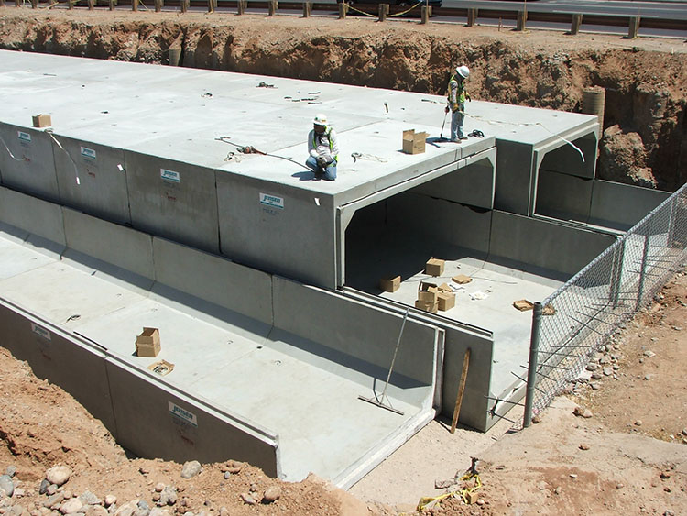
Box Culverts
(Application)
Short-span bridges (over highways, waterways,
railways, for golf courses, etc.)
Conveyance of storm water, sewage or industrial
wastes (storm drains)
Tunnels (to house conveyers, utilities, etc.; to provide
access, escape routes, etc.
Detention

Slide 47
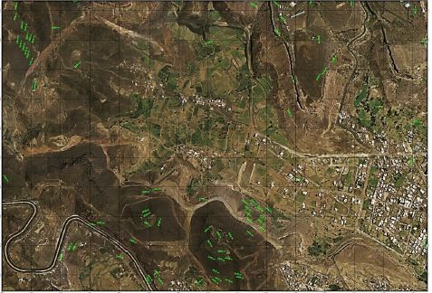
Drainage System: Basin Area
Figure [10] Basin Area
The figure shows the basin area And it includes (its area - its inclination - the highest level - the longest level - the longest waterway), and it has been found from the topographical maps and it is shown in the following table

Slide 48
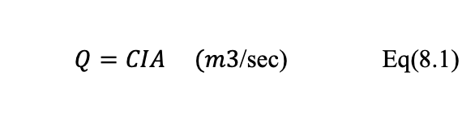
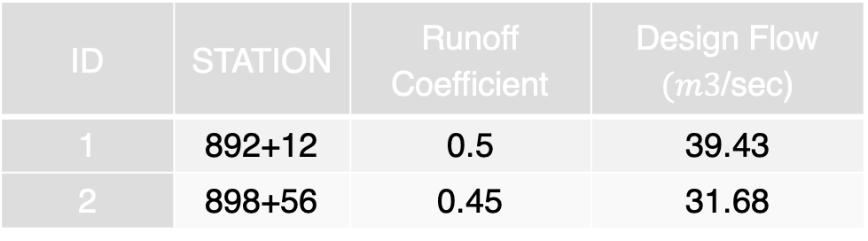
Drainage System: Basin Area
Basin Area Details:
ID | STATION | AREA (m2) | Lowest Elevation (m) | Highest Elevation (m) | Length (m) | Slope
1 | 892+12 | 2103 | 248 | 210.5 | 756 | 0.05
2 | 898+56 | 1980 | 247 | 202.9 | 708 | 0.0622
Determination of Inflow:
Table [9] Basin Area Details
ID | STATION | Runoff Coefficient | Design Flow $(m3$/sec)
1 | 892+12 | 0.5 | 39.43
2 | 898+56 | 0.45 | 31.68
$Q=CIA (m3$/sec) Eq(8.1)
Table [10] inflow

Slide 49

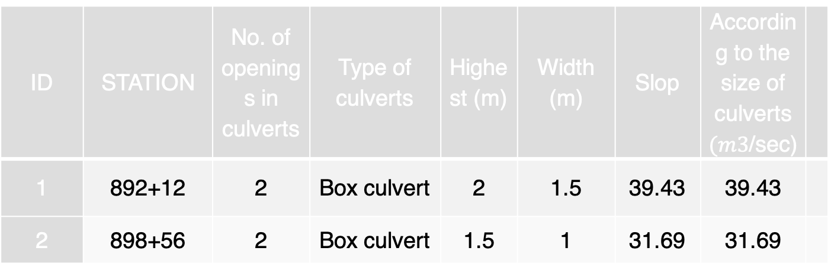
ID | STATION | No. of openings in culverts | Type of culverts | Highest (m) | Width (m) | Slop | According to the size of culverts $(m3$/sec)
1 | 892+12 | 2 | Box culvert | 2 | 1.5 | 39.43 | 39.43
2 | 898+56 | 2 | Box culvert | 1.5 | 1 | 31.69 | 31.69
Table [11] Dimensions
Height of the water:
$$h=hw−\frac{D}{2} Eq(8.2)$$
Area determined form equation:
$$A=0.45\frac{Q}{h^{\frac{1}{2}}} Eq(8.3)$$
Determine the width of culvert:
$$B=\frac{A}{D} Eq(8.4)$$

Slide 50
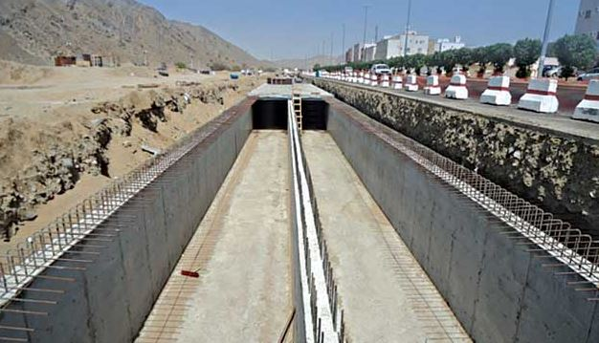
Box Culverts Cross Section
After studying the rainfall, and the inflow rate, the suggested box culvert cross section consists of 2 opening, such as this photo.
Figure [11] Box Culverts, SPA, Jeddah

Slide 51
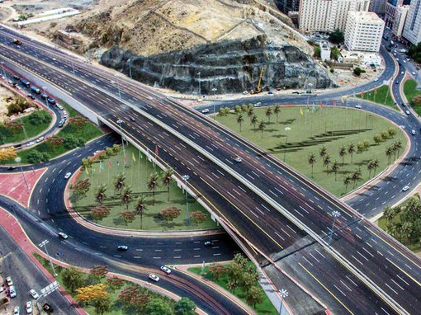
Basic Principles of Interchange
(Design Objectives)
Reduce the number of conflict points
Minimize severity of potential conflicts
Provide for smooth flow of traffic
Consider both vehicles and pedestrians
Avoid multiple and compound merging and diverging

Slide 52
Intersection Control
Conflict Points at Intersections
Crossing conflicts, however, tend to have the most severe effect on traffic flow and should be reduced to a minimum whenever possible.

Slide 53
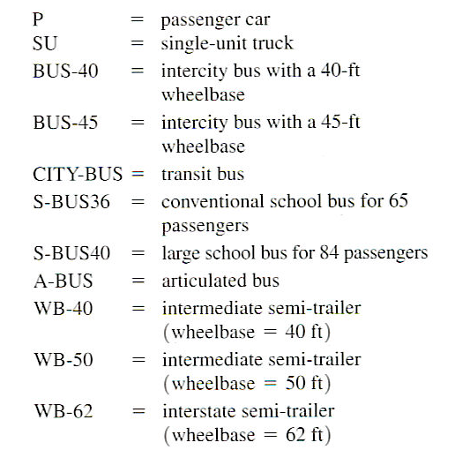
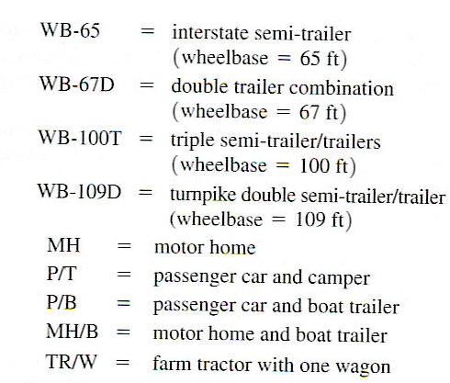
Design Vehicles
Set of 20 design vehicles with standard physical dimensions according to AASHTO

Slide 54
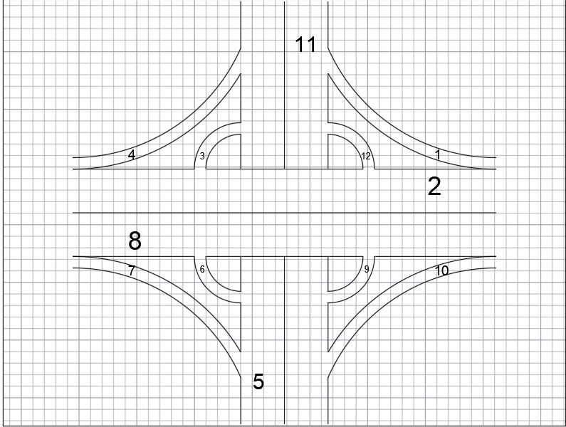
Road Intersection lanes
Using the division of the intersection into several tracks and analyzing the traffic volume for each of the tracks and their statistics, the intersection is designed to be two lanes for each movement path
Figure [13] Road Lanes

Slide 55
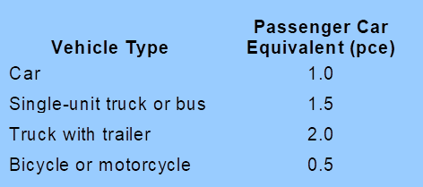
The study was conducted during daylight hours between 8 a.m. to 9 a.m., the following table shows the traffic count statistics for each type of vehicle:
Then the percentage for each vehicles types in each path:
Path | PC | Bus | Trailer | Motorcycle
1 | 65.5% | 32.1% | 2.7% | 0.65%
3 | 74.2% | 21.1% | 4.7% | 0%
4 | 74% | 21.1% | 3.2% | 1.87%
6 | 73.7% | 18.55% | 7.73% | 2%
7 | 80% | 14.88% | 4.1% | 1.3%
9 | 70.1% | 23.1% | 5.9% | 0%
10 | 76.8% | 19.3% | 3.4% | 0%
12 | 67.7% | 27.2% | 4.6% | 0%
Table [12] Percentage of Vehicles

Slide 56
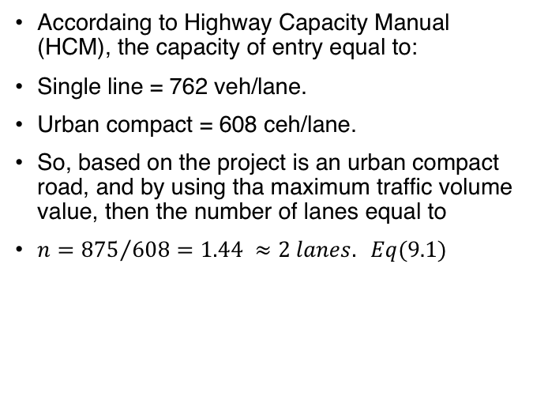
Intersection Design: Calculations
Then, PCE for each path:
Path | PC | Bus | Trailer | Motorcycle | Fhv
1 | 0.655 | 0.48 | 0.054 | 0 | 1.221
3 | 0.742 | 0.32 | 0.094 | 0 | 1.156
4 | 0.74 | 0.32 | 0.064 | 0 | 1.124
6 | 0.74 | 0.28 | 0.1546 | 0 | 1.185
7 | 0.8 | 0.22 | 0.082 | 0 | 1.102
9 | 0.7 | 0.345 | 0.118 | 0 | 1.163
10 | 0.77 | 0.29 | 0.068 | 0 | 1.128
12 | 0.677 | 0.41 | 0.092 | 0 | 1.18
Table [13] Fhv Values
Total traffic volume:
Path | Fhv | Total
1 | 1.221 | 781
3 | 1.156 | 613
4 | 1.124 | 780
6 | 1.185 | 460
7 | 1.102 | 512
9 | 1.163 | 512
10 | 1.128 | 683
12 | 1.18 | 875
Accordaing to Highway Capacity Manual (HCM), the capacity of entry equal to:
Single line = 762 veh/lane.
Urban compact = 608 ceh/lane.
So, based on the project is an urban compact road, and by using tha maximum traffic volume value, then the number of lanes equal to
$n={875}/{608}=1.44 ≈2 lanes. Eq(9.1)$
Table [14] PCE

Slide 57
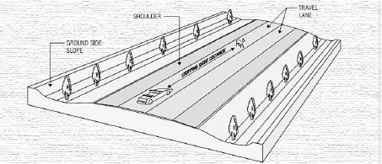
Road Cross-Section
The cross section of the road consists of different elements:
  Paved road surface.
  Road lanes.
  Cross slop.
  Shoulders.
  Sidewalks.

Slide 58

Cost Estimation
Cost Estimaition Definition
  It is a study of the cost of the project, and the economic dependencies of the project, on the state and on the consumer.
Cost Estimation Criteria:
  Cut and fill quantities.
  Leveling of ground.
  Material price.
  Equipment work time.
  Labors price.
  Management cost.
  External expenses

Slide 59
Cost Estimation: Item Cost Analysis
Item | Item deception | Unit | Quantity | Unit Price (SR) | Total
1 | Cutting and back filling the natural land according to the survey plans, including the deportation of the excess, and the supply of the minus, to reach the paving level, according to the instructions of the consulting engineer. | M2 | 7620270 | 65 | 495317550
2 | Supply and install of Sub-grade layer to get to a level of deigned Sub-base level including stake out, and compact it, to get 98% compaction degree at standard proctor test. | M3 | 2618952 | 22 | 57916944
3 | Supply and install sub-base layer, 20cm thickness according to design specification, not less than 40% CBR test, including compaction not less than 98% at standard proctor test according to instruction from consultant engineer. | M3 | 1500396 | 38 | 57015025
4 | Supply and install Base-cores layer, 20cm thickness according to design specification, not less than 80% CBR test, including compaction not less than 98% at standard proctor test according to instruction from according to instruction from consultant engineer. | M3 | 1500396 | 52 | 78020592
Table [15a] Cost Estimation

Slide 60
Item | Item description | Unit | Quantity | Unit Price SR | Total
5 | Supply and install MC1 layer, according to design specification and according to instruction of consultant engineer. | M2 | 7501977 | 2.5 | 18754942
6 | Supply and install asphalt layer, 7 cm thickness, including compaction, not less than 98%, and not less than 1900 lb stability and not less than 40000 psi flexibility, according to design specification and according to instruction of consultant engineer. | M2 | 7501977 | 22 | 165043494
7 | Supply and install RC2 layer, according to design specification and according to instruction of consultant engineer. | M2 | 7501977 | 2.5 | 18754942
8 | Supply and install asphalt layer, 5 cm thickness, including compaction, not less than 98%, and not less than 1900 lb stability and not less than 40000 psi flexibility, according to design specification and according to instruction of consultant engineer. | M2 | 7501977 | 14 | 105027678
Total |  |  |  |  | 995851167
Table [15b] Cost Estimation

Slide 61

Cost estimation: Total Cost
By calculating the cost of materials and asking several contractors and analyzing prices into business items, Total cost price equal to = 995851167 + 10% Staff Cost.
The overall project value is estimated = 1095436284 SR.

Slide 62
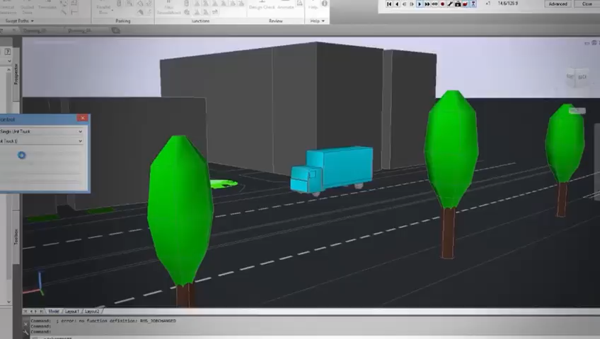
AutoDesk Civil 3D Technology

Slide 63


Slide 64





REFERENCES

Slide 65


THANK YOU FOR LISTENING

