Slide 1

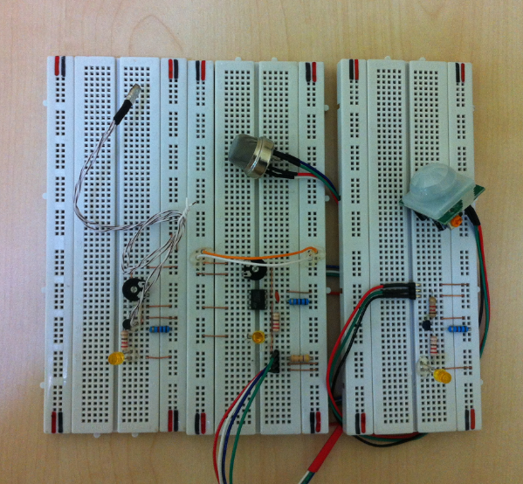
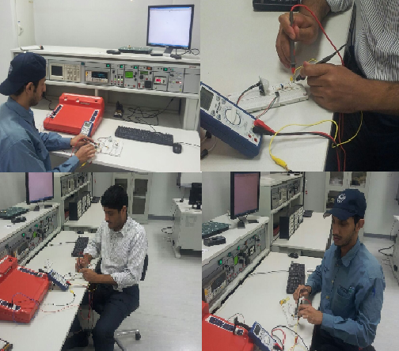
Residential Security System
Electrical Engineering Department
EEEN4311: Design Methodology
Definition
Product Architecture
Design Residential Security System that can detect multiple dangers such as Intruders, Motion Detection, Smoke, Fire,
and gases detection. These sensors will designed in a one system
Objectives
Simplicity of installation and configuration.
Use smart and long life Sensors.
Advanced security system at a very competitive low price.
System provides high level of security.
Generate alarms and activates fans in case of gas leakages.
One system detect multiple dangers.
Minimum number of components.
Real Product
Specifications
Gas Sensor:
1. High Sensitivity.
2. High Stability and Long Life.
3. Ability to detect butane, propane, methane ,alcohol, Hydrogen, smoke.
Motion Sensor:
1. Compact size.
2. High sensitivity.
3. Delay time 5s.
4. Operation Temperature: -15C -70C
5. The detection Range 7M and 140 Degree
Low maintenance cost
Easy to install
Lab Testing
Applications & Customers
Industrial and commercial Offices
Residential system that can be implemented in apartments, hotels and villas.
Team
Mohammed Daffer Al-Qahtani Instructor: Dr. Chedly B. Yahya
Al-Yami Hussin Advisor : Dr. Jawad
Al-Shammary Abdullah

