Slide 1

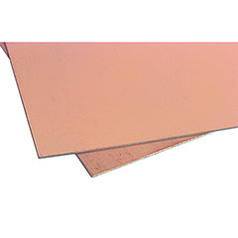
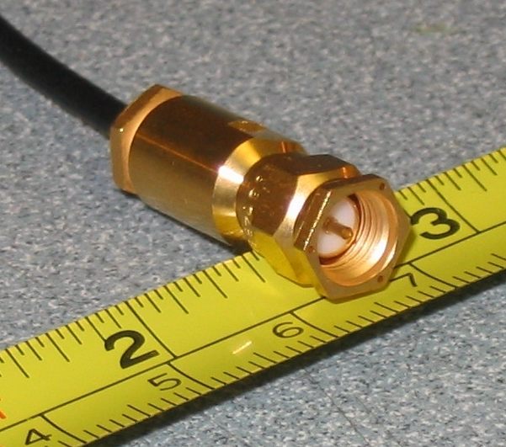
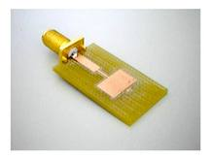
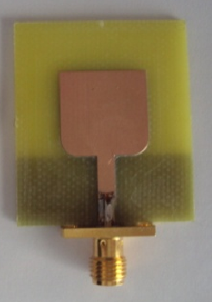
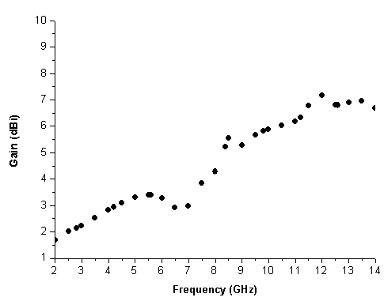
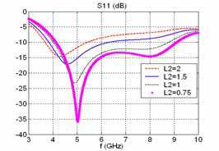
Design of Micro-strip Antenna for Wireless Communication
Electrical Engineering Department
EEEN4311: Design Methodology
Definition
Product Architecture
This project is about designing of Micro-strip patch Antenna device for specific modern application of wireless communication field with a high frequency.
⬅
Objectives
Learning new methods and designs to develop the conventional Micro-strip Antenna.
Designing prototype Micro-strip antenna device.
Project fabrication.
Testing the project and finding final results.
Presenting conference paper .
PCBoard
SMA Connector
⬅
⬅
Specifications
Real Product
low cost and easy to fabricate due to its small size
Capable of dual and triple frequency operation.
frequency range popularly from 1 GHz to 6 GHz.
The dielectric layer can be manipulated to fit different applications.
Micro-strip patch Antenna structure has two-dimensions.
Applications & Customers
Testing Results
Aircraft.
Satellites.
Medical applications.
Missiles
Future Work
Fabrication then testing by seeking for milling machine either here or abroad at USA.
upgrade for Micro-strip antenna from single patch to multipath.
present a conference paper
Team: Abdullah Al-Otaibi, Abdulaziz Al-Muhaish
Supervisor :Dr. Mohammed Morsy
Fall 2012-2013

