Slide 1

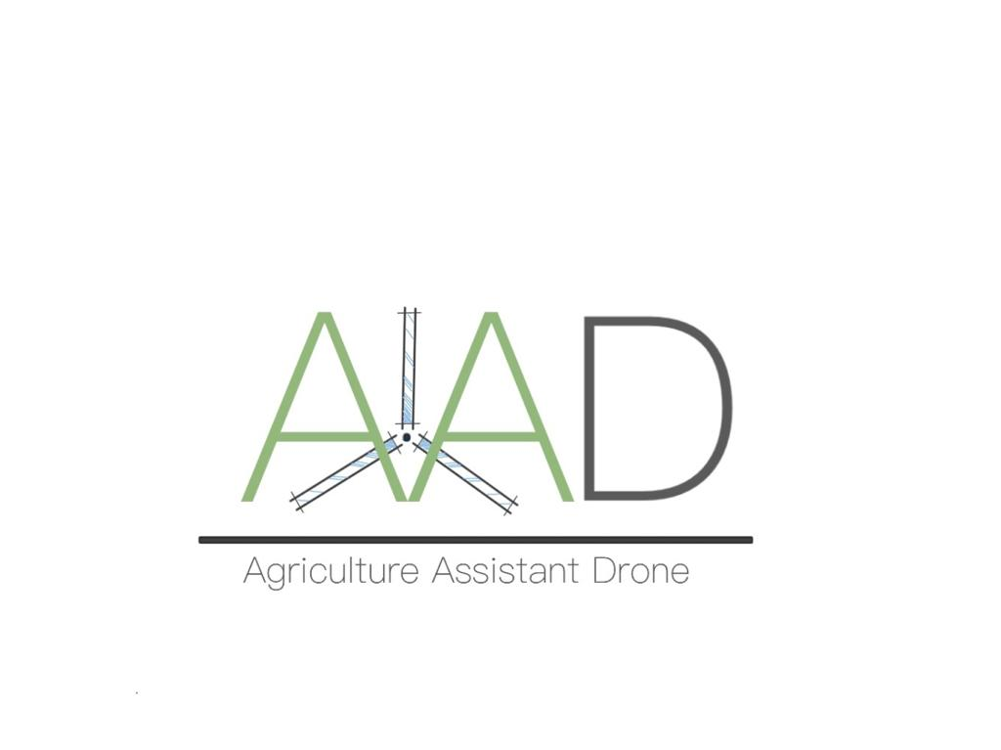
College of Computer Engineering and Science (CCES)
ASSE 4311- Learning Outcome Assessment III - CE
Section: 210
Agriculture Assistant Drone
(AAD)
Maysoon Alfares 201400842 Computer Engineering
Ghadeer Alsoghair 201403330 Computer Engineering
Shoug Alhajri 201402622 Computer Engineering
Amjad Alkhathlan 201502035 Computer Engineering
Advisor:
Dr. Loay Alzubaidi

Slide 2
Outlines
Introduction
Objectives
Project Specification
Requirement Specification
Hardware Components
Software Components
Constraints
Design
First Conceptual Design
Second Conceptual Design
Hardware Design
Software Design
Prototype Development
Aircraft Body
Creating 3D Design
Arduino UNO
Image Recognition
Stages of Applying Image Recognition
Comparison of Image Recognition in Raspberry Pi and PC
Setup Modules Communication
Xbee Setup Configuration
Test AT mode to AT mode
Test AT mode to API mode

Slide 3
Cont’d
Test and Verification
Module Testing
System Testing
Limitations
Future Recommendations
Conclusion

Slide 4
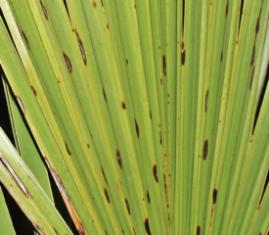

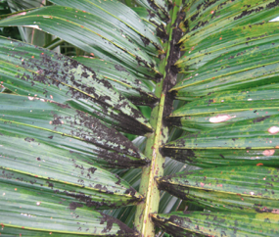
Introduction:
Problem Statement

Slide 5
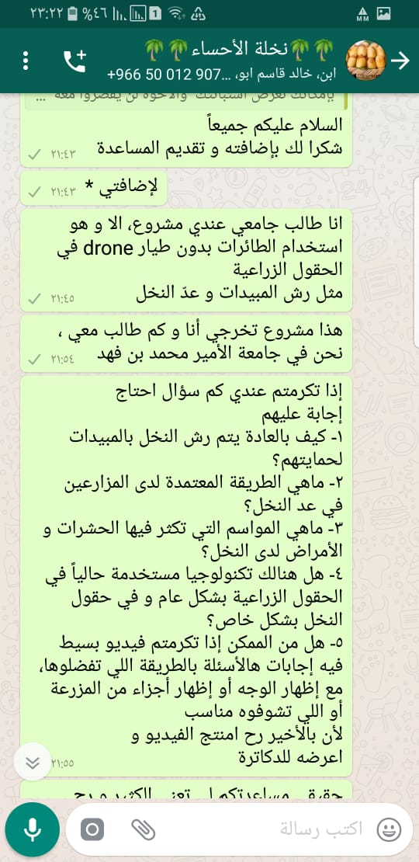
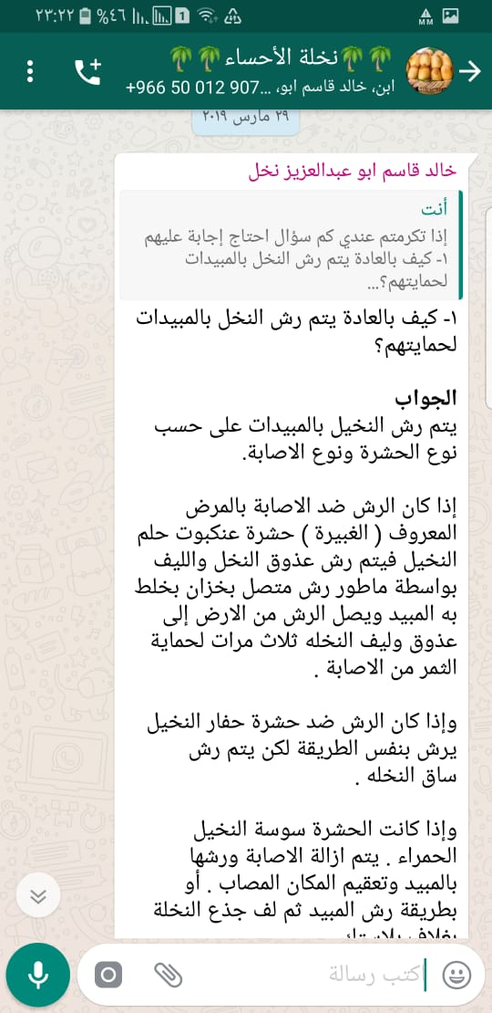
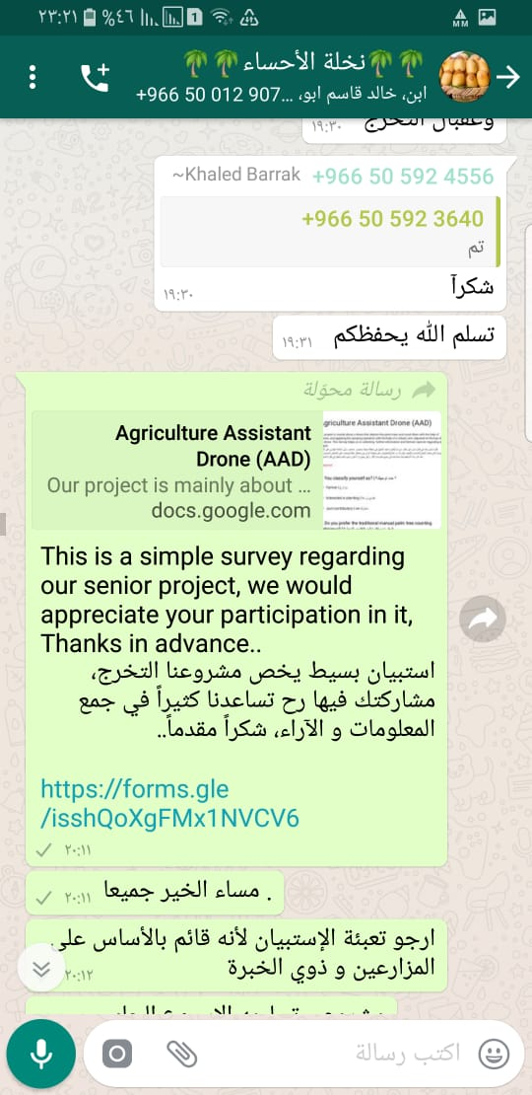
Online Interview

Slide 6
Objectives
Help in improving agriculture environment facilities.
Apply new technologies for estimating the number of palm trees in a field.
Enhance people’s knowledge regarding different applications of drones.
Contributing in creating sustainable palm tree fields, to protect and
increase the economy of dates production.

Slide 7
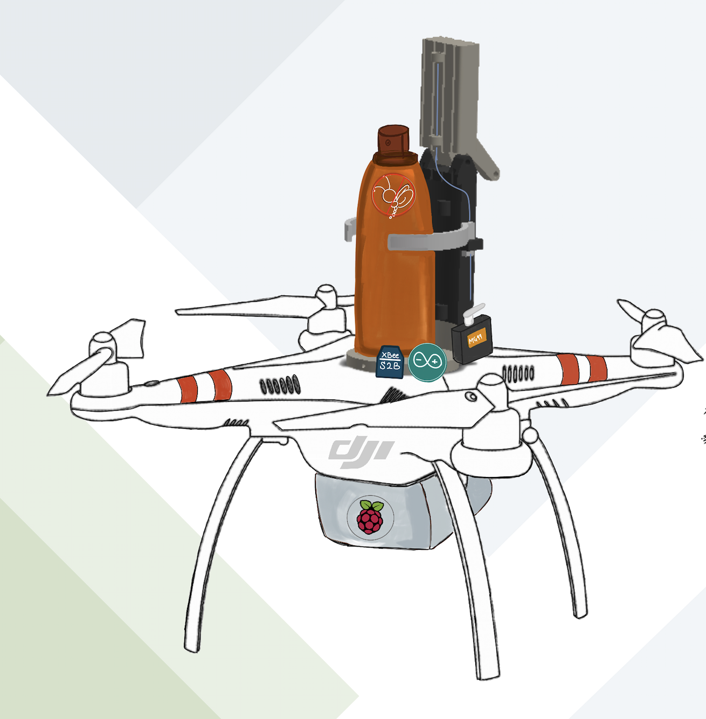
Specification:
Spraying Operation
Image Recognition
Notes:
shoug

Slide 8
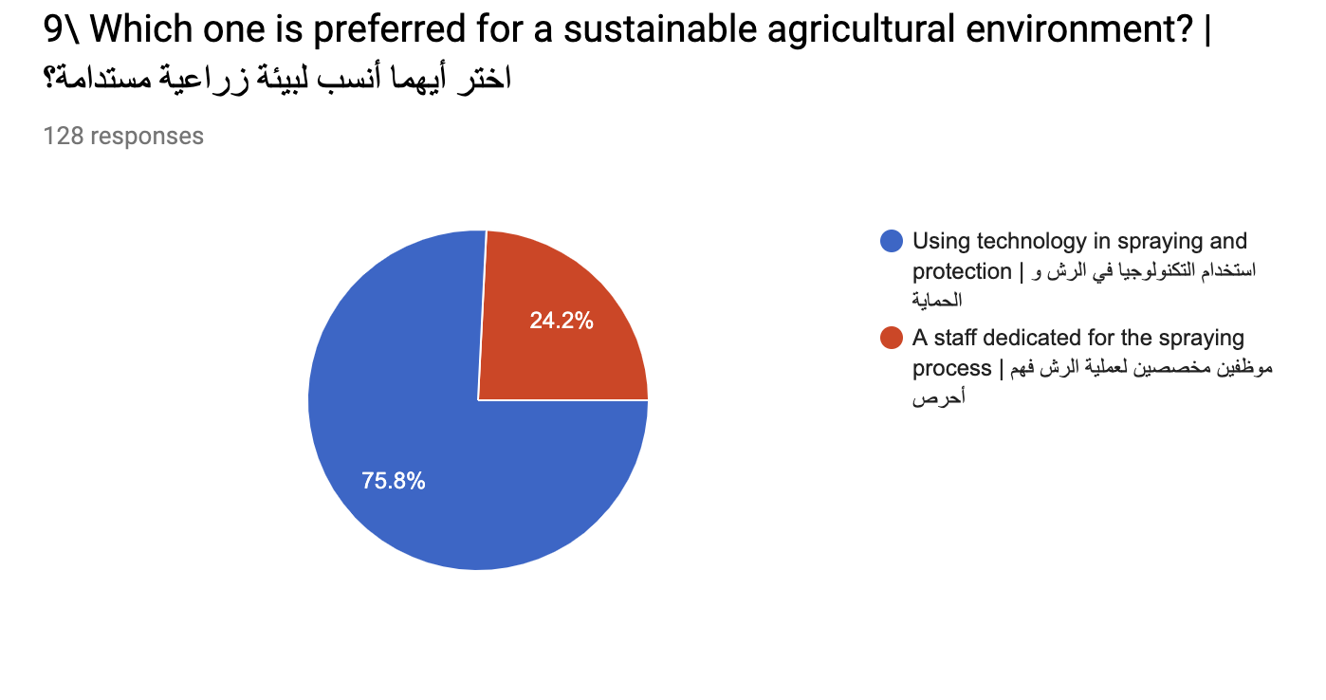
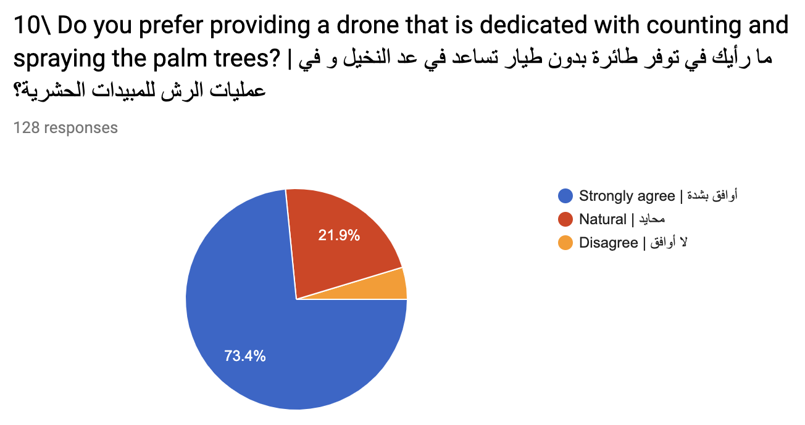
Survey:

Slide 9
Requirement Specification:
Functional Requirement
Nonfunctional Requirement
Performance
Controllability
Reliability
Safety
Accuracy
Detection
Flight Time
Weight
Distance
Detection
Reliability
1
2
Notes:
shoug

Slide 10
Functional Requirement
Performance
Controllability
Wireless communication.
The arm spray with the buttons
Reliability
Safety
The arm responding.
Avoid any collision with drone propellers
Accuracy
Detection
Results of palm trees recognition
Captured different areas

Slide 11
Nonfunctional Requirement
Flight Time
Reliability
25 minutes
Total weight
Distance
Detection
Exceeds about 1640 ft. (500 m)
Detecting only palm trees.
Weight
Weight of the drone: 1.043 kg
Weight of the 3D arm: 0.467 kg
Weight of the Raspberry Pi: 0.139 kg Total Weight: 1.649 kg
Payload : 1 Kg

Slide 12
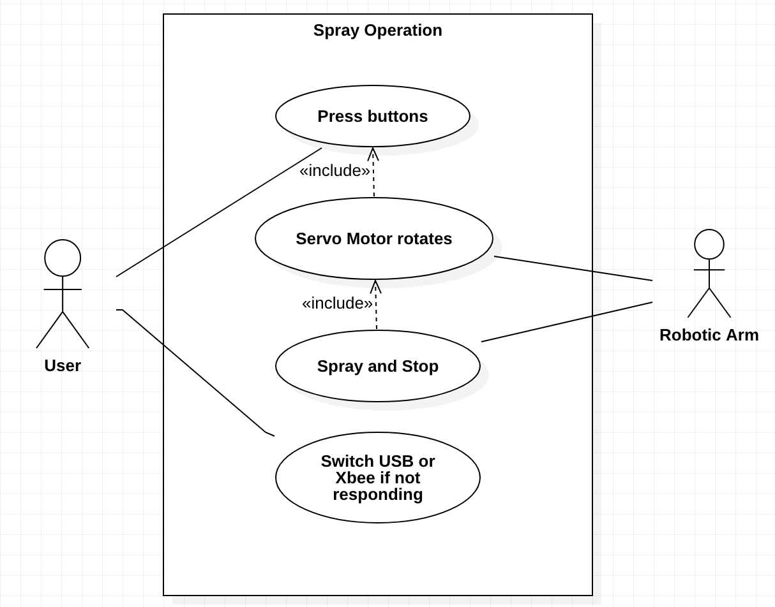
Use Case Diagrams:

Slide 13
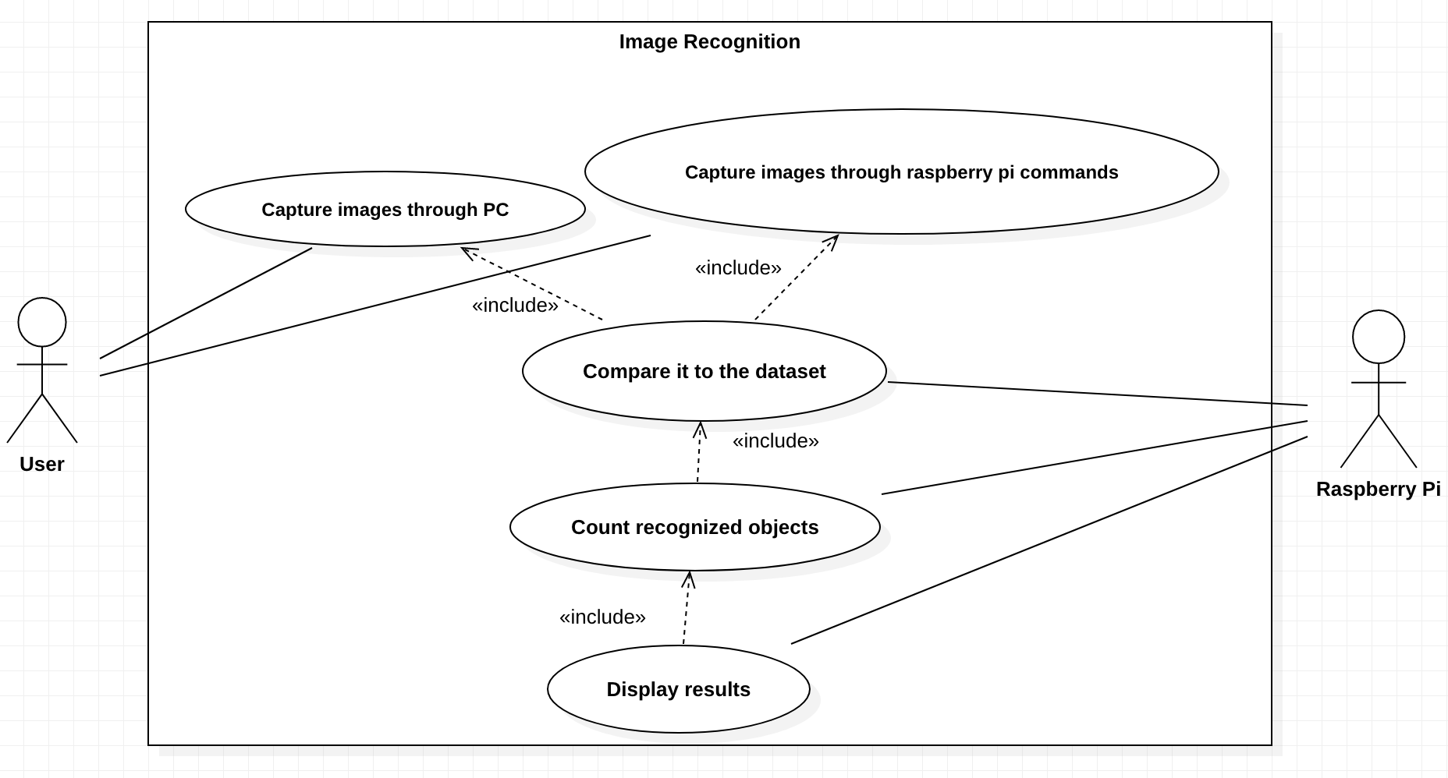
Use Case Diagrams:

Slide 14
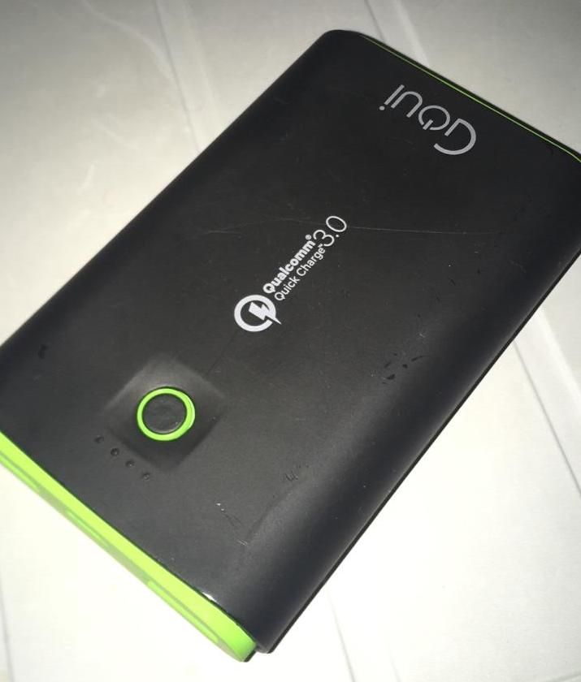
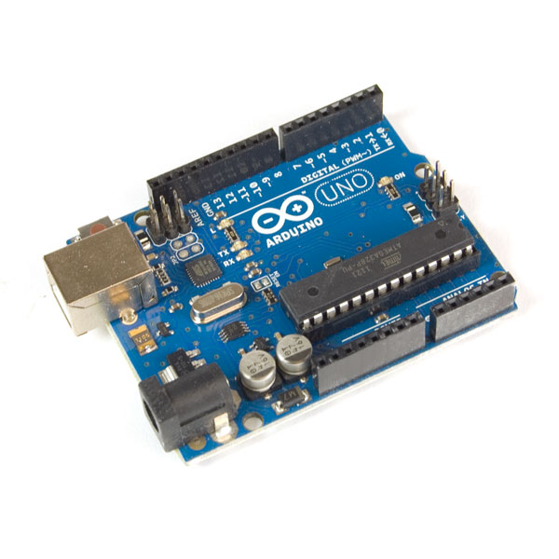
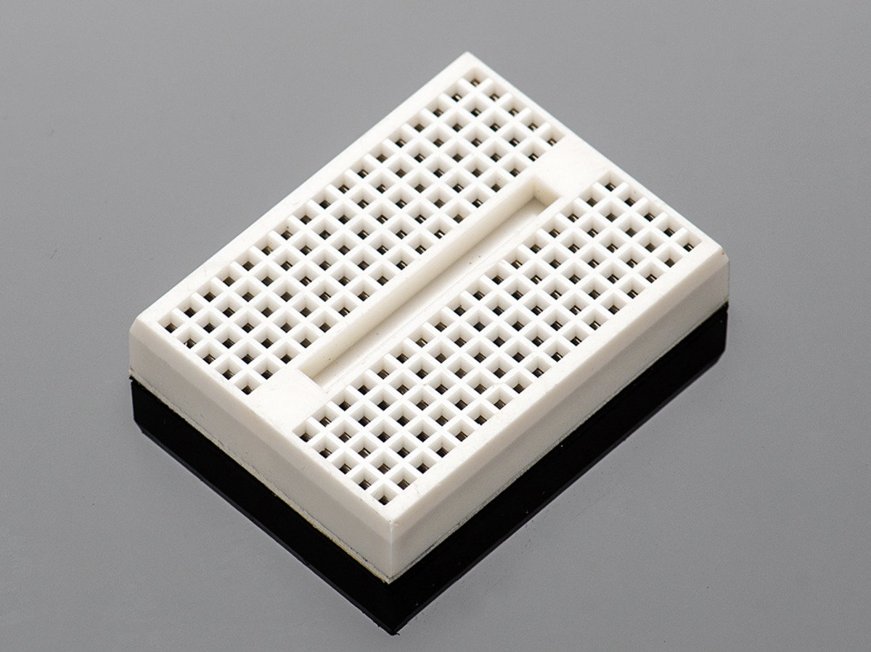
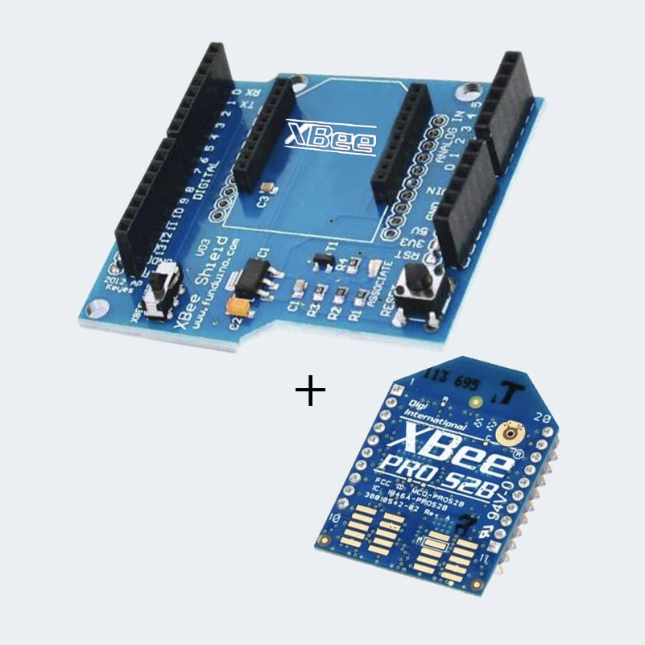
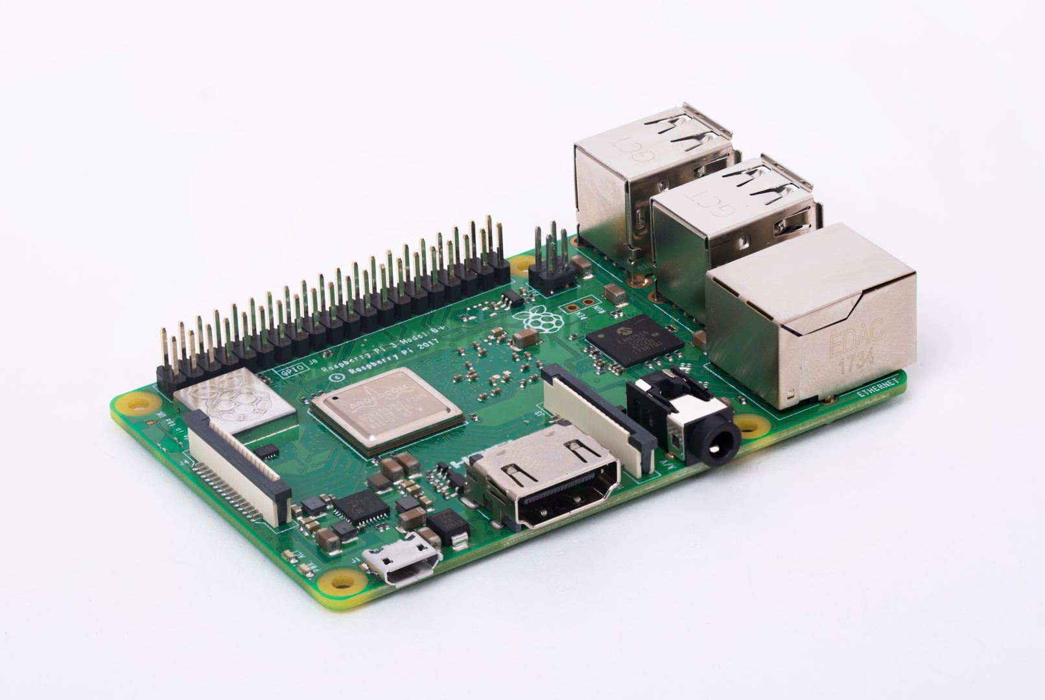
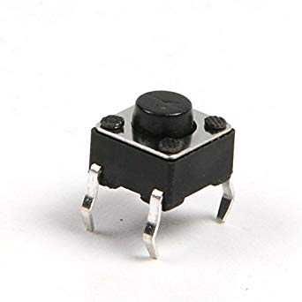
Hardware Components:
Power Bank
Arduino UNO
Mini breadboard
Xbee
Raspberry Pi
Pushbutton

Slide 15
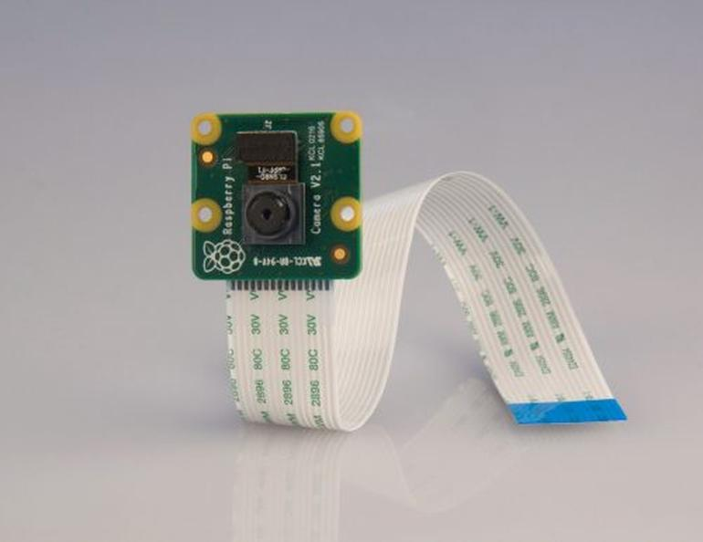

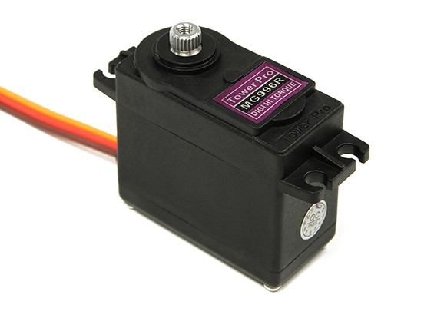
Hardware Components:
Servo Motor
Pi Camera
PC

Slide 16
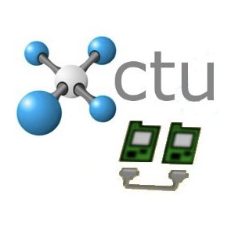

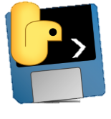






Software Components:
Arduino
XCTU
Python
LabelImg
StarUML
Trello
Google

Slide 17
Constraints:
Technical:
Arduino IDE, Raspberry pi, Python.
New components.
05
Physical:
Drone , Xbee
01
04
Design:
Select the components probably
Time:
Unavailable components
Building robotic arm
Testing
02
03
Cost
Components
Printing

Slide 18
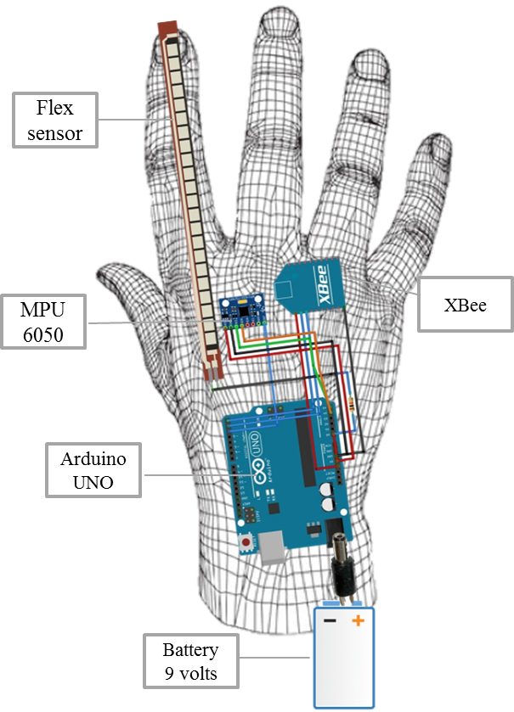
Conceptual Design:
First Conceptual Design
Drone: DJI Phantom 3
Cameras
IR Distance Sensor
XBee
Ultrasonic Sensor
RC (Transmitter and Receiver)
GPS
Arduino UNO
MPU-9520
Battery
Flex Sensor (Spectra Symbol 2.18’’)

Slide 19
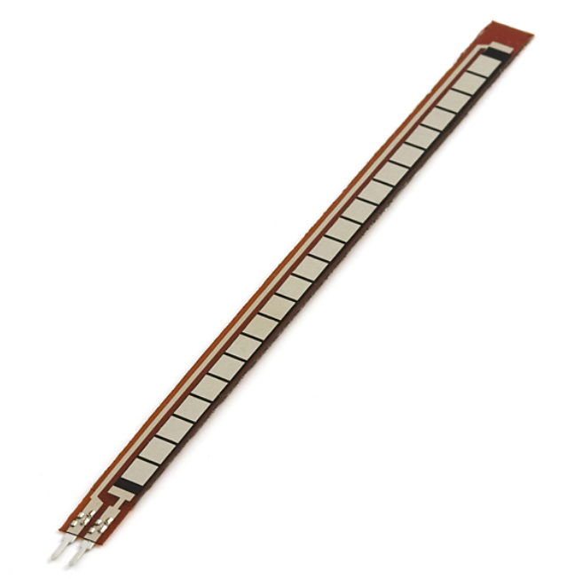
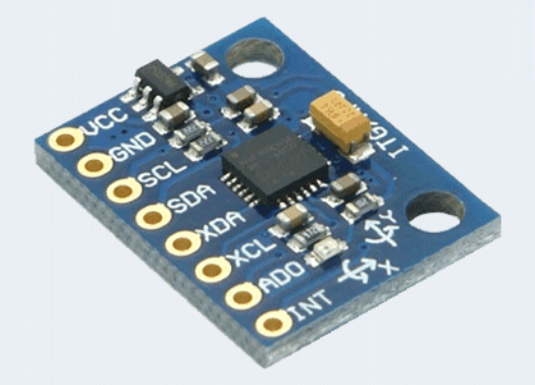
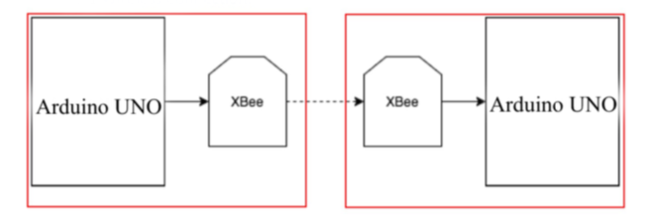
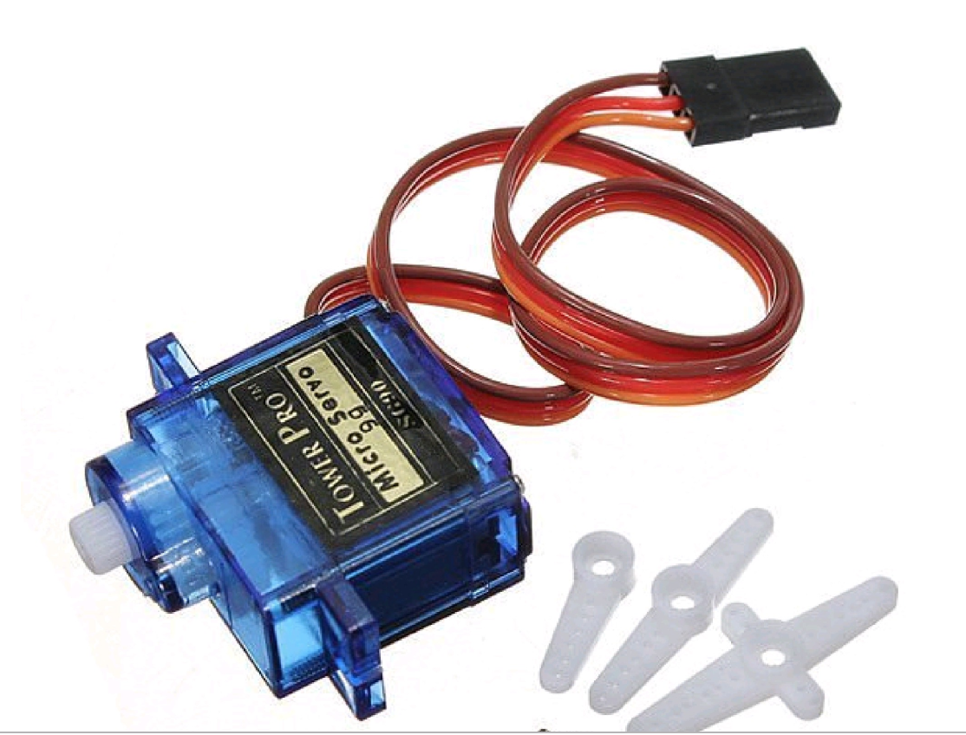
Conceptual Design:
Second Conceptual Design
Flex Sensor
MPU-6050
Two servo motors (micro servo)
Xbee (Transmitting/ Receiving)

Slide 20
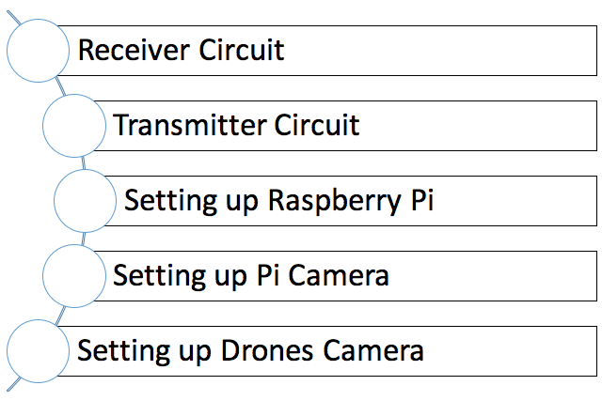
Hardware Design
Implementation

Slide 21
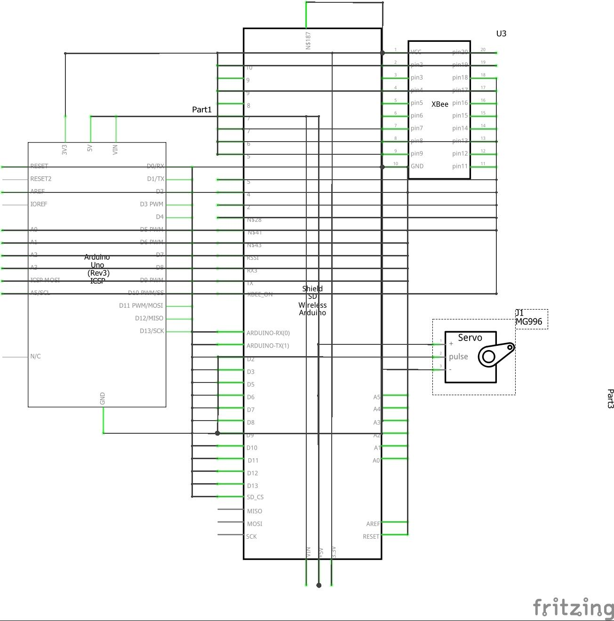
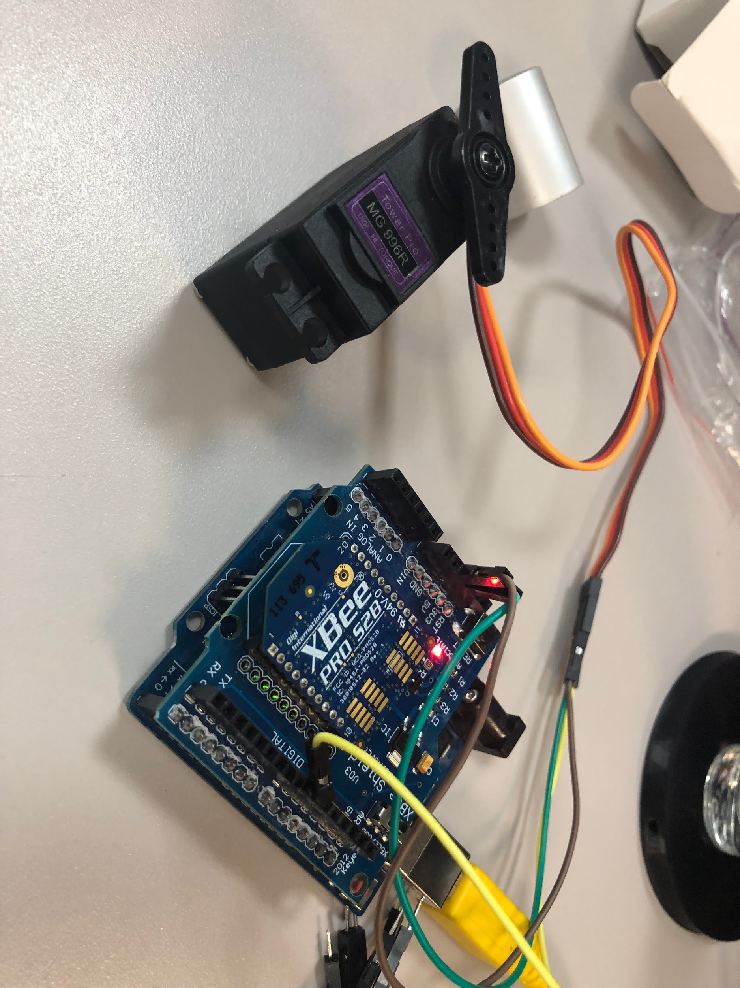
Receiver Circuit

Slide 22
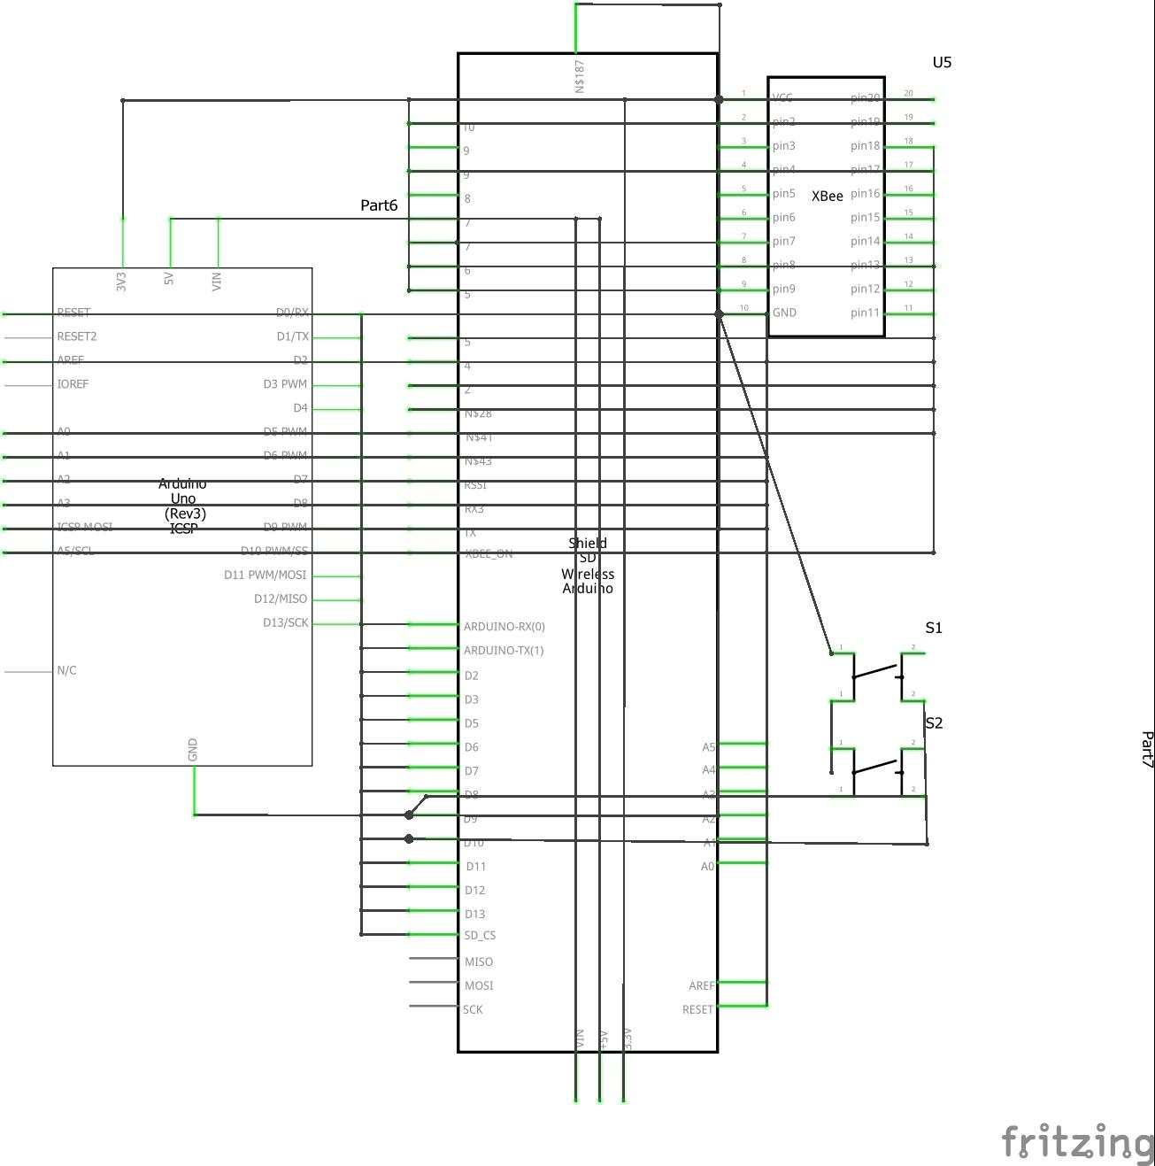
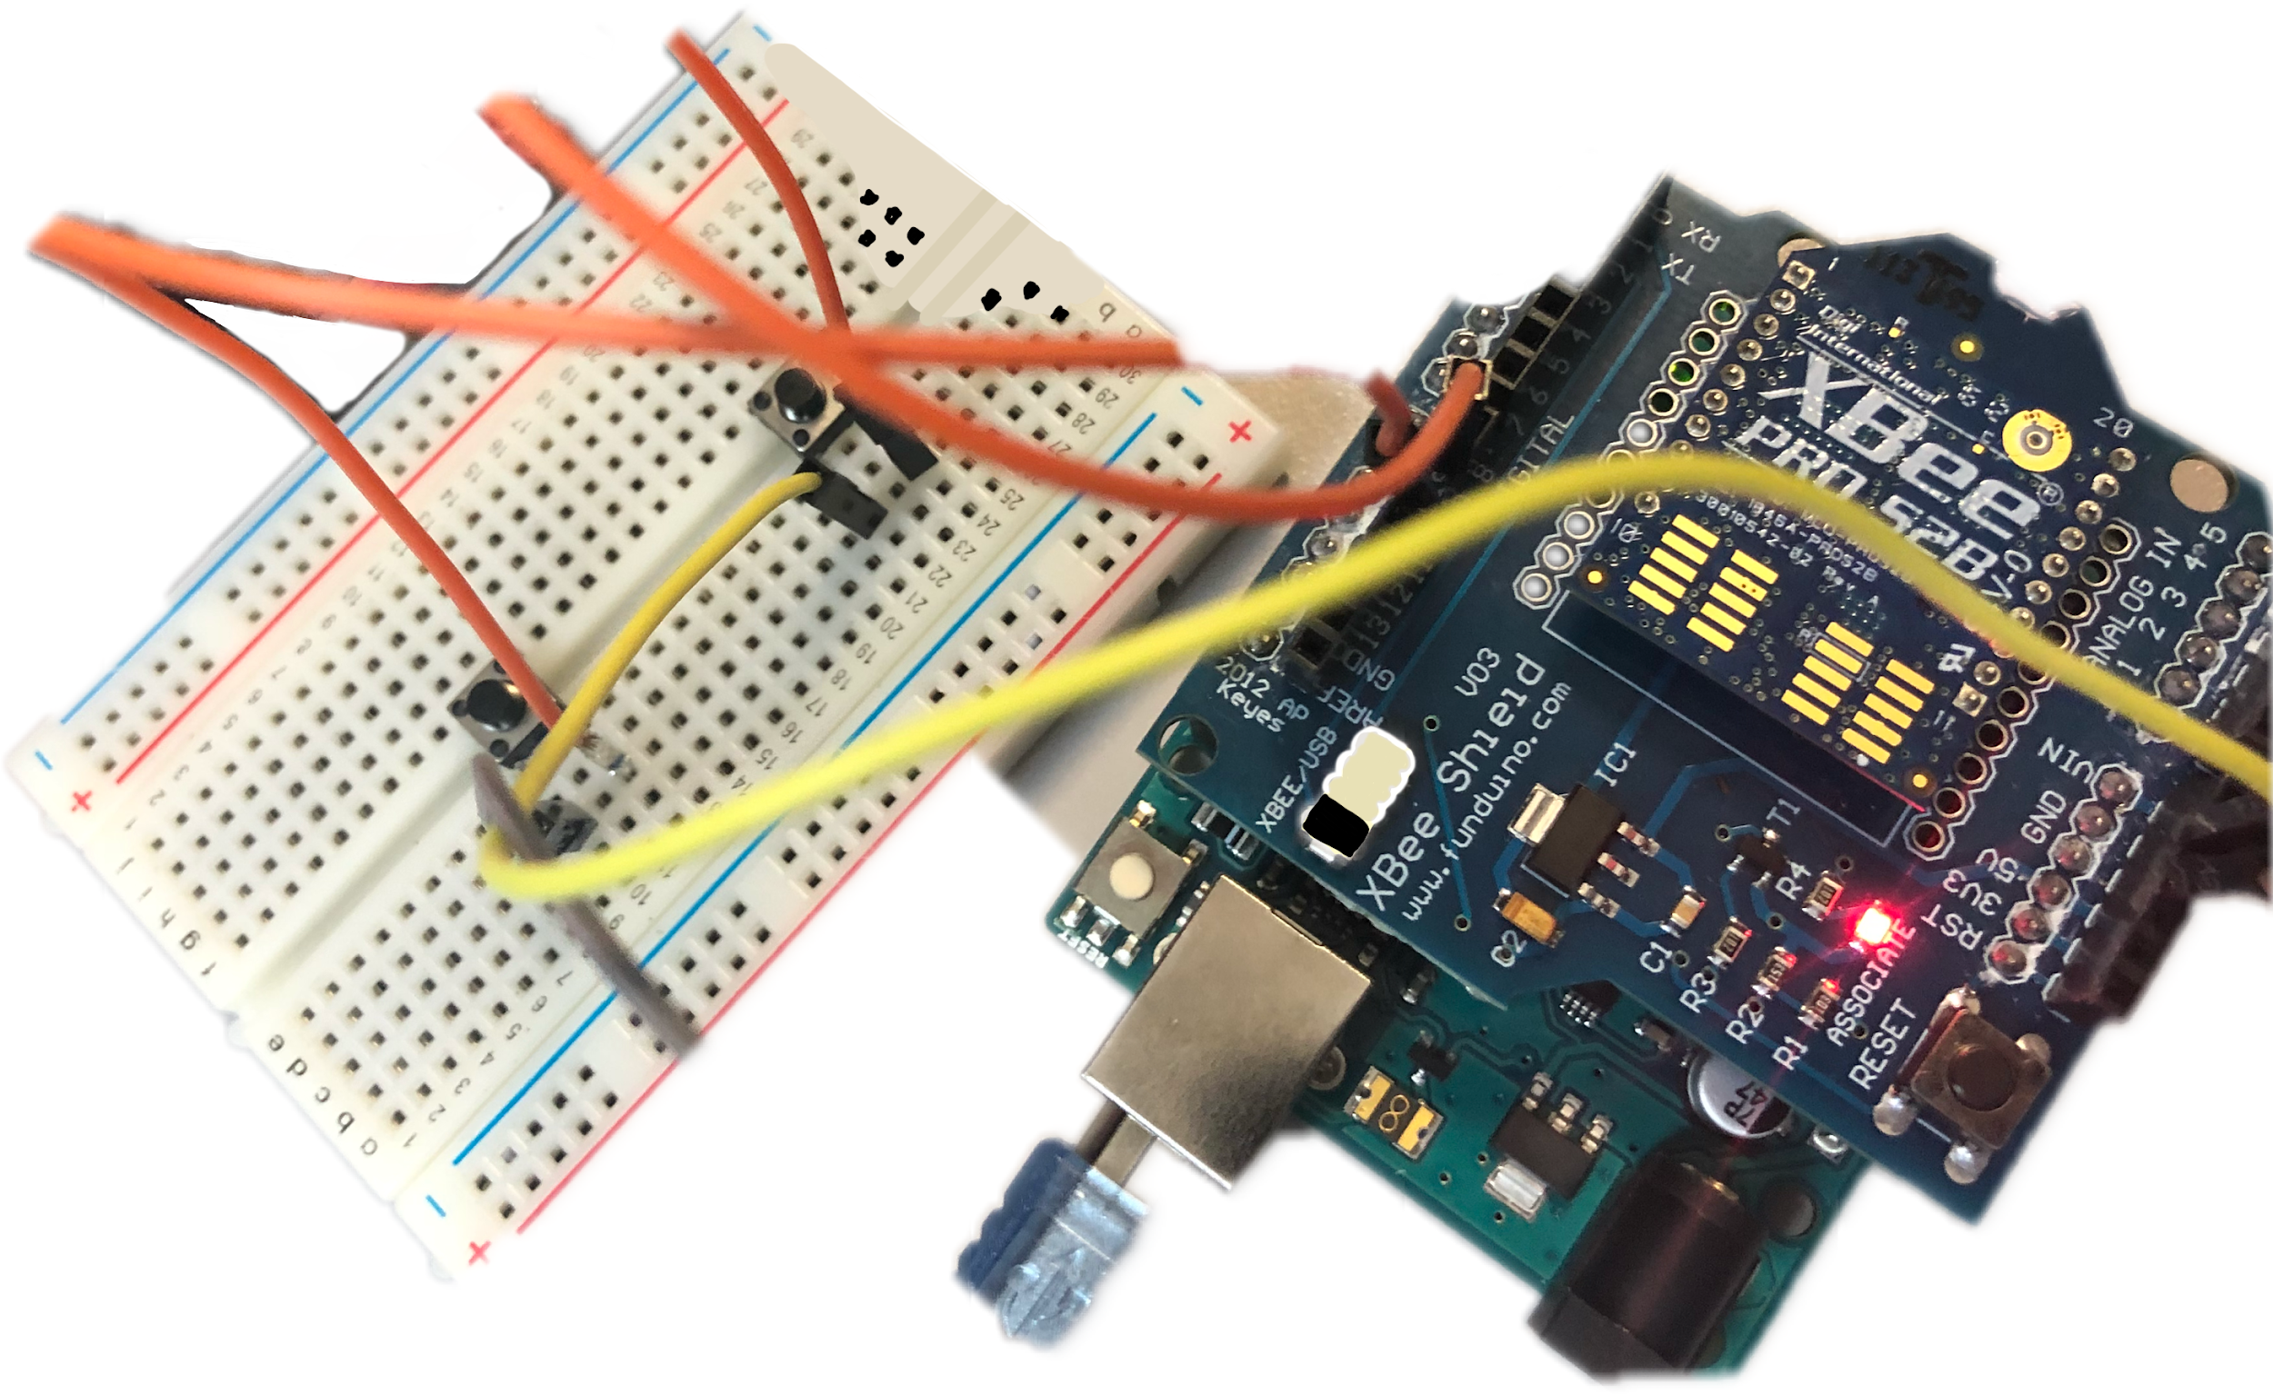
Transmitter Circuit

Slide 23
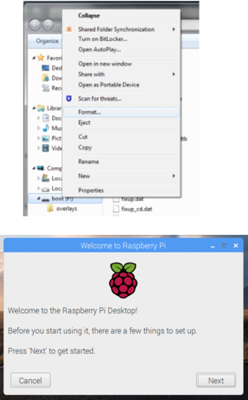
Setting up Raspberry Pi
SD Card
•Formatting the SD card by using SD card formatter
Downloading the Raspbian Scratch OS
•Burning the Raspbian OS by using the Etcher open-source
keyboard, mouse, HDMI cable and the power should be inserted into the correct raspberry ports

Slide 24
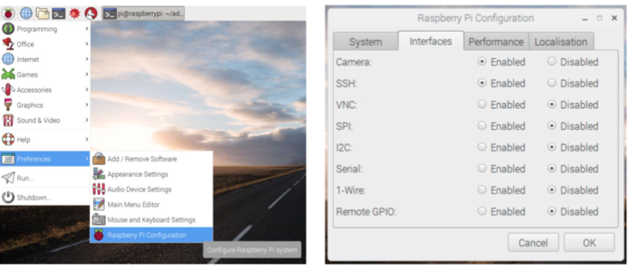
Setting up Pi camera
Enabling the camera

Slide 25
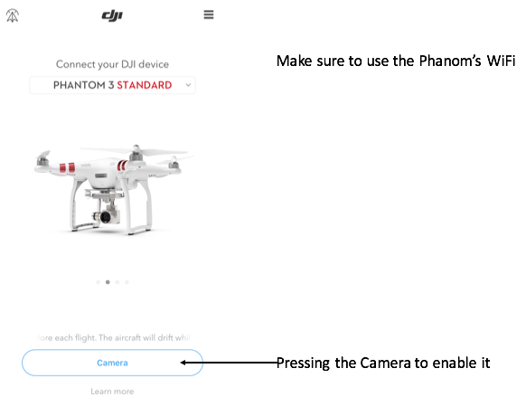
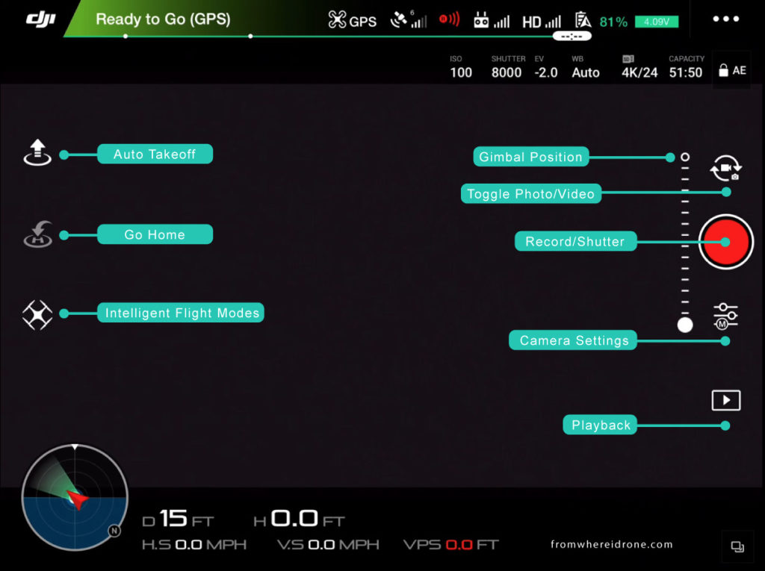

Setting up Drones Camera

Slide 26
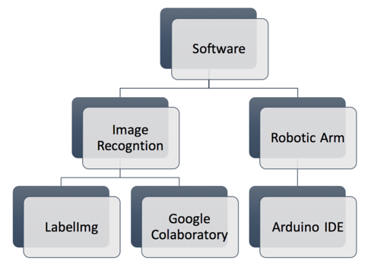
Software design

Slide 27
Arduino IDE
Arduino software Integrated Development Environment (Arduino Software IDE)
Easy to deal with
More applicable to implement with
Arduino is a stable open source electronics platform, with many libraries.
The user will find a lot of hardware that they can directly plug in, and immediately use it with an Arduino library.
It is useful to use it before implementing the actual PCB

Slide 28
LabelImg
Graphical image annotation tool that is written in Python and uses Qt for its graphical interface.
This annotation are saved as XML files in PASCAL VOC format.
By using this tool the user will be able to label the needed object from the image

Slide 29
Google Colaboratory
Free cloud service that supports GPU and TPU.
Using the Google Colaboratory programmers can improve their coding skills in Python programming language.
Can develop deep learning applications by using the popular libraries such as Keras, TensorFlow, and OpenCV.
Purpose to use for this project
Supports GPU
Uses Python
Easy to download needed dependencies

Slide 30
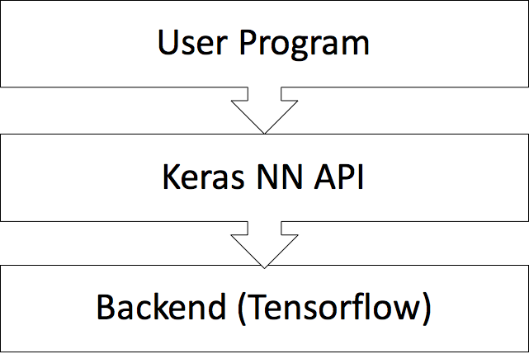
Keras API
High level API
Is a specification for building models layer-by-layer that works with multiple frameworks
Designed to be inviting, flexible, and simple to learn
works as a wrapper which wraps the efficient libraries such as TensorFlow and then will allow to define and train neural network models in a few short lines of code

Slide 31
Image Recognition
The ability of software to identify objects, places, people, writing and actions in a given image.
It is used to perform a large number of computer vision operations, such as labeling the content of images.
The software for image recognition requires deep machine learning which requires the system to be pre-trained with thousands of pre-labeled pictures
It can be performed better when using the convolutional neural network (CNN), and imagery
CNN is a class of deep neural networks, that is mostly applied for analyzing visual which consists of an input and an output layer, as well as multiple hidden layers

Slide 32
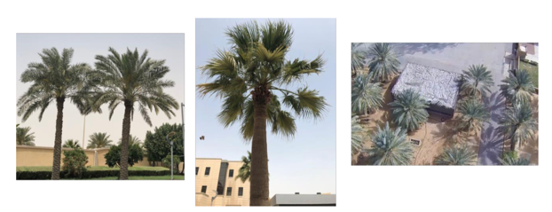
Applying Image Recognition
Dataset collection
Collecting a huge amount of palm trees images
Collected form Prince Mohammed University campus

Slide 33
Applying Image Recognition
Dataset Labeling
Labeling the object to identify the desired object and to separated it from other items.
By using the graphical image annotation LabelImg tool.

Slide 34
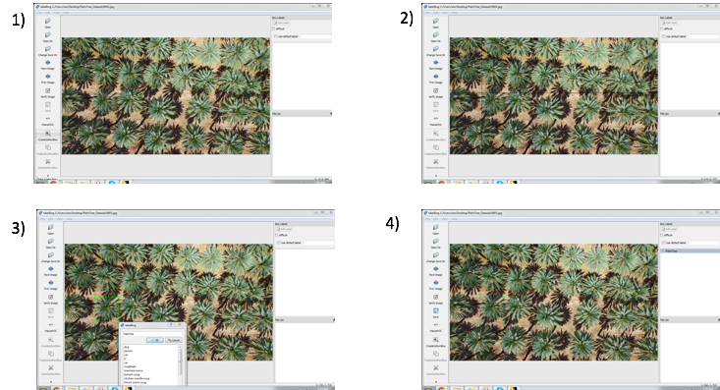
Applying Image Recognition
Dataset Labeling (Steps)

Slide 35
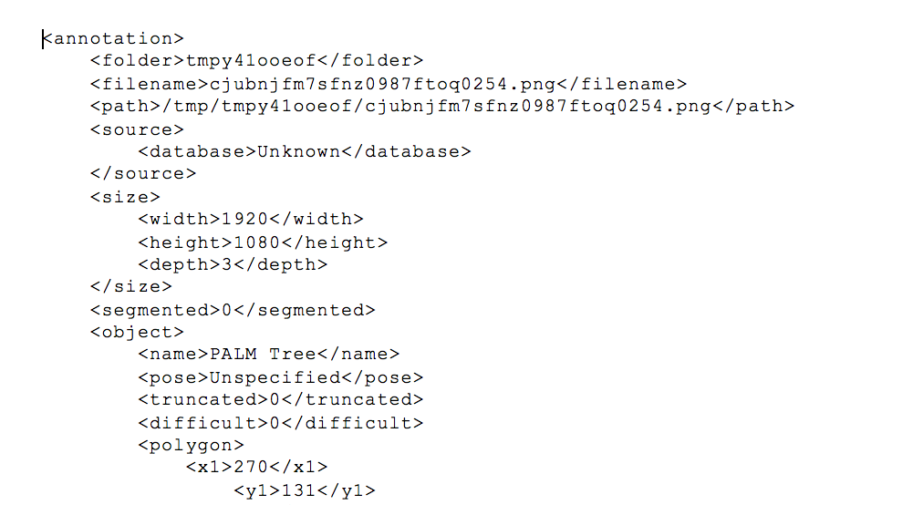

Slide 36
Applying Image Recognition
Training & counting
Google Colab is used with Python 3.6
GPU is enabled
Installing the high-level neural network API Keras

Slide 37
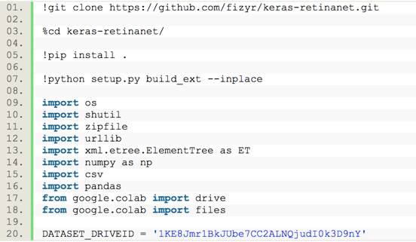
Applying Image Recognition
Training & counting(Coding)
Environment setup

Slide 38
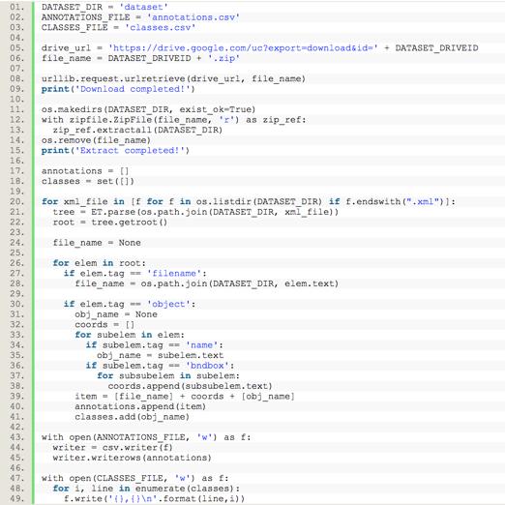

Applying Image Recognition
Training & counting(Coding)
•Making Dataset

Slide 39
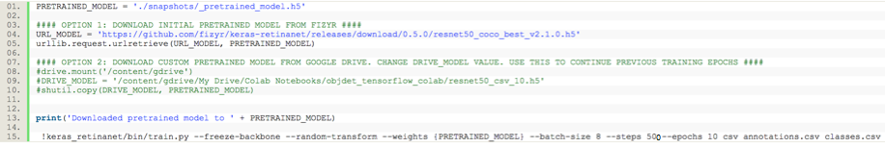

Applying Image Recognition
Training & counting(Coding)
•Training Model

Slide 40
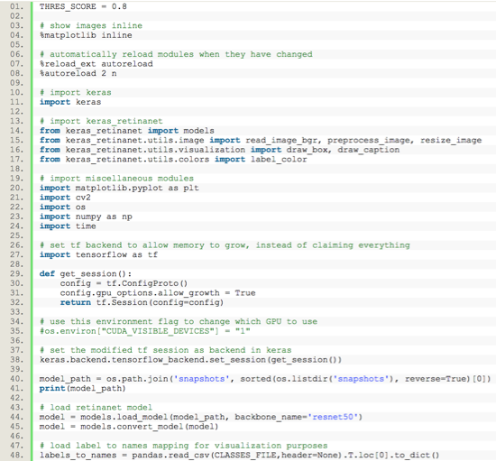
Applying Image Recognition
Training & counting(Coding)
Testing

Slide 41
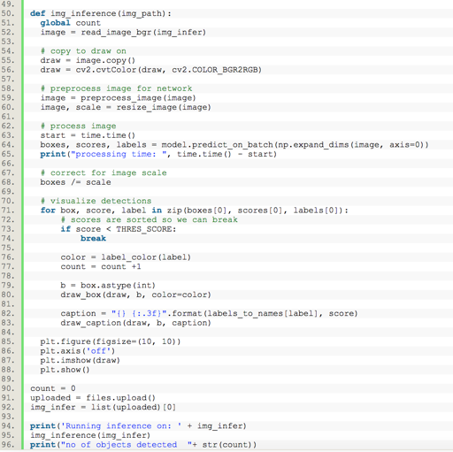
Applying Image Recognition
Training & counting (Coding)
Testing

Slide 42
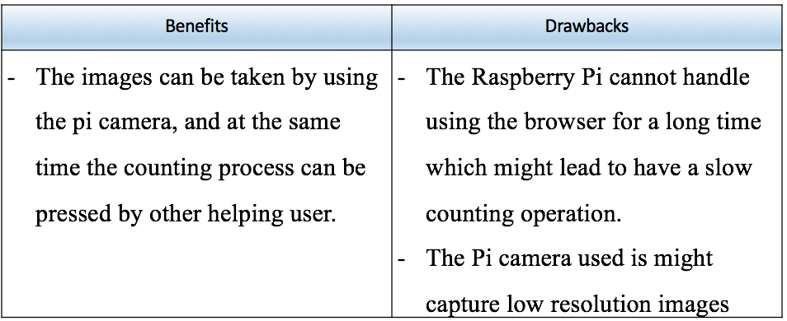
Applying Image Recognition
Two Options
Raspberry Pi

Slide 43
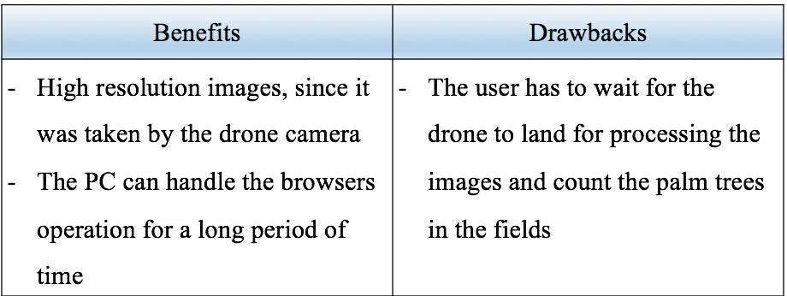
Applying Image Recognition
Two Options
Personal Computer

Slide 44
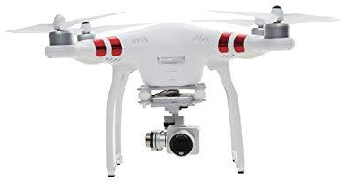
Prototype Development
Criteria | Details
Weight (Battery & Propellers Included) | 1216 g
Diagonal Size (Propellers Excluded) | 350 mm
Max Speed | 16 m/s (ATTI mode)
Max Flight Time | Approx. 25 minutes
Operating Temperature Range | 32° to 104°F (0° to 40°C)
Satellite Positioning Systems | GPS
Stabilization | 3-axis (pitch, roll, yaw)
Max Transmission Distance | FCC: 1000 m CE: 500 m (outdoors and unobstructed, aircraft's altitude at 400 feet (120 m))
Aircraft Body

Slide 45
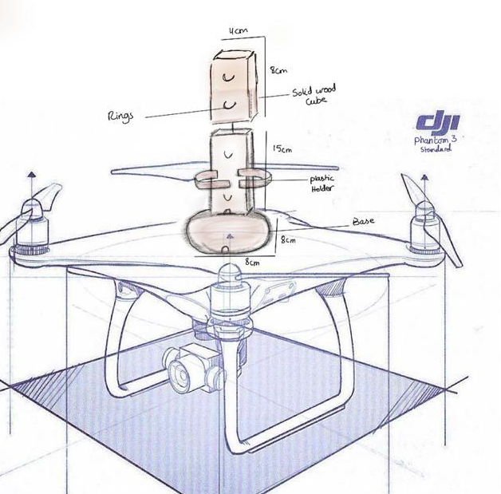
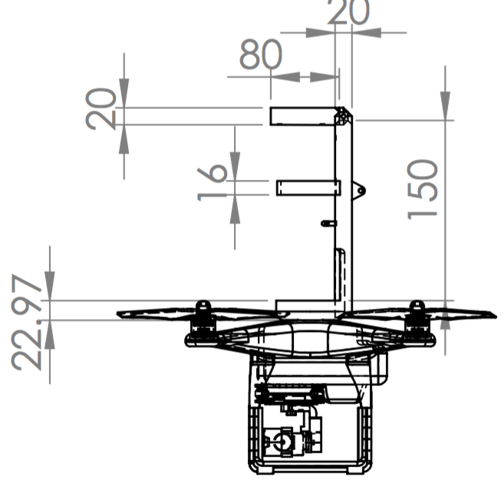


Creating 3D Design

Slide 46



Slide 47


Set up Modules Communication
Xbee Setup Configuration

Slide 48


1

Slide 49


2

Slide 50

3

Slide 51

4

Slide 52

AT Mode vs. API Mode

Slide 53

Test AT mode to AT mode

Slide 54

Once writing in router, it will show the writings as a blue colored in the router itself but going to show as red colored in the coordinator, and that means it came from the other Xbee. AT mode allowed to transmit and re-transmit communication, both router and coordinators are allowed to send to each other.

Slide 55


Test AT mode to API mode
AT
API

Slide 56
System Testing and Analysis
Modules Testing

Slide 57
Testing Pi Camera
testing the Pi camera workability by using the following commands lines
For capturing a still image by using the command line in terminal (raspistill)
For capturing a still image with a specified format (jpg) (raspistill -o testshot.jpg)
For capturing a video with the used of raspivid command
For capturing a video by specifying the time limit with the used of (raspivid –o video.h264 -t 10000) command

Slide 58

Testing Pi Camera
Testing the Pi camera with capturing an image of palm tree

Slide 59

Arduino UNO Connection with Xbee Shield

Slide 60
2. System Testing

Slide 61

Test 1: Aircraft Taking-Off

Slide 62



Slide 63

Image Recognition Test

Slide 64


Image Recognition Test
Low Accuracy
High Accuracy

Slide 65


Test 3: Interactivity

Slide 66
Test 4: Push/Release operation of the Spraying Operation Arm
Algorithm of push/release operation:
1\ Check interactivity between two Xbee has been configured, by looking to the led flashing mechanism, Tx flashes twice per sec, Rx flashes once per second.
2\ Move switch to Xbee mode
3\ Click push button
4\ Sends values through the serial port
5\ The servo motor Xbee shield takes the values from the serial port and move accordingly
6\ The top head of the arm will be pulled down and pressed the spray bottle and then spraying will done
7\ Click release button
8\ The top head of the arm will release and back to its original place, and then the spray bottle will stop spraying

Slide 67

Pseudocode
Tx

Slide 68

Tx

Slide 69

Rx

Slide 70

Rx

Slide 71


Serial Port Monitor
Tx
Rx

Slide 72

Serial Port Plotter

Slide 73

Limitations:
Duplication in counting
Camera
Battery

Slide 74

Future Work:
Fire Sensor
Different Weather Conditions
Different Fields
Improve the Design
Profinaintilty applied to the robotic arm
Flame Detector:
Using different components
Image recognition
Spraying technique
Real time video-based detection
Motion detection

Slide 75
Conclusion
Thank you for listening

