Slide 1
Square World Game for Treating Amblyopia
Sarah Alghamdi

Slide 2
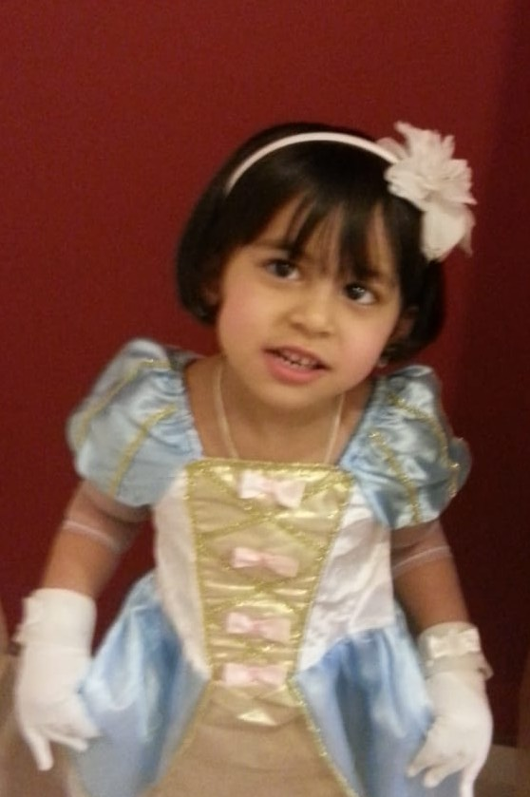

Slide 3
Agenda
1
Introduction
2
Problem and Statistics
3
Solution
4
Developed Treatment
5
Traditional and Proposed Treatment

Slide 4
Agenda
6
Objective
7
Scope and Limitation
8
Methodology
9
Conclusion

Slide 5

Introduction
Square World Game

Slide 6
Amblyopia!!
Lazy Eye
It is a vision development disorder in which an eye fails to achieve normal visual acuity, even with prescription eyeglasses or contact lenses. Amblyopia begins during infancy and early childhood.
In most cases, only one eye is affected

Slide 7
Problem and Statistics

Slide 8
Statistic
World!
around 2-3% of the entire world population is affected
2-3%
Saudi Arabia
Saudi Arabia
Amblyopia in the most of clinical studies
Amblyopia in population studies
9.5%
1.6%-3.6%

Slide 9
Statistic
Unilateral
Amblyopic Children
68.5%
31.5%
Bilateral
Amblyopic Children

Slide 10
Solution

Slide 11
Solution
.
1
Wow Vision Therapy
professionals assist their patients to overcome their obstacle through intensive office-based vision therapy .
2
By Amblyotech Company
develop games, designed to assist lazy eye patients, and these games have been approved by professional doctors

Slide 12
Project Vision and Mission

Slide 13
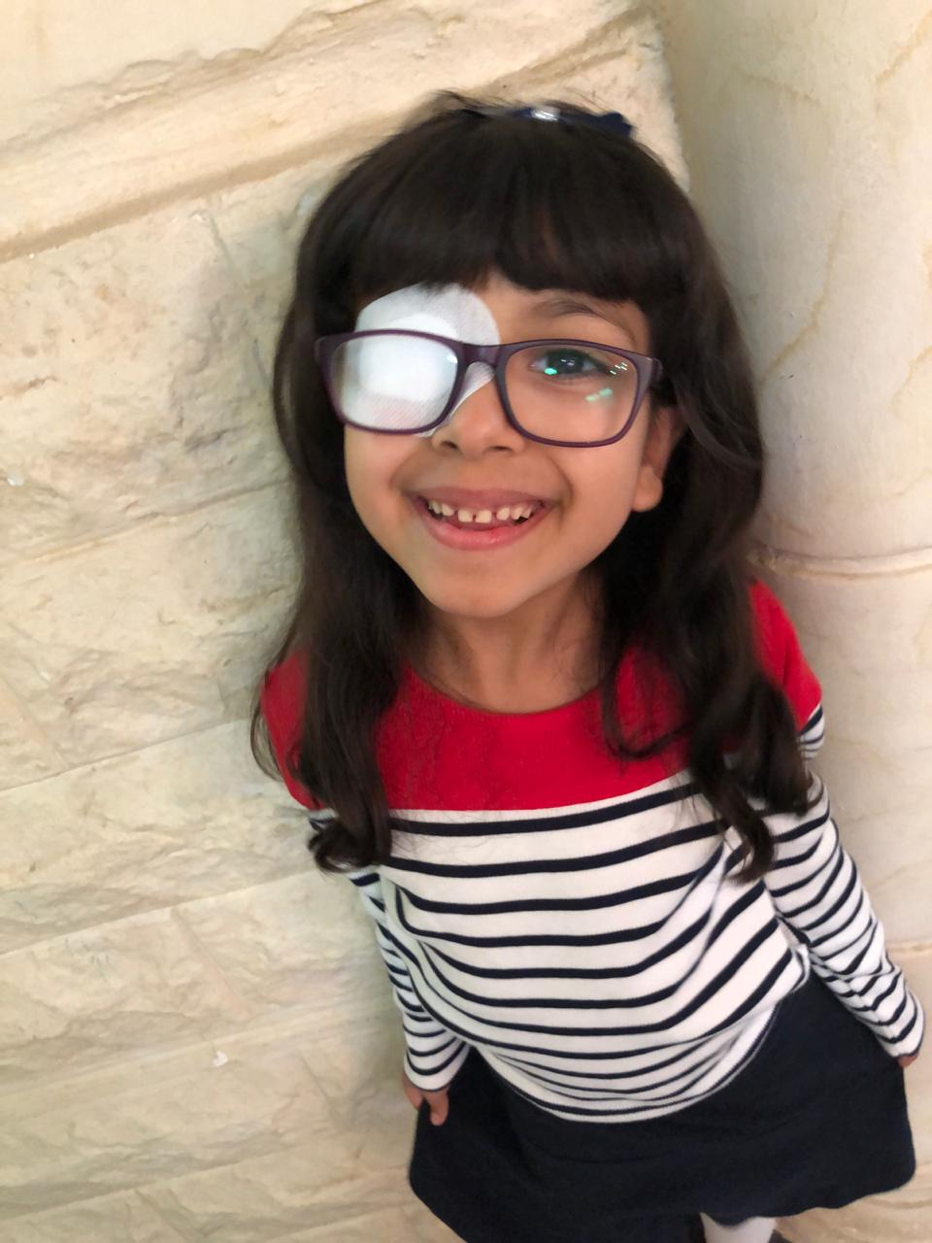

Project Vision and Mission
Our mission is to help children with amblyopia to overcome amblyopia, feel and see like other normal kids in their age
Project Vision
Project Mission
Design and develop an Android game that can help and treat Children with amblyopia or “lazy eye

Slide 14

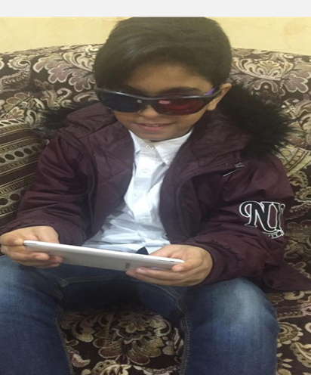







Our Team
Square World Game

Slide 15
Objectives

Slide 16
Objectives
Square World Game
Analyze the main causes and premises of amblyopia
Assess the methods and techniques that contribute to the effective treatment of amblyopia
Define the main results of using the computer game as a treatment of amblyopia
Provide advantages of the computer game in the treatment of amblyopia
Record users' scores on the game
Analyze users' records to provide an adequate assessment of the game

Slide 17
Scope and Limitation

Slide 18
Scope and Limitation
Square World Game
Scope
Limitation
?
Suitable for children between four and thirteen years old
The game is designed in Arabic language only
The game can be installed on Android devices only
Requires the use of 3D-glasses with red-green glasses
Lack of time to improve the web site and the game interface.

Slide 19
Literature Review

Slide 20
The first simple and traditional methods of treating amblyopia are penalization and direct occlusion.
The principle of these methods is to turn off the better seeing eye from the act of vision. Penalization is most effective in 2–3 year-old children (97–98%) in the period, when there are no serious sensory impairments in the visual system. Yet, its effectiveness is significantly reduced (14.3–31.2%) at the older age (Fiscalini, 2016)

Slide 21
Recently, various computer-based stimulation methods have been useful in the treatment of amblyopia. Computer programs increase the efficiency of the defective part of the visual analyzer due to a patient’s sensible solving of visual problems

Slide 22
Developed Treatment

Slide 23
Developed Treatment
Square World Game
I created a game for treating people, who suffer from amblyopia without visiting a clinic for special treatment or wearing the eye patch.
Mobile Game
Web Site

Slide 24
Methodology

Slide 25
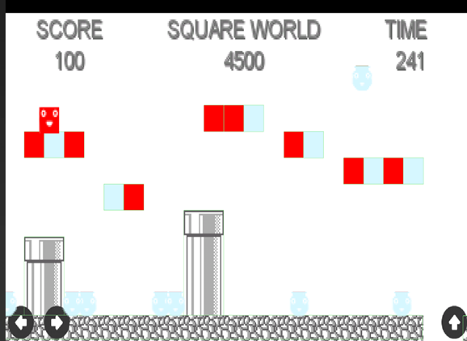
Methodology
Square World Game
Based on the game Dig Rush that Ubisoft that has been developed jointly with Amblyotech

Slide 26
Proposed Treatments to amblyopia
Square World Game
Traditional Treatment
Eye Patch Eye Drops Clinic Therapy’s
Both of these treatment take larger period of time, consume a lot of money, and affect patient self-esteem.
Developed Treatment
Games, designed to treat lazy eye.
This treatment consumes less cost and time, develops motivational environment among patients, encourages patients to score more, does not affect patient self-esteem

Slide 27
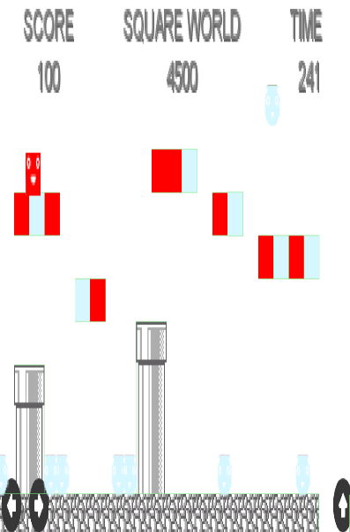
Methodology
Square World Game
Sample Size
Data Collection
seven children with amblyopia from DAMMAM Hospital
Hospital and Doctors
Web site
Study Design 2
Study Design 1
3D glasses with red-green glasses
Directing the red square to hit the blue one to collect score
The game depends on two colors, red and blue
Face Recognition
Parents can see their child improvement comparing to the other child in the same age

Slide 28
.
Technical Process
Website

Slide 29
Technical Process
Square World Game – Web Site
Create server Linux/Unix, Ubuntu 16.04 WordPress .
Create security group to allow http and https requests.
Allocate IP address for the server.
Register a domain name.
Route the domain traffic to the server
Create WorkMail service to use it with WordPress .

Slide 30
Technical Process
Square World Game – web Site
Create SES service to allow the WordPress sending emails to gamers.
Configure the SMTP on WordPress and connect it with SES service
Add themes and plugin to WordPress
Add pages with styles
Configure routing between the pages
Add widgets to pages.
Configure registrations process

Slide 31
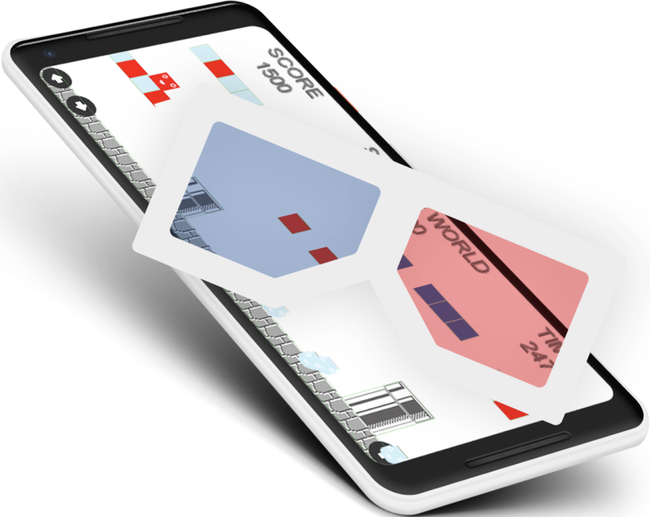
Technical Process
Square World Game – Mobile App
Mobile App

Slide 32
Technical Process
Square World Game – Mobile App
libGDX : a cross-platform Java game development framework based on OpenGL (ES), your WebGL enabled browser and iOS. You can create a game for different platforms with the same codebase.
Game Core Packages
Squareworld package
Tools Package
Sprintes Package
Enemies Package
Item Package
Screen Package

Slide 33
Game Core Packages
Squareworld package
Sprintes Package
Enemies Package
Create the world.
The object get patched / managed.
Real time rendering.
Get the body.
Get the emines.
Carries object current and last state
carry the body and shape
anime responsibilities
Moving responsibilities
Create an object to behave by the set of methods where the enemy moving object can be ruled:

Slide 34
Game Core Packages
Item
Package
Screen
Package
Tools
Package
Provide the physical sound of hitting the heads
Show the screen on the o/p screen.
Getter for the square body.
Provide the sounds and fire the event of count the new points
Render the screen as real time.
Pause the screen
Resume event
Getter for the Enemis objects.
End the contact

Slide 35
Conclusion
Square World Game
The project is based on the game Dig Rush that Ubisoft has jointly developed with Amblyotech. The game involves wearing 3D glasses with red-green glasses and directing the red square to hit the blue one to collect score. The game depends on two colors, which are mainly red and blue. In order to see different colors, a patient will be required to wear 3D glasses. Playing this game requires information to be sent to both eyes, making them work cooperatively

Slide 36
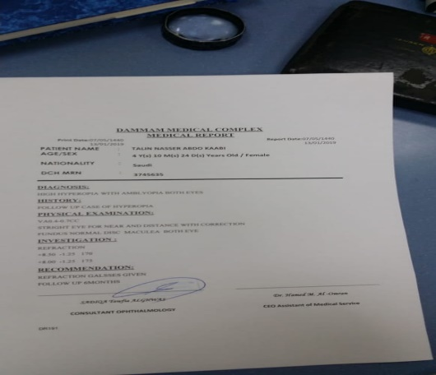
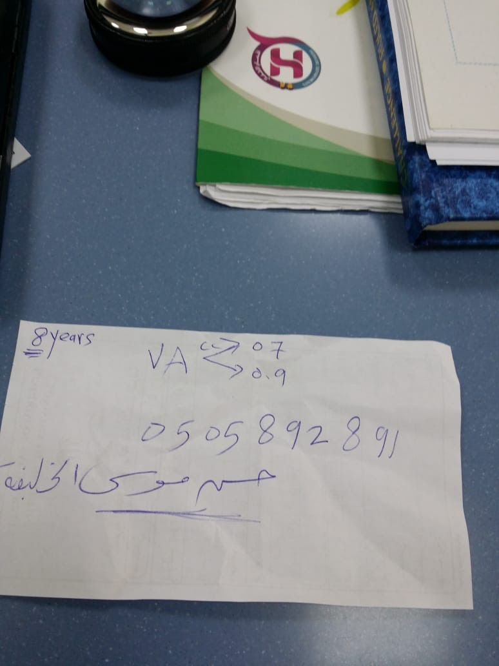
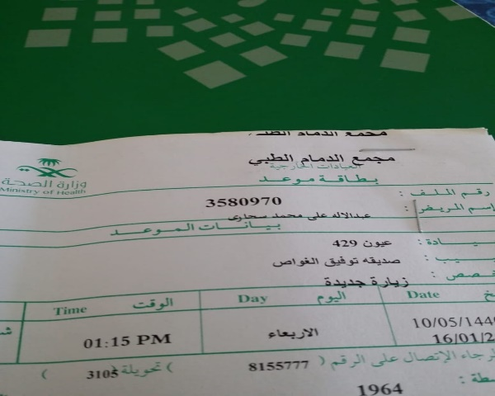
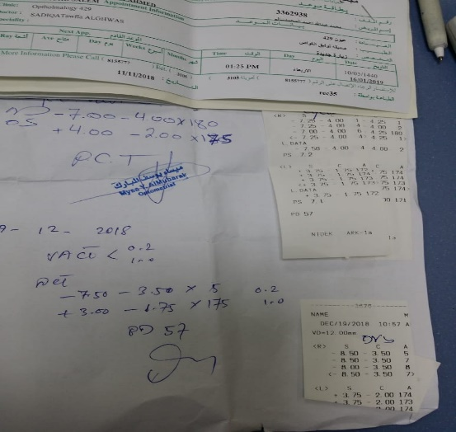
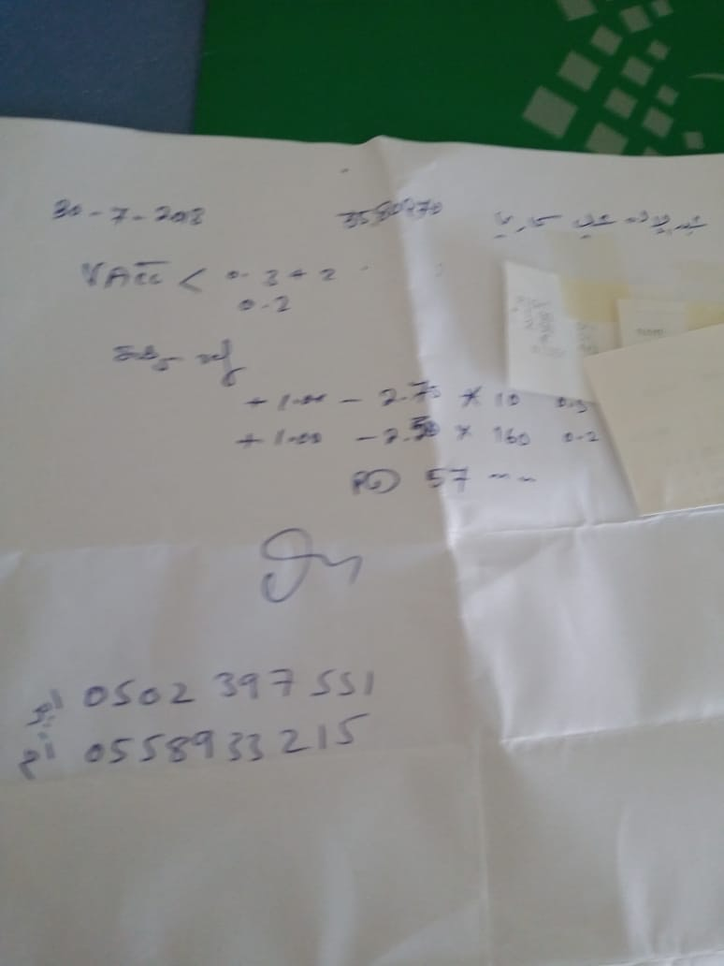
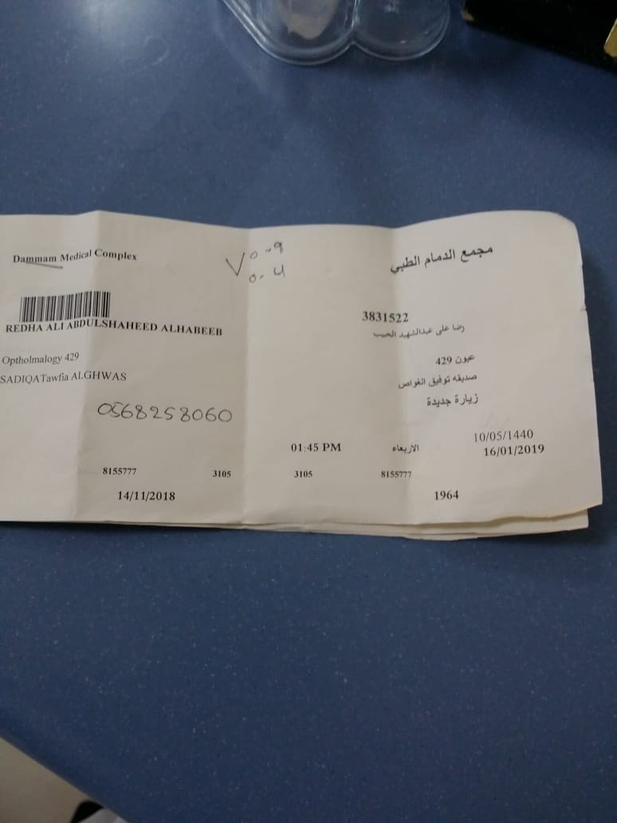
Patient information
.

Slide 37
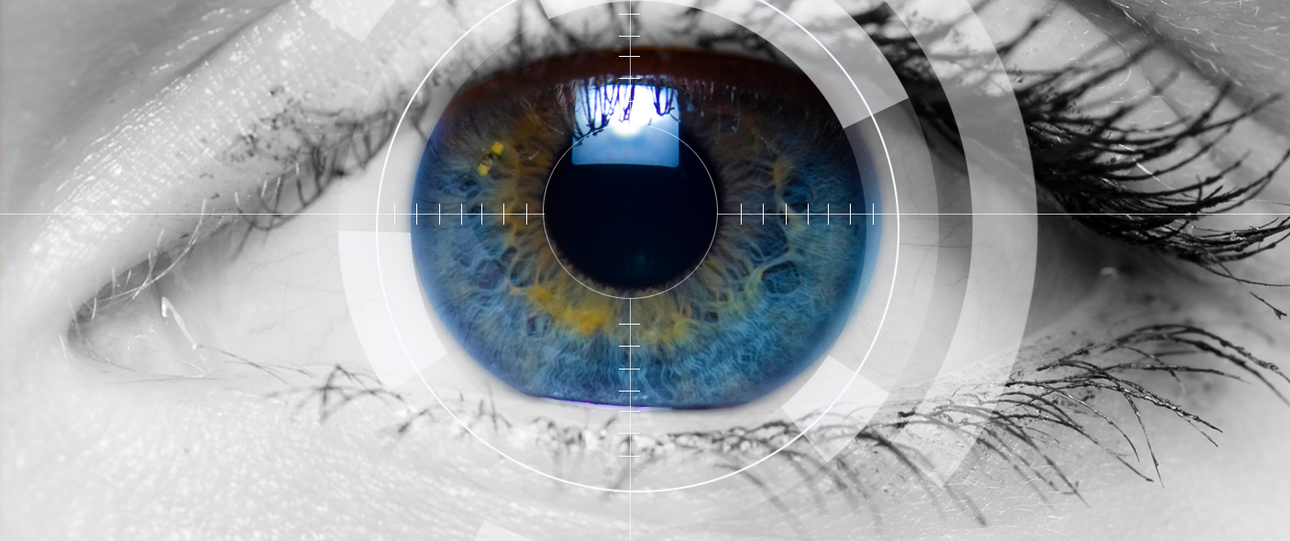
Thank you
.

