Slide 1


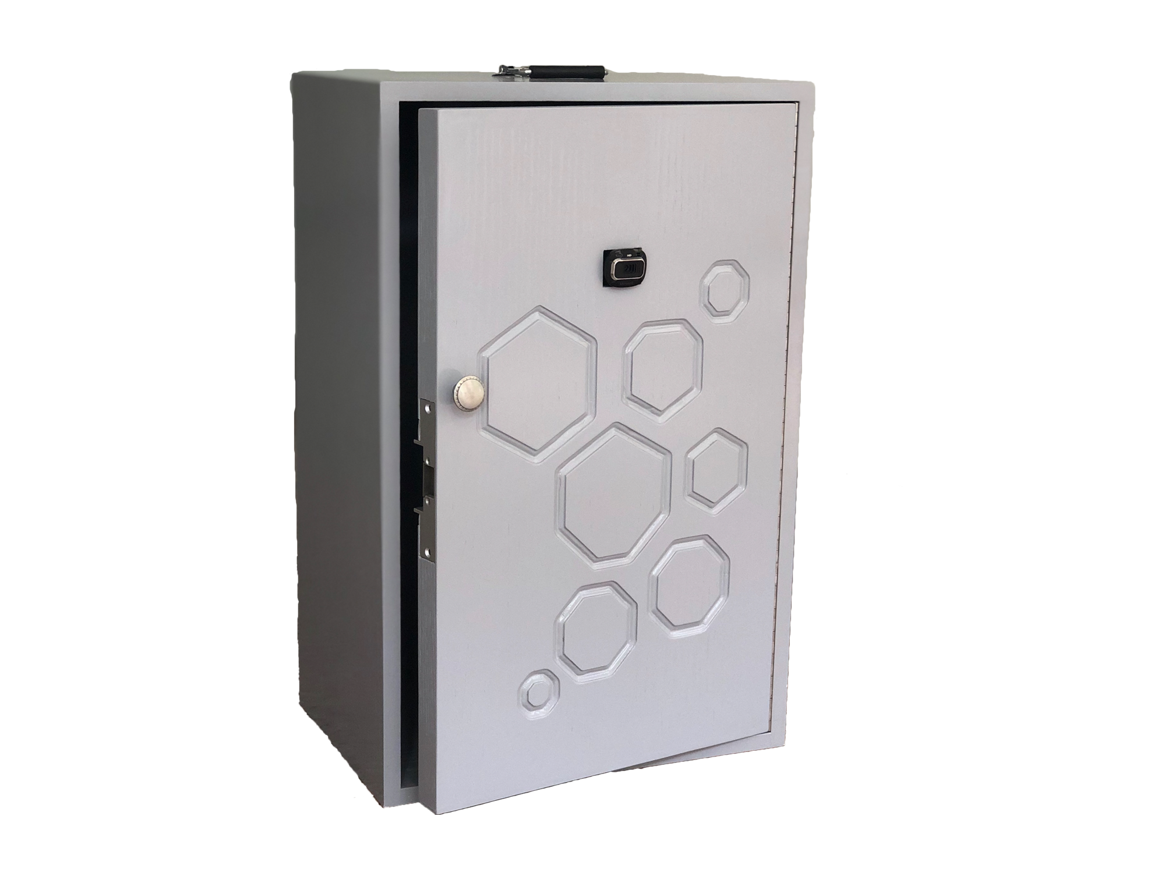
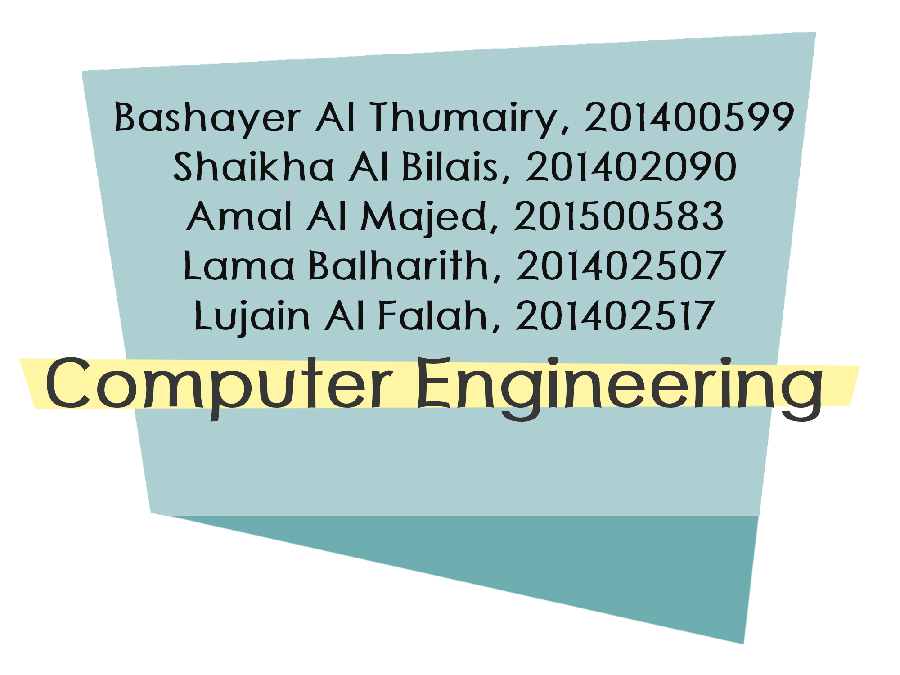
Prince Mohammad Bin Fahd University
College of Computer Engineering and Science
Department of Computer Engineering
Learning Outcome Assessment III
Senior Design Project
Advisor: Dr. Nazeeruddin Mohammad

Slide 2

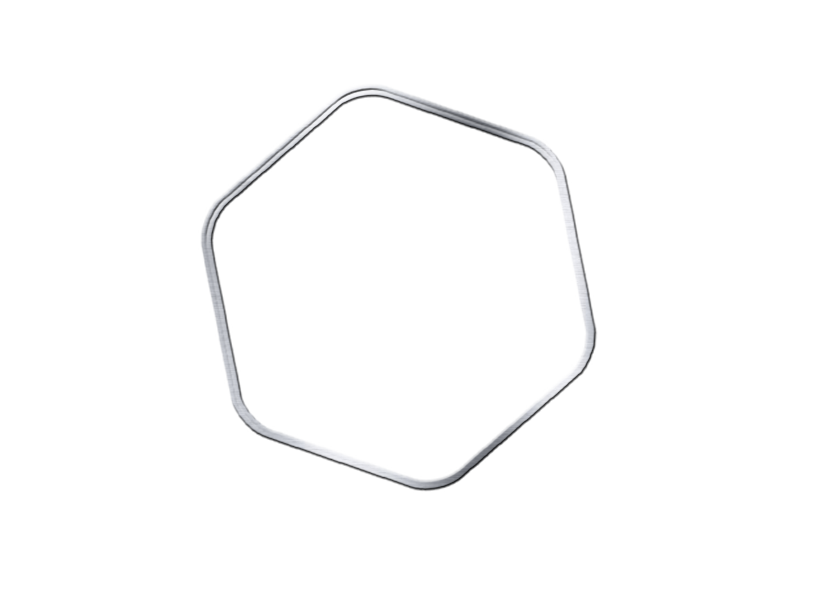

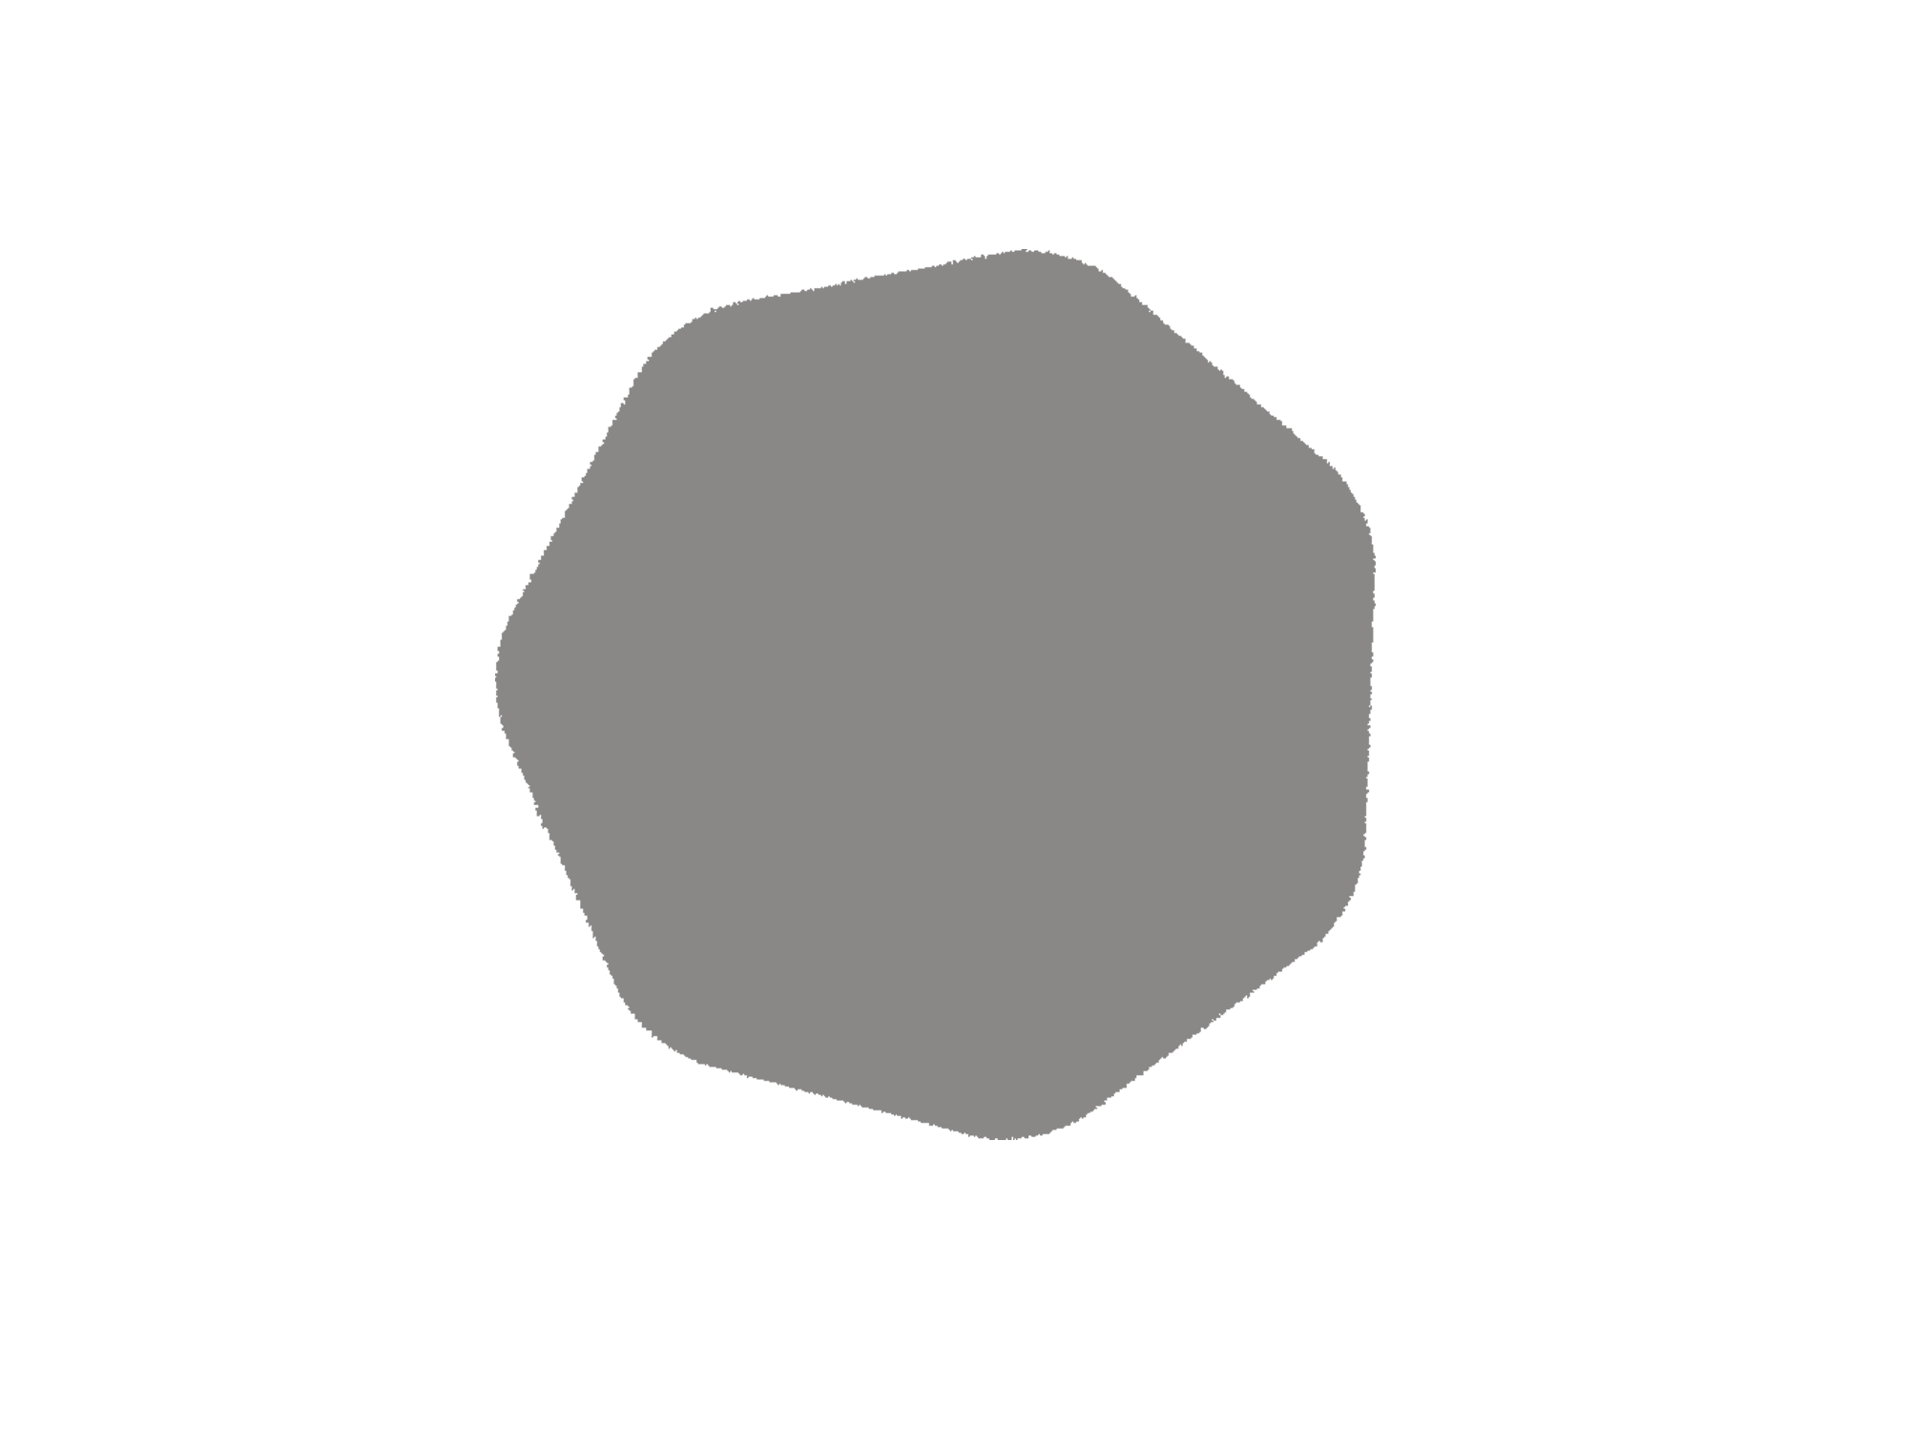

Outline
Introduction
Requirements
Project Components
Methodology
Scenario
Project Functionality
Constraints
Hardware Design
Software Design
Testing
Difficulties
Applications
Future Work
Summary
Notes:
Lama’s

Slide 3
What is Facial Recognition Door?
An autonomous door, used in security systems that is capable of recognizing and identifying a person from a digital image.
Notes:
Lama’s

Slide 4
Project Objectives
Improving the security system in the houses, buildings and work environment, by making a smart entryway, which anchors the gateway dependent on our character.
Notes:
Amal’s

Slide 5
Requirements of the Project
Scalability | Should be designed to be able to handle many users in the database and doors, which are connected over the same cloud system.
Interactivity | Must be interactive with the users, who are standing in front of the door.
Flexibility | Should be not restricted to a certain place.
Usability | Should be easy to use by people.
Reliability | User can reliable that the door will verify his identification and open for him. Should be reliable that the other users can’t tamper the strike or the door system to be unlocked.
Table 1: Project Requirements
Notes:
Lujain’s

Slide 6
Project Components - Hardware
Relay Module
Door Strike
Bread board
Push Buttons
Connecting Wires
Raspberry Pi 2 Model B
Microsoft HD Live WebCam
Display Monitor
Audio Speaker
Mouse
Keyboard
Notes:
Shaikha’s

Slide 7
Project Components - Software
Microsoft Windows 10 IoT
Microsoft Visual Studio 2017
Microsoft Azure [Subscription]
Facial Recognition Microsoft Library (in C#)
Notes:
Shaikha’s & Bashayer: how we chose them

Slide 8
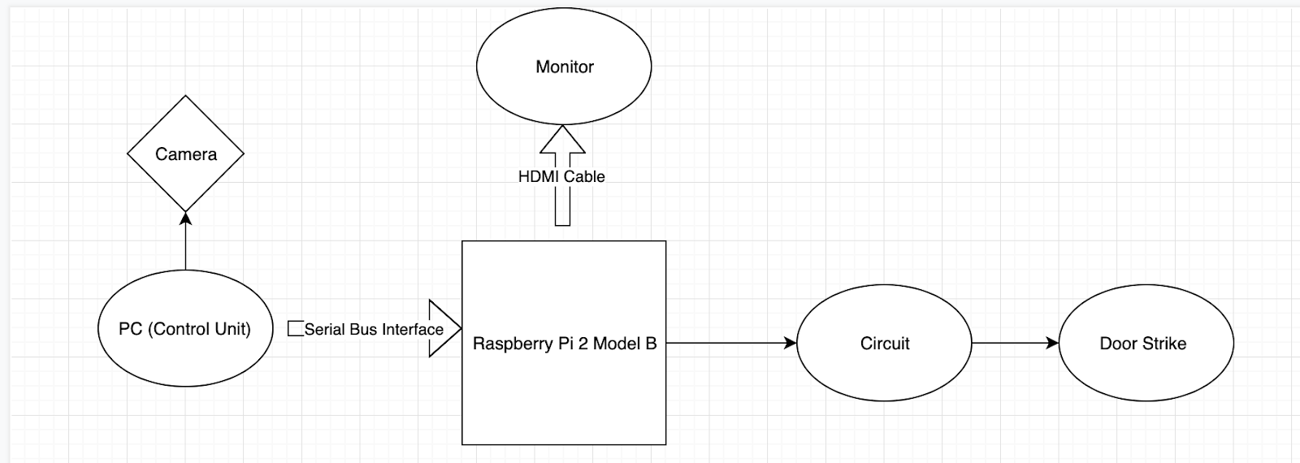
Methodology
Figure 1: Data flow Diagram
Notes:
Lama’s

Slide 9
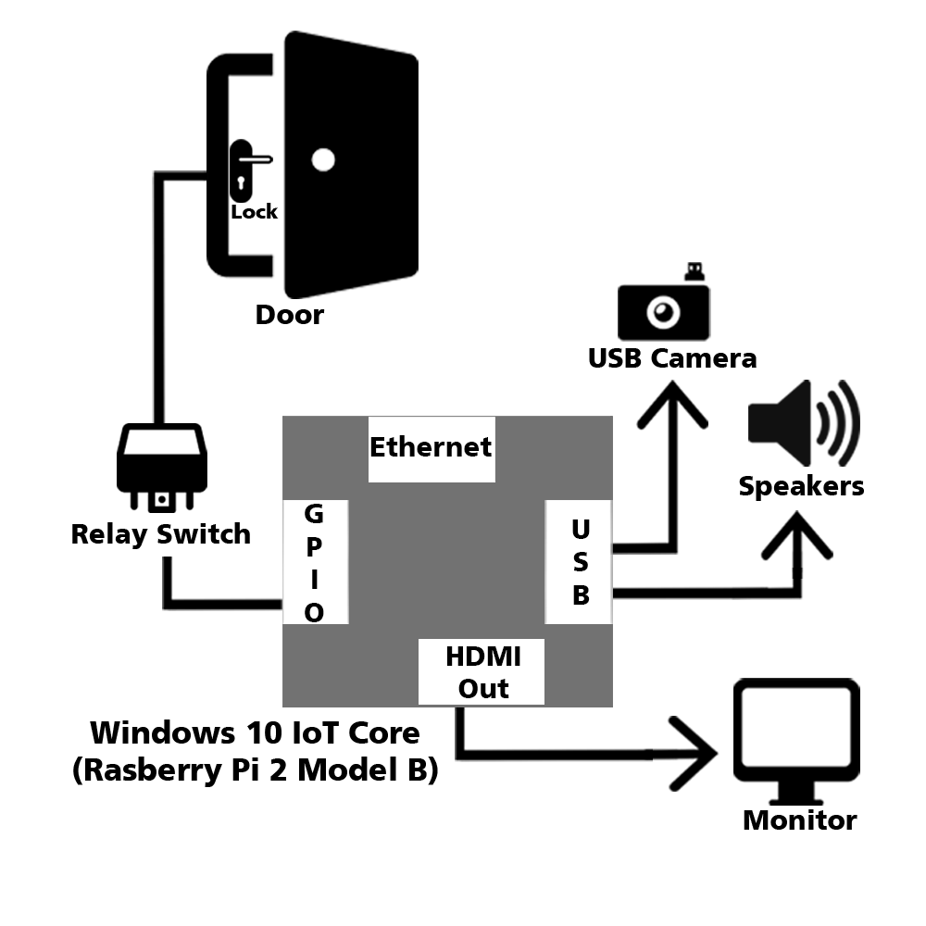
Methodology
Figure 2: Architecture of the project
Notes:
Lama’s

Slide 10
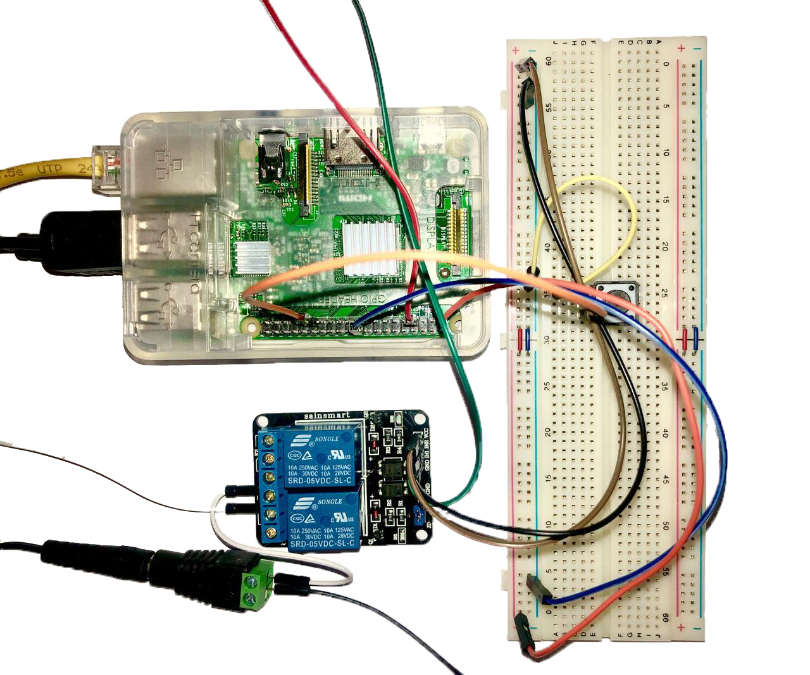
Methodology
This project is handled with a Raspberry Pi 2 model B+ which is an ARM-based single board computer.
operating system Windows 10 IoT
Microsoft Windows IoT software
OpenCv
Figure 3: Electrical Circuit
Notes:
Lama’s

Slide 11
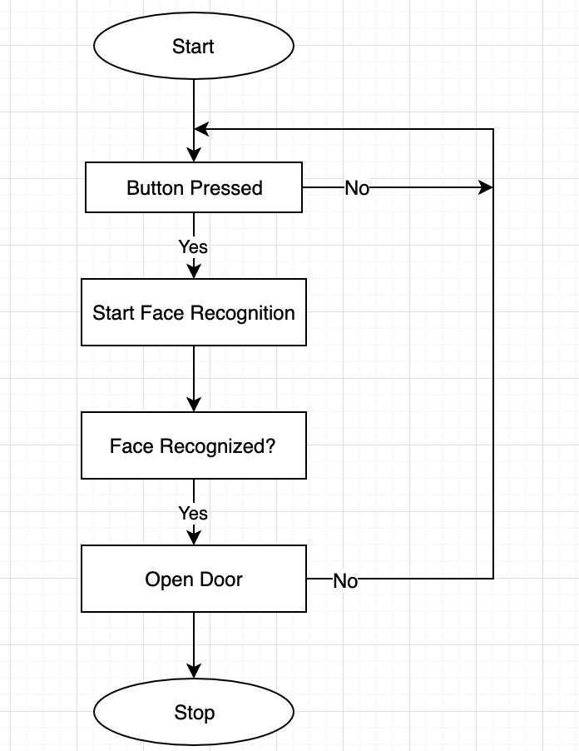
Procedural View of Detection Process
When the person press the button, the implemented code now called. Using the camera, the system capture the image sequence and compare this image with the database. if the image is a match, then in application module get the signal to unlock the door.
Figure 4: Detection Process
Notes:
Amal’s

Slide 12
Project Functionality
Controllability | Adding identities, that must be recognised over the database.
Admin user of the door is able to add multiple pictures of a user in the database.
Accuracy | User can be wearing various things on his face or head, with no effects on the process of recognizing.
Identification | Verifying the users, who can be allowed to open the door at anytime.
Security | Ensuring a security for users.
Table 2: Project Functionality
Notes:
Shaikha’s

Slide 13
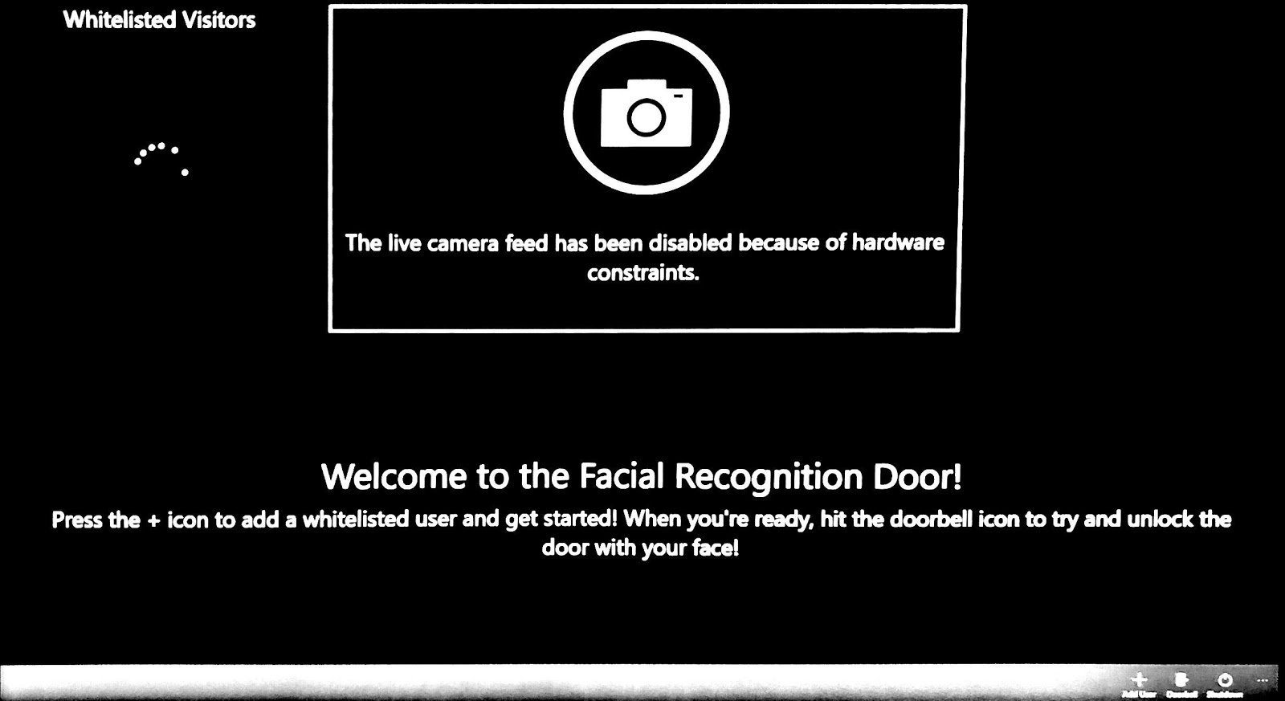
Project Functionality
Figure 5: Adding User Functionality
Notes:
shaikha’s

Slide 14
Constraints - Technical
Make sure Microsoft Visual Studio is installed in PC
SD Card have to be formatted
Download Microsoft Windows 10 IoT on SD card
Run Microsoft Windows 10 IoT on Raspberry PI
Notes:
Lujain’s & Bashayer’s

Slide 15
Constraints - Design
The hardware implementation of the face recognition door is important because it will be used in many real time applications.
The hardware devices and software applications selected carefully to obtain the high level of quality
The input images that contain the recognized face need a certain pre-processing
In order to obtain the recognition in high level the face recognition door have only two main recognition phases:
    feature identification
    Feature extraction
Notes:
Lujain’s & Bashayer’s

Slide 16
Constraints - Physical
The weight and the size of the door.
The position of the HD camera must be placed in the right position.
The quality of speakers that displays the voice to the person who will be standing in the front of the door.
Notes:
Lujain’s & Bashayer’s

Slide 17
Constraints - Cost
Equipment | Supplier | Quantity | Unit Price
Raspberry Pi 2 Model B | Local store in Khobar | 1 | $66.67
Perma-Proto Breadboard Half Size | amazon.com | 1 | $4.50
Leviton 12-Volt DC Electric Door Strike | amazon.com | 1 | $57.07
Sainsmart 2 - Channel 5V Relay Module | amazon.com | 1 | $8.99
Adafruit Female DC Power Adapter | amazon.com | 1 | $2.00
Adafruit 12V 5A Switching Power Supply | amazon.com | 2 | $19.25
Microsoft Lifecam 3000 | amazon.com | 1 | $28.86
Generic Speakers | Local store in Khobar | 1 | $11.98
SD Card class 6 | Local store in Khobar | 1 | $8.00
SD Card class 10 | Local store in Khobar | 1 | $10.67
Door Body | Local store in Khobar | 1 | $213.34
Table 3: Project Cost
Notes:
Lujain’s & Bashayer’s

Slide 18
Constraints - Time
Team members had to commitment to a timetable.
Every team member had to understand all the aspects of the project.
How did our team organized their time were we had a limited time between studying and working on this project.
Challenges that we faced in finding the suitable time and place for all the team members.
Notes:
Lujain’s & Bashayer’s

Slide 19
Hardware Design
Figure 3: Electrical Circuit
Notes:
Amal’s

Slide 20
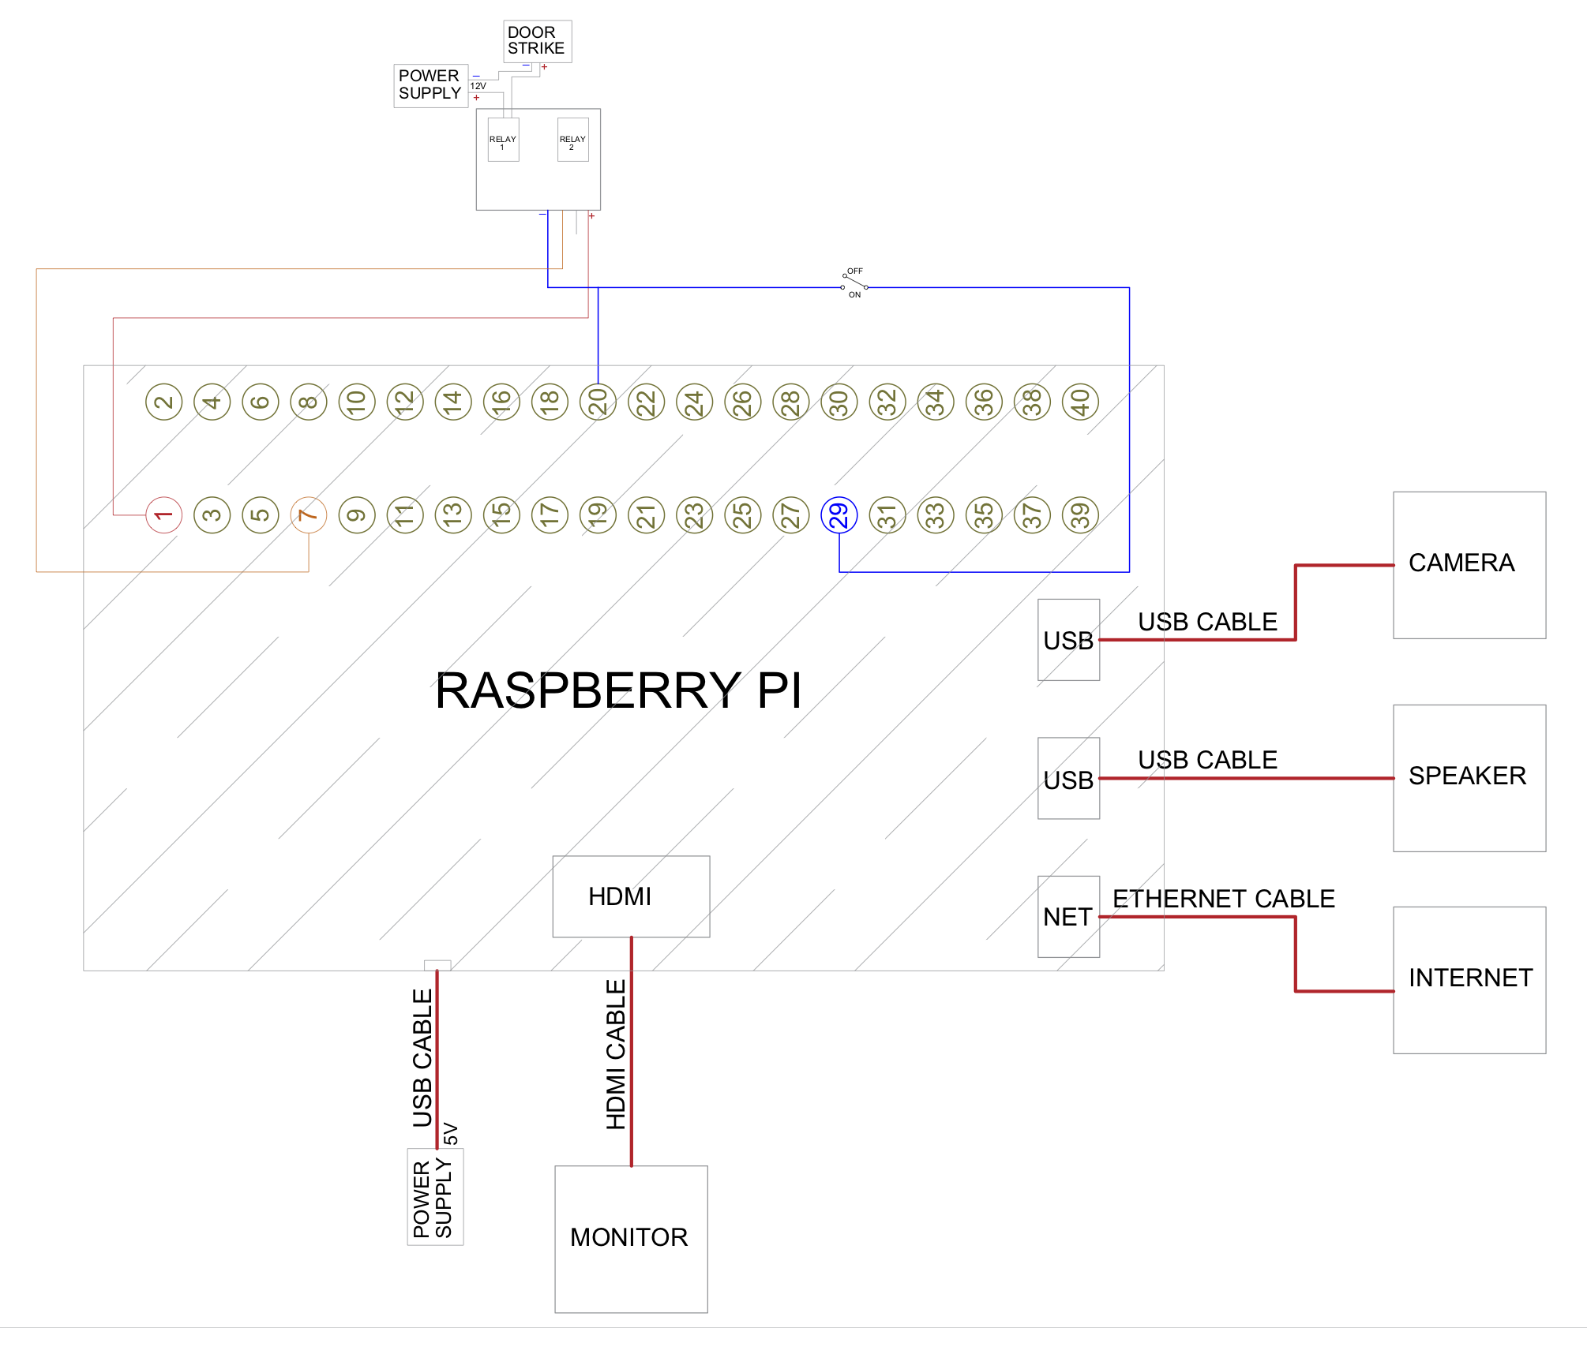
Hardware Schematic-Model
Figure 6: Schematic Model
Notes:
Amal’s

Slide 21
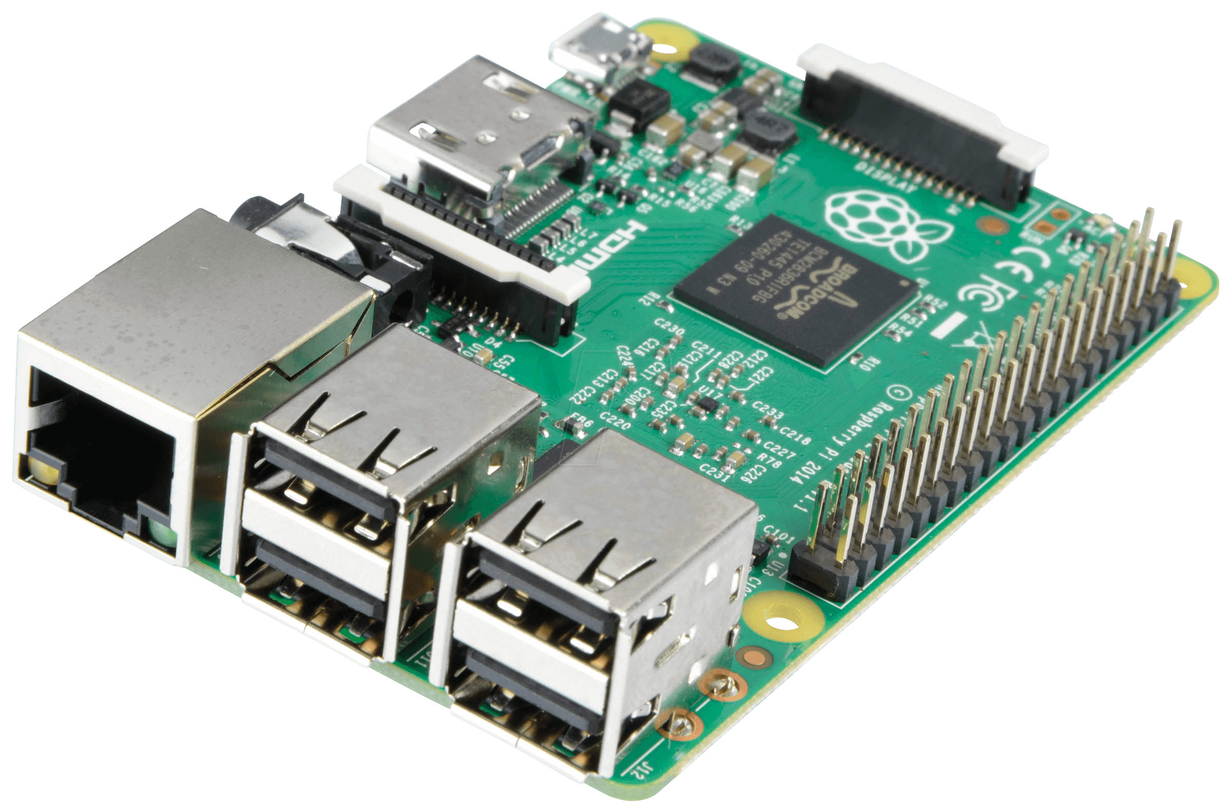
Raspberry Pi 2 Model B
Raspberry Pi 2 Model B is a microprocessor.
It has a 900MHZ quad-core ARM Cortex-A7 CPU and 1GB RAM.
A 4 USB ports for connecting the camera, keyboard, speaker, and mouse.
It contains 40 GPIO pins
A 100 Base Ethernet to connect the raspberry to the internet
A full HDMI port which is needed for connecting it to the monitor
A micro SD card slot for downloading the operating system and storing data
Notes:
Amal’s

Slide 22
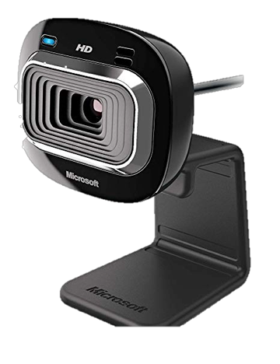
Microsoft LifeCam HD-3000
The camera has a 720p, a TrueColor technology, which give a good colorful image. It helps on detecting the features and reduce the possibility of false detection. It works out Windows from windows 8 up to windows 10.
Notes:
Lama’s

Slide 23
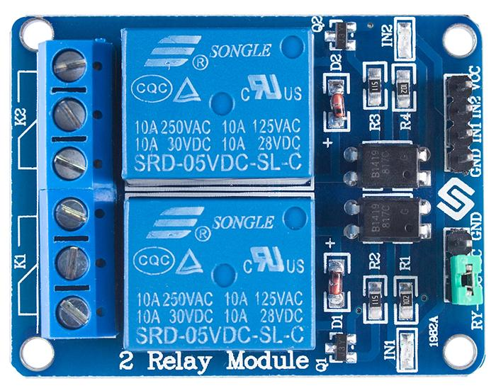
Relay Module
SaintSmart 2-Channel 5V Relay Module
Electromagnetic switch operated by a relatively small electric current that can turn on or off a much larger electric current.
Notes:
Lama’s

Slide 24
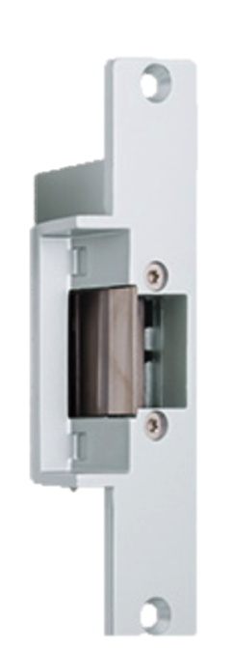
Door Strike
It is a 12 volts DC electric door strike.
It unlocked automatically by the system.
When power is connected it unlocks the door and locks the door when power is not connected.
Notes:
Lujain’s

Slide 25
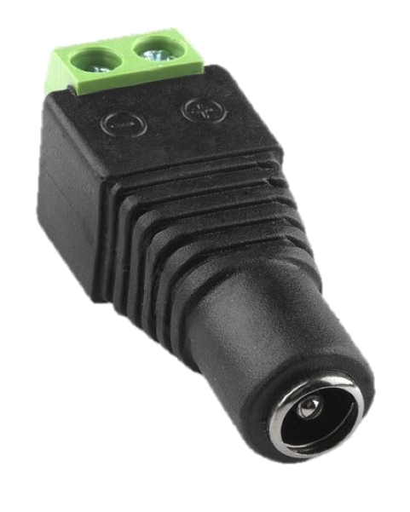
Female DC Power Adapter
Adafruit Female DC Power Adapter
Used to connect a DC power wall wart to the board
Notes:
Lujain’s

Slide 26
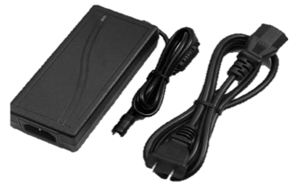
Power Supply
Adapter type: Switching
Voltage: 12 V
Current supply: 5 A
Output power: 60 W
Number of output: 1 pcs
Weight: 0.30 KG
Power density: 300 to 1500 W/kg
Notes:
Lujain’s

Slide 27
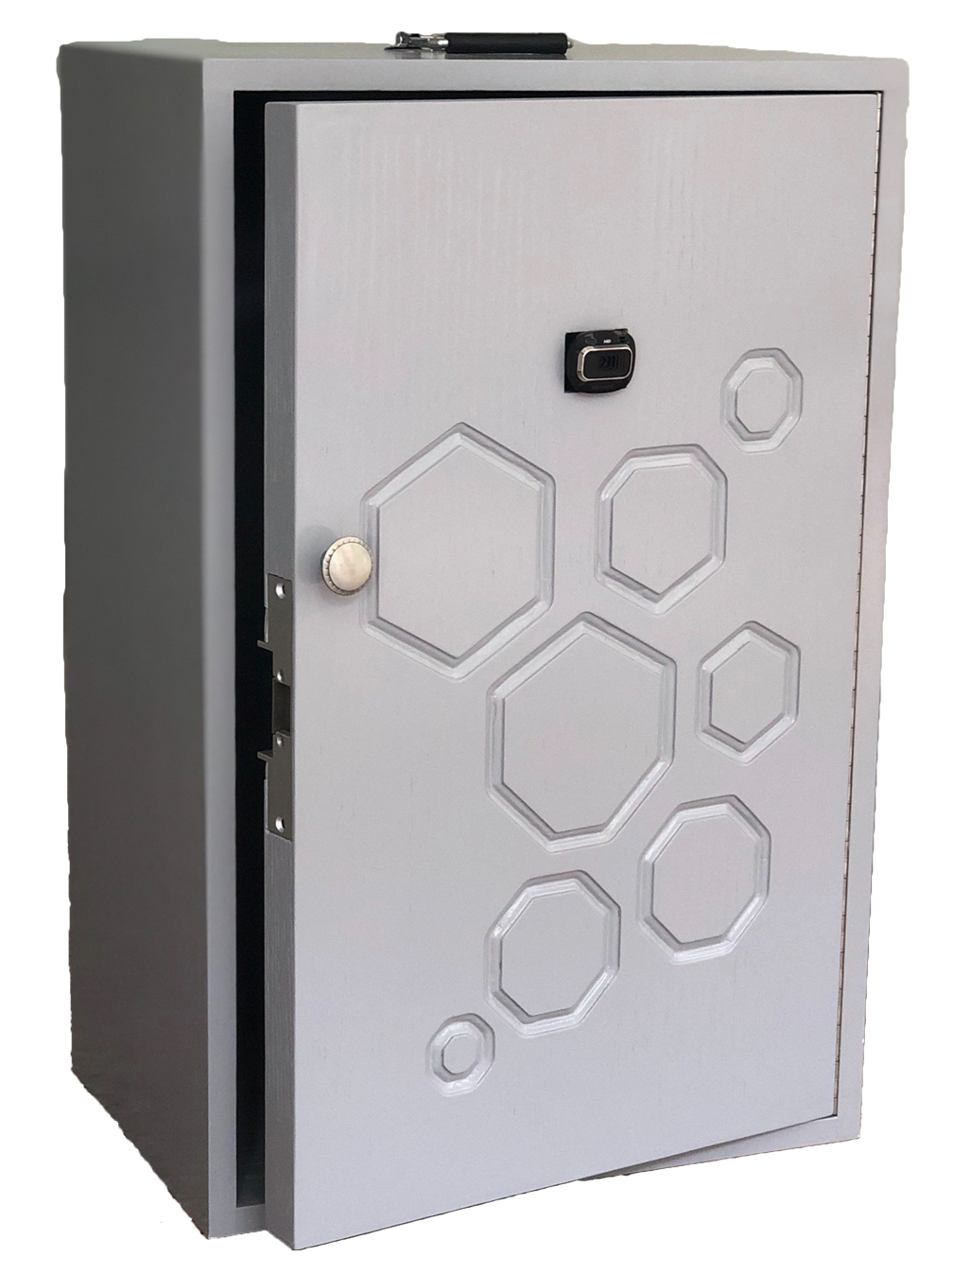
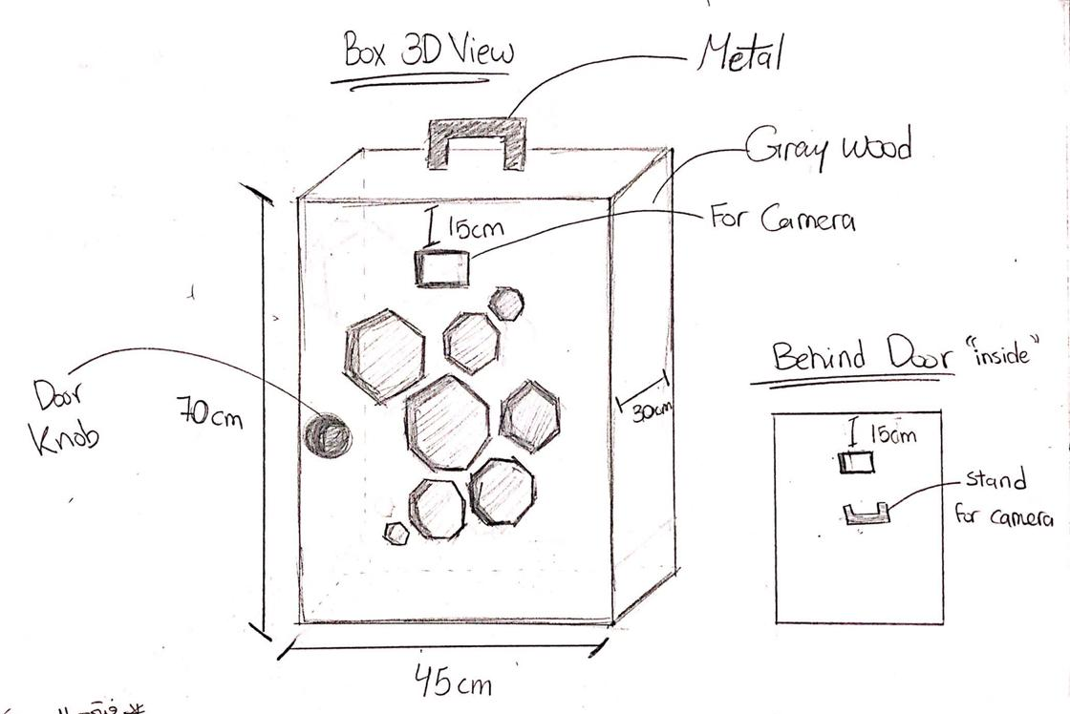
Project Body (Door)
Figure 7: Door Design Sketching
Notes:
Shaikha’s

Slide 28
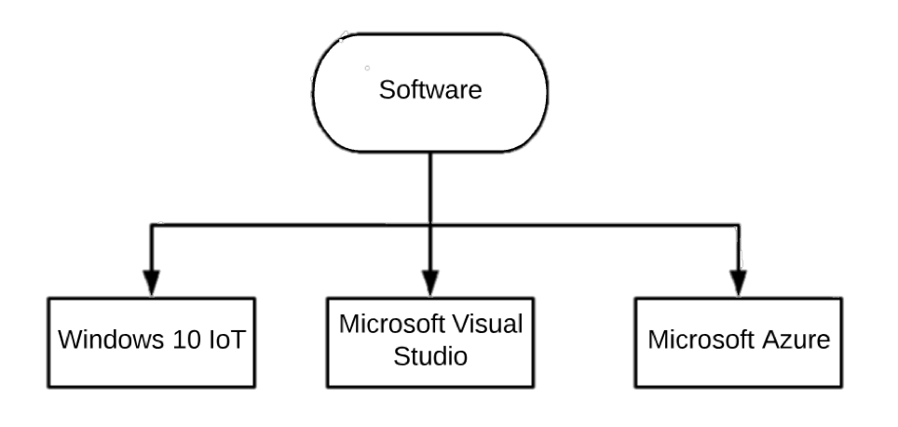
Software Design
Figure 8: Project Software Design
Notes:
Bashayer’s

Slide 29

Microsoft Windows 10 IoT Core
An Operating system developed by Microsoft
Version of Windows 10 Optimized for Smaller devices.
It runs of Raspberry Pi 2 and 3
Notes:
Bashayer’s

Slide 30

Microsoft Visual Studio
An integrated development environment from Microsoft.
Used to develop websites, application, computer programs, and web services
Written in C# and C++ language
Notes:
Bashayer’s

Slide 31

Microsoft Azure
Set of cloud computing services to build and manage applications over a global network by providing many tools and frameworks.
API service: a cloud-based service, which provides the most advanced face algorithms.
It has two main functions:
  Face detection with attributes
  Face recognition
Notes:
Bashayer’s

Slide 32
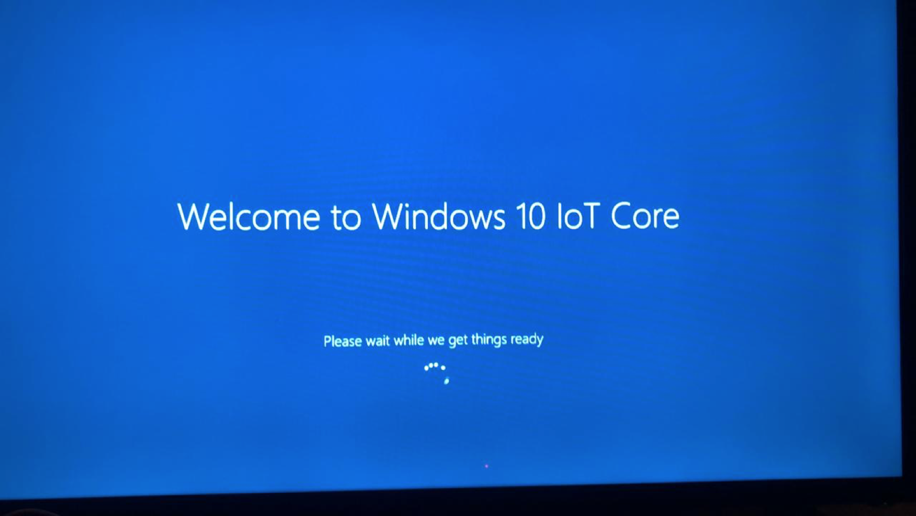
Testing
Notes:
Lama’s

Slide 33
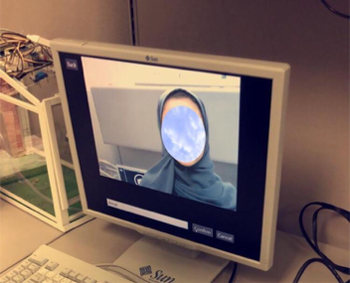
Testing
Emotions recognition: anger, contempt, disgust, fear, happiness, neutral, sadness, and surprise.
Enrollment profile: contain a collection of representation.
  Facial shape change.
  Lighting.
  With glasses and without.
Notes:
Lujain’s

Slide 34

Difficulties
The team members have faced some challenges during working on the project but there is no project that works perfectly without any challenges and difficulties while working on it.
Challenges and difficulties
  SD Card.
  Raspberry pi.
  Software worked perfectly, then it stopped working.
  Camera not being able to detect.
Notes:
Lujain

Slide 35
Applications
Since the project idea is mainly about security and safety, the sector of use and application was ideally selected for the following areas:
House, prison, mall or Shop, hospital, university, company, library, and lockers.
Notes:
Shaikha’s

Slide 36
Future Work
To utilized for night observation with development of raspberry pi security conventions.
Adding infrared producing system to recognize individual's face on the off chance that they wore mask
Sensors to give alerts
Phone application to provide several services
For security applications
3D image detection
Notes:
Shaikha’s

Slide 37
Summary
This project has essentially highlights: increasing the security and safety method, control and observing the automation to home/work or any selected environment. By applying this project there will be more security and trustiness in the home or any selected place, facial recognition project helps in prevent playing or cheating with the identities, so no one can enter a selected place unless he or she has a permission, this would help in order to have smart and safe life (in security) Finally, we have complete this project efficaciously and gained suitable results.

