Slide 1





Underwater Exploration ROV for Fish Image Classification
Made By,
Kinza Waqar – 201500120
Sarah Khan – 201500635
Shifa Khaja – 201501810

Slide 2
Outlines
Project Architecture
Hardware Design
Conclusion & Future Work
Objectives
Specifications
Software Design
Challenges
Life long learning
Testing
Implementation
Hardware Components
Constraints

Slide 3
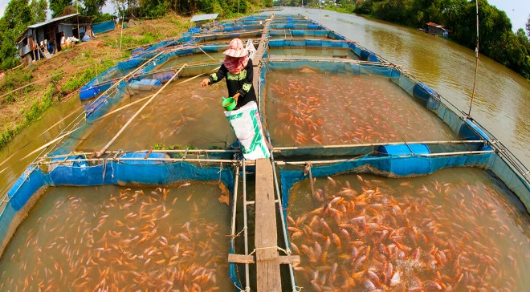
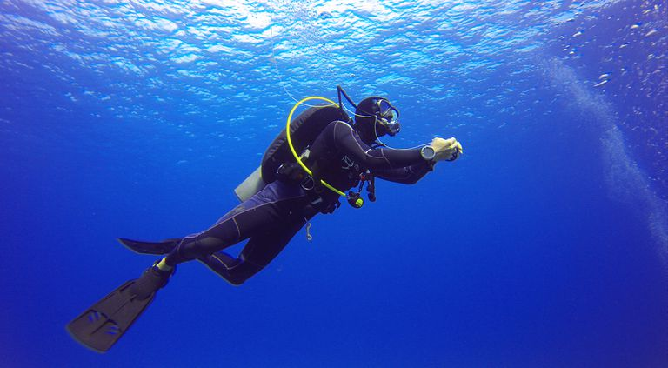
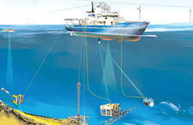
Motivation
Around 95% of the oceans in the world are undiscovered.
Contribute towards robotic developments in underwater environment.
Significant importance in the field of biodiversity and study of aquaculture
Provides a cost effective solution for fish farmers to assure efficient harvest, healthy fish crop and environmental protection.

Slide 4
Objectives
Use a remote or voice controlled boat for underwater exploration.
Use a camera to capture fish images and transmit them to the user’s laptop via wireless connection.
Fish images will be classified using Convolutional Neural Networks

Slide 5
Functional Requirements
Balancing on water
Control the motion
Use of camera to capture images
Generate Output
Receiving and storing of images
Use of Machine learning algorithm

Slide 6
Non – Functional Requirements
Connectivity
Environmental
Performance
Reliability
Usability

Slide 7
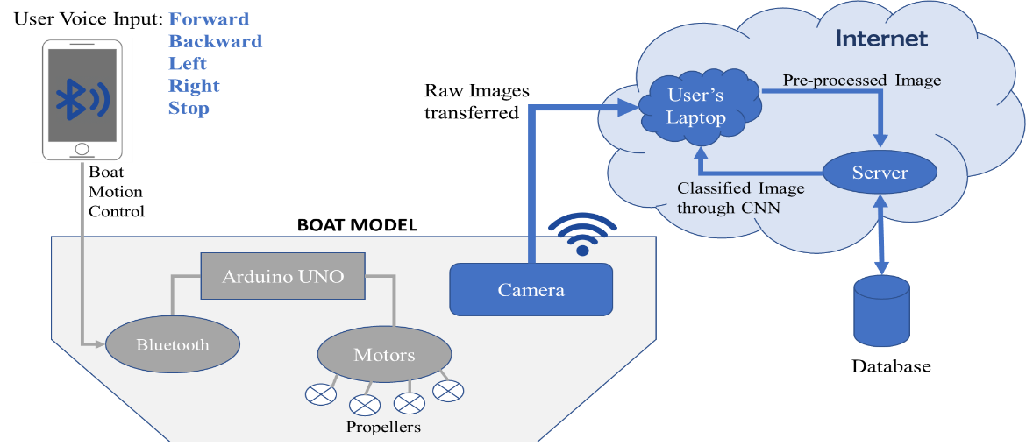
Project Architecture
System Block Diagram for Voice Controlled ROV

Slide 8
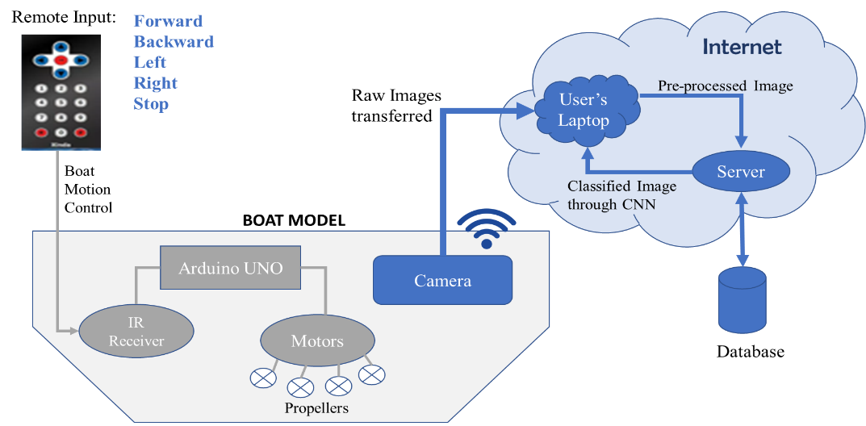
Project Architecture
System Block Diagram for Remote Controlled ROV

Slide 9
Prototypes Designed

Slide 10
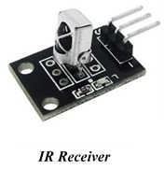
Components
Infrared Sensor

Slide 11
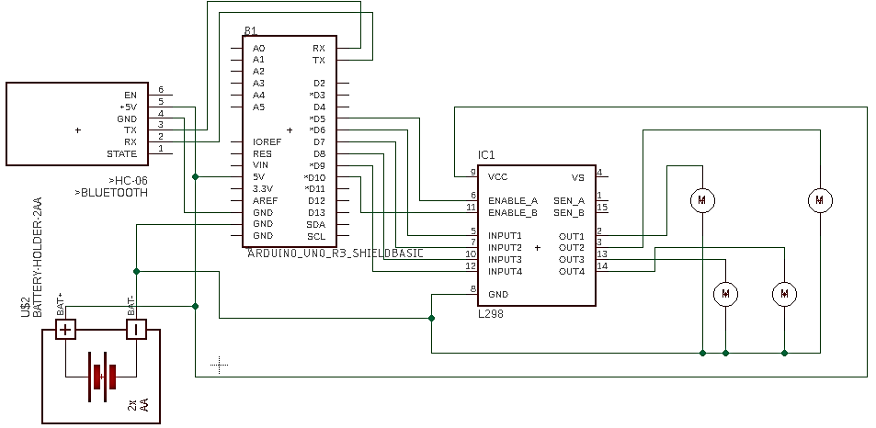
Schematics

Slide 12
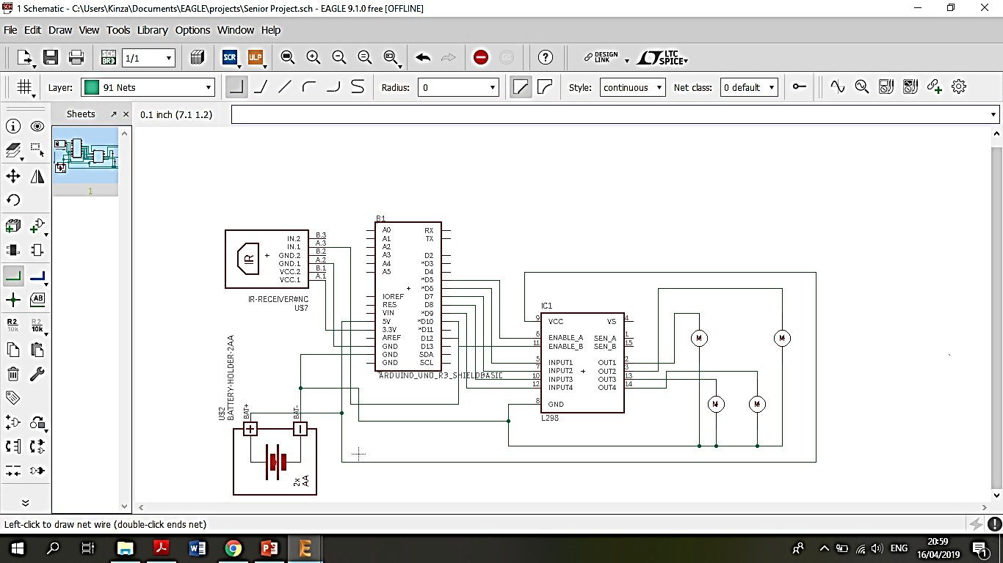
Schematics

Slide 13



Software Development Platforms
TensorFlow
Keras
Arduino IDE

Slide 14


Camera programming
Controls camera using GoPro API library
take_photo(2);
getMedia( );
Transmits captured images wirelessly
GoPro Camera
Laptop

Slide 15
The choice of CNN
Challenges of visual recognition algorithms
Data driven approaches
CNN - opted for fish classification

Slide 16

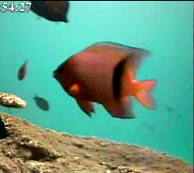
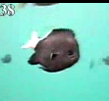
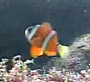
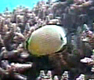
Data collection
Fish Recognition Ground-Truth dataset
Video processing software on videos - 10 camera - 12 hours a day
Manual labelling – consists of 24971 images

Slide 17
Training
Epochs
The number of times the entire dataset is passed forward & backward through the neural network model
As the no. of epochs increase, so does performance. However, it should be restricted such that it does not cause overfitting.
Defines the number of samples that will be propagated through the xnetwork
Large batch size increases the performance in terms of accuracy and regularization but should not cause overfitting.
Batch Size

Slide 18
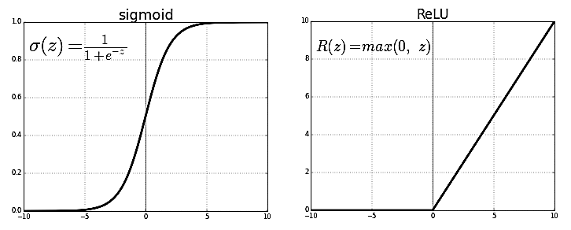
Training
Activation Function
Their task is to convert input signal in a node to an output signal which will then be an input signal to the next node.
Introduce non-linear properties to the neural network.
ReLu is widely used for their convenient properties.
Multiple Layers
A CNN architecture is formed by a stack of distinct layers that transform the input volume into an output volume.
More no. of layers will increase the performance however, it may result in the overfitting of the model.
Backpropagation
The goal is to find a set of weights such that they reduce the loss function.
Initially, computation is started with some set of values for weights and biases, after which they are improved slowly by using an optimizer.

Slide 19
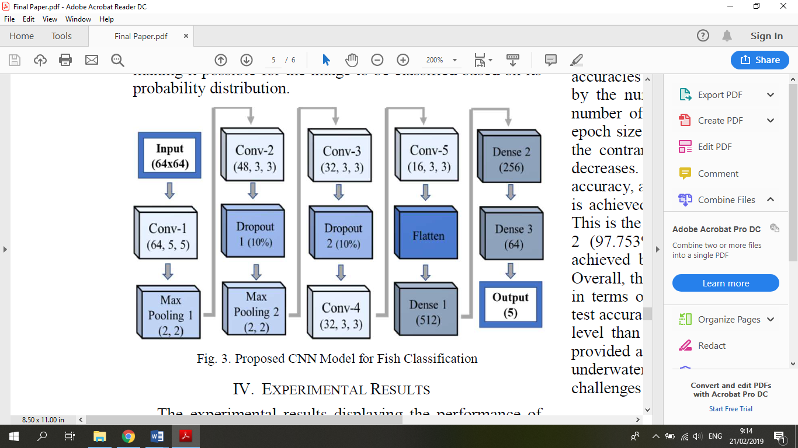
CNN Architecture
Dataset [24971 images]
Training Set [19976]: 80% of total images
Validation Set [1997]: 10% of Training set
Testing Set [4994]: 20% of total images
99.876 % validation accuracy & 98.122% test accuracy

Slide 20
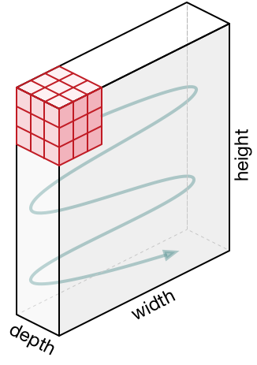
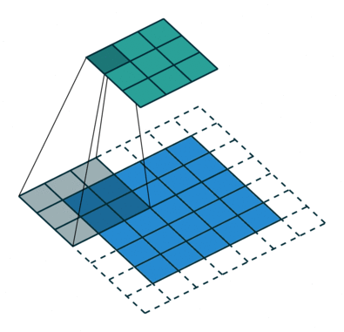
Convolution Layer
Kernel is shifted from left to right and top to bottom until it covers the whole input image
Conducts matrix multiplication at each shift and sums all the values in the end to reach to the convoluted output.
kernel
Convoluted Feature Output:
Conv – 1: Extract features like edges
Conv – 2: Extract features like spots or pattern of fins
Conv – 3: Extract features like pixel location of lower fin
Input image

Slide 21
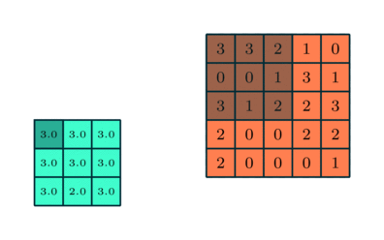
Max Pooling Layer
Reduce the spatial size of the convoluted output from the layer before it.
  Computational power required to process the data decreases
  Acts as noise suppressant
Max pooling output
Convolved feature
Maximum value from the portion of the image covered by the Kernel

Slide 22
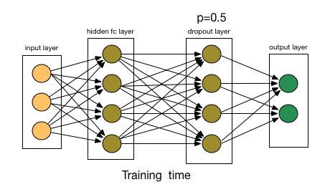
Dropout Layer
Randomly selected neurons are “dropped-out” during training to prevent overfitting of model.
  Their contribution to the activation of downstream neurons is removed on the forward pass and any weight updates are not applied to the neuron on the backward pass.
Regularized output: generalize well from the training data and make good predictions for unseen data

Slide 23
Flatten Layer: Input from prior layer (2D) flattened to a one-dimensional column vector
Fully Connected/Dense Layer: Features are connected together through weights and a non-linear activation function (ReLu) is applied on it.
  Contains trainable parameters/weights that are updated using backpropagation
Output Layer/SoftMax: Uses probability distribution to predict input image’s class out of the five categories.

Slide 24
Code implementation
Include Libraries
Initialize the buttons and variables
Setup the input and output pins
Write functions for directions
Make required delays
Output from the IR sensor is converted in the code form.
Compared with the codes saved earlier
If received code matches the saved code - ROV will move accordingly

Slide 25
CNN Training Algorithm
Initializing
Loading and pre-processing images
Model configuration
Define the layers and their parameters
Model fitting
Train the model and view result

Slide 26
Initializing
Load Images
Using os.listdir(basepath) to load and PIL to open image
Allimages[] appended with Image array
Pre-process Images
Resize to 64x64
Convert to greyscale
SignLabel[] appended with each directory name
Reshape it to be [samples][channels][rows][columns]
Normalize image inputs from 0-255 to 0-1

Slide 27
Split Dataset
Training set: ListImg contains all 24971 images
Testing set: RandList contains 20 % of 24971 images (4994) randomly selected
Label Images
Append Test Images with SignLabel[]
Append Train Images with SignLabel[]

Slide 28
Model configuration
def my_model():
model = Sequential()
model.add(Conv2D(64, (5, 5), input_shape=(1, imx_size, imy_size), activation='relu'))
model.add(MaxPooling2D(pool_size=(2, 2)))
model.add(Conv2D(48, (3, 3), activation='relu'))
model.add(Dropout(0.10))
model.add(MaxPooling2D(pool_size=(2, 2)))
model.add(Conv2D(32, (3, 3), activation='relu'))
model.add(Dropout(0.10))
model.add(Conv2D(32, (3, 3), activation='relu'))
model.add(Conv2D(16, (3, 3), activation='relu'))
model.add(Flatten())
model.add(Dense(512, activation='relu'))
model.add(Dense(256, activation='relu'))
model.add(Dense(64, activation='relu'))
model.add(Dense(5, activation='softmax')) # Number of Output Clases
# Compile model
model.compile(loss='categorical_crossentropy', optimizer='adam', metrics=['accuracy'])
return my_model

Slide 29
Model Fitting
Fit Model
Training data array
Label data array
10% validation_split
Epoch size: 50
Batch size: 50

Slide 30
CNN Testing Algorithm
Images from GoPro (new_img)
Defining an object for GoPro
Call stored CNN model using loaded_model
Pre – Process captured images
Run the command - loaded_model.predict_classes(new_img)
Predict class & define the fish species

Slide 31
System Testing and Analysis
Component testing
Integrating components
System Testing
Environment testing
The complete test

Slide 32
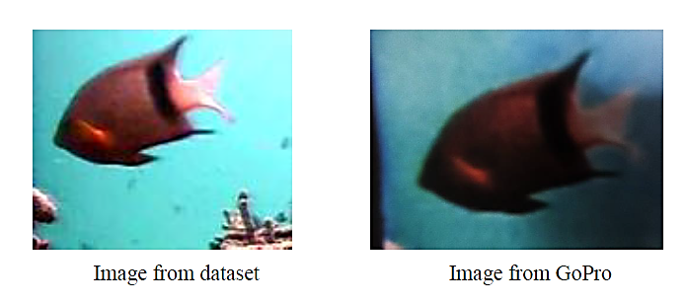
Software Testing: CNN
Problem: Images from trained model not suited to project’s demo environment.
    Due to the difference in lighting and the blurriness between the images in the dataset and the images captured by the camera.
Solution: Create a dataset with images taken from GoPro.

Slide 33
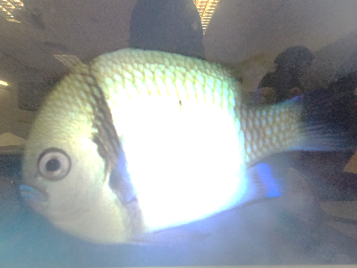
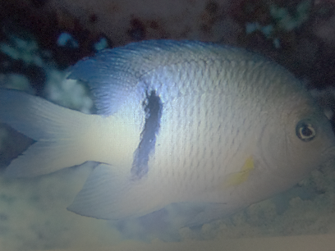
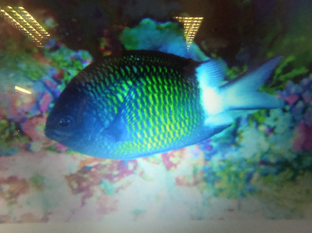
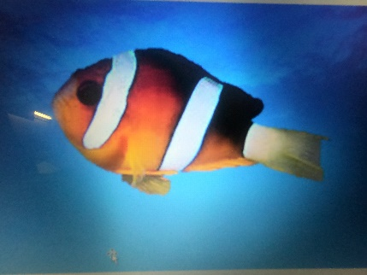
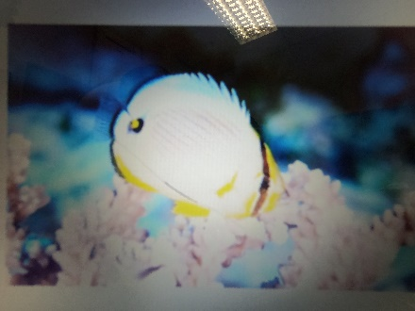
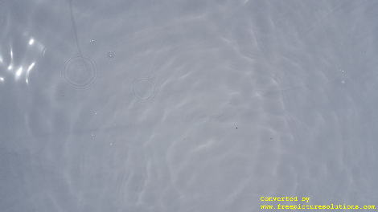
Validation Accuracy of 77.55%
GoPro’s Dataset
Class 1
Class 2
Class 3
Class 4
Class 5
Class 6

Slide 34
Challenges
Waterproofing all the hardware components
Assembling the hardware components inside the boat
Ensuring that the boat doesn’t capsizes.
Limited hardware capability; GoPro camera & Bluetooth module
Identifying the best hyperparameters for CNN model.
Developing appropriate dataset for the working environment.

Slide 35
Constraints
Economical
Environmental
Manufacturability
Safety
Time
Reliability

Slide 36



Life long learning
Teamwork
Effort
Cooperation
Coordination
Understanding
Steps of a project
CNN
Arduino
Go Pro
Circuit development
Hardware building

Slide 37
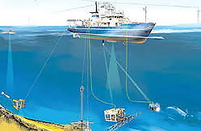
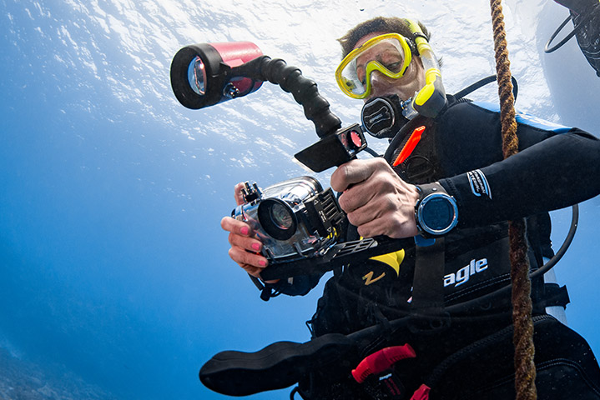

Applications

Slide 38
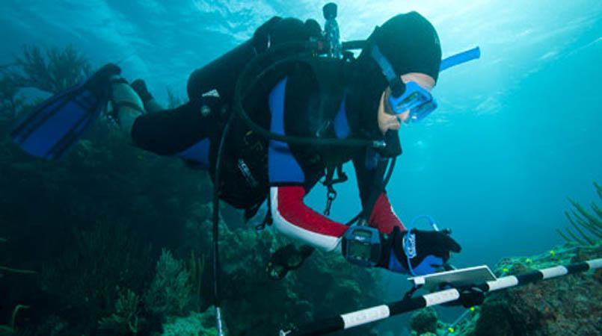
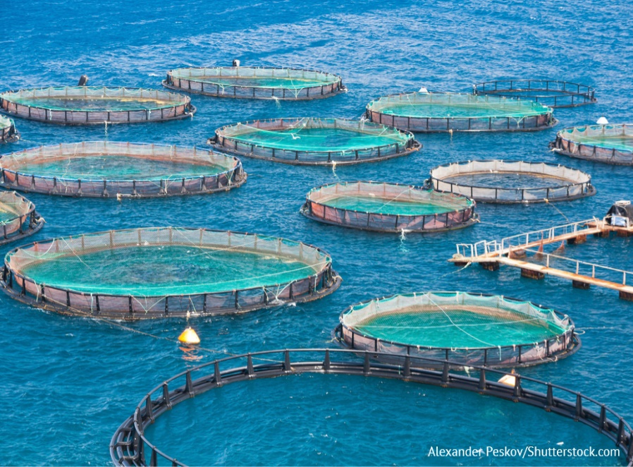
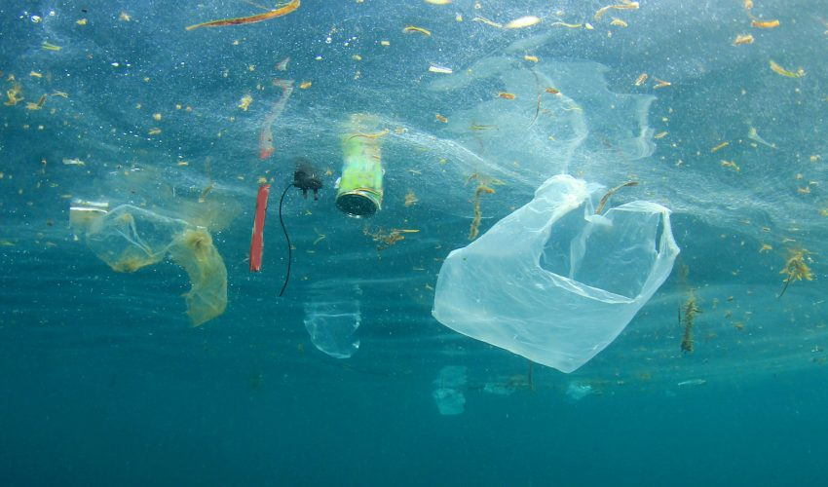
Applications

Slide 39
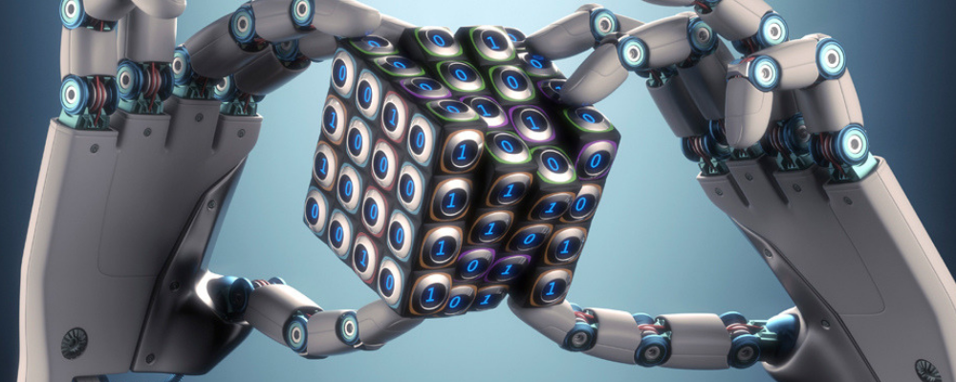
Conclusion & Future Work
By automatic detection of key features, this technology provides a more focused approach to asset monitoring and reporting.
By utilising artificial intelligence, personnel can spend more time on critical analysis and management than watching hours of video.

Slide 40
Software (CNN):
  Collect data for more classes of fish species and train
  Find the best hyperparameters for solving classification problem specific to application environment
  Include ability to count number of same fishes in an image
Hardware (Boat ROV):
  Use ultrasonic sensor to avoid obstacles
  Attach lamp to provide favourable lighting conditions in dark environments
  Further develop as submarine prototype

Slide 41
THANKS !
ANY QUESTIONS ?

