Slide 1

Home/self assistant robot
Student Name Student ID
Atheer Aldossari 201201825
Rehab Alotaibi 201301274
Mishal AlKhalifa 201302327
Advisors:
Dr Loay Alzobaidi

Slide 2
Introduction
Why we choose this topic?
What is it about?
Background

Slide 3
Project Specifications:
The project aims at designing an advanced home assistant system as well as personal assistant using web server Google, Bluetooth and Wi-Fi technology.
This project is a smart assistant that can do tasks such as the following
Set alarm.
Check the weather.
Turn on\off light.
Turn on\ off fan.
Play music.
Fire detection.
Object detection.

Slide 4
Flow chart of system design

Slide 5
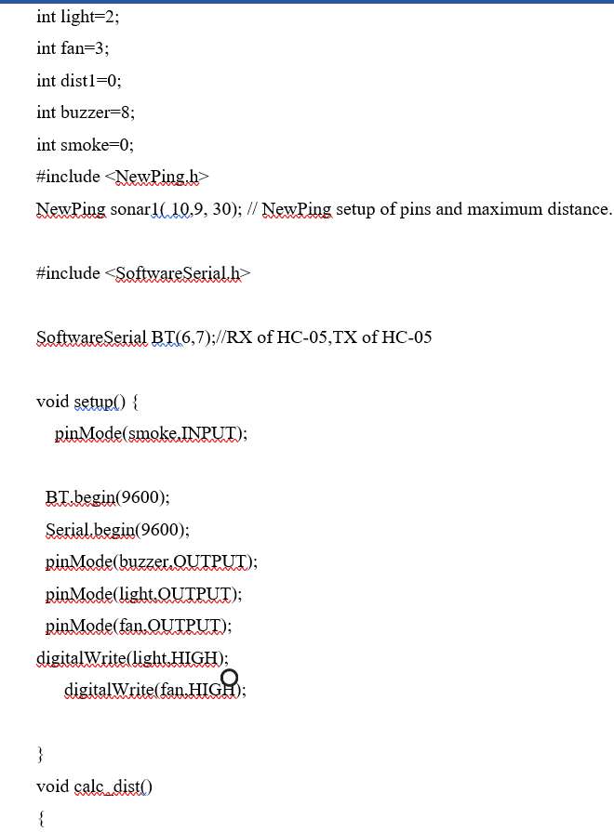
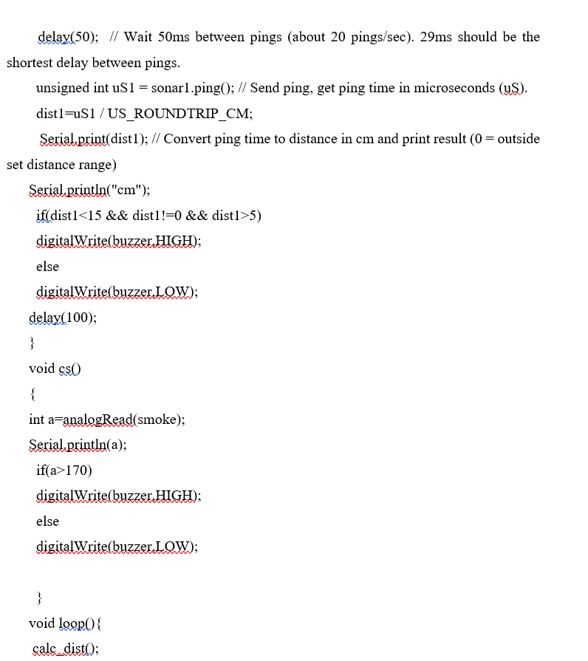
Software

Slide 6
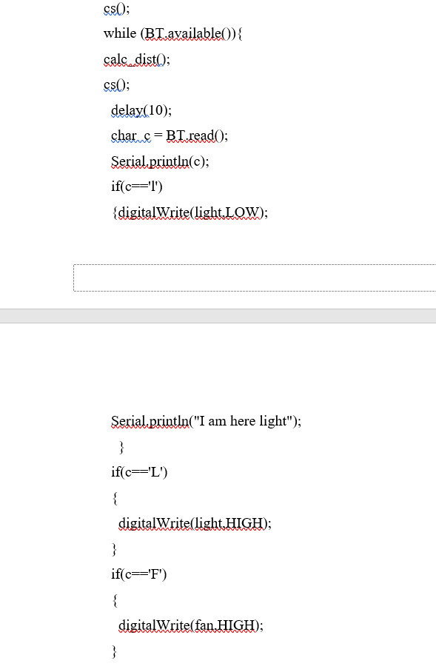
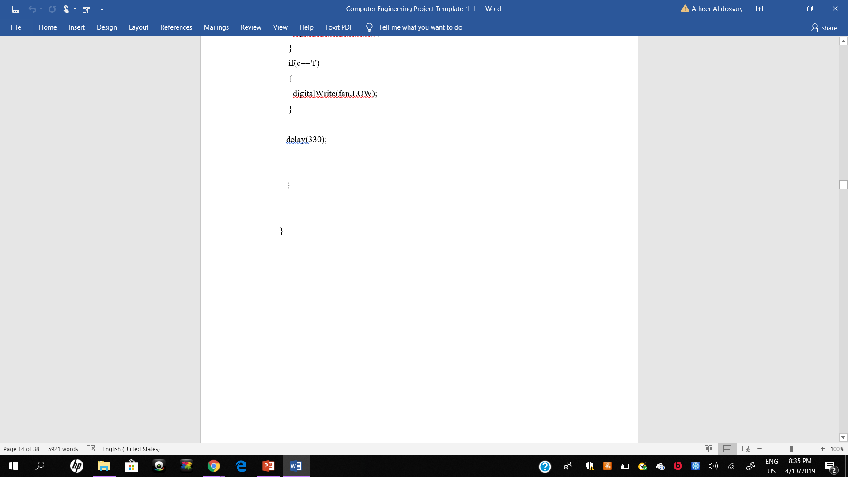

Slide 7
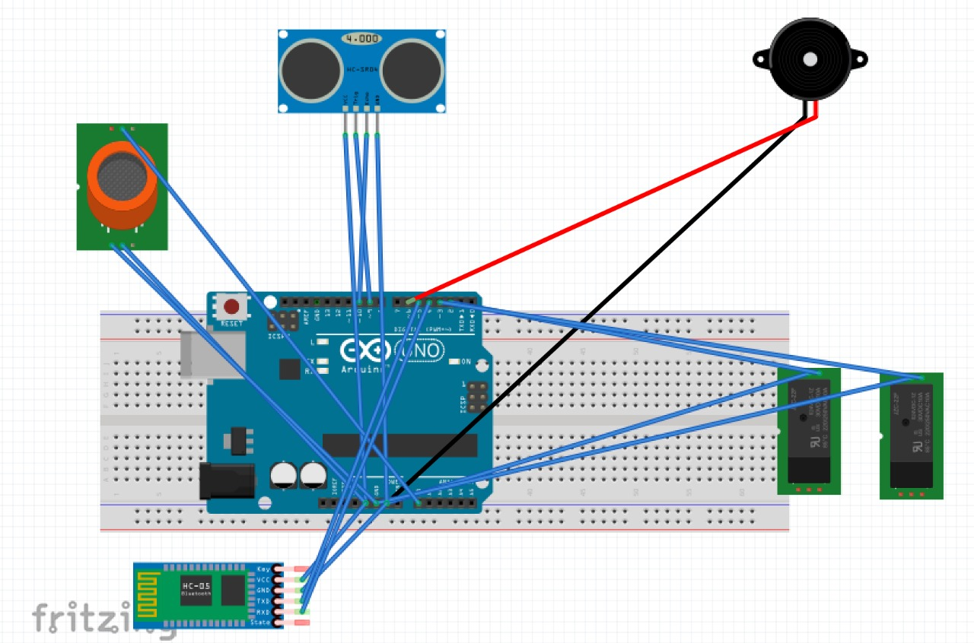
System design

Slide 8
    Task Per Weeks Breakdown

Slide 9
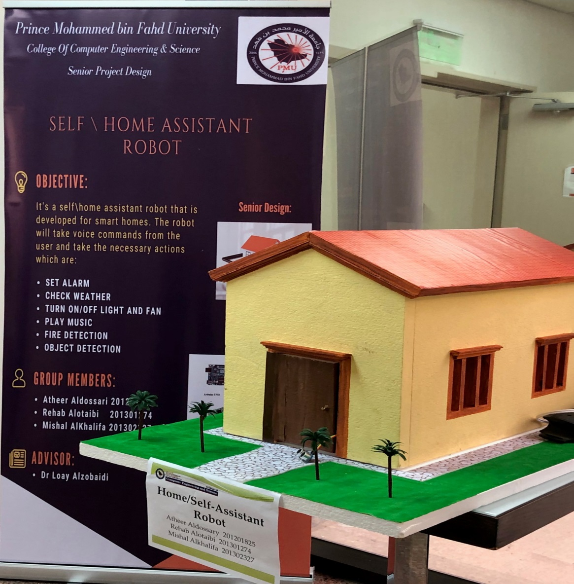
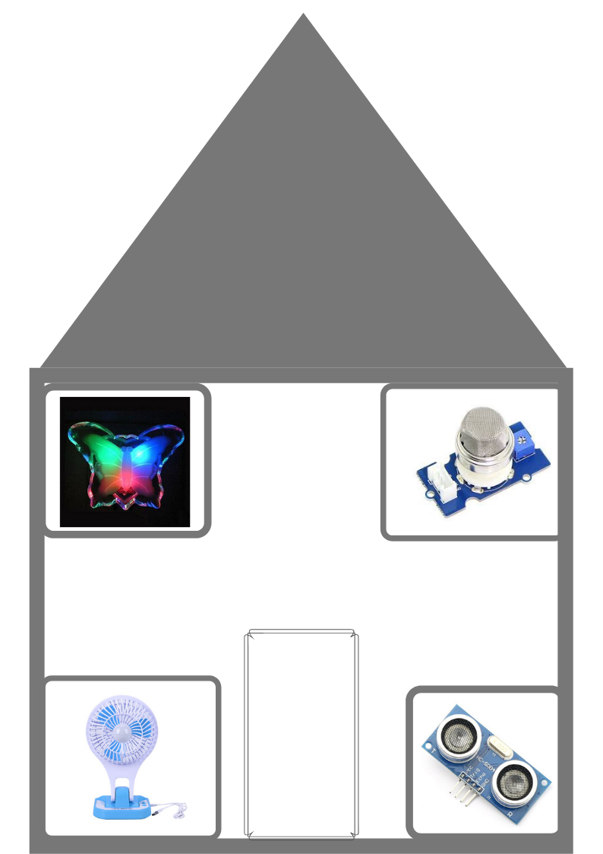
Prototype

Slide 10
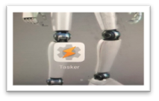
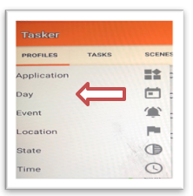
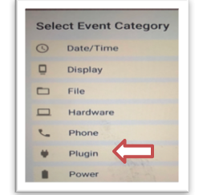
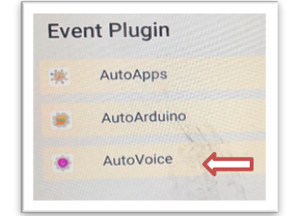
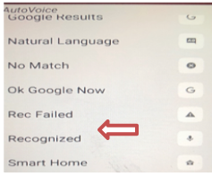
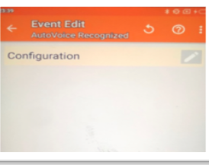
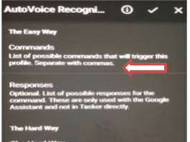
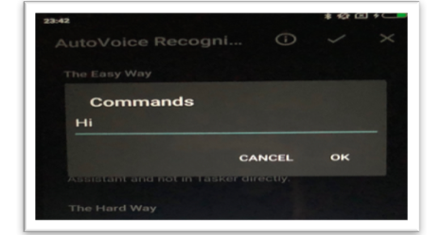
Android application
Steps using tasker application
1) 2) 3) 4)
5) 6) 7) 8)

Slide 11
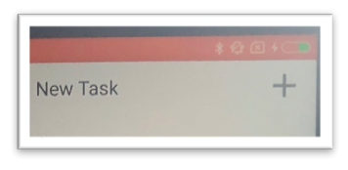
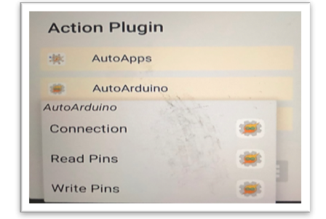
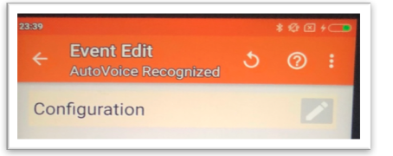
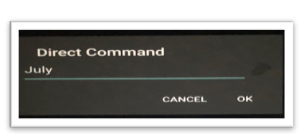
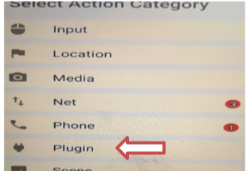
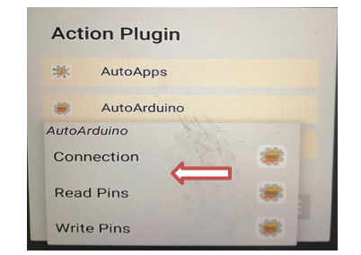
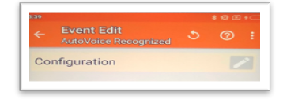
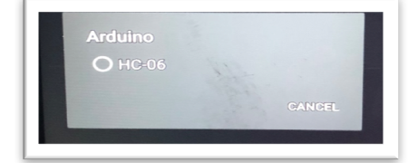
Cont. Steps using tasker application
9) 10) 11) 12)
13 ) 14) 15) 16)

Slide 12
Functional | non-functional
The robot will listen to voice commands and should take action based on that. | The robot will listen to voice commands and should take action based on that. In order to do that the Arduino is connected to relays to control the on and off by the switch it contains.
It should turn on/off light | The recognized data is sent to the Arduino via Bluetooth that is connected to the Arduino, then based on the asked action its work
It should turn on/off fan | There are three apps that are controlling the whole system, which are: 1- Auto Voice application: which is used to intercept with Google now and recognizing the voice command. 2- Tasker: which is used to set the tasks. 3- Auto Arduino: which is used to connect the Arduino and send commands.
Play music | Reliability: The robot should work all the time and must operate with accuracy, meaning it identifies and associates the exact and correct command and do action based on that command.
Object detection: it must detect objects from at least 10 m and send alarm.
Smoke detection: it must detect smoke and send buzzer.

Slide 13

Hardware
Voltage main: 220 V
Relay coil voltage: 5V
Bluetooth module
Power sockets
Relay power max
Controller: Arduino UNO
Processor: Android phone
Ultrasonic sensor
Gas sensor MQ2
Wires
Fan
Small lamp

Slide 14
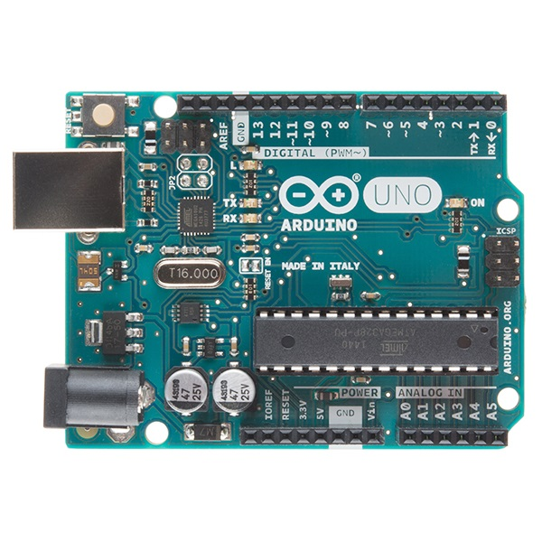
Arduino UNO

Slide 15
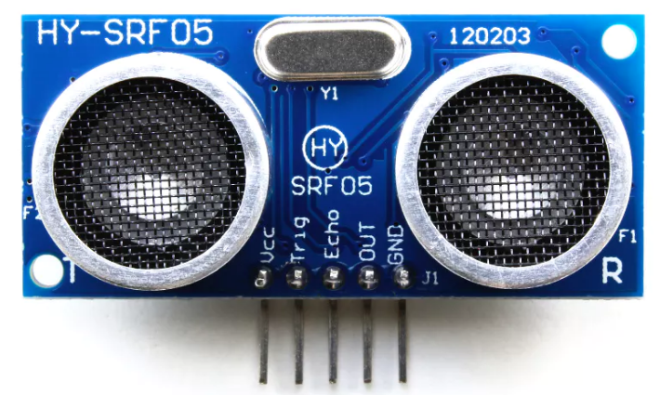
Ultrasonic sensor

Slide 16
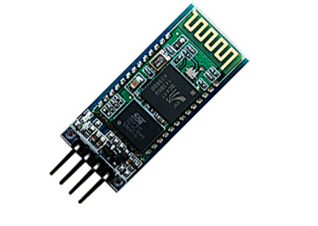
Bluetooth
HC06 Bluetooth module

Slide 17
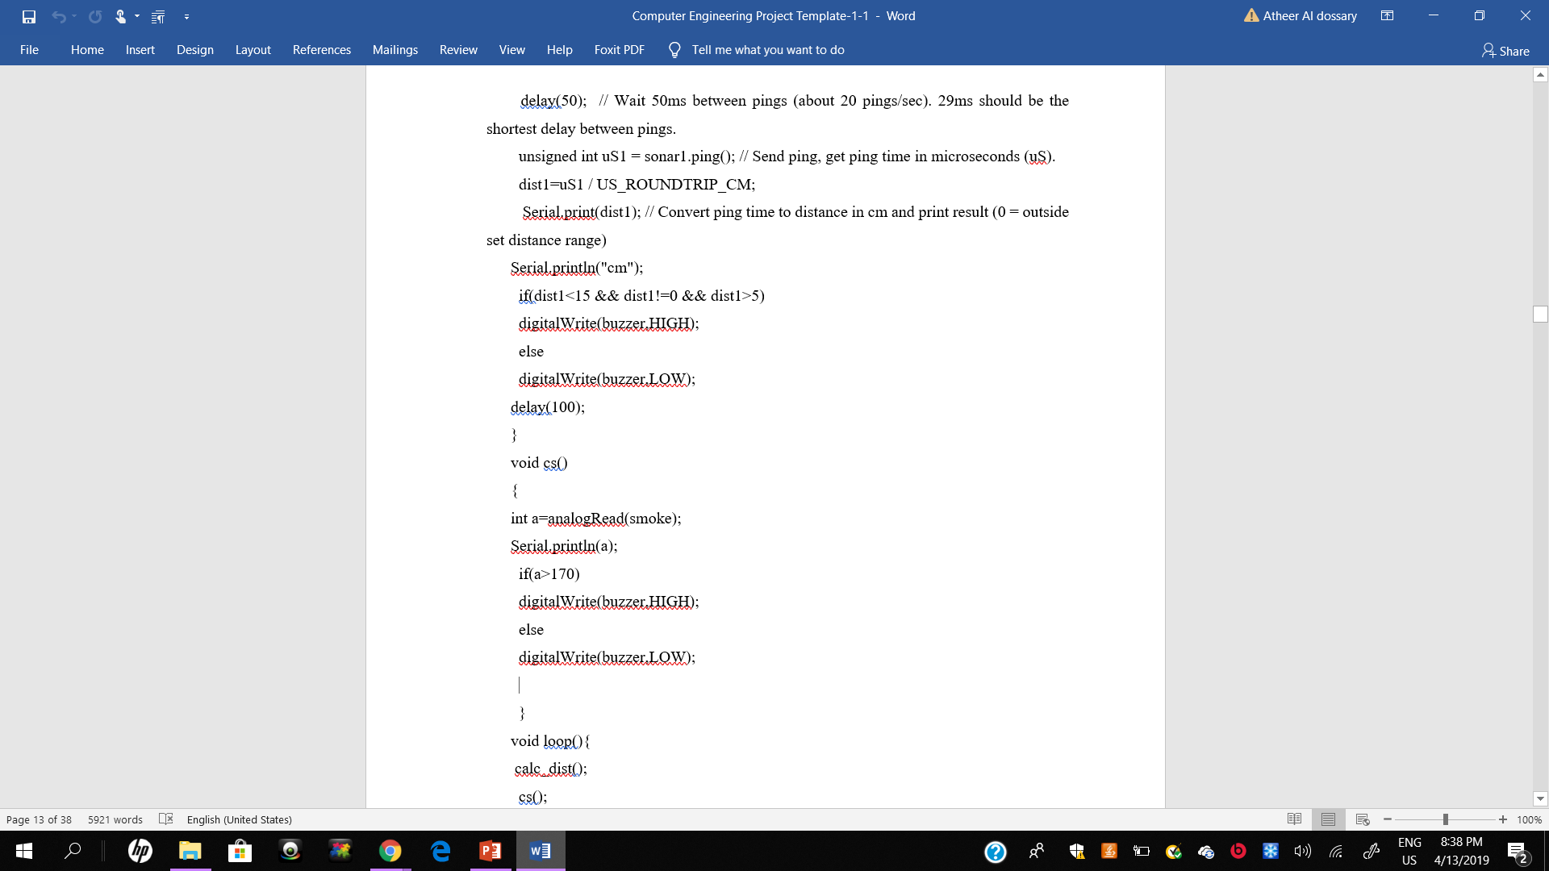
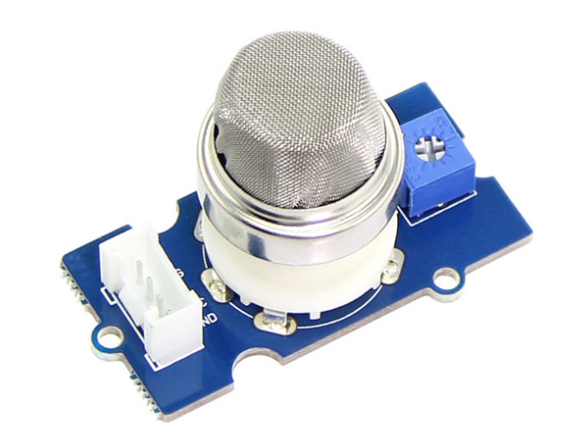
Gas sensor MQ2

Slide 18
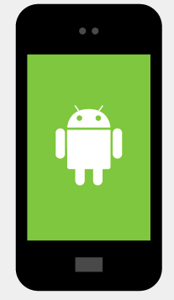
Applications used
Android device
Auto Voice application
Auto Arduino
Tasker application

Slide 19
  Contribution of Team Members
Team member | Tasks
Atheer Aldossari | Android applications
Rehab Alotaiabi | Order the hardware equipment
Mishal AlKhalifa | Integrating Arduino UNO with android phone

Slide 20
Challenges
The voice recognition it some times recognizes different word
Setting meeting and finalizing the due work
Safety due to electricity
Sensitive components such as wires and sockets

Slide 21
Future plans
Water leak detection.
Power measure
Control cameras in houses

Slide 22
Conclusion
Lastly, the main objectives of the project were reached all the functional requirements were successfully reached

