Slide 1
Conceptual Landfill Design and Energy Recovery Potential for Greater Dammam Area
AbdulRahman Al-Blooshi 201001936
Umar I. Ahmed 201102979
Wasi Ul Hassan 201100925
Mohammad Shammout 201102967

Slide 2
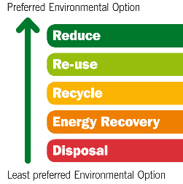
Outline
Background
Project Objectives
Methodology
Results
Conclusion

Slide 3
Background
Saudi Arabia has one of the largest population growth rates in the world, with a current population at almost 29 million; Greater Dammam Area has population around 2.3 million
Rapid economic development and a high standard of living lead to high generation of municipal solid waste (MSW)
Conventional methods for waste disposal involve the mass landfilling of all MSW, with little to no informal recycling efforts.
Current waste management system is not sustainable to effectively meet future waste demands
ISWM approach must be applied to improve waste management system

Slide 4
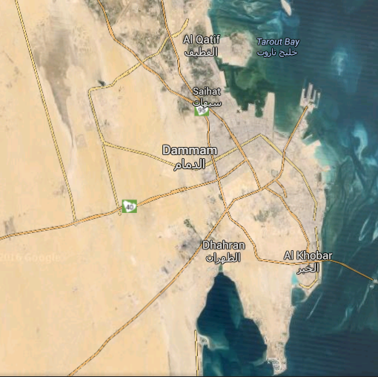
Study Area
Greater Dammam Area

Slide 5
Project Objectives
Evaluate the current state of MSW management in the country, and look into the latest available waste disposal technologies
Gather preliminary data to assess the level of public awareness regarding the issue of local waste management
Forecast waste generation in the near future based on current data regarding population, per capita consumption, and waste composition
Apply given data to create a conceptual design for an appropriate landfill as well as explore the potential for waste-to-energy recovery processes

Slide 6
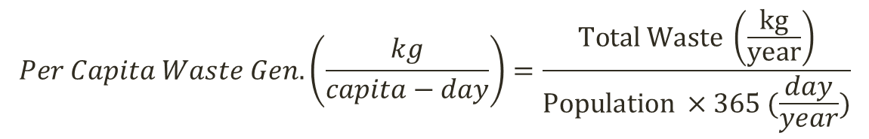
Methodology
Literature review of scholarly works on local MSW management as well as globally available waste disposal technologies was conducted
Public awareness on this issue was evaluated with the use of a survey conducted throughout the study area
The results of this survey were analyzed using IBM SPSS statistical analysis software
Data was collected on current incoming waste volumes and composition from the local municipality. Per capita waste generation was computed using the following formula:
$$Per Capita Waste Gen. \left(\frac{kg}{capita−day}\right)=\frac{Total Waste \left(\frac{kg}{year}\right)}{Population ×365 (\frac{day}{year})}$$

Slide 7
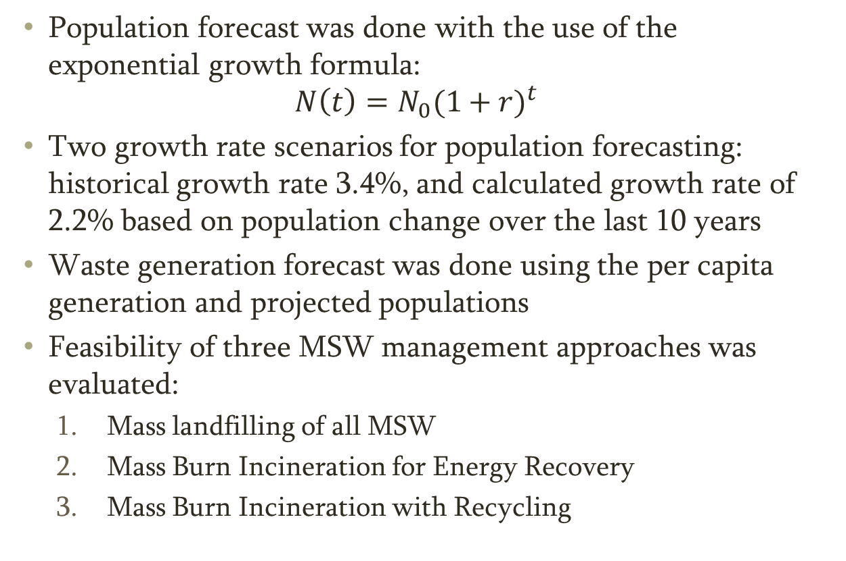
Methodology
Population forecast was done with the use of the exponential growth formula:
$$N\left(t\right)={N_{0}(1+r)}^{t}$$
Two growth rate scenarios for population forecasting: historical growth rate 3.4%, and calculated growth rate of 2.2% based on population change over the last 10 years
Waste generation forecast was done using the per capita generation and projected populations
Feasibility of three MSW management approaches was evaluated:
  Mass landfilling of all MSW
  Mass Burn Incineration for Energy Recovery
  Mass Burn Incineration with Recycling

Slide 8
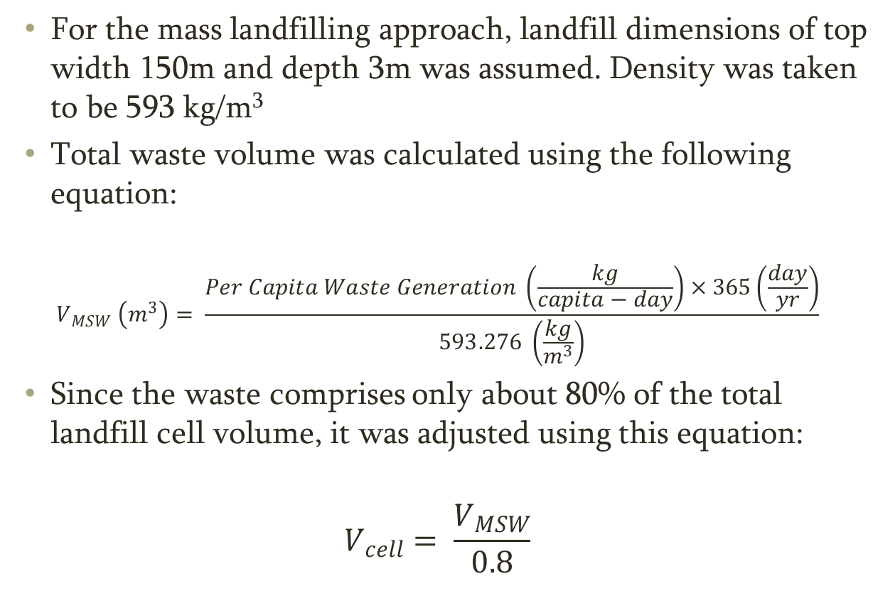
Methodology
For the mass landfilling approach, landfill dimensions of top width 150m and depth 3m was assumed. Density was taken to be 593 kg/m³
Total waste volume was calculated using the following equation:
$$V_{MSW} \left(m^{3}\right)= \frac{Per Capita Waste Generation \left(\frac{kg}{capita−day}\right)×365\left(\frac{day}{yr}\right)}{593.276 \left(\frac{kg}{m^{3}}\right)}$$
Since the waste comprises only about 80% of the total landfill cell volume, it was adjusted using this equation:
$$V_{cell}= \frac{V_{MSW}}{0.8}$$

Slide 9
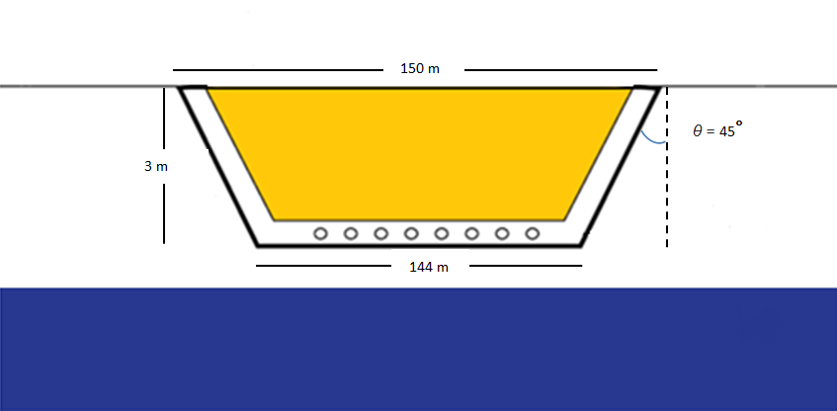
Schematic Cross-Section of Landfill Cell

Slide 10
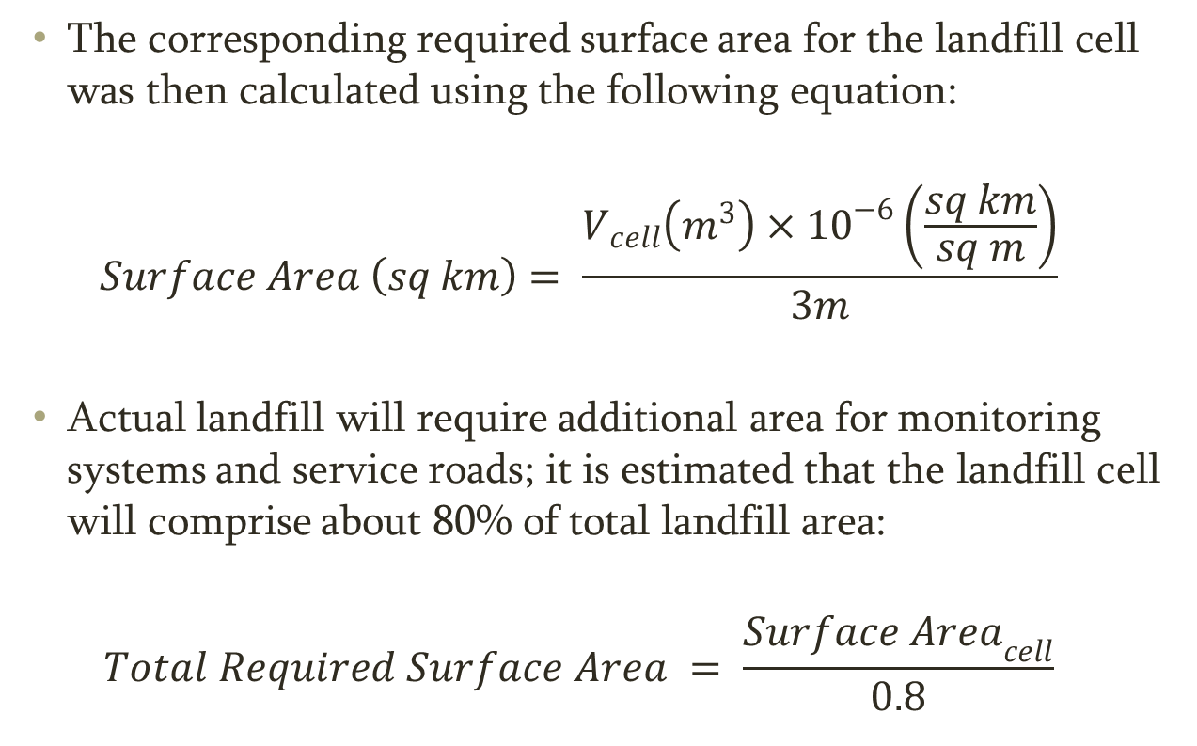
Methodology
The corresponding required surface area for the landfill cell was then calculated using the following equation:
$$Surface Area \left(sq km\right)= \frac{V_{cell}\left(m^{3}\right)×{10}^{−6}\left(\frac{sq km}{sq m}\right)}{3m}$$
Actual landfill will require additional area for monitoring systems and service roads; it is estimated that the landfill cell will comprise about 80% of total landfill area:
$$Total Required Surface Area = \frac{{Surface Area}_{cell}}{0.8}$$

Slide 11


Methodology
Forecasting the power generation potential requires the waste composition in order to determine the Lower Heating Value (LHV) of the waste
Energy recovery potential and power generation potential are then calculated using the following equations:
Net Power Generation potential is then calculated by factoring in the efficiency of the process, about 25% in this case:

Slide 12
Methodology
For mass burn approach, total MSW generation is used for the calculation of power generation potential
For mass burn with recycling approach, all recyclable materials are excluded; these include glass, paper, metal, and plastics
Excluding recyclables significantly reduces total mass of waste being incinerated; also affects the LHV of the waste

Slide 13
MSW Composition for Greater Dammam Area

Slide 14
Results
Survey Sample Characteristics
Age Group | Participants | %
<30 | 137 | 27.3
30-39 | 158 | 31.5
40-49 | 97 | 19.4
50-60 | 70 | 14
>60 | 28 | 5.6
Unspecified | 11 | 2.2
Total | 501
Education Level | Participants | %
High School | 68 | 13.6
Diploma | 57 | 11.4
Bachelors | 258 | 51.5
Masters | 94 | 18.8
PhD | 13 | 2.6
Unspecified | 11 | 2.2
Total | 501

Slide 15
Results
Survey results indicate public is not fully satisfied with current waste management practices
It is believed much more can be done to divert waste away from landfills
Most survey participants are not willing to pay a monthly fee for improved waste services
Residents are willing to practice in-house waste segregation if an appropriate government recycling scheme is in place
Most residents believe the key to improving waste services is improving public awareness

Slide 16
Results
Population Forecast
MSW Generation Forecast
Current: 2.5 million
2040 (1): 5.51 million
2040 (2): 3.96 million
Current: 1.88 million tons
2040 (1): 4.33 million tons
2040 (2): 3.24 million tons

Slide 17
Results
Volume Requirements
Surface Area Requirements
Current: 2.7 million cubic m
2040 (1): 14.4 million cubic m
2040 (2): 8.0 million cubic m
Current: 0.91 sq. km
2040 (1): 4.83 sq. km
2040 (2): 2.69 sq. km

Slide 18
Results
Net Power Generation Potential (Mass Burn)
Net Power Generation Potential (Mass Burn w/Recycling)
Current: 66.7 MW
2040 (1): 153.8 MW
2040 (2): 114.8 MW
Current: 6.7 MW
2040 (1): 15.6 MW
2040 (2): 11.7 MW

Slide 19
Conclusion
The design approach of mass landfilling depicts the consequences of the current waste management methods
Mass landfilling is not a feasible long-term waste management option
A considerable amount of power can be generated with the use of the mass burn, but the high amount of harmful emissions means public support may not be strong
The best option is mass burn with recycling; majority of waste will be recycled and only residuals would end up being incinerated for energy
This approach is economically feasible and environmentally friendly; residents of the Greater Dammam Area are likely to cooperate with this waste management strategy

