Slide 1

Project title: Automated Storage and Retrieval System (ASRS)
Team Members:
*Thamer Alaqeel 201200928
Mohammed Al-Mahasnah 201102745
Ali Al-Ghazal 200901960
TurkiAlmutairi 201102637
Mohammed alsamih 201200821
CO Advisors: Dr.NADER SAWALHI
Advisor: Dr.NADER SAWALHI

Slide 2
Outline
Project Objectives
Background
Design and Progress
Testing, and Results
Summary, conclusions and Future work

Slide 3
Objectives
Design and build a prototype ASRS new design that can be used in libraries and in stores
The system includes a transporting mechanism and control system
To design new robotic tasks that can introduce more tasks in simple operations
A prototype is produced and tested

Slide 4
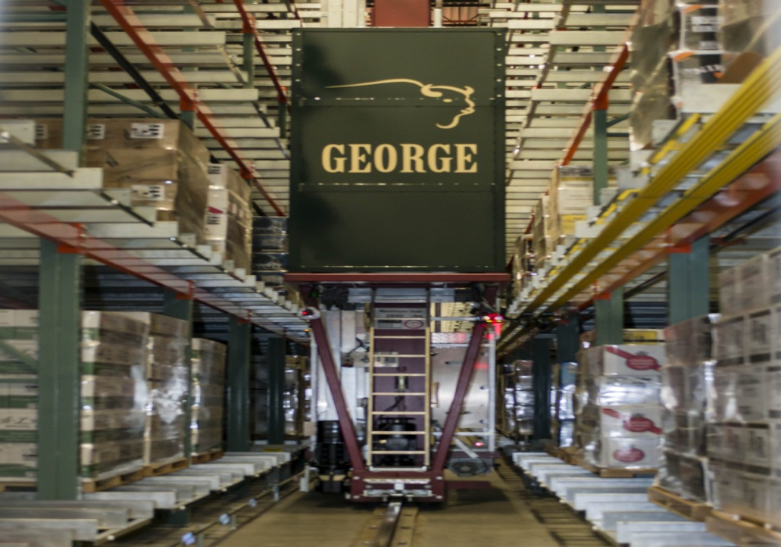
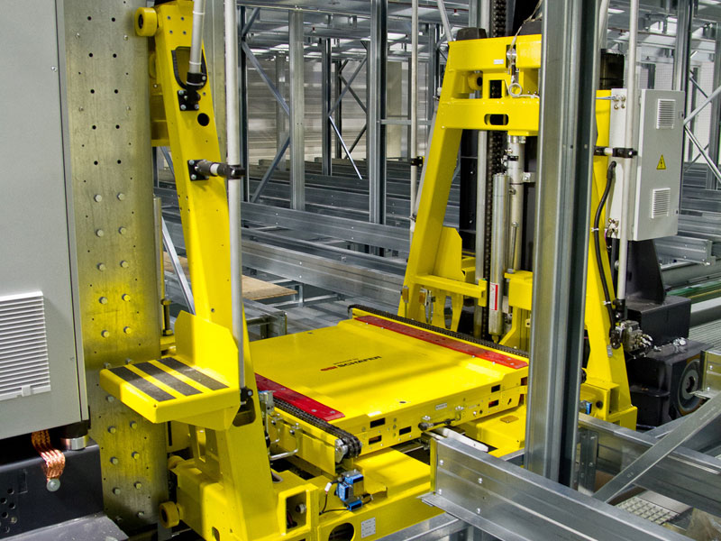
Background
ARSR are widely used in industry . First started in the 1960s, .. Very advanced through computer control
Benefits in industry and in warehouses
Double-deep AS/RS High-density, multiple-deep AS/RS
Notes:
initially focusing on heavy pallet loads but with the evolution of the technology the handled loads have become smaller

Slide 5
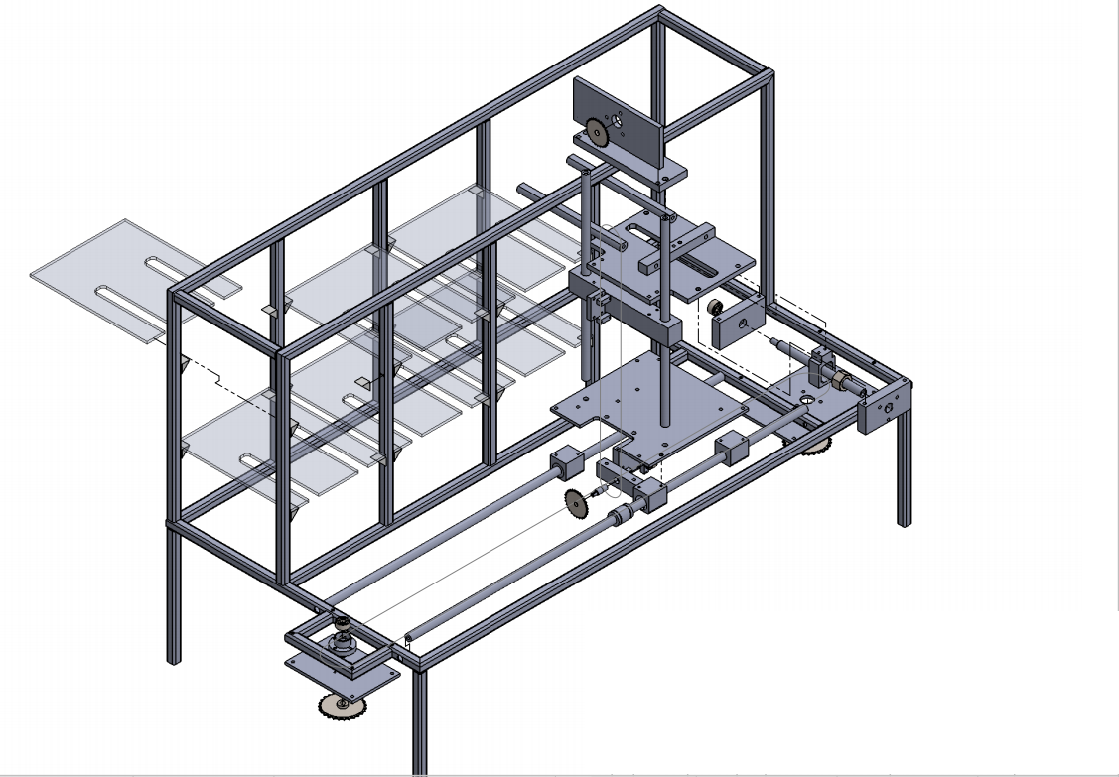
Design and Progress
Project main parts
Mechanism

Slide 6
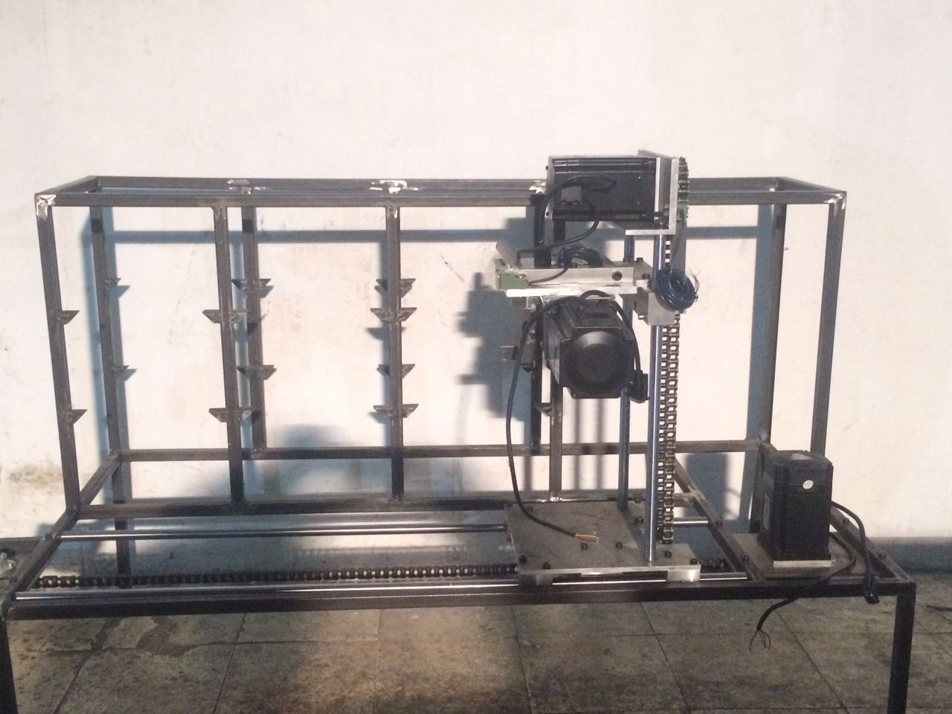
Project main Parts

Slide 7
Project main Parts
Figure (1.1): Main Part

Slide 8
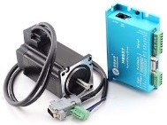
Project main Parts
Three motors
X, Y, and Z axis

Slide 9
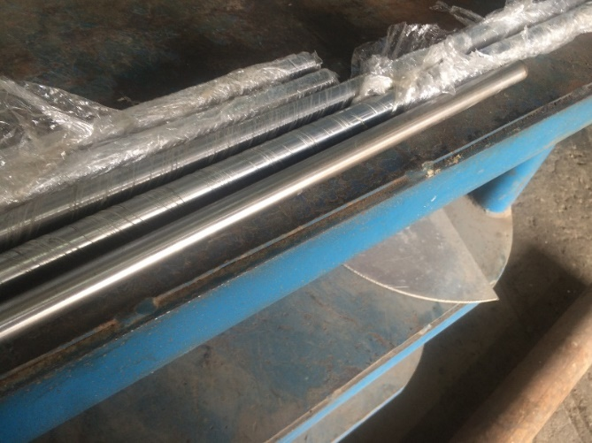
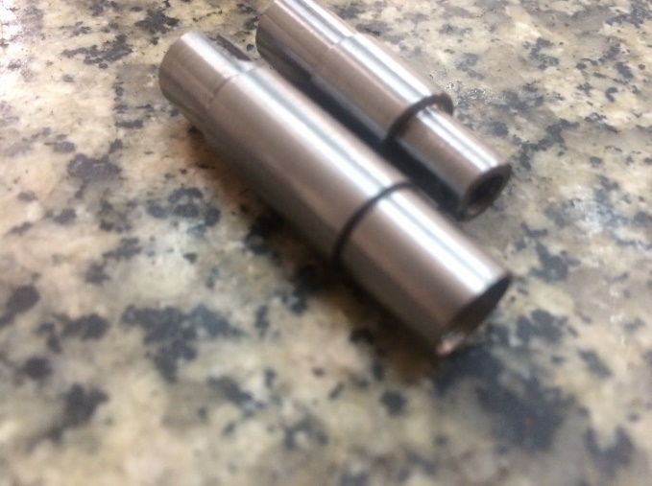
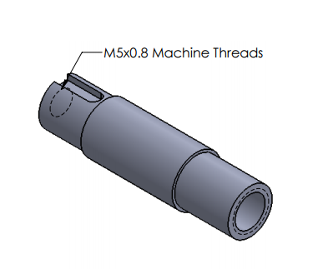
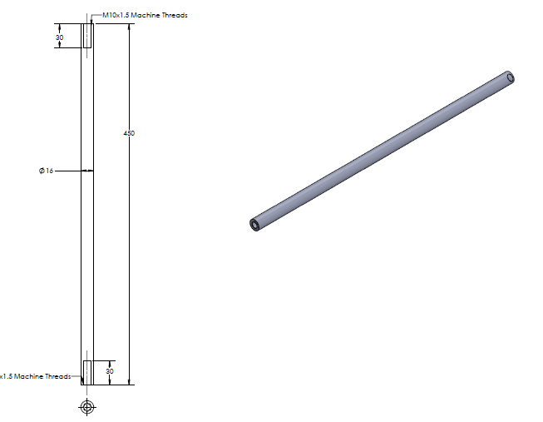
Project main Parts
Figure (1.2): chrome rod
Figure (1.3): sprocket shaft

Slide 10
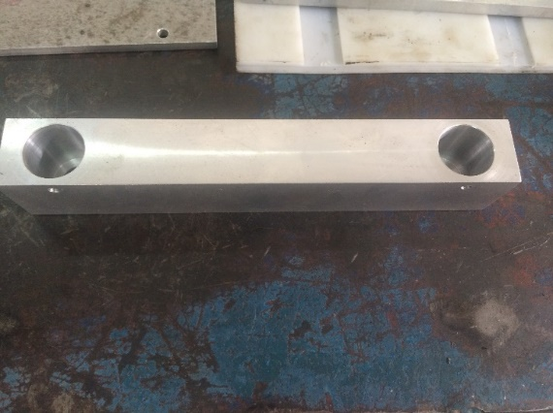
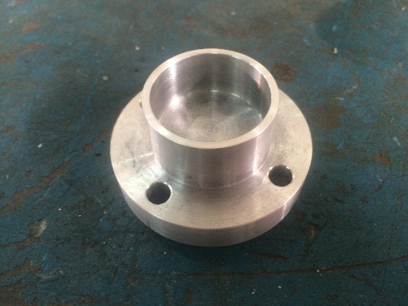
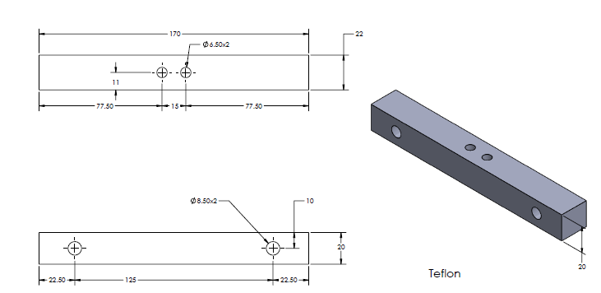
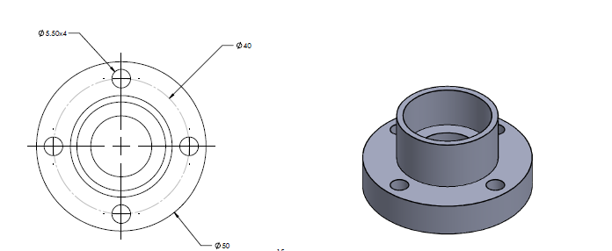
Project main Parts
Figure (1.4): Fork Part1
Figure (1.5): bearing holder

Slide 11
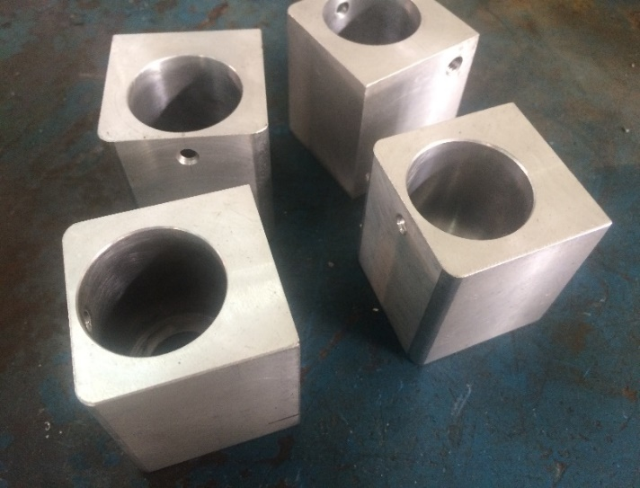
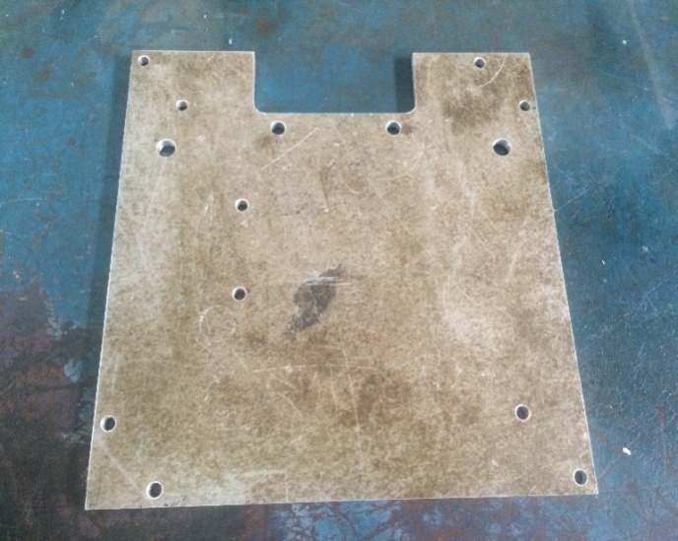
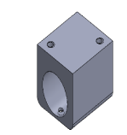
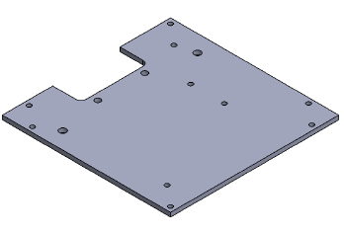
Project main Parts
Figure (1.6): slider bearing housing
Figure (1.7): Motor Mount plate

Slide 12
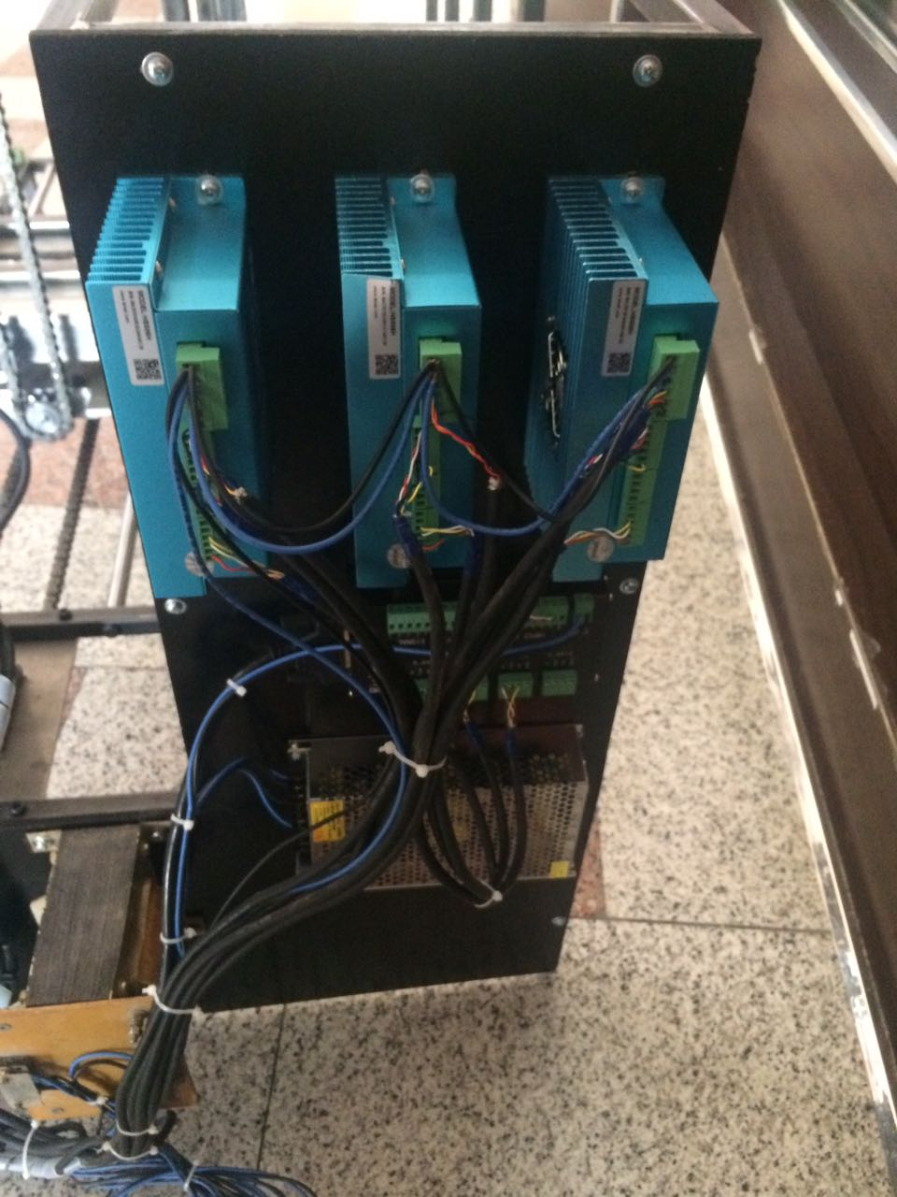
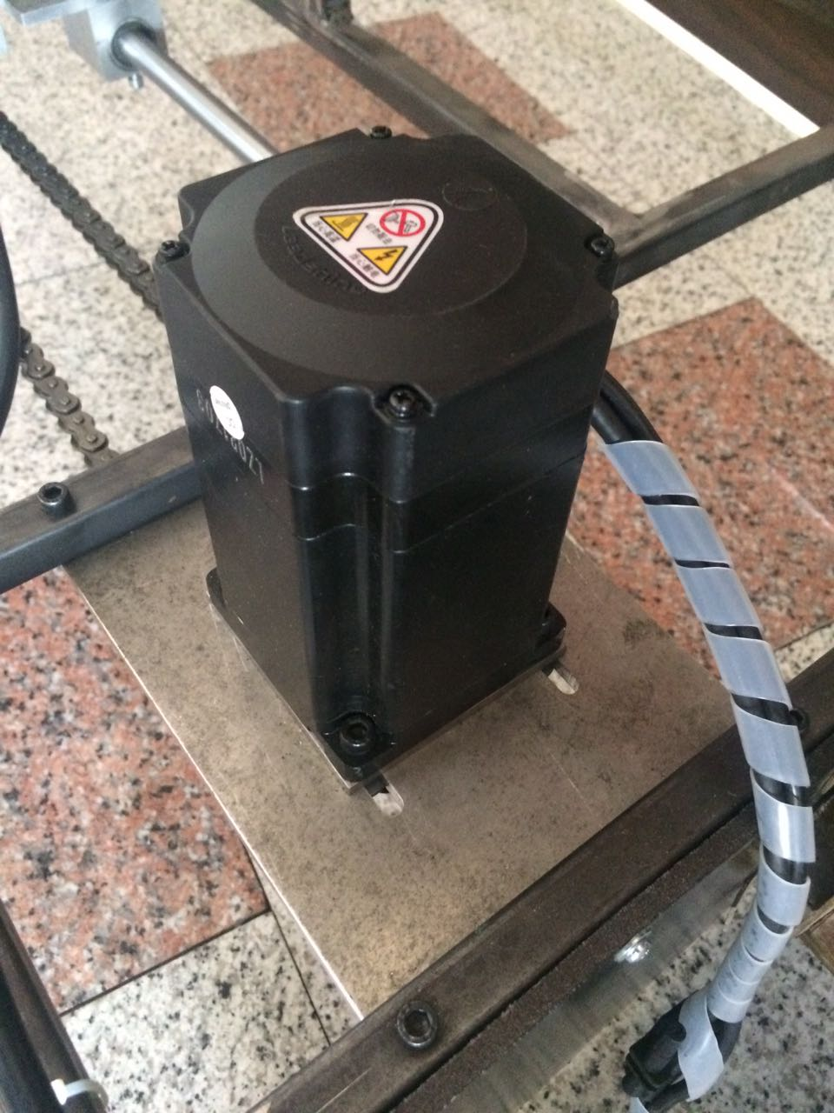
Project main Parts

Slide 13
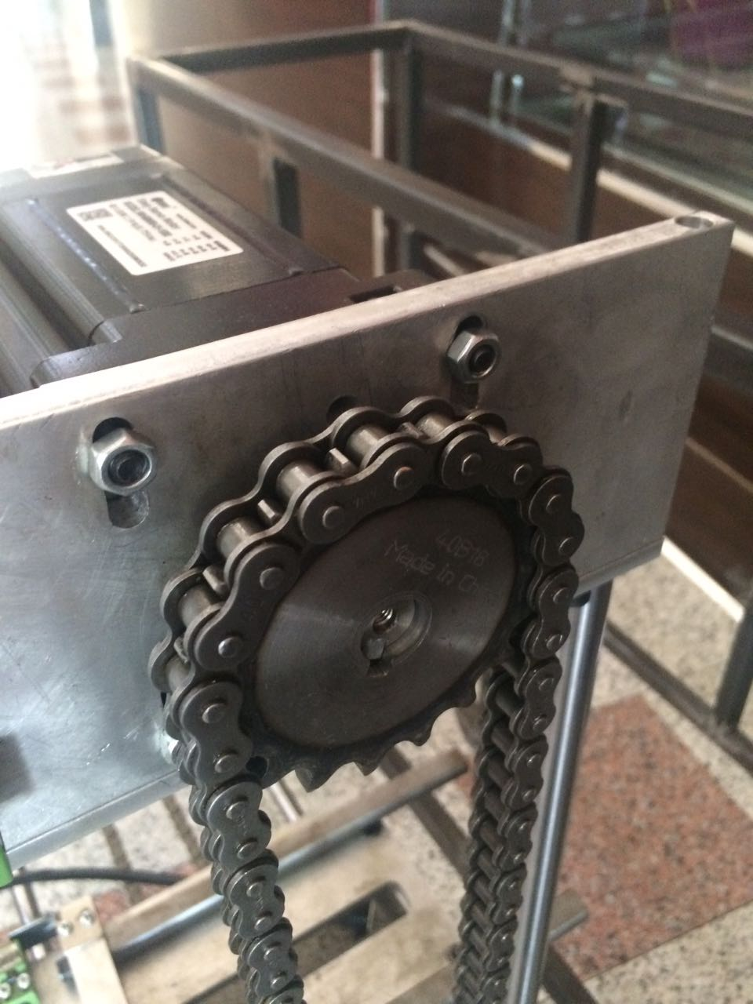
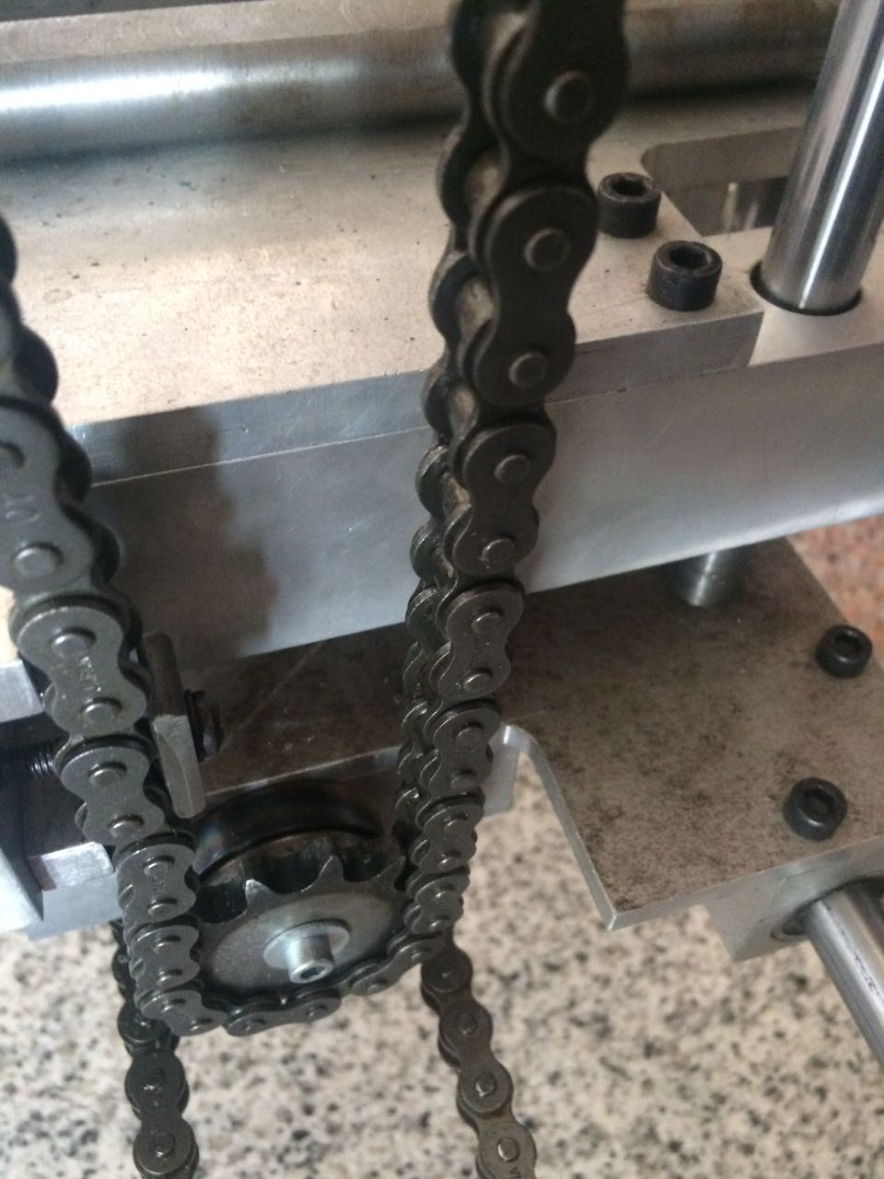
Project main Parts

Slide 14
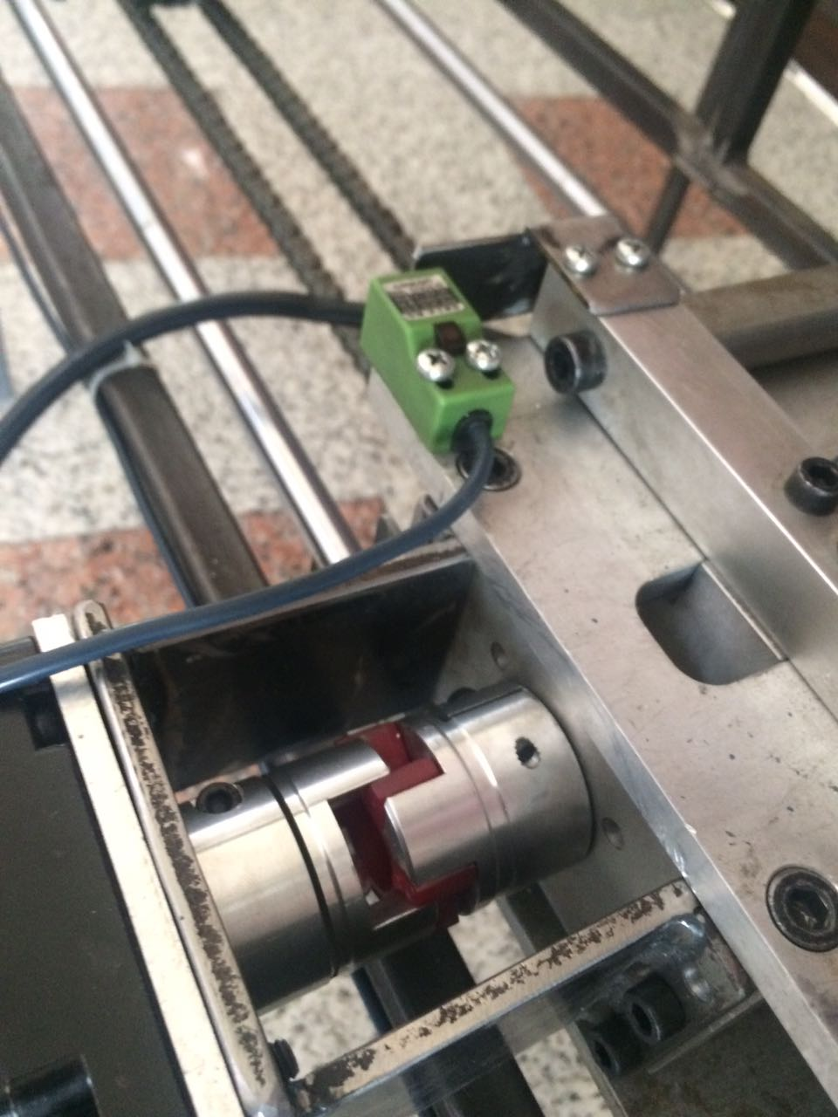
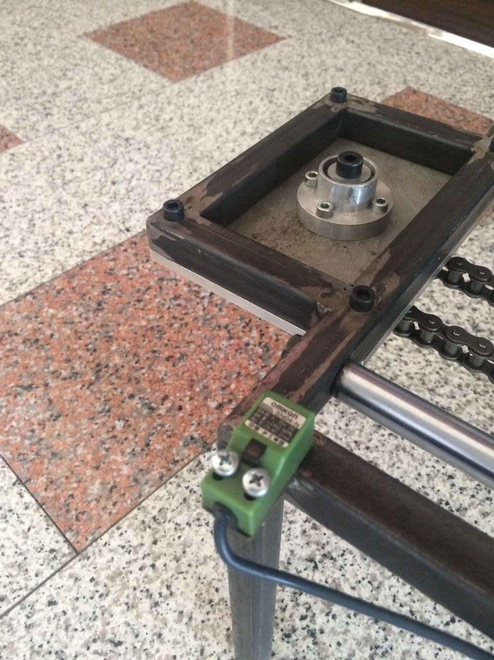
Project main Parts

Slide 15
Fork rod
Mine Frame
The Rack
The Fork
vertical holder
Motor plate
Motor mount plate
Sprocket shaft
Chrome rod
Slider bearing housing
Ball bearing
Sprocket
Bearing holder
Sprocket Chain

Slide 16
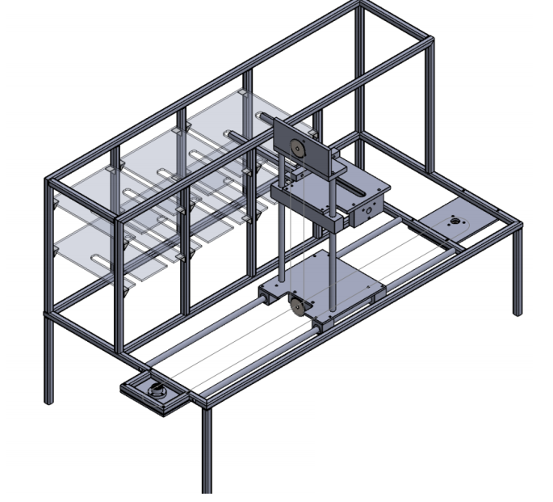
Mechanism
X-axis
Y-axis
Z-axis
Servo Motor

Slide 17
motors specification
Selection Procedure
The first step is to determine the drive mechanism for your equipment. Some examples are direct rotation, a ball screw, a belt and pulley or a rack and pinion. Along with the type of drive mechanism, you must also determine the dimensions, mass and friction coefficient, etc. that are required for the load calculation:
Dimensions and mass (or density) of load
Dimensions and mass (or density) of each part
Friction coefficient of the sliding surface of each moving part
Next you will need to determine the required specifications for the equipment:
Operating speed and operating time
Positioning distance and positioning time
Sopping accuracy , Resolution , Position holding , Power supply and voltage and Operating environment
Specific features and requirements such as; Open-Loop, Closed-Loop, Programmable, Feedback, IP rating, Agent approvals, etc.

Slide 18

Servo #stepper motor
The HBS series offers an alternative for applications requiring high performance and high reliability when the servo was the only choice,
while it remains cost-effective. The system includes a 2-phase stepper motor combined with a fully digital, high performance drive and
an internal encoder which is used to close the position, velocity and current loops in real time, just like servo systems. It combines the
best of servo and stepper motor technologies, and delivers unique capabilities and enhancements over both, while at a fraction of the cost
of a servo system.

Slide 19

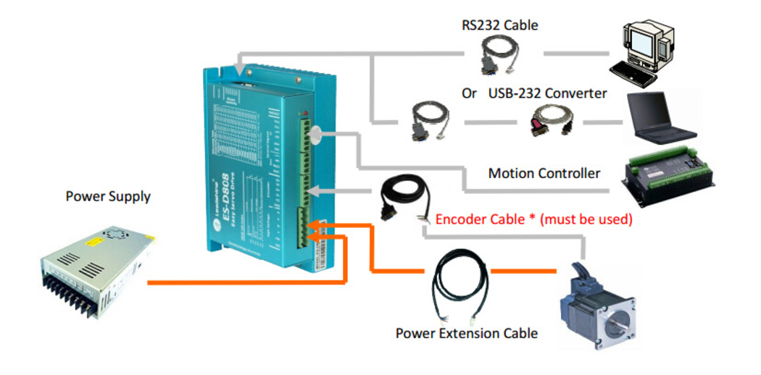

Slide 20
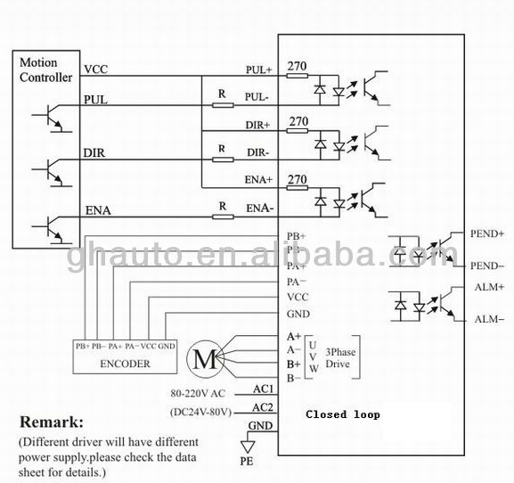
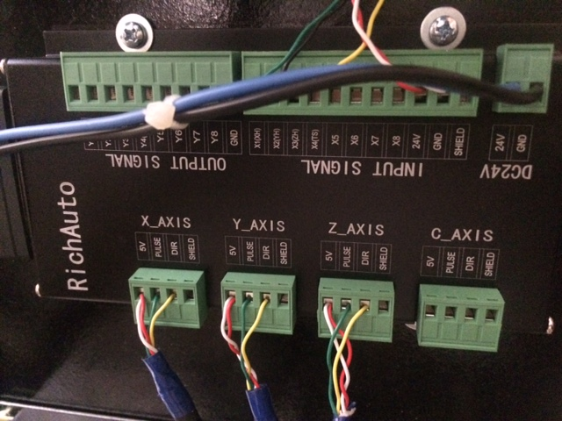
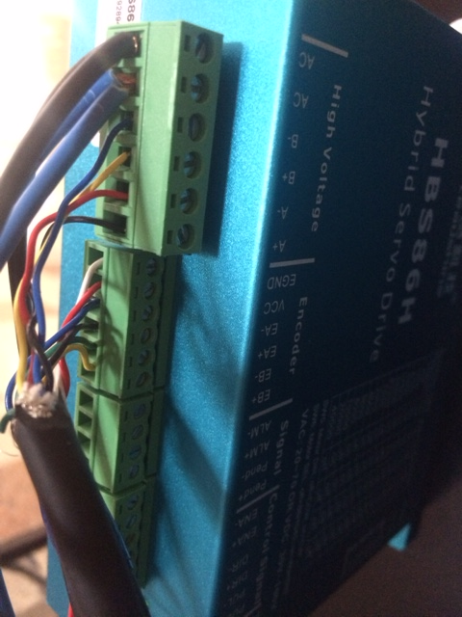

Slide 21
Selection of the Motor
hybrid servo #stepper
Stepper based servo control
Direct 120 / 220 / 230 AC input, or DC to 100V
Closed position loop to eliminate loss of synchronization
No torque reservation
Load based output current for extra low motor heating
Smooth motor movement and low motor noise
Quick response and no hunting
No overshooting and almost zero settling time
High starting torque, high inertial loads
Plug-and-play, no tuning for most of applications

Slide 22
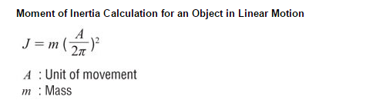

Slide 23
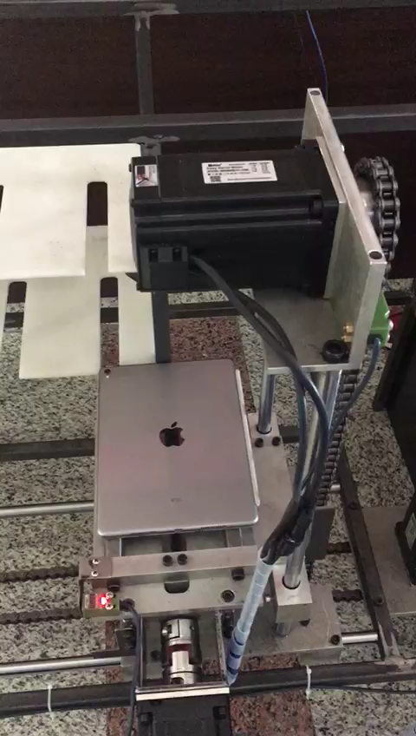
Testing and Results

Slide 24
Summary, conclusions and Future work

Slide 25
Thank you for listening
Q & A

