Slide 1


Adjustable Single Weight Lifting Machine
Mechanical Engineering Senior Project
Group #12
Advisor: Ragu Kannan
Co Advisor: Nader Sawalhi

Slide 2
Outline
Introduction
Objectives
Background
Design
Work Tasks
Challenges

Slide 3
Introduction
Bodybuilding sport is highly diffused between people in all ages starting from 16 years old.
Lifting machines are so heavy, costly, take a lot of space in the gym and hard to be moved.
The Adjustable Single Weight Lifting Machine is our solution.
ASWLM is a machine that allows the user to lift different weights by using one weight bar only.

Slide 4
Objectives
Inventing a new Idea Replaces the physical weight addition method.
Decrease the cost of GYM machines manufacturing.
Lightweight machines which can be carried everywhere.
Avoid injuries which may occur while changing the weight.
Decrease the space used for GYM equipment.

Slide 5
Background
Machines Types
-Resistance Machines
-Cardiovascular Equipment

Slide 6
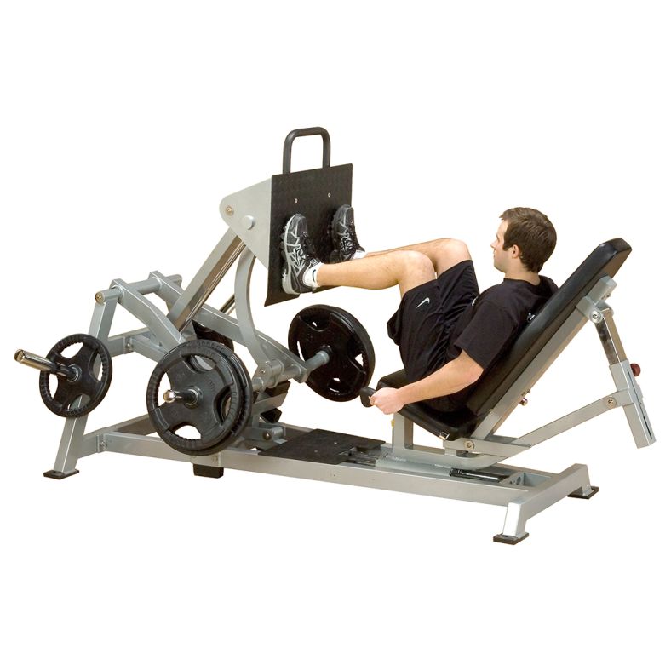
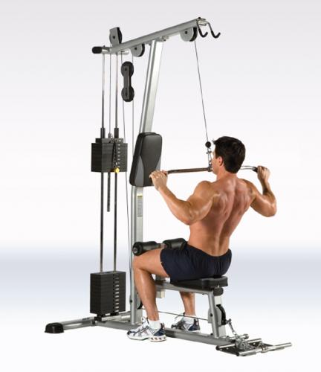
Background
Sport types and exercise mechanisms
Horizontal Seated Leg Press Lat Pull-Down

Slide 7
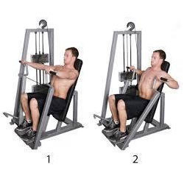
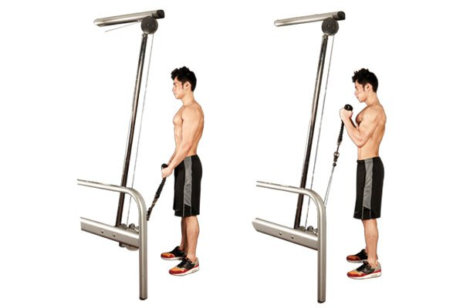
Background
Cable Biceps rope Seated Chest Press

Slide 8
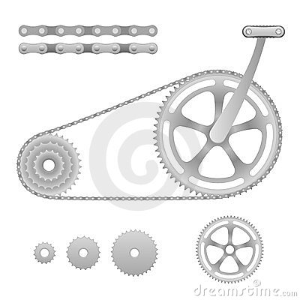
Background
Bicycle Gears

Slide 9
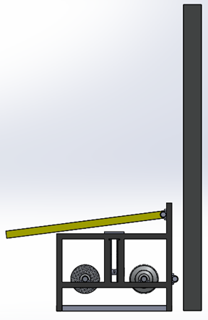
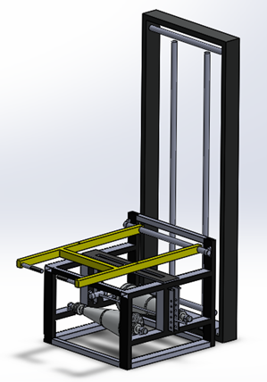
Design
Overall design (Isometric View)
Height (170cm)
Width (64x75 cm)

Slide 10
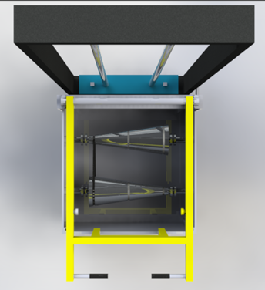
Design
Overall design (Top View)

Slide 11
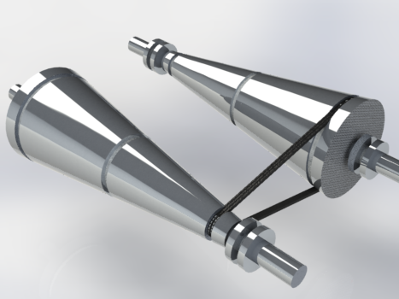
Design
Aluminum Cones
Large diameter
Small diameter
Ratio is 4:1
Small diameter (4 cm)
Large diameter (16 cm)
Shaft diameter (3 cm)
Shaft

Slide 12
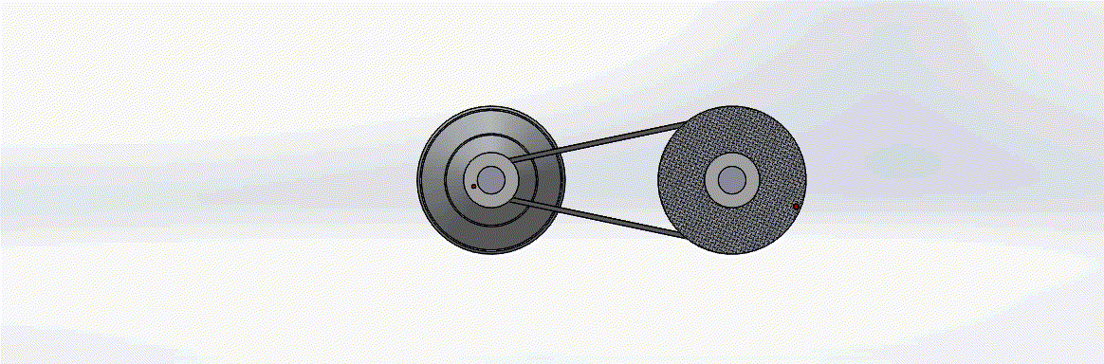
Design
Aluminum Cones (mechanism)

Slide 13
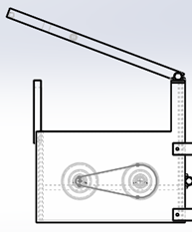
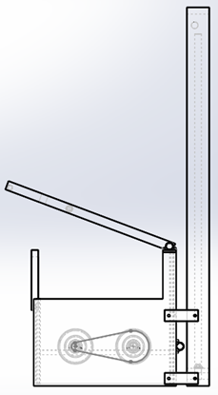
Design
60 cm
[W = FD]
W: Work
F: Force
D: Distance
37.5 cm
Calculations
150 cm
The training arm will be lifted up to 60 cm to rotate the shaft 37.5 cm which is 4 times the circumference (9.4 cm) of the shaft (4 turns)
1:4 | 4:1 | 1:1
37.5x F = 20kg x 150cm F = 80 kg | 37.5x F = 20kg x 9.4cm F = 5 kg | 37.5x F = 20kg x 37.5cm F = 20 kg

Slide 14


1:4
4:1

Slide 15
Testing and Results
Testing Details
Test Name | Date | Results
Arm Movement and Bearing Rotation | 16/05/17 | Was done Successfully
Con Pulley Movement | 16/05/17 | The cons rotate perfectly without any problem
Initial Test for the Whole System | 24/05/17 | Ropes material was not perfect
Final Test | 27/05/17 | Rope was changed, The machine worked fine
Friction Coefficients
Material | μ | Results
Rubber on Aluminum | 0.5 - 0.8 | We did not test it
Rubber on Wood | 0.6 - 0.85¹⁾ | Succeeded

Slide 16
Testing and Results
VIDEO

Slide 17
Design Constrains
Economic | Manufacturability | Safety
Marketing analysis | Production of components | Operational
Manufacturing cost | Purchase of components | Human
Distribution costs | Assembly

Slide 18
Work Tasks
Working on the Project Report
Buying aluminum Billets
Buying pulleys, Bearings, Belt and Ropes
Fabrication of the Aluminum Billets
Manufacturing the Steel parts
Assemble everything together
Testing and Review

Slide 19
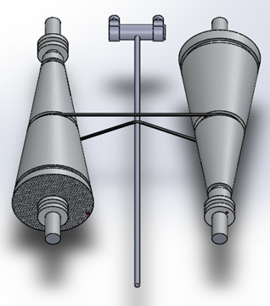
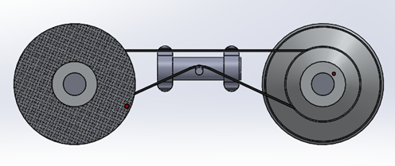
Future Improvements
Changing the belt location.
  Adding a steel shaft to tighten the belt

Slide 20
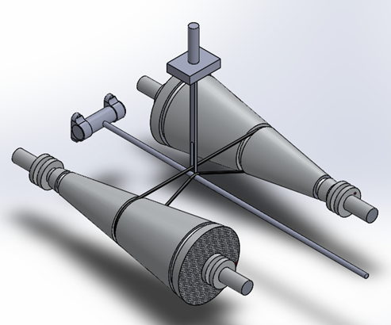
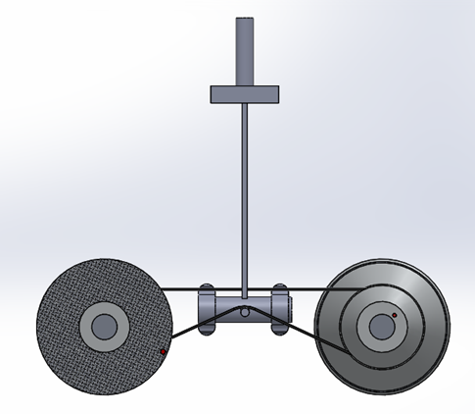
Future Improvements
Use a handler to change the belt location

Slide 21
Future Improvements
Use better pulleys and bearings.
Select better material for cons.

Slide 22
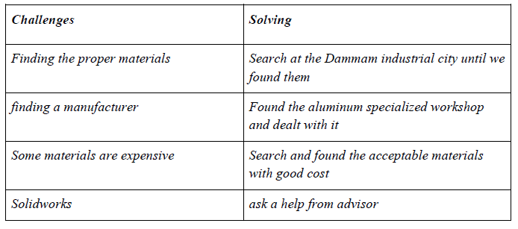
Challenges

Slide 23
Acknowledgment
Prince Mohammed bin Fahad University has prepared us to be qualified engineers who can work in various fields in industry, make changes effectively and contribute to the success of our country in future.
We would like to thank Dr. Ragurahman Kannan for his expert advice and encouragement throughout this difficult project, as well as Dr. Nader AlSawalhi for his valuable directions and motivating words.
We would also like to thank Saudi Aramco Eng. Ahmad AlShammari for his support as a consultant in our project issues

Slide 24
Thank you for your Listening

