Slide 1

Design & Manufacturing Of Automotive Tire Changing Mechanism
Final Presentation – Spring 2017
Project Advisors:
Advisor Name: Dr. Muhammad Asad
Co-Advisor Name: Dr Nader Sawalhi
Group Members:
1- Mohammed Al-Otaibi | 201202606
2- Yousef Naffaa | 201201700
3- Saeed Al-Ghamdi | 201101066
4- Abdullah Al-Zahrani | 201101872
Notes:
NOTE:
To change the image on this slide, select the picture and delete it. Then click the Pictures icon in the placeholder to insert your own image.

Slide 2
Outline
Objectives and Motivation of the Work
Brief Background
Design
Design Specifications and Items Selection
Testing and Results
Summary and Conclusions
Recommendations

Slide 3
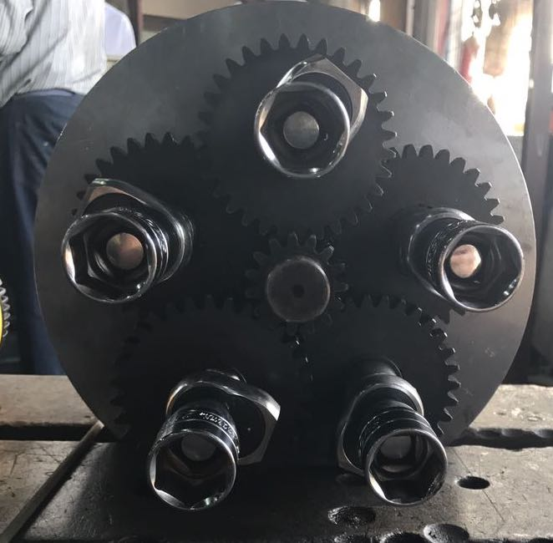
Objectives and Motivation of the Work
Objectives:
Design and manufacture an automotive tire changing mechanism.
Reduce the amount of time and energy.
Minimizing the weight of the prototype.
Applications:
Tire manufacturing companies.
Workshops.

Slide 4
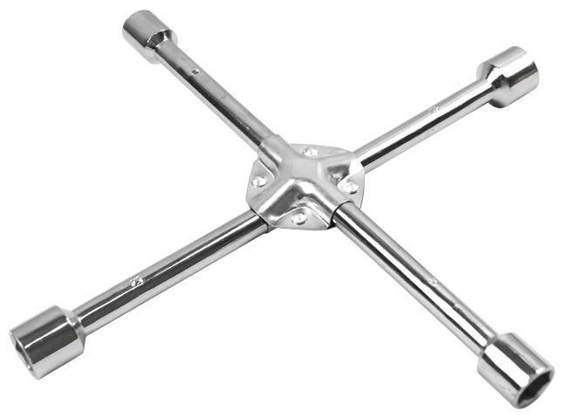
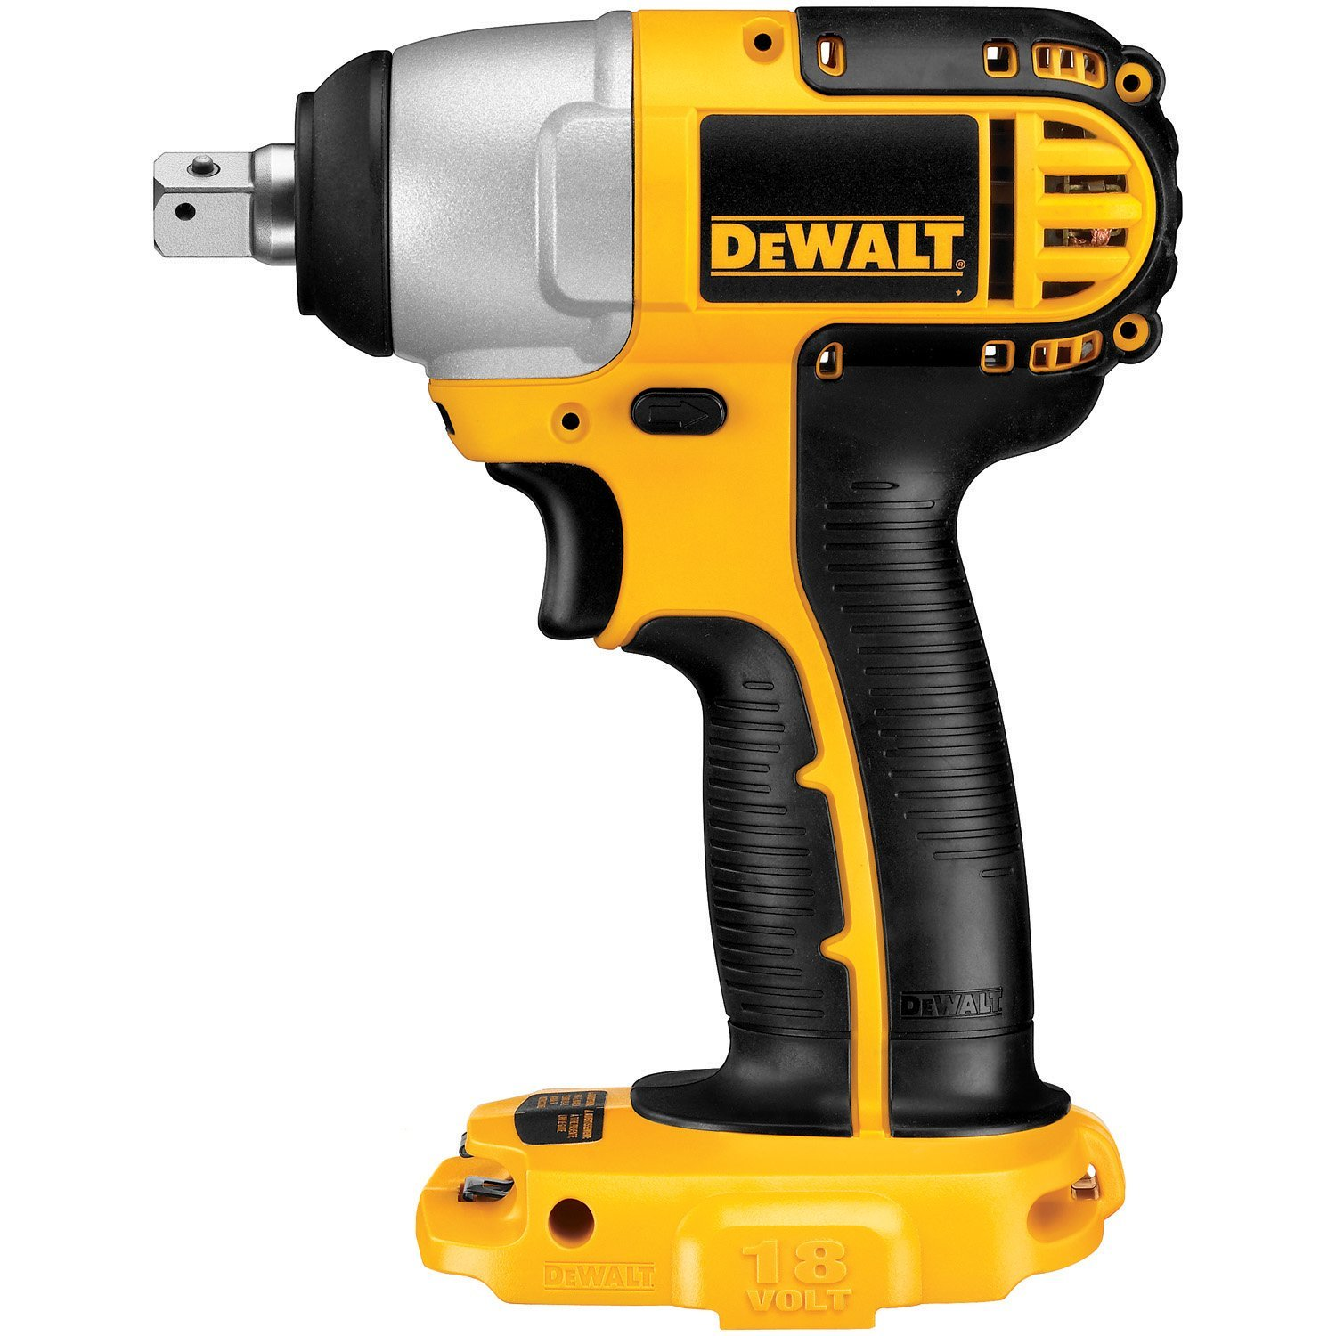
Brief Background
Similar Mechanisms.
Lug Wrench
Impact Wrench

Slide 5
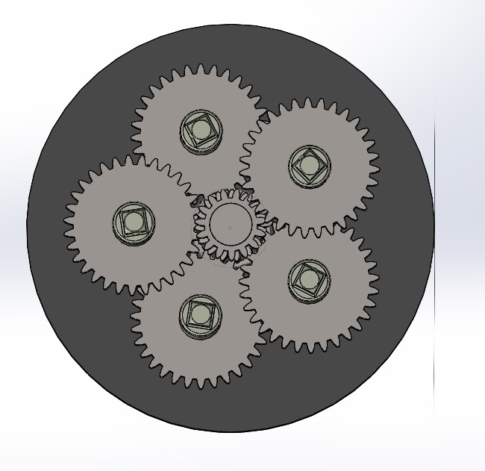
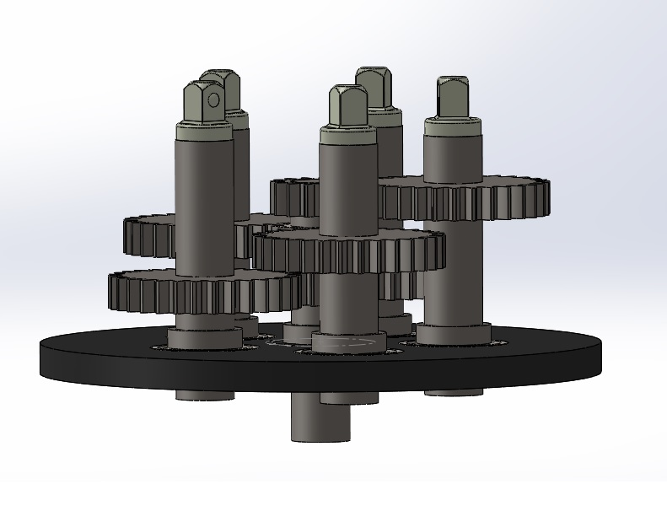
Design (SolidWorks)

Slide 7
Summary of Design
 | Driver Gear | Driven Gear | Circular plate | Shaft
No. of Teeth (mm) | 15 | 31 | - | -
PCD (mm) | 15.624 | 35.624 | 114.3 | -
Diameter (mm) | 37 | 37.5 | 240 | 25
Module | 2.5 | 2.5 | - | -
Thickness (mm) | 14 | 14 | 10 | -
Pressure angle | 20 | 20 | - | -
Length (mm) | - | - | - | 111

Slide 8
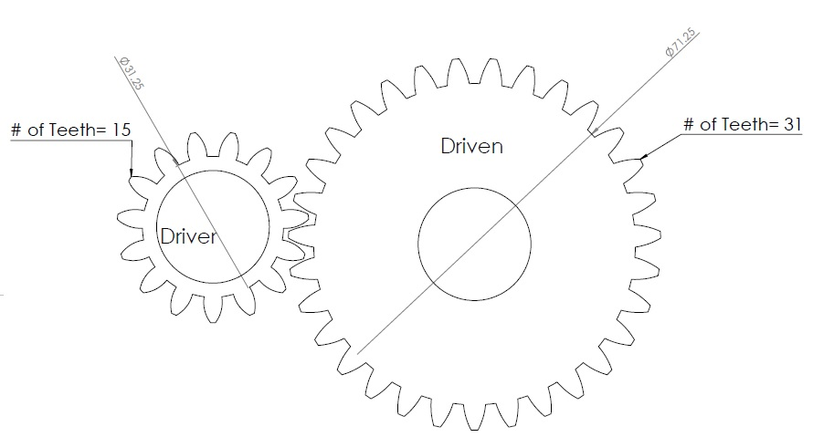

Design Specifications and Items Selection
Gears:
$Ratio=\frac{N.driven}{N.driver}=\frac{31}{15}=2.066$
Torque
Torque required to unscrew one nut 59 Nm
Torque Required to unscrew one nuts 295 Nm

Slide 9

Design Specifications and Items Selection
Shaft
$Mmax=PL$= 4.45(.077) = 0.343 N
S =$\frac{πd3}{32}$=$\frac{π\left(0.025\right)^3}{32}=$ 1.534E-06
$σmax=\frac{Mmax}{S}=$ 224 Kpa
$τmax=\frac{Tr}{J}=\frac{\frac{140.5\left(.0125\right)}{1}}{\frac{π{\left(0.025\right)}^{4}}{32}}= 45.8 Mpa$
SOF= $\frac{Max shear stress for material}{Max Shear stress}=\frac{327.5}{45.8}=7.1$

Slide 10
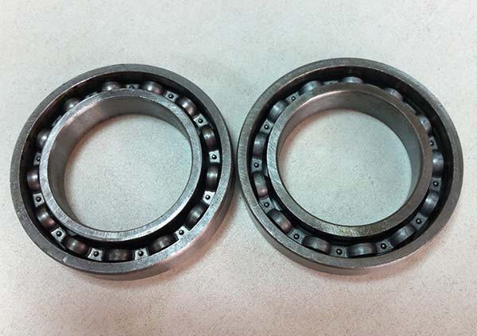

Design Specifications and Items Selection
Bearing:
$C10={\left(\frac{ζDn60}{ζR}\right)}^{1/a}={\left(\frac{\left(5000\right)\left(200\right)\left(60\right)}{{10}^{6}}\right)}^{1/3}=3.9 KN$
Deep Groove Ball Bearing Specification (KOYO.60005)
Inner diameter | 25mm
Outer diameter | 47 mm
Thickness | 8 mm
Mass bearing | 0.055 kg
Basic dynamic load rating | 8.06 KN
Basic dynamic load rating | 4.75 KN
Fatigue load limit | 0.212 KN
Limiting speed | 20,000 rev/min

Slide 11
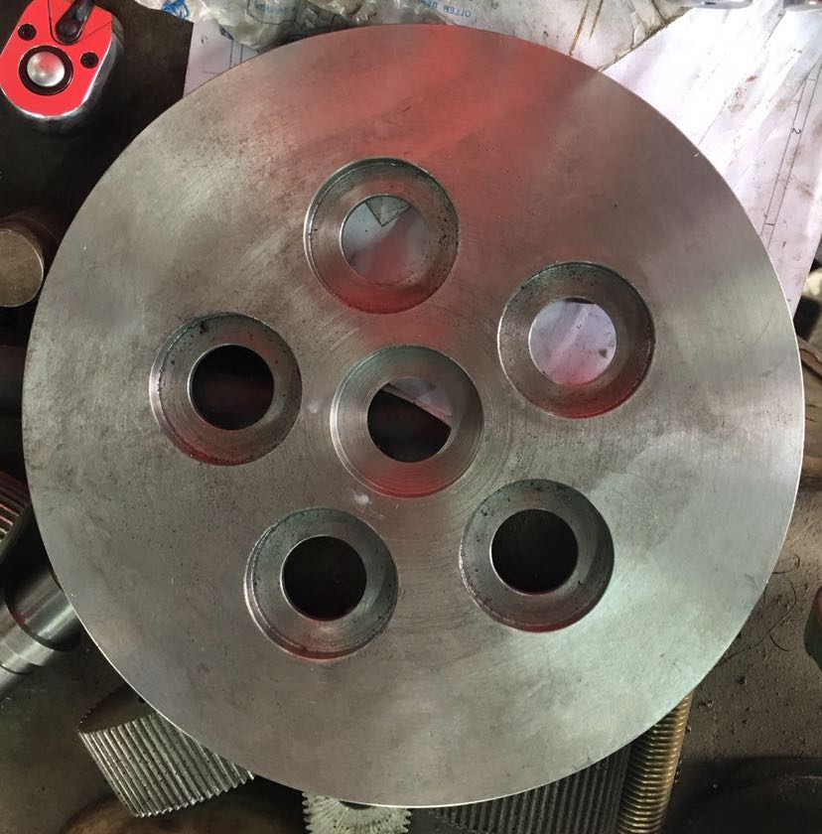
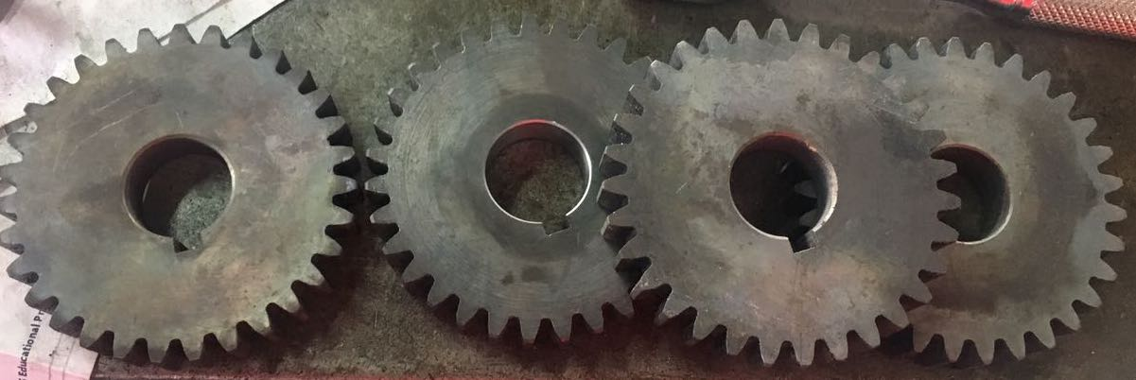
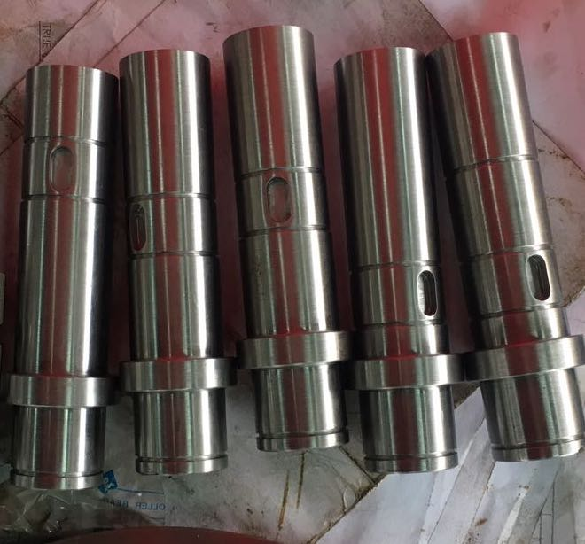
Manufacturing

Slide 12
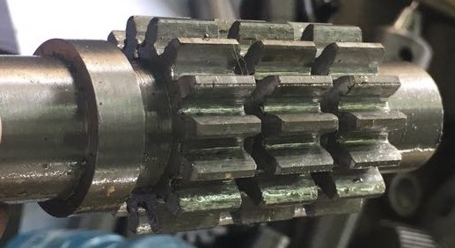
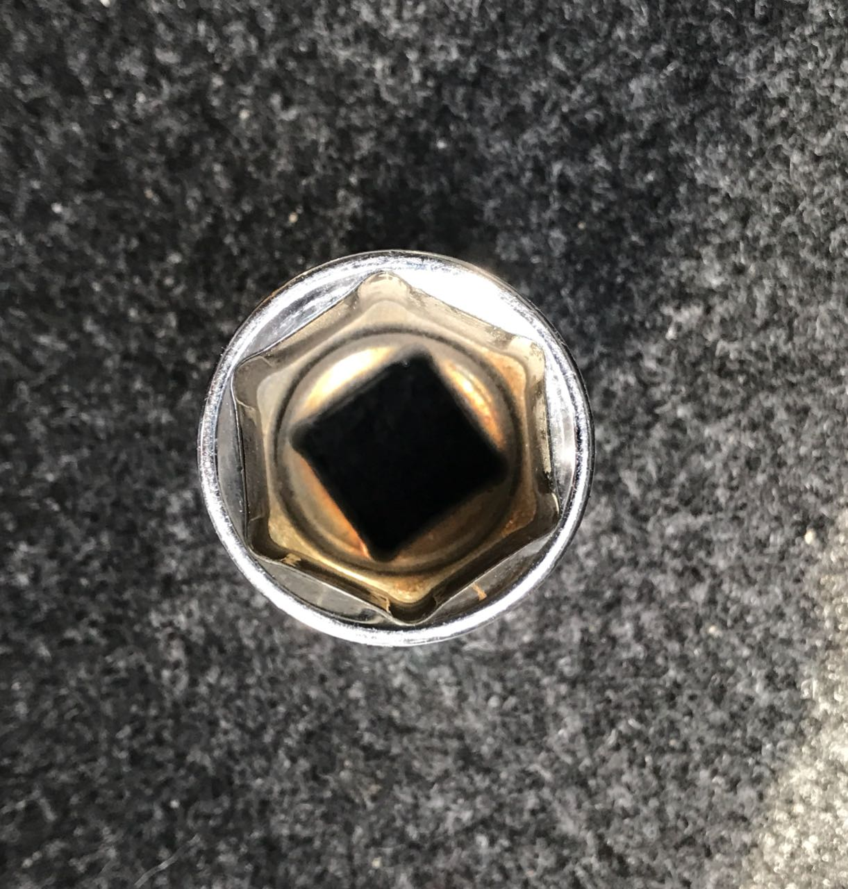
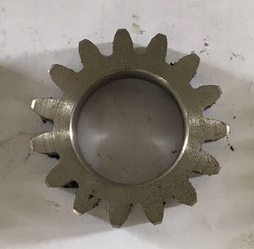
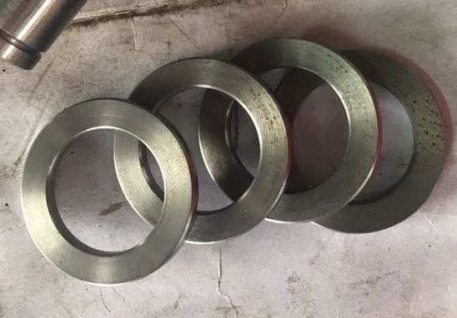
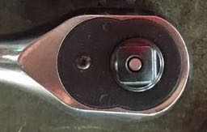
Manufacturing

Slide 13
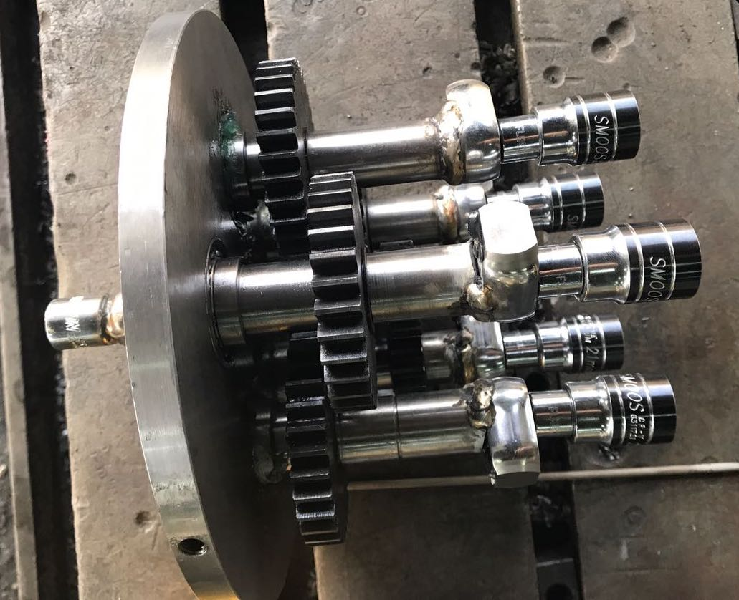
Manufacturing

Slide 14
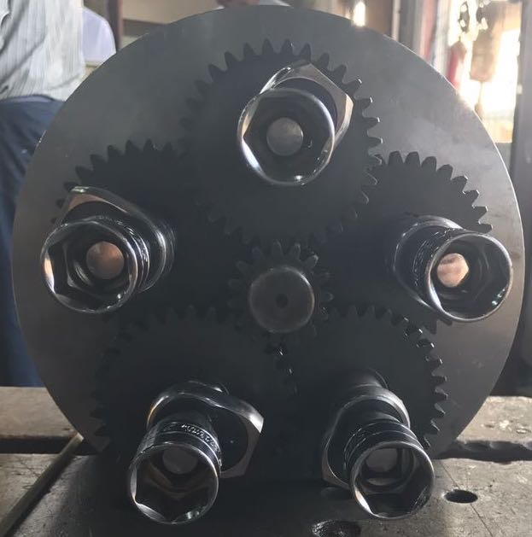
Manufacturing

Slide 15
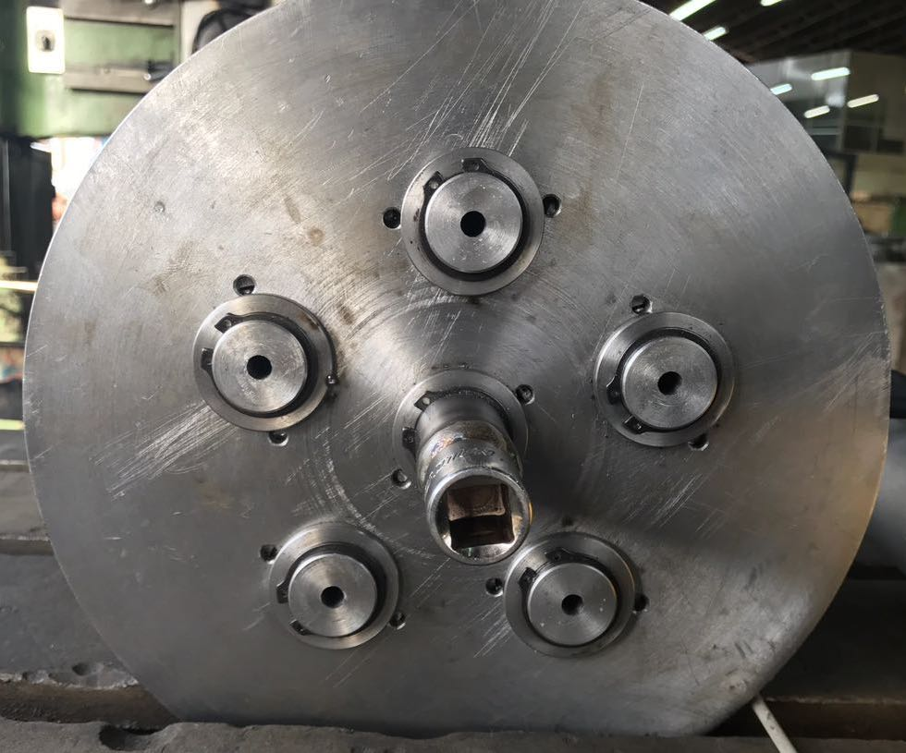
Manufacturing

Slide 16
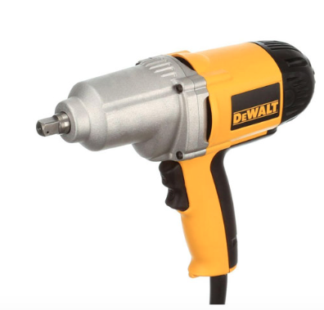
Impact Wrench Specification
Impact Wrench Specification
Max Torque | 440 N.m
No. load Speed | 2200 rpm
Weight: | 3.2 Kg
Power | 710 Watts
Amps | 7.5 Amps

Slide 17
Testing & Result
The time taken to unscrew nuts in seconds.
 | Unscrew one nut | Unscrew five nuts
Lug wrench | 50 | 250
Impact wrench | 10 | 50
Our design | - | 11

Slide 18
Video

Slide 19
Summary
We successfully managed to design and manufacture an automotive tire changing mechanism that reduces the time for change tires.
Our project can be used in a variety of applications such as tire manufacturing companies and workshops.
Our design has the capacity to unscrew 5 nuts in 11 seconds.
We used the theoretical knowledge that we have gained from mechanical engineering courses and apply it in our project practically.
Finally, working on this project taught us how to work under pressure, especially when we had to meet strict deadlines.

Slide 20
Recommendation
Before finalizing the final design for the project, we recommend to search for the available parts and materials in the market, and find alternatives.
We recommend following to the tasks’ time durations provided in Gantt chart to avoid any delay in completing the project.

Slide 21
Thank you for listening

