Slide 1
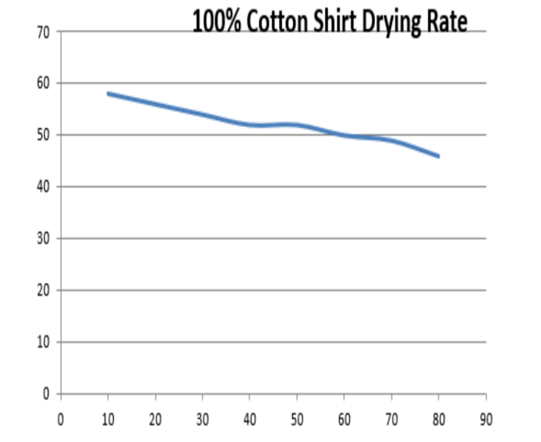
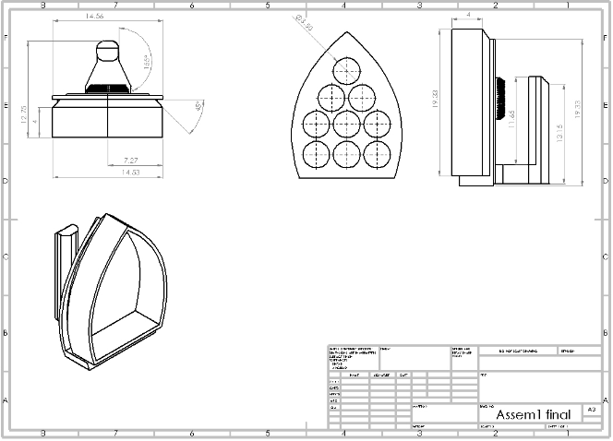
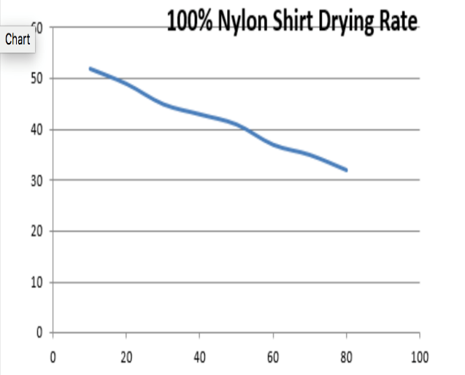
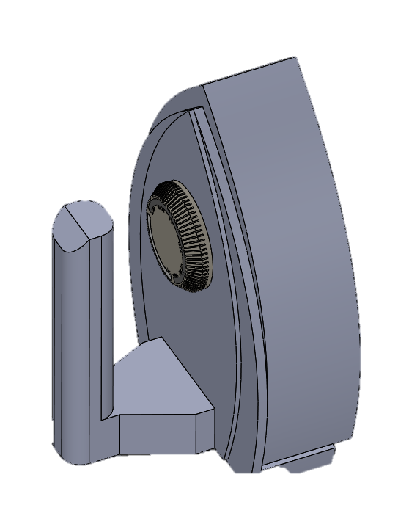
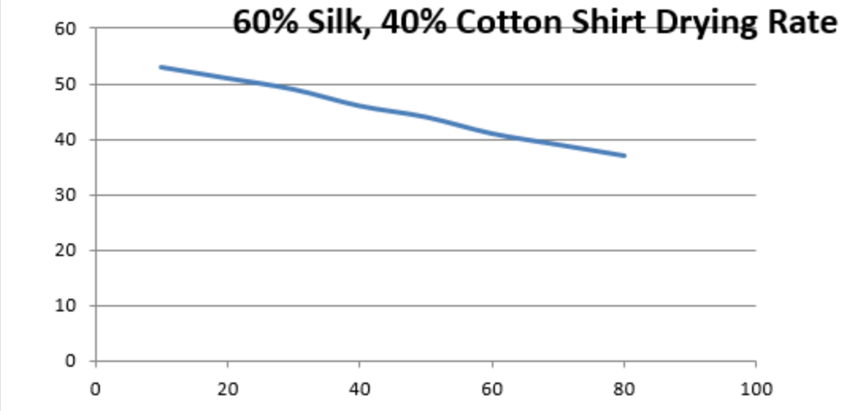
Project Summary:
It is known that ultrasounds induce vibrations to material. Initial experiments have shown that ultrasound can be used in drying clothes and cleaning engineering components. Through the same phenomenon, the idea could be commercialized into various different applications and home appliances. This project aims to design an ultrasound emitting device primarily for the use with different cloth types to both dry and straighten out creases that exists when clothes are wet. The device will initially be tested on wet fabrics, where a 99% energy saving is expected. The components will be subjected to long exposure to the ultrasounds and the effect on them will be studied.
Design
Results
Engineering Standers
- IEEE 1452 Smart Transducer.
- ISP/TC 61 Plastic Standards.

Slide 2

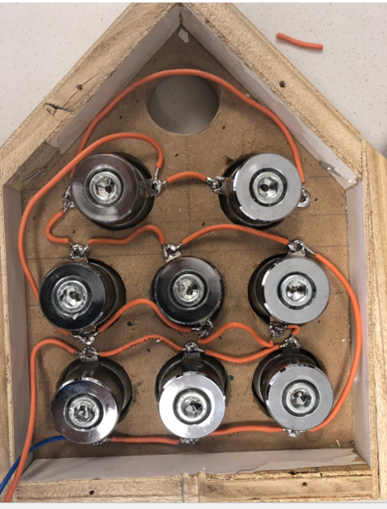

Prototype
Project Relevance
Reduce energy consumption
Cheaper manufacturing
Aligns with vision 2030
Increasing drying efficiency
Collage of Engineering
Mechanical Engineering Department
Acknowledgments
Ultrasound Drying
Objectives
We’d like to express our deepest gratitude to Dr. Panos and Dr. Nader Swalhi. They have been more than supportive and were always there when we needed them. Without their guidance, this project wouldn’t have been possible. We’d also like to thank the Prince Mohammad Bin Fahd university, for giving us this opportunity to apply our knowledge in a practical manner.
Student Name
Khalil Alabbasi
Mohammed Alotaibi
Abdulaziz Homaidan
Mohammed Yousef
Musaab Alkhaldi
ID
201400071
201100964
201301605
201301735
201302447
- To create an energy efficient iron that uses ultrasound waves.
- To allow for ease of use for consumers.
- To find an alternative means to heat generated household items.
Advisor : Dr. Panos Sphicas
Notes:
To change this brochure, replace our sample content with your own. Or, if you'd rather start from a clean slate, press the New Slide button on the Home tab to insert a new page. Now enter your text and pictures in the empty placeholders. If you need more placeholders for titles, subtitles or body text, copy any of the existing placeholders, then drag the new one into place.
And did you notice we made fold marks for you? They are really light, but if you don’t like them showing on your brochure, select and delete them before you print.

