Slide 1
Design and Manufacturing of an improved Car Wiper Mechanism
SUPERVISOR: Dr. Muhammad Asad
Co SUPERVISOR: Dr. Nader Sawalhi
1. Abdulaziz Alshehri* - 201201996
2. Abdullah Alshammari - 201202417
3. Abdulmohsen Alkhaldi - 201200454
4. Faleh Aldossary -201202444
5. Abdulhadi Abdullah -201300520

Slide 2
Outline
Project Objectives
Background, Motivation and relevance
Design Constraints Engineering Standards
Conceptual Design Theoretical Calculations and Fabrication
Design specifications and item selection
Experimental Setup, Testing and Results
Conclusions and Future work

Slide 3
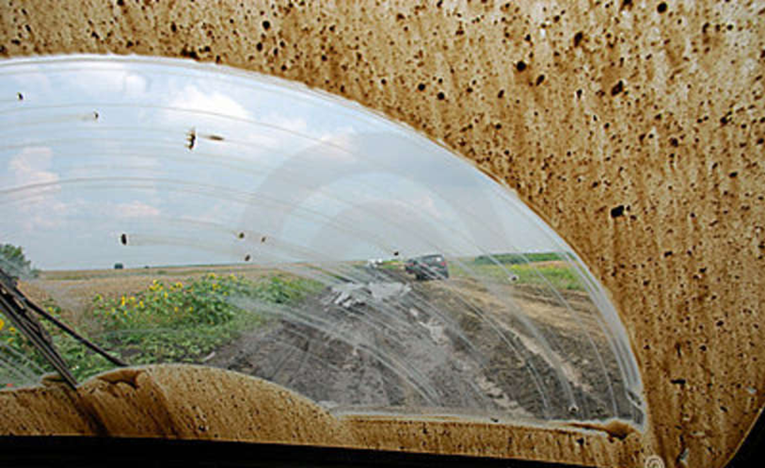
Project Objectives
Design an improved car wiper.
Produce a CAD model. for the new design.
Manufacturing a prototype.
Test and evaluate the prototype.

Slide 4
Background, Motivation and relevance
Developing and improve the mechanism of the wiper.
Function of car wiper in regular mechanism which does not clean whole windshield and how it is improved by our project.
Our design to cover the whole area of the windshield.
Using extra wiper to clean the complete area.
Our project can increase the safety of the driver.
Our design is friendly with the environment because it dose not cause pollution or any negative side.

Slide 5
Design Constraints Engineering Standards
Sustainability
Environmental
Social

Slide 6
Design Constraints Engineering Standards
Economic
Manufacturability
Safety

Slide 7
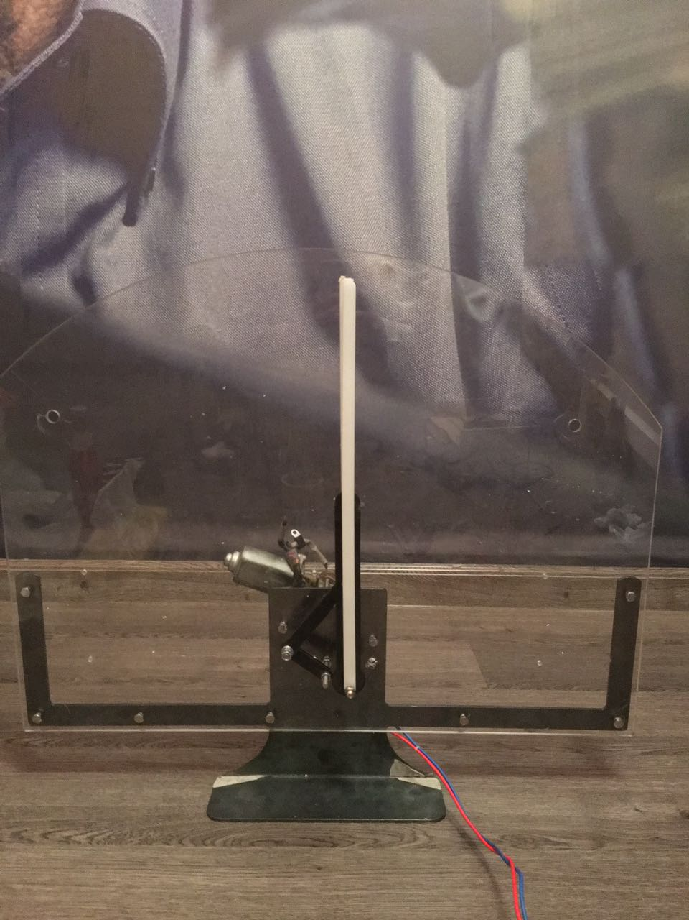
Design Constraints Engineering Standards
Engineering Standards | Components
Acrylic | Windshield
Mild Steel. st37 | Slotted slider crank
Polycarbonate | Wipers

Slide 8
Conceptual Design Theoretical Calculations and Fabrication
We used (slotted slider crank mechanism)
Other alternatives such as:
Cam shaft mechanism
Rack & Pinion mechanism

Slide 9
Conceptual Design Theoretical Calculations and Fabrication

Slide 10
Conceptual Design Theoretical Calculations and Fabrication

Slide 11
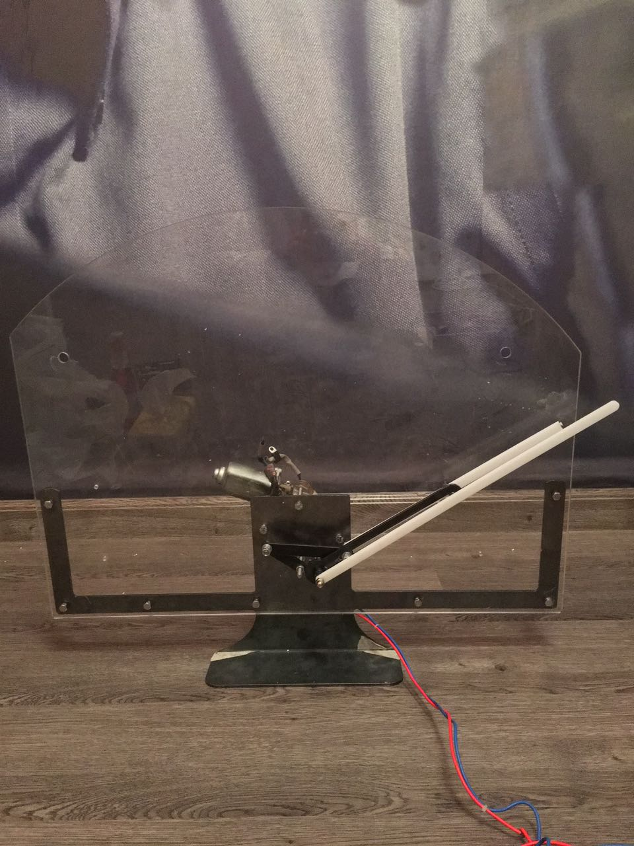
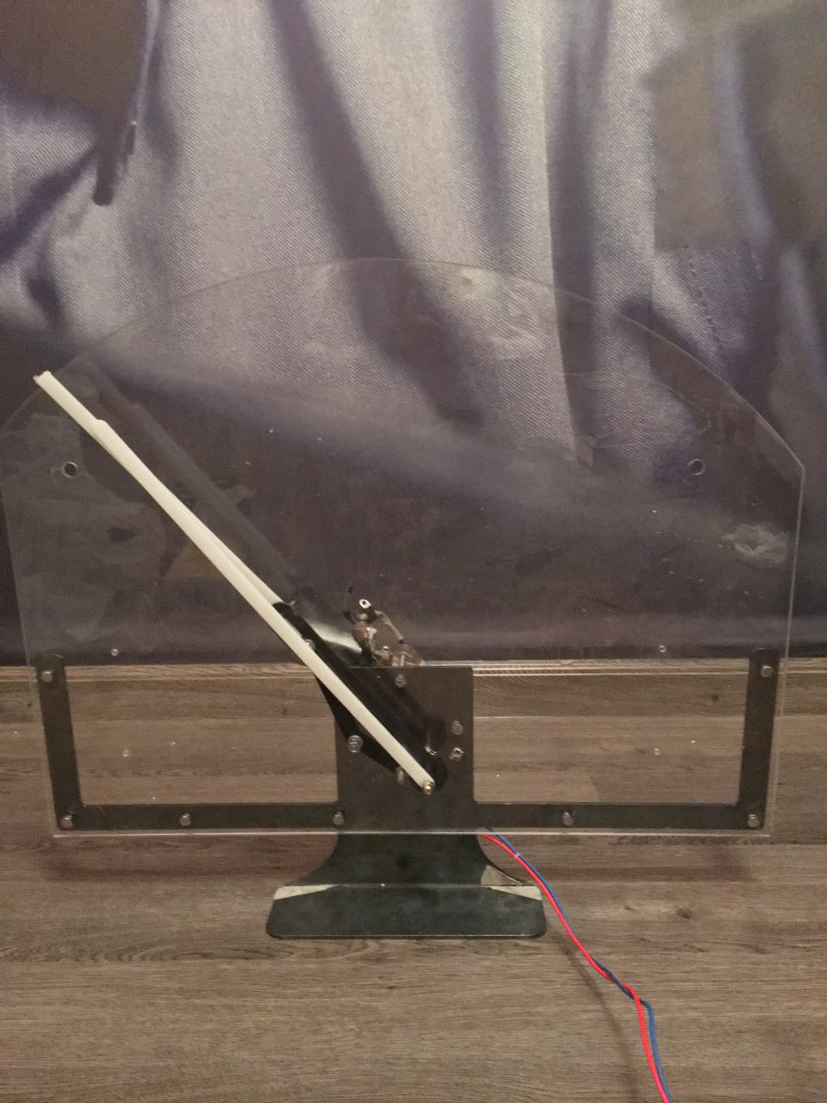
Conceptual Design Theoretical Calculations and Fabrication
18.5 cm
16 cm

Slide 12
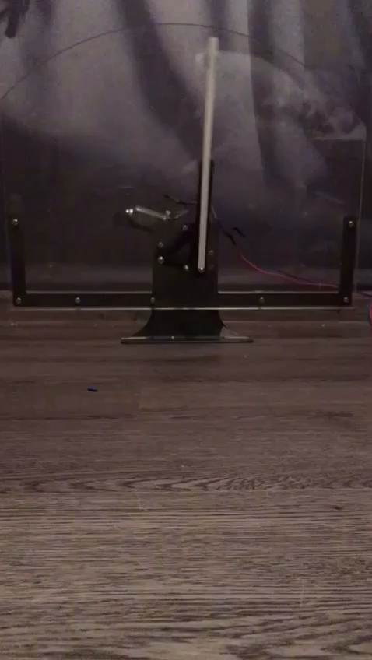
Conceptual Design Theoretical Calculations and Fabrication

Slide 13
Design specifications and items selections
Motor
Windshield
Slotted slider crank
Wipers

Slide 14
Experimental Setup, Testing and Results
Bringing the original car wiper mechanism.
Designing out new mechanism and add it to the original mechanism.
Assemble the components of the design project.
Using a motor of 12V , 2.4 A for both wipers
Making a base that holds our mechanism and the motor.
Test the design and make sure that it is working.
The results of this project achieved by clearing the uncover area of the windshield.

Slide 15
Experimental Setup, Testing and Results

Slide 16
Conclusions and Future work
Install another motor that rotates the small link.
Use 360 degree motor for extend the wiper twice in the travel.
Make the extension wiper on the same shaft with the original mechanism.

Slide 17
Thank you for listening !

