Slide 1

DESIGN OF Dynamometer for engine testing
Team 10
Mechanical Engineering Assessment III
Mid Term Presentations Schedule
SPRING 2017/2018
SALEH SAMHOOD 201201571
MOHAMMED ABU ALSAUD 201302399
RAYAN ABABUTAIN 201200459
HASSAN ALWAYAL 201200150
IBRAHIM ALOREIFEJ 201200230
Advisor: Dr. Panos Sphicas
Co-Advisor: Essam Jasim

Slide 2
Outline
Project objectives.
Background, motivation, and relevance.
Design:
- Specification
- Conceptual design
- Theoretical Calculations
- Fabrication
Results and future work.

Slide 3
Project objectives
Design and build a dynamometer (shaft, breaks, safety cover, and bearings).
Develop the instrumentation of the dynamometer (force gage, rotational speed meter and optical thermometer).
Test the dynamometer.
Measure break engine power output.
Notes:
Here are our objectives:
1) The first objective of our project is we want to reduce humidity without using refrigeration system, but only heat addition.
2) Second, Introduce silica gel as a desiccant dehumidifier material.*
3) Third, we aim to use the silica gel as a medium to reduce humidity.
4) After achieving the above objectives our ultimate goal is to incorporate the dehumidifier into the evaporative air conditioner system in the humid region.

Slide 4
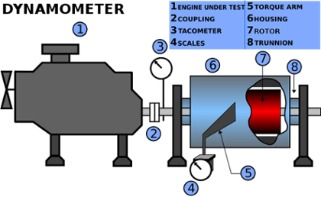
Background
A dynamometer, or "dyno" for short, is a device for measuring force, moment of force (torque), or power. For example, the power produced by an engine, motor or other rotating prime mover can be calculated by simultaneously measuring torque and rotational speed (rpm).

Slide 5
Background
Reason
Experimenting new concept
Revelozinazation dynamometer.
Benefits
Having better control of the breaking technology.
Safety
Increasing efficiency and Reduce power consumption .
Improve weighing machine

Slide 6
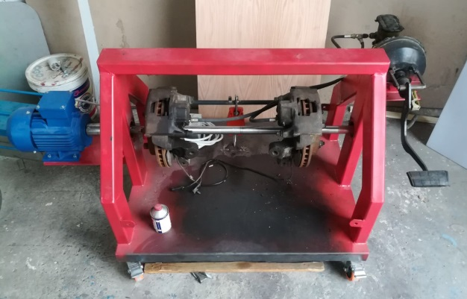
MOTIVATION & RELEVANCE
Use in industrial
Automotive testing
Engines
Use in sport workshops
Performance testing

Slide 7
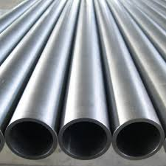
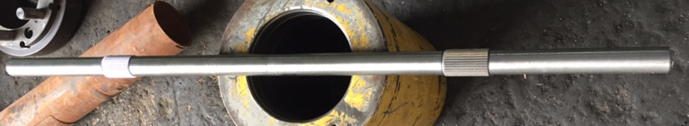
DESIGN SPECIFICATION
AISI 1020 steel
High machinability, high strength and high ductility
Used for engineering parts and components, machinery parts and shafts

Slide 8
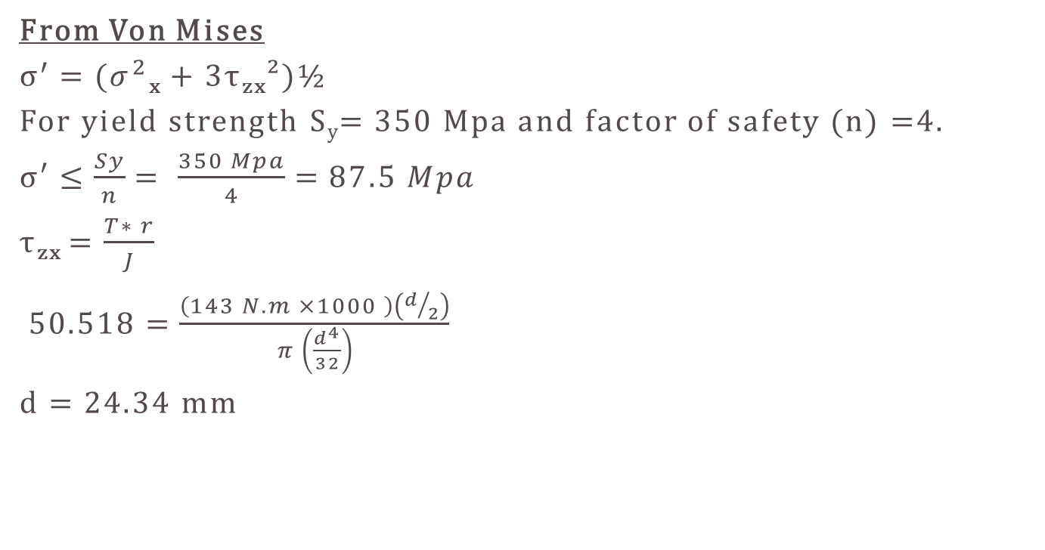
Shaft Diameter
From Von Mises
$σ^{′}=(σ^{2}$_{x} + 3τ_{zx}²)½
For yield strength S_{y}= 350 Mpa and factor of safety (n) =4.
σ′ ≤$\frac{Sy}{n}= \frac{350 Mpa}{4}=87.5 Mpa$
τ_{zx} = $\frac{T∗ r}{J}$
$50.518=\frac{\left(143 N.m ×1000 \right)\left(d/2\right)}{π \left(\frac{d^{4}}{32}\right)}$
d = 24.34 mm

Slide 9
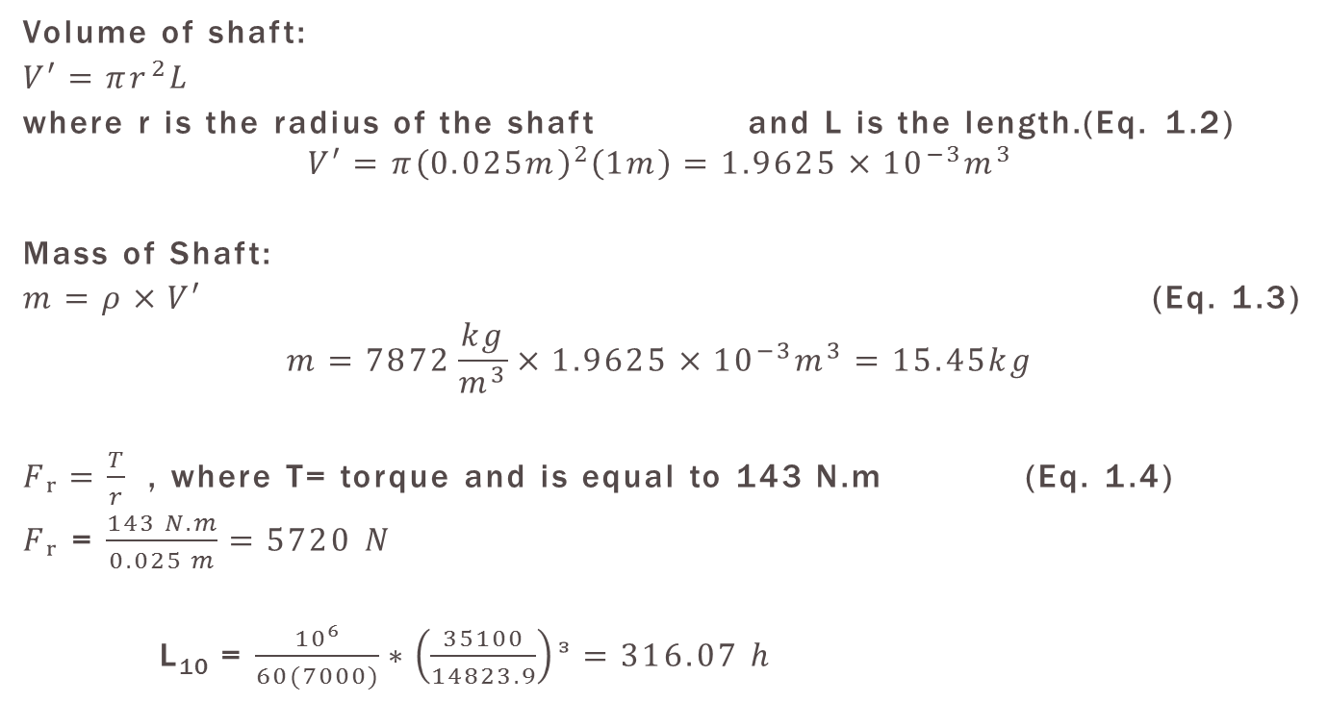
Shaft Diameter
Volume of shaft:
$V′=πr^{2}L$
where r is the radius of the shaft and L is the length.(Eq. 1.2)
$$V′=π{\left(0.025m\right)}^{2}\left(1m\right)=1.9625×{10}^{−3}m^{3}$$
Mass of Shaft:
$m=ρ×V′$ (Eq. 1.3)
$$m=7872\frac{kg}{m^{3}}×1.9625×{10}^{−3}m^{3}=15.45kg$$
$Fᵣ=\frac{T}{r}$ , where T= torque and is equal to 143 N.m (Eq. 1.4)
$Fᵣ$ = $\frac{143 N.m}{0.025 m}=5720 N$
L₁₀ = $\frac{{10}^{6}}{60(7000)}∗\left(\frac{35100}{14823.9}\right)ᵌ=316.07 h$

Slide 10
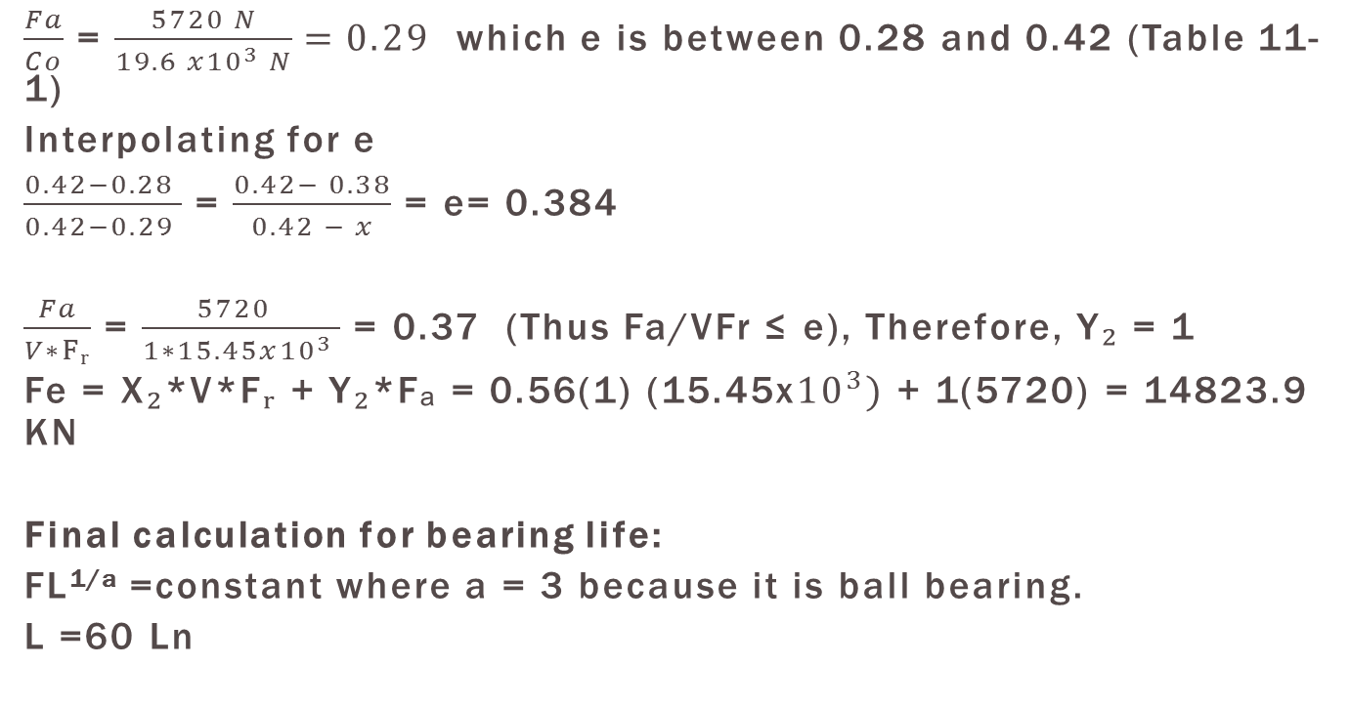
Bearing calculation
$\frac{Fa}{Co}$ = $\frac{5720 N}{19.6 x{10}^{3} N}=0.29$ which e is between 0.28 and 0.42 (Table 11-1)
Interpolating for e
$\frac{0.42−0.28 }{0.42−0.29 }$ = $\frac{0.42− 0.38}{0.42 − x}$ = e= 0.384
$\frac{Fa}{V∗Fᵣ}$ = $\frac{5720 }{1∗15.45x{10}^{3} }$ = 0.37 (Thus Fa/VFr ≤ e), Therefore, Y₂ = 1
Fe = X₂*V*F$ᵣ$ + Y₂*Fₐ = 0.56(1) (15.45x${10}^{3})$ + 1(5720) = 14823.9 KN
Final calculation for bearing life:
FL^{1/a} =constant where a = 3 because it is ball bearing.
L =60 Ln

Slide 11
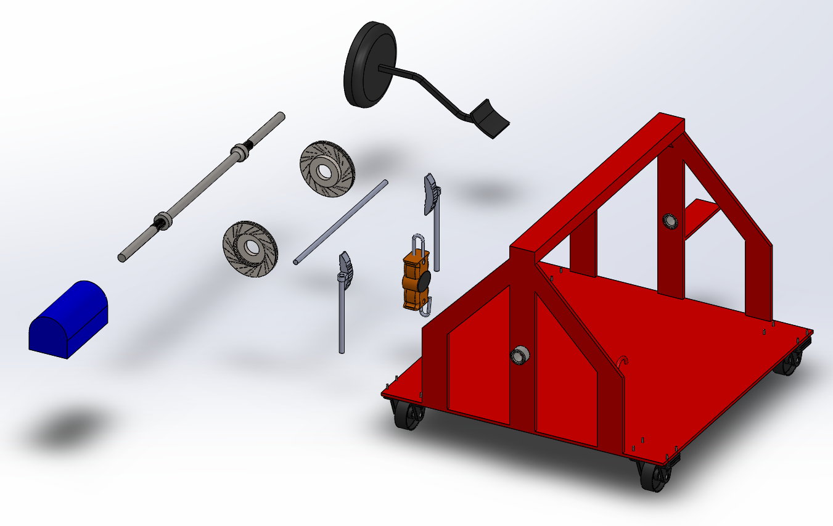
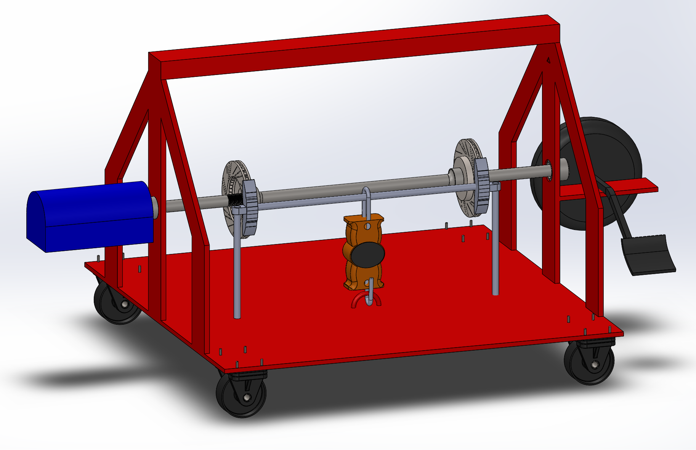
Conceptual design
Exploded View
Collapsed View

Slide 12
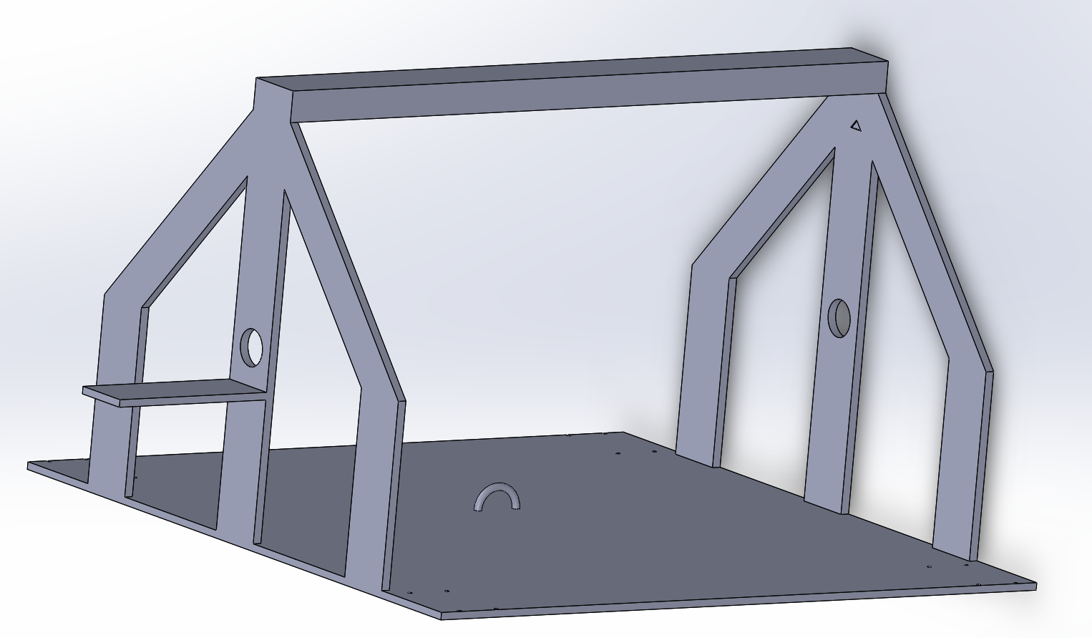
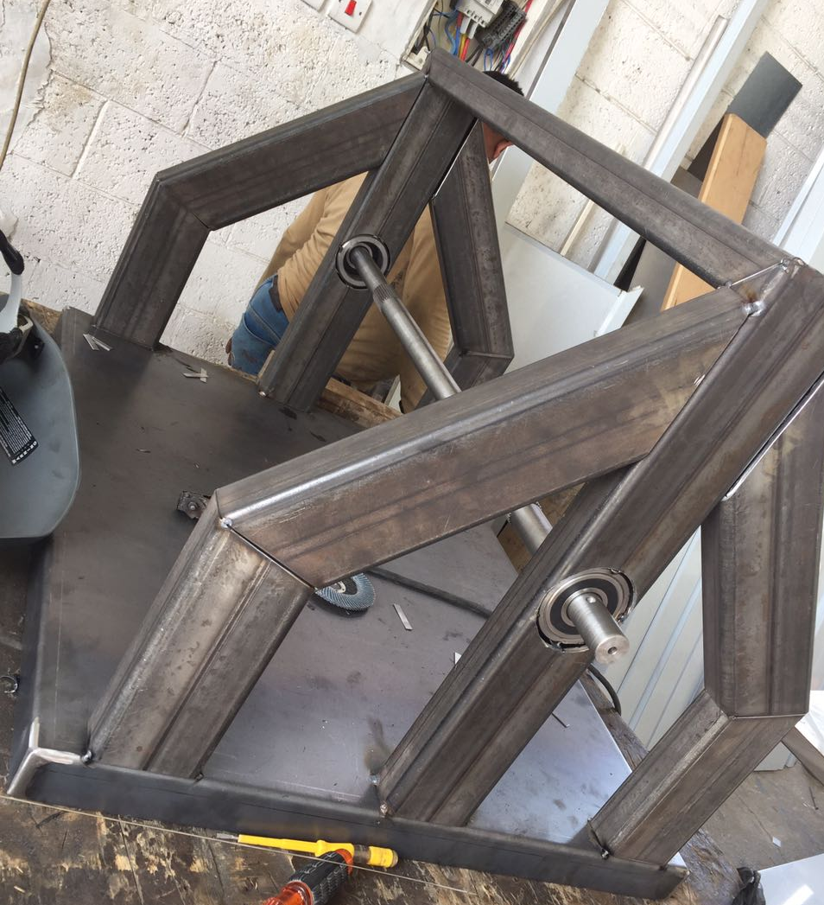
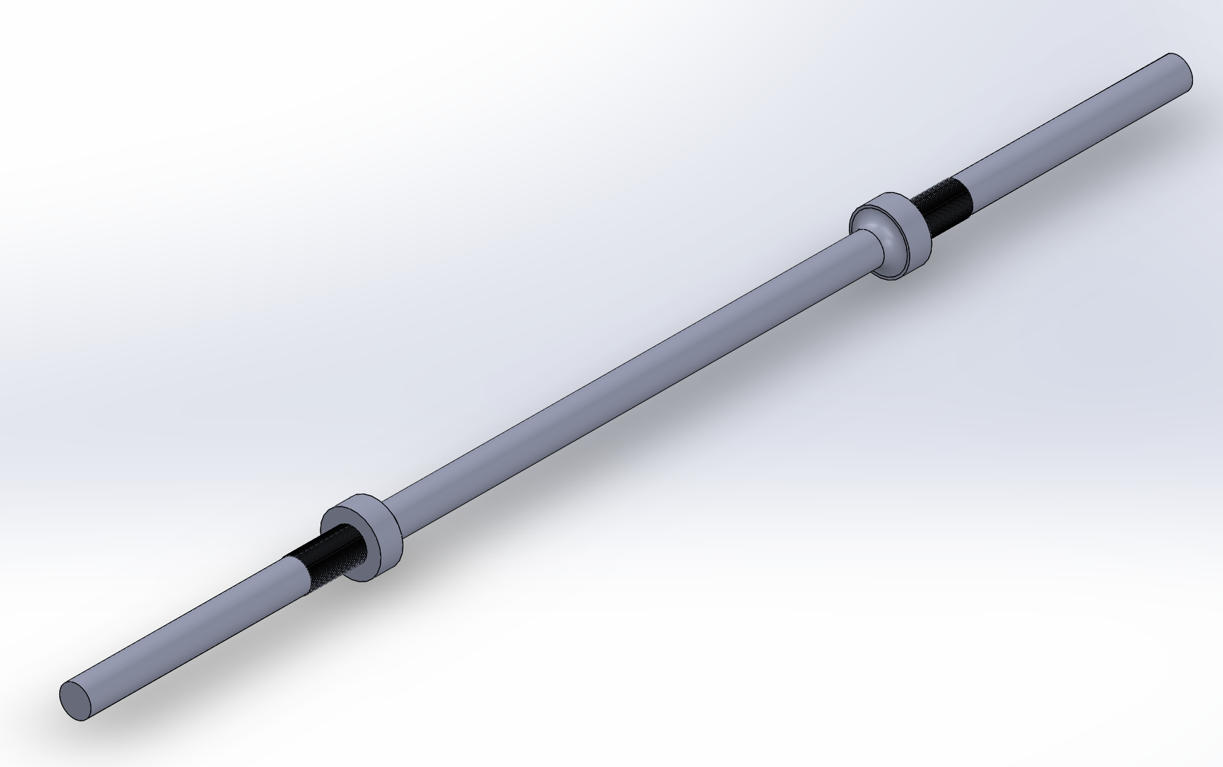
Design specification & Fabrication
Trolley & Shaft

Slide 13
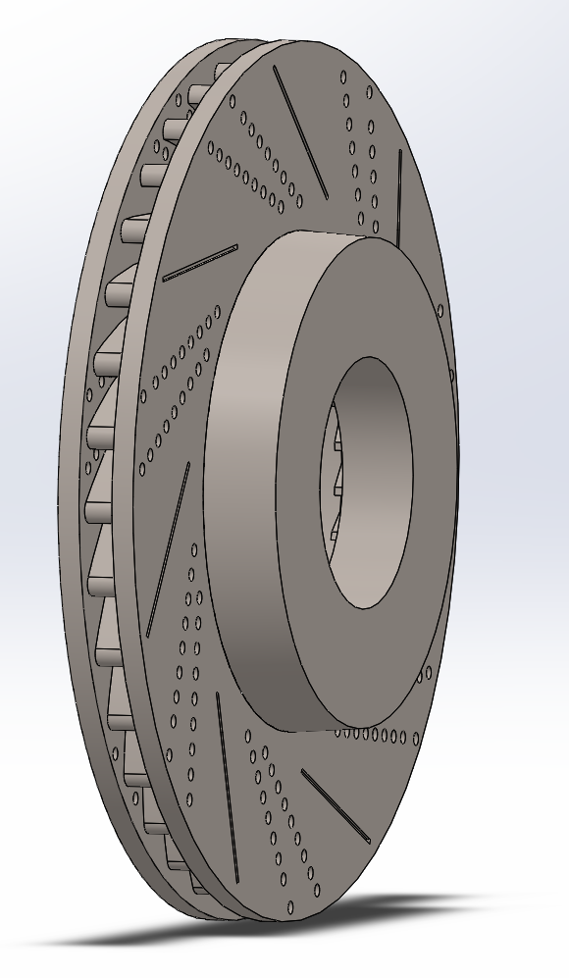
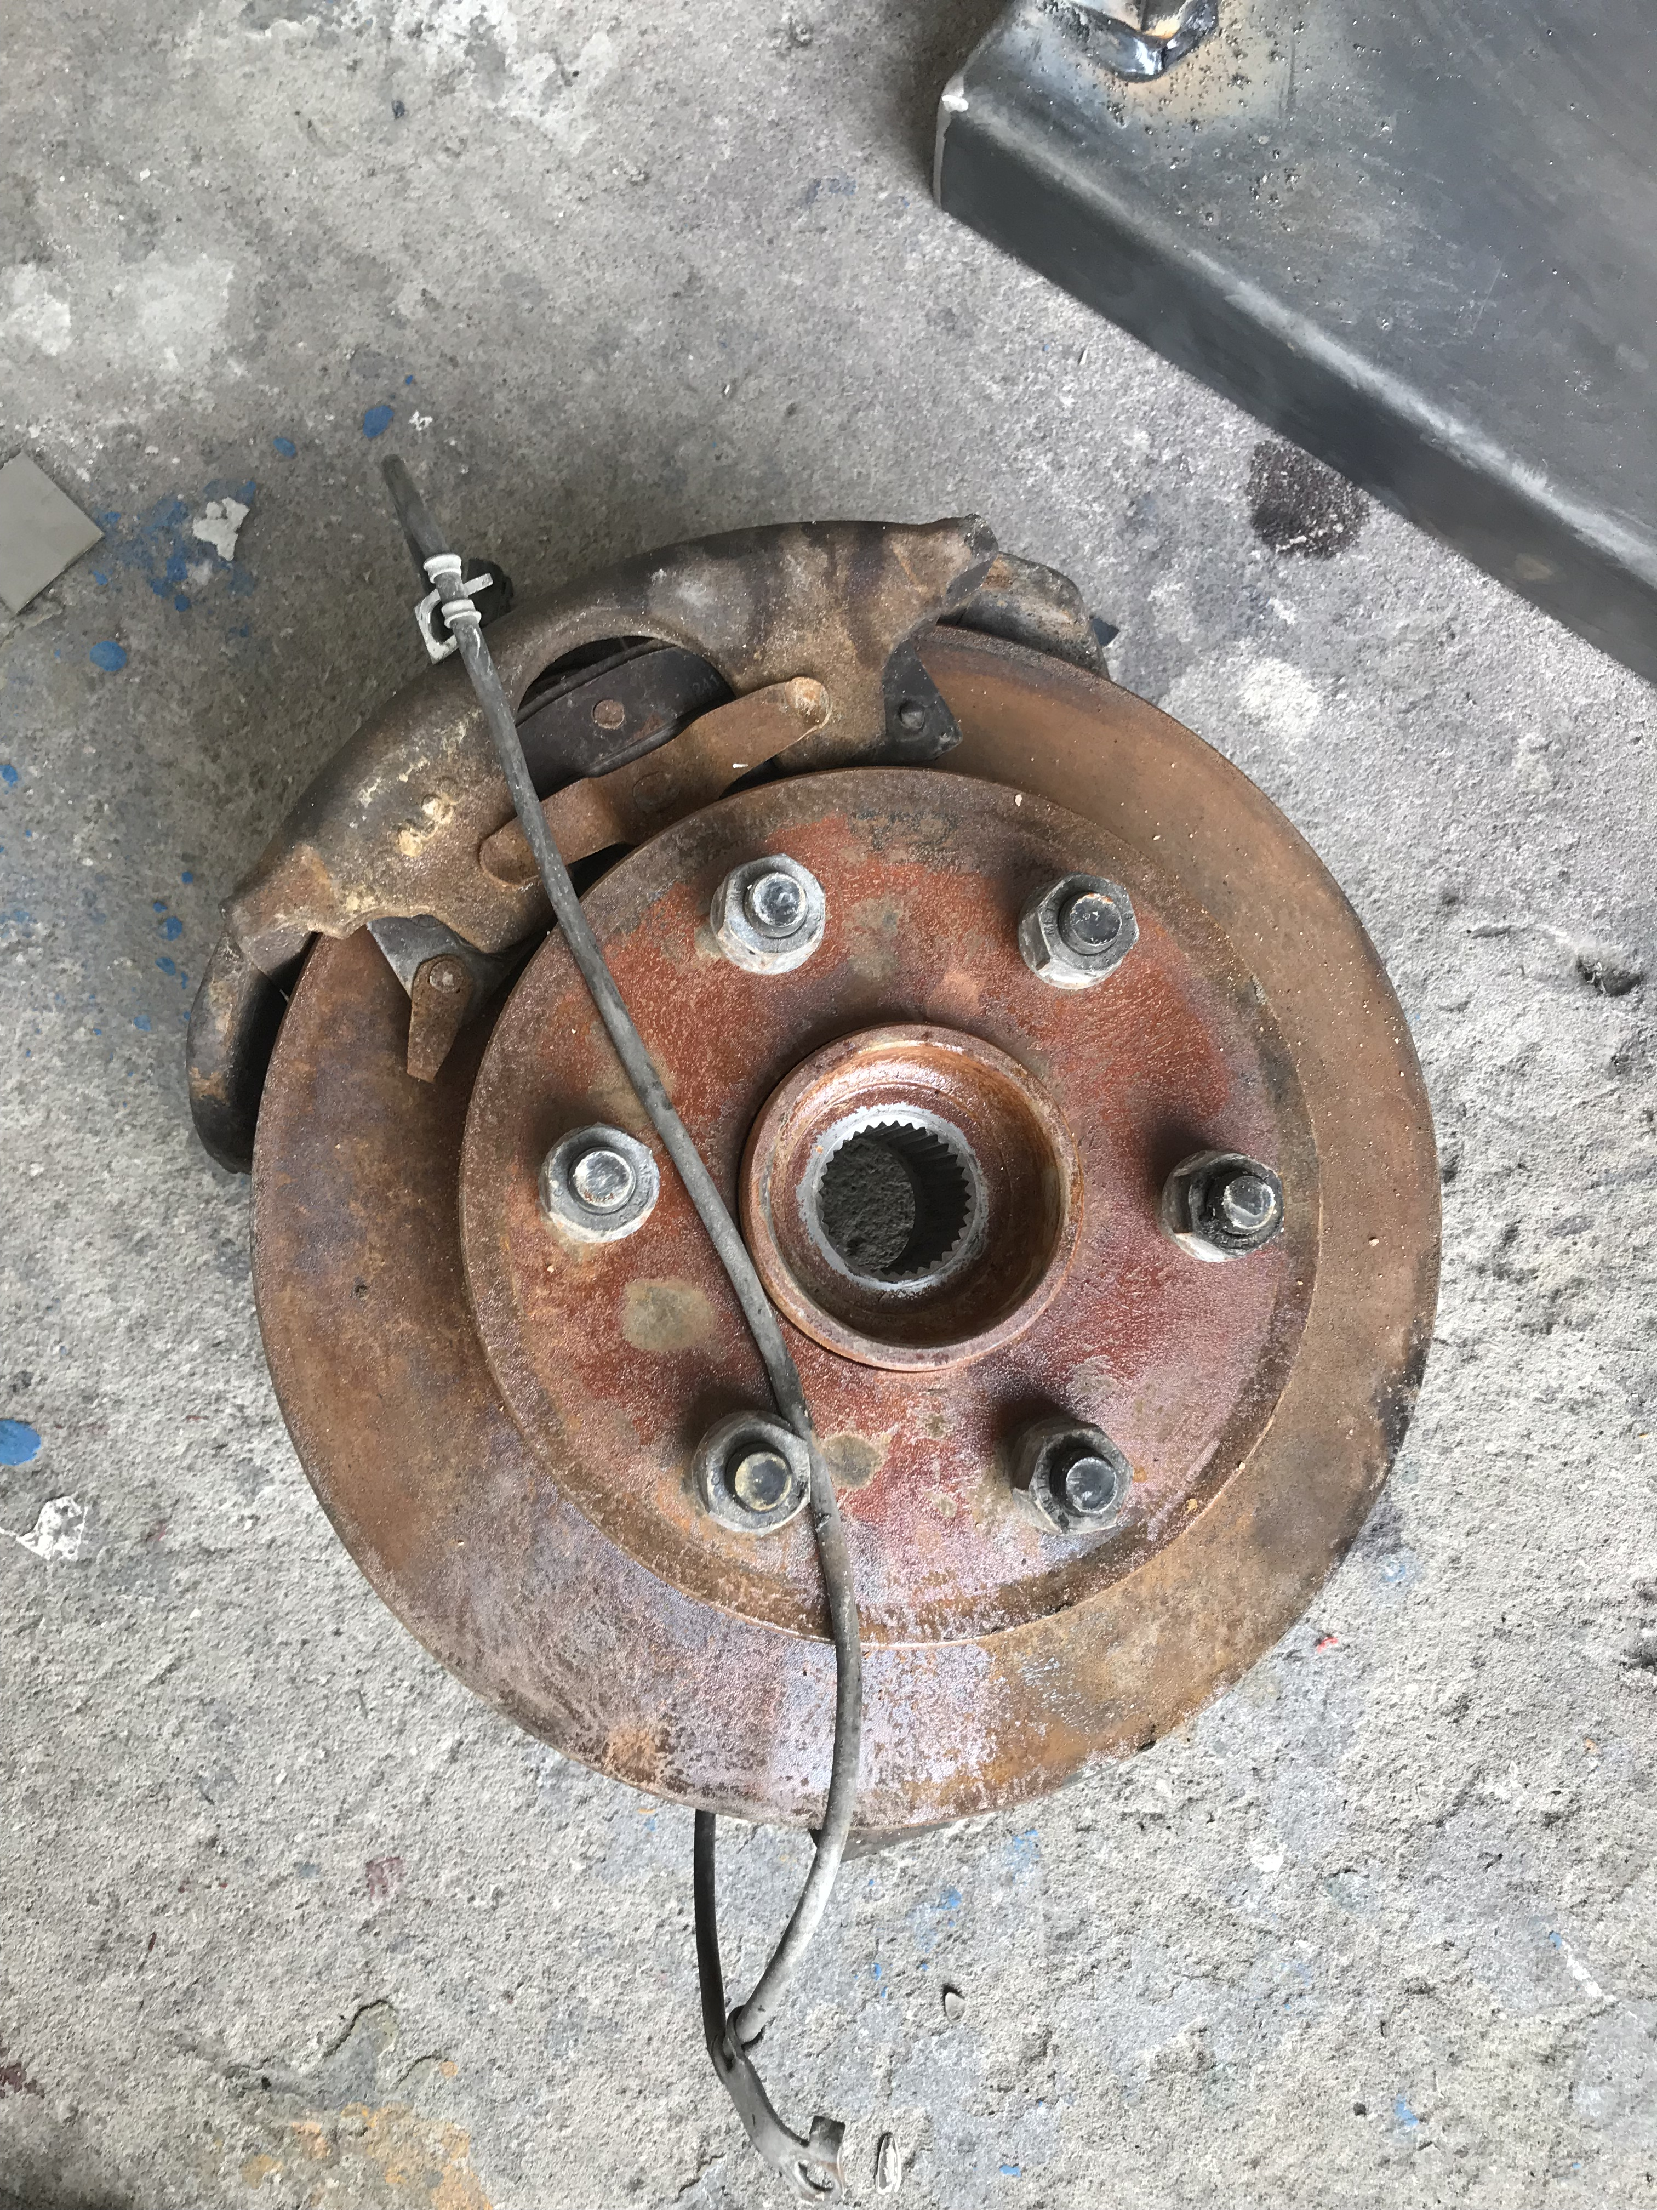
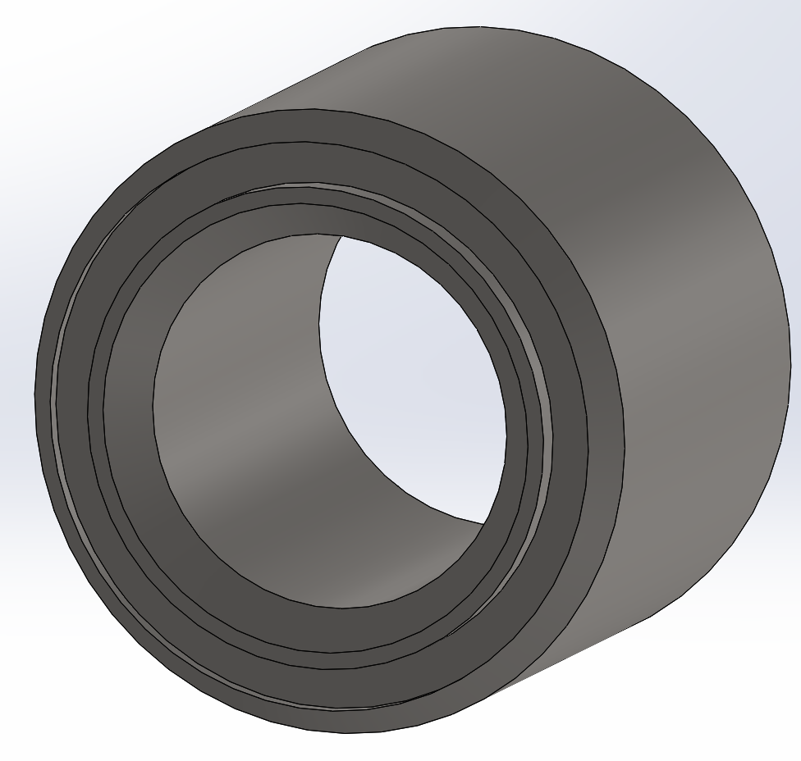
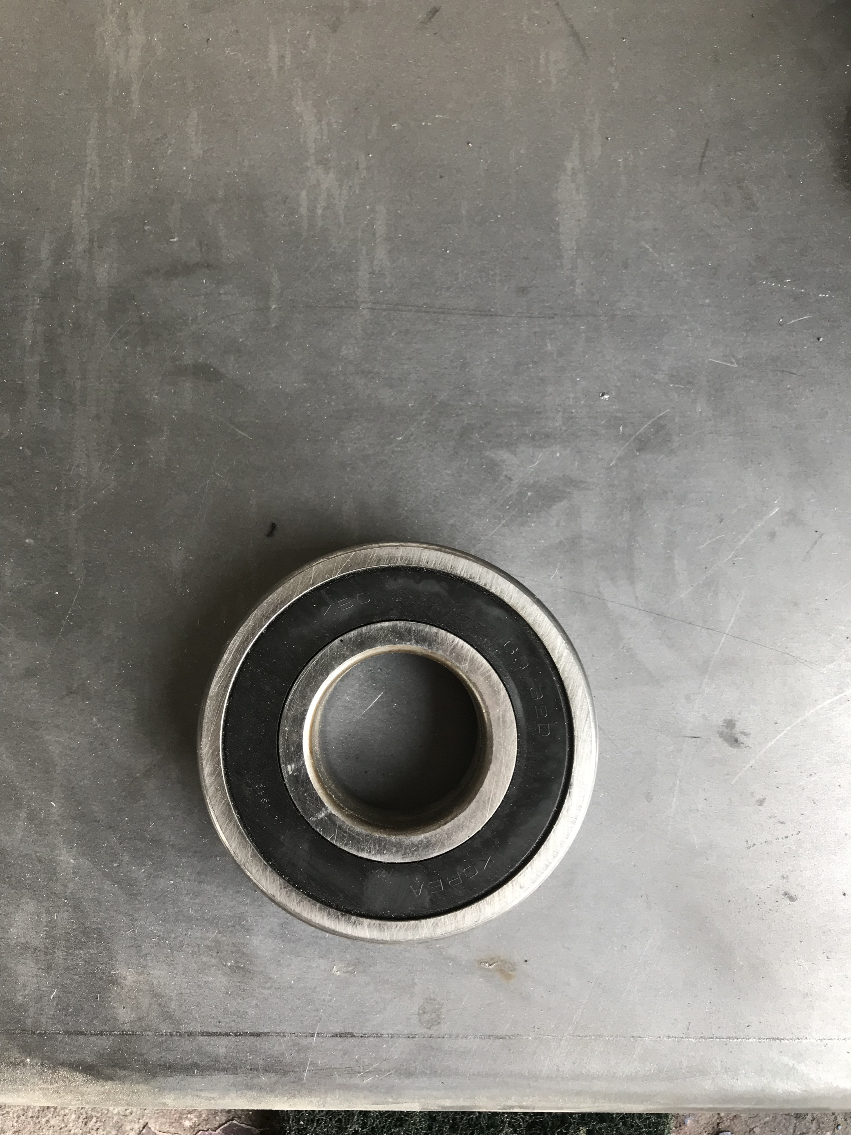
Conceptual design
Disk & Bearings

Slide 14
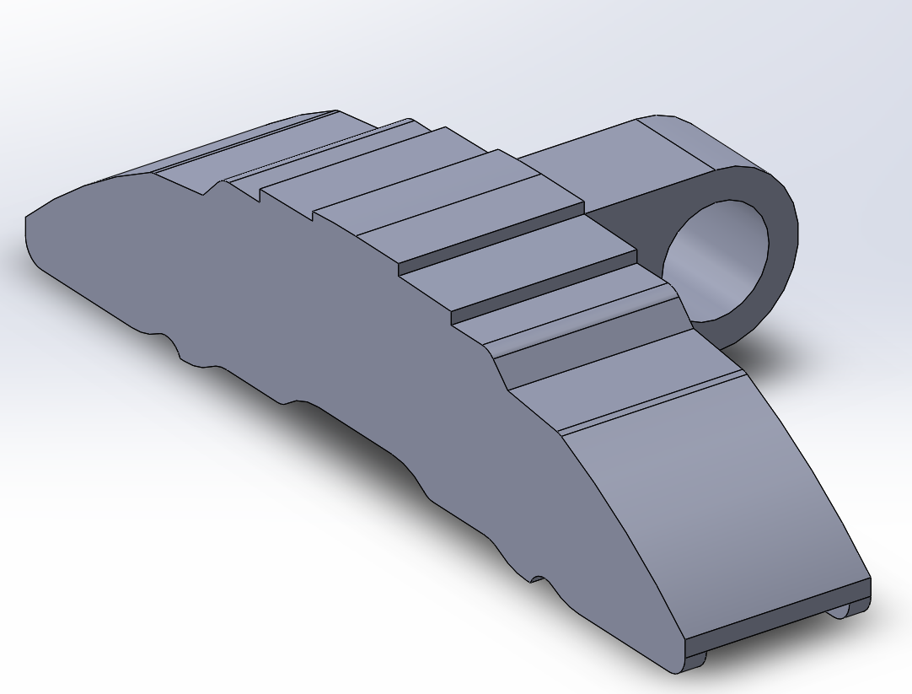
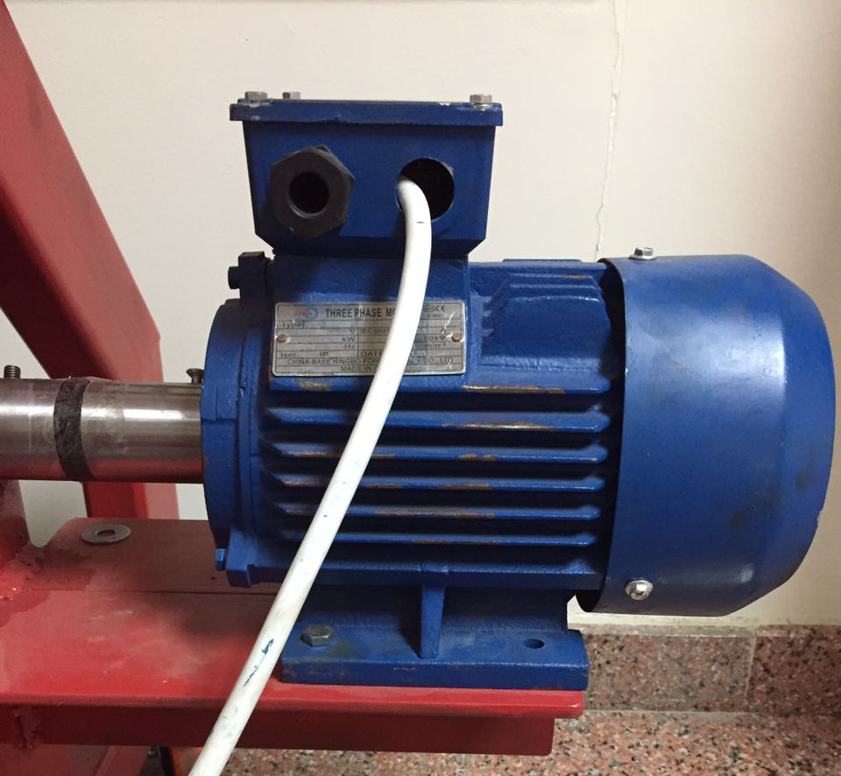
Conceptual design
Caliper & Motor

Slide 15
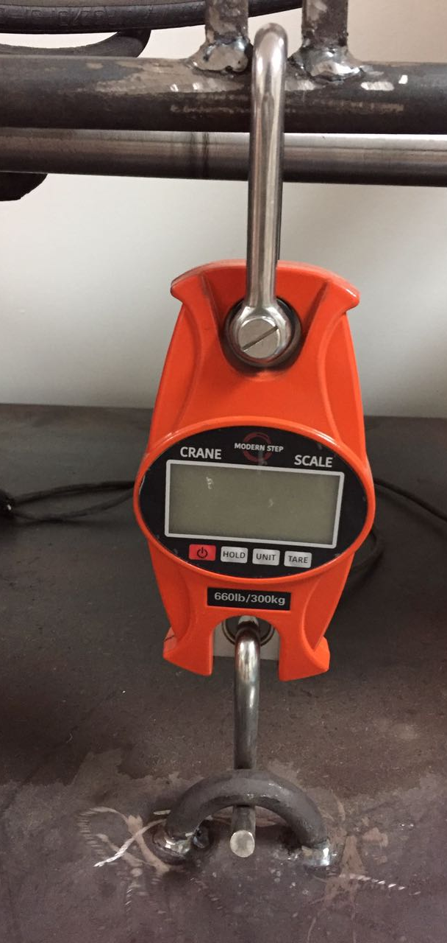
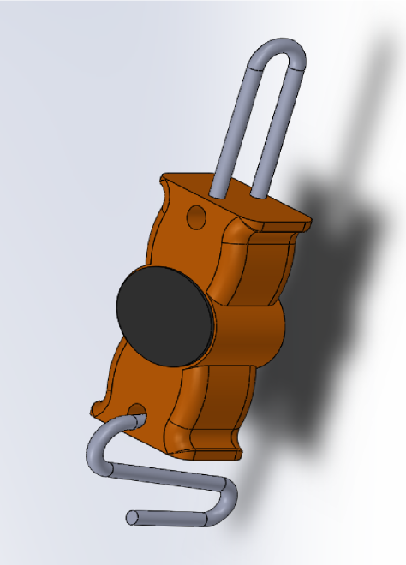
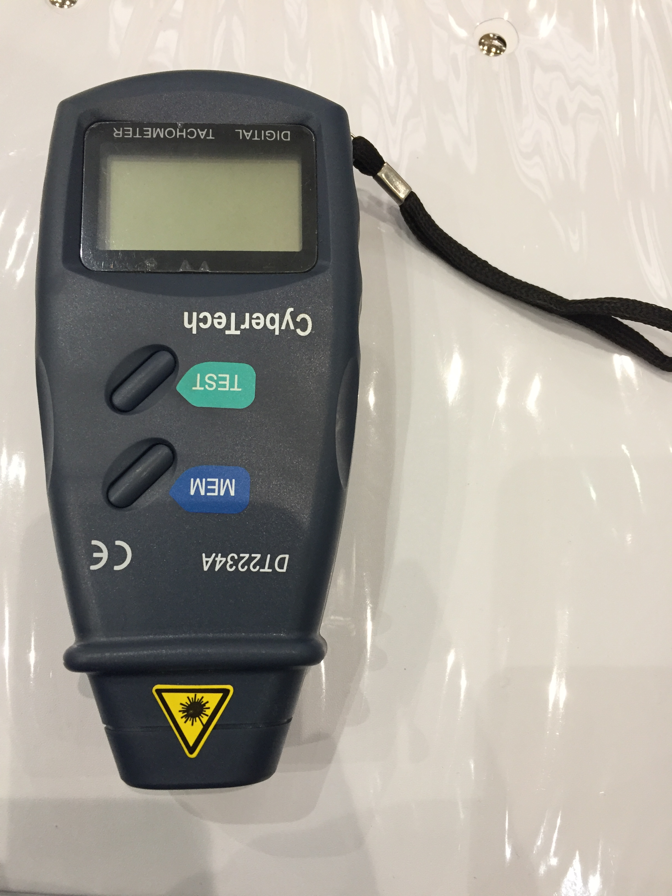
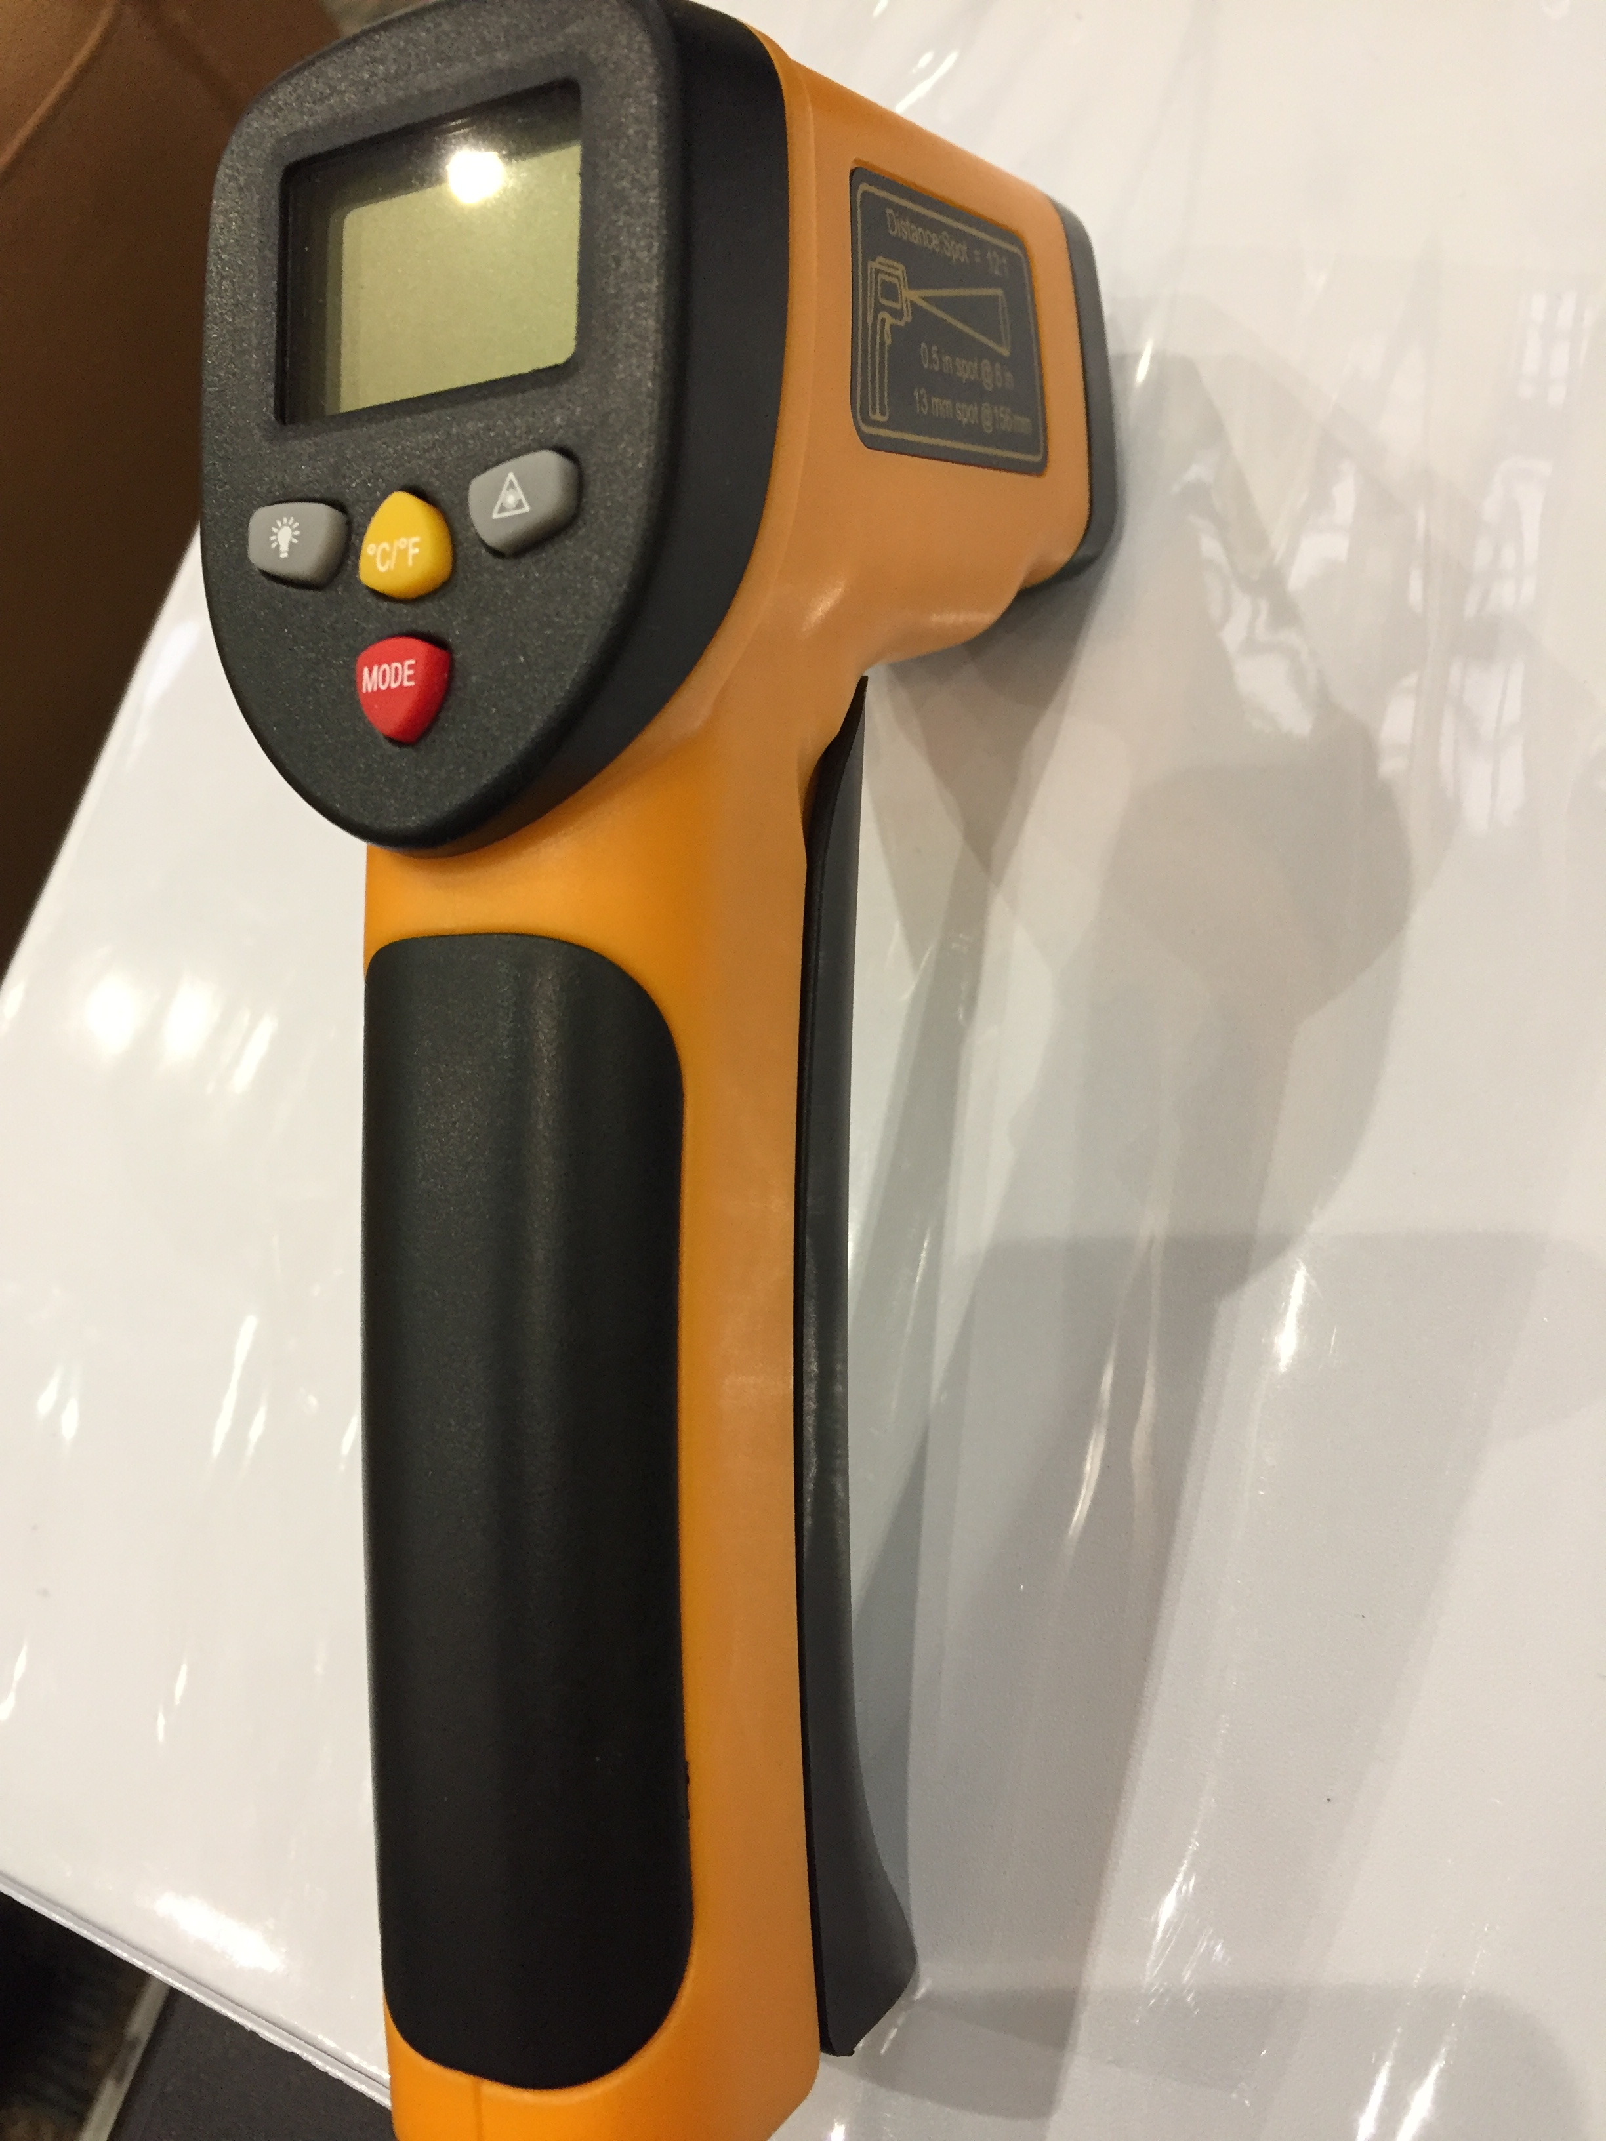
Conceptual design
Force gauge & Tachometer & Optical Thermometer

Slide 16
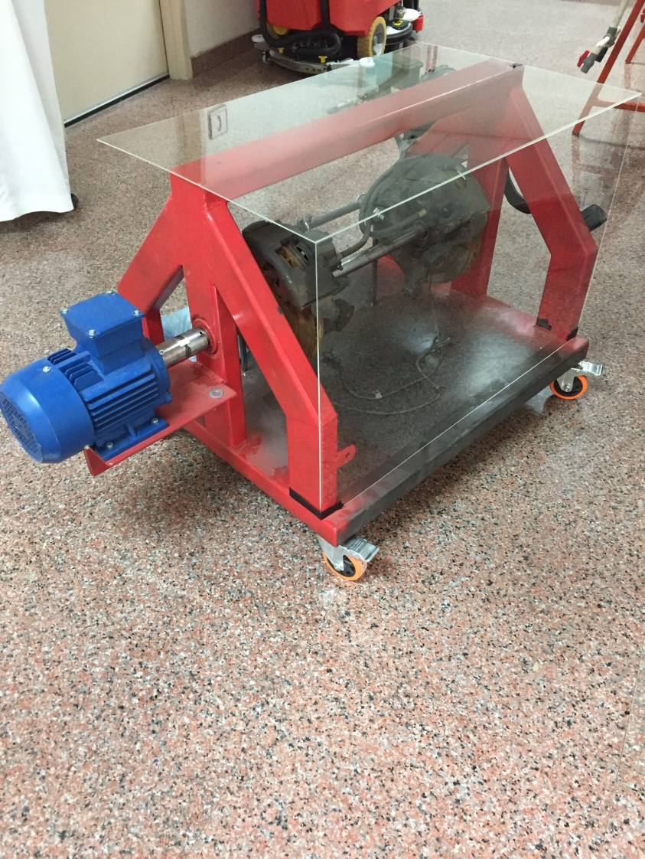
Experimental procedure
Placing the safety
Start the motor
Set the brake
Set RPM from motor controller
Measure RPM with tachometer
Measure force with force gage
Change RPM from motor controller
Repeat 4 and 5

Slide 17
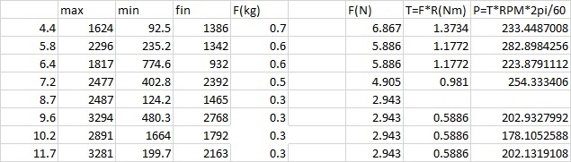
RESULTS

Slide 18
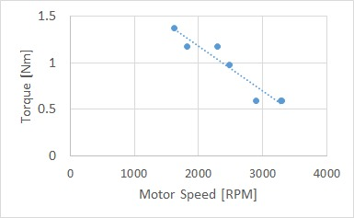
RESULTS

Slide 19
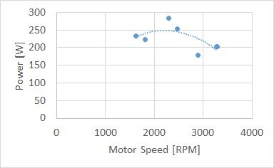
RESULTS

Slide 20
Future Work
1. fix the breaks
2. add bearing and support in the middle of the shaft
3. change the motor-shaft coupler to an elastic coupler
4. weld the force gauge on the frame of the table
5. get a better tachometer

Slide 21
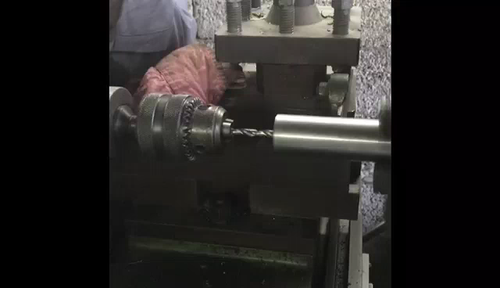

Slide 22
Questions ?
Thank you for your attention

