Slide 1

Design of an Energy-Efficient Bicycle
Team #4
Team Members:
Ahmed Mohammed 201200501
Faisal Aldosari 201200888
Abdullaziz Alshamrani 201203368
Abdulaziz Alghamdi 201102875
Muhanad Alyami 201200665
Advisor: Dr. Muhammad Asad
Co-Advisor: Dr. Nader Sawalhi

Slide 2
Outline
Objectives
Background
Design
Design specifications
Testing
Result
Summary & Recommendations

Slide 3
Objectives
Design of an energy-efficient bicycle.
Reducing the effort required for pedaling.
Motivating people to use bicycles
Extending the validity period of brakes.
Speed optimization.

Slide 4
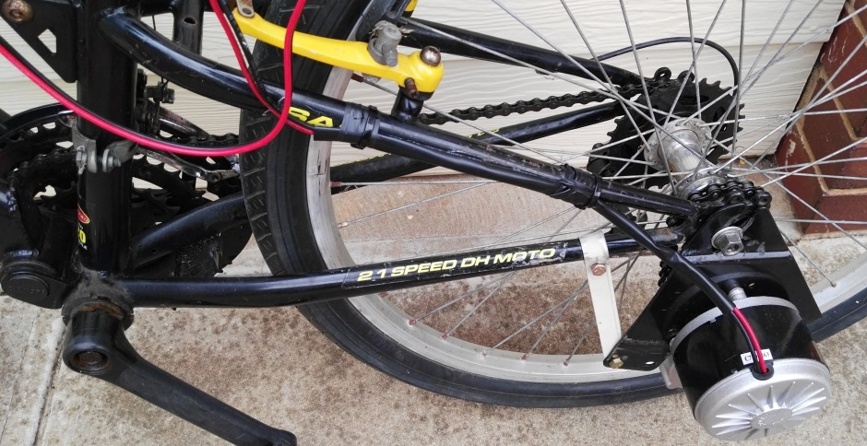
Background
Electric bicycles

Slide 5
Previous Work
A study of the power required of an electric bicycle (2017)

Slide 6
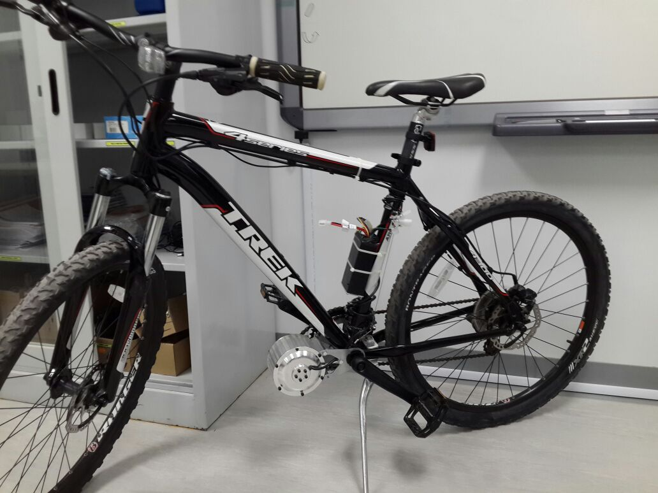
Previous Work
Inclination (%) | Speed (Km/h) | Range (Km) | Weight (Kg) | Power to overcome air resistance (W) | Power to overcome rolling resistance (W) | Power consumption (Wh/Km)
0 | 30 | 87 | 105 | 146 | 111 | 10.7
15 | 16 | 14 | 105 | 22 | 792 | 59.75
25 | 9.9 | 9 | 105 | 5 | 791 | 97.09

Slide 7
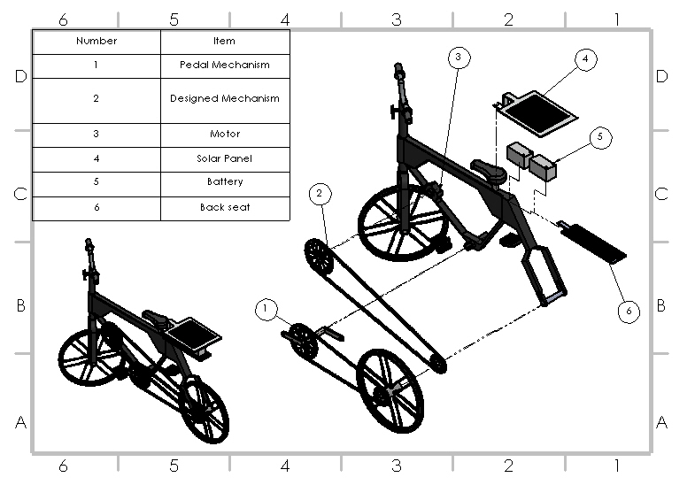
Design

Slide 8
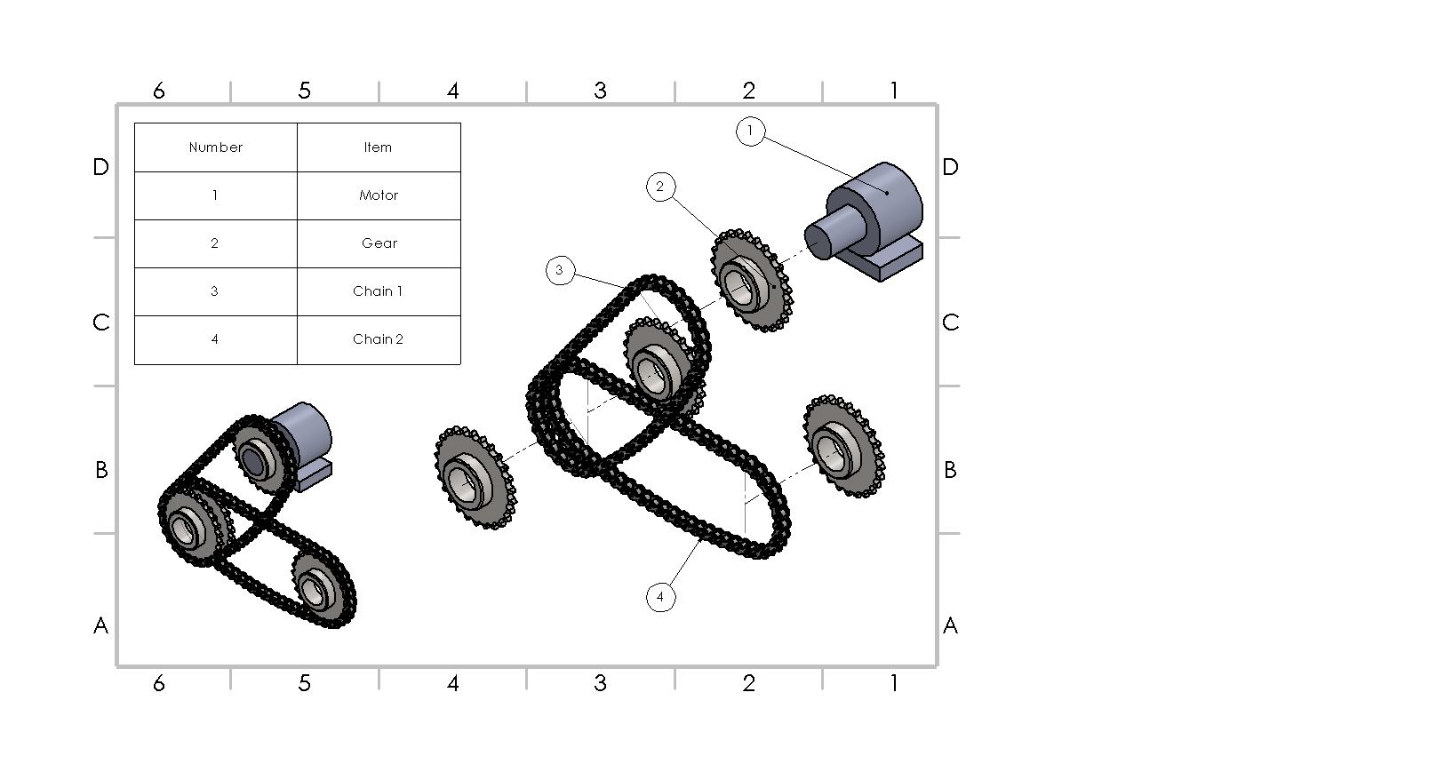
Design of Gear Mechanism

Slide 9
Design of Gear Mechanism
Term | Dimension
Teeth number of motor gear (1) | 44 teeth
Teeth number of rear gear (2) | 20 teeth
Teeth number of rear gear (3) | 16 teeth
(1)
(2)
(3)
Gear Ratio= 44/16 = 2.75

Slide 10
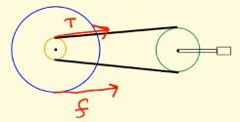
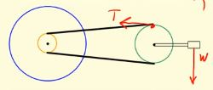
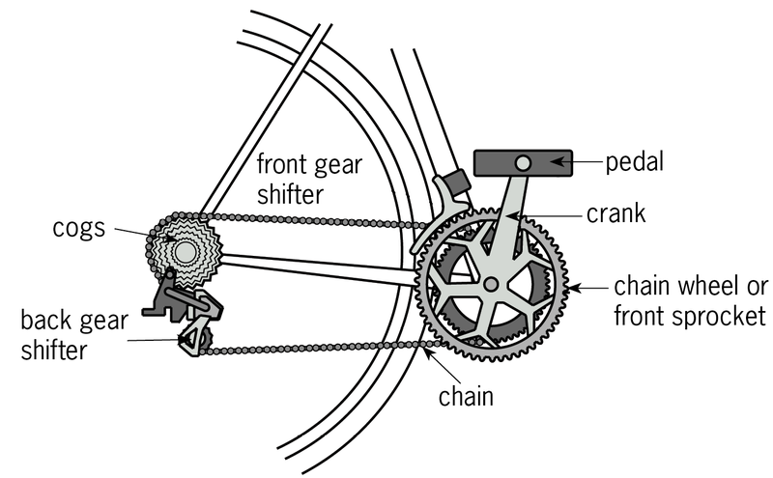

Design Calculations
Torque on Crank:
$τ_{c}$ = $R_{c}$ T - $R_{p}$ W = 919.70 N
Torque on Wheel:
$τ_{w}$ = $R_{g}$ T = 18.40 N·m
Friction:
f = $\frac{R_{g} }{R_{t}}$ T = 6.25 N

Slide 11
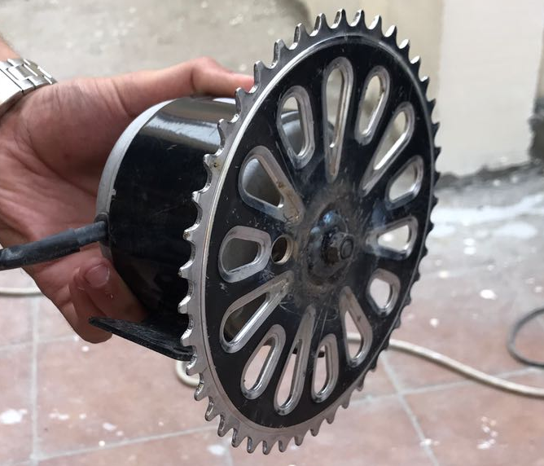
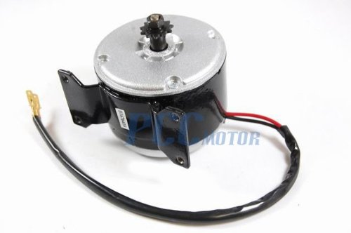
Motor Specifications
Specifications
Voltage | 24 V
Power | 280 W
Current | 15.4 A
Weight | 2.04 kg
RPM | 2750 rpm

Slide 12
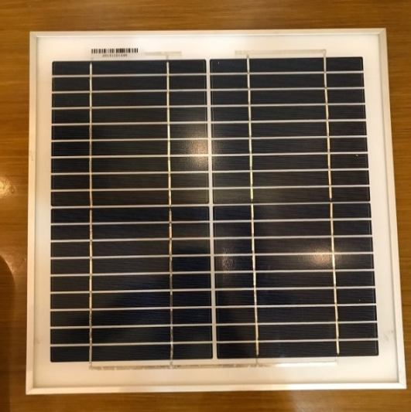
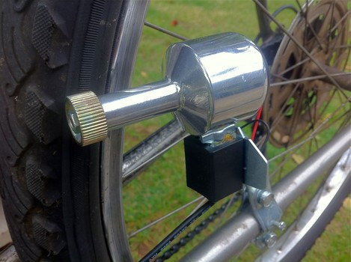
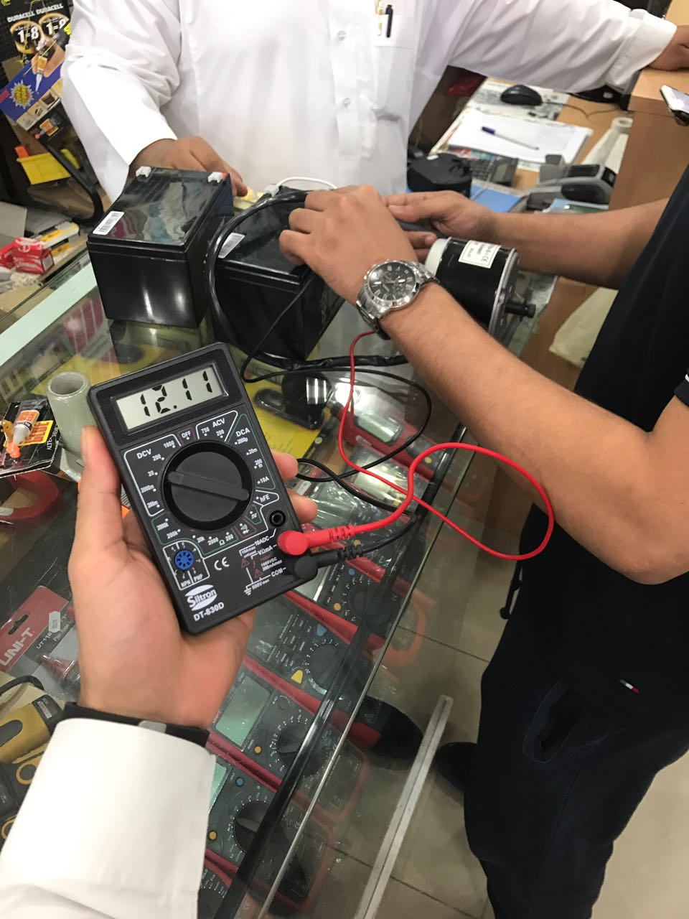
Items Specifications
Component | Specifications
Solar Panel | 10 W, 17.5 V, 0.58 A, 1.08 kg, 340x290x17 mm
Generator | 6 W, 0.4 kg
Battery | 12 V, 12 Ah

Slide 13
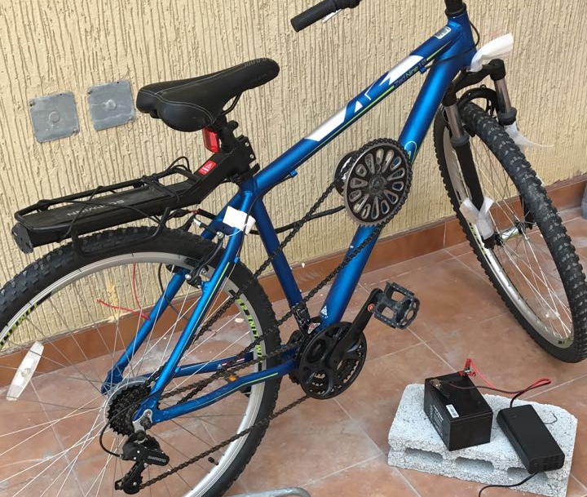
Testing & Results
First Test:

Slide 14
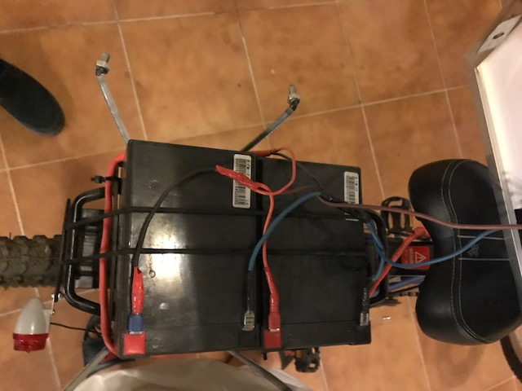
Testing & Results
Second Test:
Two batteries were connected in parallel
The wires heated
The switch was burned

Slide 15
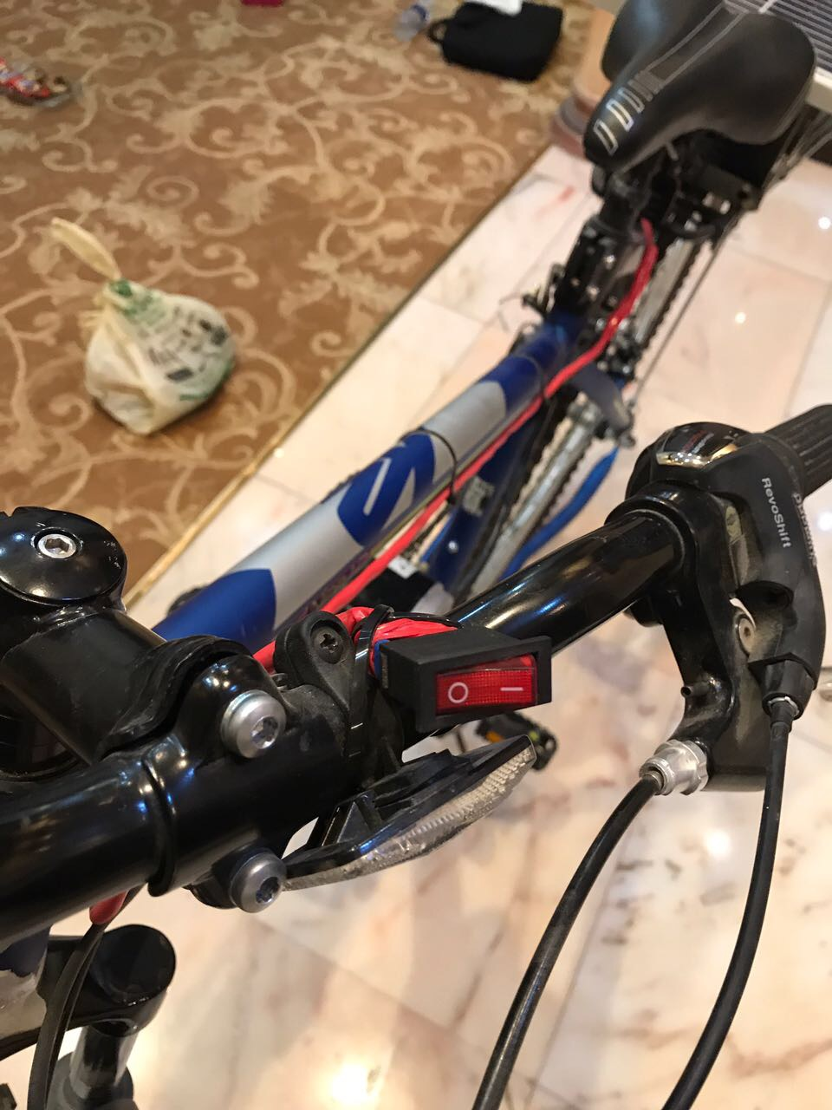
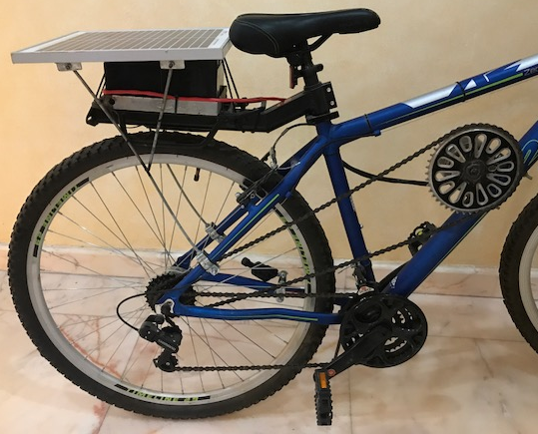
Testing & Results
Third Test:
Installed Solar panel
New Switch

Slide 16
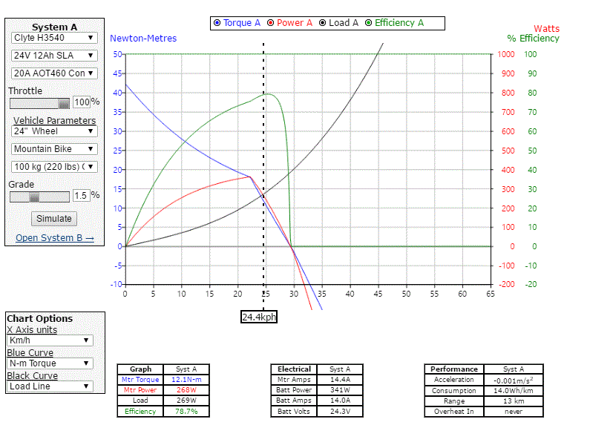
Overall Results

Slide 17
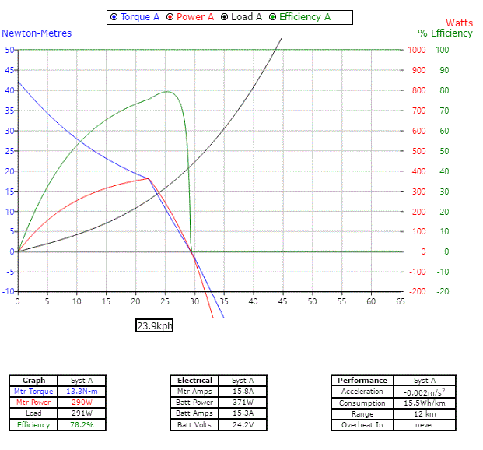
Overall Results

Slide 18
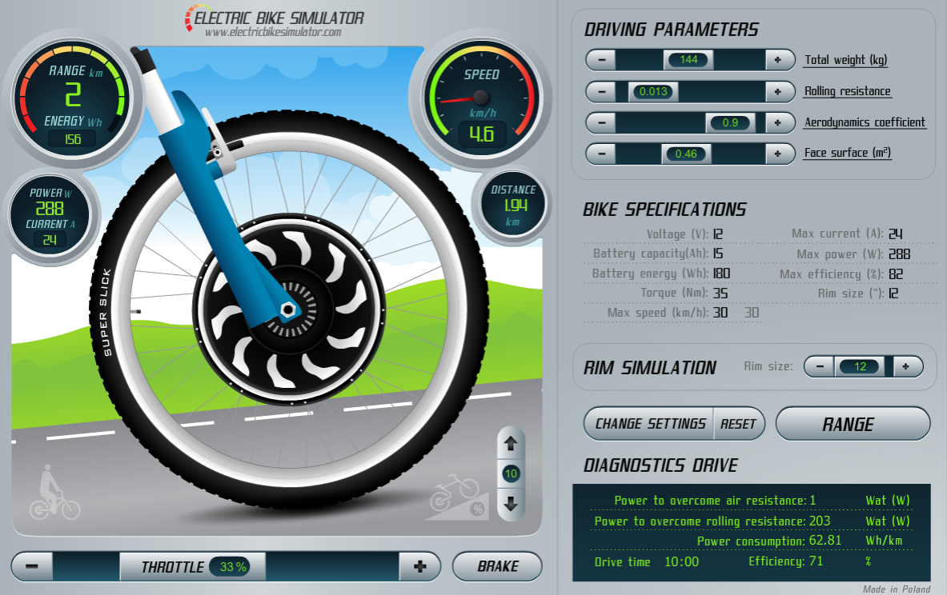
Overall Results
Bicycle simulation at speed of 10 km/h and 10% inclined surface

Slide 19
Summary & Recommendations
Adding controller to the system to adjust the speed of the motor.
Regeneration of power.

