Slide 1

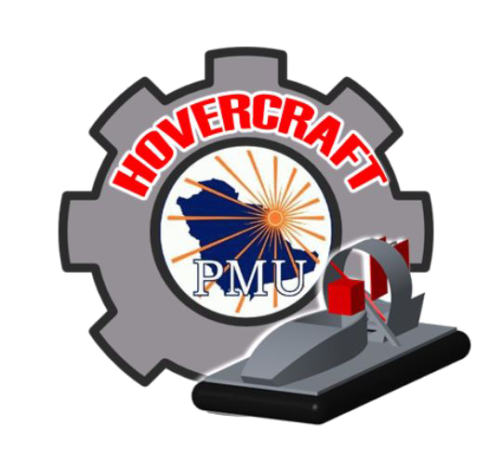





PRESENTED BY:
Abdullah Al-Muraisel 201100546
Meshal Othman 201302079
Abdullah AlZahrani 201000170
Hussain ALHaider 201300297
Mahdi Almarzoug 201201060
Saud Al-Shamsi 201100333
ADVISOR
Prof. Faramarz DjavanRoodi
CO.ADVISOR
Dr. Nader Al-Sawalhi

Slide 2

Outline
Meshal Othman
Background Information
Objectives and motivation of the work
Literature Review ( Brief Background)
Design specifications and items selection
Experimental setup, testing, and Results
Summary, conclusions and Future work

Slide 3

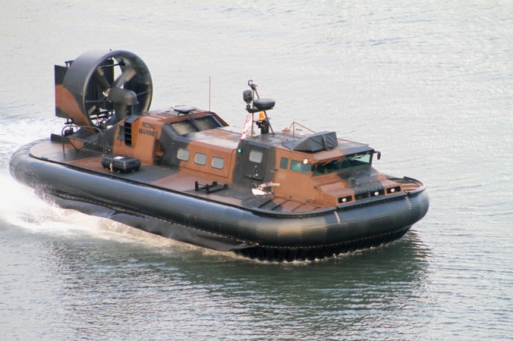
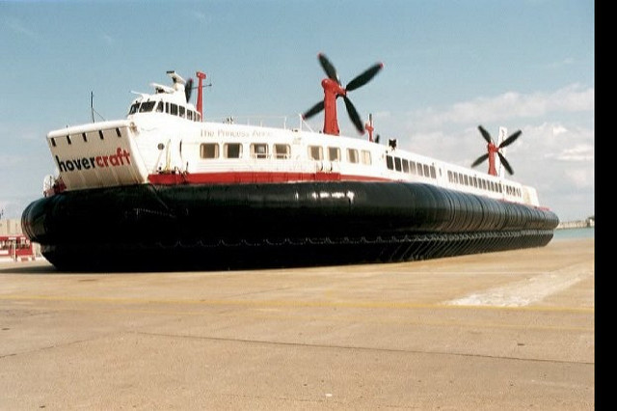
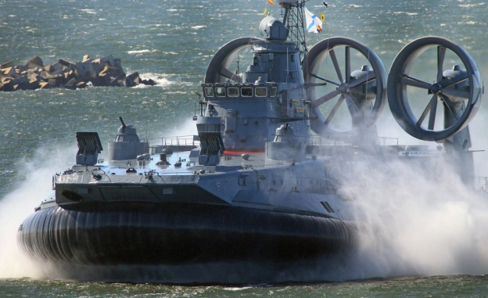
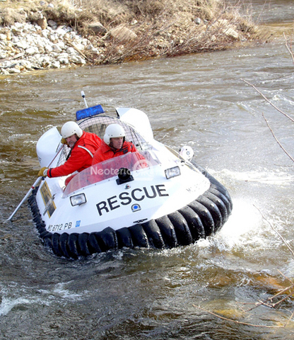



Background
Information
Mahdi Almarzoug
What is a Hovercraft ?
What is the uses of the Hovercraft ?
- A Hovercraft is a vehicle that floats above
any lands such as ice, sand, grass, and water.
Transportation
Military
Rescue

Slide 4
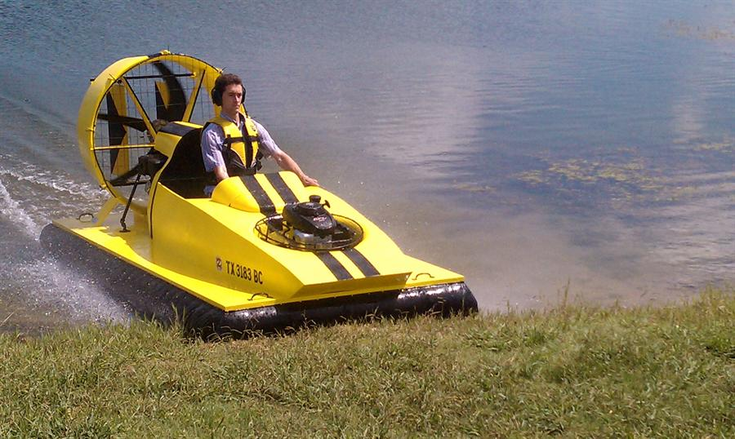
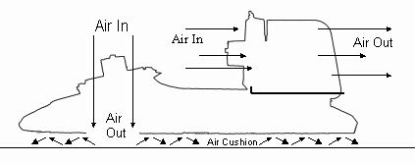
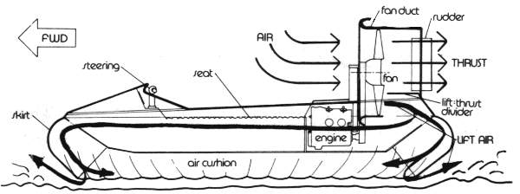
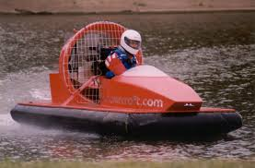
Background
Information
How it works ?
A
B

Slide 5
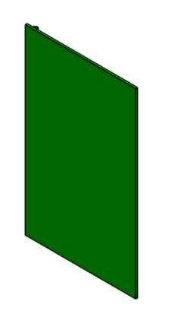
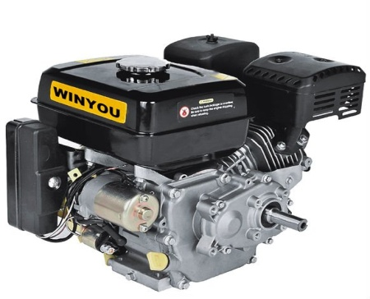
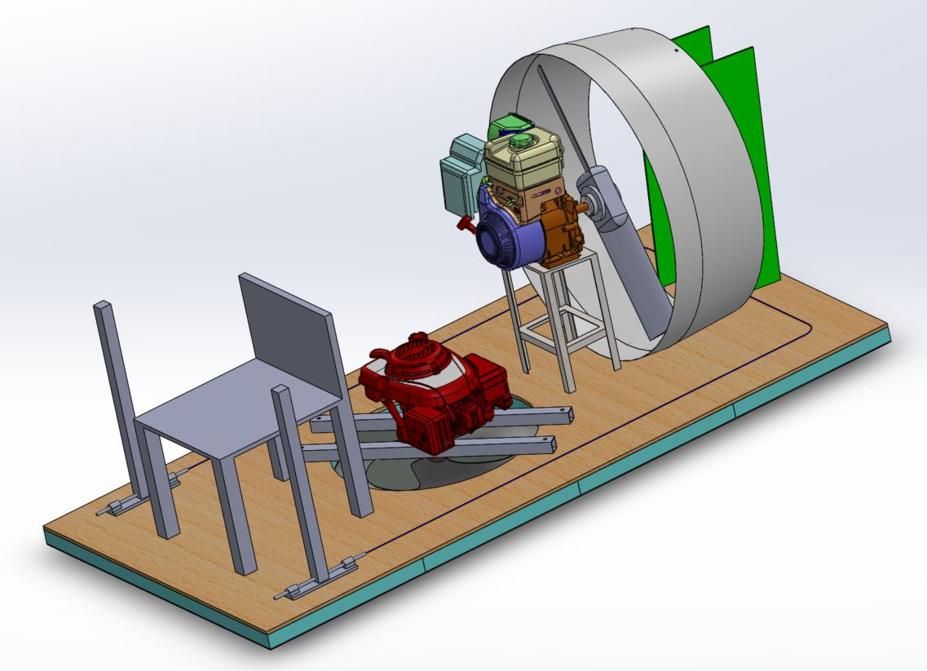
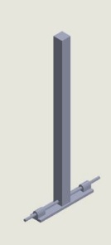
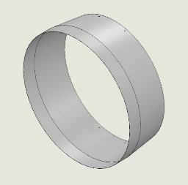
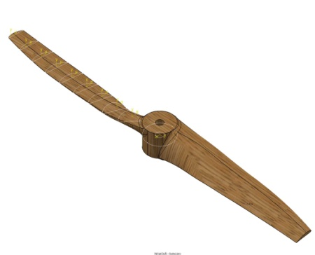
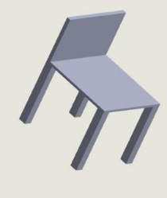


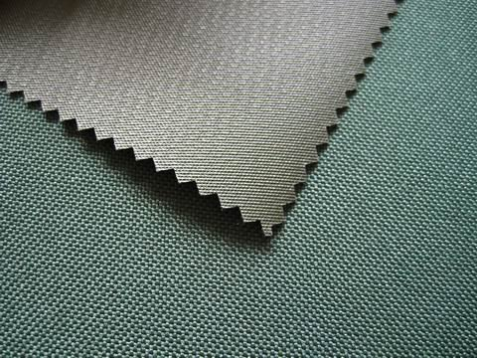
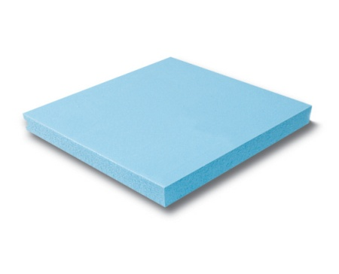
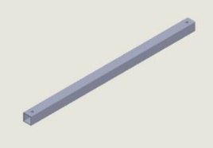
Background
Information
The components of the Hovercraft ?
Engines
Rudders
Control Stick
Thrust Duct
Fans
Chair
Hovercraft Base
Skirt
Rectangular
Profile
Foam

Slide 6
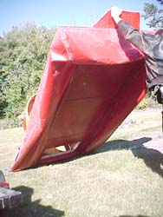
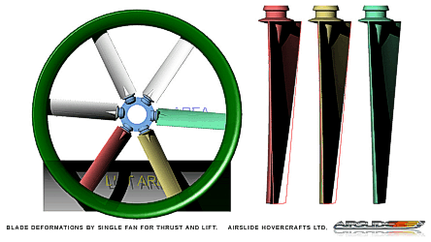
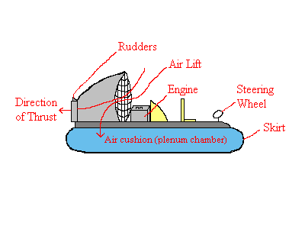
Background
Information
Abdullah Al-Muraisel

Slide 7

Objectives
Meshal Othman
Prototype a Hovercraft with simple design and can do the required function of movement.
The approach design of hovercraft is to move with a rated speed of 10-15 km/h.
Hovercraft can tolerate with more weight up to 200 kg and runs under intensive operation smoothly.
Improve the factor of safety for all materials during all operation process.
Propagate new vision for a vehicle can operate in different circumstances.

Slide 8

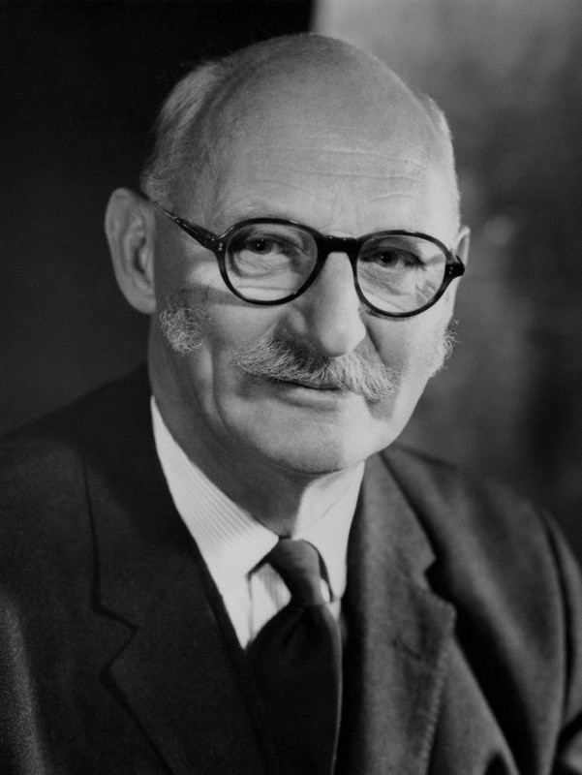
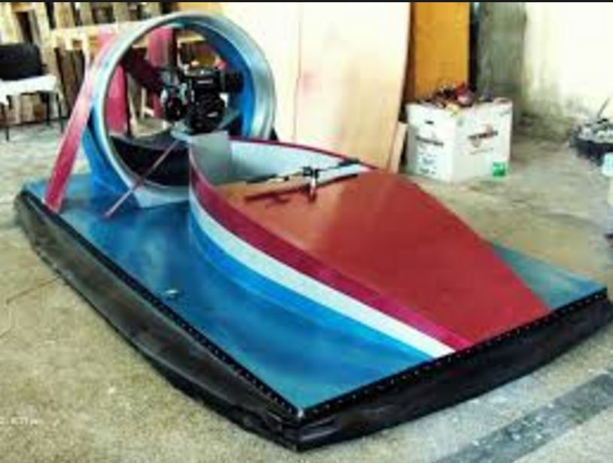
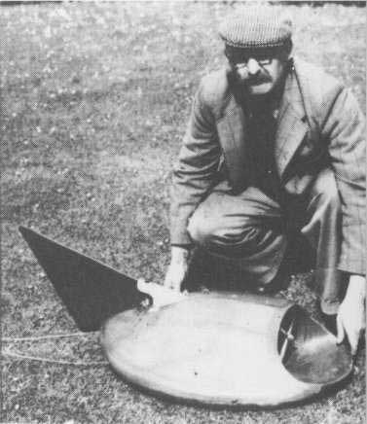
Literature Review Brief Background
Saud Al-Shamsi
Sir John Thornycroft and Mr.Christopher Cockerell.
Distinguishing our project.

Slide 9
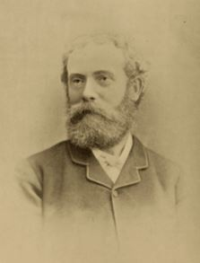
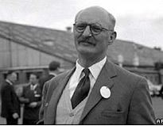
Literature
Review
Imagination
Sir John Thornycroft
  British architect
Christopher Cockerell
  First Innovator
  First hovercraft
  established in 1952
Does not prove
Improve the imagining for Sir John
to push the air for lifting
Skirt idea with small open gaps to lift the hovercraft

Slide 10
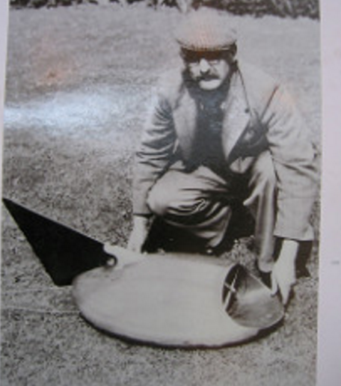
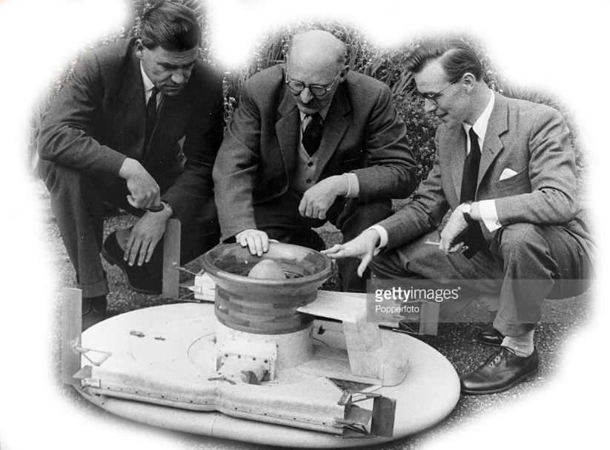
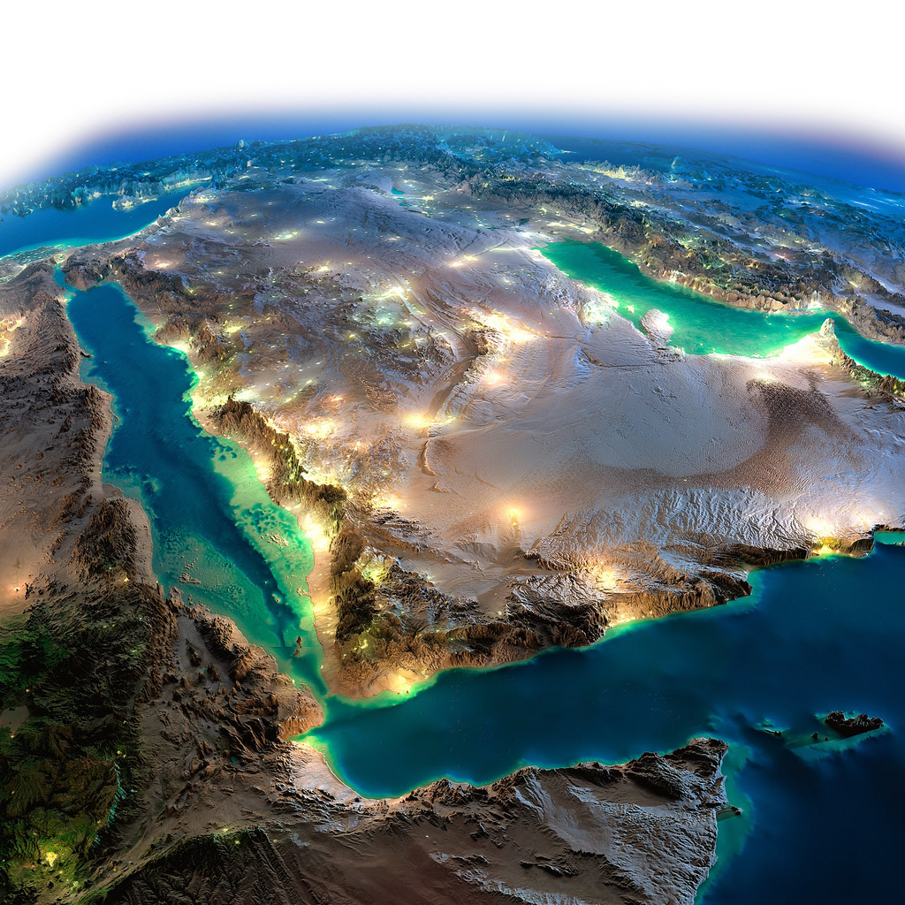
Literature
Review
Christopher Cockerell
Inventor of the hovercraft,
with his first prototype that proved the idea would work

Slide 11
Literature
Review
What distinguishing our project?
START
CAD - DRAWING
Calculation
Choosing material
GO BACK
FINISH
Outcomes
Testing
Fabrication
1/ Construct CAD model for our Project.
2/ Material selection depends on our calculation.
3/ Assembly drawings are given in manufacturing steps
4/ Publicize the concept of hovercraft in KSA

Slide 12
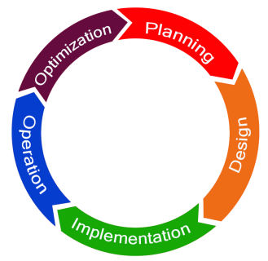
Design specifications
Abdullah AlZahrani
we determined the most important principles to structure our hovercraft, we consider the following Specifications:
Design and assemble the parts of the vehicle using CAD
Construct a vehicle with a dimension of 2.40 m in length and 1.20 in width.
Implementing two engines one for thrust with rated power of 10HP and another one with a rated power of 6-7HP for left .
Construct the Manual mechanism system to monitor the hovercraft.
Minimize the weight of the hovercraft by select materials like (plywood, foam, MDF, and fiber glass).

Slide 13
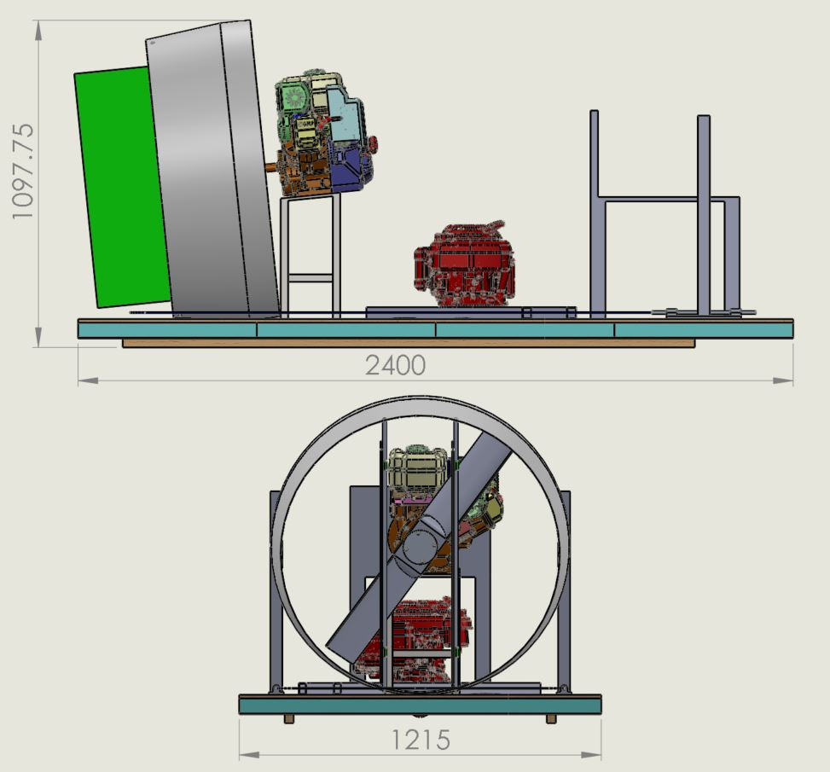
Design specifications
Design Methodology
We determined the type and specifications of the hovercraft designing based on factors :
we determined the type and specifications of the hovercraft designing based on factors :
Limit of speed.
    Engine Power
Low weight.
    Pressure
    Sizing of hovercraft
Durability.
    Thrust and lift
Limit of Speed
    Engine Power
Low Weight
    Sizing of Hovercraft
    Pressure
Durability
    Thrust and Lift

Slide 14
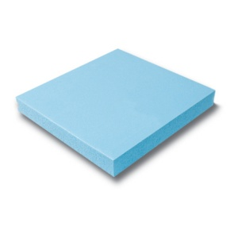


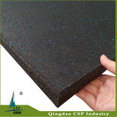

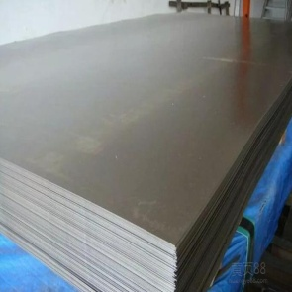
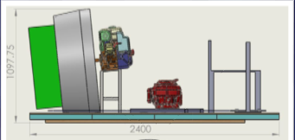
Design
specifications
Select the hovercraft parts based in design, specifications and performance functions

Slide 15

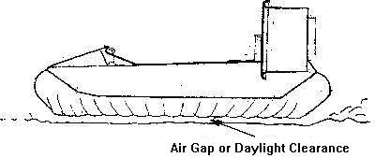
Experimental setup, testing, and Results

Slide 16
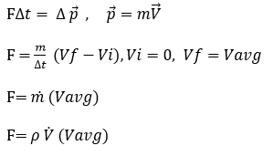


Experimental setup, testing, and Results
Equation For hovercraft :
One of the most important equations in designing a hovercraft are :
Thrust Calculation:

Slide 17
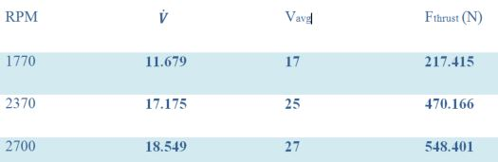
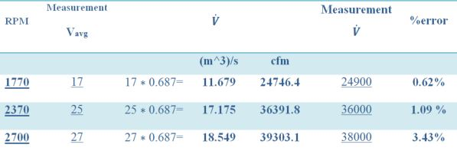
Experimental setup, testing, and Results

Slide 18







Experimental setup, testing, and Results
Needed Power for lift :

Slide 19
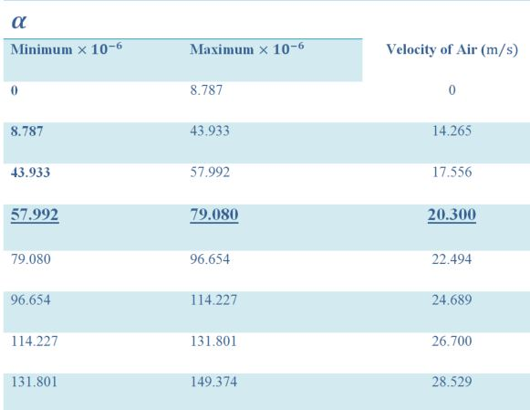
Experimental setup, testing, and Results

Slide 20
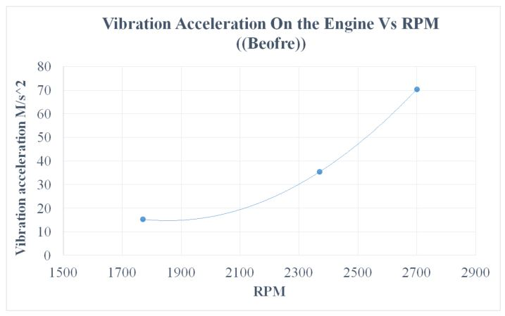
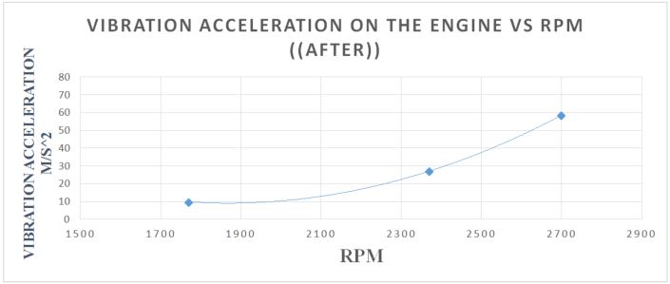
Experimental setup, testing, and Results

Slide 21
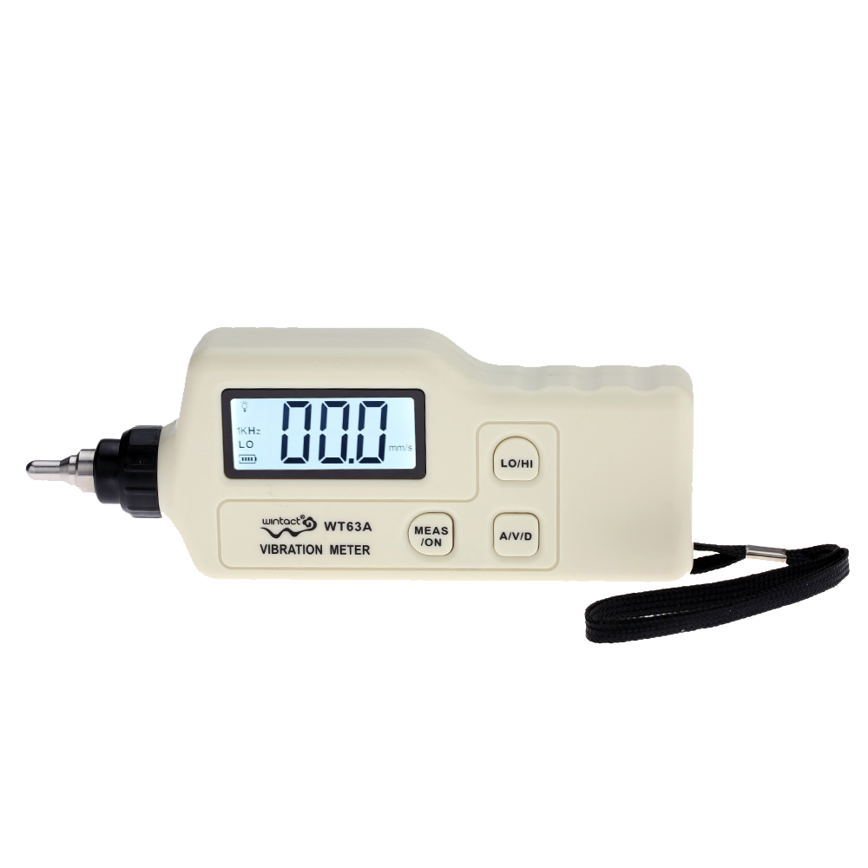
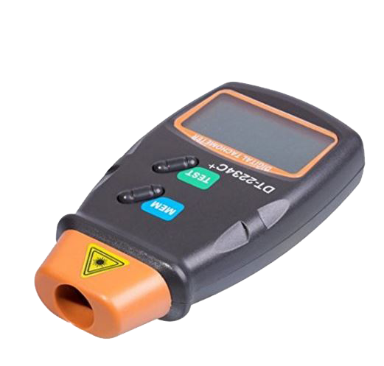
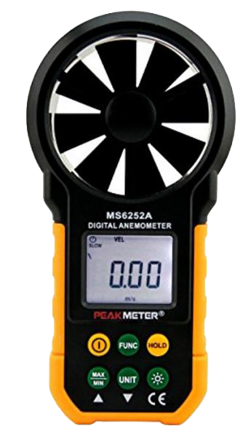
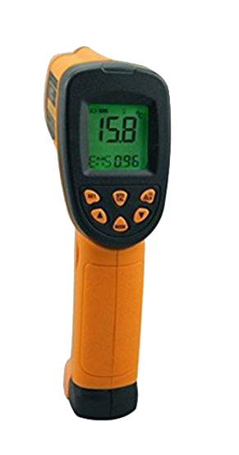
Experimental setup, testing, and Results
Handheld Digital Laser Photo Tachometer RPM
Vibrometer
Laser gun
Digital Anemometer Handheld Wind Speed Meter Gauge Air Volume Meter Backlight Air Velocity

Slide 22

Summary, conclusions and Future work
Abdullah Al-Muraisel
In consolation, we as a team went into the process of designing and manufacturing of one person hovercraft. Hovercraft is a vehicle which can float in any lands also it is known by Air Cushion Vehicle due to its ability to move by cushion or skirt filled with air. The concept of the hovercraft is simple, starts with a particular kind of wood that has the property in carrying loads attached to a skirt in order to surround the air which leads to developing pressure under the hovercraft.

Slide 23
conclusions and Recommendation
Abdullah Al-Muraisel
As a team, we come up with recommendations that lead to have a faster and more durable hovercraft which give better results.
Try to reduce vibration generated by the motor by using some materials to absorb the vibration impacts.
For fast hovercraft, we recommend to use two engines, one horizontal shaft for thrust and one vertical shaft for the lift to increase the power which leads to more powerful hovercraft which can handle more weight and sliding easily on surfaces.
Use Carbon-Fibre or Fiberglas for all body of the hovercraft to minimize the total weight but it is costly.

Slide 24
Video

