Slide 1


Design of a
Pneumatic Powered Bicycle
*Abdulelah Almarqabi 201400105
Sohaib Imran 201303504
Salman Siddique 201303877
Mohammad Faraaz 201400318
Abdullah Bashir 201400533
Advisors
Dr. Mohammad Asad / Dr. Nader Sawalhi

Slide 2
Content
Objectives
Background
Relevance
Constraints & Standards
Design
Testing & results
Conclusion & future recommendations

Slide 3



Objectives
To design a pneumatic powered system for a bicycle
To achieve a boost when required

Slide 4
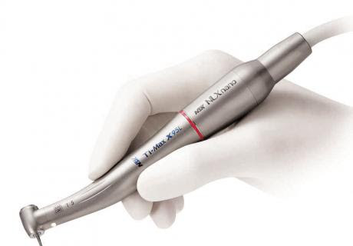

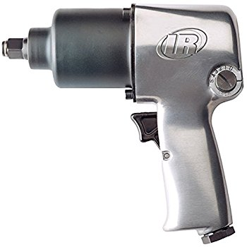
Background
Pneumatic motors have existed in many forms over the past two centuries
Widespread success in the hand-held tool industry
Impact wrenches, pulse tools, nut runners, dental drills, etc.

Slide 5
Motivation and relevance
Elon Musk
Every year 17.6 million bikes are sold in India.
Reducing Global warming
Global warming is one of the biggest issues worldwide

Slide 6

Design Constraints

Slide 7
Design Constraints (1)
1.Geometrical constrain
  Weight of an average human is 80 kg’s
2. Sustainability
  More economical
  But depends on the person, and also on the terrain
3. Environmental
  Extremely hot weather in the kingdom

Slide 8
Design Constraints (2)
4. Economic
  High cost /low demand
  Variation in bike prices
5. Manufacturability
  Confined space
6. Safety
  Good quality helmets
  Alert lighting system

Slide 9
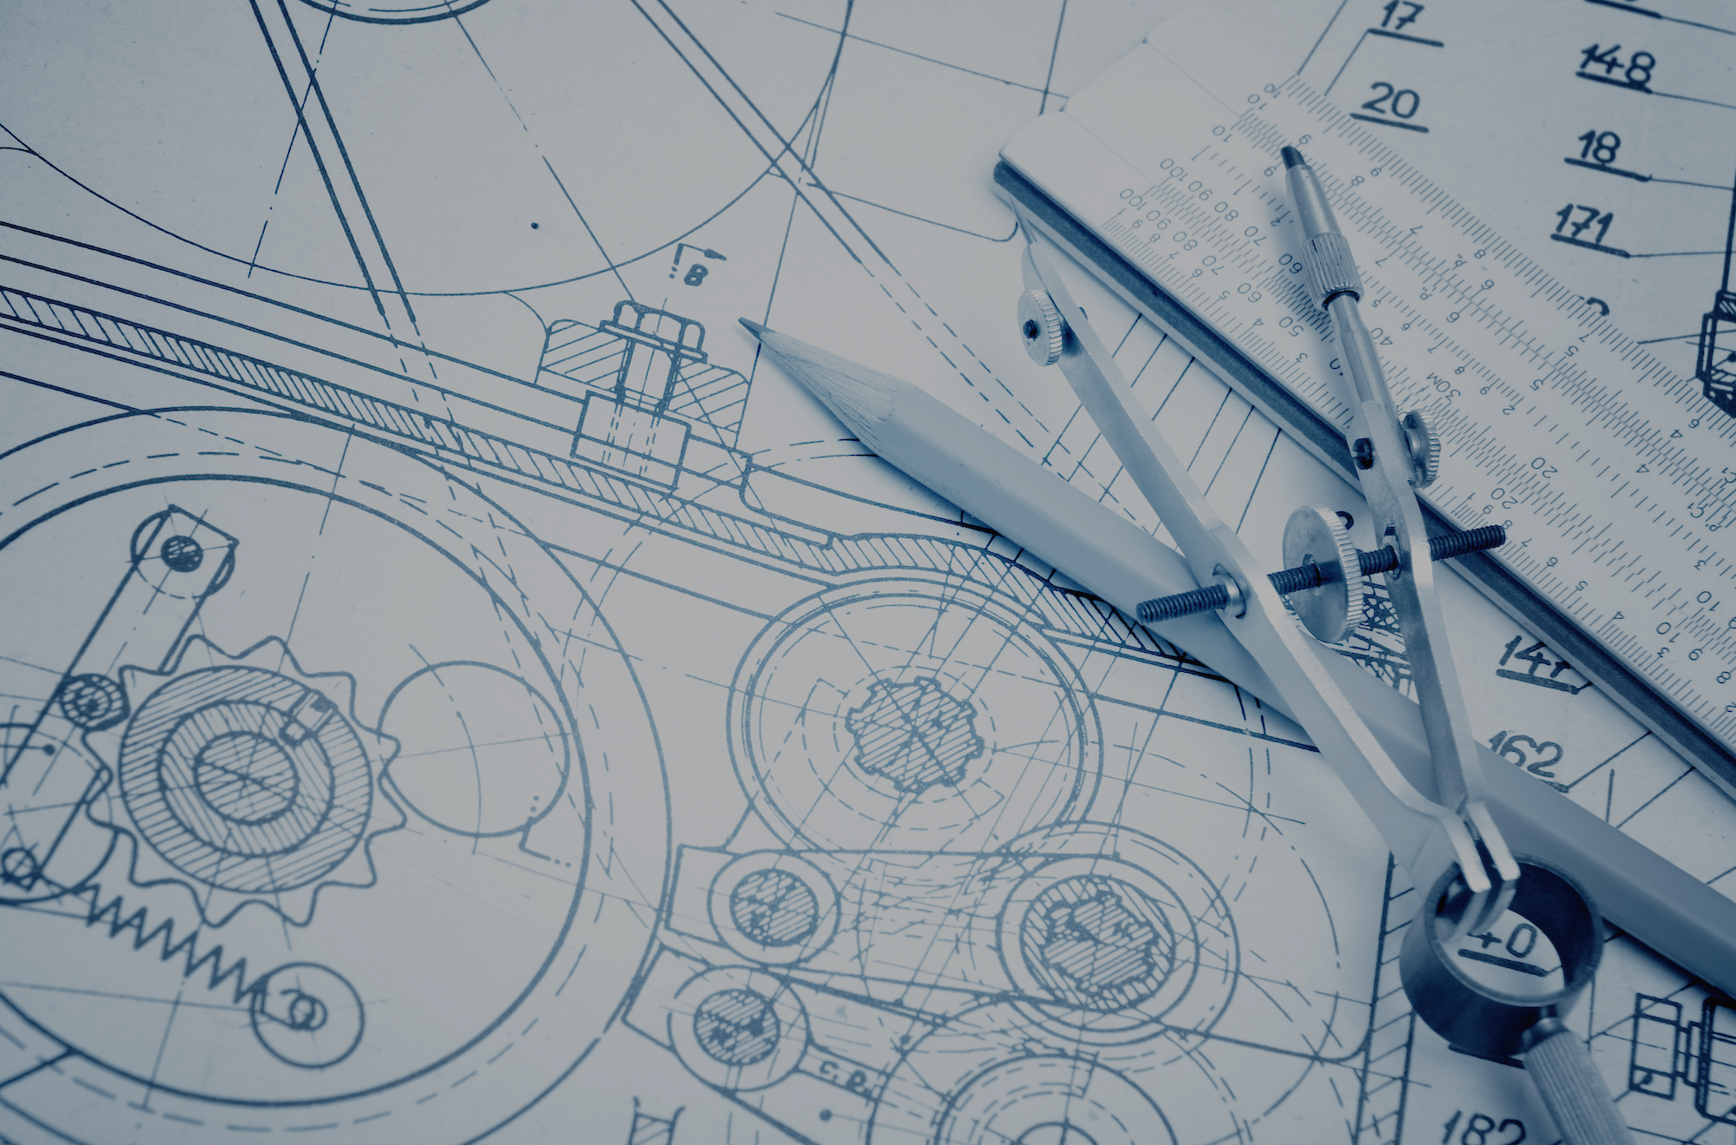
Engineering Standards

Slide 10
Engineering Standards
ISO 4210:2014 standard for bicycles
StVZO standard (Bike safety)
ISO 3857-2:1977
ASME BPVC Section VIII-Division 1

Slide 11
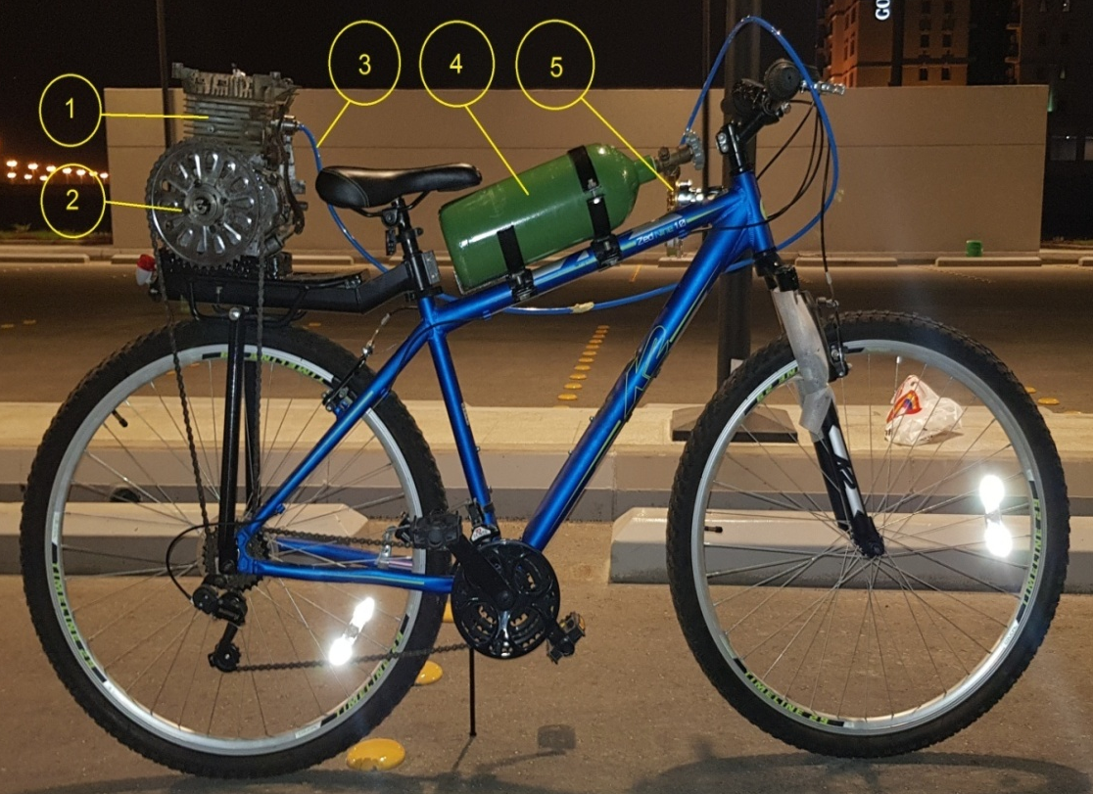
Design
Components:
Engine
Sprocket
Pneumatic hose
Cylinder
Regulator

Slide 12
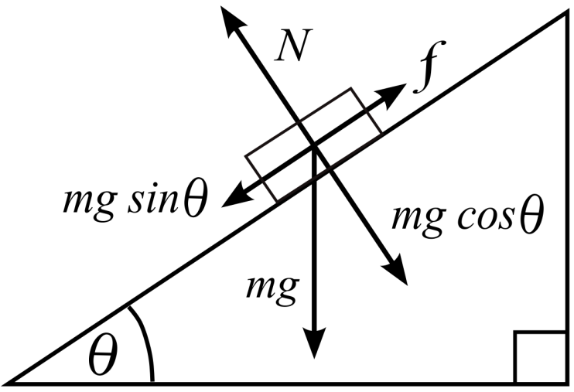
The Calculations
Equations
Weight = mass x gravity
Force = drag force + Wsinᴓ
Torque = Force x Radius
Area = π x radius²
Pressure = force x Area
Energy = change in heat – change in work
Work = change in volume x pressure
Results:
Force = 513.47 N
Pressure = 2.61 bar

Slide 13
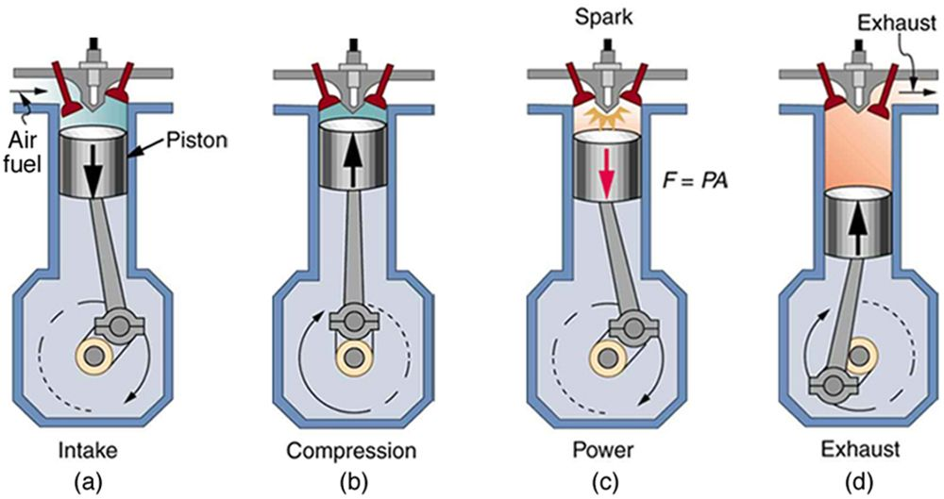
The Engine
Robin Engines model EY15-3D
4-stroke cycle

Slide 14
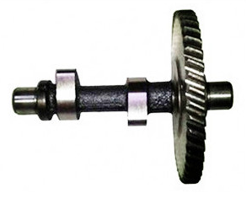
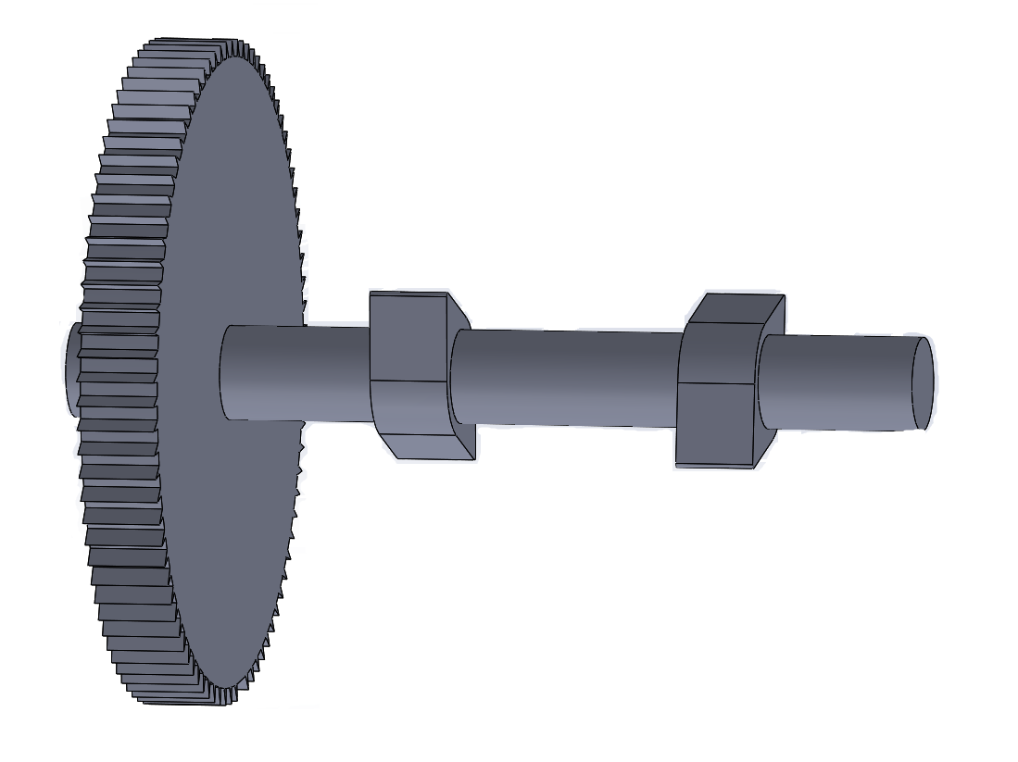
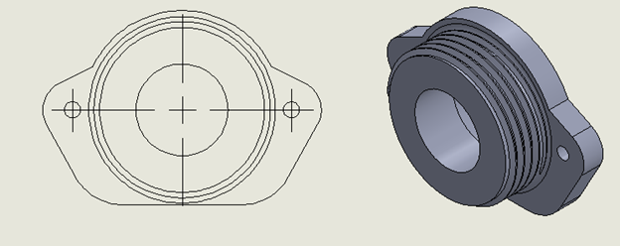
Modifications
Cam Shaft
Adapter

Slide 15
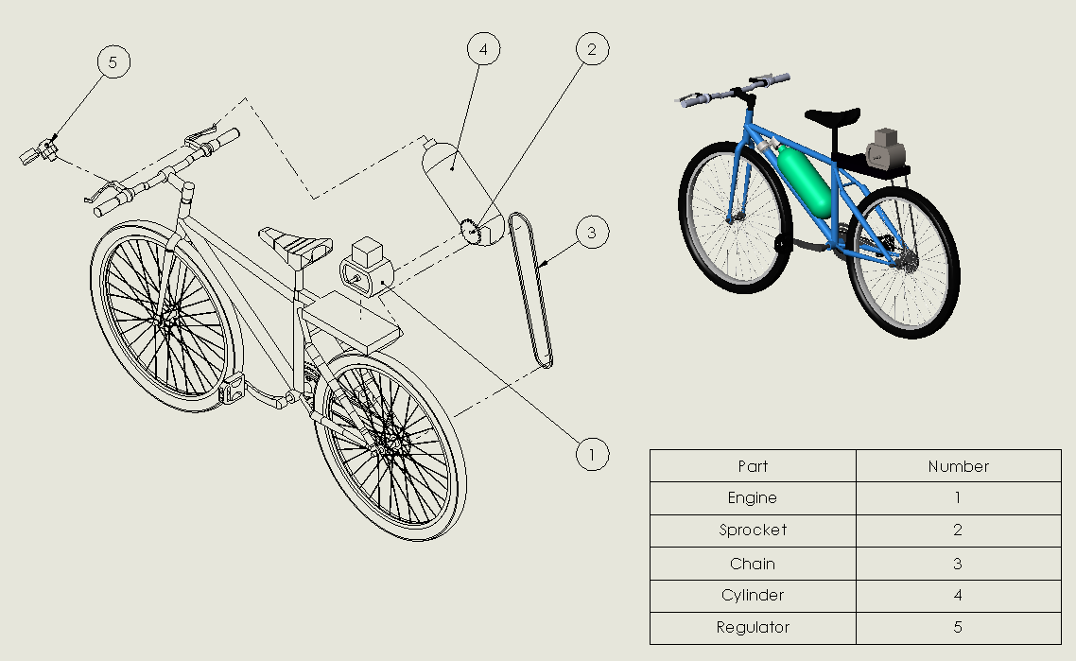
CAD Drawing

Slide 16
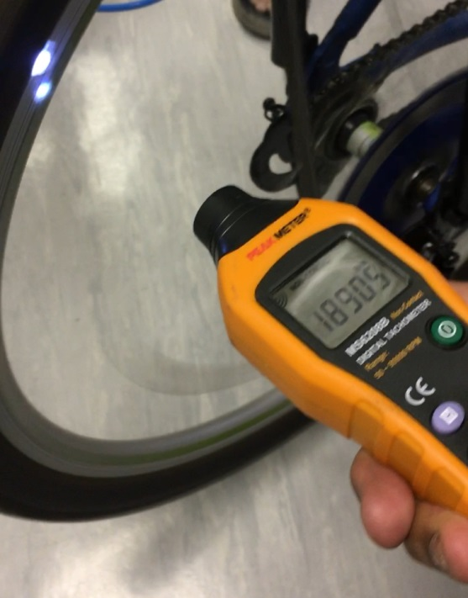
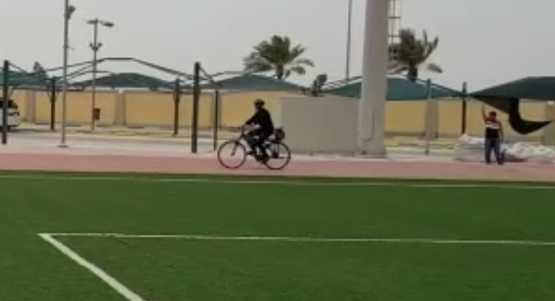
Testing Setup
3 tests
  Measuring tank usage time
  RPM
  How fast the bike can finish a 50m

Slide 17
Results
Pressure (bar) | Time (seconds)
6 | 82
8 | 70
10 | 55
12 | 42
RPM test - factor of 2.74 at a pressure of 5 bars
“1890.5 RPM”
Distance – 50m, 6 bars, 25% reduction in time

Slide 18
Recommendations & Conclusion
Design of a pneumatic cylinder-piston engine
Material used
Dimensions used

Slide 19
Acknowledgement
We appreciate the support and guidance of the Mechanical Engineering department. Special thanks to Dr. Mohammad Asad and Dr. Nader Sawalhi for their continued support to us throughout our work.

