Slide 1

Design of Solar Thermal Collector for The
Purpose of Optimizing Coil View Factor
Group #4
 | Student ID | Student Name
1 | 201302587 | Ibrahim Balhareth
2 | 201303522 | Meshal Al Saiari
3 | 201301889 | Omar Al Otaibi
4 | 201300164 | Marwan Al Refaei
5 | 201200399 | Mahmoud Khojandi
Project Advisors: Dr. Esam Jasim

Slide 2
Content
Project objectives
Background
Motivation and relevance
Engineering standards, design constraints and specification
Conceptual design and theoretical calculations.
Assembly and fabrication
Design problems and troubleshooting.
Project cost
Conclusion

Slide 3
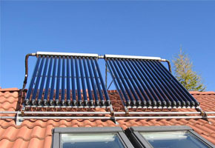
Project Objectives
Design a number of coil geometries.
Study heat transfer in different coils geometries.
Conduct experiments to study the best coil geometry effectiveness.

Slide 4
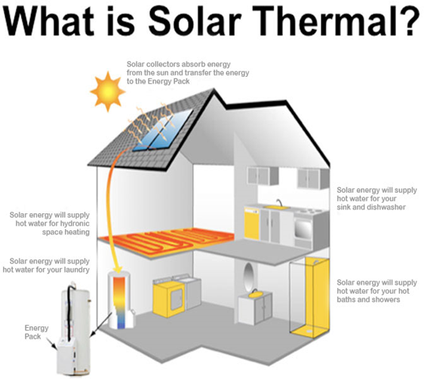
Background
Definition of Solar Thermal Collector
Solar thermal usage people use solar thermal power to heat water and air. The two general types of solar heating systems are passive systems and active systems.
Solar collectors are either non concentrating or concentrating.
Some different types of solar thermal panel collectors:
  Evacuated tube solar thermal systems
  Flat plate solar thermal systems
  Thermodynamic panels
  Solar thermal air collectors
  Solar thermal bowl collectors
Notes:
In 1973 there was energy crisis. A few years later in 1980s, a new Mechanical Engineering principle was used in the University of New Mexico to save energy and rely more on renewable energy. The renewable energy was basically depending on sun irradiation to get heat through solar thermal collector. Unfortunately, the focus on renewable energy was forgotten in 90s due to energy cost decrease. Now, due to the increase in energy prices and not to be likely decreasing times soon, it is a great opportunity to focus on utilizing thermal solar collector again.

Slide 5
Motivation and Relevance
Simplicity of solar thermal collector systems.
Zero energy cost
Comparatively maintenance free
Utilization of environmental resources

Slide 6
Engineering Standards and Design Constraints
Engineering standards and materials selection of system parts were listed below:
No. | Part Name | Type of Material | Reference Standard | Standard Description
1 | Coil | Coper of Alloy C12200 | ASTM B88 | Seamless Copper Water Tubes
2 | Piping connection | CPVC | ASTM D2846 | Plastic Hot Water Distribution Systems
3 | Thermal box | MDF Wood | ASTM D5664 - 17 | Wood of Elevated Temperatures Surface
4 | Collector window | Glass | ASTM E765-80 | Flat Plate Solar Collectors
5 | Solar Diffuser | Aluminum Alloy | ASTM B209M | Aluminum-Alloy Sheet and Plate
6 | Hoses connection | Thermoplastic | ASTM F645 - 15a | Thermoplastic Water- Pressure Piping Systems

Slide 7
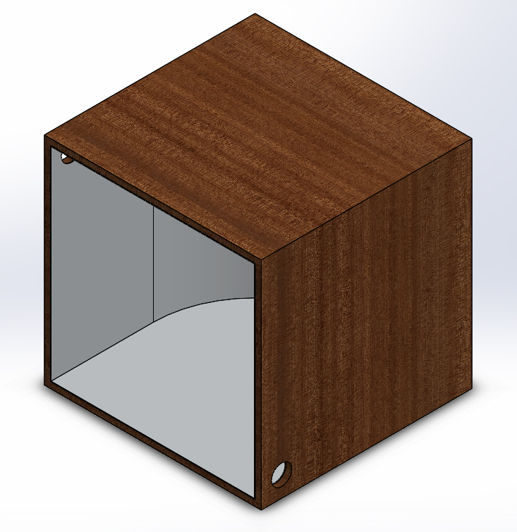
design specification
Thermal collector Box
specification | Description
Material of front side | Glass
Material of the box | Wood
Internal lining | Aluminum sheet
Weight | 2 kg
Length | 0.53 M
Width | 0.53M
Depth | 0.515 M
Color | Black
Absorption Area | 1.5 m^2
Volume | 0.125 m
Thickness of glass | 0.05 m
Thickness of wood | 0.15 m

Slide 8
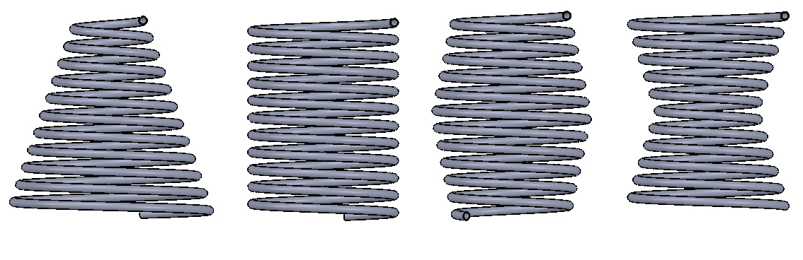
design specification
Conical | Cylindrical | Barrel | Hourglass
Coils
specification | Description
Material | Copper
Length | 6 m
Outer Diameter | 0.012m
Weight | 5 kg
Thickness | 0.001m

Slide 9
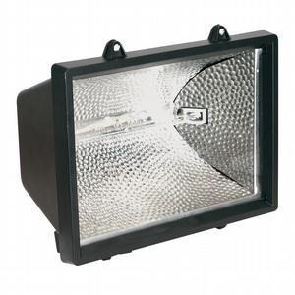
design specification
Radiation Source
Specification | Description
Lamp Power | 1000 W
Length | 0.17m
Diameter | 0.1m
Lamp Type | Halogen

Slide 10
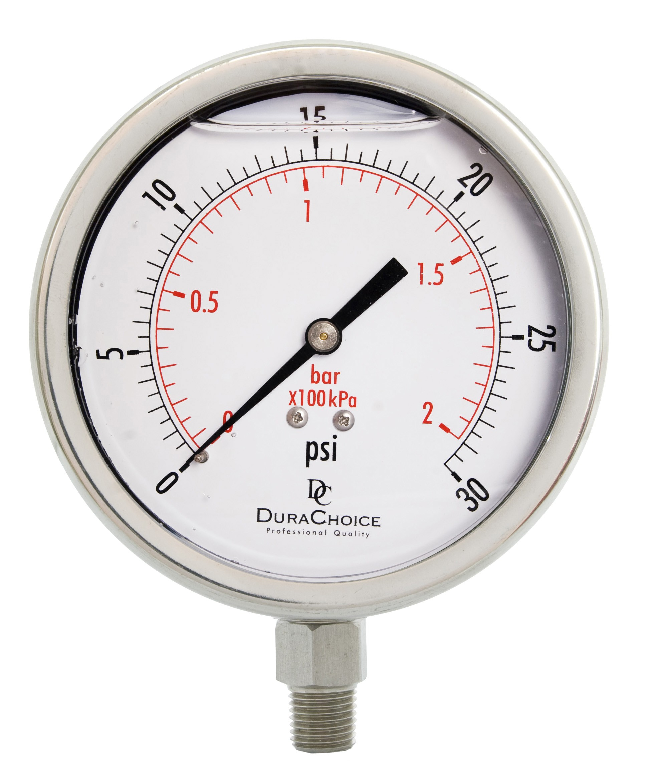
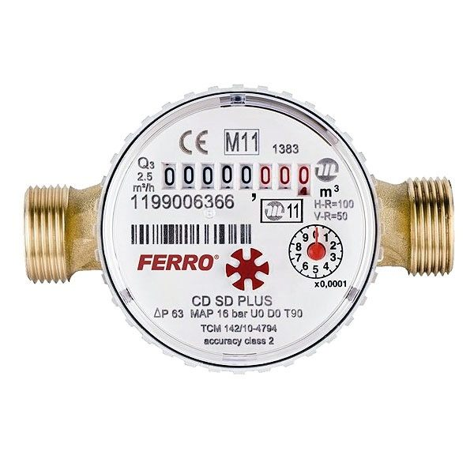
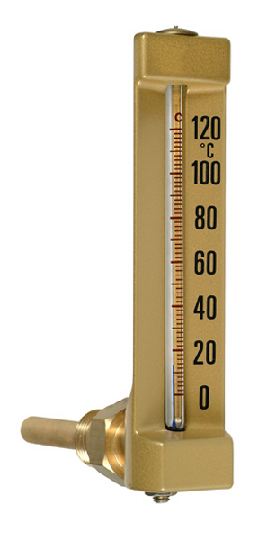
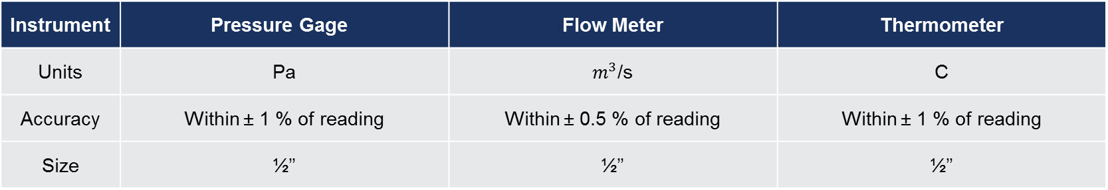
design specification
Instrument | Pressure Gage | Flow Meter | Thermometer
Units | Pa | $m^{3}$/s | C
Accuracy | Within ± 1 % of reading | Within ± 0.5 % of reading | Within ± 1 % of reading
Size | ½’’ | ½’’ | ½’’

Slide 11
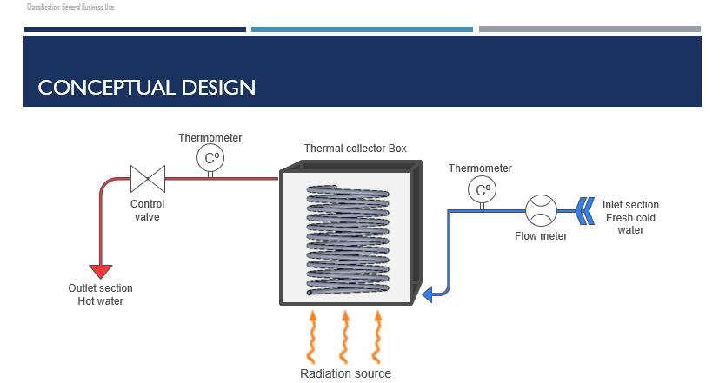

Slide 12
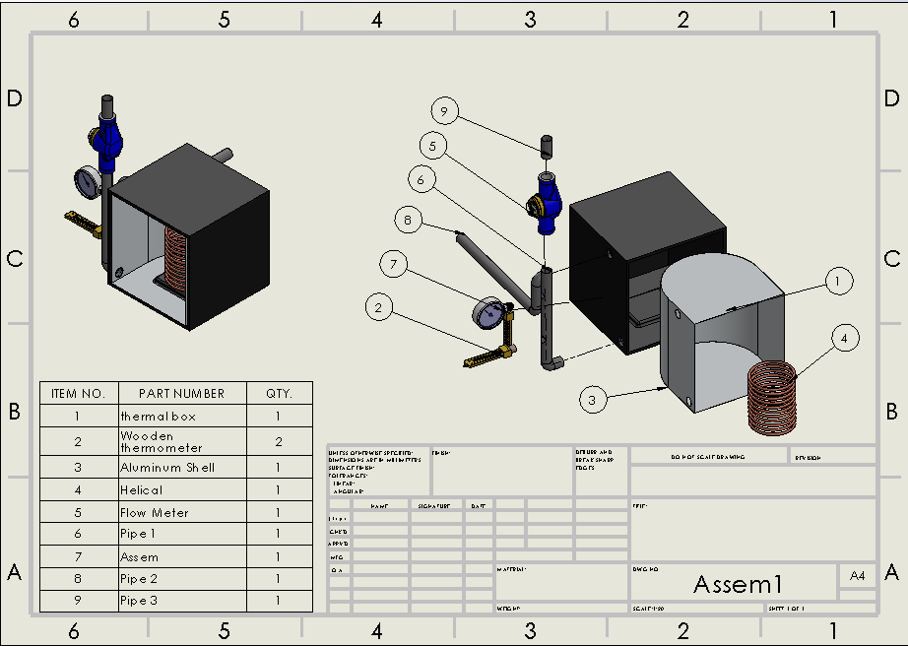
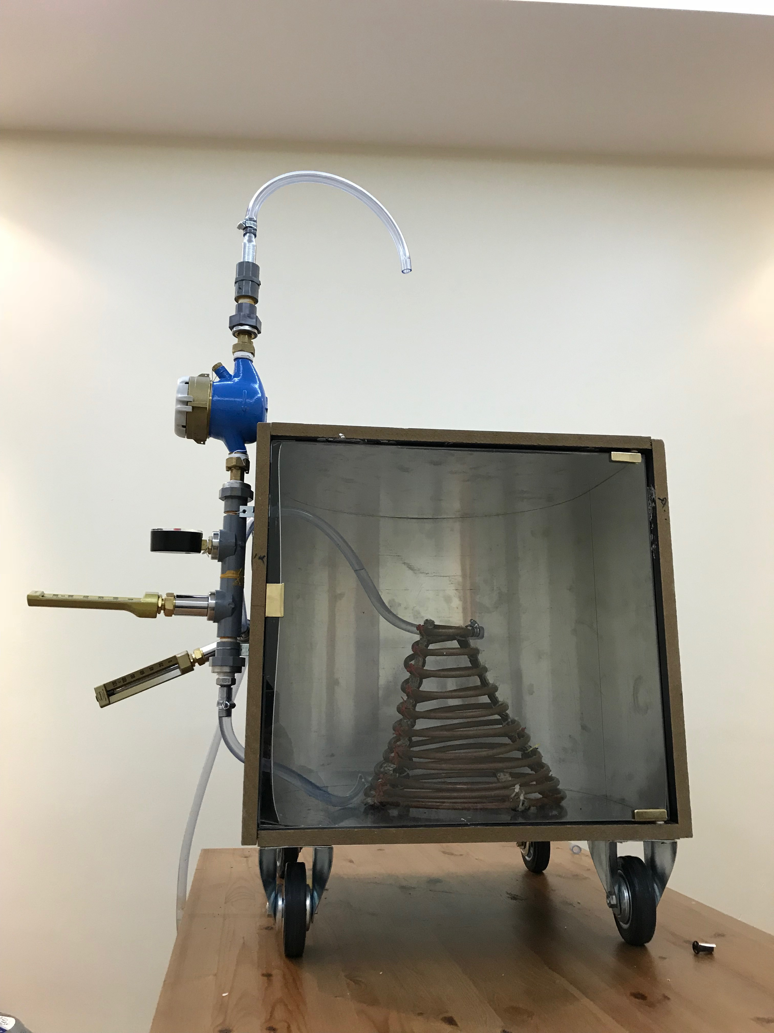
conceptual design

Slide 13
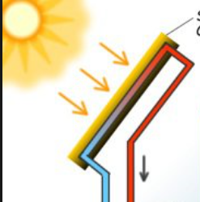
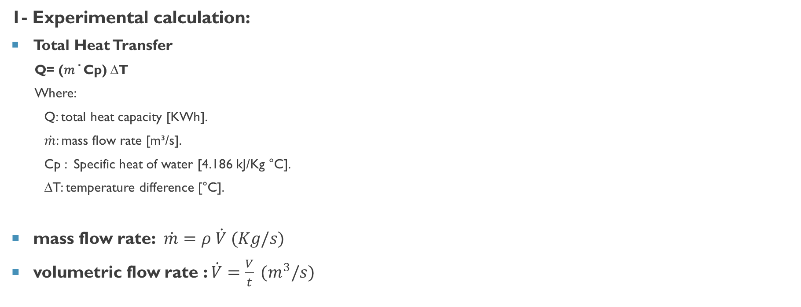
Experimental and theoretical calculations
1- Experimental calculation:
Total Heat Transfer
  Q= (𝑚 ̇ Cp) ∆T
  Where:
  Q: total heat capacity [KWh].
  $\dot{m}$: mass flow rate [m³/s].
  Cp : Specific heat of water [4.186 kJ/Kg °C].
  ∆T: temperature difference [°C].
mass flow rate: $\dot{m}=ρ \dot{V} (Kg/s)$
volumetric flow rate : $\dot{V}=\frac{V}{t} (m^{3}/s)$

Slide 14
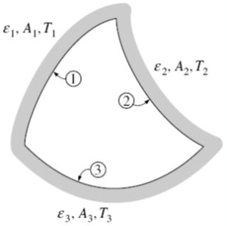
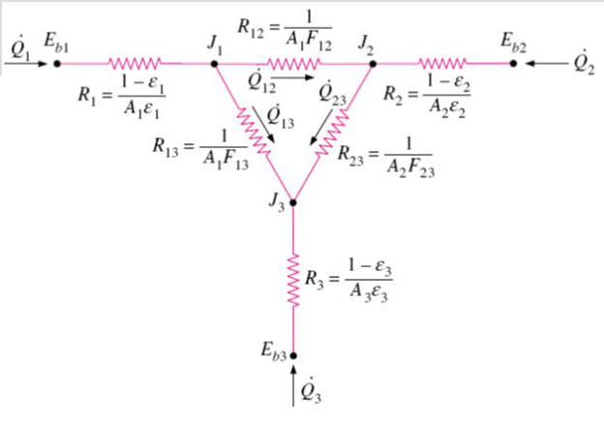
Experimental and theoretical calculations
considered the theoretical radiation heat transfer for coils in our project by apply modeling of temperature difference ∆T of coils theory.
Where:
1: Light source.
2: Coil surface.
3: Surrounding surface.
2- modeling of temperature difference ∆T of coils
Emissivity
View Factor F
Net Heat Transfer Radiation Q
Theatrical ∆T

Slide 15
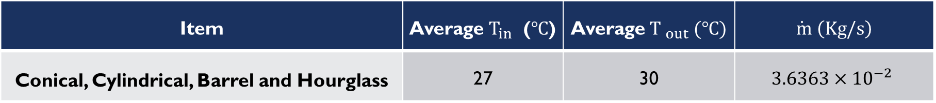
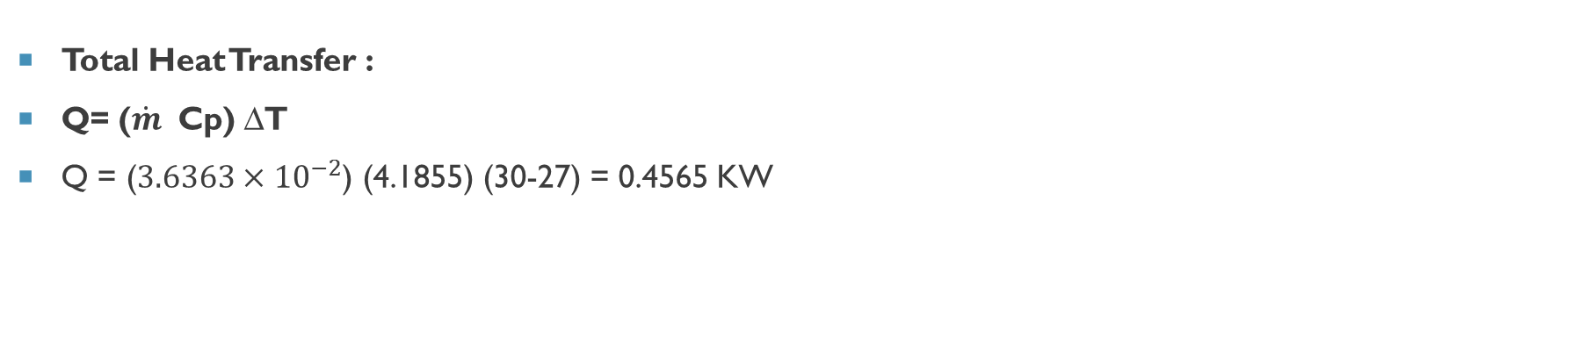
Experimental Results
Item | Average $T_{in}$ ($℃$) | Average${T }_{out} (℃)$ | $$\dot{ m} \left(Kg/s\right)$$
Conical, Cylindrical, Barrel and Hourglass | 27 | 30 | $$3.6363{×10}^{−2}$$
Total Heat Transfer :
Q= ($\dot{m}$ Cp) ∆T
Q = ($3.6363{×10}^{−2}$) (4.1855) (30-27) = 0.4565 KW

Slide 16
Assemble fabrication
Copper coils
Piping and joints
Thermal collector box
Completed project assemble

Slide 17
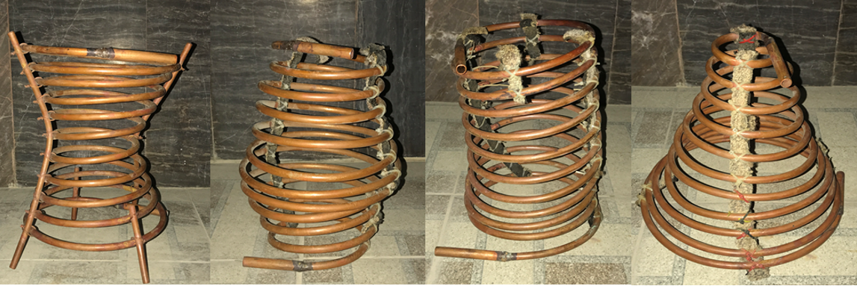
Assemble fabrication
Coil:
  Different of coil geometries to find out which one has more effectiveness.
  Black paint of coils to increase the emissivity.
Black copper coil emissivity | 0.89

Slide 18
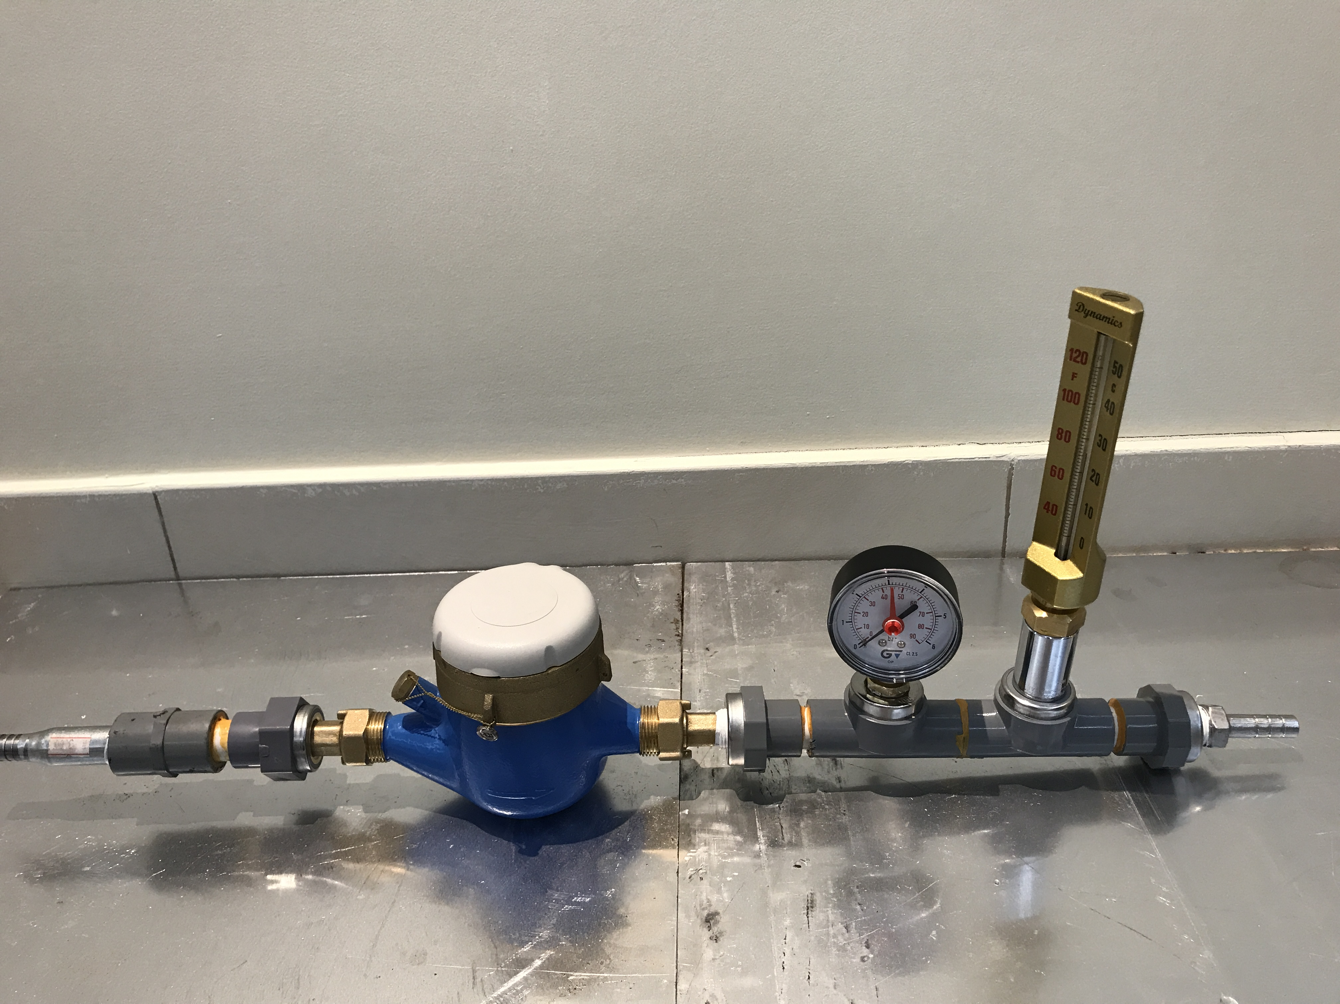
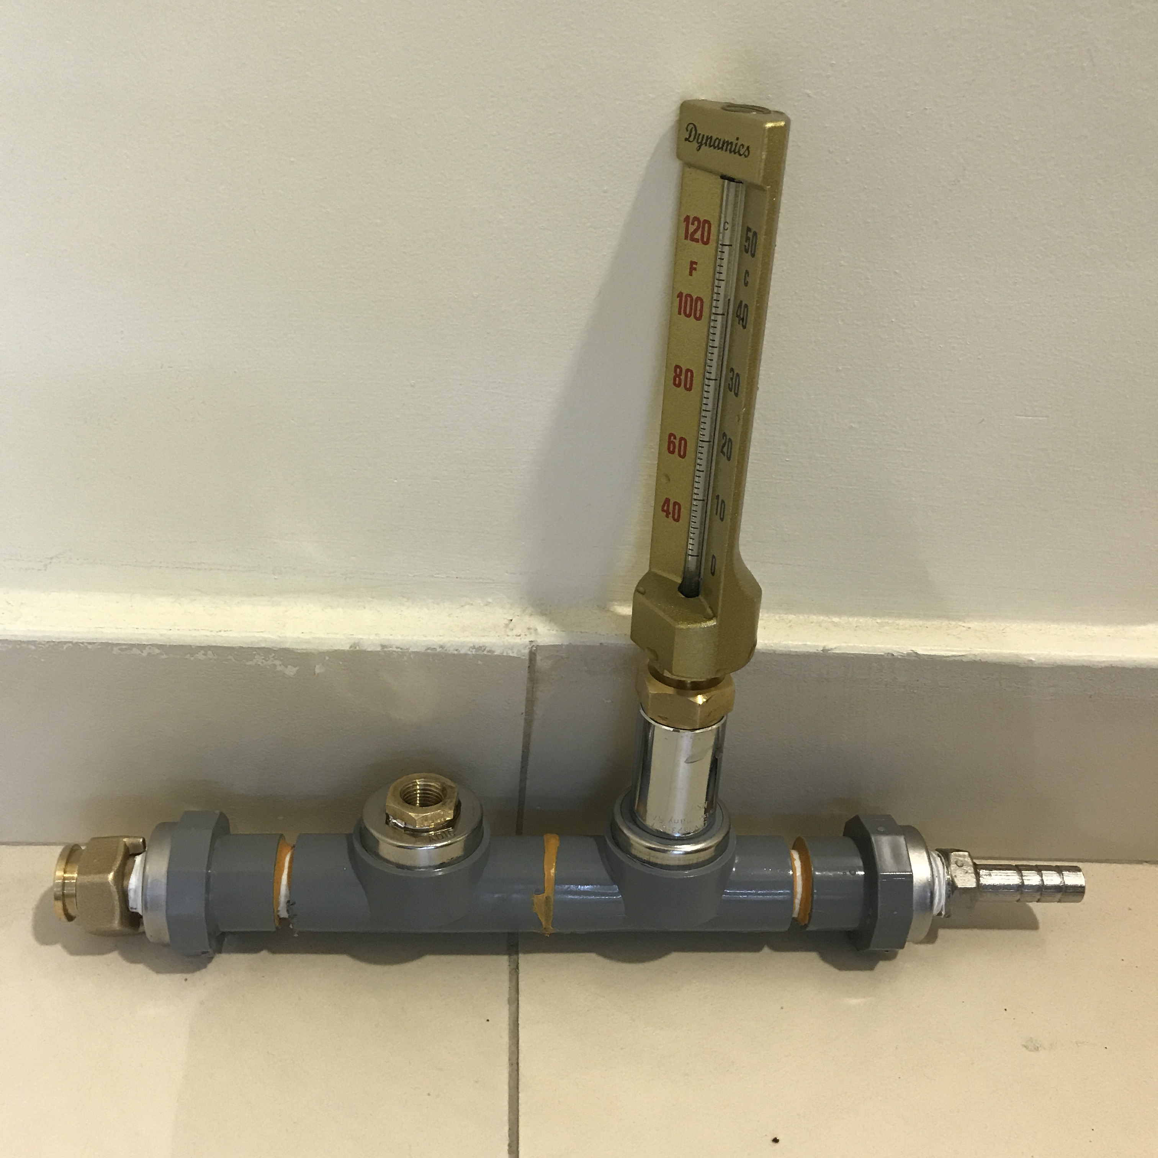
Assemble fabrication
Piping and Joints:
  connect Plastic pipes together by sealant glow then joint it with Plastic hoses.
  Tight the nuts and isolated by Teflon to prevent it from the leakage
  Tightening the measurement tools in the pipes by adapters also seal it by Teflon:
Measurement Used In The System Fixed In The Pipe
Inlet | Out Let
Flow Meters | Thermometer
Pressure Gage
Thermometer

Slide 19
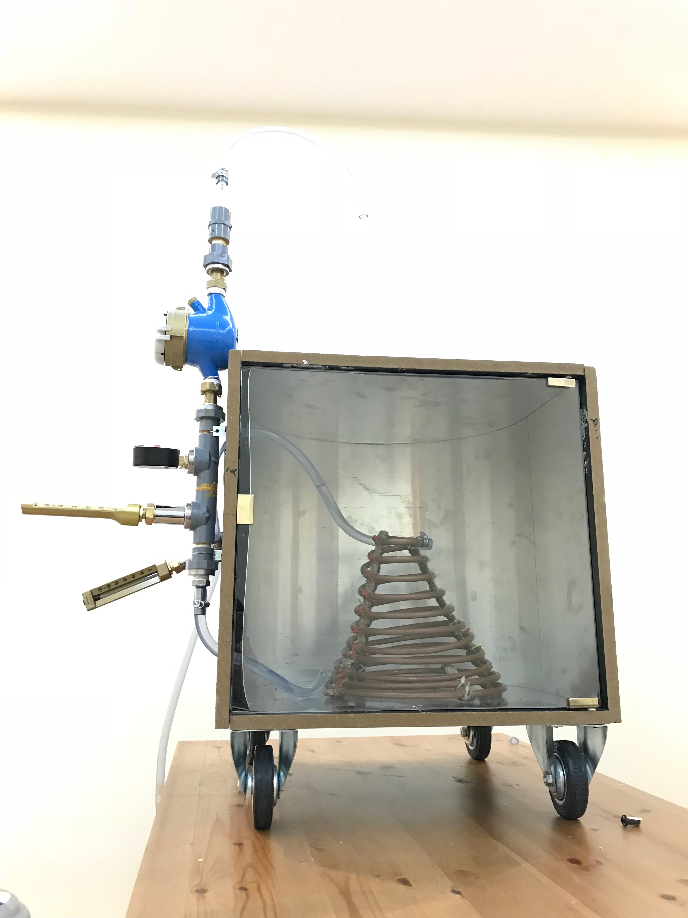
Assemble fabrication
Solar thermal collector box:
  Wood wall chosen due to high isolation to conserve energy, low cost and high emissivity
  Inner Aluminum with U shape to reflect the radiation and the emissivity is not high so, if we used the concave lens will give more concentrating reflect to the coil
Aluminum commercial sheet emissivity | 0.09

Slide 20
Assemble fabrication
Assembled:
  Placed one of coil pipe inside the box
  Connecting pipes and hoses together with the coil pipe from the inlet to the out let
  Aim radiation source to the coil to give it energy of radiation.

Slide 21
Design problems and system improvement
Thermal collector Tinfoil
High fluid velocity and air bubbles in the flow
Collector box glass door & light bulb glass cover
Radiation source (Heater)
Copper coil color

Slide 22
Thermal collector Tinfoil
Tinfoil
Curved Aluminum Sheets
Inside Tinfoil Sheets

Slide 23
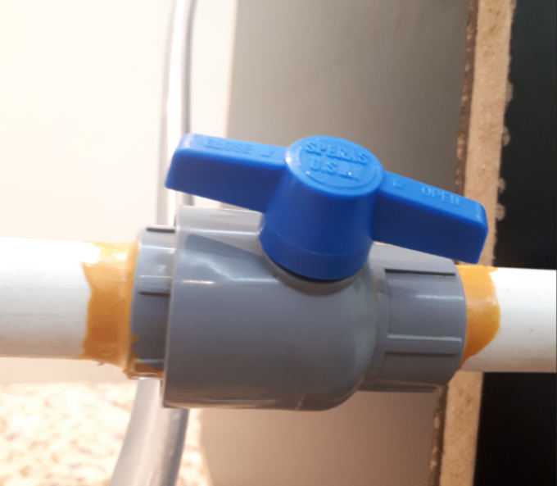
High fluid velocity and air bubbles in the flow system
Control Valve

Slide 24
Radiation source (Heater)
Floodlight
Heater
Floodlight
(Final Installation)

Slide 25
Collector box glass door & light bulb glass cover
Collector Box Glass Door
Floodlight Glass Cover

Slide 26
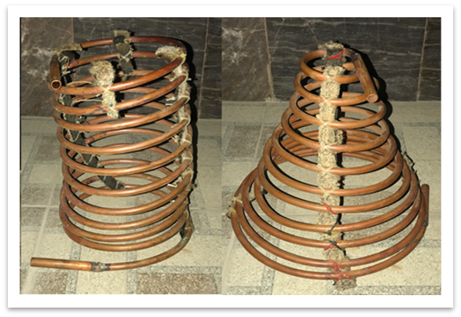
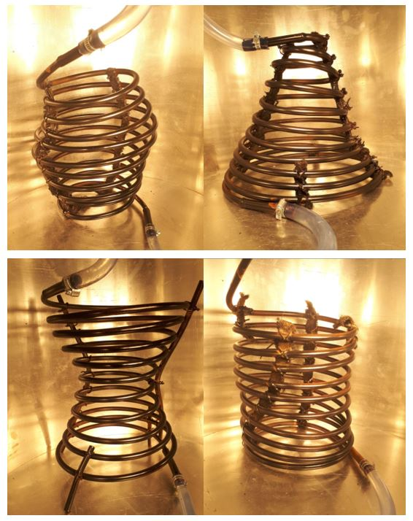
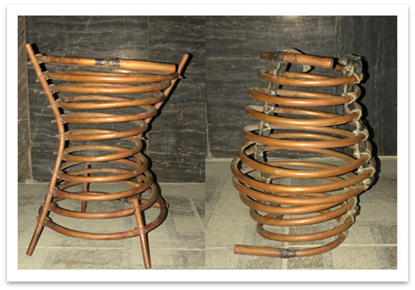
Copper coil color
Original Copper Color Black Copper Color

Slide 27
Project Bill of Materials and Budget
Item | Price SR | Item | Price SR
MDF plate | 90 | Thermometer | 250
Assembly Labor | 50 | Heater | 120
Labor cut | 15 | Control Valve | 15
Glass | 100 | Fitting PVC | 30
Labor work glass | 50 | 10m Hose | 30
4 Tires | 32 | Light | 60
Handle | 6 | PVC Pipes | 50
Aluminum Foil | 50 | Copper Coil with Labor | 500
Aluminum Sheet bended | 150 | Banner | 150
Nails | 5 | Books | 300
Glue | 11 | Brochure Poster | 50
Hose | 20 | Pump | 45
Clips | 2
Total Price |  | 2500 SR

Slide 28
CONCLUSION
The objective of our project is to study the heat transfer on different coil geometries by radiation. We are aiming to provide a study after creating experiment on the different coil geometries and how they behave.
Going in line with our country vision by 2030, we are aiming to provide alternative solutions for energy by designing solar thermal collector with different coil geometries.
We have manufactured the collector box along with coil geometries. Also we provided thermometers, manometers, one way valve, controller valve and flow meter to test the system under controlled condition to get accurate results.
The design of this project “extruded parts” were completed using Solidworks Software.

