Slide 1
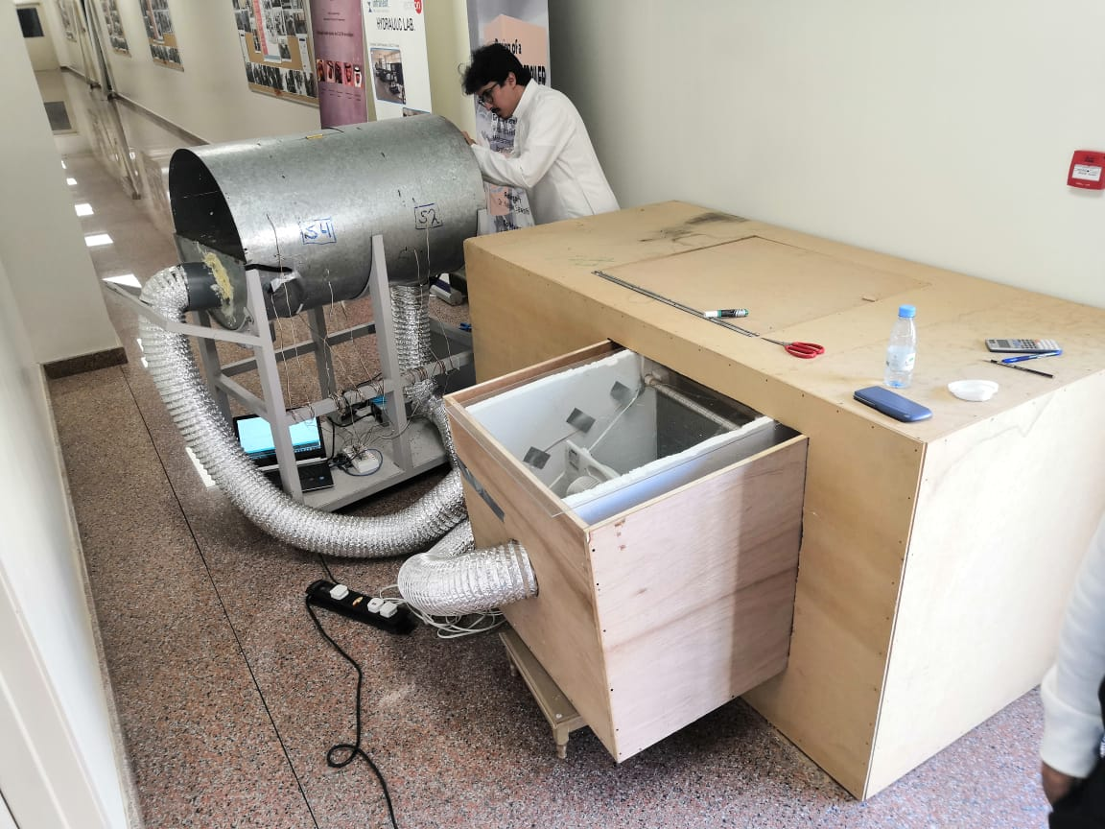

Design and Manufacturing of desiccant disk for use in dehumidifiers and air conditioners
Group : #6
Khalil Ahmed* 201400545
Abdulkarim Alharbi 201401466
Saud Aljar 201402823
Mohammed Alraqtan 201400114
Abdulelah Alshehri 201200553
Project Advisor
Dr. Panos Sphicas
Project Co-Advisor
Dr. Mohammed Almahdi

Slide 2
Outline
Objectives
Background & Motivation and relevance
Design Constraints Engineering Standards & Design specification
Conceptual Design, Calculations & fabrication
Experimental setup, Testing & Results
Conclusion & Feature Recommendation

Slide 3
Objectives
1
1. Improve the instrumentation and data acquisition (newer and more thermocouples, installed fan anemometers, installed more RH sensors).
2. Design and build a direct and an indirect evaporative cooler. Test and compare the results from the two coolers.
3. Installed DC fans that can be powered by a 12V 15amp Battery.
4. Create inspection hatch and close leaks in the desiccant disk.
5. Test the system and acquire new improved data.

Slide 4
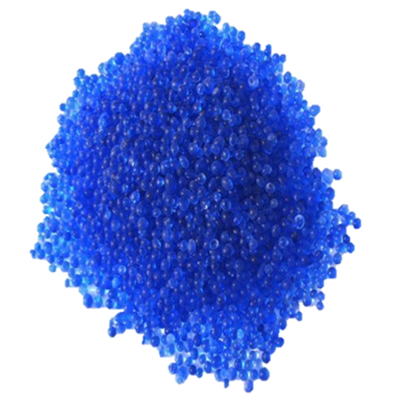
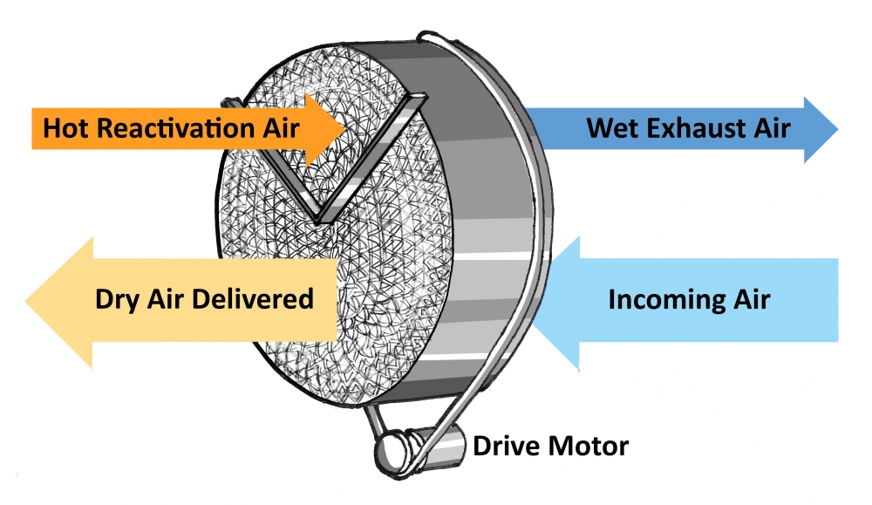
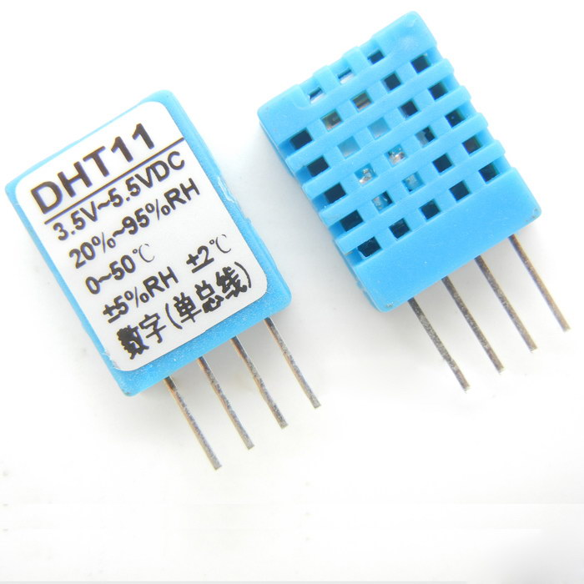
Background & motivation and Relevance
2
Silica Gel
DHT11 Sensors

Slide 5
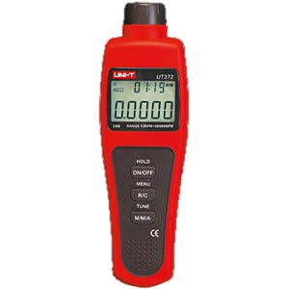
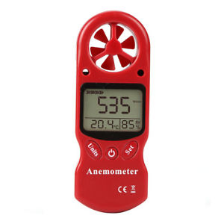
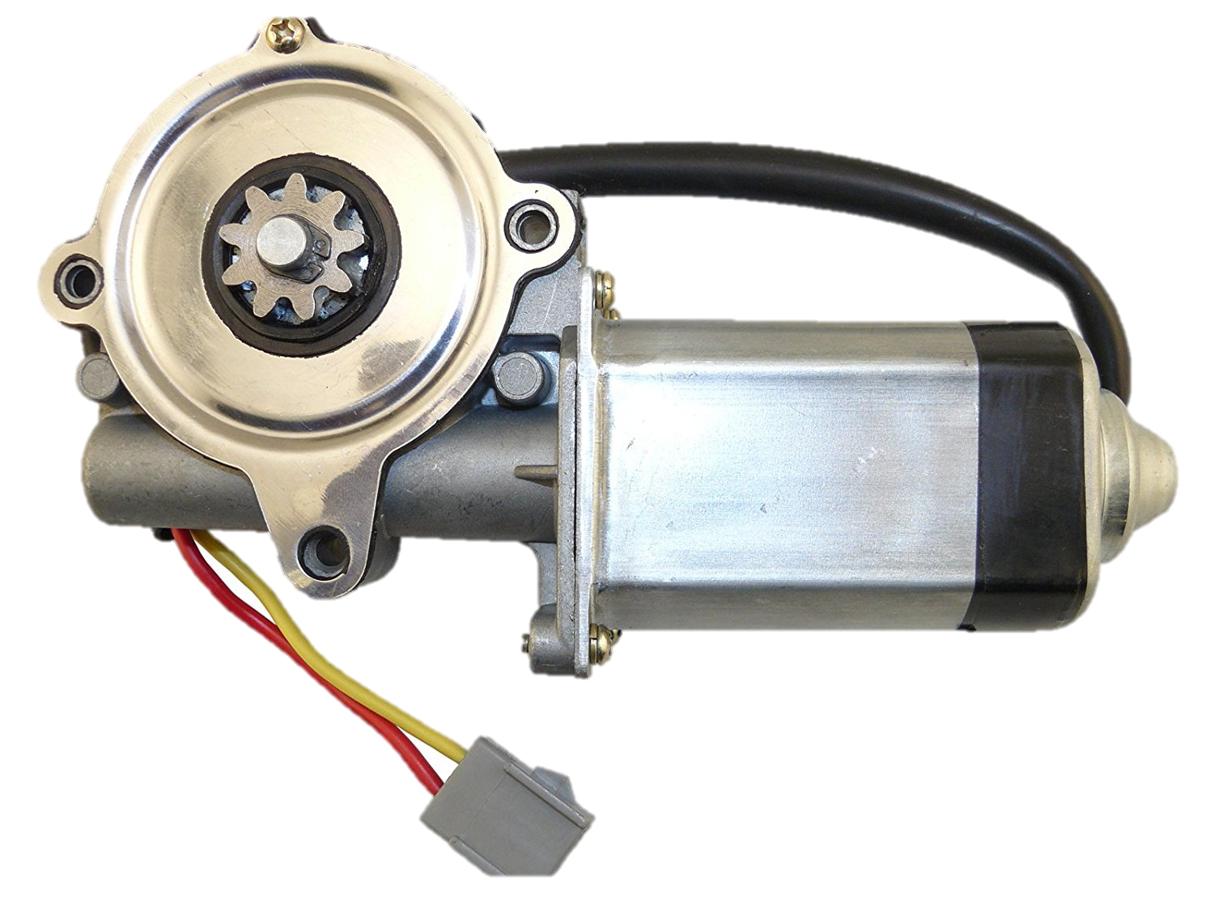
Design & Specifications
3
Anemometer
Tachometer
10-100000 RPM
Fan
52 RPM
19 N.M

Slide 6
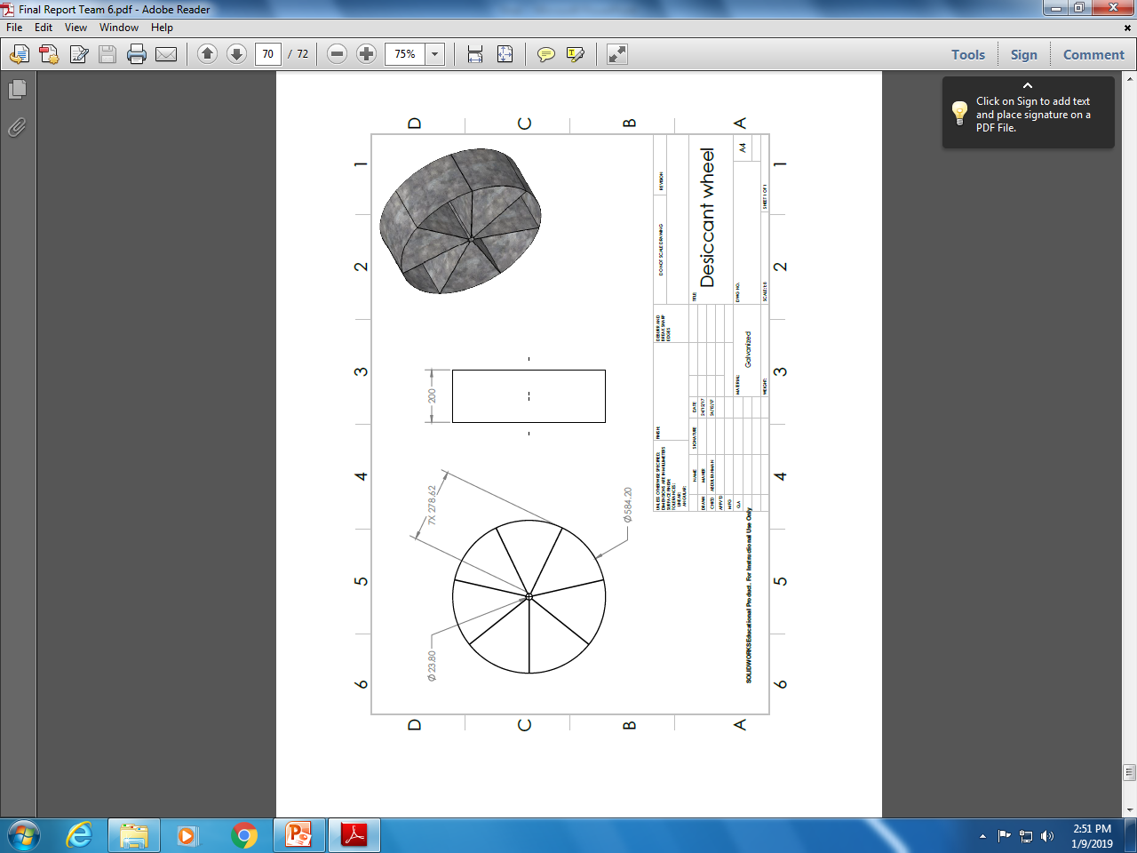
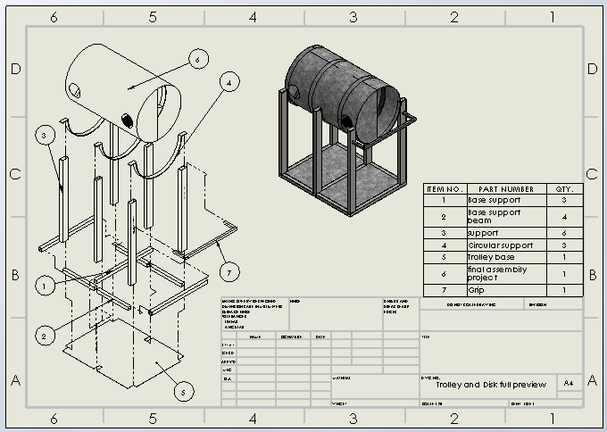
Design & Specifications

Slide 7
Design & Specifications
3
#No. of sensor | Place of sensor
Sensor 1 | Hot Air
Sensor 2 | Dry Air( outlet to evaporator )
Sensor 3 | Hot Wet Air
Sensor 4 | from room after evaporative cooler
1
4
2

Slide 8

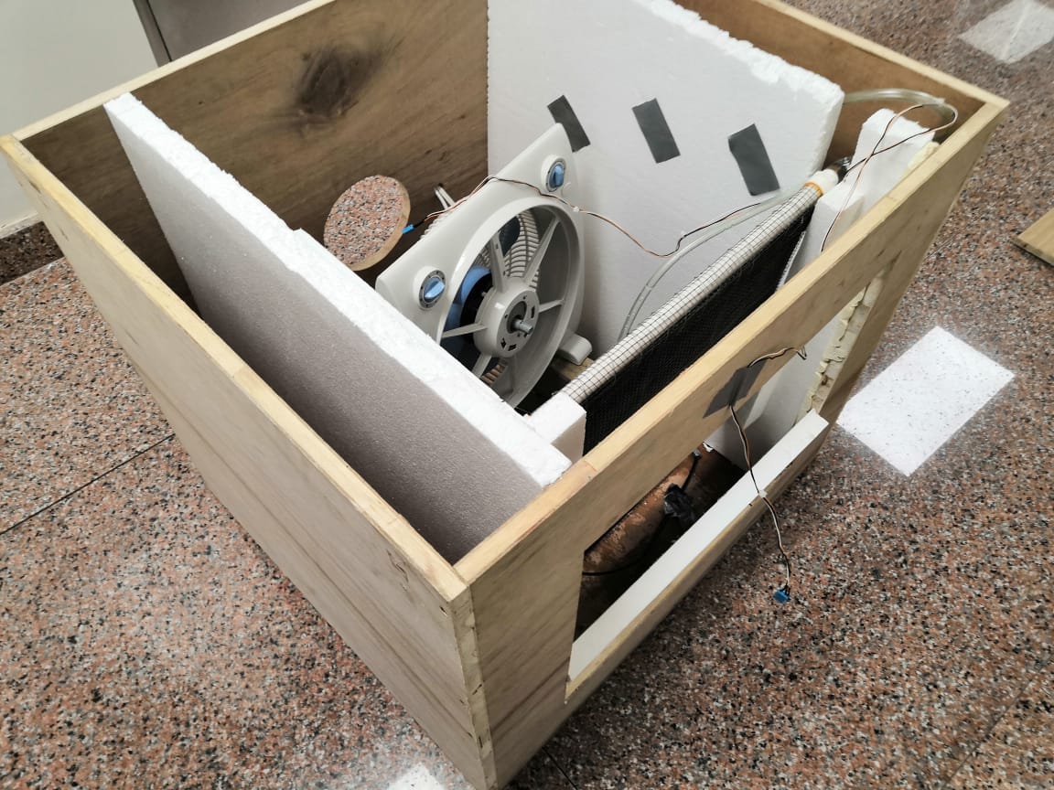
Design & Specifications
Humidity and Temperature Sensors on Arduino
#No. of sensor | Place of sensor
Sensor 5 | Before evaporative cooler
Sensor 6 | After evaporative cooler
5
6

Slide 9
Constraints
Environments
Economical
Manufacturability
Safety
Sustainability
Geometrical constraints
Engineering standards

Slide 10
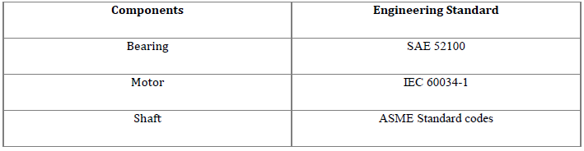
Engineering Standards

Slide 11
Conceptual Design, Calculations & fabrication
4

Slide 12
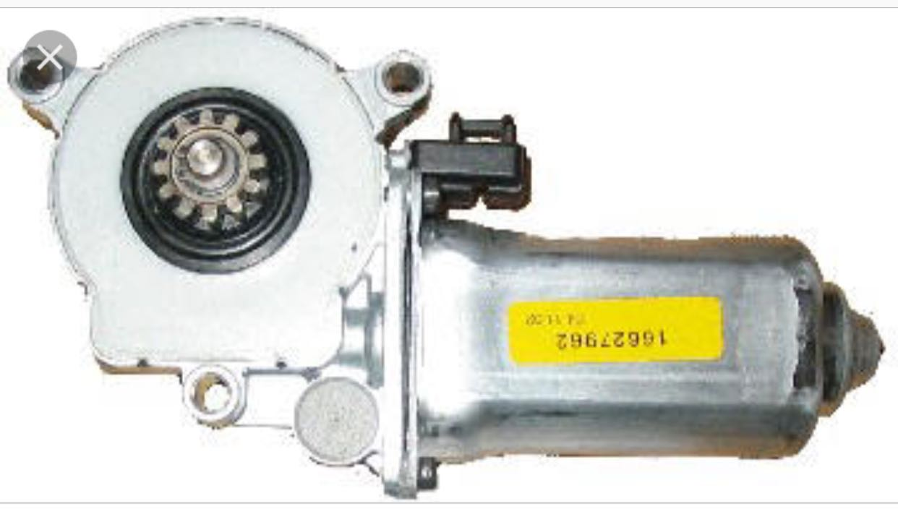
Motor
Item | Type | Speed | Power | Efficiency
Motor | Car window motor for Chevrolet Caprice 1995 | The speed is 52 RPM | The motor should have the appropriate torque to rotate the desiccant wheel 19 N.M | The efficiency should be high to reduce the power consumption of the system.

Slide 13
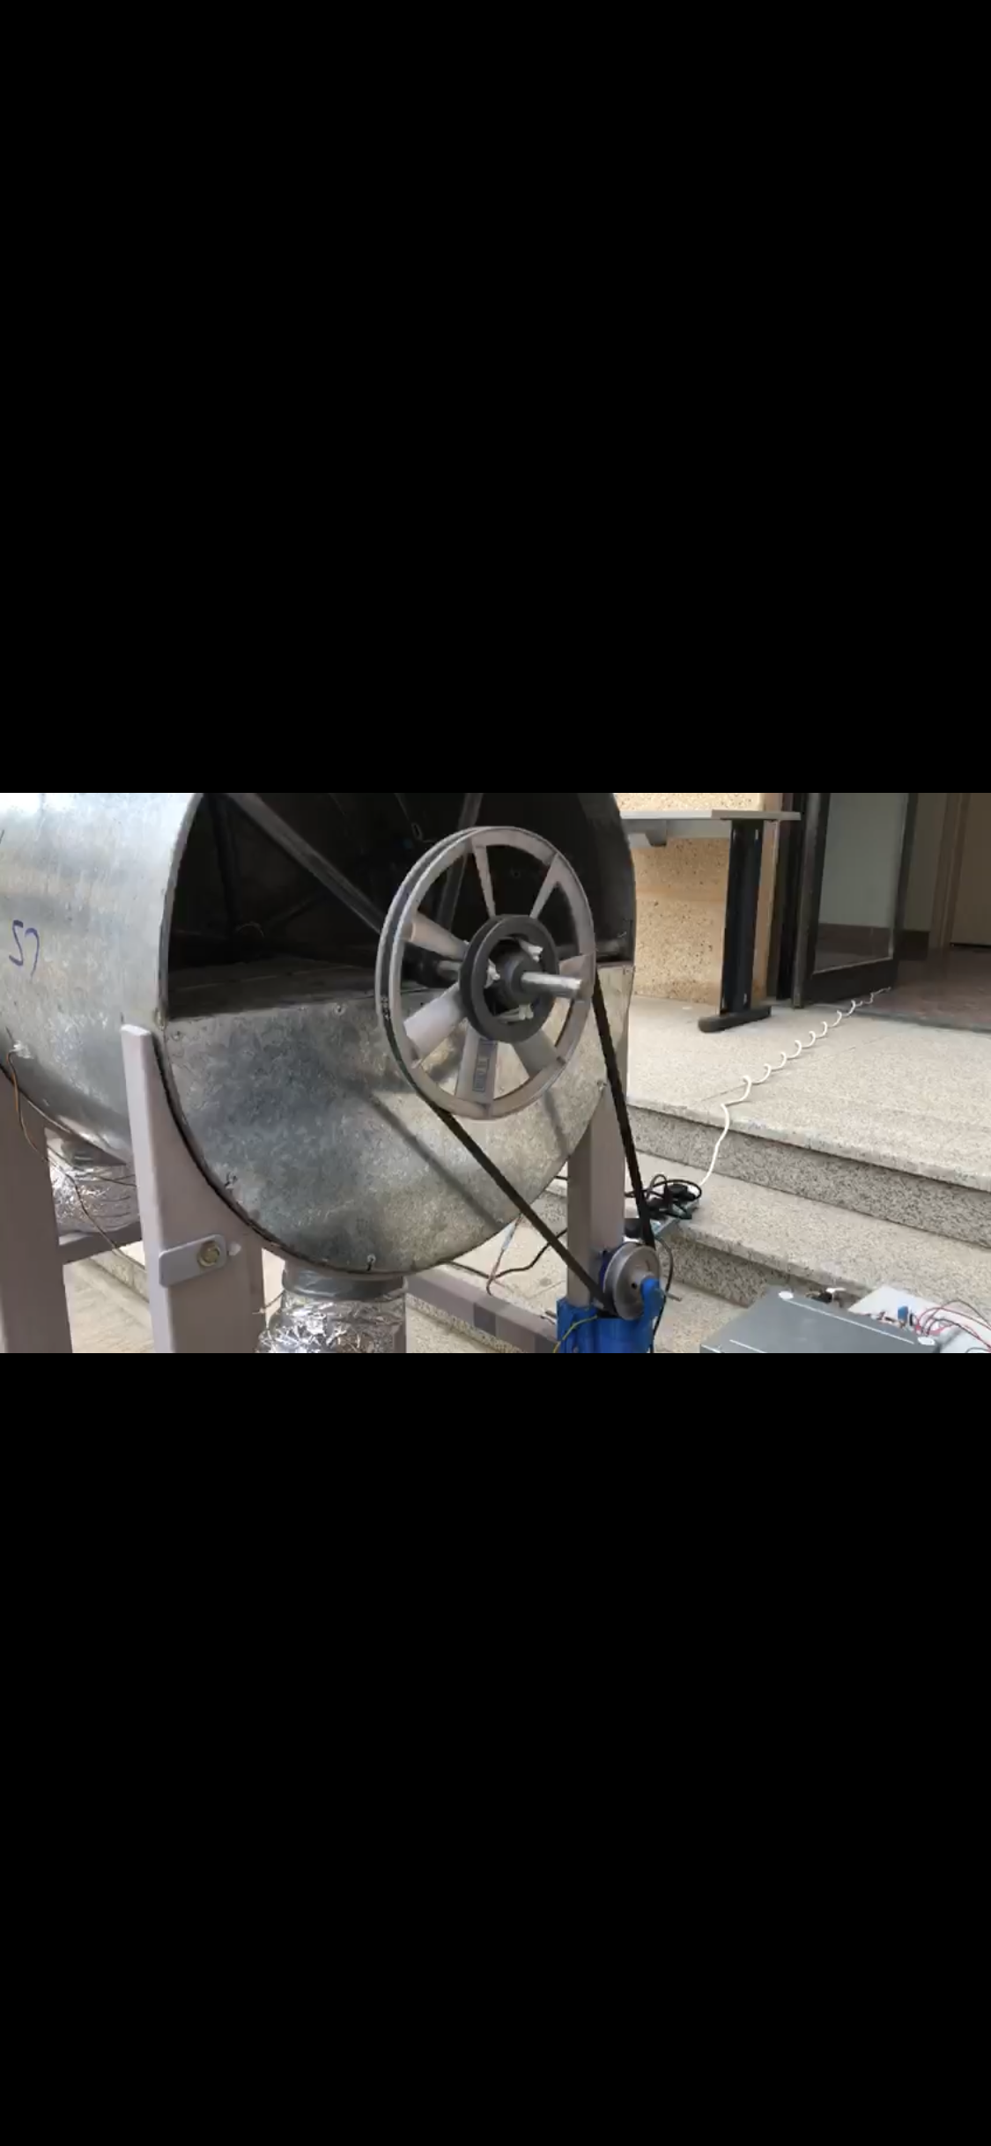
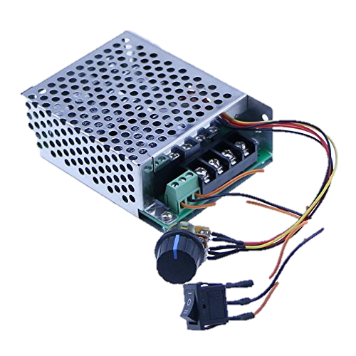
What we need:
- Torque (Disk) = 9 Nm
- RPM (Disk) = 0.08 rpm
1
Car window motor:
- Torque = 19 Nm
- RPM = 52 rpm
2
Using two aluminum
pulleys with
3:1 ratio
3
DC speed controller

Slide 14
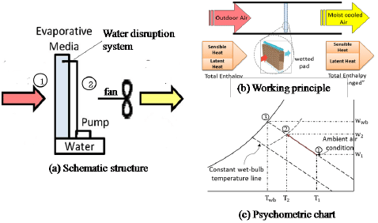
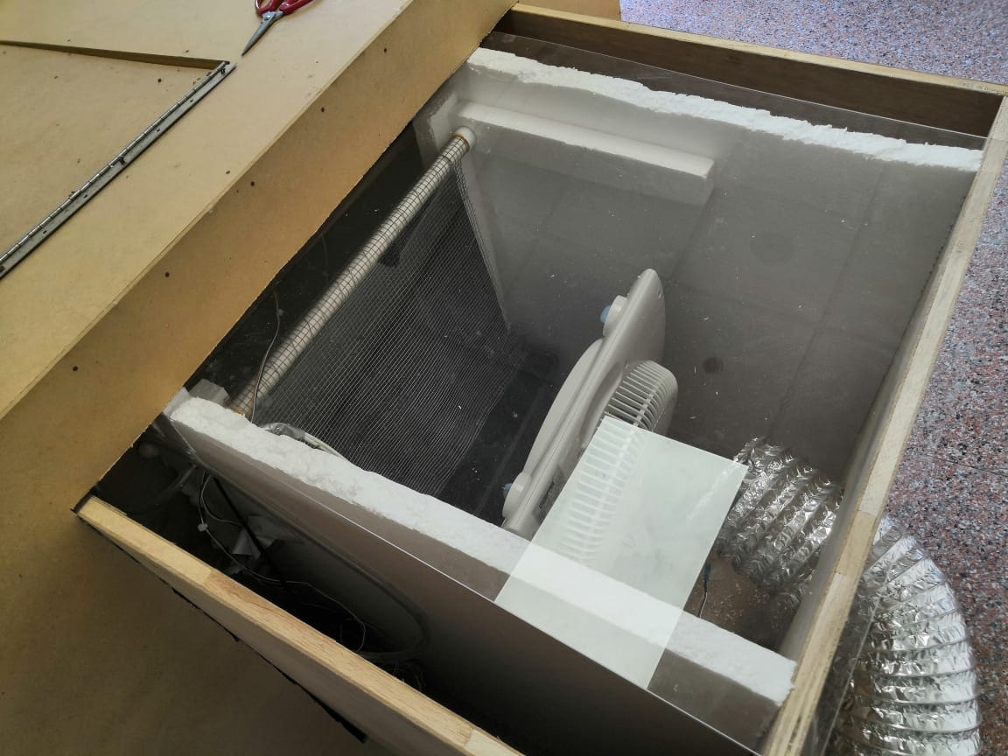
Evaporative Cooler
Evaporator 1
Direct

Slide 15
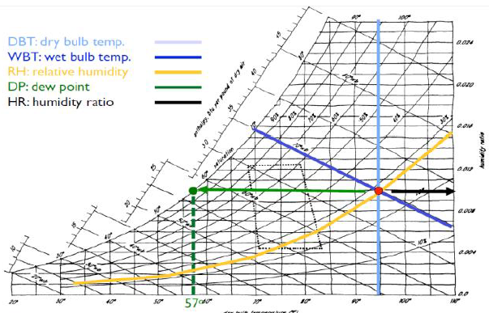
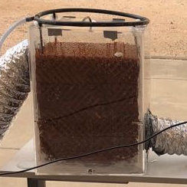
Evaporative Cooler
Evaporator 2
indirect

Slide 16
Overall

Slide 17
Testing & Results
5

Slide 18
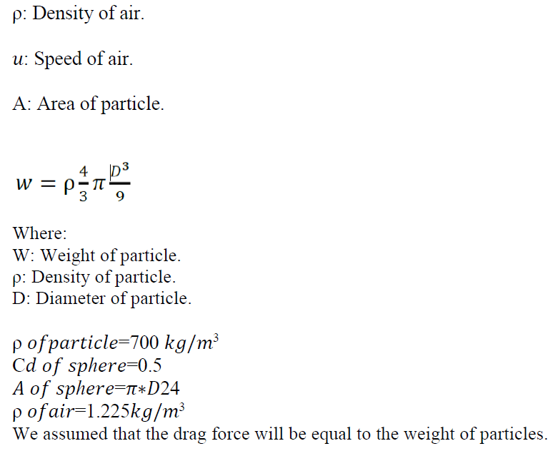
Used Formulas
Speed of air calculation
F =0.5 C𝑑ρ𝑢2𝐴 Equation 1
Equation 2

Slide 19
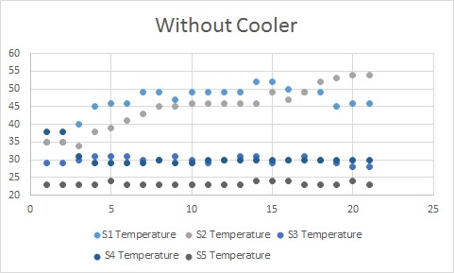
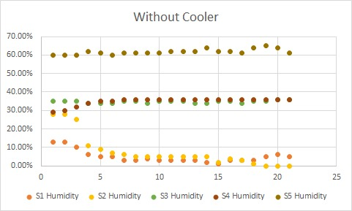
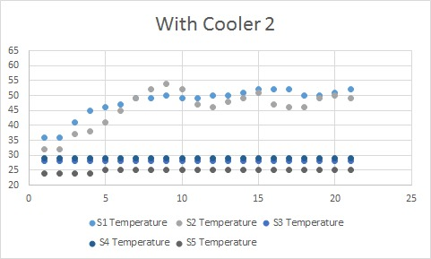
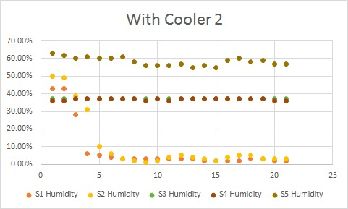
Testing & Results
#No. of sensor | Place of sensor
Sensor 1 | Hot Air
Sensor 2 | Dry Air( outlet to evaporator )
Sensor 3 | Hot Wet Air
Sensor 4 | from room after evaporative cooler
Sensor 5 | Before evaporative cooler
Sensor 6 | After evaporative cooler

Slide 20
Conclusion& Recommendation
6
Make it a solar energy dependent
Changing the Silica gel from time to time
Find an alternative solution to measure Velocity

Slide 21
Regards

