Slide 1

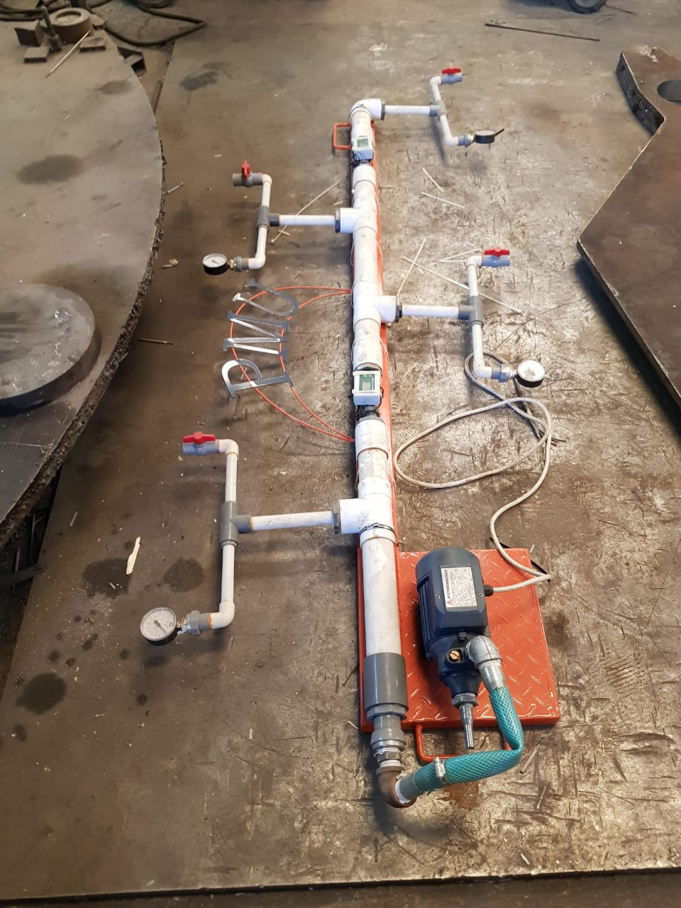
Design and Construction of a Piping Network System for Domestic use
Group#7
Mohammed Al-Nasheri 200901642
Madi Al-Hajri 201202517
Fahad Al-Jubreen 201300079
Omar Hassan 201300315
Mohamad Al-Boushi 201303694

Slide 2
Content
Project Objective
Project Background
Engineering Standards
Conceptual Design
Calculations
Testing & Results
Conclusion & Recommendation

Slide 3
Project Objective
Design and Build Water Piping System
Calculate the Major and Minor Losses
Determine Pumping Power Required for the highest head losses.
Compare the theory outcome with experimental measurements

Slide 4
Project Background
Water distribution system for domestic sustainability
Water piping systems are used everywhere
System Importance

Slide 5
Project Background
Theoretical and experimental
Calculate the major and minor losses
Determine the pumping power requirements

Slide 6
Engineering Standards
ASME B31.1 :
  Low Pressure pipes
    Nominal diameter (4 to 24 inch)
  Internal pressure 545 kPa (79 psi) or less
  High Pressure pipes
  Nominal diameter (0.5 to 27 inch)
  Internal pressure 550 to 2170 kPa (80 to 315 psi)

Slide 7
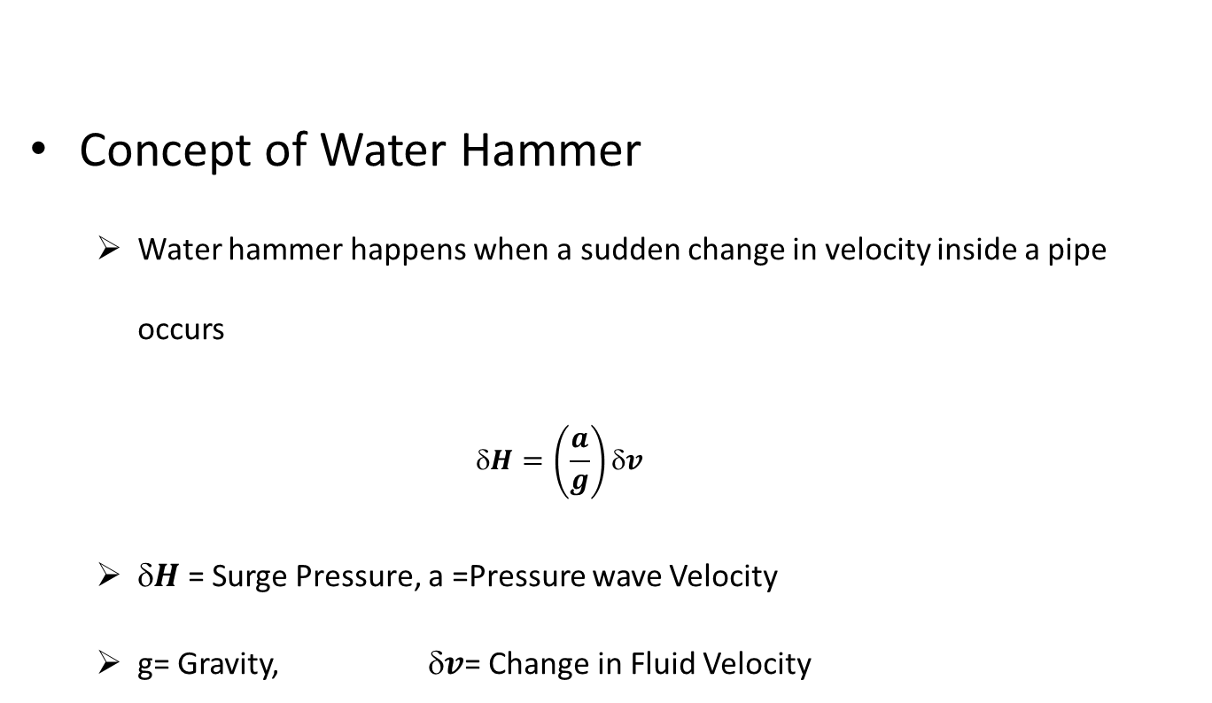
Engineering Standards
Concept of Water Hammer
  Water hammer happens when a sudden change in velocity inside a pipe occurs
  $$H=\left(\frac{a}{g}\right)δv$$
  $H$ = Surge Pressure, a =Pressure wave Velocity
  g= Gravity, $v$= Change in Fluid Velocity

Slide 8
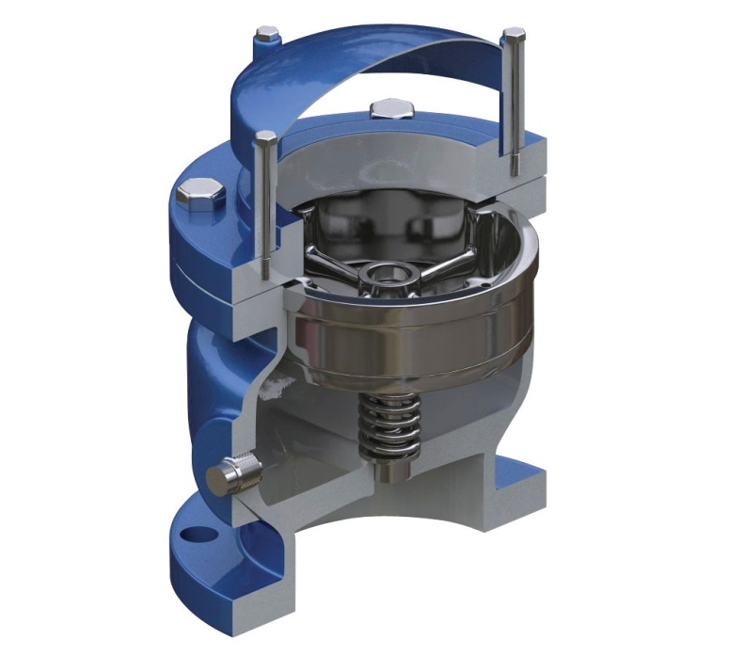
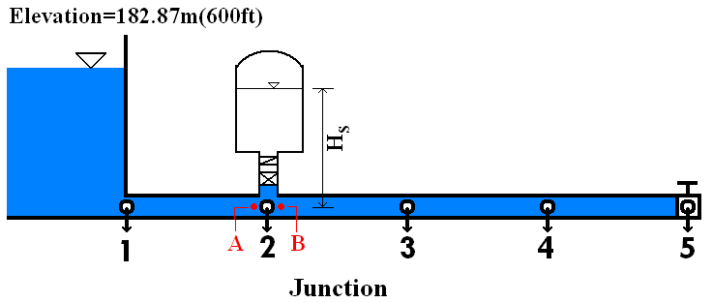
Engineering Standards
Pipeline System Safety
Air in Pipelines
Air release-vacuum relief valves
Surge Tanks

Slide 9

Conceptual Design
Q= V x A
Re = $\frac{Vx D}{M}$ → if Re > 4000 → f = $\frac{.025}{({Log\left(\frac{k}{3.7D}+\frac{5.74}{{Re}^{0.9}}\right))}^{2}}$
→ if Re < 4000 → f = $\frac{64}{Re}$
$k$ is Roughness Factor

Slide 10
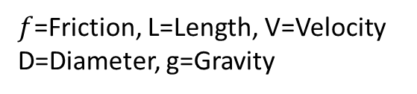


Conceptual Design
Darcy-Weisbach Friction Head loss Equation
HL Major = $\frac{f L V^{2}}{D 2 g}$→
HL Minor = $\frac{KL V^{2}}{2 g} \text{→}$
Pumping Power Requirement
  P = $\frac{Q x H x g x \text{p}}{Pump Effeciency}$
$f$=Friction, L=Length, V=Velocity
D=Diameter, g=Gravity
K=Factor from the table
Q =Mass Flow-Rate
H =Head Loss
$g$=Gravity
$\text{p}$=Density

Slide 11
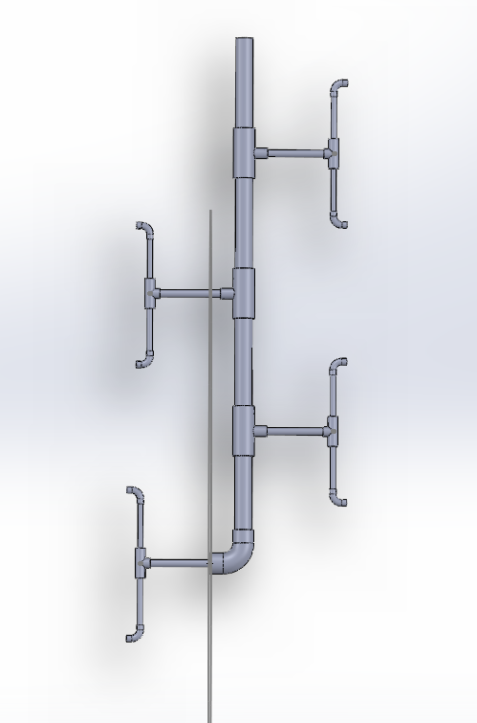
Conceptual Design
Collapse View

Slide 12
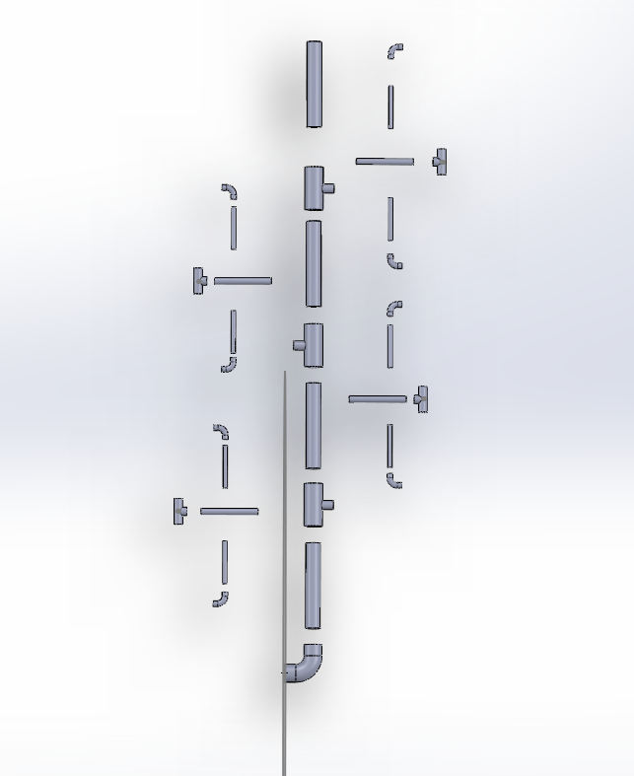
Conceptual Design
Exploded View

Slide 13
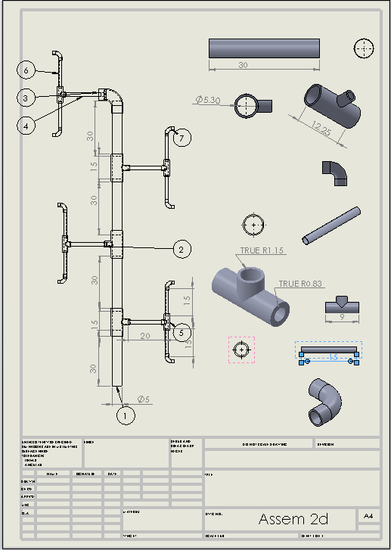
Conceptual Design
2D Drawing

Slide 14
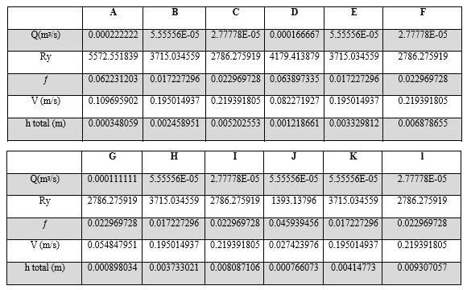
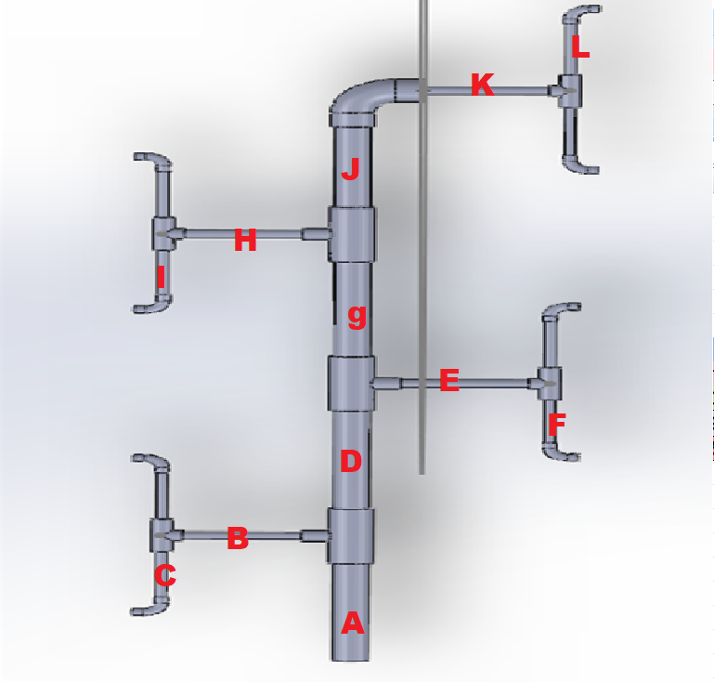
Calculations

Slide 15
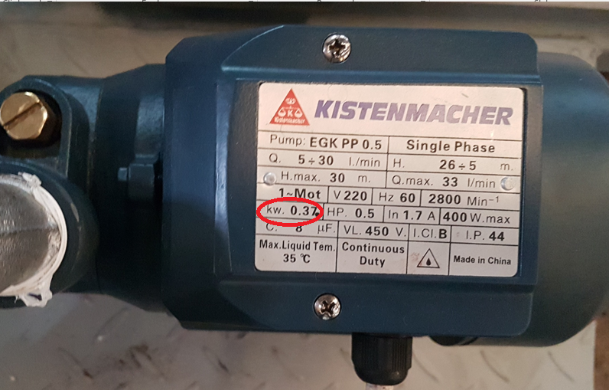
Calculations
Pump power = 0.272706772 kw
And safety factor 1.35
Power needed = 0.3565 KW

Slide 16
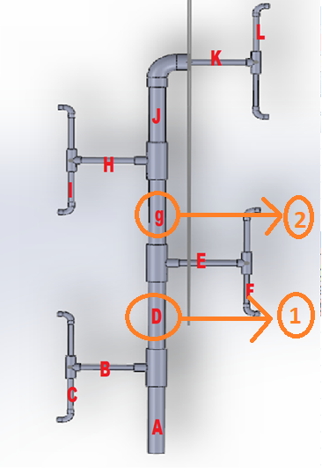
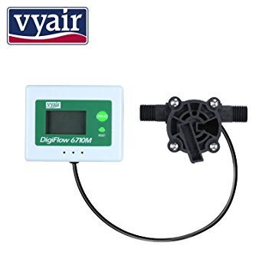
Testing & Results
Compare the theory with experimental measurements:
2 Digit-Flow Sensor
In our calculation
  First Q1= 9.99 L/m
  Second Q2= 3.3 L/m
Flow Digi reading
  First Q1= 7.22 L/m
  Second Q2= 2.87 L/m

Slide 17
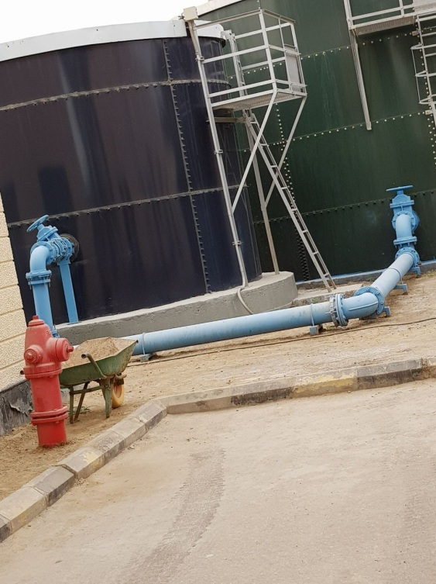
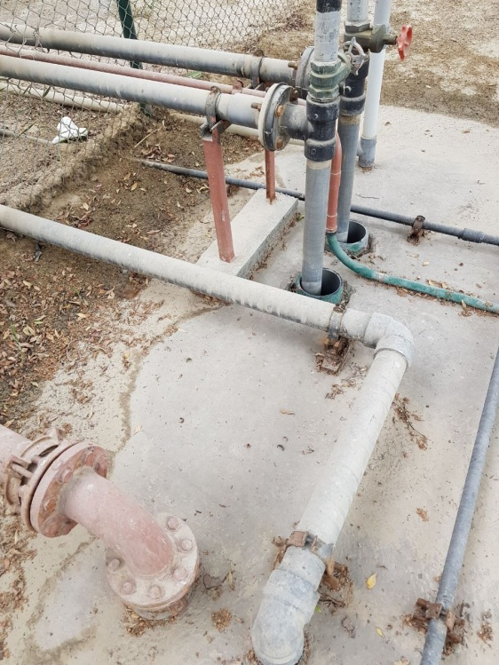
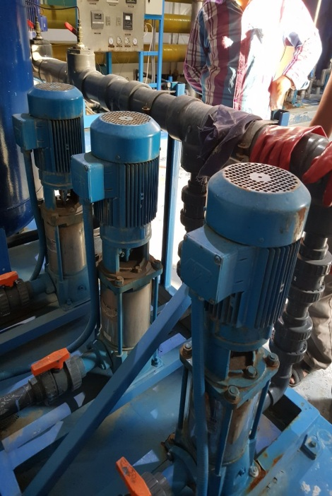
Conclusion & Recommendation
  Site Visit
  Full calculations of the Flow for the System
  Major Head Loss calculations for the System

Slide 18
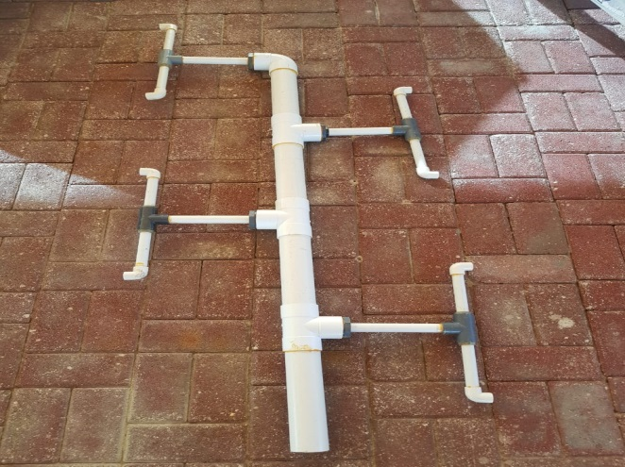
Conclusion & Recommendation
  CAD design, purchase the materials & prototype built
  Measurement and testing of the piping system
  Compare the theory with the experiment data

Slide 19
Conclusion & Recommendation
  Add more Digit-Flow Sensor
  Easy on big Scale project
  Re-calculate in different angle

Slide 20

Thank You

Slide 21


