Slide 1

College of Engineering
Department of Mechanical Engineering
Fall 2018-2019
Design of Energy Harvesting by Shock Absorber
Done By Team3: Advisor:
Saad Alumari
Nasser Alajmi Dr. Rajuraman Kannan
Saad Alqahtani
Mohammed Alnaimi

Slide 2
Content
Project Objectives
Background
Design Constraints
Conceptual design
Design specifications
Experimental setup
Conclusions

Slide 3
Project Objectives
Capture wasted energy and converted to useful energy
Reduction of fuel consumption
Reduction of air pollution
Applicable for any kind of automobile

Slide 4
Background
Converting Mechanical energy to Electrical energy
Using the shock absorber vibration
Mechanism and generator inside the shock absorber working as a damper

Slide 5
Cont.
Harvesting energy shock absorber can lower fuel consumption by 1.5 to 6 percent, depending on the vehicle and driving conditions
Our system can be used as a power source, we can harvest energy from the vibrations and delivered it to an external battery and it can use as a backup

Slide 6
Design Constraints
Geometrical Constraints
  Typical size of shock absorber between 70-120 mm Dimeter, 400-500 mm Length
  Limited size of mechanism
Motor Constraints
  Dc generator 12volts
  Charge 12 V battery
  High resistance (torque)
  Gear box

Slide 7
Standard
Bevel Gears
  ANSI/AGMA standard 2003-B97
  KHK / PB3-4515 , PB3-1545
Ball Bearing
  AISI52100 steel
  KG International , Single Row – 600 x 53.7 ISQW

Slide 8
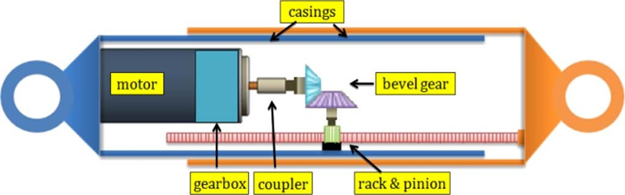
Conceptual design

Slide 9
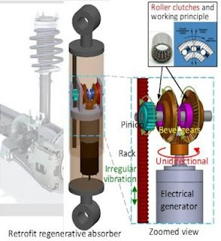
Improvement

Slide 10











Modelling of shock-absorber
Typical Shock Absorber New Shock Absorber Design
$$m_{v}$$
$$m_{v}$$
$$k_{1}$$
$$C_{1}$$
$$C_{1}$$
$$m_{w}$$
$$m_{w}$$
$$k_{2 }$$
$$C_{2}$$
$$k_{2 }$$
$$C_{2}$$

Slide 11

Equation of modelling
$$z=\left[\begin{matrix}C_{1}\left(iw\right)+k_{1}−m_{v}w^{2} & −C_{1}\left(iw\right)−k_{1} \\ −C_{1}\left(iw\right)−k_{1} & \left(iw\right)\left(C_{1}+C_{2}\right)+\left(k_{1}+k_{2}\right)−m_{w}w^{2}\end{matrix}\right]$$
$$x=\left[\begin{matrix}x_{1} \\ x_{2}\end{matrix}\right] ; F=\left[\begin{matrix}0 \\ \left(iwC_{2}+k_{2}\right)H\end{matrix}\right]$$
$$zx=F$$
$$x=z^{−1}F$$

Slide 12
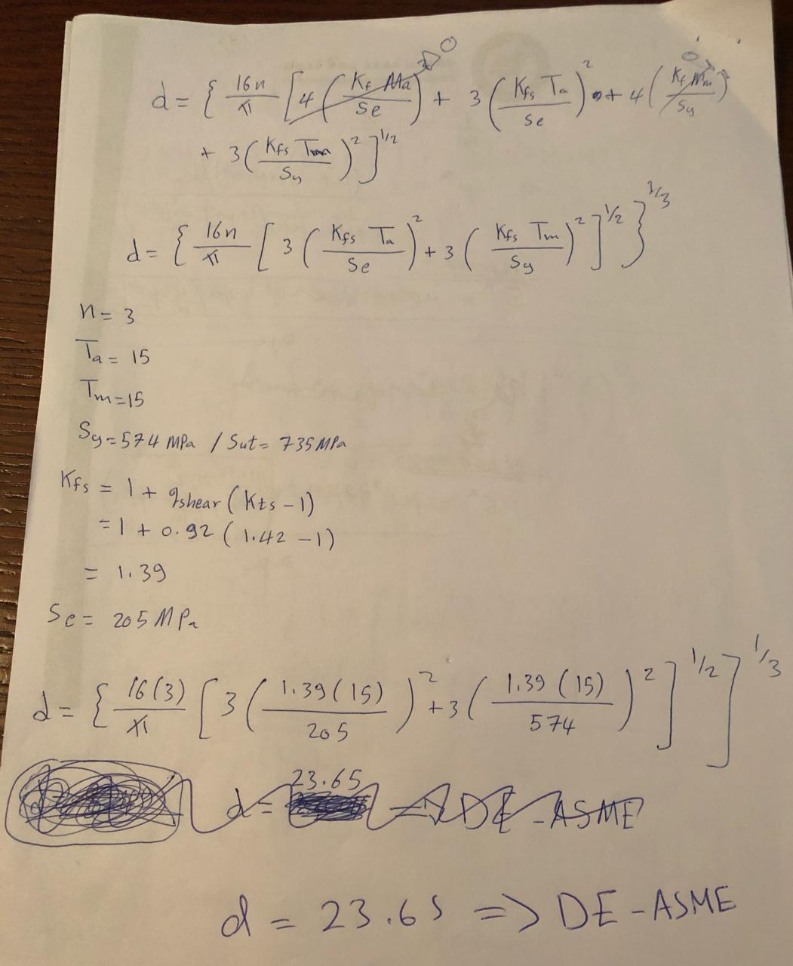
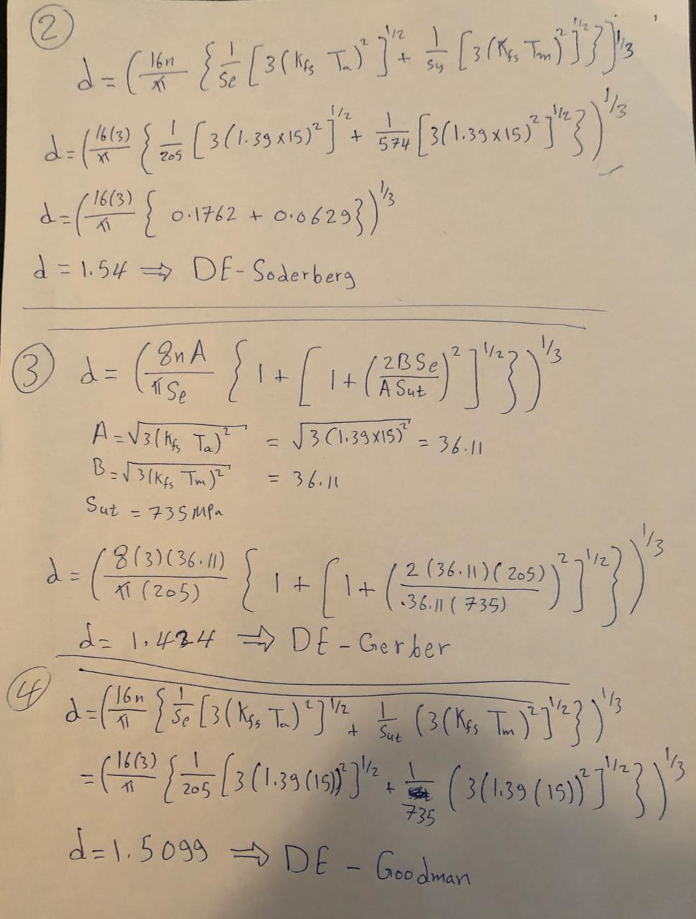
Theoretical calculation
Shaft Calculations

Slide 13
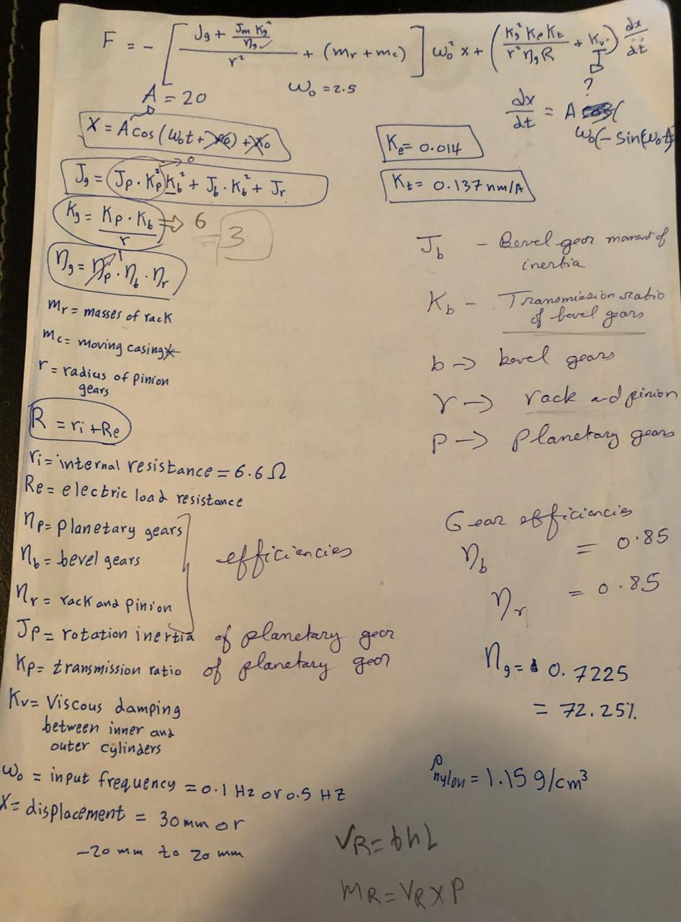
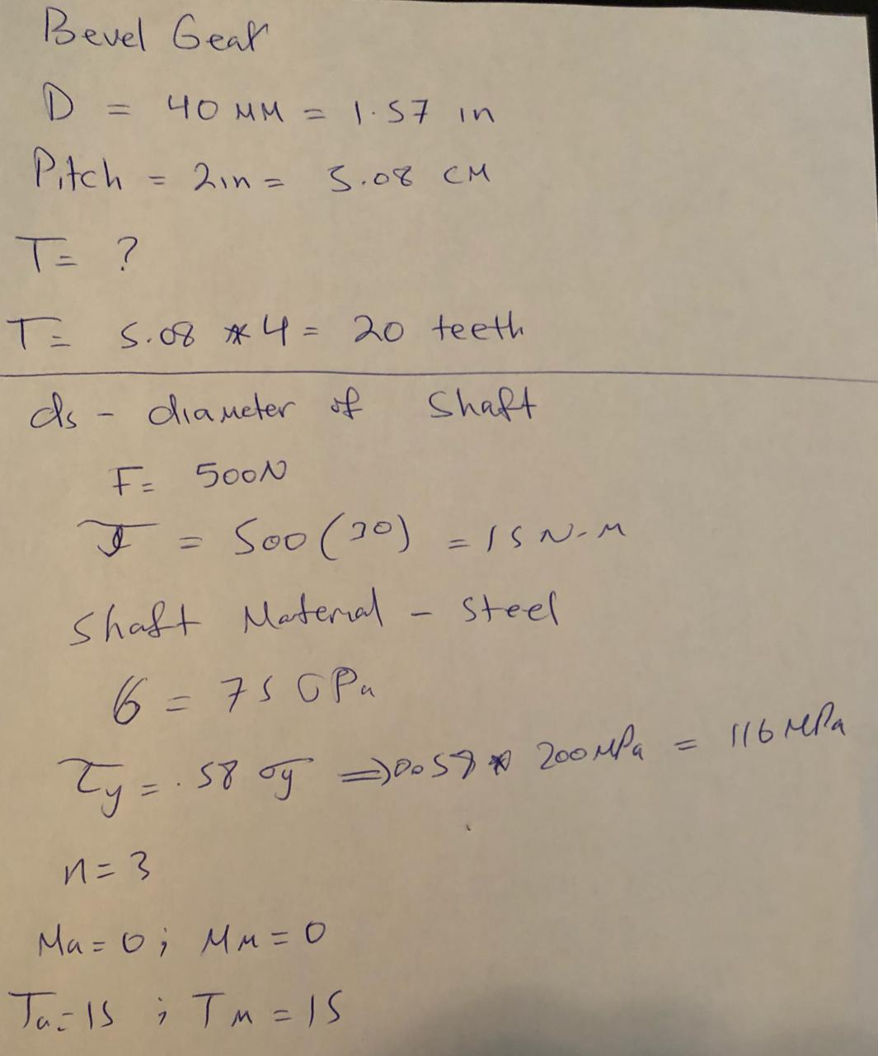
Cont.
Force calculation Bevel gear calculation

Slide 14
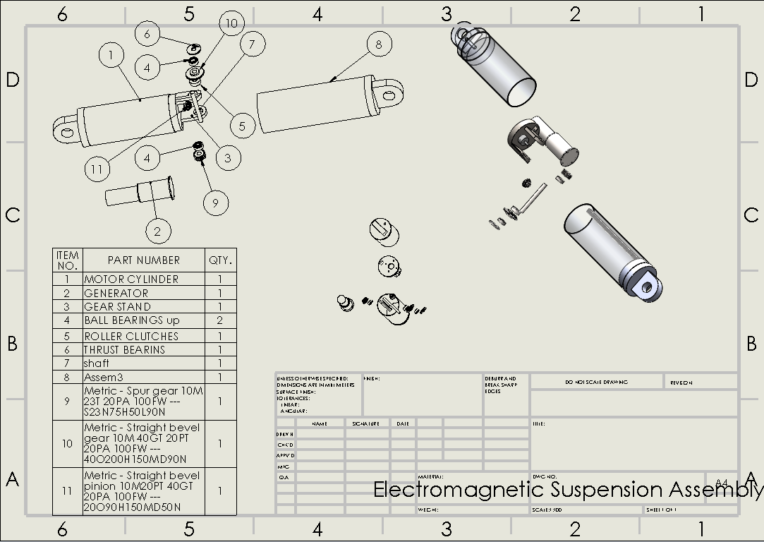
2D Drawing

Slide 15
Item selection
Rack & pinion
Two bevel gear
Shaft
One way roller clutch
DC motor
Ball bearings

Slide 16
Testing and results
Fig. Rpm of generator inside shock absorber and the produced Voltage.
Fig. Rpm of generator inside shock absorber and the produced Current in different speeds.

Slide 17
Testing and results
RPM | Voltage | Current | Power (W)
150 | 0.6889 | 0.0569 | 0.039198
250 | 1.243 | 0.1027 | 0.127656
350 | 1.411 | 0.1166 | 0.164523
450 | 1.788 | 0.1469 | 0.262657
550 | 2.075 | 0.1714 | 0.355655
650 | 2.731 | 0.2257 | 0.616387
750 | 3.085 | 0.2549 | 0.786367
850 | 3.259 | 0.2693 | 0.877649
950 | 3.667 | 0.3028 | 1.110368
1050 | 4.012 | 0.339 | 1.360068
Fig. The power output during different speeds.

Slide 18
Conclusion and future recommendation
Use lighter material
Upgrade the motor
Use one way roller clutch and two bevel gears to convert
two way rotation to one way rotation
Use planetary gears to increase rotation speed of shaft
connected to motor

Slide 19
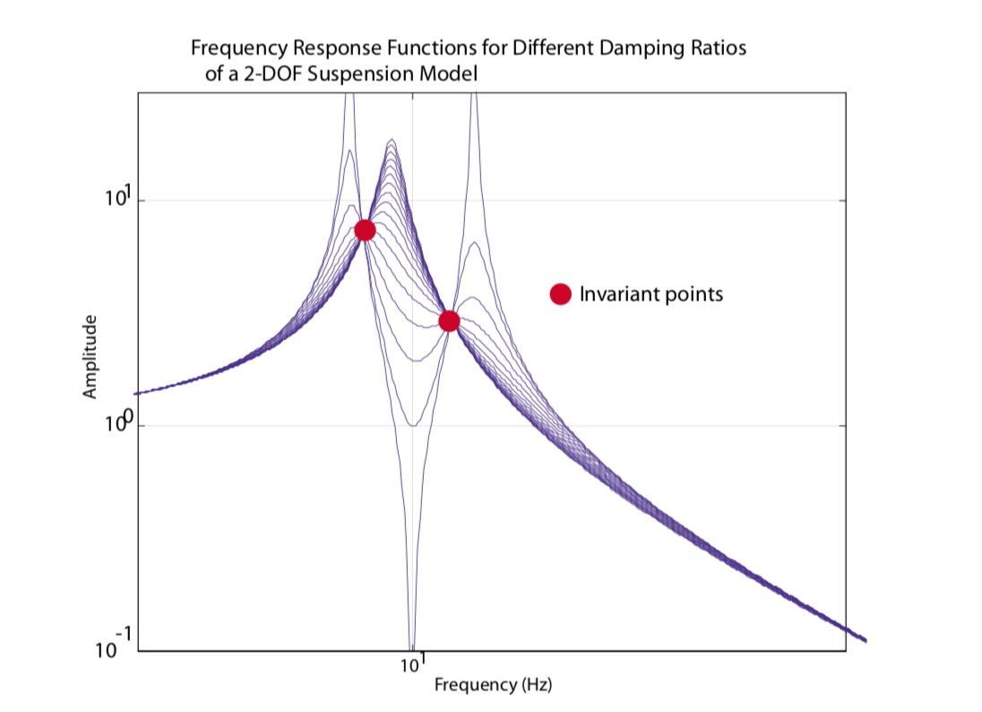







Conclusion and future recommendation
Optimize power output by changing the damping constant corresponding to motor
$$m_{v}$$
$$z=\left[\begin{matrix}C_{1}\left(iw\right)+k_{1}−m_{v}w^{2} & −C_{1}\left(iw\right)−k_{1} \\ −C_{1}\left(iw\right)−k_{1} & \left(iw\right)\left(C_{1}+C_{2}\right)+\left(k_{1}+k_{2}\right)−m_{w}w^{2}\end{matrix}\right]$$
$$x=\left[\begin{matrix}x_{1} \\ x_{2}\end{matrix}\right] ; F=\left[\begin{matrix}0 \\ \left(iwC_{2}+k_{2}\right)H\end{matrix}\right]$$
$$zx=F$$
$$x=z^{−1}F$$
$$k_{1}$$
$$C_{1}$$
$$m_{w}$$
$$k_{2 }$$
$$C_{2}$$

Slide 20
