Slide 1

PRINCE MOHAMMAD BIN FAHD UNIVERSITY
College of Engineering
Department of Mechanical Engineering
Fall 2018 -2019
Project Title
Design of a Water Jet Cart
Advisor: Dr. Aymen Jendoubi
Students:
Abdullatif Alnaeem, 201300820
Ahmed Zarea, 201401994
Ayed alshammari, 201500404
Saleh Bin Matar, 201400491
Fawwaz Aldossary, 201202152
Abdullah Mohsen, 201203277
Group #2

Slide 2
Outline
Introduction and motivation
Objectives
Design Constraints
Calculations
Results
Conclusions and future recommendations

Slide 3
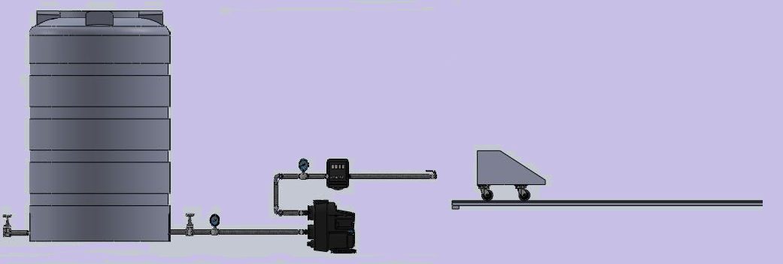
Introduction
Designing a jet cart system to provide power by using kinetic energy of water to move the cart.
The work, the system design, and the efficiency done by the jet system are calculated carefully using engineering tools.

Slide 4
Objectives
1. Design a cart based on standards that would be best for maintaining stability.
2. Design water jet system to produce an exact calculated pressure of water to propel the cart.
3. Understand and apply the basic concepts of Fluid Mechanics to carry out professional engineering activities in the field of fluids

Slide 5
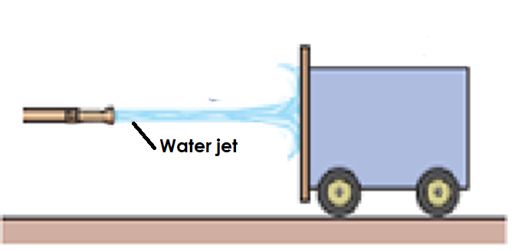
Importance
Analyze and understanding the jet system and the basic working principle of simple jet.
Determine flow rates, pressure changes, minor and major head losses for viscous flows through pipes,
Understand the effects of pumps, pipes and fittings in such systems and Design simple pipe systems to deliver fluids under specified conditions.

Slide 6
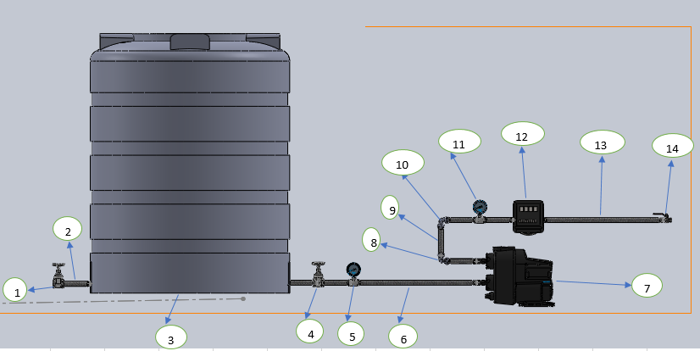
Conceptual design
1- Gate valve 2- 1 inch pipe 3- water tank
4- Gate valve 5- pressure gauge 6- 1 inch pipe
7- Water pump 8- 90 degree elbow 9- 1 inch pipe
10- 90 degree elbow 11- pressure gauge 12- flow meter
13- 1 inch pipe 14- ball valve

Slide 7
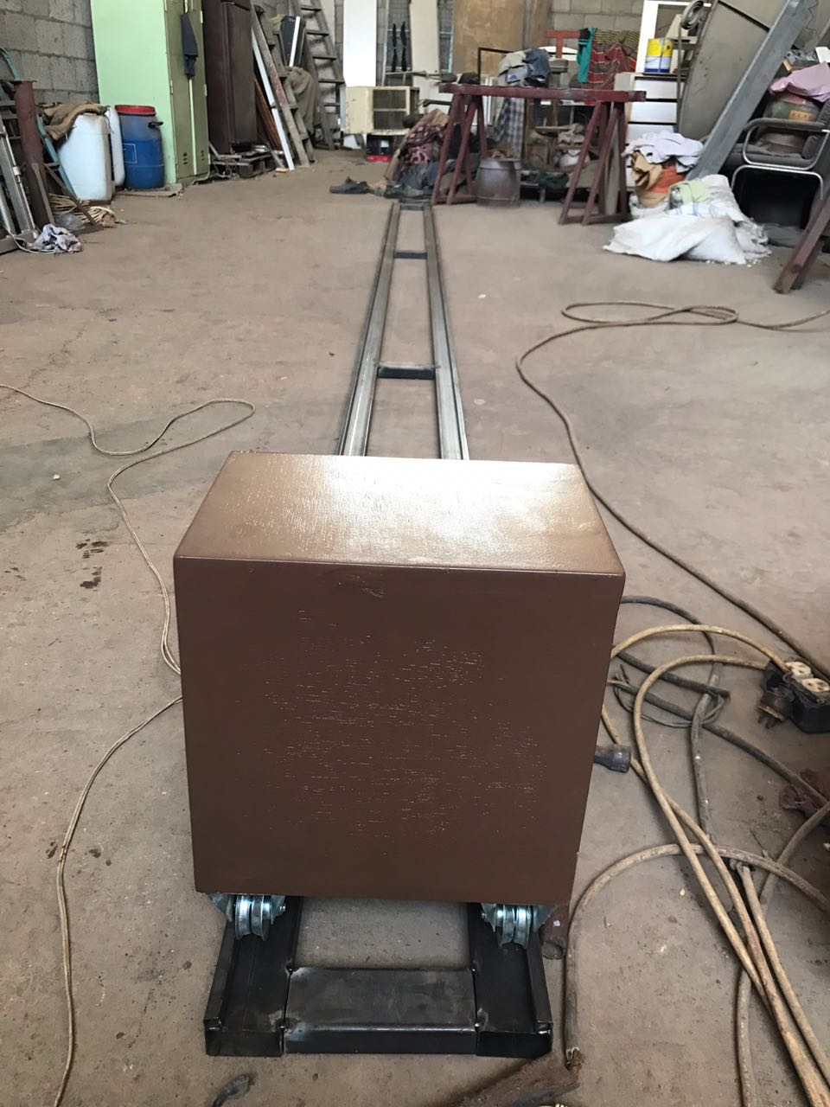
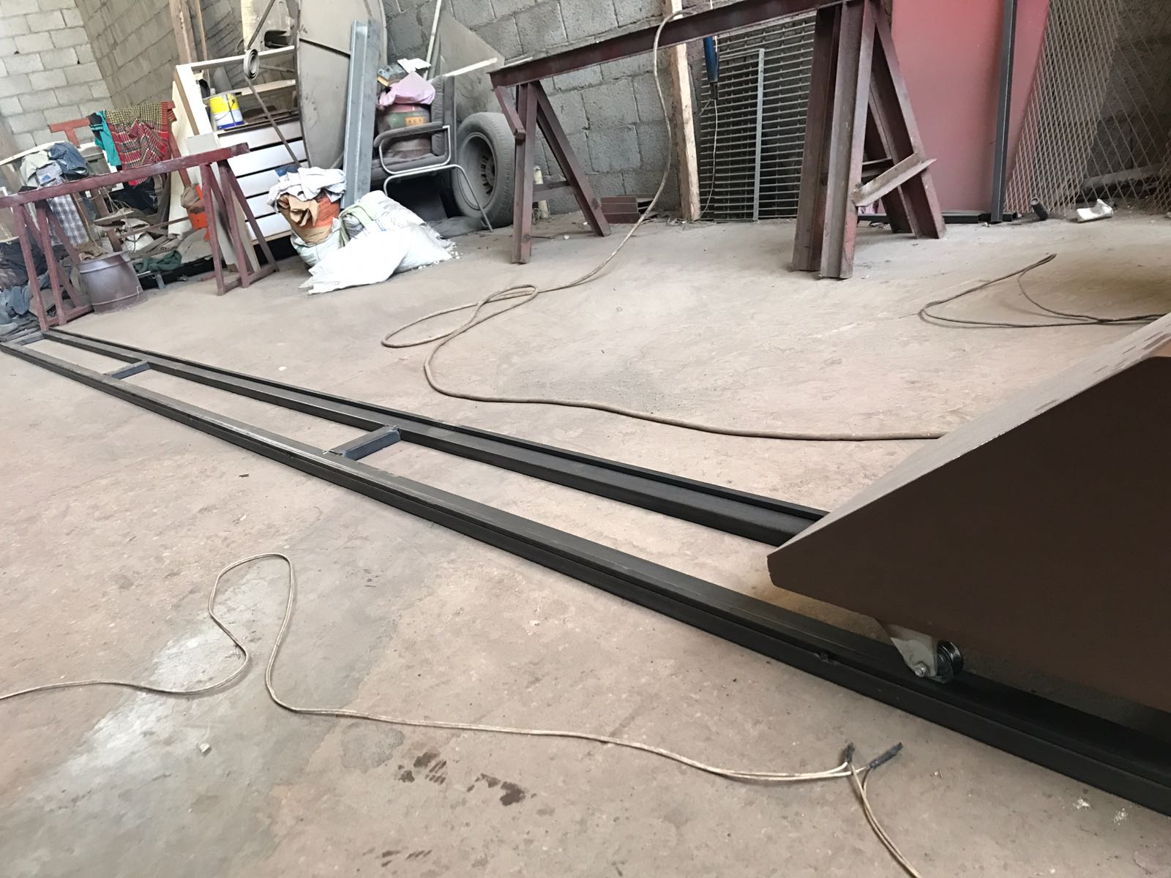
Cart Design
Material used: Wood make the cart very light weight.
Front shape inclined reduce the level of aerodynamic resistance.
The wheel of cart is steel wheel because the idea is running the cart in railway to make the calculation of friction force between the wheel and the railway easier.

Slide 8
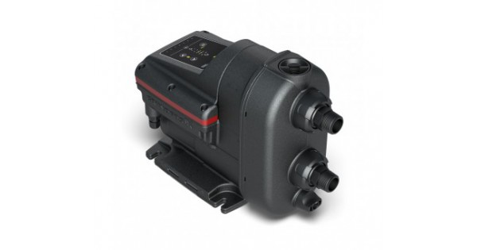
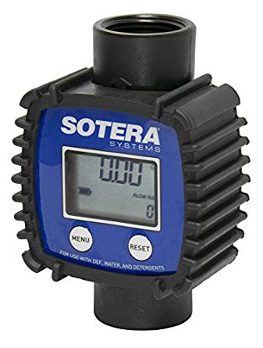
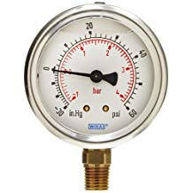
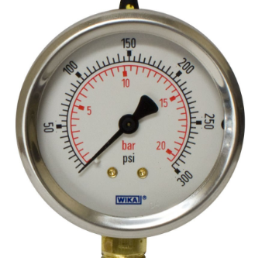
Project Main parts
Variable speed water pump
Flowmeter
Pressure Gauge

Slide 9
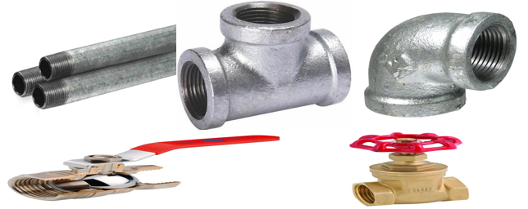
Standard
NPT stands for National Pipe Tapered threads, also known as ANSI/ASME B1.20.1 pipe threads. It is a U.S. standard for measuring tapered threads on threaded pipes and fittings

Slide 10
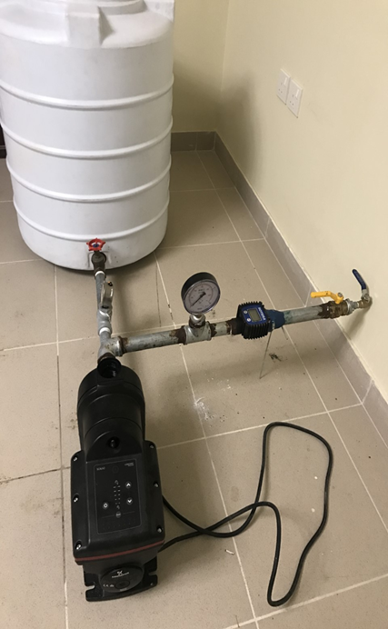
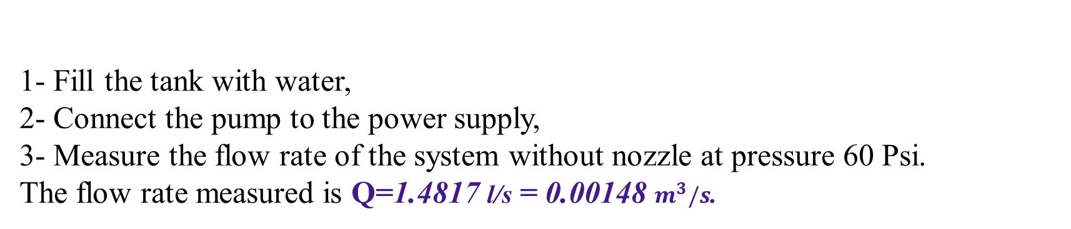
Testing
1- Fill the tank with water,
2- Connect the pump to the power supply,
3- Measure the flow rate of the system without nozzle at pressure 60 Psi.
The flow rate measured is Q=1.4817 l/s = 0.00148 $m^{3}/s$.

Slide 11
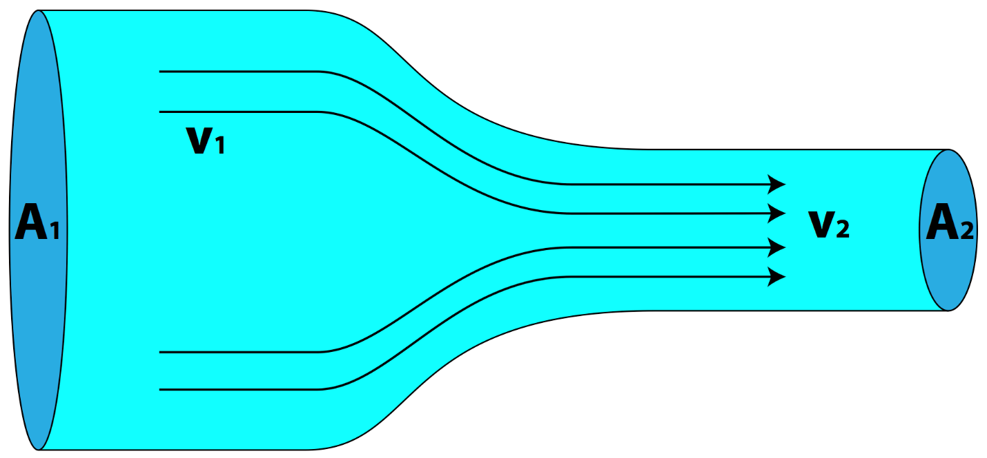
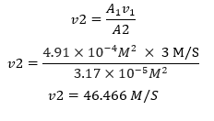
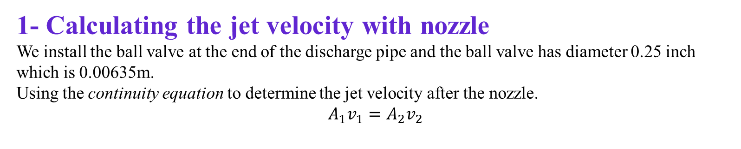
Calculations and Results
1- Calculating the jet velocity with nozzle
We install the ball valve at the end of the discharge pipe and the ball valve has diameter 0.25 inch which is 0.00635m.
Using the continuity equation to determine the jet velocity after the nozzle.
$$A_{1}v_{1}=A_{2}v_{2}$$
We rearrange the equation to find nozzle velocity:

Slide 12
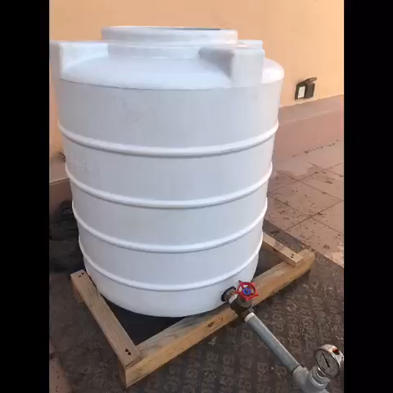
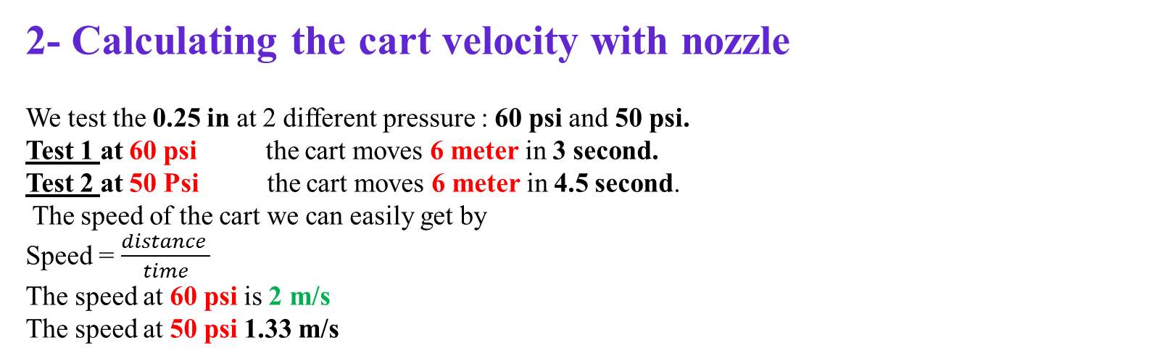
2- Calculating the cart velocity with nozzle
We test the 0.25 in at 2 different pressure : 60 psi and 50 psi.
Test 1 at 60 psi the cart moves 6 meter in 3 second.
Test 2 at 50 Psi the cart moves 6 meter in 4.5 second.
The speed of the cart we can easily get by
Speed = $\frac{distance }{time}$
The speed at 60 psi is 2 m/s
The speed at 50 psi 1.33 m/s

Slide 13
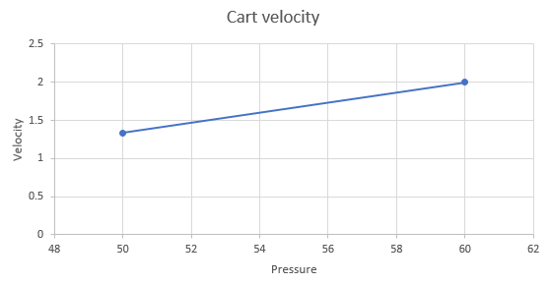
The jet pressure (Psi) and cart speed (m/s)

Slide 14
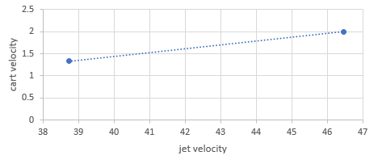
The jet velocity (m/s) and cart velocity (m/s)

Slide 15
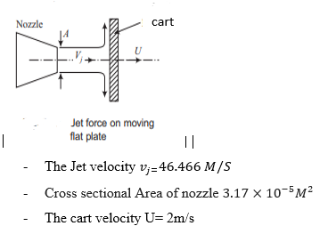
The impact of jet acting in the Cart
We analysis the impact of the jet system at the highest speed of the cart which is 2 m/s.

Slide 16
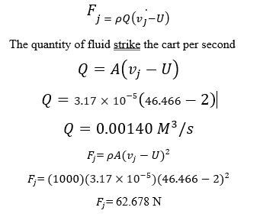

The jet force
The work done by the jet on the Cart

Slide 17
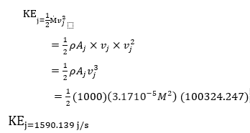
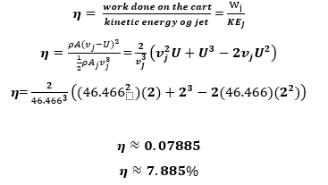
The Kinetic Energy of The system
The Efficiency of the system

Slide 18
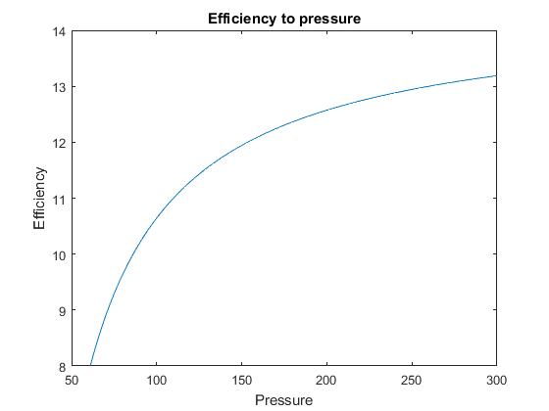

Slide 19
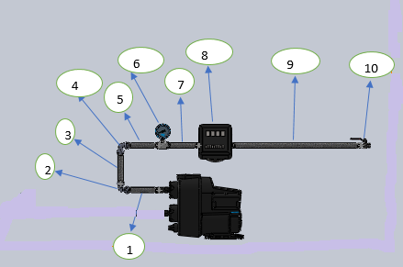
Calculating The Head Losses In The System
h_{loss} = Σ h_{major_losses} + Σ h_{minor_losses}
Where:
h_{loss} = total head loss in the pipe or duct system
h_{major_losses} = major loss due to friction in the pipe
h_{minor_losses} = minor loss due to the components in the system
The major loss will occur in the components number 1, 3, 5, 7, and 9 while the minor losses will occur in the components number 2, 4, 6, 8, and 10.
h_{loss} = Σ h_{major_losses} + Σ h_{minor_losses}
= 0.106 m + 1.44 m
h_{loss} = 1.5536 m

Slide 20
Conclusions
Water jet cart is designed and tested successfully based on engineering solving problems learned at PMU.
The Kinetic Energy of The system designed is calculated and equal to 1590.13 j/s and the velocity of the cart designed is 2 m/s
This project help us to:
improve and enhance our skills in problem solving and to use the engineering skills to find the best way to deal with complex problems in fluid mechanics projects.
use and manipulate many devices such us flow meter, pressure gauges, pumps…
increase our computer skills by programming a C++ program

Slide 21
Future recommendations
To increase the efficiency of our jet system we need to reduce the cart weight.
In any pipe system the connection between pipe and fitting must be same material.
Connecting steel with polymer for example will cause problem in the system like leaking or damaging the tools threaded.
To improve the jet system efficiency do not change the pump size immediately but try to study the system components.

Slide 22
Thank You
Questions ?

