Slide 1

Fully Electric Car with Solar Panels as a Secondary Source of Power

Slide 2
Hello!
Student Name Student ID
Ali Raza 201302233
Abdulaziz Al Momen 201300043
Abdulhadi Al Qahtani 201200290
Abdulaziz Abu Aishah 201300128
Ammar Al Brahim 201302533
Project Advisor Dr. Faramarz Djavanroodi
Project Co Advisor Dr Nader Sawalhi

Slide 3

Out Line
Introduction
Objectives and Motive of The Project
Brief Background
Design and Specification
Experimental Setup, Testing & Results
Summary, Conclusions and Future Work

Slide 4
Instructions for use
EDIT IN GOOGLE SLIDES
Click on the button under the presentation preview that says "Use as Google Slides Theme".
You will get a copy of this document on your Google Drive and will be able to edit, add or delete slides.
You have to be signed in to your Google account.
EDIT IN POWERPOINT®
Click on the button under the presentation preview that says "Download as PowerPoint template". You will get a .pptx file that you can edit in PowerPoint.
Remember to download and install the fonts used in this presentation (you’ll find the links to the font files needed in the Presentation design slide)
More info on how to use this template at www.slidescarnival.com/help-use-presentation-template
This template is free to use under Creative Commons Attribution license. You can keep the Credits slide or mention SlidesCarnival and other resources used in a slide footer.

Slide 5
Objectives and Motive of The Project
1
Let’s start with the first set of slides

Slide 6
One of the fastest ways to build clean energy economy is to allow more people to benefit from it” – Billy Parish AMERICAN ENVIRONMENTAL ENTREPRENEUR, AUTHOR, AND ACTIVIST

Slide 7
Objective
To make a cleaner and cheap source of energy.
To convert a diesel engine buggy to a fully electric car
To make a source of energy which is less dependant on fossil fuels.
Reduce carbon print by using solar panels and rechargeable acid batteries.

Slide 8
Motivation Of The Project
British Petroleum report issued in 2013 based on the proven global oil.
USA environmental Protection Agency Report
Alternatives are either complete electric cars or solar cars.
We chose to go with hybrid electric / solar car to make it more practical
and realistic.

Slide 9
Maps
United States Of America

Slide 10
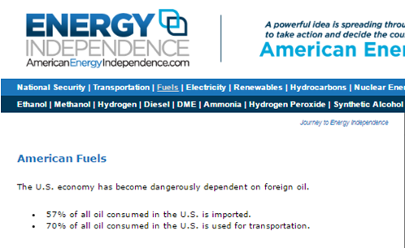
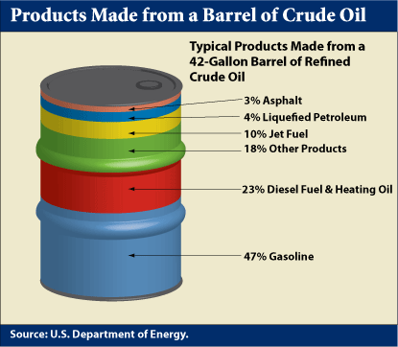

Slide 11
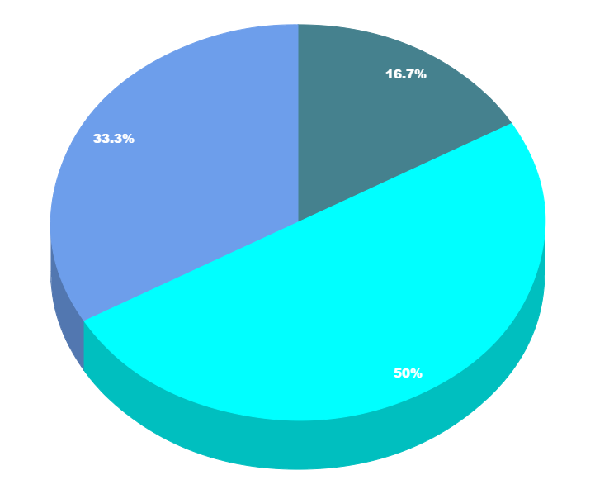
You can copy&paste graphs from Google Sheets

Slide 12
Maps
Kingdom of Saudi Arabia

Slide 13

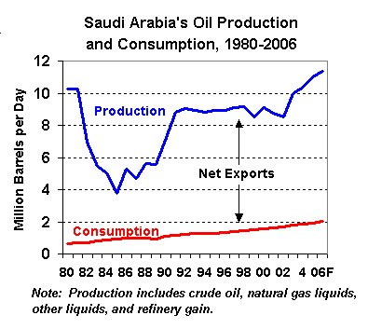

Slide 14
Brief Background
2
Let’s start with the Second set of slides

Slide 15
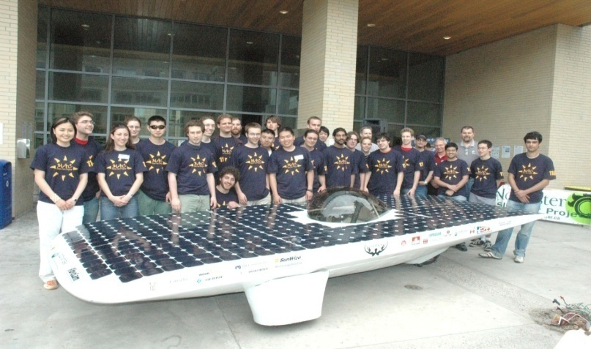
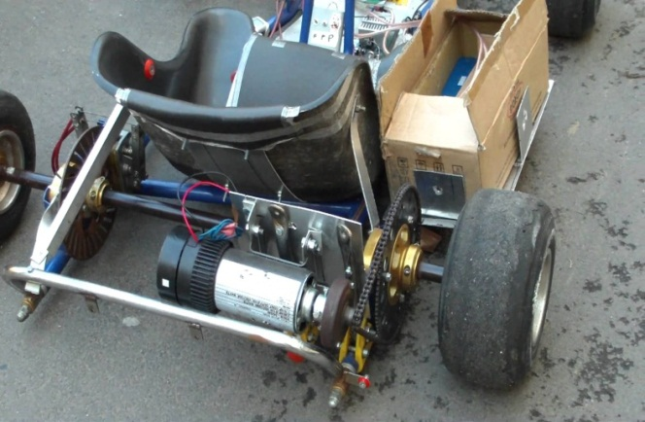
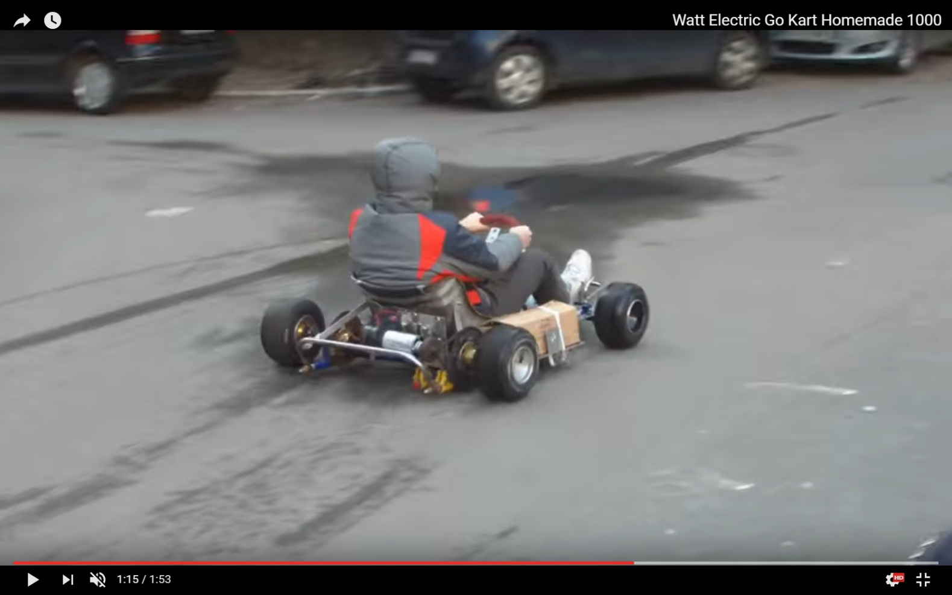
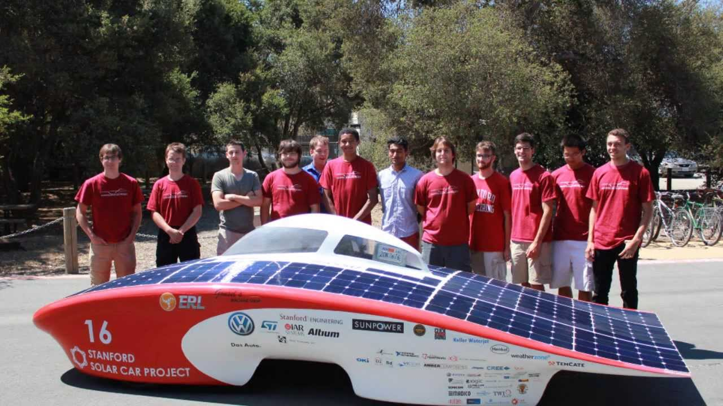
Previously Done Similar Projects:
McMaster Solar Car Project 2. University Of Michigan Electric go-kart

Slide 16
Design & Specifications
3
Let’s start with the Third set of slides

Slide 17
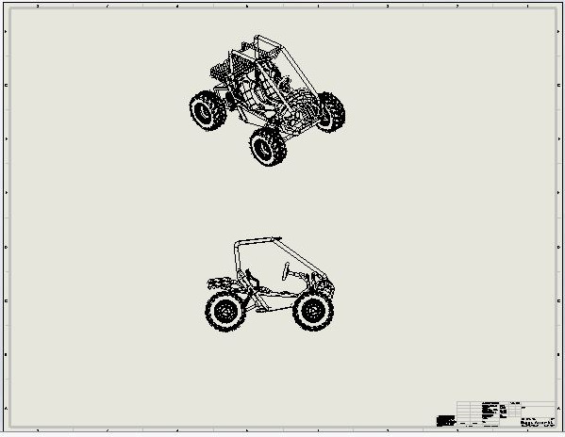
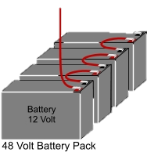
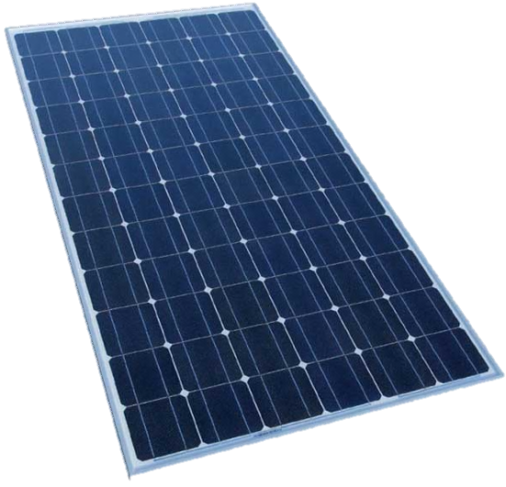
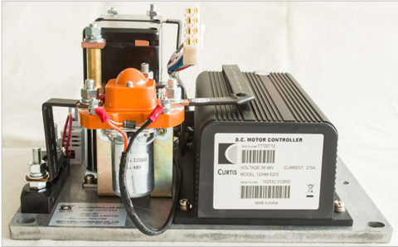
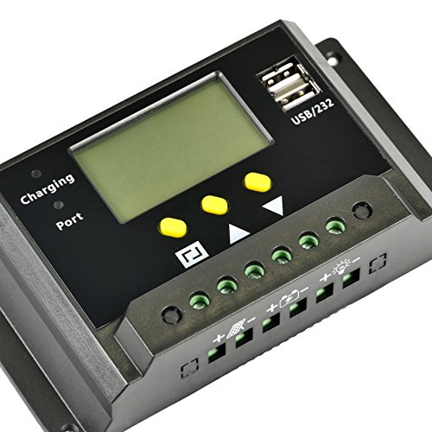
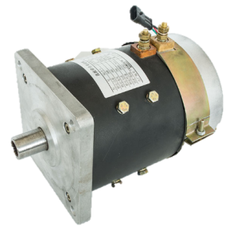

OREX AR-M100W Mono Crystalline Solar Panel
Motor Controller: Curtis 1204M + Kit
Solar Panel Controller
DC Series Motor : XQ-3-4
Sprockets & Chain Mechanism

Slide 18
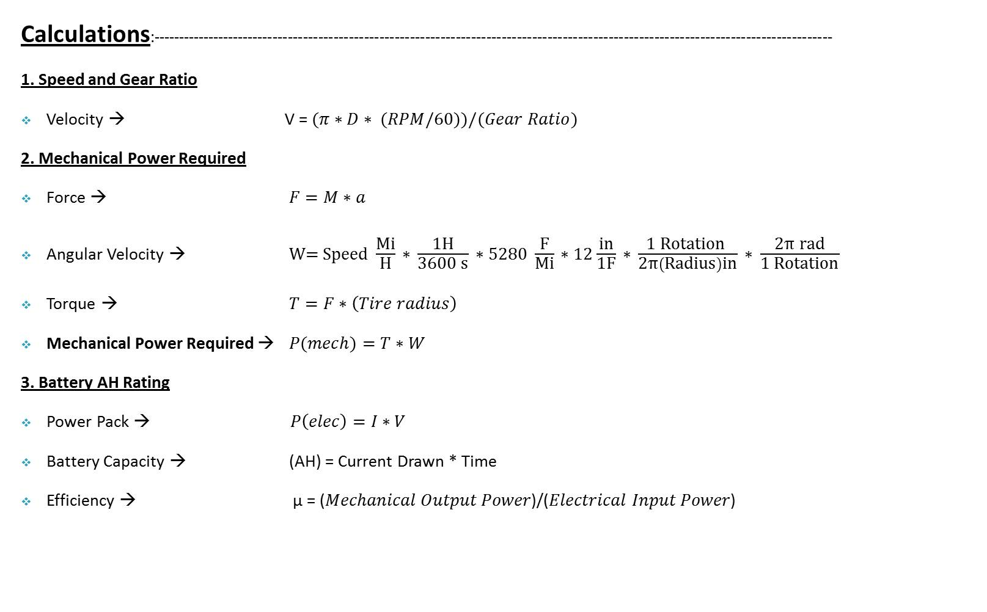

Slide 19
Specification | Calculated Value
Gear Ratio | 2.6:1
Mechanical Power Output | 3752 Watts
Electrical Power Output | 3800 Watts
Power Losses | 722 Joule/Second
Efficiency | 0.81
Top Speed | 60km/h

Slide 20


Slide 21
Experimental Set Up, Testing & Results
4
Let’s start with the Fourth set of slides

Slide 22

3 Subsystems
Electrical Sub System
Our Electrical Sub Sytem consists of the following components:
12V Lead Batteries (x4)
Motor Controller
Dc Series Motor
Throtle Pedal
Solar Sub System
Our Solar Sub System consists of the following components:
Solar Panel
Solar Panel LCD Controller
12V Lead Batteries (x4)
Mechanical Sub System
Our Mechanical Sub System consists of the following components:
Dc Series Motor
Brakes

Slide 23
Electrical Sub System:
Experimental Setup & Results
Test | Result
Batteies Drainage at 60 Km/h ( after mechanical sub system testing) | 1 Hour
Batteries Charging using DC battery charger | 10 Hours
Dc Series Motor | Clockwise rotation
Connecting the motor to the motor controller
Connecting the Throttle to the Motor Controller
Connecting the DC Motor to the Drive Shaft
Run it at max Throttle till the bateries drain
Charge the Batteries

Slide 24
Solar Sub System:
Experimental Setup & Results
Test | Result
Batteries Charging using Solar Panel(100w) | 36.8 Hours
Connecting the Solar Panel to the Solar Panel Controller
Connecting a single 12V to the Solar Panel Controller
Parking it under the for a complete day(dawn to sunset)

Slide 25
Mechanical Sub System:
Experimental Setup & Results
Checking the Braking System
Replacing Brake Pads
Changing Brake fluid
Tesing Brakes
Accelerating from 0km/h
Testing the Chain/Sprocket Mechanism at various speeds
Test | Result
Acceleration | 0.84m/s²
Braking Distance from 60Km/h | 25 Meters
Chain/Sprocket Mechanism | No Slack

Slide 26
Steps of our Project
Obtaining a used chassis
Dismantling
Fabrication
Assembly
Testing

Slide 27
Our Project funnel
20%
15 February 2017
40%
20 March 2017
60%
15 April, 2017
80%
02 May, 2017
100%
26 May, 2017

Slide 28
Summary, Conclusion and Future Work
5
Let’s start with the Final set of slides

Slide 29
Summary of the Project
Fossil Fuels are still considered as an essential and ideal source of energy.
Reducing the dependency on fossil fuels is a huge challenge.
We are utilizing a cleaner source of energy.
Utilizing electric batteries, Dc Motor and a Solar Panel to charge the
batteries.
Our testing shows that our car can reach the top velocity 60km/h
and that it is stable and safe

Slide 30
Conclusion of the Project
Implementation of Electric Cars is possible in Saudi Arabia.
Solar Panels can be used in Electric cars in Saudi Arabia to have cleaner
energy, due to abundance of sunlight through out the year.

Slide 31
Future Work for the Project
Improve efficiency by using lighter chassis material(Alloy).
Usage of more efficient Solar Panels(Carbon Nano-tubes).
Usage of Lithium Batteries for better power consumption and reduction of
weight.

Slide 32
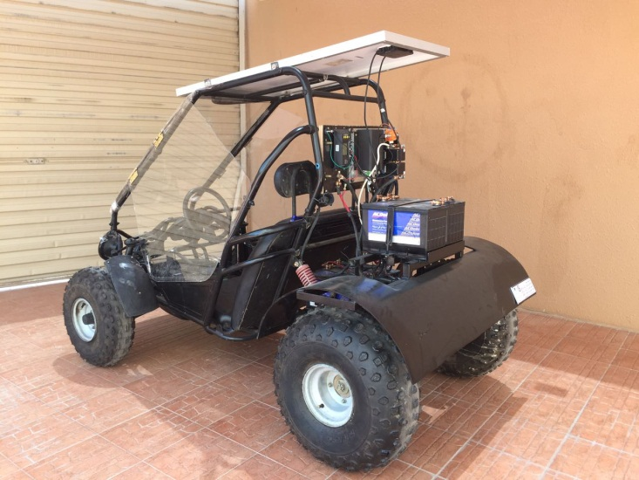

Slide 33
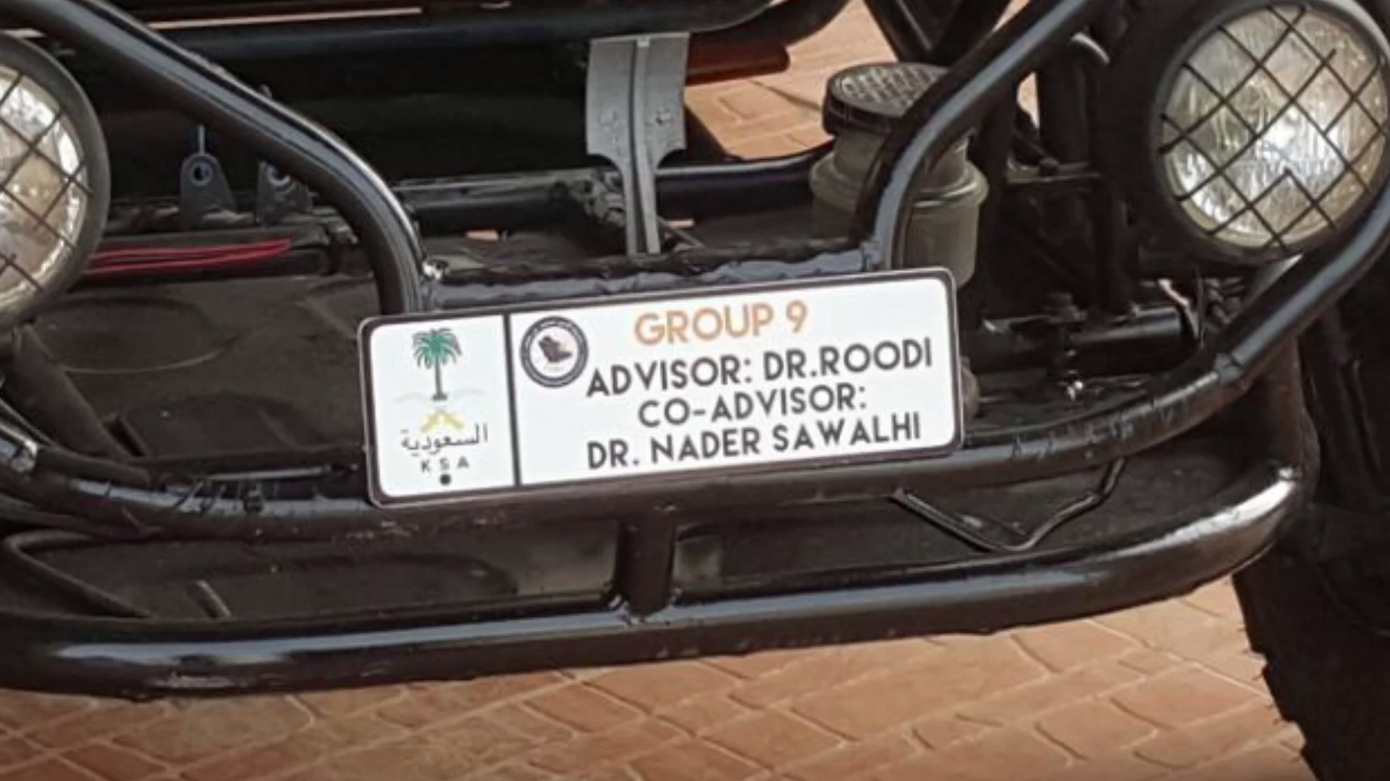

Slide 34
Thanks!
Any questions?
You can find me at:
@username
user@mail.me

