Slide 1


ASSE4311-AsseIII/ME 106
Final Presentation
5/29/2017
Design and Experimental Study on
Air-Dehumidification Performance using Supersonic Nozzle
#Group: 3
Prepared by:
ID Number | Member Name
201100253 | Mohammed Alhindi
201102784 | Omar Alnafisi
201201386 | Abdulrahem Alboainain
201102679 | Abdullah Aleisini
201000974 | Bassam Al-Baqawi
Advisor
Dr.Esam Jassim
Co-Advisor
Dr.Nader Sawalhi

Slide 2


Outline
Experimental setup,
Testing, and Results
Design Specifications
and Items Selection
Present by:
Abdullah Aleisini,
Mohammed Alhindi and
Bassam Al-Baqawi
Present by:
Abdullah Aleisini
Background
Challenges and
Obstacles
Present by:
Omar Alnafisi
Present by:
Bassam Al-Baqawi
Objectives
Conclusions
Present by:
Omar Alnafisi
Present by:
Abdulrahem Alboainain

Slide 3
Objectives
Test multiple designs for supersonic nozzle and compare the result between them in
efficiency and humidity level.
Our testing goals are to dehumidify the humidity air below 25% and get separation efficiency above 75%.
Solution to dehumidify the natural gas.
To examine different sizes of diffusers and
investigate their effect on gas-particle
interaction.

Slide 4

Background
Problem statement:
Oil and gas industry- discovering, producing and
transporting the natural gas. Throughout these
processes, they face a real challenge with natural gas.
Natural gas is most often mixed with significant
quantities of water and others unwanted solid particles.
These unwanted particles can cause many serious problems during expansion process of natural gas:
corrosion, excessive pressure drop, hydrate, the decrease of its heating value and the reduction in gas transmission
efficiency.

Slide 5
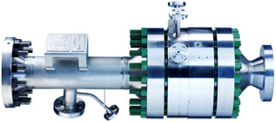
Background
Project description:
Supersonic nozzle is a reliable technology for oil and gas industry for its compatibility and feasibility.
It is employed to overcome the deficit of the traditional method, related to gas dynamics, thermodynamics and fluid dynamics theories.
The studies and results showed positive impact on the separation technology due to:
1-Simplicity in designing
2-Cost effective in manufacturing
3-Feasibility in maintenance.

Slide 6
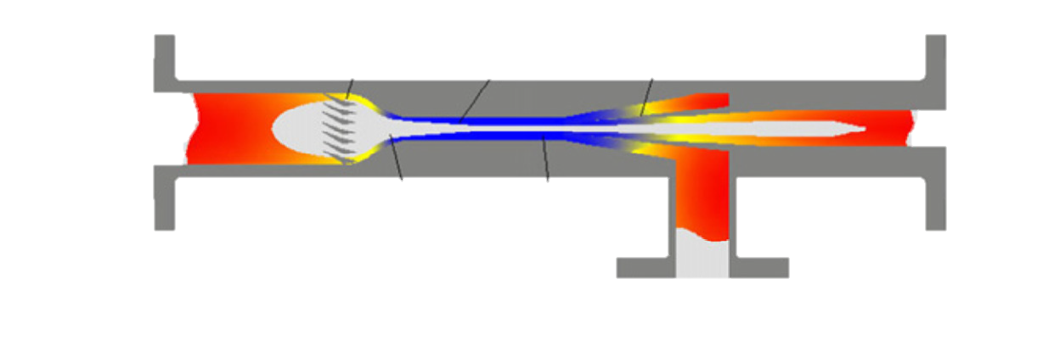
Background
Swirling
Vanes
Nozzle
Diffuser
Dry
Gas
Wet Gas
Central
Body
Liquid + Slip Gas
Typical Supersonic Nozzle Separator system

Slide 7
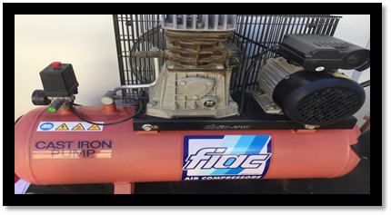
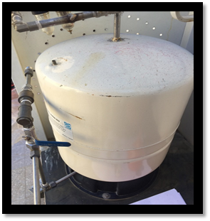
Design Specifications and Item Selection
Our system will be consist of two subsystems:
Supersonic nozzle separator system which consists of ( Nozzle, separator, and diffuser).
Test stand system which consists of
( 220V Air compressor, pressurized tank, pipes, pressure gauge,
ball valves, tees, elbow, check valve and water drop let separator).

Slide 8
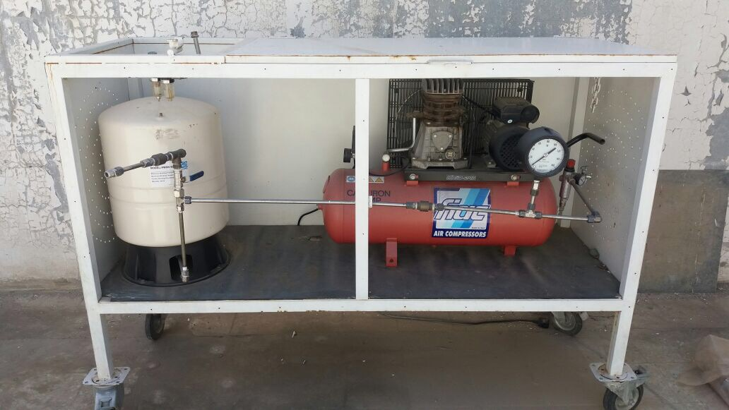

Slide 9
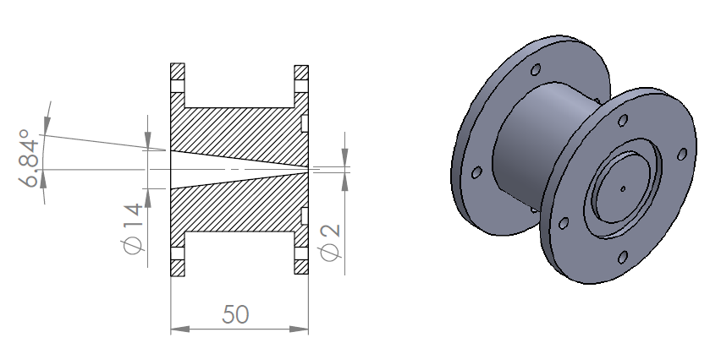
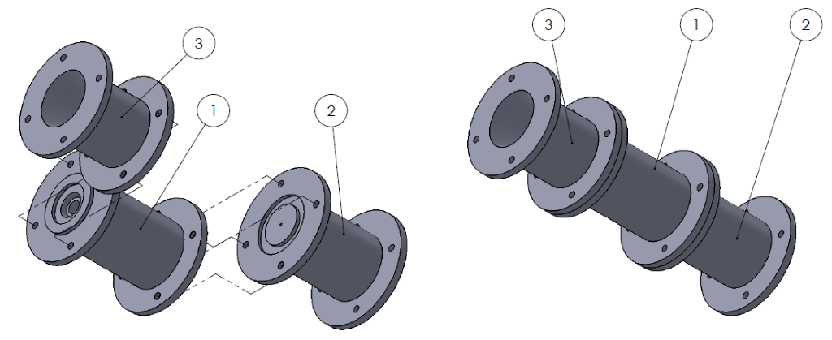
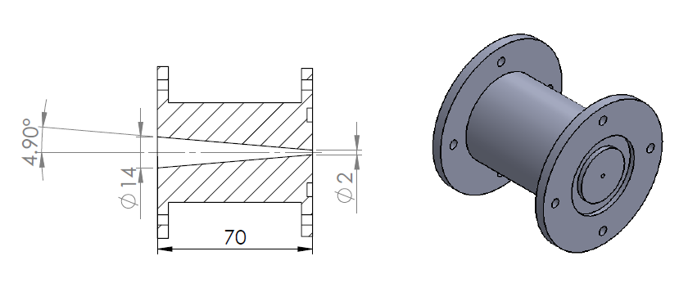

Design Specifications and Item Selection
ITEM NO. | PART NUMBER
1 | Separator
2 | Diffuser
3 | Nozzle

Slide 10
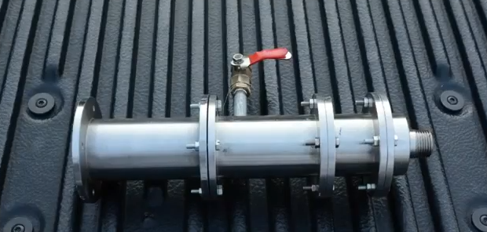

Slide 11
Experimental setup
First, we fill the air pressurized tank with water and turn on the air compressor and wait for the pressure to build up.
Second, we open the outlet valve and measure the humidity level from the air compressor and pressurized tank system it should give us from 95% to 100% in order to conduct the experiment.
Third, we connect the supersonic nozzle separator system to the air compressor and pressurized tank system.
Finally, we open the outlet valve and measure the humidity level from the supersonic nozzle separator system with three different diffusers and note the results.

Slide 12
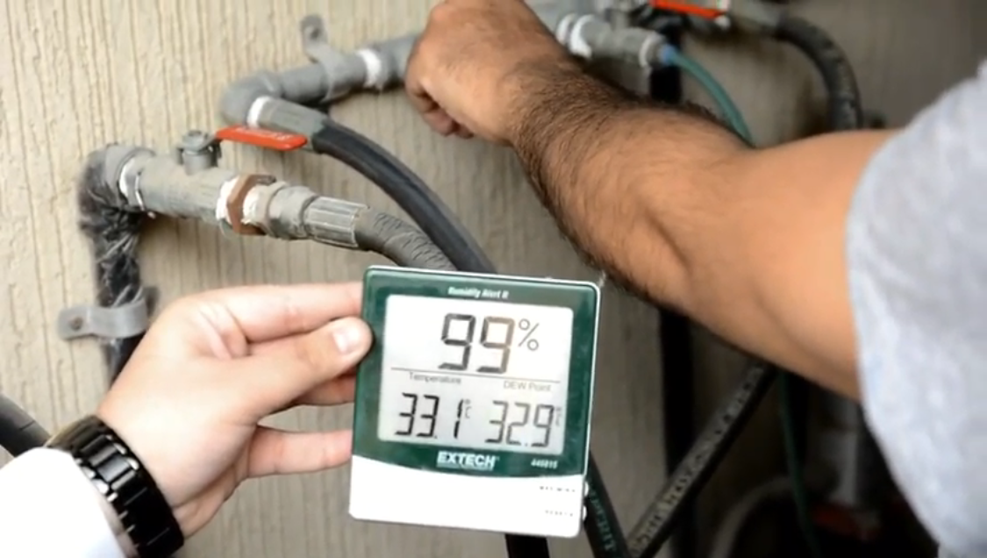

Slide 13
Testing
In the beginning, the test fails because there are some problems such as leaking and low humidity level. We solved the problems by tightening all the pipes and applied Teflon tape on all the fitting and threads to prevent any leaks. In addition, we add rubber gasket between the Nozzle, separator, and diffuser to prevent any further leaks. Our testing goals are to dehumidify the humid air below 25% and get separation efficiency above 75%.

Slide 14
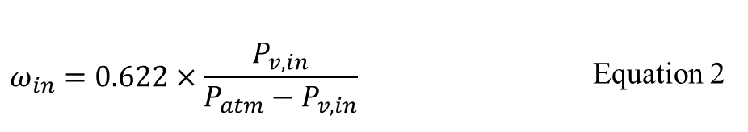

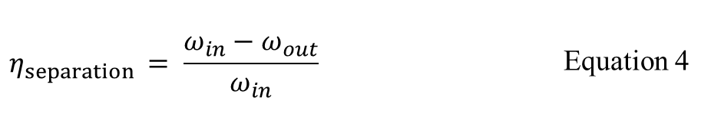
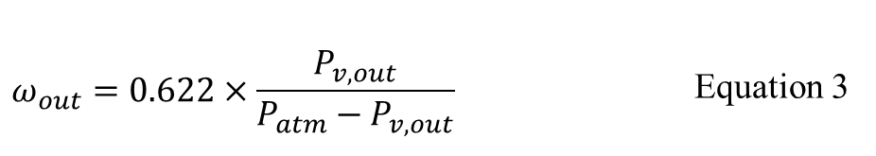
Equations We Used
$$P_{v}=φ×P_{s}$$ | Equation 1
$$ω_{in}=0.622×\frac{P_{v,in}}{P_{atm}−P_{v,in}}$$ | Equation 2
$$ω_{out}=0.622×\frac{P_{v,out}}{P_{atm}−P_{v,out}}$$ | Equation 3
$$η_{separation }= \frac{ω_{in}−ω_{out}}{ω_{in}}$$ | Equation 4

Slide 15
Results
The inlet humidity level is about 99%.
We got the best performance from using the 90mm diffuser.
We reached our goal which is below 25% humidity level and above 75% separation efficiency.
Diffuser Size | Humidity Level | Separation efficiency
50 mm Diffuser | 18% | 76%
70 mm Diffuser | 17% | 76%
90 mm Diffuser | 17% | 78%

Slide 16
Challenges and Obstacles
Throughout this project, there were some difficulties:
Problems regard the place to store the system.
Problems with other courses’ projects.
Problems regard delays in manufacturing our parts.
Problems with equipment/components.
Problems with changing the final exams date.
Problems with troubleshooting of operation the test stand system.

Slide 17
Summary
We learned many things and we gained some experience, knowledge, and skills. Working in a group with different members taught us how to get benefits from using many skills, for example, time management, proper communication, teamwork, problem-solving, responsibility, organization, negotiation, troubleshooting and conflict management. Also while working in this project we learned the different function of the nozzle and diffuser. The most important thing that we get the chance to apply the knowledge and experience that we gained from the university.

Slide 18
Conclusion
In conclusion, this project is about finding a solution to dehumidify the natural gas by using supersonic nozzle separator system.
The main focus of this project was to design three diffusers with different length and with the same inlet and exit diameter.
We achieved in our study 18% humidity level with 50mm and 17% humidity level with 70mm and 90mm diffusers
We contributed to this study by testing the system with three different diffusers and our result was better than the previous group which they achieved 23% humidity level.

Slide 19
Future Recommendations
In order to carry on with our study, we recommend to experiment with different diffuser, nozzle and separator dimensions and try to get results lower than 15% humidity level. In addition, we recommend trying a different material, for example, Teflon and plastic. Furthermore, we recommend experimenting with a diffuser length more than 90mm. In addition, we recommend changing the pressurized tank in the test stand system to a proper one that is not containing a balloon inside it. Finally, we recommend to connect two supersonic nozzle separator system together and try experimenting with it.

Slide 20
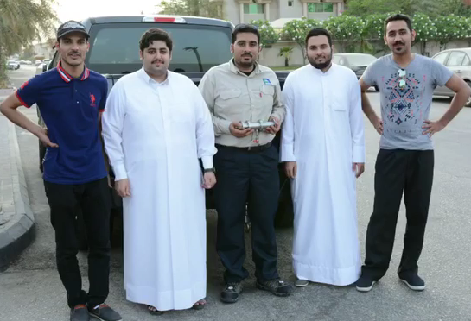
Thank You

