Slide 1
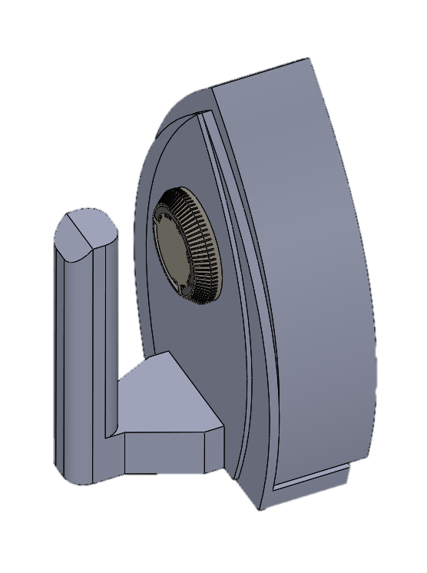


Ultrasound Drying
Names
ID
Khalil Alabbasi* 201400071
Mohammad Yousef 201301735
Abdulaziz Al-Homaidan 201301605
Mohammad Al-Otaibi 201100964
Musab Al-Khaldi
201302447
Advisor: Dr. Panos Sphicas

Slide 2
Outline
Objectives
Background
Design
Design Constraints, Specifications, Item Selection
Experimental Set up, Testing, Results
Conclusion

Slide 3
Objectives
Design a drying device that operates on Ultrasound.
Reduce electricity and power usage.
Show the use of ultrasound applications other than medical.

Slide 4
Background motivation and relevance
Ultrasound
Transducers
Piezoelectric Crystals
Viscoelastic Materials
Cellulose Materials

Slide 5
Motivation
Vision 2030
People are more cost conscious
The need to innovate
Growing climate concerns

Slide 6
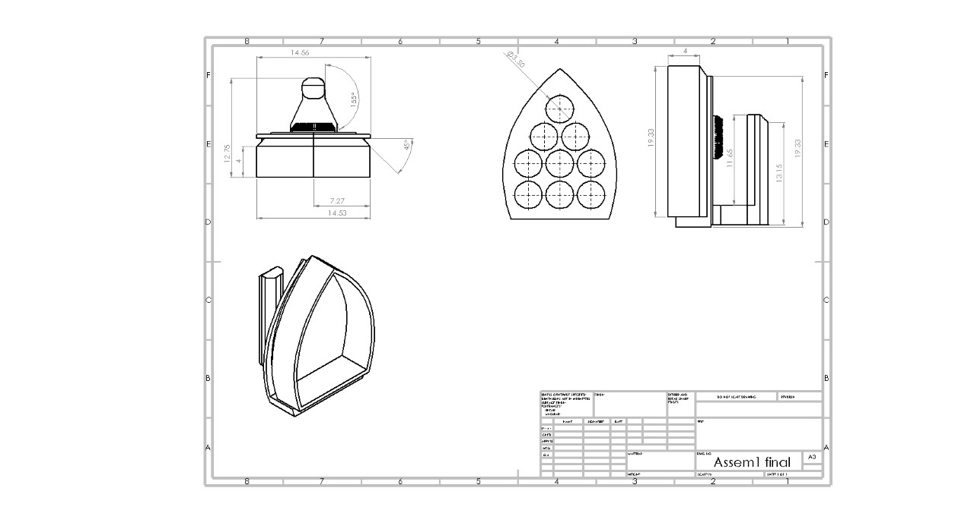
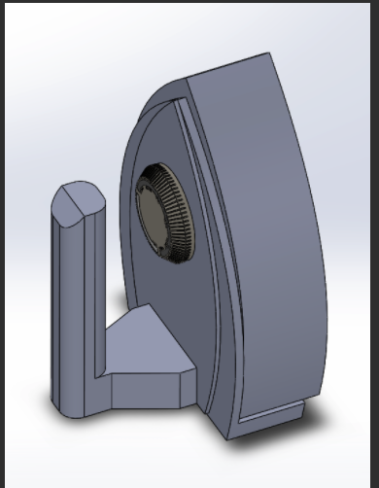
Design
2D Schematic
3D Solid works drawing

Slide 7
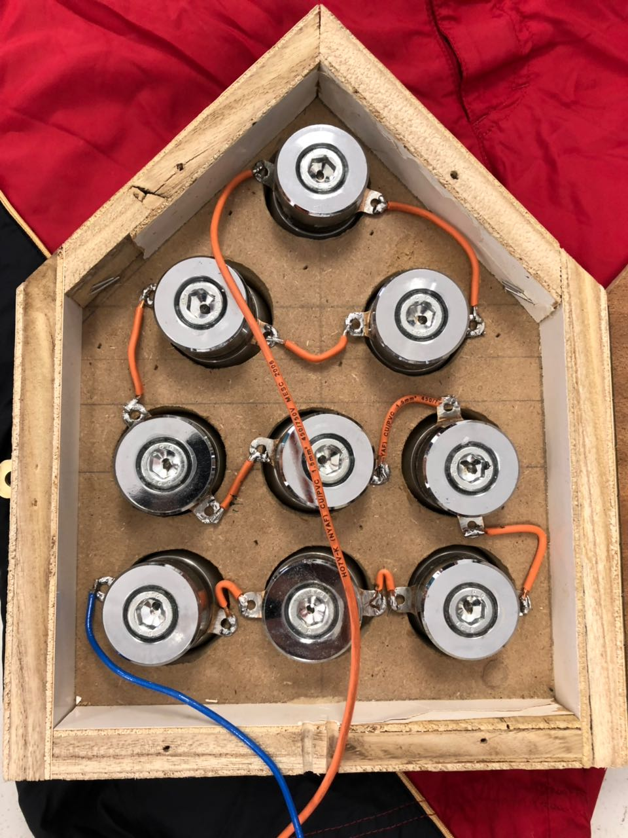
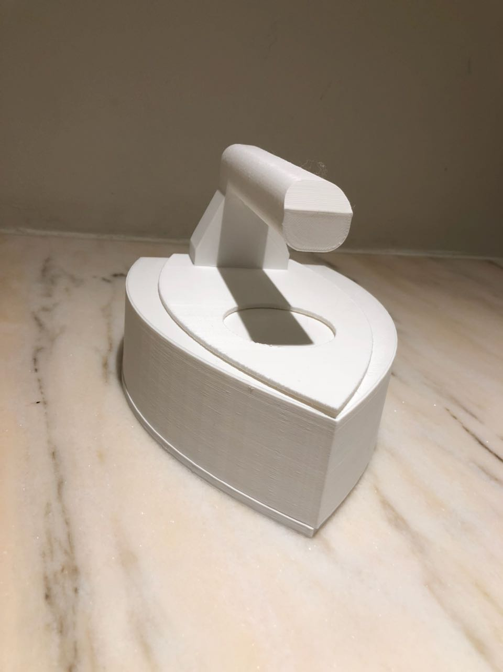
Prototype
Wood Prototype
Plastic prototype

Slide 8

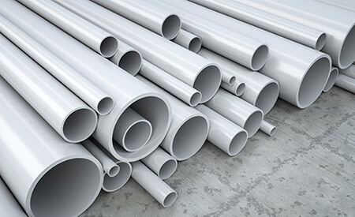
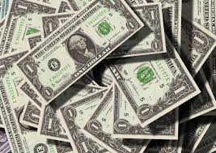

Design Constraints
Environmental
Economical
Social
Un-optimized design
Material Based

Slide 9

Engineering standards
IEEE 1452 Smart Transducer Standard
ISP/TC 61 Plastic Standards
Standardization of nomenclature for products in the field of plastics

Slide 10
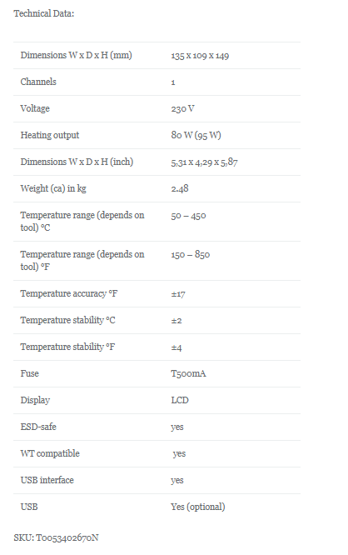
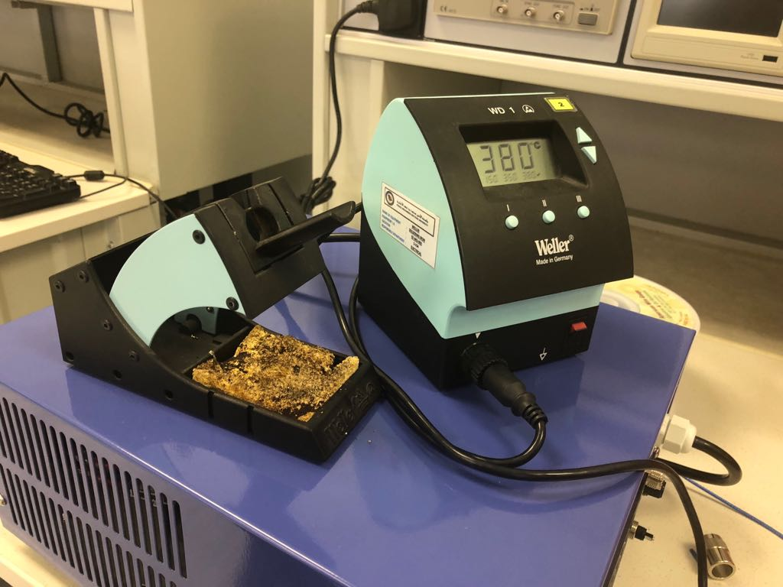
Project Specifications & Item Selection
Soldering Iron

Slide 11
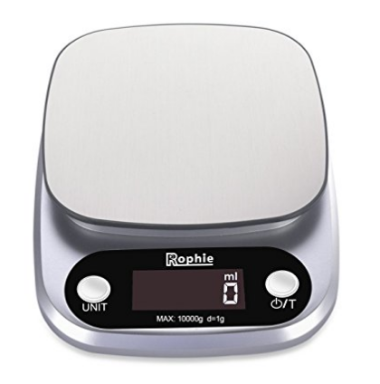
Digital Scale
Weight Range: 0-50 kg/0-551,1

Slide 12
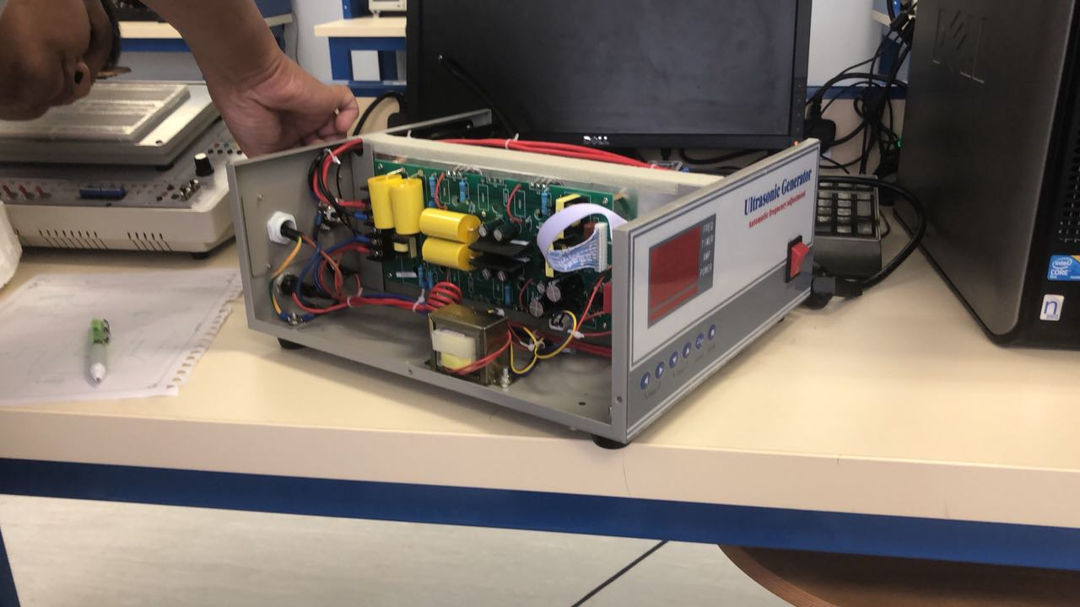
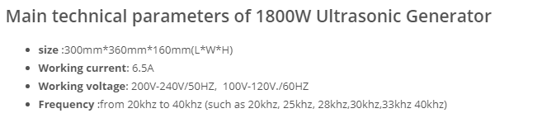
Generator

Slide 13
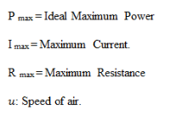
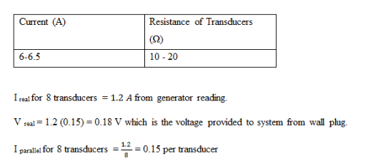
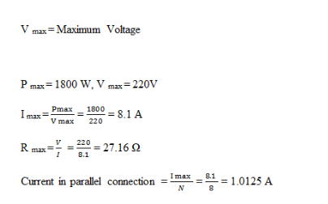
Calculations

Slide 14
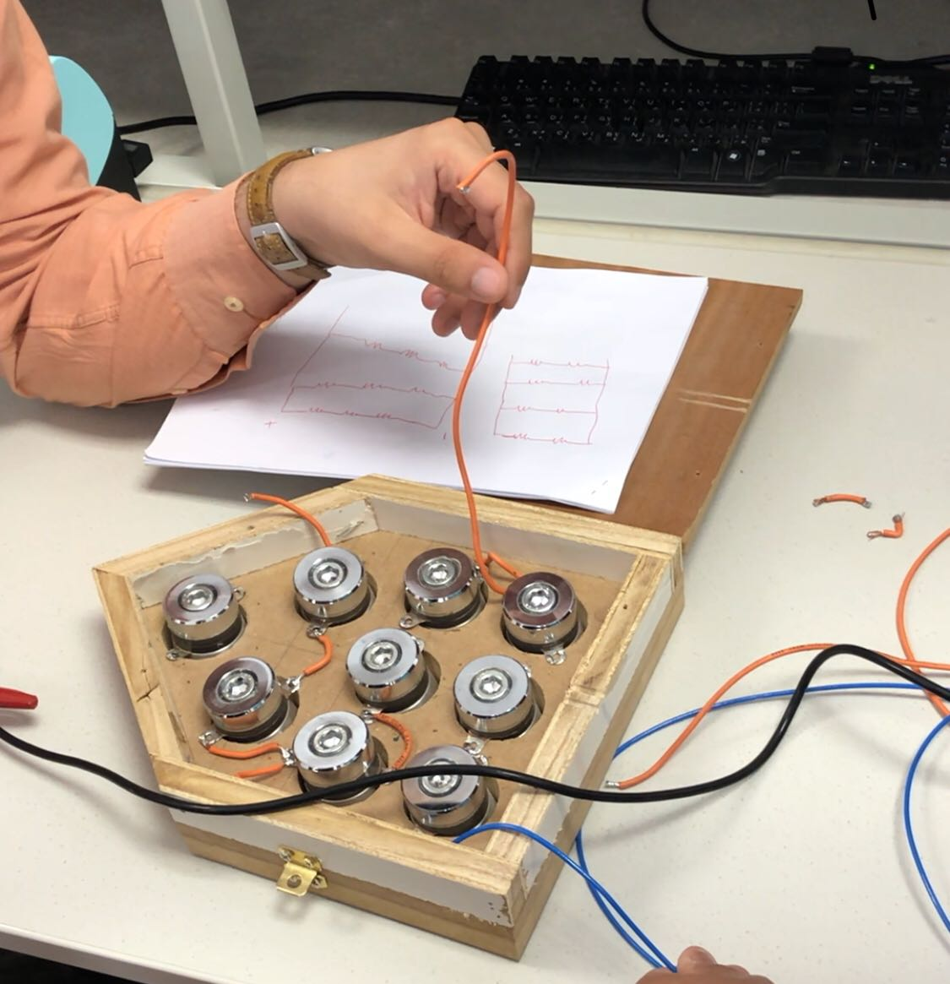
Experimental Setup
Connected in different configurations:
All in series
Combination two in series and three in parallel
Finally all parallel.
Tested different power and frequency modes continuous and finally burst.
We deduced that burst mode was more effective.

Slide 15
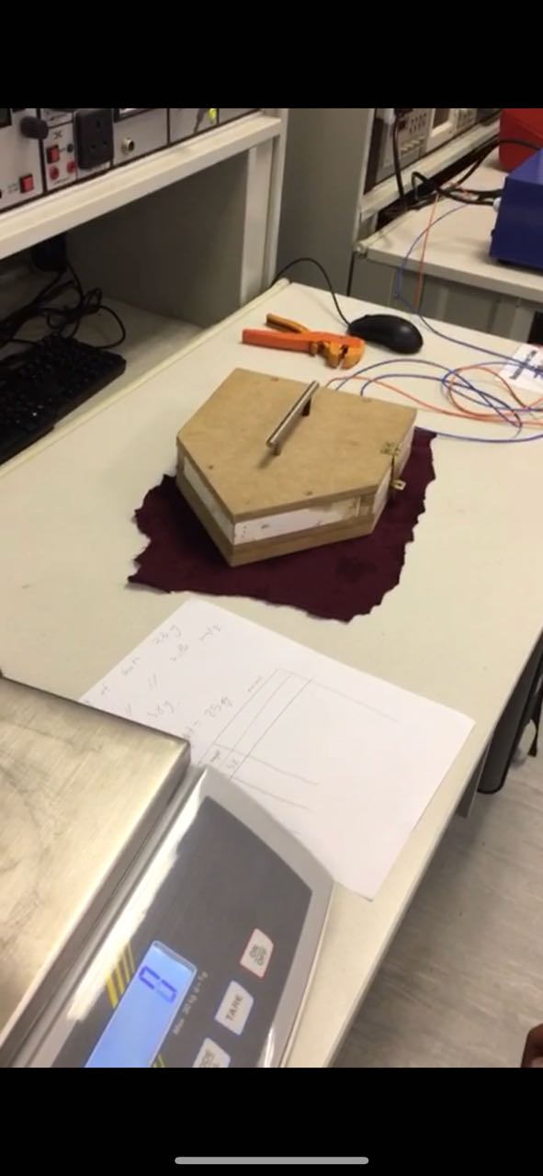
Testing
Weigh the fabric on the digital scale.
Submerge fabric in water.

Slide 16
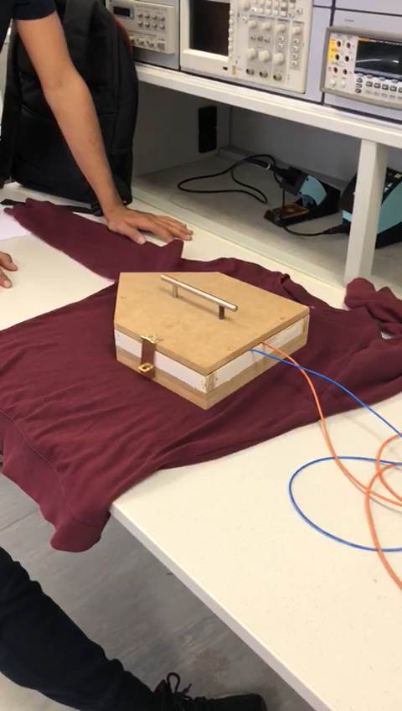
Testing 2
Put fabric under prototype
Leave it for a 10 minute time period

Slide 17
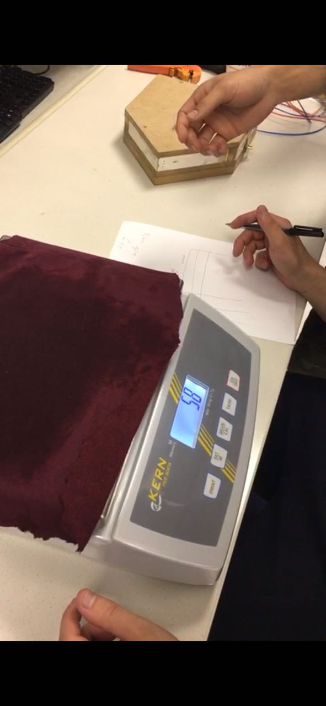
Testing 3
Weigh the fabric on the digital scale.
Repeat drying

Slide 18
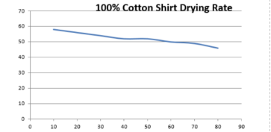
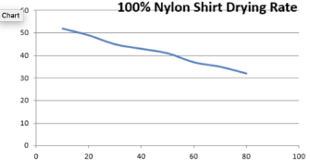
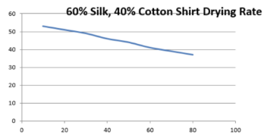
Result
Weight (g)
Weight (g)
Time(Minute)
Time(Minute)
Weight (g)
Time(Minute)

Slide 19
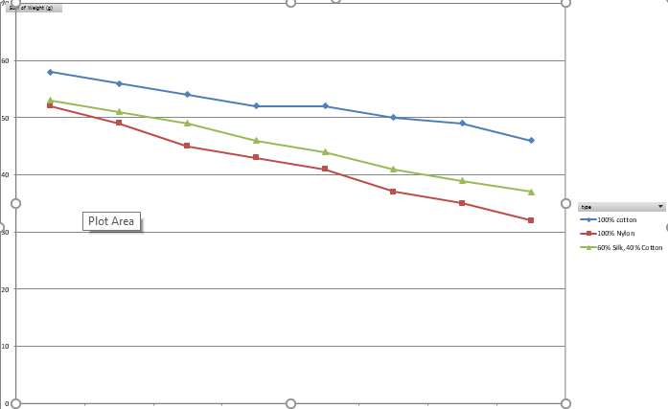
Discussion
Cotton was the slowest to dry.
Nylon was the fastest.
Ultrasound drying doesn’t change characteristics of drying (compared to traditional drying procedures.
Weight (g)
Time(Minute)

Slide 20
Conclusions
Future Recommendations
Add sensors to detect fabrics
Add humidity sensors
Optimize design
Change variables to see what other aspects affect materials

