Slide 1
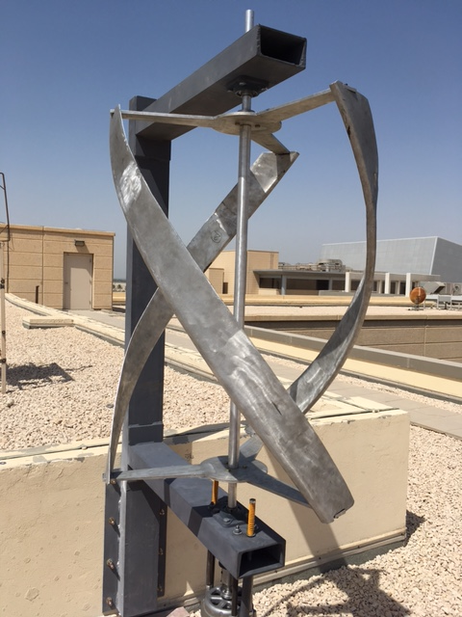
Small Size Helical Wind Turbine
Ahmed al ramadan 201200322
Mohammed al sayid 201300090
Mubarak al wesmi 201202485
Ameen al naseer 201100306
Muath al Mansour 201002152
Advisor: Dr. Nader Sawalhi

Slide 2
Outline
Objectives and Motivation
Background
Design specification
Main components.
Design Testing in SolidWorks
Experimental setup
Summary, conclusion and future work

Slide 3
Objectives
Design and construct a Small wind turbine (100 to 500 Watts) to produce renewable energy
Cut the cost of lighting street especially on highways and remote areas
Reduce the use of wiring to light the streets
Decrease the demand factor for the whole city
Provide charging stations in walking areas and parks

Slide 4
Motivation
Electricity in Saudi Arabia is mainly generated by means of fossil fuels.
As the fossil fuels increase their cost so does electricity.
Thus, we must look for other means to produce energy.
Renewable energy is the best candidate to replace conventional energy production methods as it is the most environmentally friendly.

Slide 5
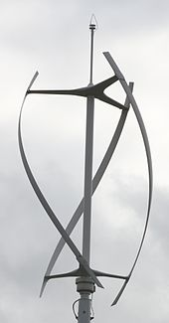
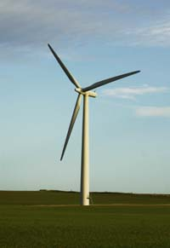
Background
Renewable Energy
Types of turbines
  Horizontal turbine
  Vertical turbine
Gorlov turbine
  Advantages

Slide 6
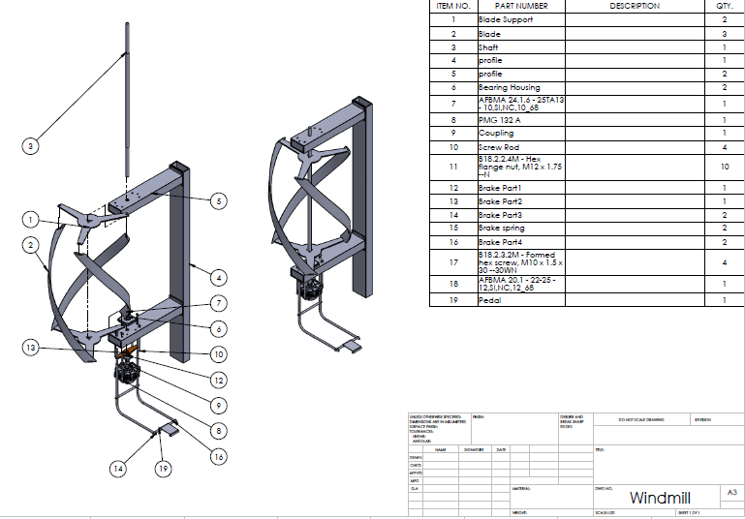
Design Specification
Assembly dimensions
L: 1.0 m
D: 0.7 m
Blades and blade support is made from Aluminium
Shaft Sizing: solid aluminium shaft, 1.6 m with two chamfers 0.5 m from the middle.
Two bearings attached at 0.15 m above and below the blade support.
The lower is a thrust bearing to take up axial load
Blade profile (NACA 0018)

Slide 7

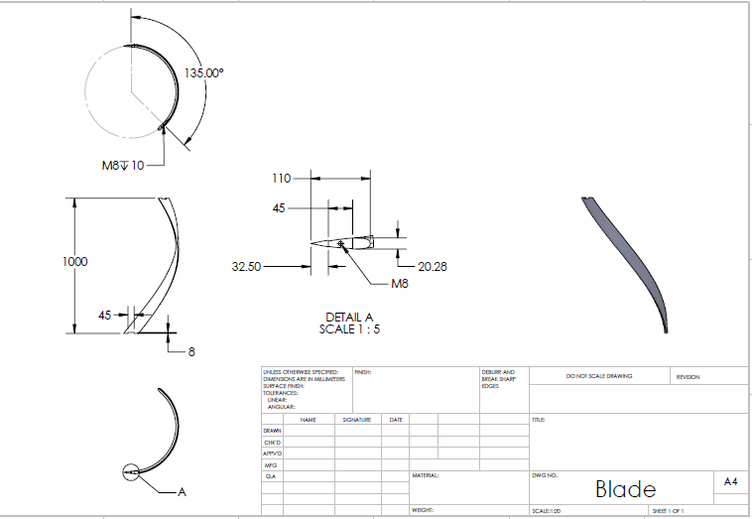
The Blades
The blade profile we used is the NACA0018
The profile is efficient for the design of a vertical turbine functioning at low wind speeds.
The profile offers medium between the performance of a thin blade and the durability of thick blades profile.

Slide 8
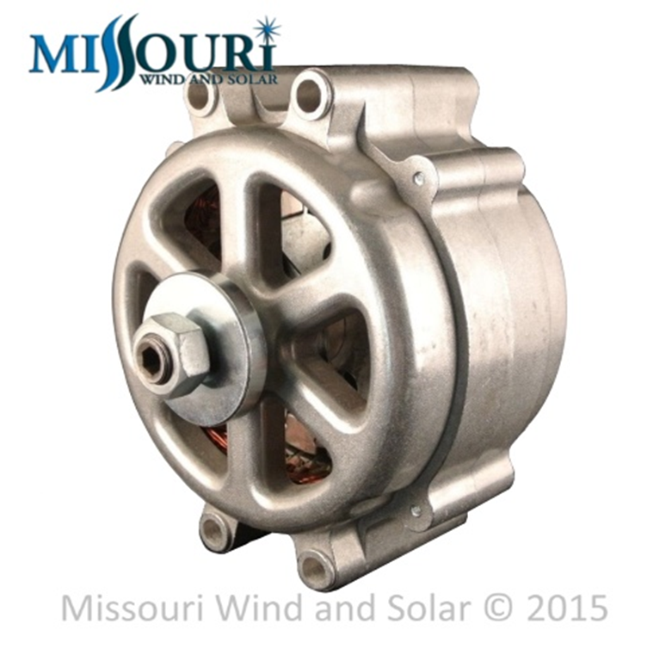
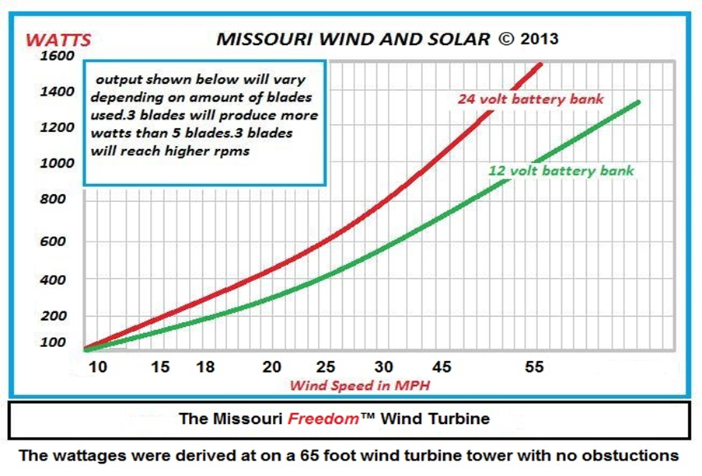
The Generator
We went for a permanent magnet generator (PMG).
The PMG eliminates the need for a gearbox.
The model we went with is Freedom PMG™ Permanent Magnet Generator.
Skewed stator core with high grade electrical steel and heavy duty copper windings.
Zinc plated 14 rare earth neodymium magnet rotor.

Slide 9
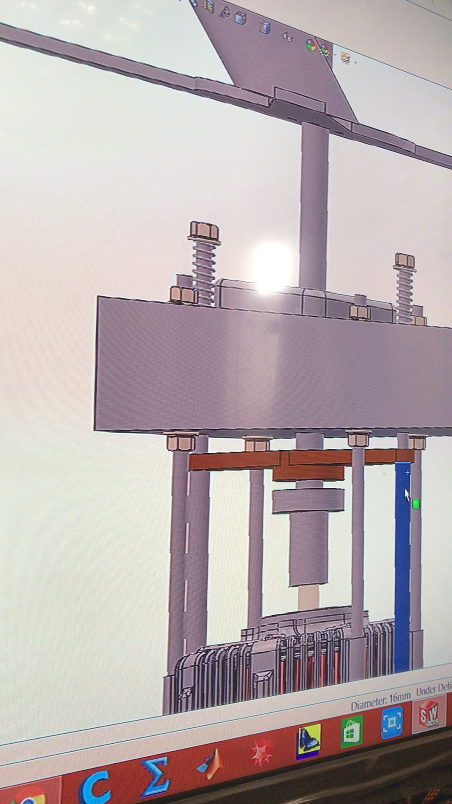
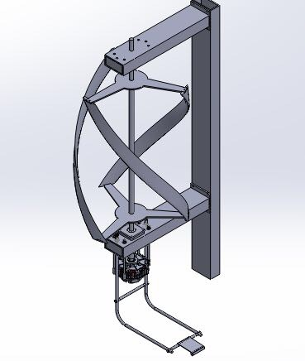
Breaking Mechanism

Slide 10
Video

Slide 11
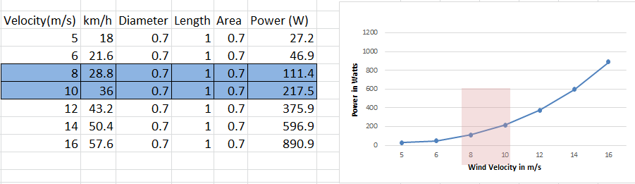

Power Output
Power Calculations based on the size of the wind turbine Power is function of the wind velocity, surface area, air density. There is an efficiency factor of 55 %
P =
$$0.5×ρ×A×V^{3}×Cp$$

Slide 12
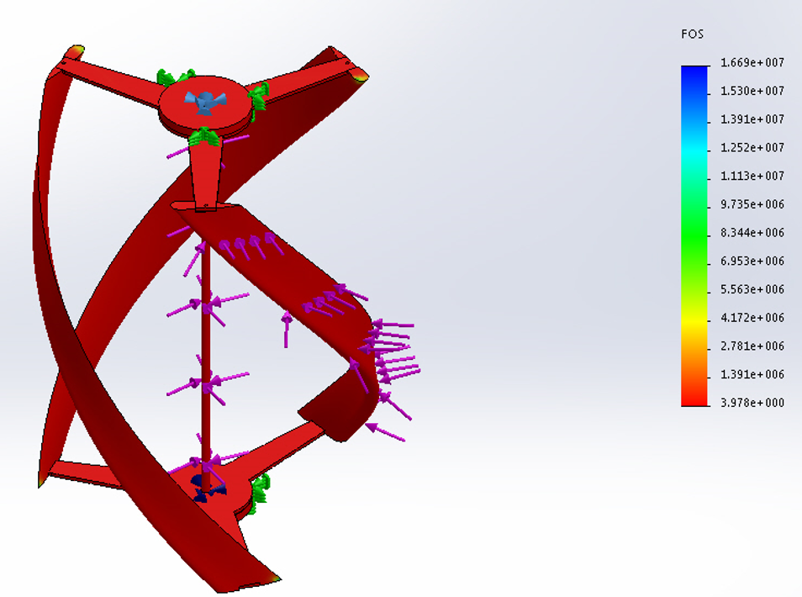
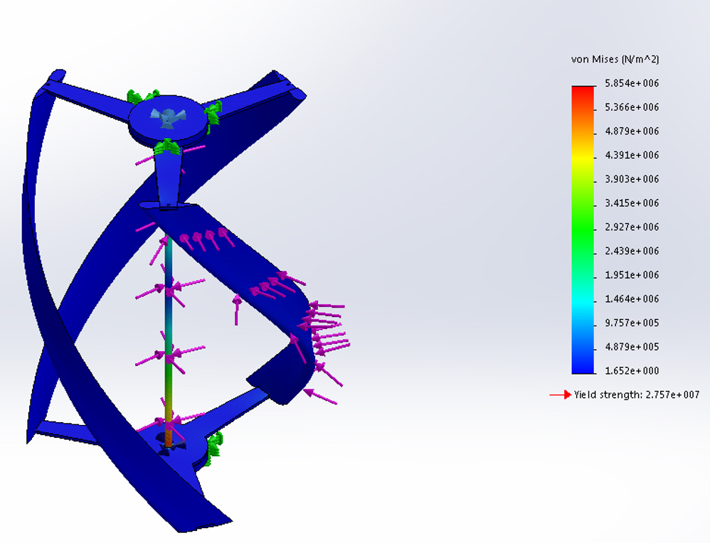
Design Testing in SolidWorks
Static Loading
  Wind Force on one blade (force calculated as 5 N at a speed of 8 m/s)
  Torque Load based on Power and angular rotation calculation (Tip speed of 2.25 was used)
  Factor of Safety: 4 Von Misses stresses: 5.85 MPA

Slide 13
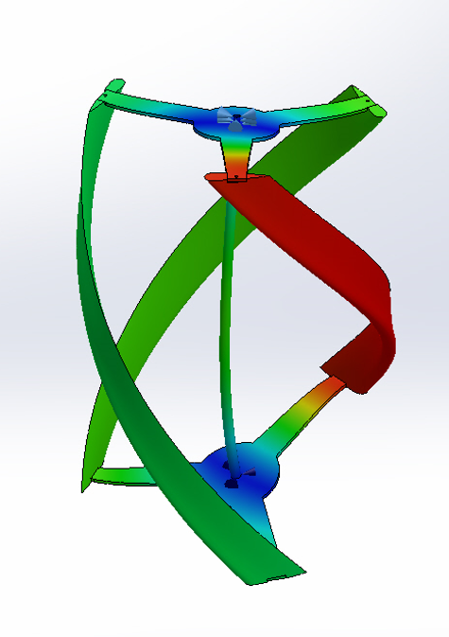
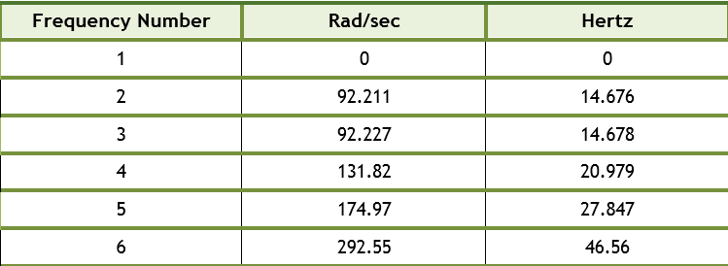
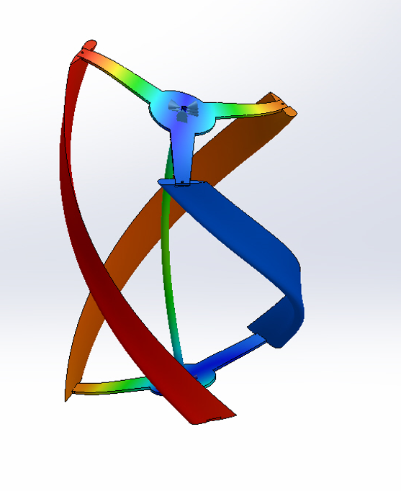
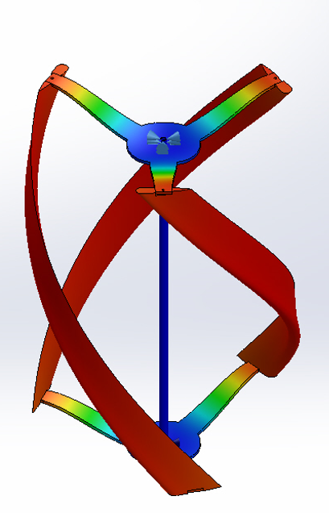
Design Testing in SolidWorks
Natural Frequencies and Resonances
14.68 Hz corresponds to a wind speed of 116 km/h
(with a tip speed of 2.2 this is 52 km/h)

Slide 14
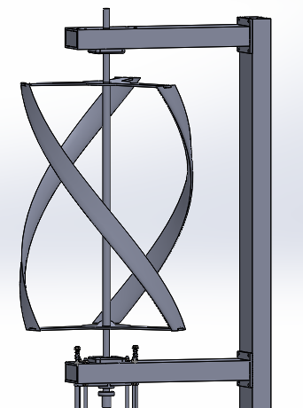
Installation
The turbine is installed on the roof of the university
We will Mount the turbine on a 0.16 x 0.08 m shafts.
The shaft will be fixed to a wall using heavy duty fixtures.

Slide 15
Experimental Setup and Testing
The rotational speed and the vibrations will be measured using sensors.
The parameters then will be compared to the calculations.
The experimental work is still ongoing.

Slide 16
Summary, Conclusions and Future Work
The demand for energy is increasing and we must diversify our sources for energy, thus renewable energy is the best option.
the experimental work is still ongoing.
We would like to thank Dr. Sawalhi for his continues guidance throughout this project.

Slide 17
Thank you for listening.

