Slide 1

Optimization of ignition timing in spark ignition engine
College of Engineering
Department of Mechanical Engineering
Spring 2016-17
Senior Design Project:
Group members:
Ibrahim AlAbdulhadi 201101256
Mushari Alharbi 201100959
Majed Alotaibi 201100716
Ali Al-Radhi 201101315
Abdullah Bassri 201103049
Advisor: Dr. Esam Jassim

Slide 2
Outline
Introduction
Objectives
Background
Design
Testing
Time table
Challenges
Engine
Conclusion
Recommendations

Slide 3
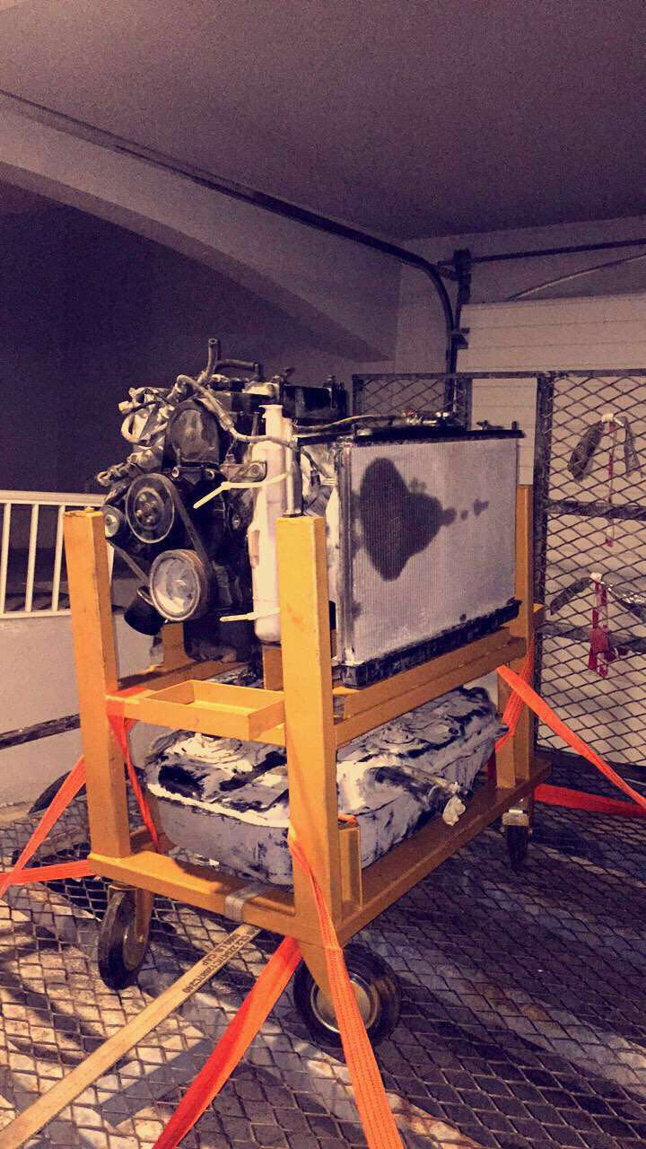
Introduction
Engine Specifications
Ignition timing is considered one
of the most important functions for
achieving the highest efficiency
Optimize ignition timing in spark
ignition engines and study how it
affects on the performance

Slide 4
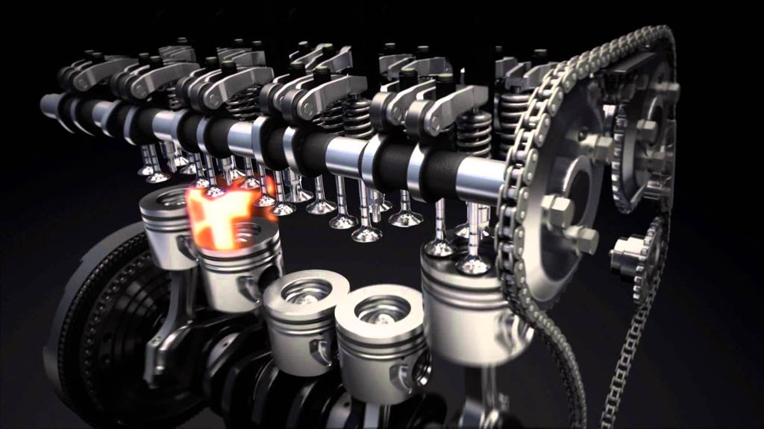
Objectives
Optimizing ignition timing in a spark
ignition engine
Identifying relationship between
ignition timing and exhaust emission
Radiator effectiveness in relation
to ignition timing

Slide 5
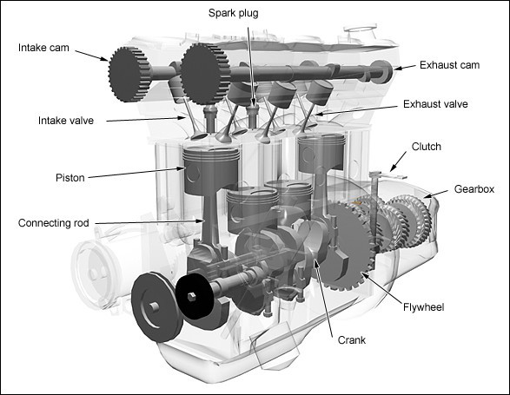
Background
Ignition timing is crucial in the
performance of the engine
There are many factors that
influence proper ignition timing
for a given engine and a fuel
Effects of the ignition timing
on the exhaust gas

Slide 6
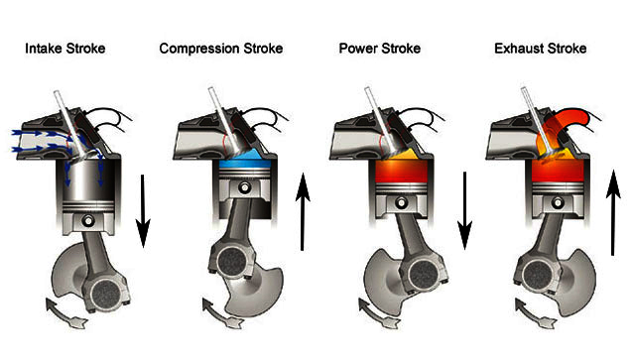
Four stroke cylinder cycle
Intake stroke
Compression stroke
Power Stroke
Exhaust stroke

Slide 7
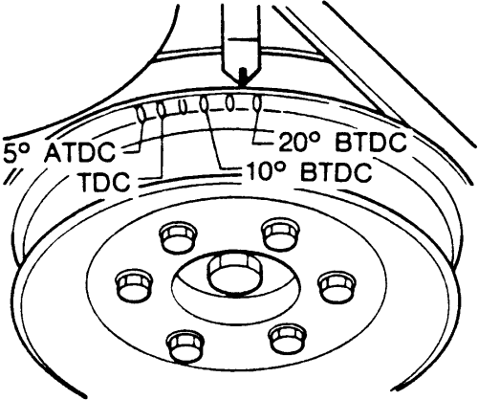
Camshaft Angle Adjust
By changing the camshaft angle the intake of fuel and air into a piston changes thus changing the ignition time with respect to piston position, and therefor changing the performance as a hole.

Slide 8
AutoCAD design

Slide 9
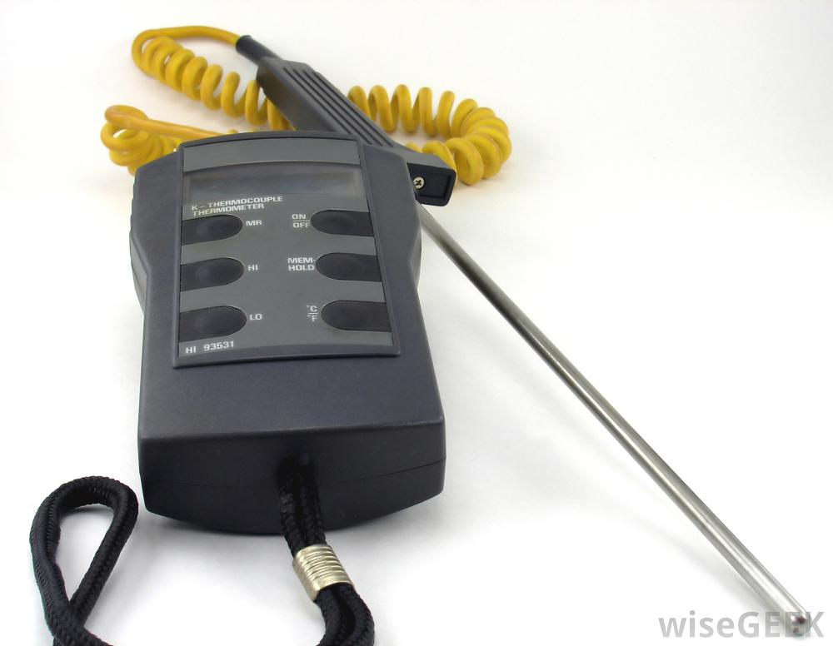
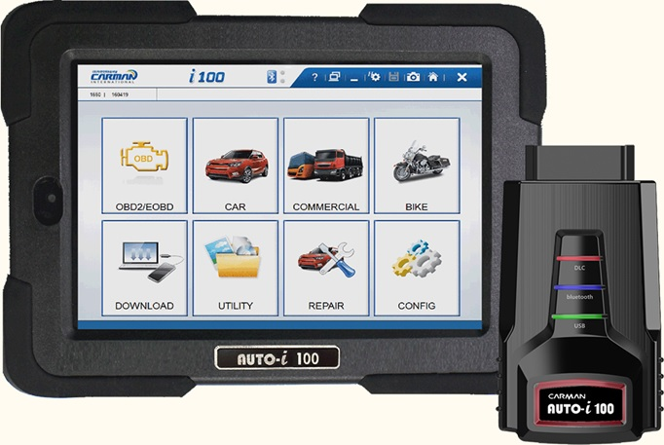
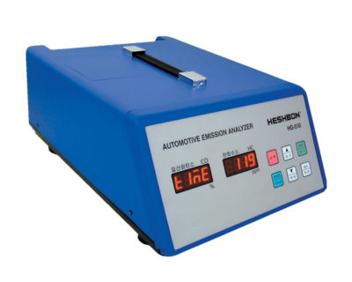
Testing
Thermocouples to get radiator coolant temperature
i100 for measuring Ignition timing, and camshaft angle
HG-510 for exhaust gas analysis
Thermocouples
i100 Carman
HG-510

Slide 10
Results – Part 1
BTDC | Q max (Kw) | Q actual (Kw) | Tw out predicted (C˚) | Tw out measured (C˚)
7 | 36.762 | 33.0858 | 39.522 | 45.6
10 | 28.251 | 25.426 | 38.47 | 37.2
12 | 21.639 | 19.475 | 37.66 | 34.4

Slide 11
Results – Part 2
BTDC | Co (%) | a | b | d | e | f
12 | 0.06 | 10.7745 | 4.549 | 3.4507 | 9 | 40.512
10 | 0.05 | 11.0622 | 5.1244 | 2.8756 | 9 | 41.5939
7 | 0.04 | 2.3809 | 5.6191 | 2.3809 | 9 | 42.5239
BTDC | Ø | CO2 (%) | CO (%) | H2O (%) | N2 (%)
12 | 6.2869 | 7.91 | 6 | 15.65 | 70.44
10 | 6.45479 | 8.75 | 5 | 15.36 | 70.99
7 | 6.5992 | 9.44 | 4 | 15.12 | 71.44

Slide 12

Time Table
Task 1
Task 4
Task 6
Task 7
Feb 12
Mar 12
Apr 26
Apr 30
Task 2
Feb 19
Task 3
Task 5
Task 8
Task 9
Mar 5
Apr 23
7 May
10 May
Week 2
Week 3
Week 5
Week 6
Week 12
Week 12
Week 13
Week 14-16
Wee k 14-16
Task 1:Group Formation
Sun 12/2/17
Thu 16/2/17
Task 2: Gantt Chart
Sun 19/2/17
Thu 23/2/17
Task 3:Chapter 1&2
Sun 5/3/17
Thu 9/3/17
Task 4:Engine & Sensors Purchase
Sun 12/3/17
Thu 16/3/17
Task 5:Midterm Presentation
Sun 23/4/17
Thu 23/3/17
Task 6:Testing & Chapter 4
Sun 26/4/17
Thu 30/4/17
Task 7: Chapter 5&6
Thu 30/4/17
Thu 4/5/17
Task 8: Final Report Completion
Mon 29/5/17
Thu 1/6/17
Task 9: Final Presentation
Mon 29/5/17
Mon 29/5/17

Slide 13

Challenges
Locating engine
Local market
  Doesn't support research services
  Lacking of skilled operators/ workforce
Overweight of the engine

Slide 14
Challenges
Assembling the engine in the frame
Electrical connection
Unavailability of some parts- Gas sensor

Slide 15
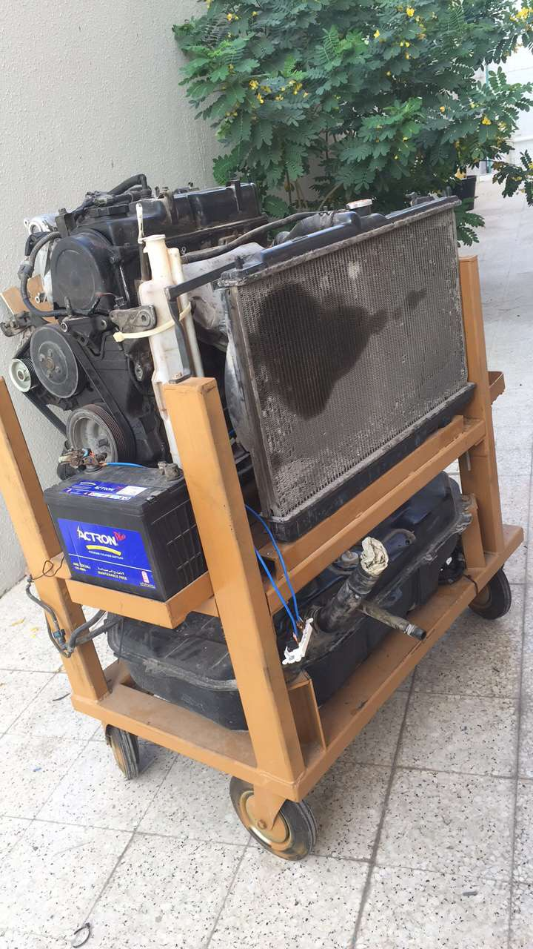
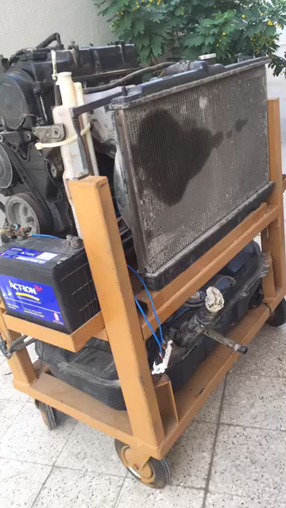
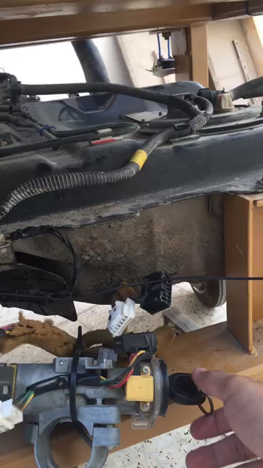
Engine

Slide 16
Conclusion
Ignition timing affects many variables
The optimum angle
Temperature of water out
Exhaust gas emissions

Slide 17

Recommendations
Buying a new engine to get in order to decrease efficiency losses
Using various types of biofuel and compare results
Availability of sensors (torque sensor)
The usage of more advance technology such as the computer simulated dashboard, and LAB simulated experiments

Slide 18
Thank you for your attention

