Slide 1


Robot Bolt Cleaner
*Hassan al hajji 201303088
Bander al saihati 201300510
Aadil Ansari 201203143
Mohammed Ibrahim khan 201303748
Mohammed alabdalmohsan 201401099
Advisors
Dr. F.D.Roodi/ Dr. Essam Jassim

Slide 2
Content
Objectives
Background
Relevance
Constraints & Standards
Design
Testing & results
Conclusion & future recommendations

Slide 3
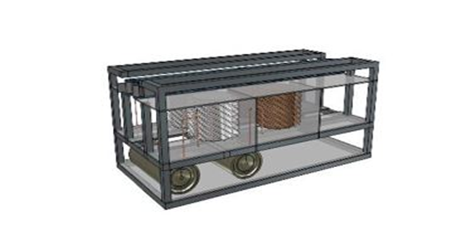
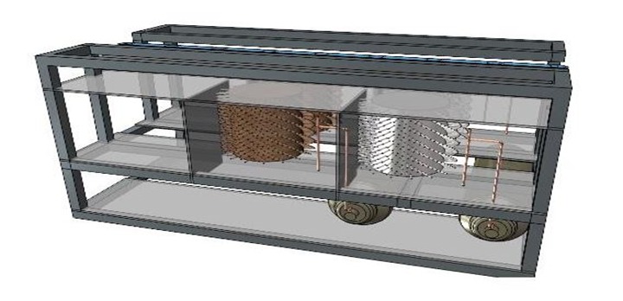
Objectives
To design a robot bolt cleaner
To achieve quality cleaning in less time and with better time management.

Slide 4
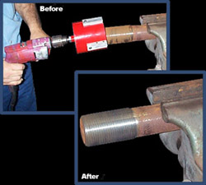
Background
Cleaning of the bolts has been done in many ways for a very long time
Widespread success in the hand-held tool industry
Drill Machine, pulse tools, nut runners, cup brushes etc.
Maintaining safety standards and finding a good alternative substitute

Slide 5
Motivation and relevance
Internship
Every year 500,000+ is wasted on cleaning of the tools excluding the labor charges.
Easily movable and safe.
Safety is one of the key factors if any company is working in the kingdom with Saudi Aramco.

Slide 6

Design Constraints

Slide 7
Design Constraints (1)
1.Geometrical constrain
  Average size of a bolt used by the companies is way bigger than what we are using, this would affect us financially
2. Sustainability
  Time efficient
  Using of jet spray or chemicals
3. Environmental
  Extremely hot weather in the kingdom

Slide 8
Design Constraints (2)
4. Economic
  High cost /low demand
  Variation in sizes of bolts
5. Manufacturability
  Falling of bolts at higher torque
6. Safety
  Good quality gloves
  Training

Slide 9
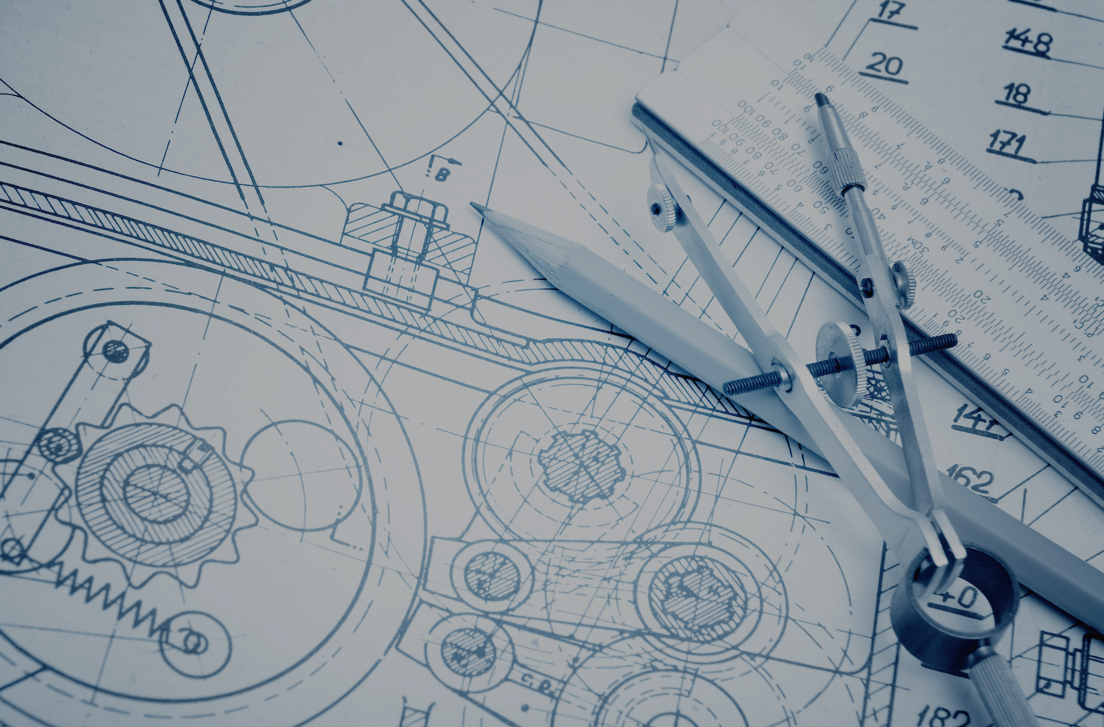
Engineering Standards

Slide 10

Engineering Standards
ISO 11963:2012 Polycarbonate sheet
ISO 9001, ISO 14001 SKF bearings
Bauer gear motor (CSA international)

Slide 11
Design
Components:
Acrylic sheet
Brush
Chemical substance
Pulley
belt
chain
Limit switch
Dc motor

Slide 12
The Calculations
Results:
Torque = 1.37 Nm
Pressure = 2.61 bar
Linear speed = 1.57 cm/s
Time = 24 seconds
Equations
Linear speed(v) = w x r
Time(t) = Distance/ Speed
Force = Torque/ Radius
Power = Tourqe x W
Pressure = force x Area

Slide 13
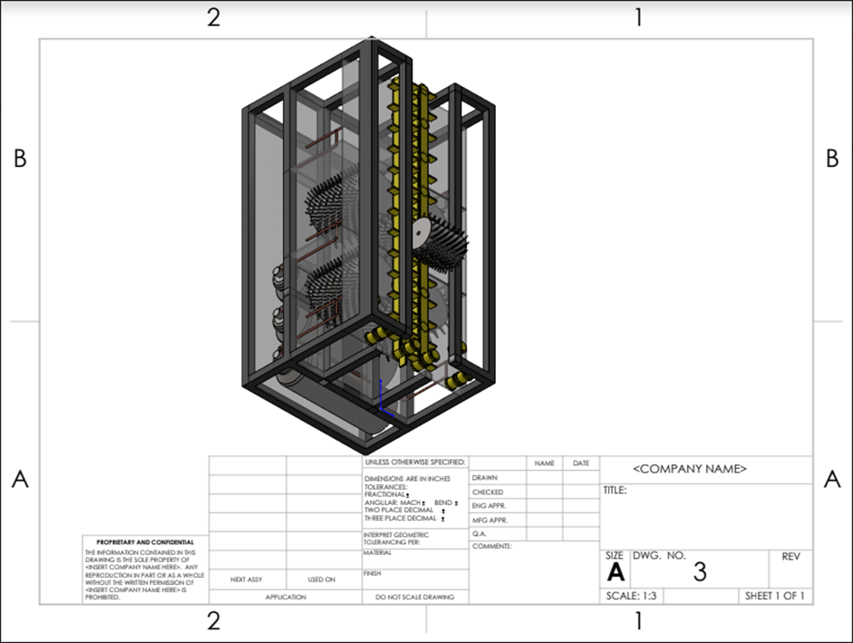
CAD Drawing

Slide 14
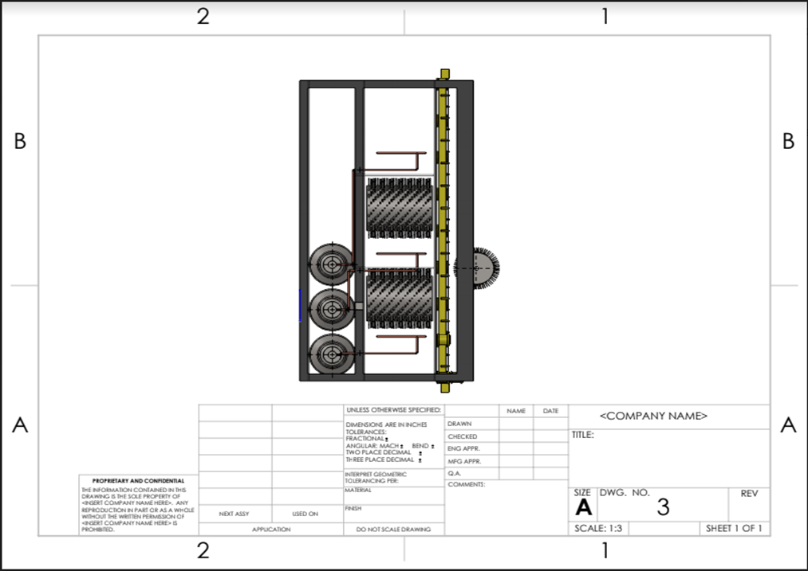
CAD Drawing

Slide 15
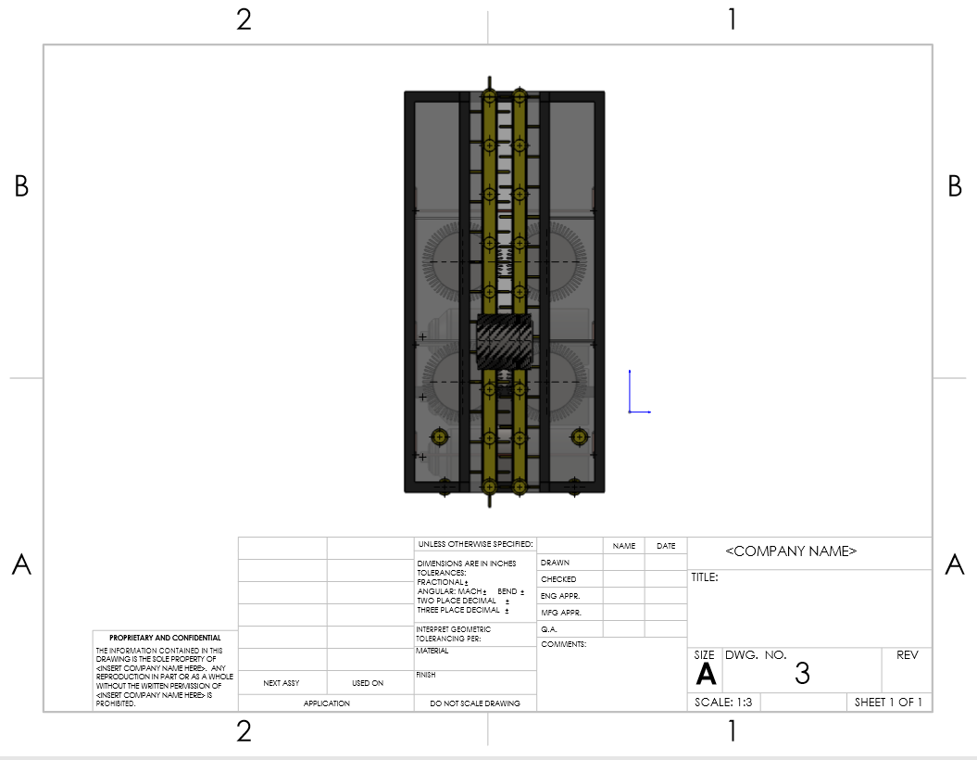
CAD DRAWING

Slide 16
Testing Setup
3 tests
  Measuring tank usage time
  RPM
  How many bolts can be cleaned in 1 minute

Slide 17
Results
Pressure (bar) | Time (seconds)
3 | 45
5 | 32
7 | 23
9 | 16
RPM test -

Slide 18
Recommendations & Conclusion
Design of a jet spray instead of chemicals for rust removal.
Material used
Dimensions used

Slide 19
Acknowledgement
We appreciate the support and guidance of the Mechanical Engineering department. Special thanks to Dr. F.D.Roodi for his continued support to us throughout our work.

Slide 20
Thank you for listening

